Slide 1
ESA passive microwave activities - GSICS 2024 report
Raffaele Crapolicchio
ESA ESRIN
14/03/2024

Slide 2
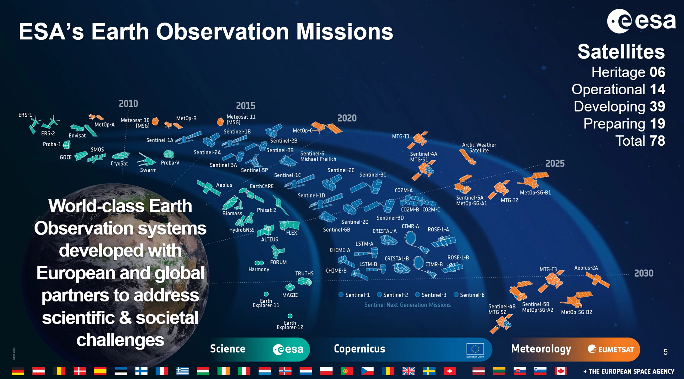

Slide 3
Content
  SMOS Mission status
  SMOS Validation platforms
  RFI monitoring, reporting, detection
  DOMEX experiment status (L-band radiometer in Antarctica)
  CIRM Mission
  AWS Mission
  Hydro-GNSS Mission
  Conclusion
  Acknowledge
  Backup slides

Slide 4
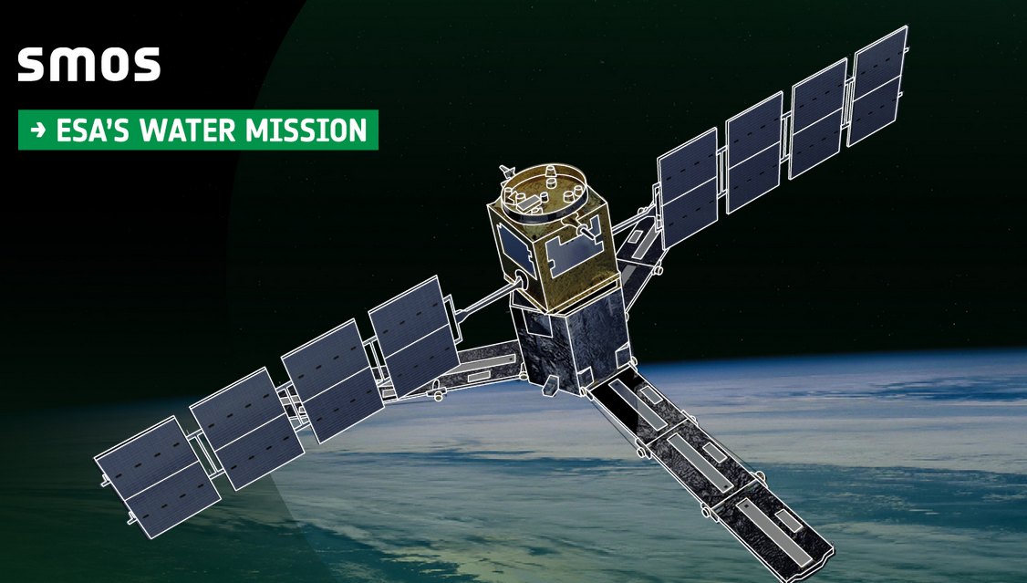
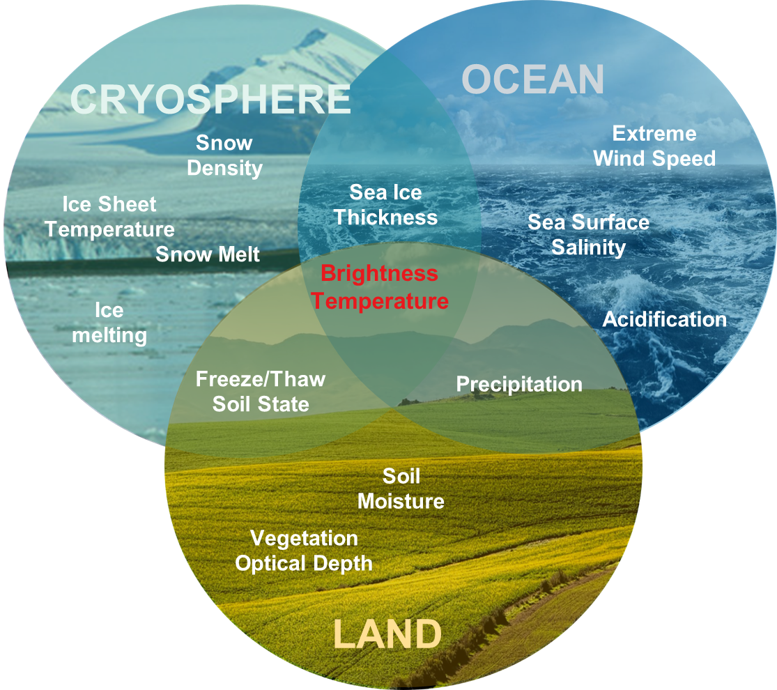
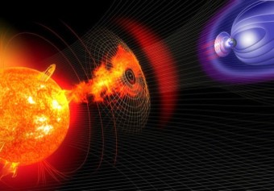
Launched in November 2009 in polar orbit about 750 Km altitude
Mission extended till 2025
SMOS mission overview of operational and experimental products
First 2-D Interferometer Radiometer (MIRAS) in Space providing a variety of geophysical quantities from Earth Surface emissivity at L-band
+ geophysical quantities from Ionosphere and Sun (prototype)
Space Weather
L-band Solar flux
Ionosphere electron content

Slide 5
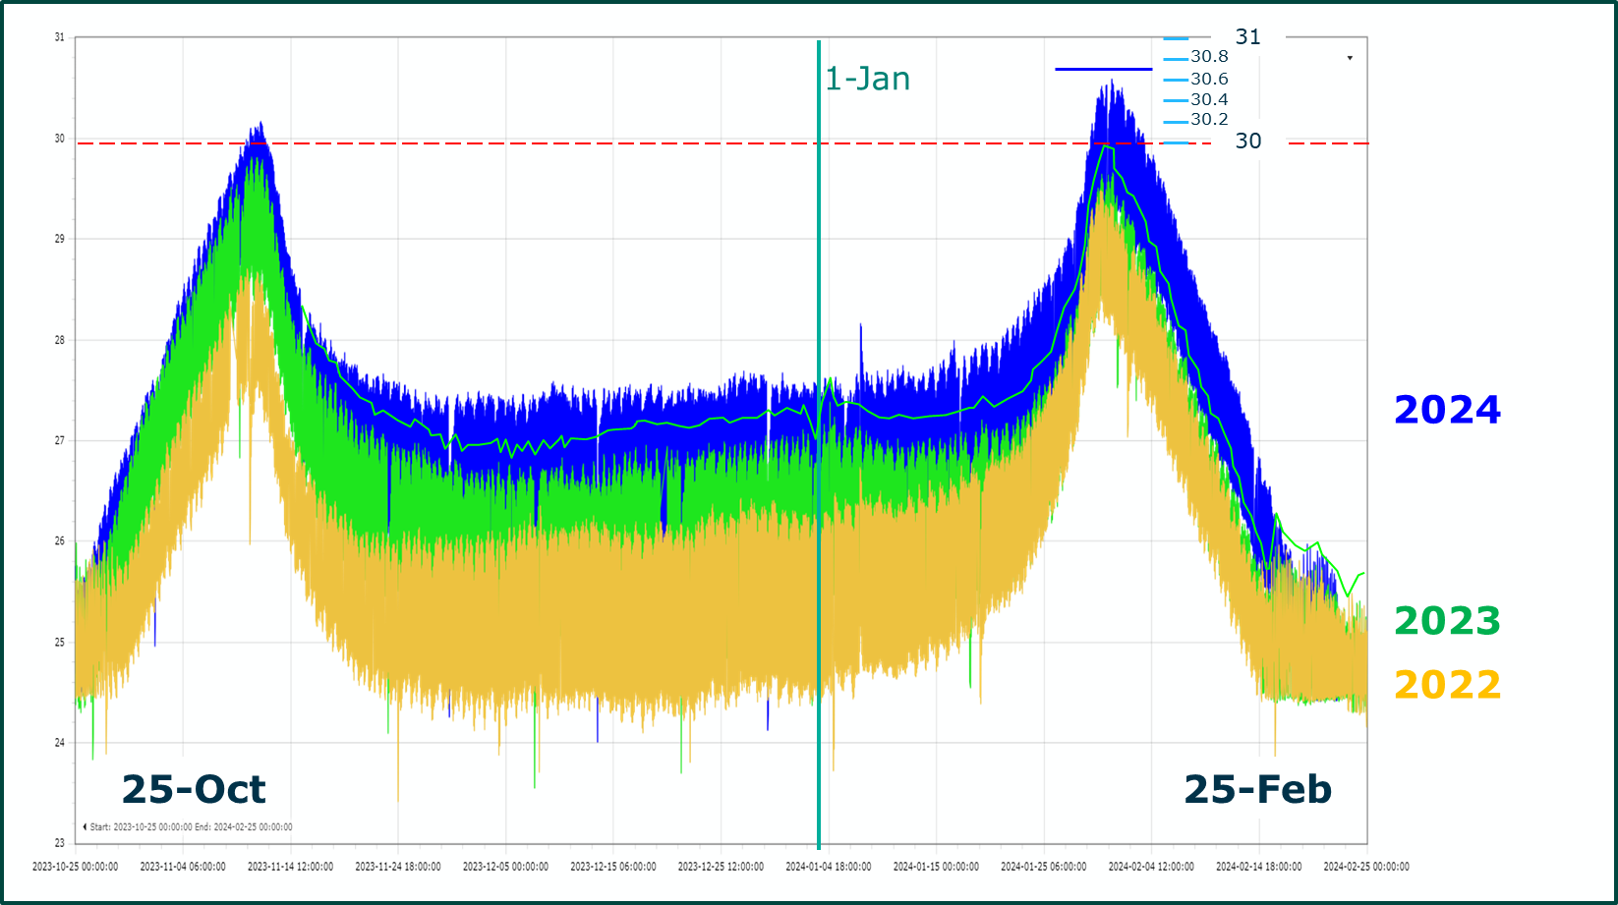
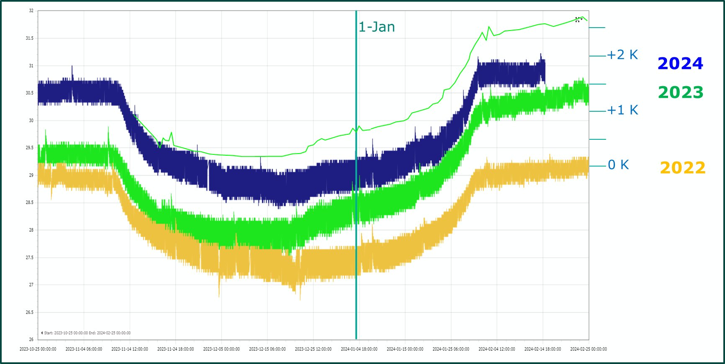
MIRAS SMOS Payload status
After more than 14 years in orbit, MIRAS still remains in very good shape.
All housekeeping telemetry parameters remain very well within limits.
Payload operations are very smooth and well optimised.
All known anomalies are covered by their corresponding recovery actions and procedures
Minor concerning issues:
Arm-A temperature increase. It is slightly increased in 2023/2024 (+1C)
CCU temperature is increasing (+0.5C from 2023) but far from hard limit value ( it is carefully monitored).

Slide 6
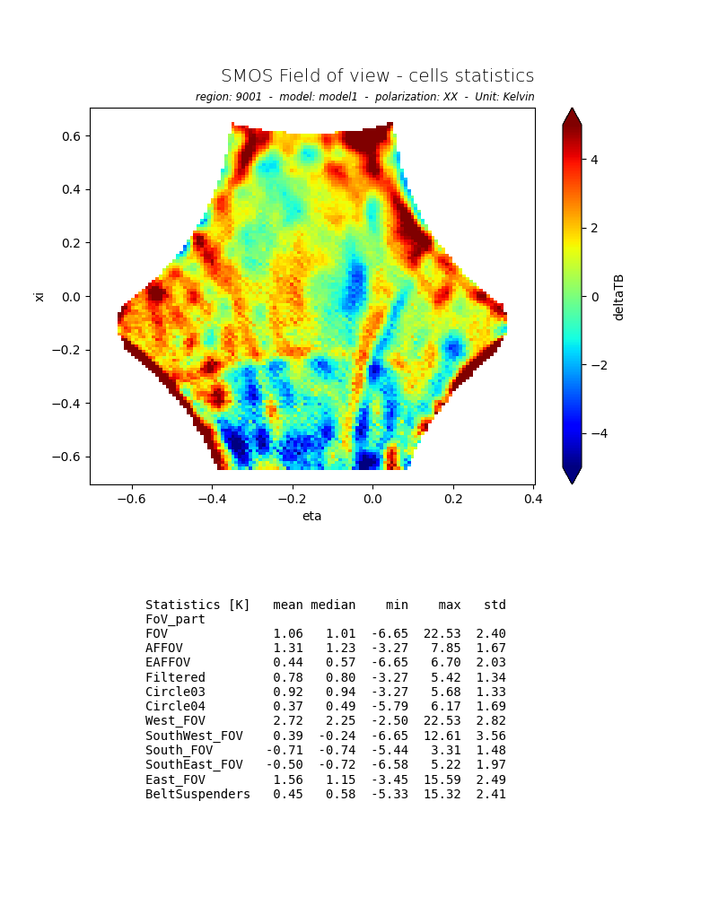
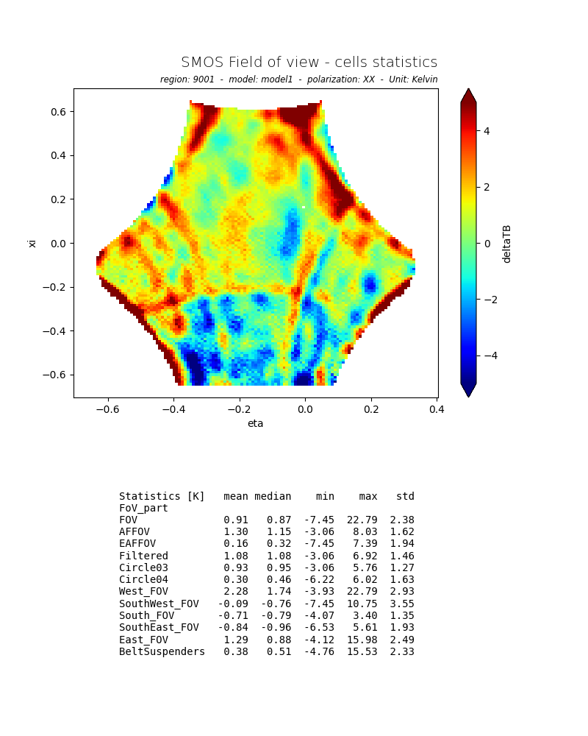
SMOS Platform anomalies
GPS anomaly on the 08th of September 2023, starting at 15h45m33s. CNES decided for a cold start of the GPS to bring it back. This operation was performed on 12/09/2023, in the morning, and it was successful. Science data was acquired and will be processed off-line with restituted PVT.
The first Safe Hold Mode (SHM) was triggered on Thursday 22nd February 2024 at 05:10:00z. The second SHM on 3rd of March 2024 at 15:59:38z. The anomalies most probably were triggered by a platform fault detection (FDIR) related with a platform on board software (OBSW) data corruption most likely caused by a radiation SEU. No damage in any of the platform or payload units was detected during the first S-band acquisition after the anomalies. First data quality checks suggest that the platform and MIRAS are operating as expected and data dissemination was resumed on 12th March 2024.
Brightness Temperature differences over Ocean between measurements and Forward Model.
Left Image before SHM on 20Th February. Right Image after the second SHM on 8th March
Spatial biases patterns and statics are very similar confirming nominal status of payload and calibration.

Slide 7
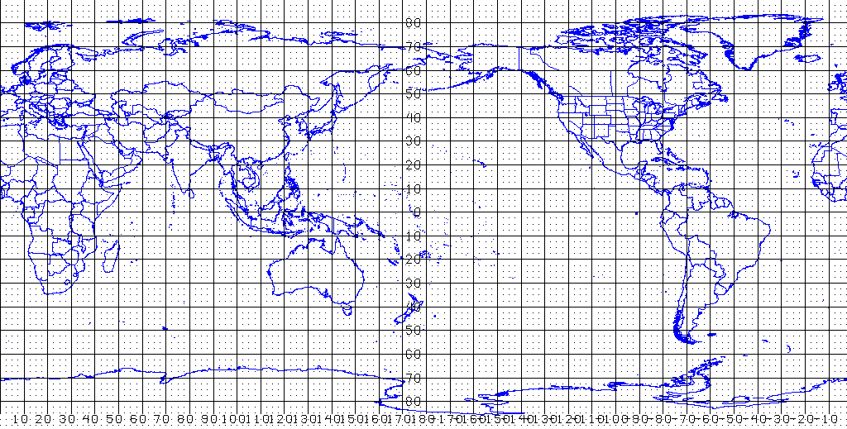
SMOS Brightness Temperature (BT) performances (Ocean)
Bias between BT from Ocean Forward Model and SMOS over a selected Pacific Ocean area
Salinity model: ISAS up to Dec 22, WOA09 onwards
Others geophysical parameters from ECMWF forecast
Metrics: Hovmöller tool & trends

Slide 8
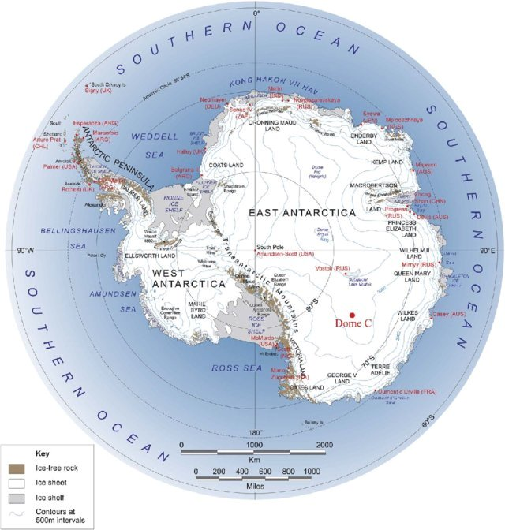
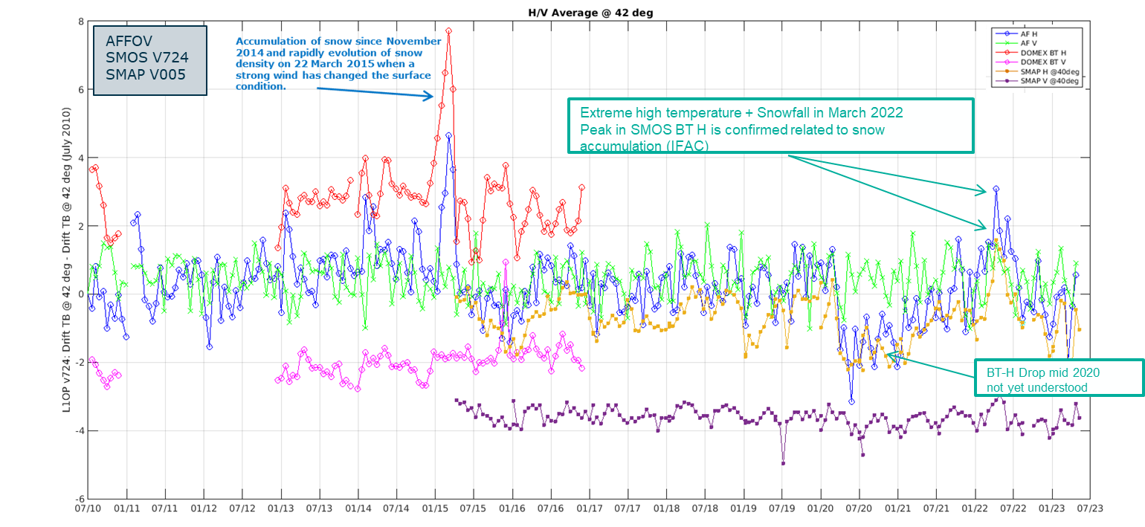
SMOS Brightness Temperature (BT) performances (Antarctica)
Data is extracted from the MIR_SCLF1C products for the Dome-C point (e.g Grid Point ID: 7181872)
Average and STD of BT are computed each 18 days for HV for the different FOV areas: AFFOV and entire FOV.
Average value in June 2010 has been subtracted from each statistics in order to highlight the variation.
Comparison with Domex data and SMAP data is also available.

Slide 9


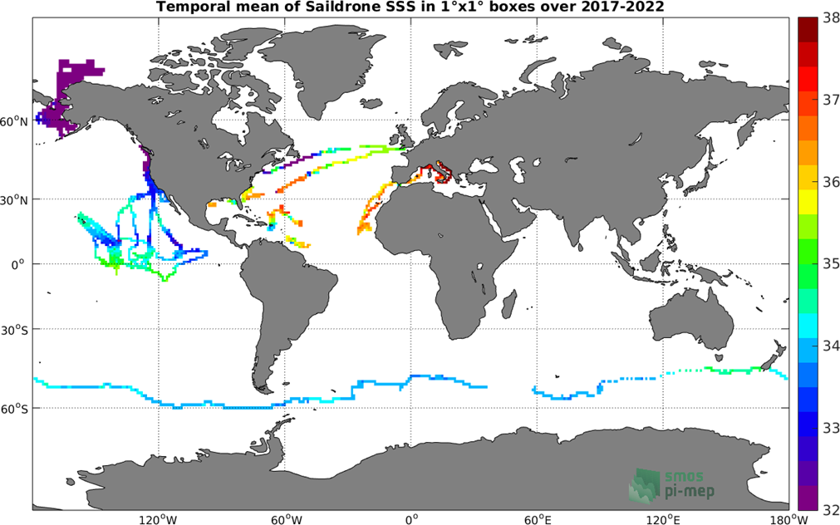
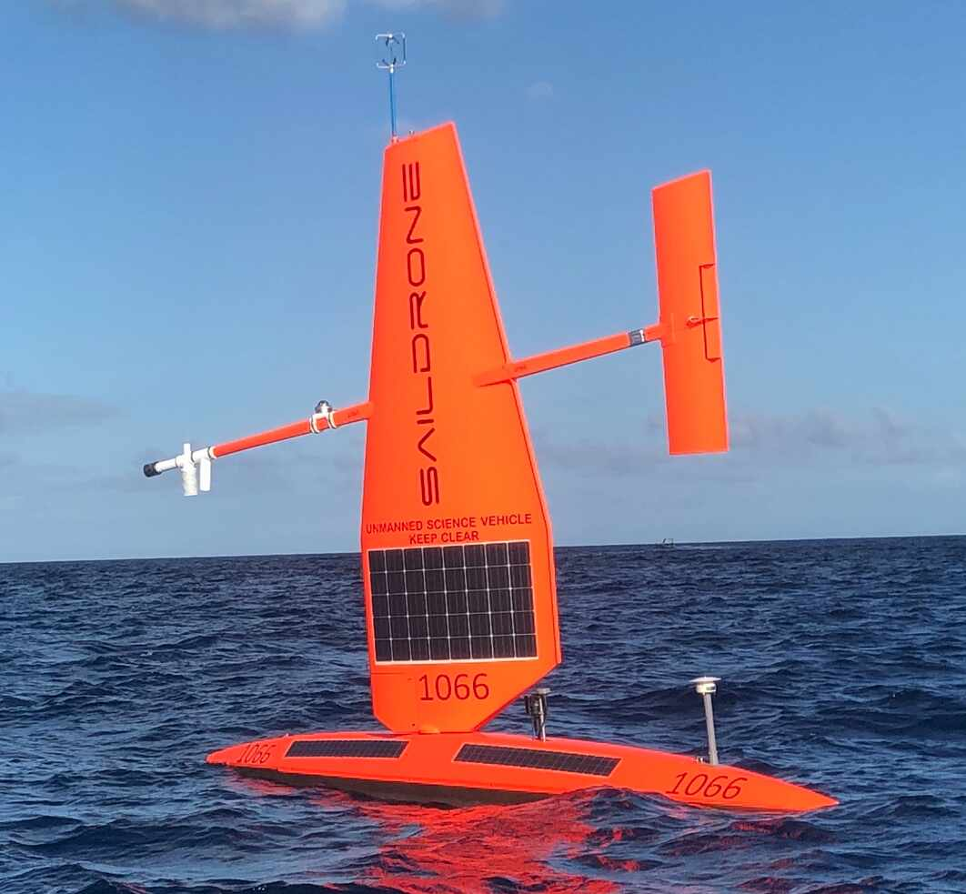
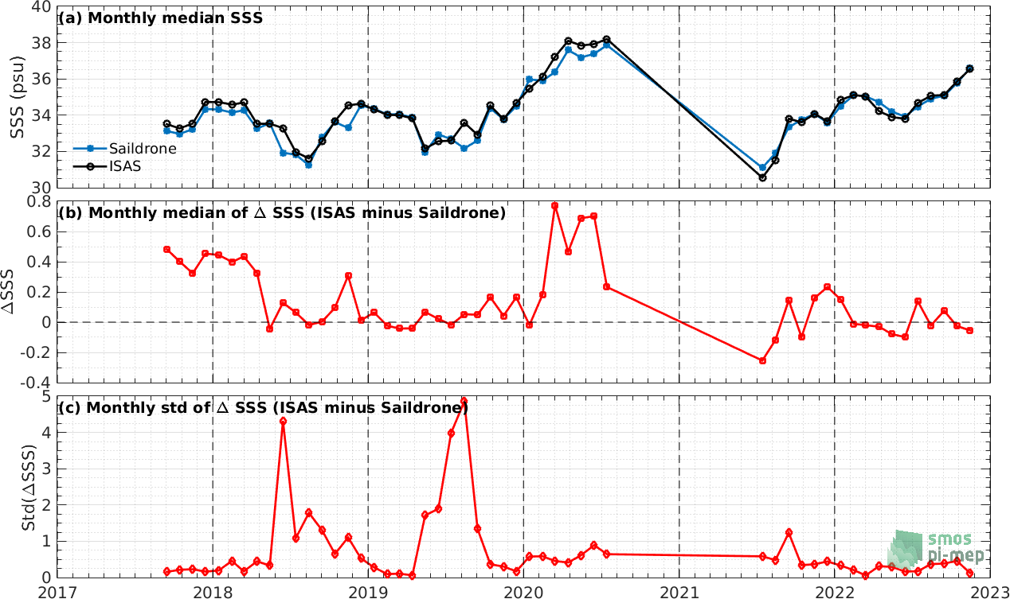
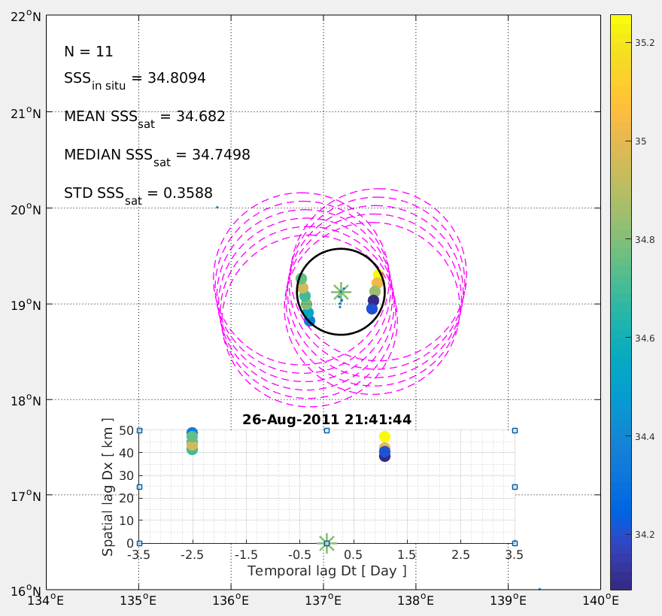
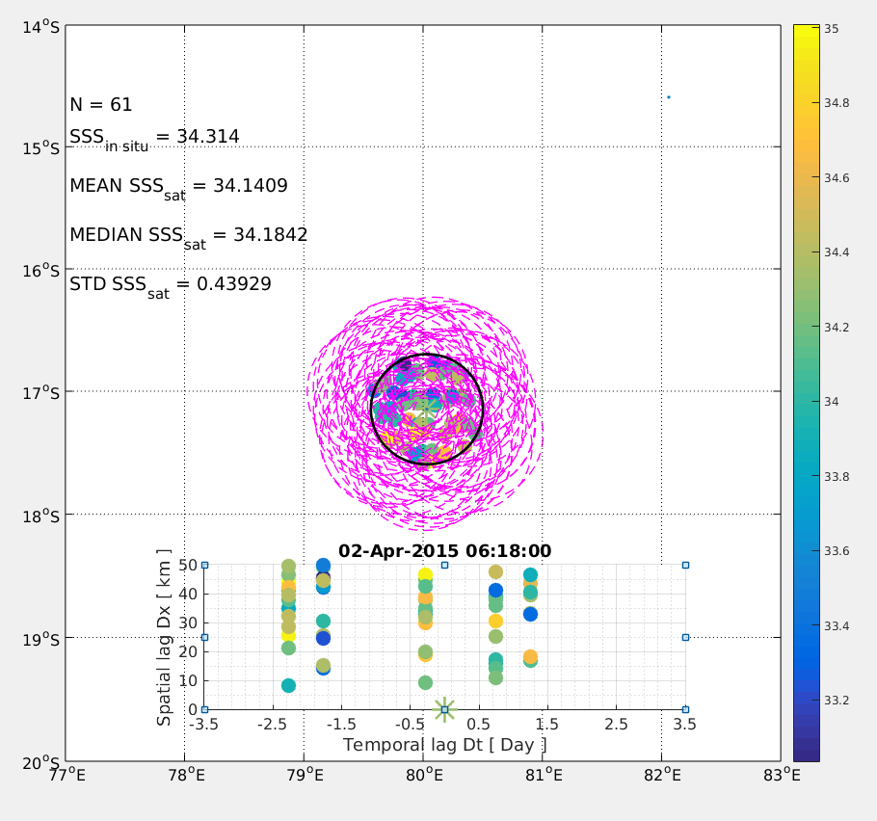
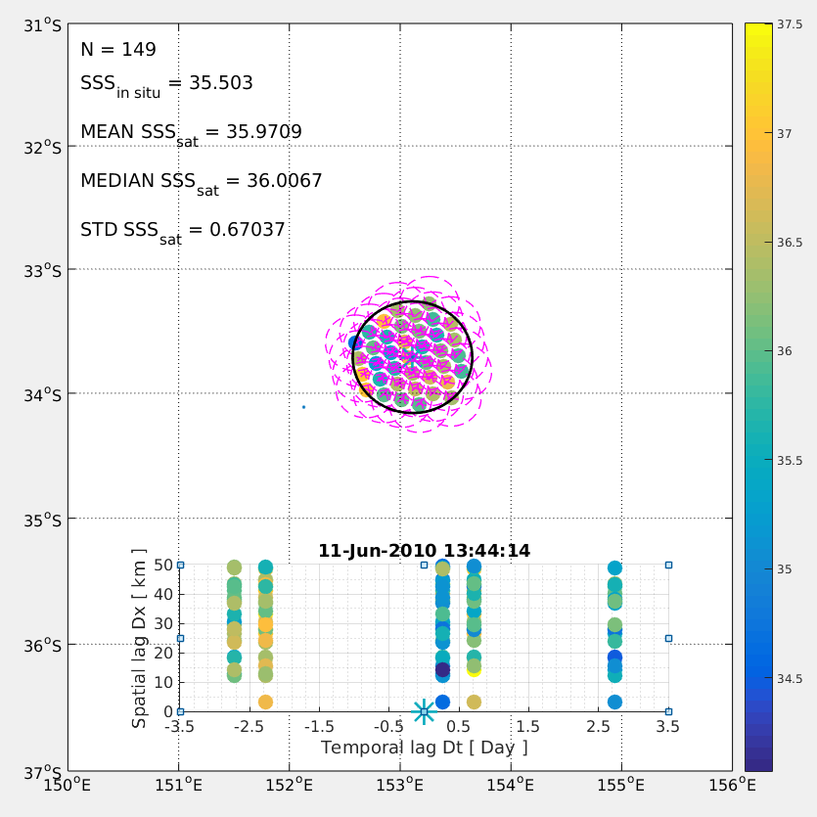
Pilot-Mission Exploitation Platform (Pi-MEP) Salinity
Single web-based environment to visualize, validate, monitor, assess and exploit Satellite Salinity data (SMOS, SMAP, Aquarius). Broad variety of online Tools to extract, inter-compare datasets and compute relevant statistics. Pi-MEP phase-2 (July 2023 – June 2024):
Operation
  New match-up file and dataset expansion including saildrones
  Support to routine QC
Research and Development
  Representation errors characterization
  “Committed area” identification
  Spatial/temporal information content
  Exploitation studies
NASA partnership
  Roll-out novel NASA MDB criterion and documentation
www.salinity-pimep.org
AQUARIUS
SMAP
SMOS
Argo
Satellite
Temporal mean of Saildrone SSS (upper map), Comparison between Saildrone and ISAS sea surface salinity (lower plots)

Slide 10
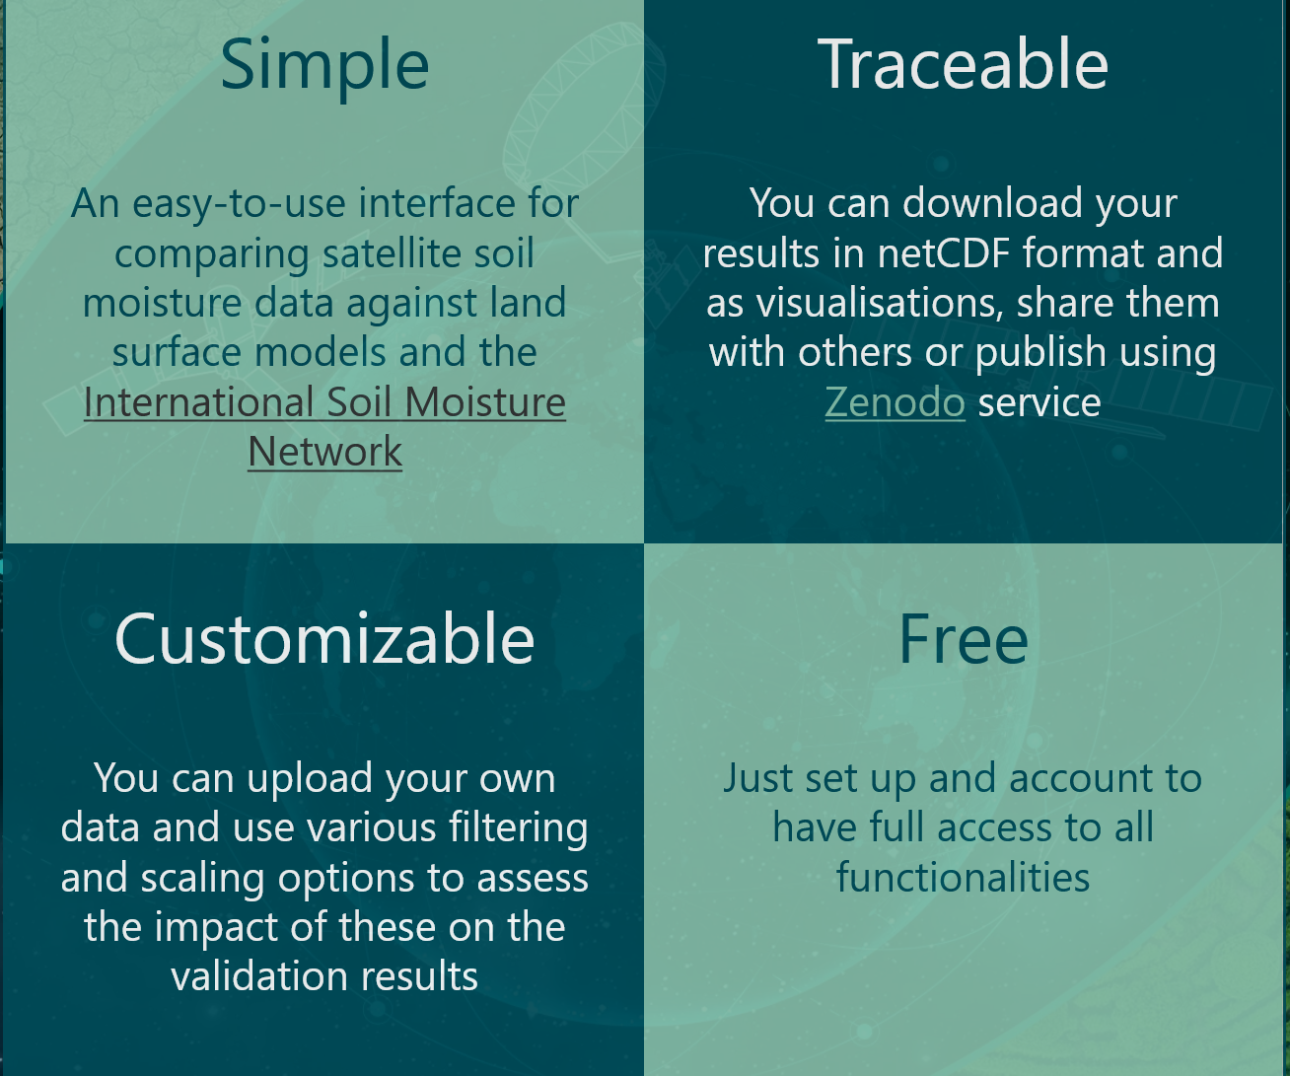
Quality Assurance for Soil Moisture (QA4SM) https://qa4sm.eu
QA4SM = on line validation service, provides a standardized validation system for soil moisture satellite derived measurements vs in situ observation and models. QA4SM platform is maintained and evolved by ESA in the framework of the FRM4SM: Fiducial Reference Measurements for Soil Moisture - Earth Online (esa.int) lead by AWS, TU Vienna and Cesbio.
Next QA4SM release 3 (June 2024) includes:
  Spatial Scale Quality Indicator indexes (QIs): describing sub-pixel heterogeneity of land cover, soil texture, biomass, organic carbon content, water body fraction
  Temporal scale-related QIs: describing data gap characteristics (quasi-randomly, intermittently, prolonged, …)
  Temporally-dynamic QIs: describing seasonal changes in measurement uncertainty
  Dataset update for SMOS and SMAP Mission

Slide 11
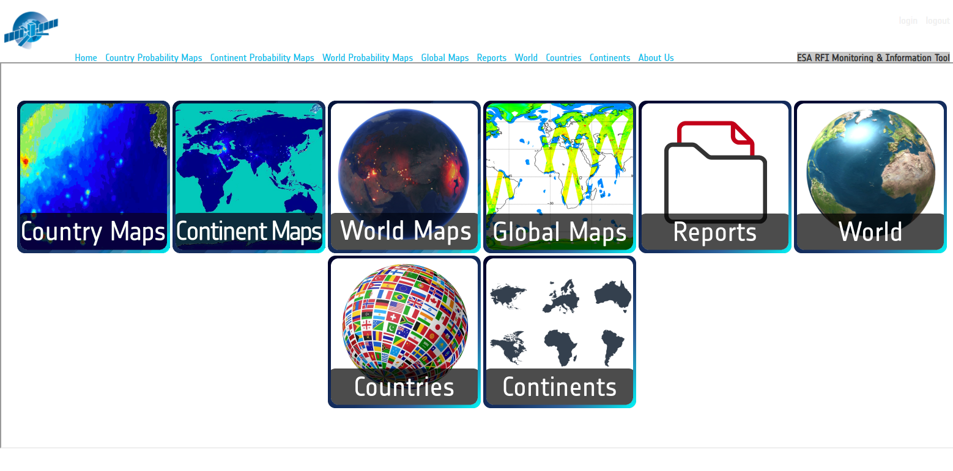
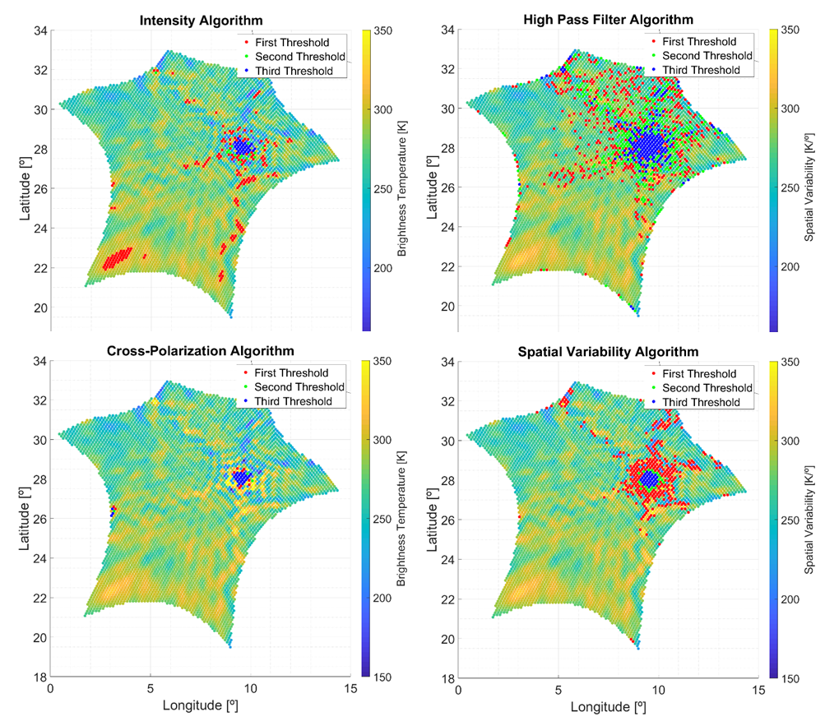
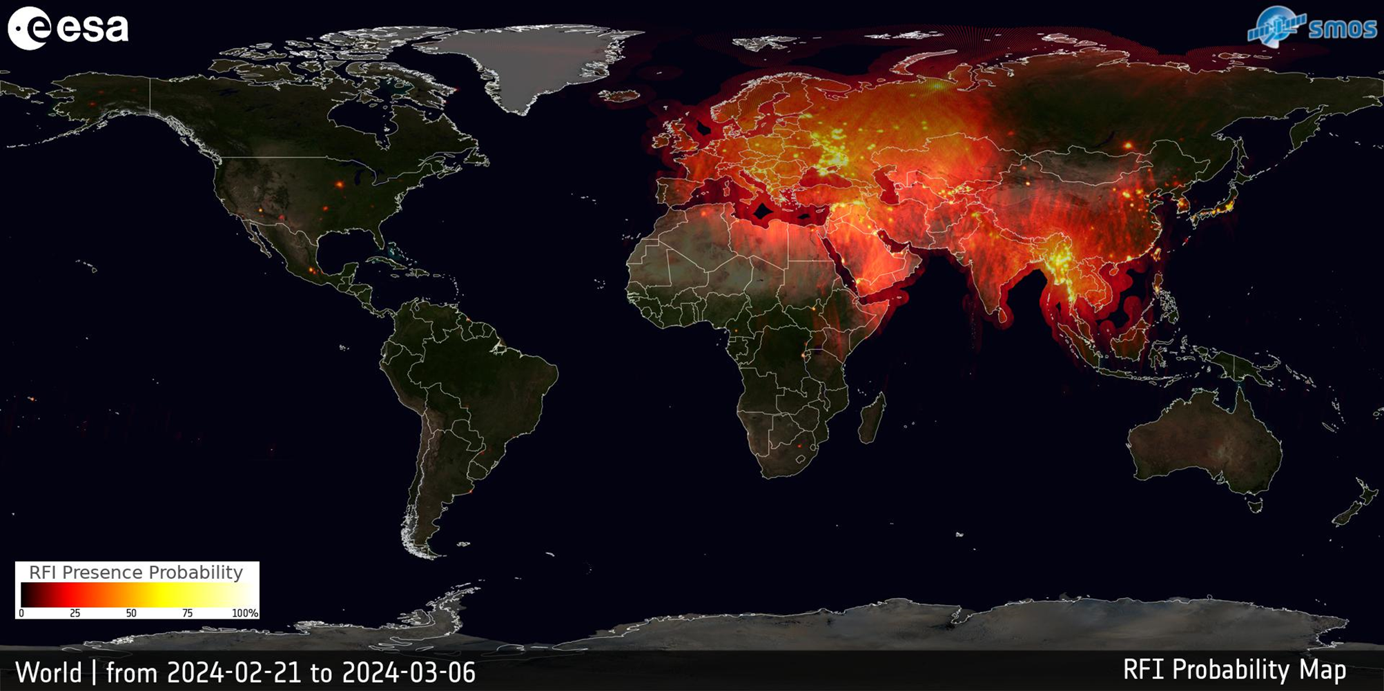
ESA RFI Monitoring, Reporting and Detection
RFI monitoring and information tool (ERMIT)
https://rfi.smos.eo.esa.int/
Ground RFI Detection System (GRDS)
GRDS is an on-ground system whose purpose is to detect and remove RFI from EO data. The system has been developed with a flexibility in the design to be able to ingest data from any EO passive microwave mission. It applies several thresholds at once, to customise for each user’s needs (see figure below as an example applied to SMOS image).

Slide 12
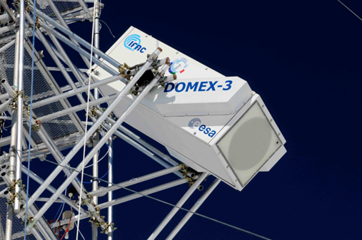
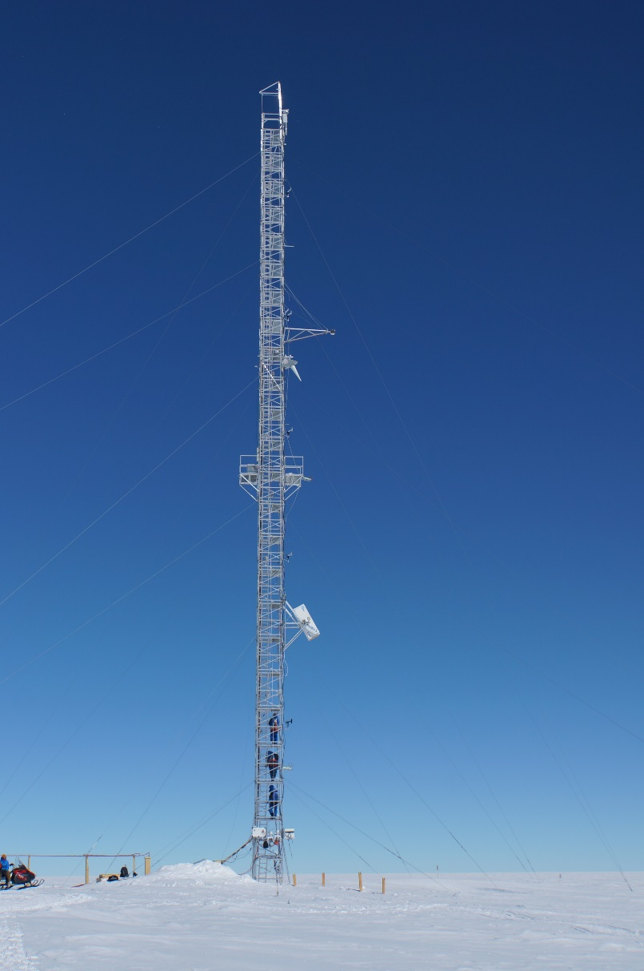
RADOMEX: L-band microwave radiometer @ Concordia
Temp in winter: -90°C
Temp in summer: -20°C
From the launch of the SMOS mission particular attention was paid to the region of Dome-C, Antarctica, with the aim of characterizing this area as a potential extended target for calibrating and monitoring low frequency microwave radiometers.
Why Dome –C ?
  High penetration of e.m. waves in the ice sheet and high temporal stability in the physical properties (including temperature below 10 m). It is theoretically expected that Tb remains stable in time.
  Well covered by SSO satellites (SMOS, SMAP, etc.)
  Spatial homogeneous and small slopes at satellite footprint scale
  Infrastructure (Concordia station) and ancillary data available
Experiments (DOMEX) that include ground-based L-band radiometer (RADOMEX) measurements were conducted at Concordia Station since 2004 and continuously since 2012 supported by ESA and PNRA. The long-term experiment was recommended in order to provide a continuous independent data record of ground-based radiometric measurements covering the SMOS – Aquarius – SMAP era thus verify target stability over time and monitor changes in target characteristics that may affect the long-term reference signal.
image credits: IFAC
15 m

Slide 13
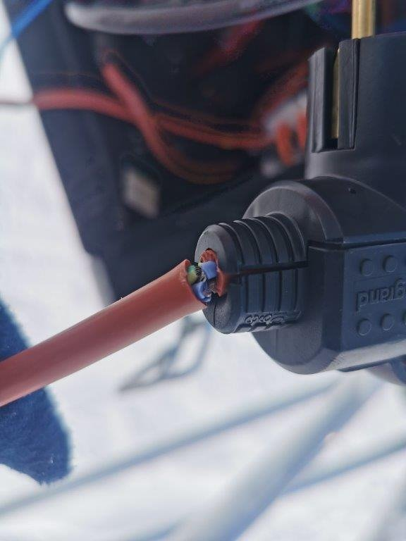
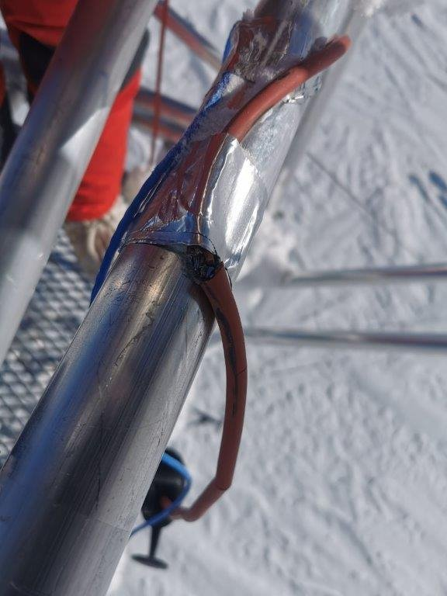
RADOMEX: L-band microwave radiometer @ Concordia
Nov. 9th of 2023 Summer campaign started
Nov 19th The logistics replaced the 230V cable which was torn in several points. The cable cause the failure of Radomex from June 29th 2023.
From Nov 19th to Jan 4th : restart of the RADOMEX and first tests to check all the devices. Anomalous behavior has been found on H-pol. the issue has been solved! The MEMS have been removed and bring in laboratory for the isolator’s assembly.
Jan 4th 2024: first acquisitions with the MEMS and the isolators installed
Jan 9th to today: “Blind” calibration alternating 42 to 140 every 15 minutes
Beginning of Feb 2024 departure from Dome-C
The RADOMEX has been restarted after more than 4 months of inactivity. ​
image credits: IFAC

Slide 14
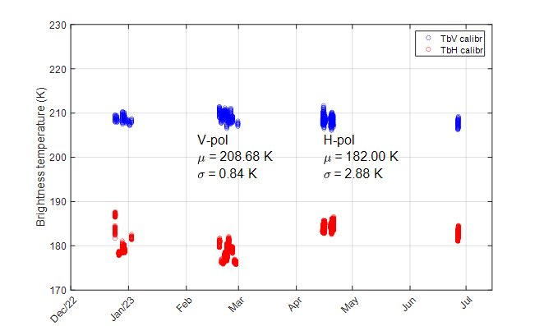
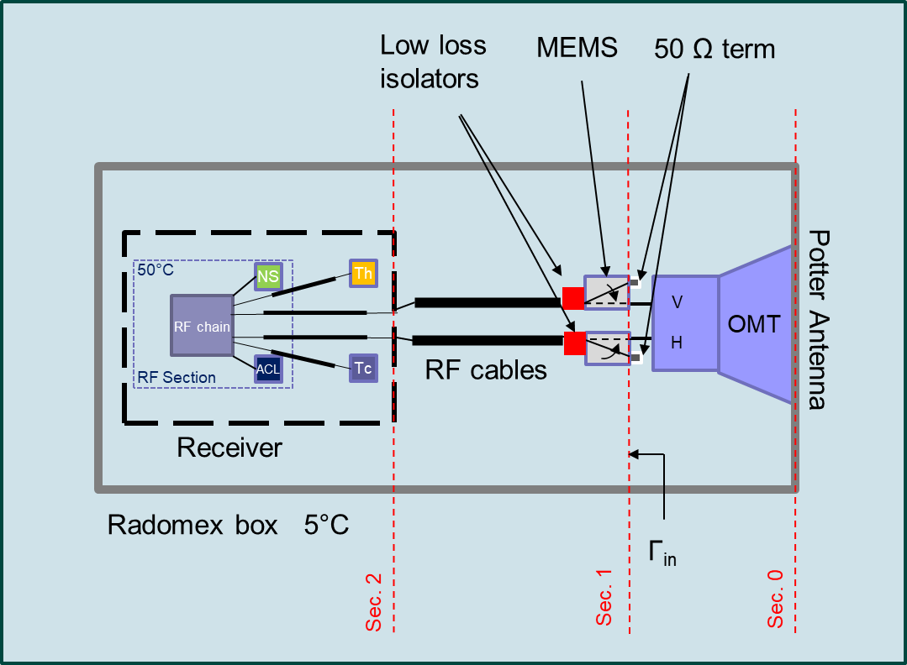
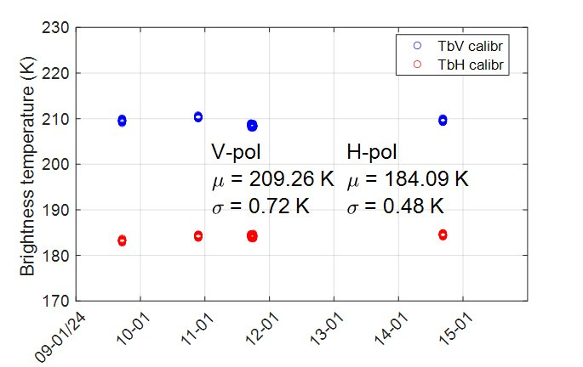
RADOMEX: 2024 updates
2023 MEMS
2024 MEMS + isolator
image credits: IFAC
2023-24 Summer campaign:
Installation of 2 low loss ferrite isolators
Preliminary calibration with the new isolators performed
To do:
Antenna pattern deconvolution and comparison with SMOS, SMAP ​
Recalibration of the entire DOMEX-3 timeseries from 2012​
image credits: IFAC

Slide 15
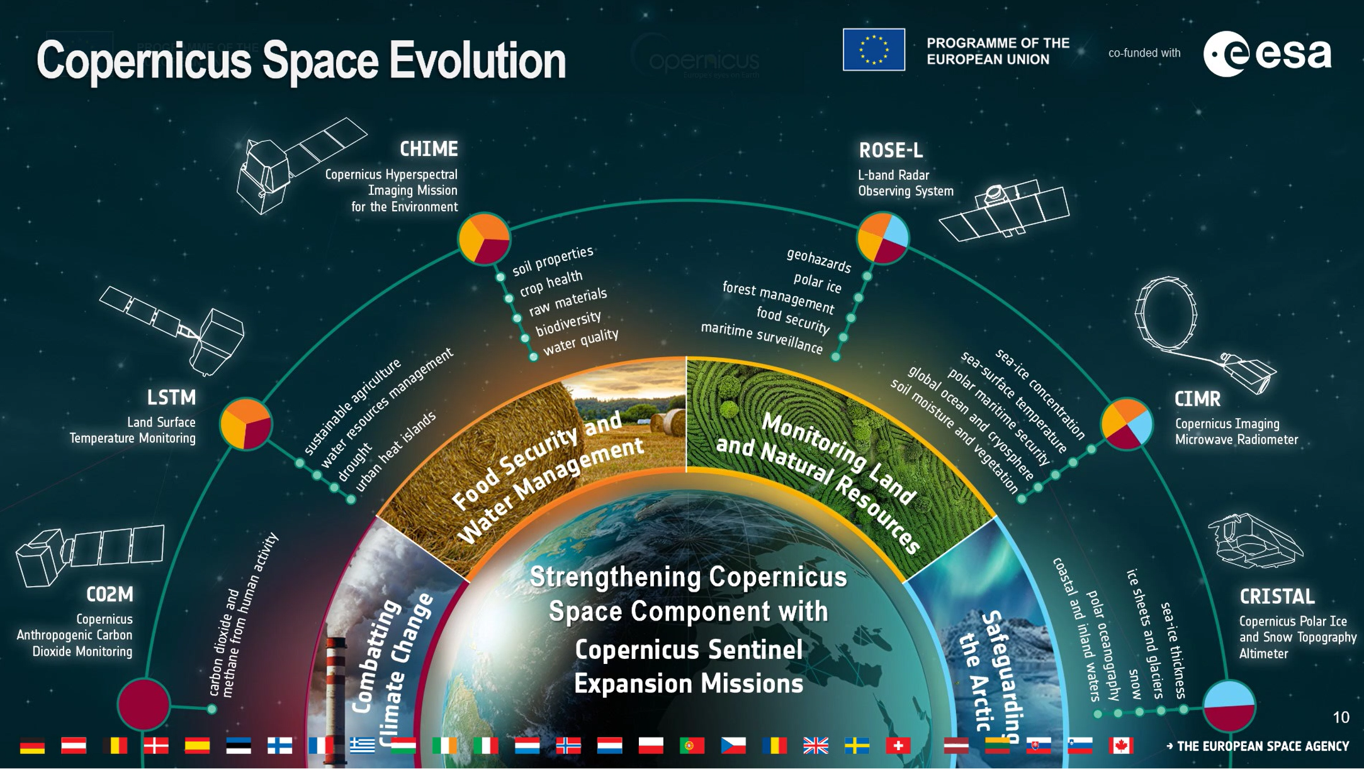
(https://cimr.eu/)

Slide 16
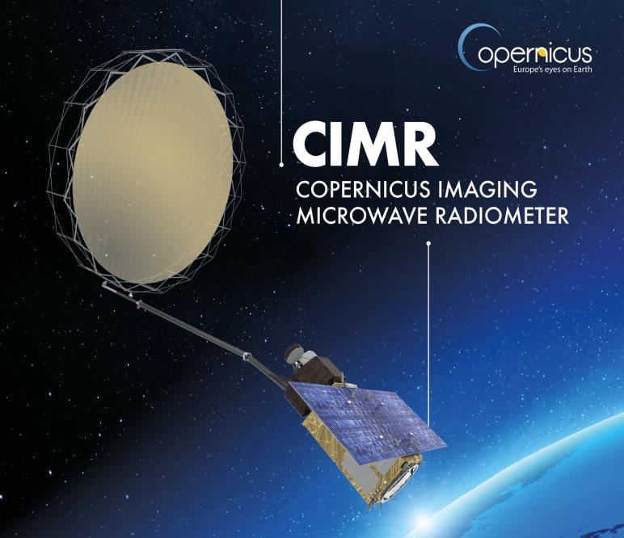
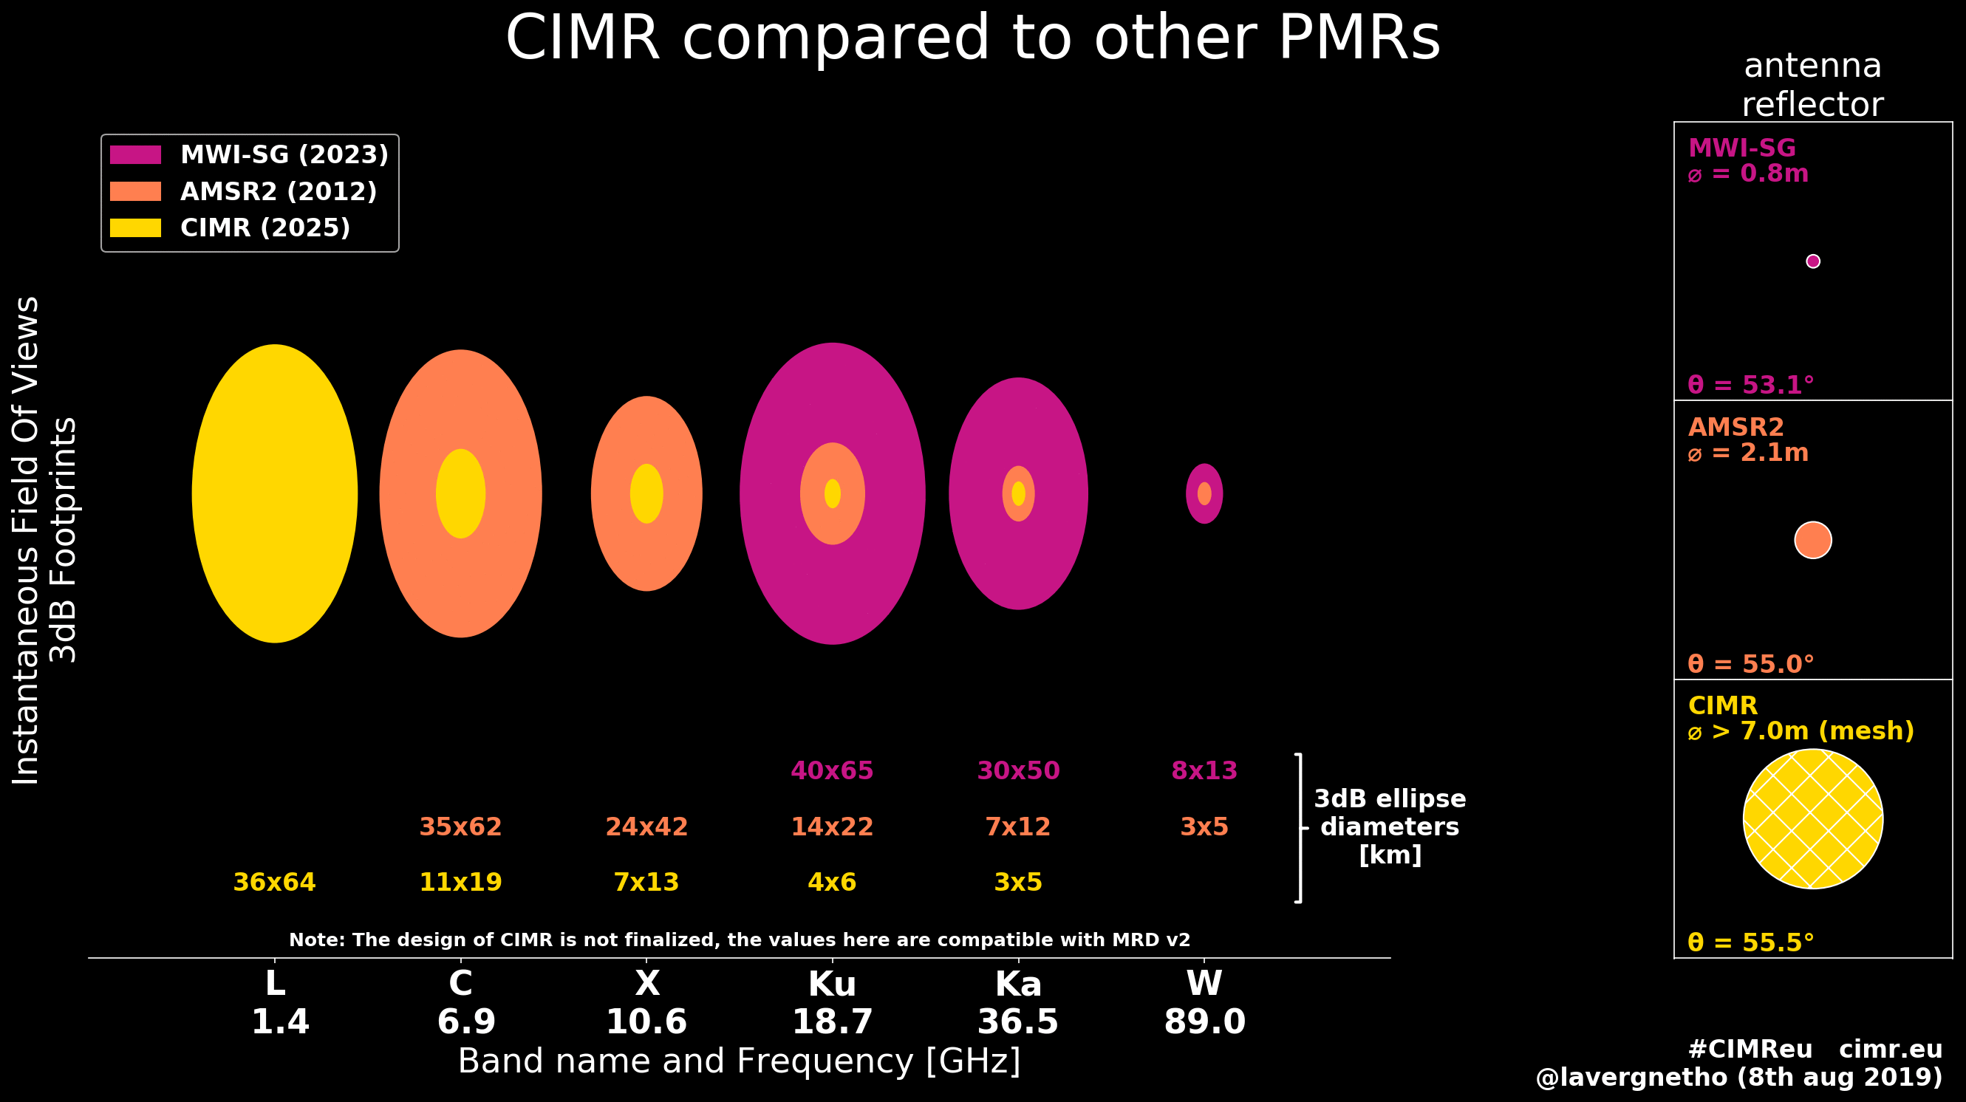
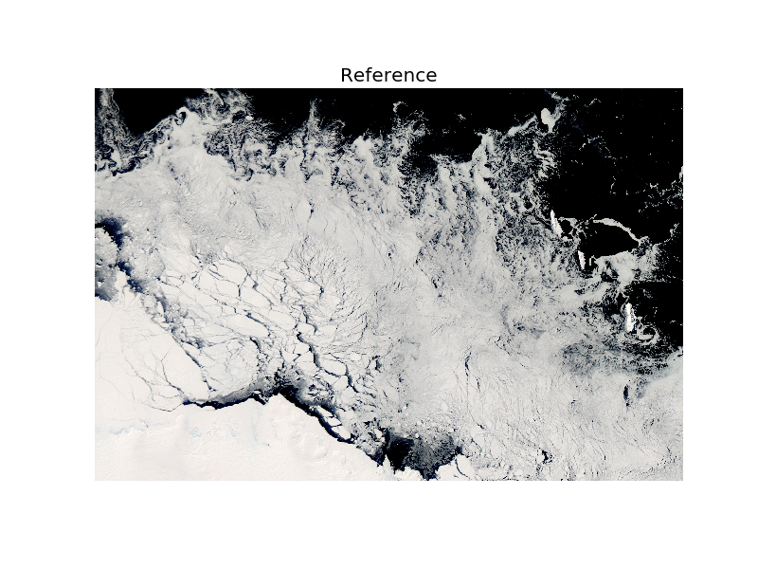
CIMR (https://cimr.eu/)
CIMR Channels (GHz, Full Stokes): 1.4 6.9 10.65 18.7 36.5
Resolution (km): <60 ≤15 ≤15 ≤5.5 ≤5 (g:4km)
NEΔT (K @150K): ≤0.3 ≤0.2 ≤0.3 ≤0.4 ≤0.7
Tot. Standard Uncertainty(K): ≤0.5 ≤0.5 ≤0.5 ≤0.6 ≤0.8

Slide 17
CIMR Level-2 Product Families
Level-1 (independent of coverage domain)
Level-2 (families as function of coverage domain and timeliness)
ESA
EUMETSAT
L1a
L1b
L1c
Polar
Global Land
Global Ocean
Global Atmosphere
NRT1H
SIC
SIED
SID
OWS
NRT3H
SIC
SIE
SST
SIT
SIED
SID
ITY
SND
SIST
SSS
OWV
NTC
SIC
SIE
SST
SIT
SIED
SID
ITY
SND
SIST
SSS
OWV
NRT3H
TSA
SWE
LSWT
LIC
FT
LST
SM
MMVI
SWF
NTC
TSA
SWE
LSWT
LIC
FT
LST
SM
MMVI
SWF
NRT3H
SST
SSS
OWV
NTC
SST
SSS
OWV
NRT3H
PCP
LWP
TCWV
NTC
PCP
LWP
TCWV

Slide 18
CIMR status
CIMR Mission is now in full C/D phase – we are starting to building hardware.
The CIMR platform PDR has been successful and we are now developing the Engineering Model (EM) units.
CIMR has a dedicated RFI processor on-board to detect and mitigate the impact of RFI in real time within the RFPU using 7 Digital processors.
We are in pretty good shape today and we are moving in the right direction for launch in 2028.
CMIR Level 1 end to end simulator (L1E2E) it is a detailed simulator, computationally demanding, V2 under development, delivery by end 2024
CIMR Scientific End-to-end Prototype Simulator (SCEPS) is designed to evaluate CIMR mission performance using a dedicated Mission Performance Evaluation Framework (MPEF) using a fast simulator to confirm Scientific Readiness Level (SRL 6) at CDR. The MPEF – uses 2 simulators – the Industrial L1E2E and SCEPS. This is essential to make effective and practical progress.

Slide 19
CIMR status
DEVALGO is a study dedicated to piloting several baseline algorithms for use in the SCEPS scientific simulator in support of the CIMR Critical Design Review (CDR). An innovative approach to use Jupyter books, python notebooks is used for a set of key L2 variables (not all). The algorithms to develop were selected to make sure that all of the CIMR functionality could be tested at CDR. The study makes use of open source tools and is unique at this point. On-line resource (ATBD) see https://github.com/CIMR-Algos. Algos V2.0 to be finalized by summer 2024. DEVALGO Workshop March 13 in Oslo.
MACRAD (Metrological Analysis of CIMR Radiometry) Foundation is the propagation of uncertainties starting from input variables, their statistical distribution, and relationships. Based on BIPM Guide to Uncertainty Modelling (GUM). We are using the COMET Toolkit to do the work (open-source community code developed by NPL).
CIMR RGB regridding toolbox has kicked off. It includes a library function to allow remapping of CIMR data to different grids and projections. The tool will take L1b inputs and have flexible modular capability to provide L1c options and L1r products (remapping products that are specific to L2 retrieval chains)
L2PAD is the definition of operational L2 Product algorithms . The KO was on 21st November 2023. Next PM in March 2024. Activity is to define the ESA L2 algos and uncertainties for ESA L2 products. The study will provide L2 test data products to the community and inputs to the pre-flight and consider all of the Polar and Land products in the MRD that are under development now. Expert User group to evaluate the progress and approach in 1.5 years from now.

Slide 20
CIMR-AIR status
CIMR-AIR airborne instrument. The study KO was in October 2023 to develop CIMR-AIR.
CIMR-AIR is an instrument that includes the full 5-frequency bands in H&V in a compact form that can be flown on a research aircraft. The intent is to collect pre-launch data to support algorithm developments and for in orbit valuation of CIMR.
The instrument is a side looking configuration with a single beam per frequency at same OZA of CIMR. The system has its own Position, Velocity and Time (PVT) information (additional to the aircraft) and includes a fully functional user interface with some basic L2 processing to confirm that the instrument is working.
CIMR-AIR will operate on aircraft to cover the large distances of CIMR footprints in a time short enough to allow a meaningful validation. A visible and a thermal infrared camera will be also present on-board. We have maximum altitude ceiling of 3000m but the reference altitude (for performances and specifications) is at 1000m.
CIMR-AIR will fly circular patterns to mimic CIMR footprints to a certain degree.
Requirement Review has passed, the initial campaign could start in June 2025

Slide 21
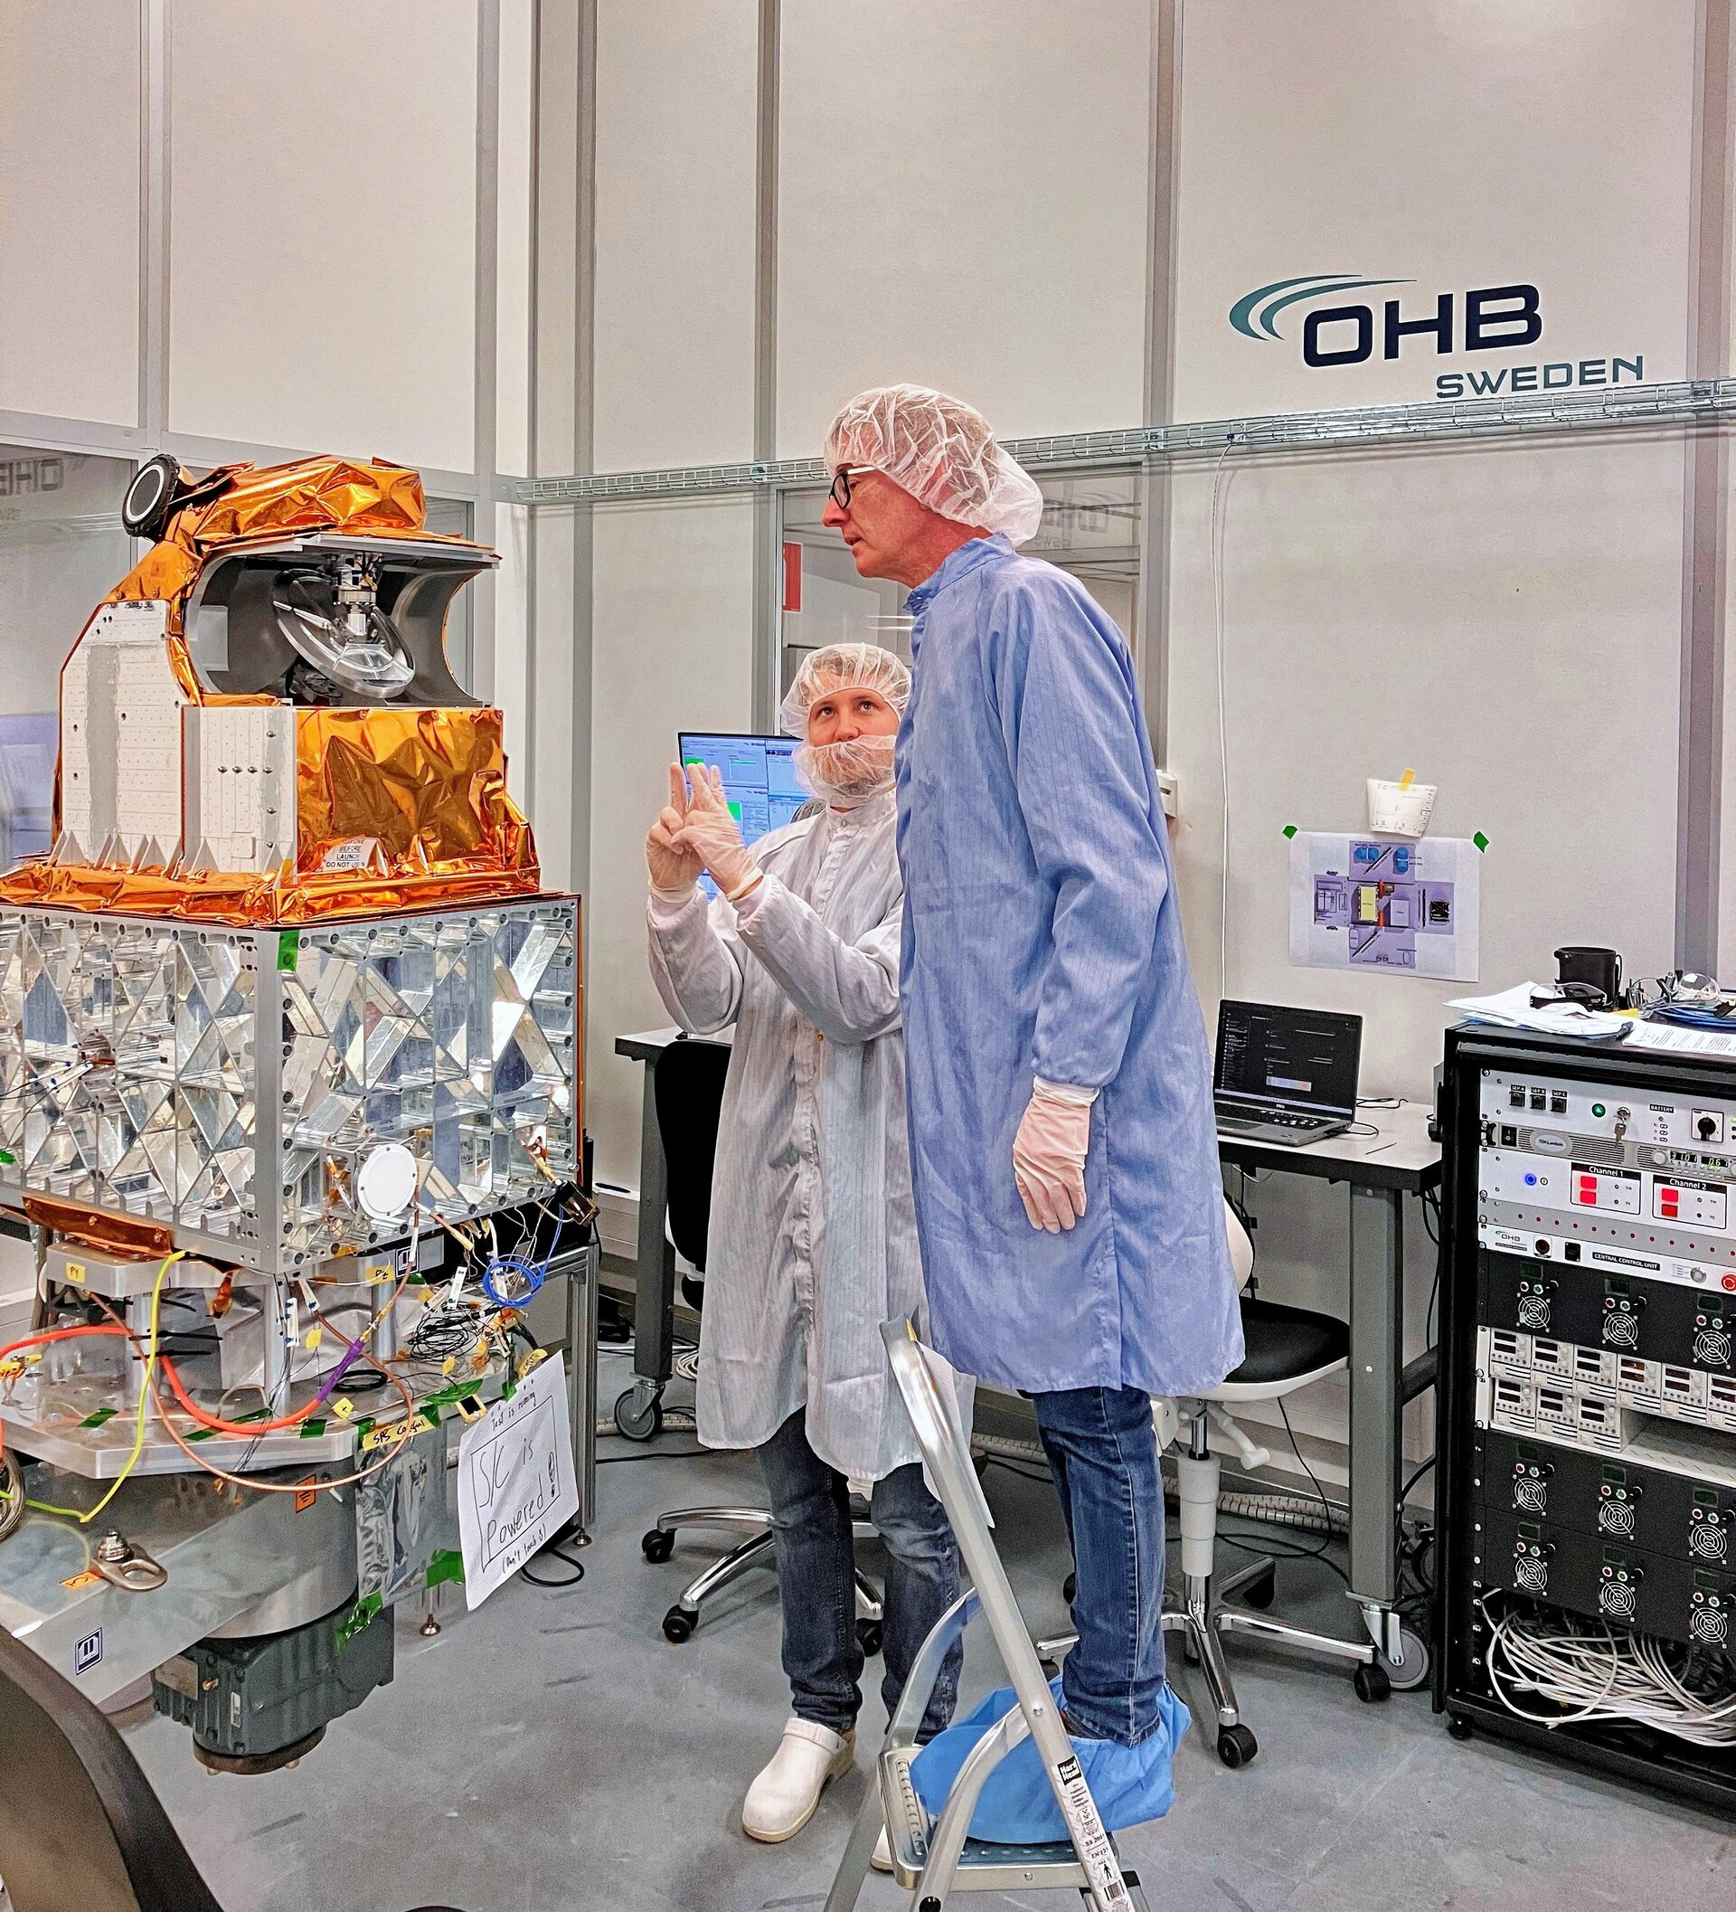
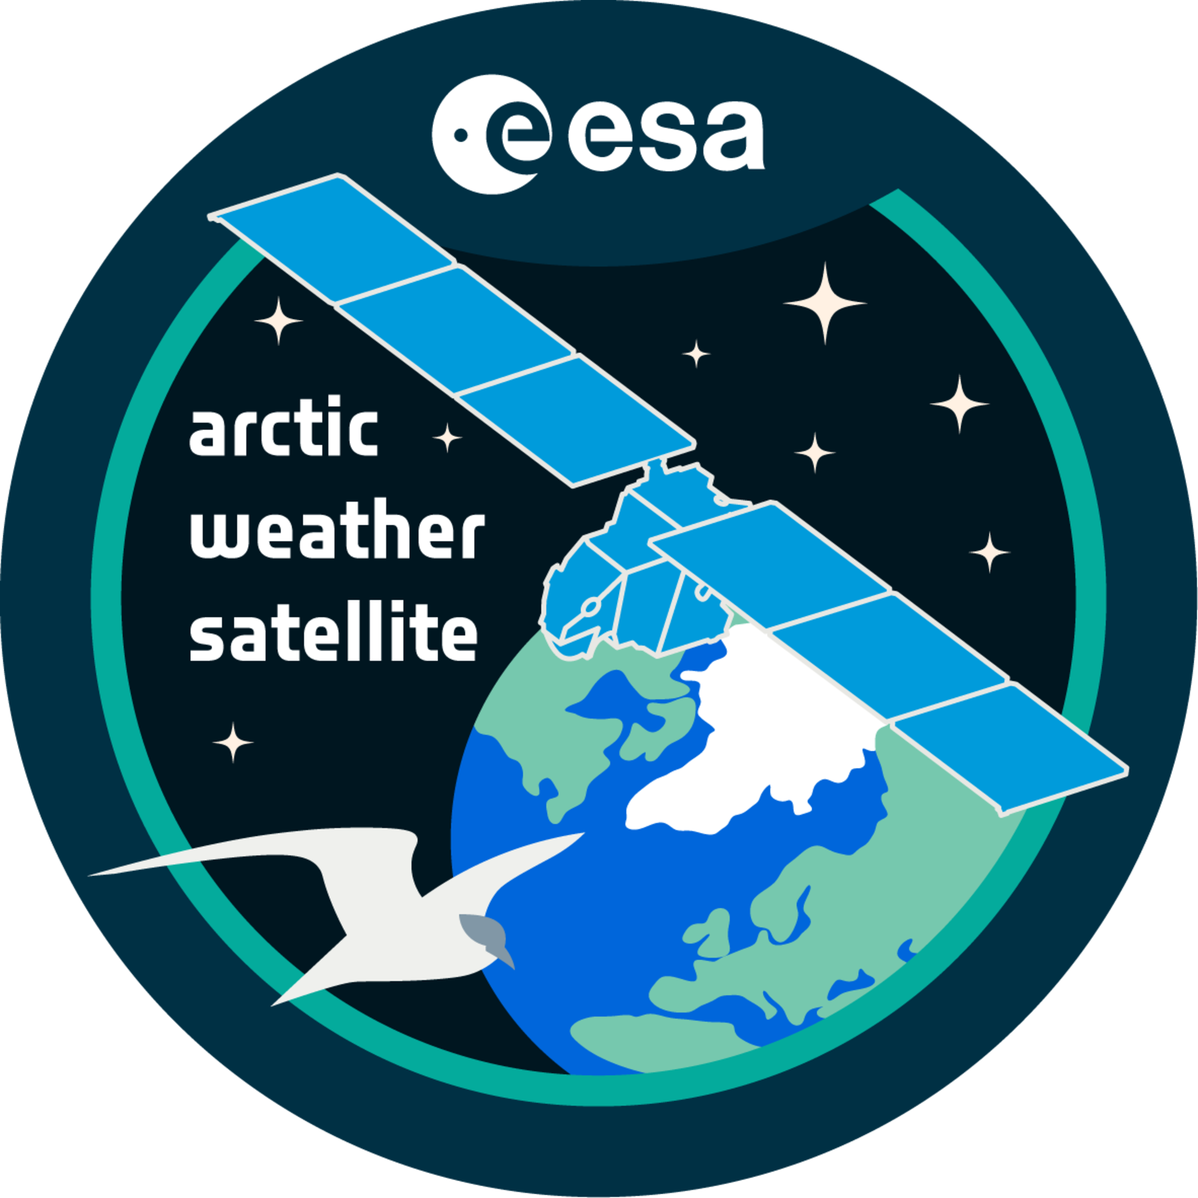
Arctic Weather Satellite (AWS) ESA - Arctic Weather Satellite
The instrument will provide high-resolution humidity and temperature soundings of the atmosphere in all weather conditions.
The payload is 19-channel cross-track scanning microwave radiometer (heritage of the Microwave Sounder developed for the MetOp Second Generation satellites.
Instrument is now under integration test with the platform.
Once these tests have been completed, the satellite will be shipped back to manufacture for some final checks before it is shipped to SpaceX’s launch site in Vandenberg, California in April. Liftoff is slated for 1 June 2024 on a Falcon 9 rocket. Inspecting the Arctic Weather Satellite
Inspecting the Arctic Weather Satellite, image credits: OHB

Slide 22
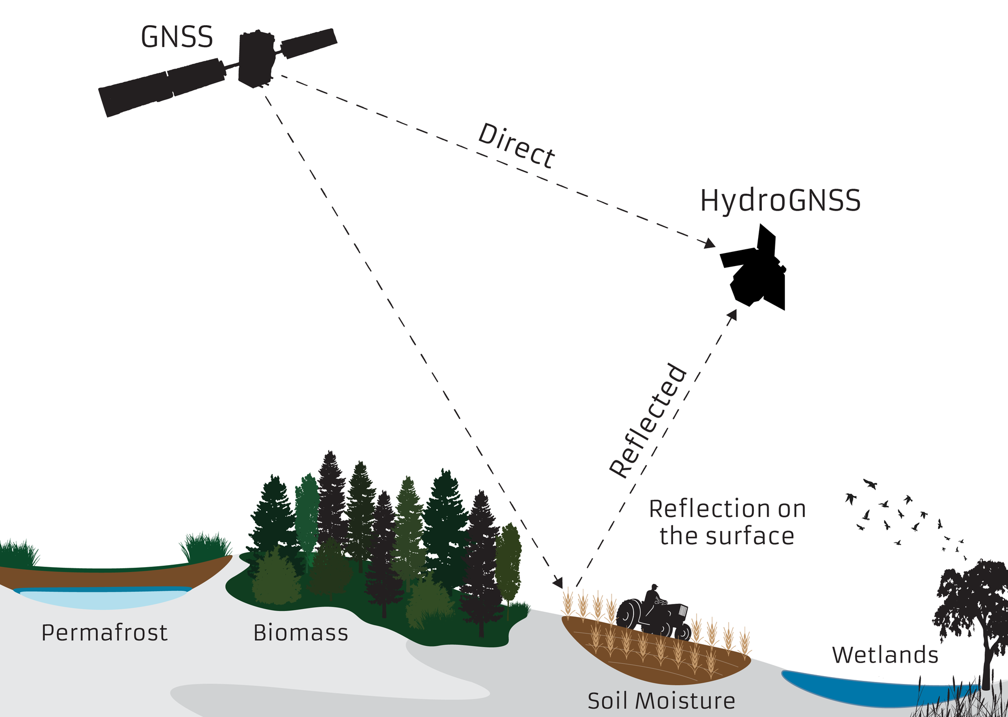
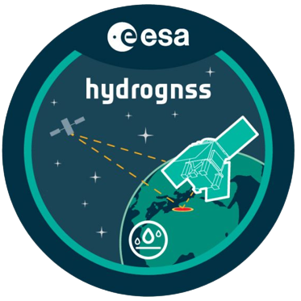
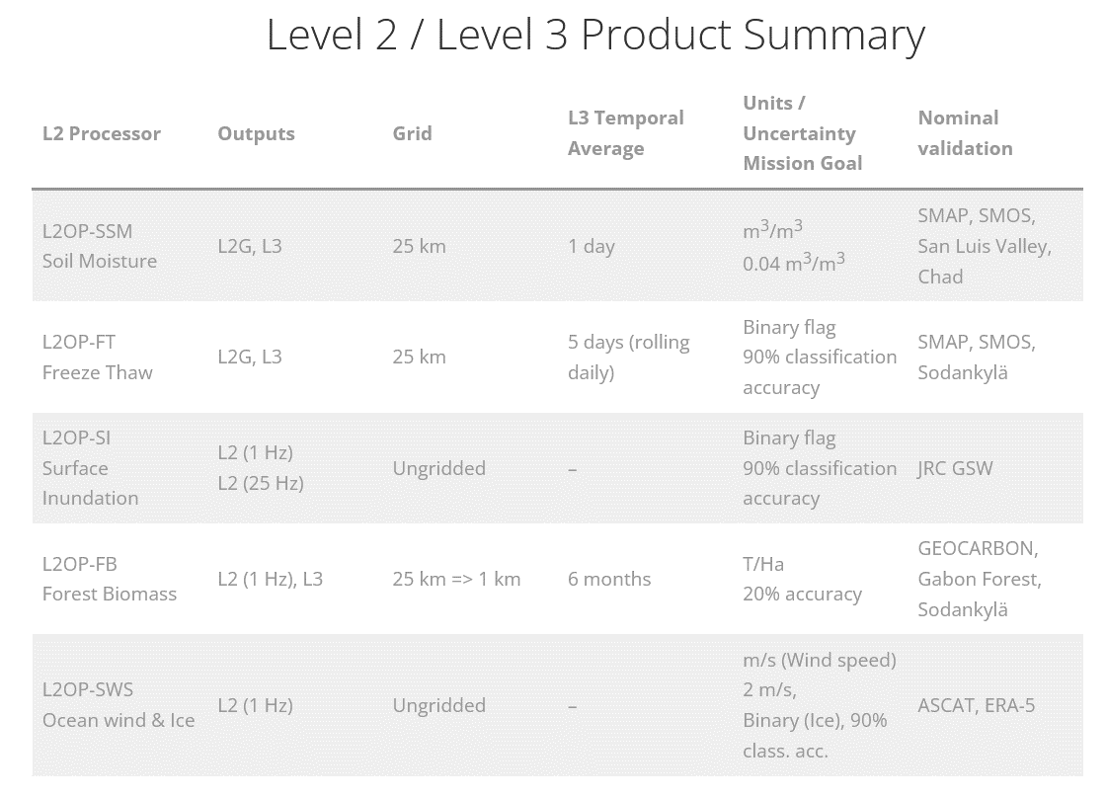
HydroGNSS https://www.hydrognss.org/
HydroGNSS is one of the new Scout missions being developed within ESA’s Earth Observation FutureEO programme.
ESA’s HydroGNSS mission will now comprise two identical satellites to halve the time it takes to revisit the same place on Earth’s surface
Liftoff is planned for Q4-2024 or Summer 2025 depending on launcher.
Orbiting Earth 180 degrees apart, the two identical satellites will use Global Navigation Satellite System (GNSS) reflectometry to measure important climate variables such as soil moisture, freeze–thaw state over permafrost, inundation and biomass.
The satellites will also measure wind speed over the ocean and sea-ice extent as secondary products.
HydroGNSS reflectometry, image credits: SSTL

Slide 23
Summary
SMOS Mission (https://earth.esa.int/eogateway/missions/smos) with plans to go beyond 2025
  Platform and Payload in good condition, no criticality despite few recent anomalies
  SMOS long term calibration monitoring is stable
  SMOS – SMAP Brightness Temperature inter-comparison continues to show good agreements between the two sensors
  New L3 Freeze and Thaw soil state product (v300) and L4 sea ice thickness product (v206) since November 2023
  Preparation for full mission reprocessing (4th) in 2024 is on-going (revisit L1 calibration, L2 retrieval algorithms and auxiliary files)
Validation platforms for soil moisture (QA4SM: https://qa4sm.eu/ui/home) and sea surface salinity (PiMep: https://www.salinity-pimep.org/) have been upgraded (e.g. new products and functionalities)
DOMEX experiment (L-band radiometer in Antarctica) has continued with radiometer update
RFI monitoring and reporting has continued (https://rfi.smos.eo.esa.int/)
CIRM mission (https://cimr.eu/) passed PDR. Engineering model under development. Preliminary L1 and L2 algorithm and products definition.
AWS (ESA - Arctic Weather Satellite) and Hydro-GNSS ) https://www.hydrognss.org/ ) Missions ready to launch

Slide 24
Acknowledge
Presentation inputs from:
  Manuel Martin-Neira (ESA)
  Michele Scagliola (ESA)
  Roberto Sabia (ESA)
  Giovanni Macelloni (IFAC)
  ESA SMOS RFI team
  SMOS Calibration team
  ESA SMOS Expert Support Laboratories
Thank you for your attention
Point of contact: Raffaele.Crapolicchio@esa.int

Slide 25
Backup slides

Slide 26
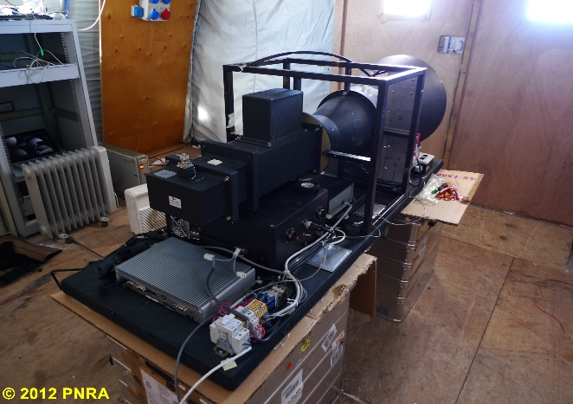
RADOMEX: L-band microwave radiometer
Temp in winter: -90°C
Temp in summer: -20°C
Frequency : 1413 MHz
Bandwidth: 27 MHz
Sensitivity = 0.2 K (Ti =2 sec)
Polarization: H and V
Antenna: Potter Antenna
HPBW: 20°
Active (PID) thermal control
Accuracy : 1 K
Key points:
Must be robust, failure tolerant and stable in time (unreachable Feb though Nov, quite similar to space!)
RF section is thermal compensated ( stability better than 0.1°C over years)
Temperature on the cables and connector is measured by PT100
Internal frequent calibration (every measurement cycle over 4 reference loads
External calibration (clear sky + hot target) at monthly scale
15 m

Slide 27
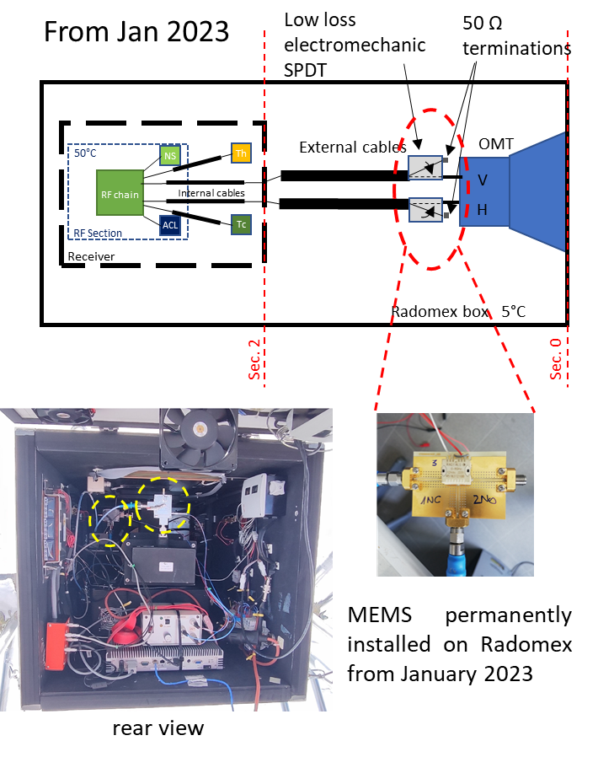
2023 Radomex Instrument Updates
To improve Absolute Calibration, an external Single Pole Double Throw switch switch (MEMS Radiall R51631210T) was connected at to the OrthoMode Transducer , it allows to connect the receiver to the antenna or to a 50 ohm termination
(1)
Sky acquisition 140 deg for 15 min
(2)
Ice sheet acquisition
42 deg for 15 min
During each sky observation, external absolute calibration is computed using:
clear sky as cold external reference (3.95 K)
50Ω Termination referred to the antenna plane as external hot reference
Gain and Offset are derived and then applied to the consecutive snow observation at 42 deg.
Preliminary results
50 Ω
termination
SKY

Slide 28
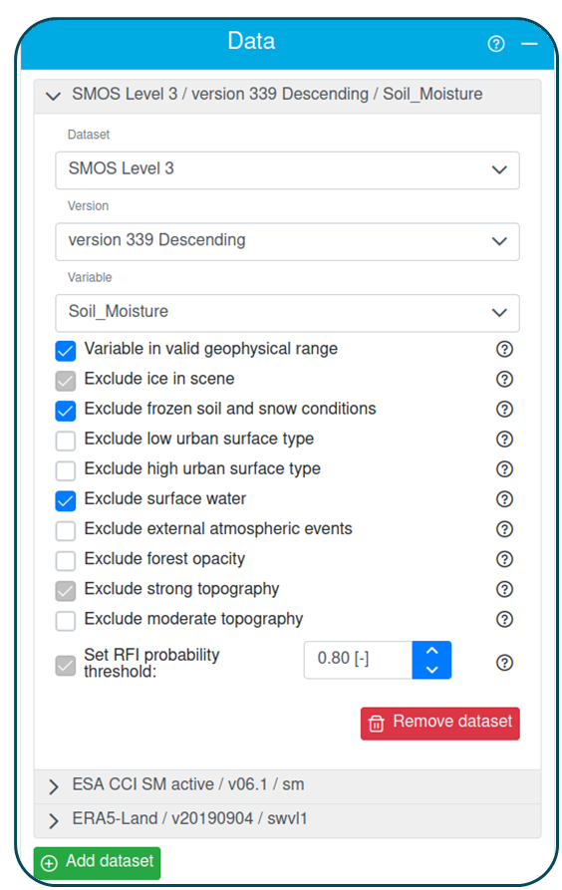
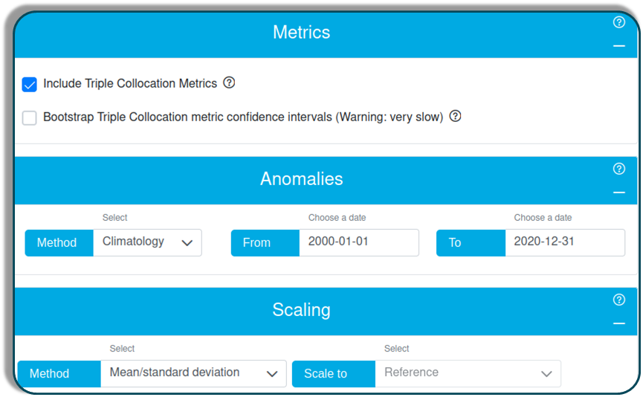
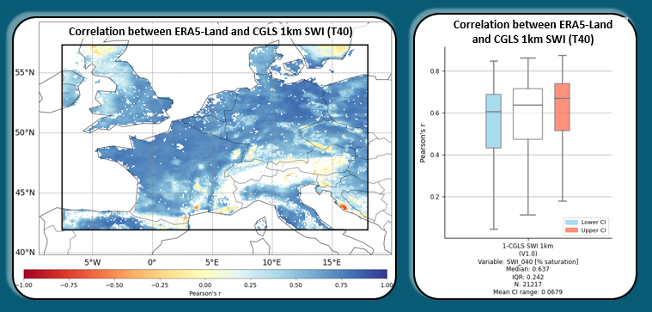
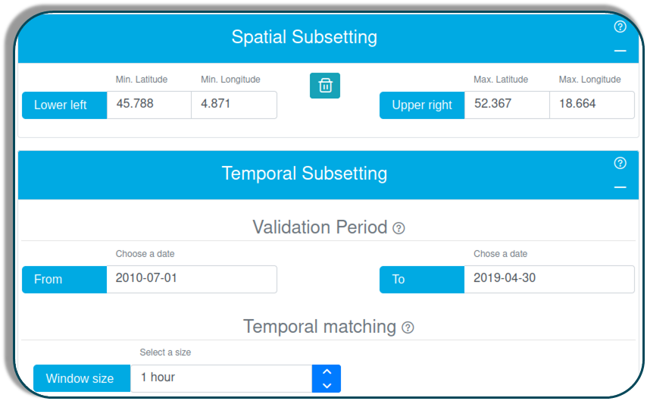
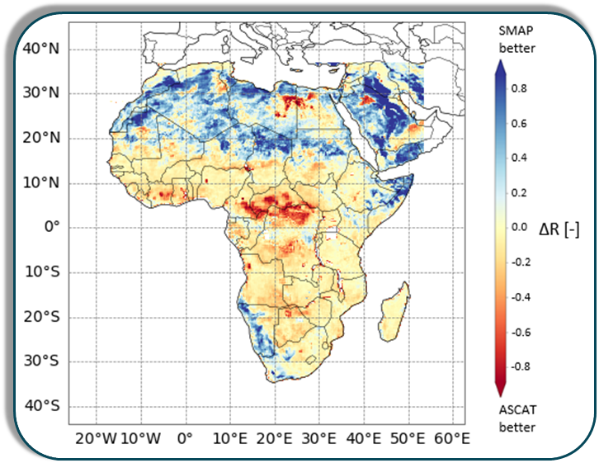
QA4SM Workflow https://qa4sm.eu
1) Data Selection
2) Customize Settings
3) Process, visualize, share & download
Validation metrics ↑
tables, maps, box plots,...
Comparisons →
difference maps,
ISMN metadata based comparisons, ...
Temporal / spatial subsets, validation metrics + CIs, anomaly computation, ...
Up to 5 satellites + 1 reference
Public example: Published Validation of ESA CCI (C3S) Soil Moisture with ERA5 https://qa4sm.eu/ui/validation-result/e9a9d43a-deac-4ea5-bbcb-855065fbbeb8

Slide 29
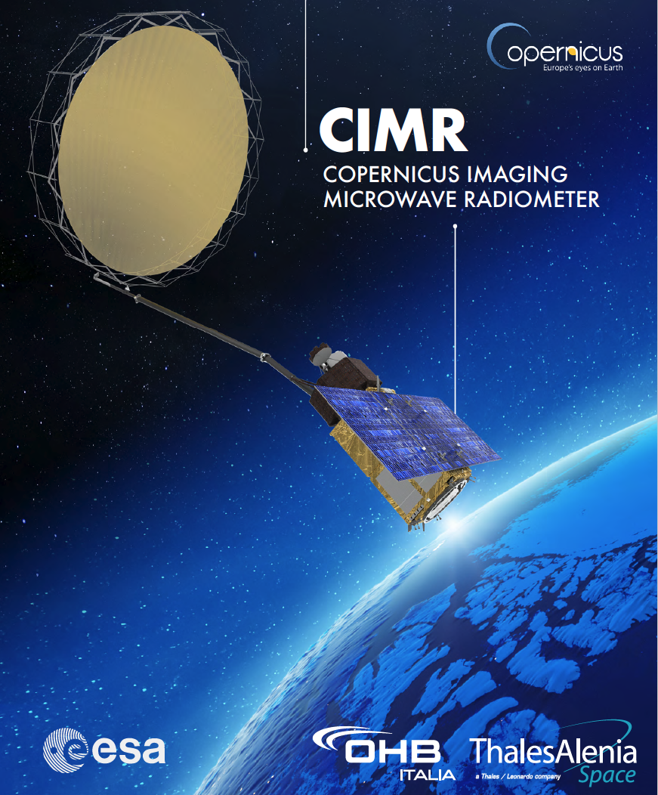

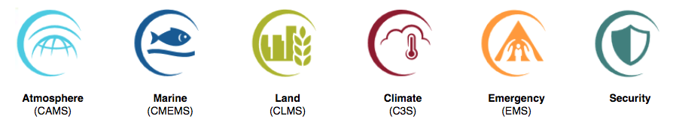
The Copernicus Imaging Microwave Radiometer CIMR
Polar Oceans are fundamental to understanding the global environment
CIMR is designed to:
  Prevent the anticipated Gap in capability
  Be “ready” for an ice free Arctic
  Key variables: Sea Ice Concentration, Sea Surface Temperature, thin Sea Ice Thickness, Sea Surface Salinity, Wind Speed, soil moisture…
  Low frequency/High Spatial resolution (5–15 km)
  Measurements every ~6 hours in the Polar regions, no hole at the pole
  95% global coverage every day for application in all Copernicus Services
Directly addresses the EU Arctic Policy.
A ‘Game Changer’ for Copernicus
The European Commission and the High Representative of the Union for Foreign Affairs and Security Policy issued to the European Parliament and the Council, on 27 April 2016, a joint communication that proposed "An integrated European Union policy for the Arctic"

Slide 30
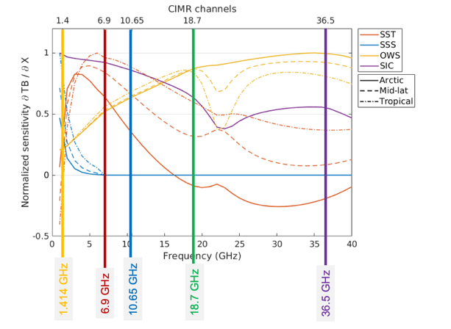
CIMR channel selection
1.4135 GHz: SIT, SIC, SSS, WS, SM, SD
6.9 GHz: SIC, SST, SIT, IST, WS, SID, SM, SD
10.65 GHz: SST, PCP, WS, SD, SM
18.7 GHz: TCWV, LWP, PCP, SIC, SD, SM, SID
36.5 GHz: SIC, SST, LWP, TCWV, PCP, SIC, SWE, SD
SIC = Sea Ice Concentration,
SST = Sea Surface Temperature, SIT = Sea Ice thickness,
SSS= Sea Surface Salinity,
WS = Wind speed,
LWP = Liquid Water Path,
TCWV = Total Column-liquid Water Vapour,
SD = Snow Depth,
SM = Soil Moisture,
SWE = Snow Water Equivalent,
SID = Sea Ice Drift,
PCP=precipitation
(Killic et al, 2020)
Channels (GHz, Full Stokes): 1.4 6.9 10.65 18.7 36.5
Resolution (km): <60 ≤15 ≤15 ≤5.5 ≤5 (g:4km)
NEΔT (K @150K): ≤0.3 ≤0.2 ≤0.3 ≤0.4 ≤0.7
Tot. Standard Uncertainty(K): ≤0.5 ≤0.5 ≤0.5 ≤0.6 ≤0.8
Notes:
Figure MRD-4.2.2.1 Location of CIMR bands and sensitivity of brightness temperature for open seawater over a range of observing frequencies in the microwave band for a set of key geophysical parameters (From Gabarro et al, 2017). This figure clearly highlights why CIMR channels are chosen to maximize the information available in the 1.4-37 GHz frequency range. See Figure MRD-2.4.1.1 for CIMR frequency relationships for SIC.

Slide 31
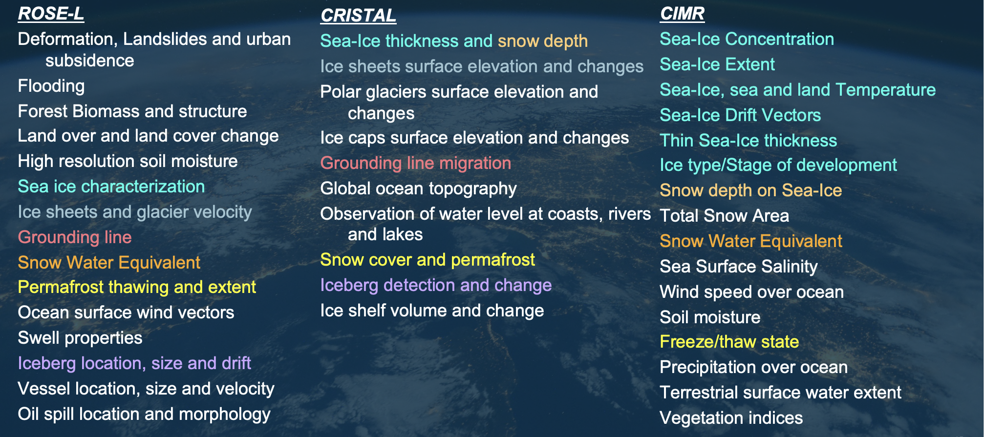
CIMR status (https://cimr.eu/)
CIMR Channels (GHz, Full Stokes): 1.4 6.9 10.65 18.7 36.5
Resolution (km): <60 ≤15 ≤15 ≤5.5 ≤5 (g:4km)
NEΔT (K @150K): ≤0.3 ≤0.2 ≤0.3 ≤0.4 ≤0.7
Tot. Standard Uncertainty(K): ≤0.5 ≤0.5 ≤0.5 ≤0.6 ≤0.8
Copernicus mission (active/passive) commonalities
Preliminary Design Review system and instrument was successfully achieved end 2022
Mission is now in phase C-D
Mission Requirements Document available at https://cimr.eu/documents
Launch of CIMR-A in 2028+ (CIMR-B few years later)

Slide 32
CIMR Level-1 and Level-2 Processing chain
The high level design for the CIMR Level-1 and Level-2 processing chain is presented here

Slide 33
CIMR ESA/EUMETSAT responsibilities
ESA will operate the CIMR Mission and generate Level-1a, Level-1b and Level-1c products.
For Polar Regions and Global Land product families, ESA will develop Level-2 pipelines for all relevant products.
EUMETSAT will develop separate pipelines for Global Ocean and Atmosphere product families starting from ESA Level-1 products.
The ESA and EUMETSAT pipelines at Level-2 are thus independent by design.
Validation and quality control aspects are thus the responsibility of each respective Agency with respect to Level-2 Mission Requirements.

Slide 34
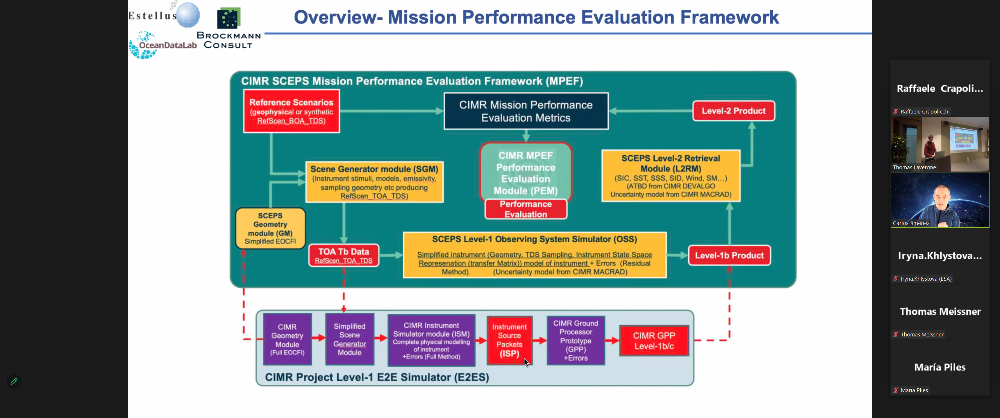

Slide 35
