Slide 1
Validation of Microwave Humidity Sounder- II and Microwave Temperature Sounder-III onboard FenYun-3F in the post-launch phase
Yang Guo
Juyang Hu, Songyan Gu, Fangli Dou, Chengli Qi, Ling Sun，Xiuqing Hu
CMA

Slide 2
Outline
Instrument introduction
On-orbit instrument performance
MWHS-II
MWTS-III
Summary

Slide 3
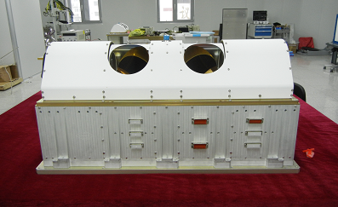
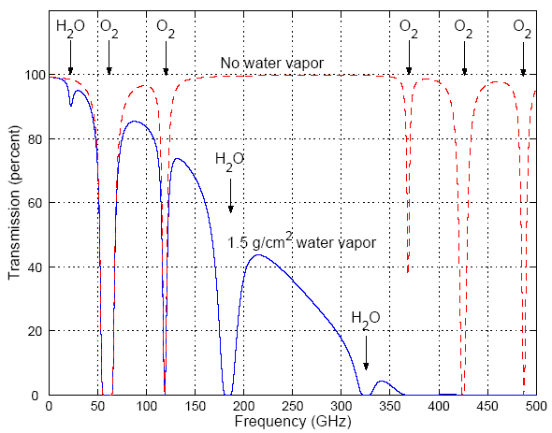
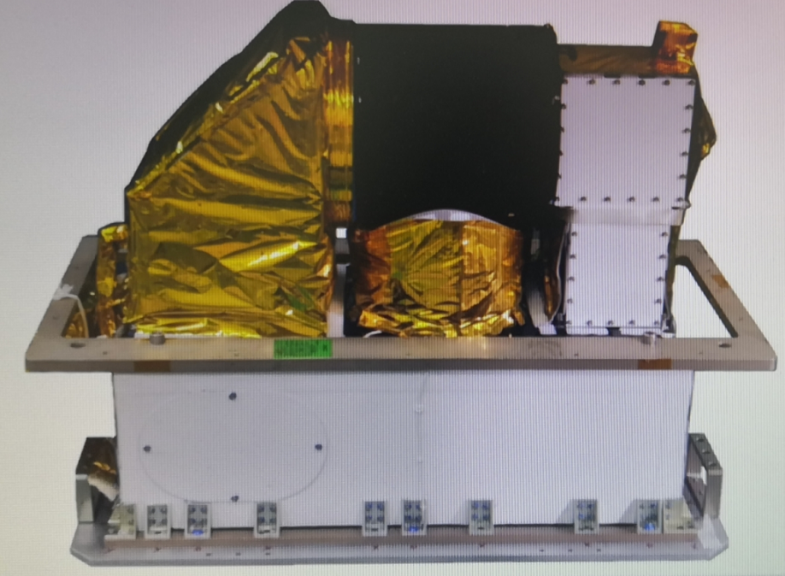
Instrument introduction
FY-3F MWHS-II was turned on August 8, 2023, and has been operating normally in orbit ever since.
FY-3F MWTS-III was turned on August 9, 2023, and has been operating normally in orbit ever since.
50-60GHz
118GHz
183GHz

Slide 4
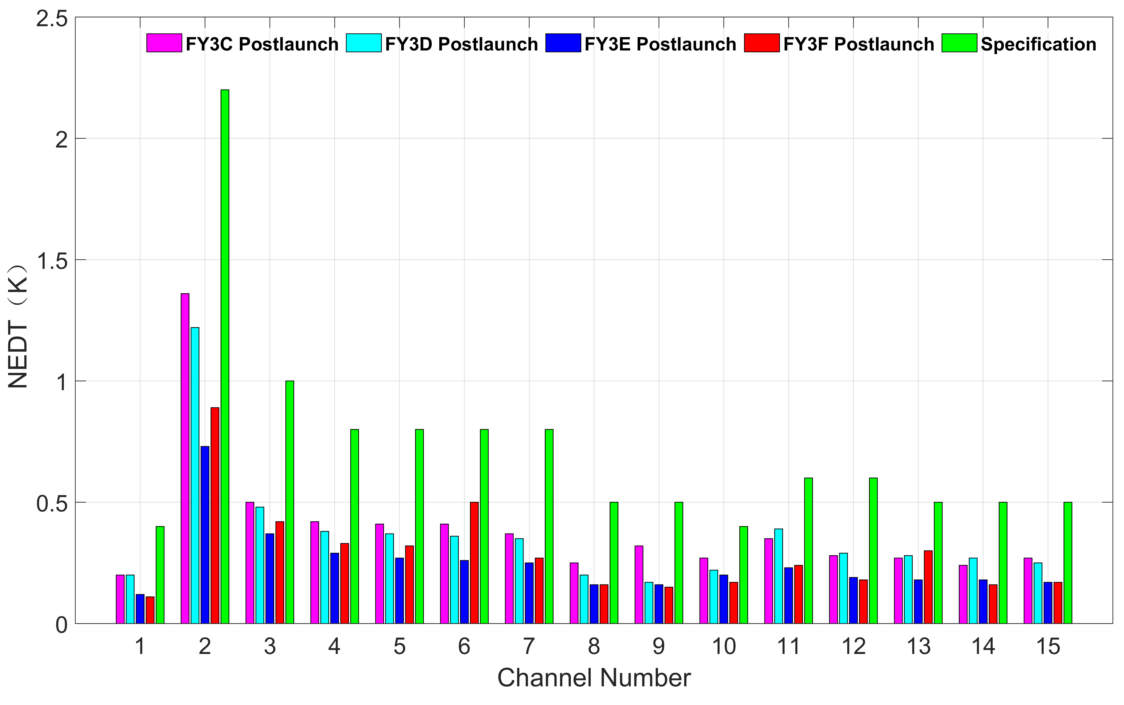
On-orbit instrument performance-MWHS-II

Slide 5
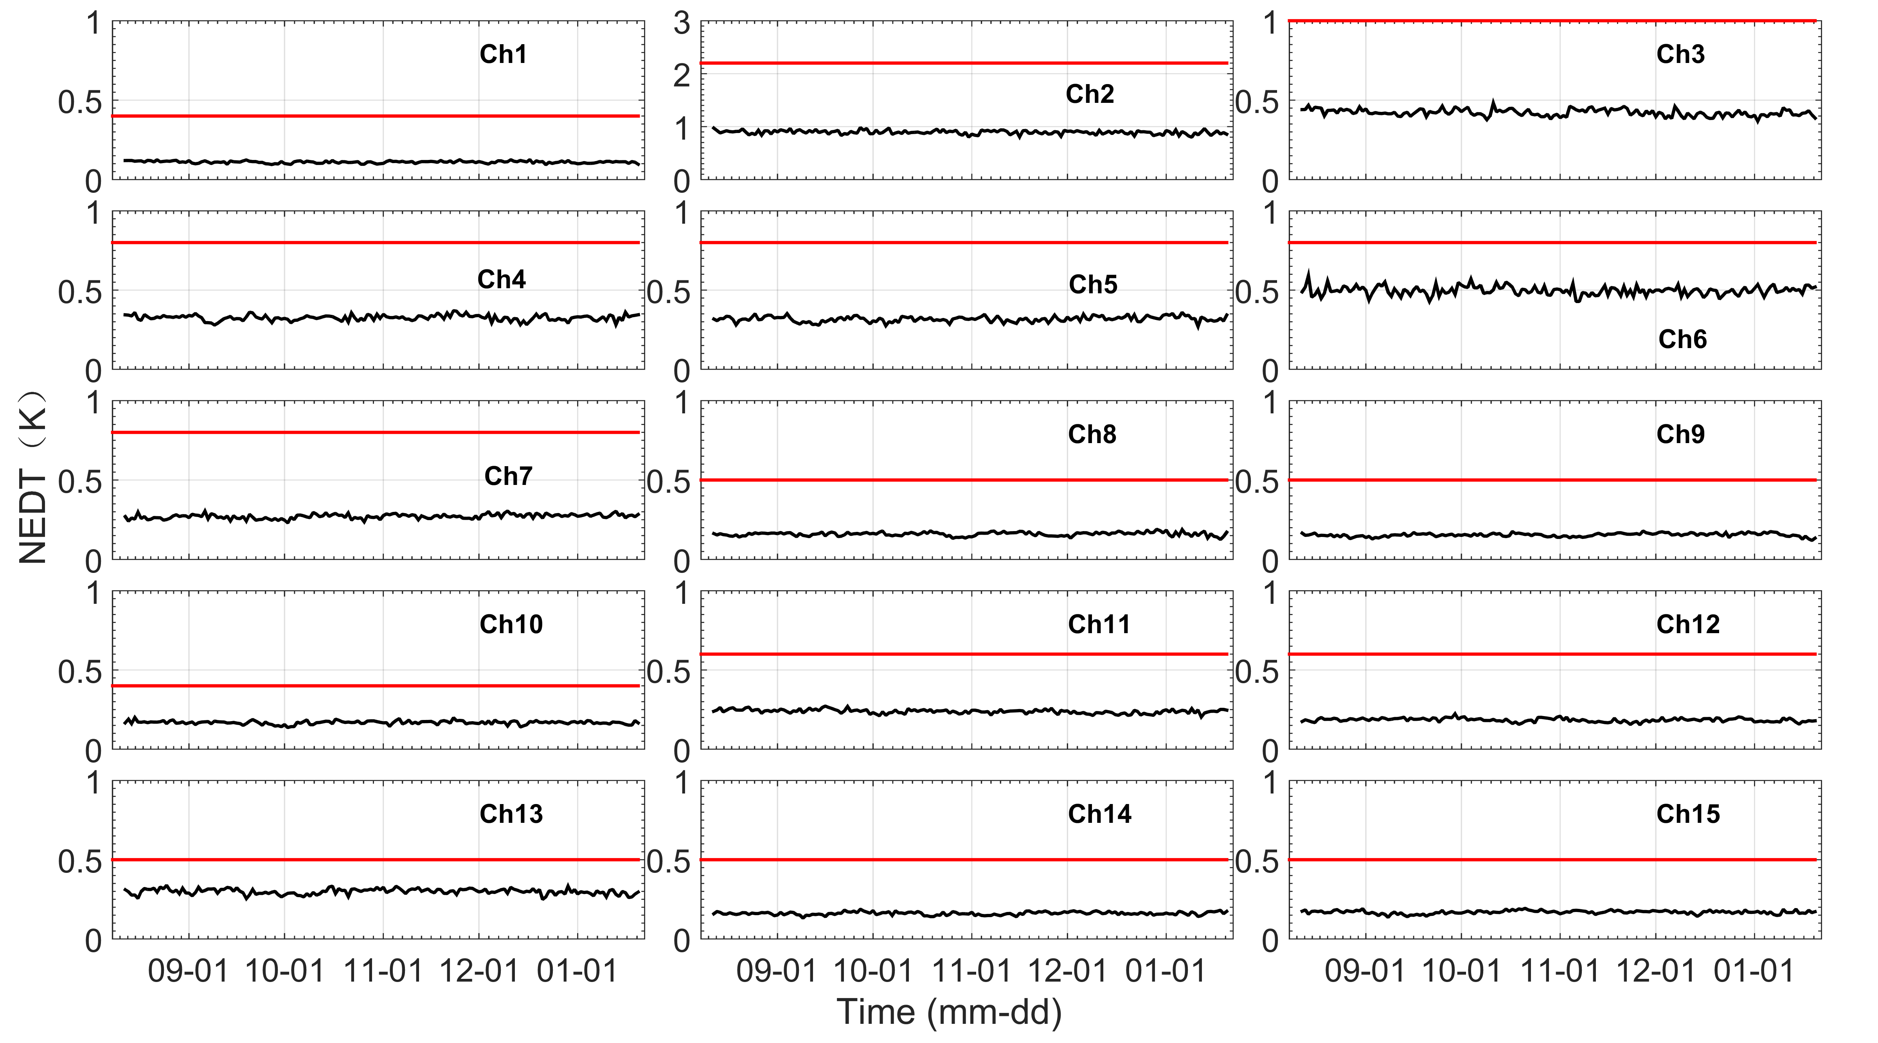
On-orbit instrument performance-MWHS-II

Slide 6
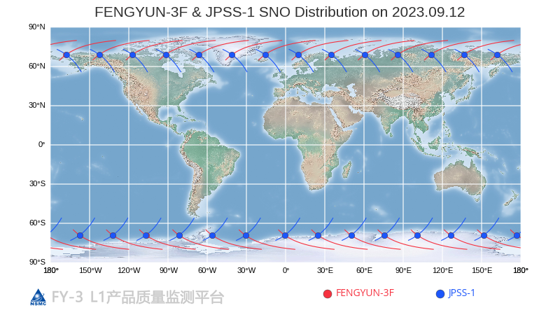
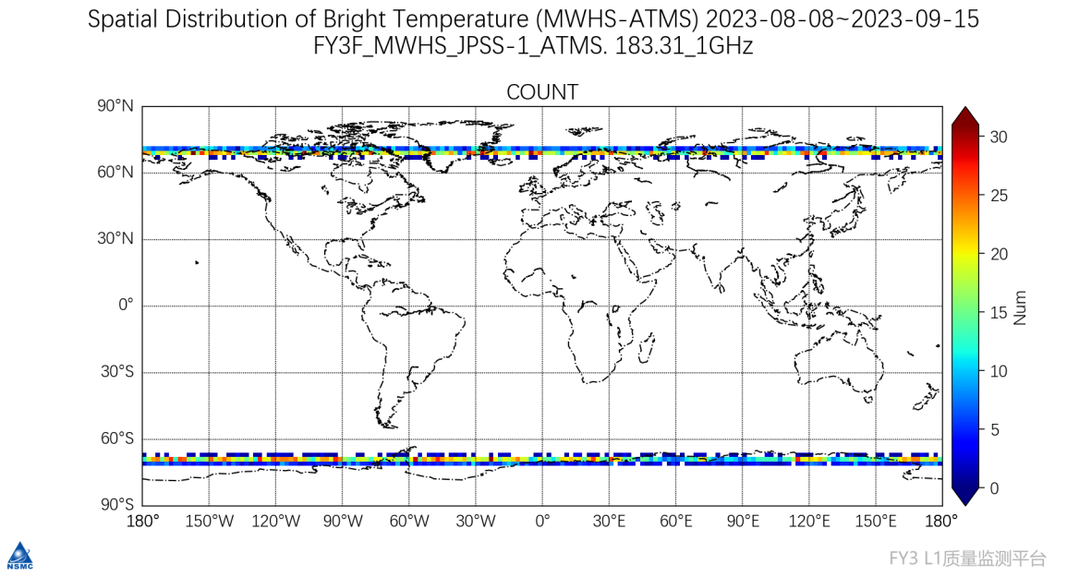
On-orbit instrument performance-MWHS-II
The SNO data with a time difference greater than 15 min and spatial distance greater than 3 km are rejected in the comparison. The data used in this study is within an earth-viewing-angle of ±5°
Compared Channel
Center Frequency （GHz） | MWHS-II (Channel Number) | ATMS (Channel Number)
183.31±1 | 11 | 22
183.31±1.8 | 12 | 21
183.31±3 | 13 | 20
183.31±4.5 | 14 | 19
183.31±7 | 15 | 18

Slide 7
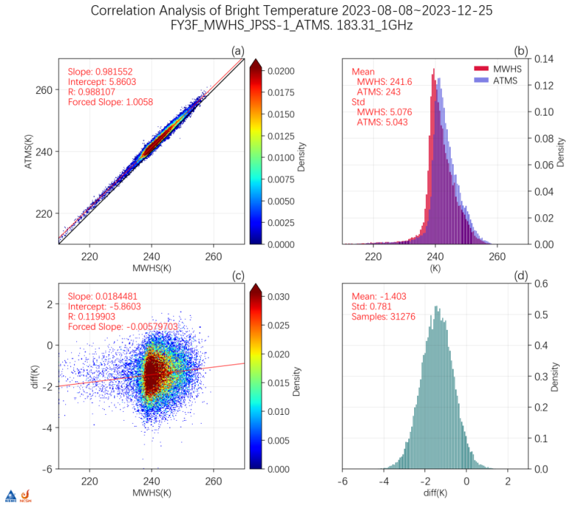
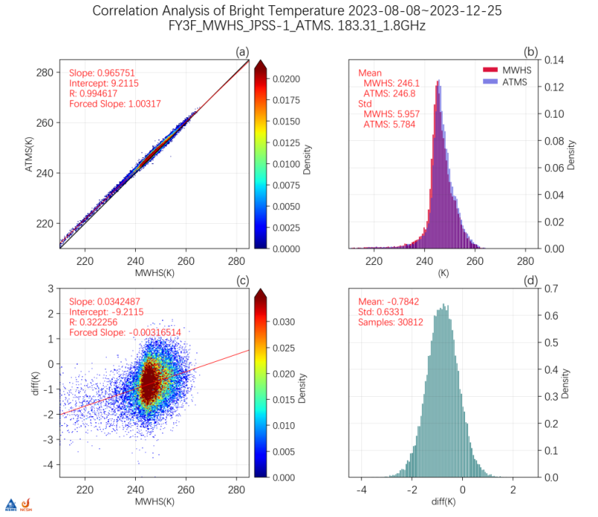
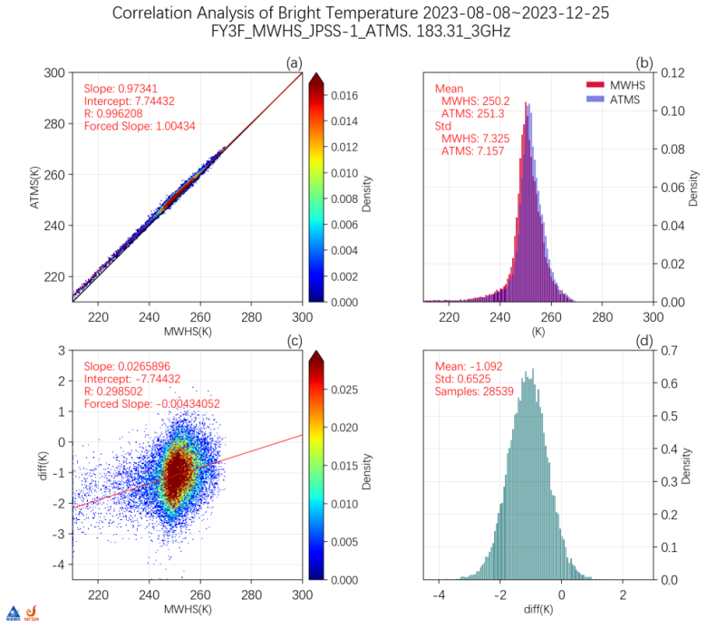
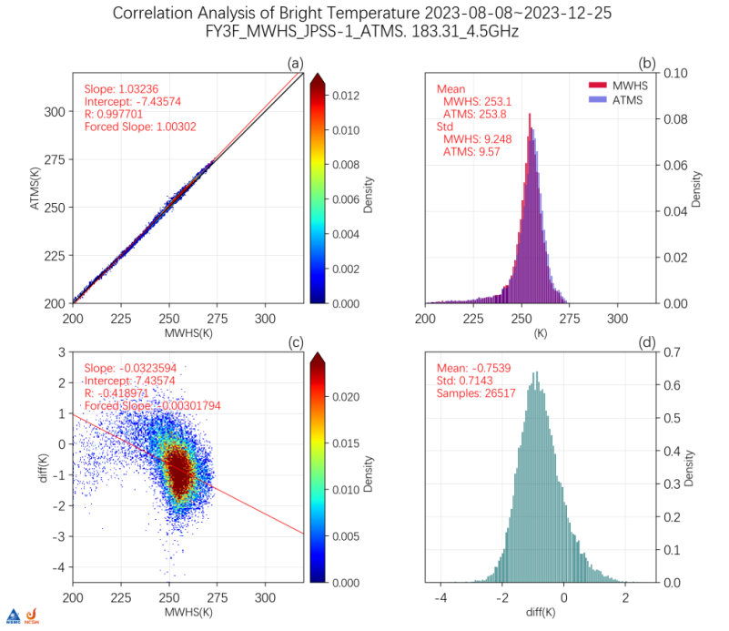
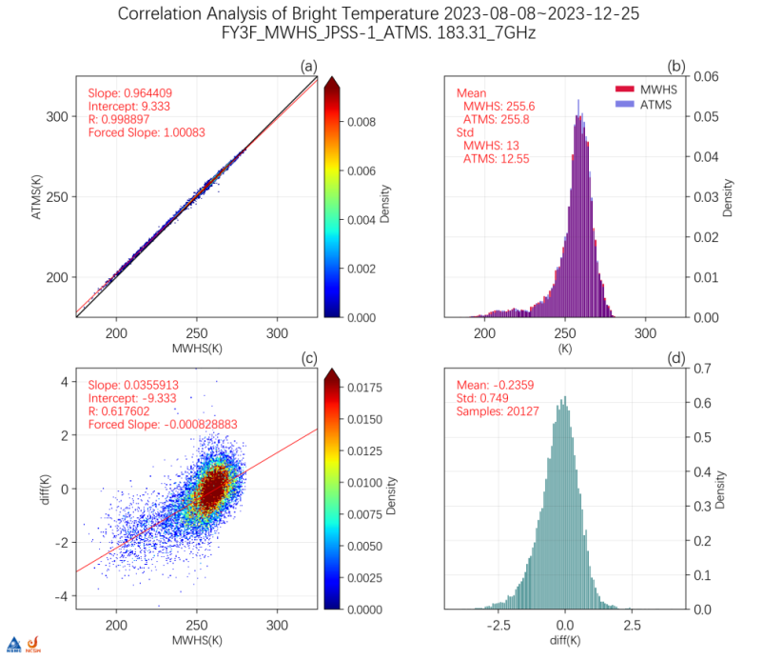
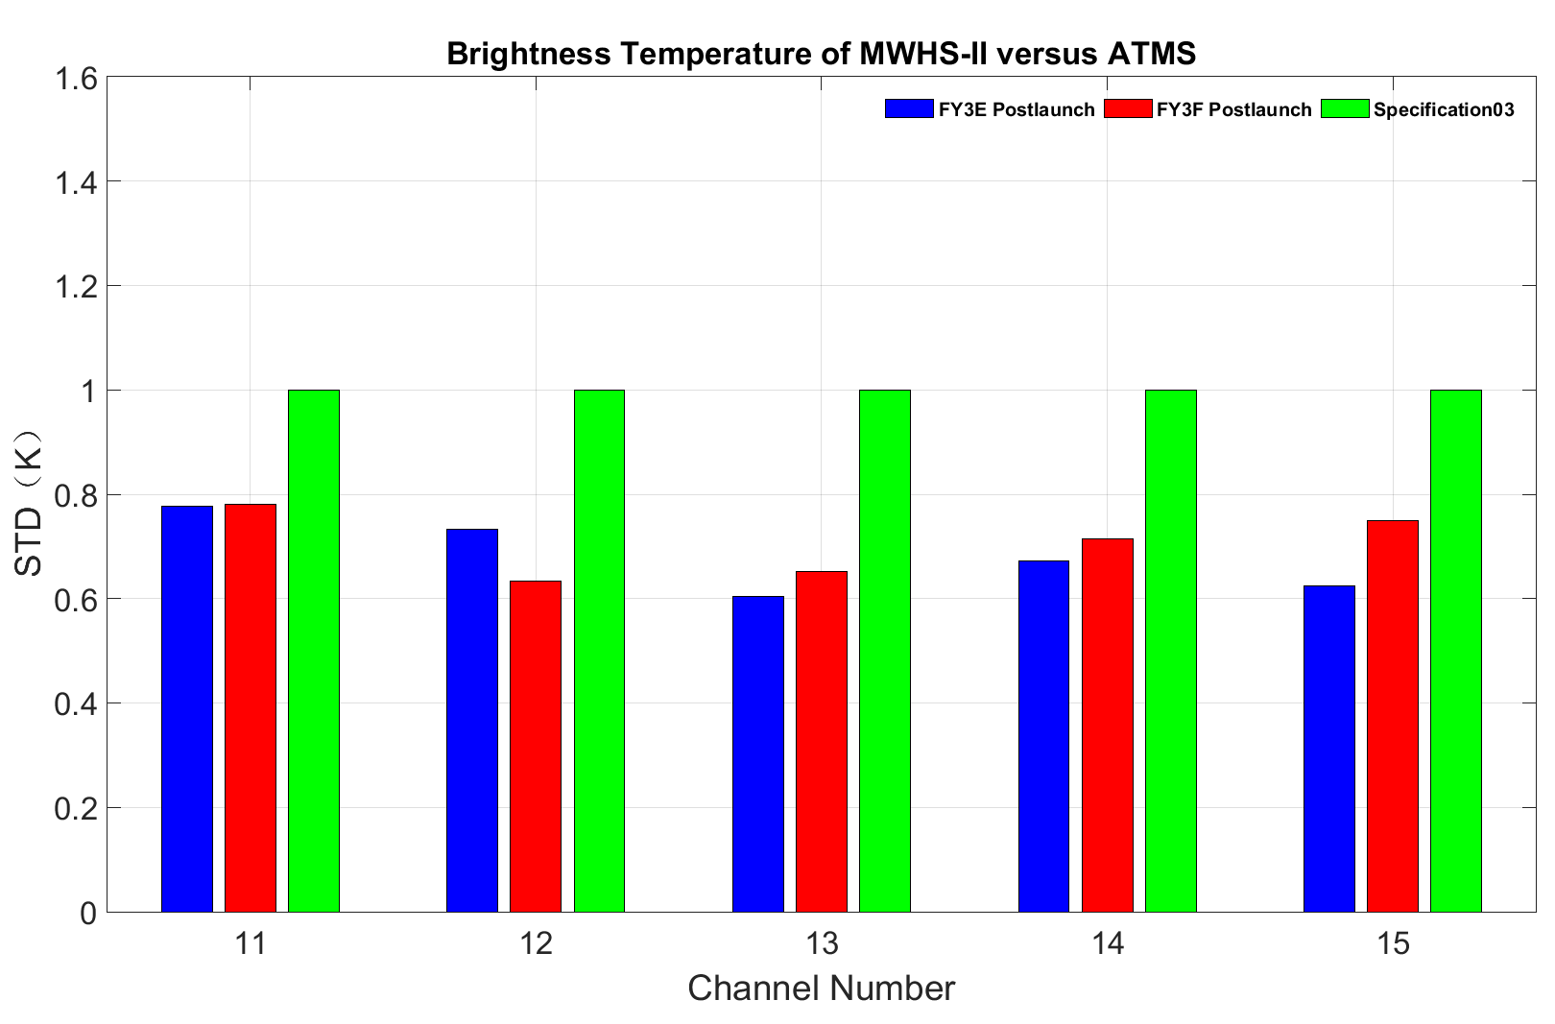
On-orbit instrument performance-MWHS-II
183.31±1GHz
183.31±1.8GHz
183.31±3GHz
183.31±4.5GHz
183.31±7GHz

Slide 8
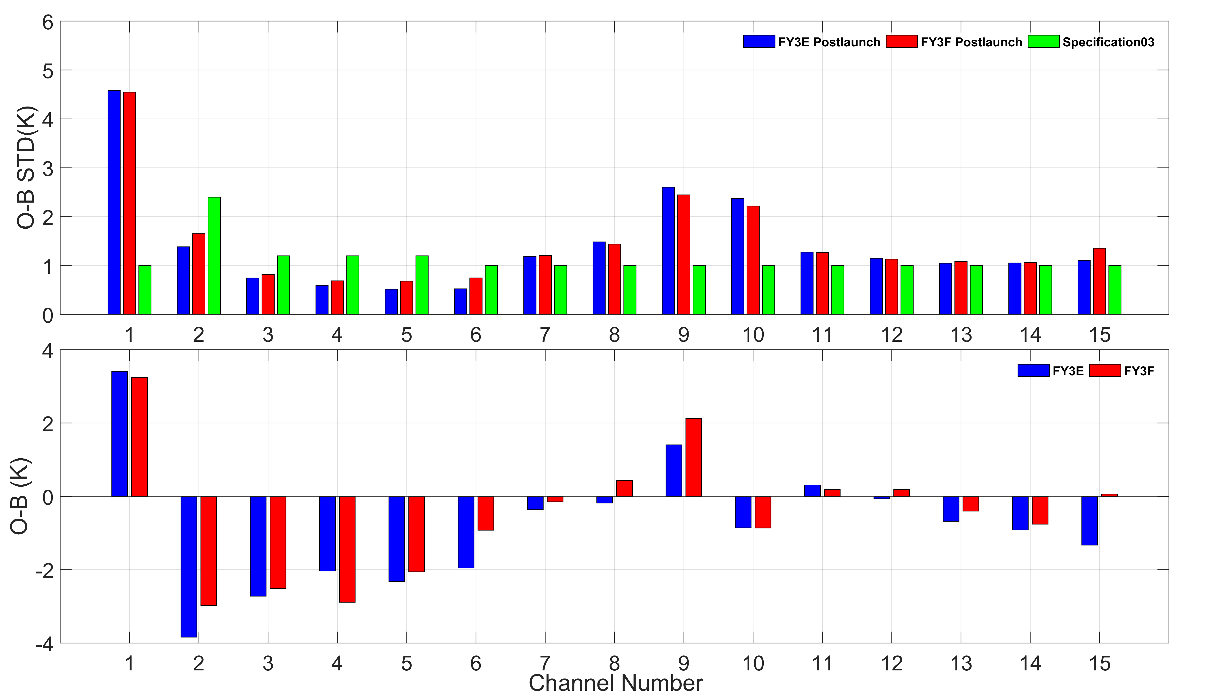
On-orbit instrument performance-MWHS-II

Slide 9
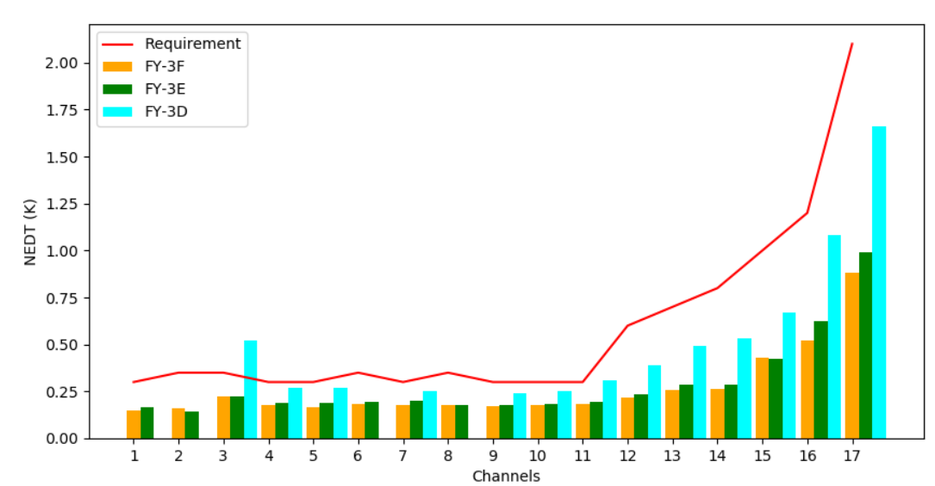
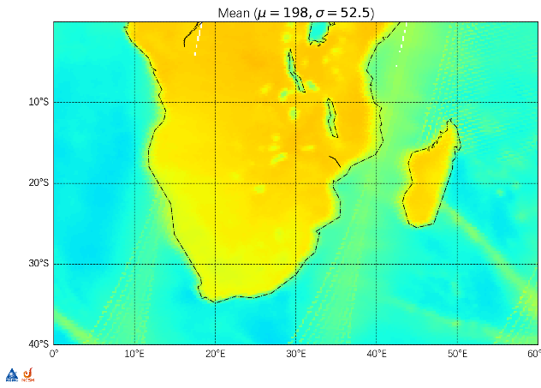
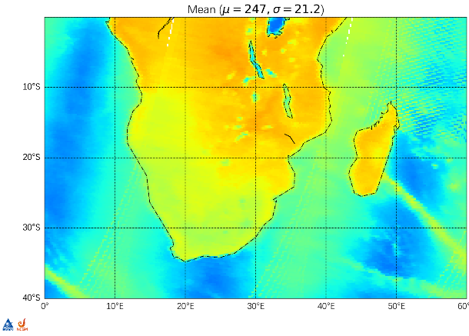
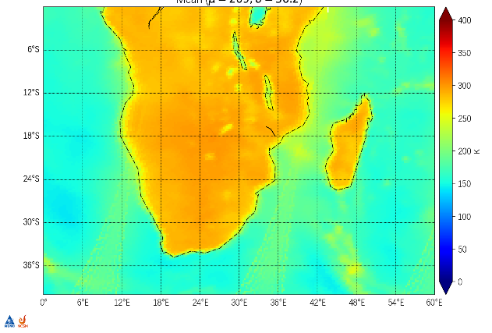
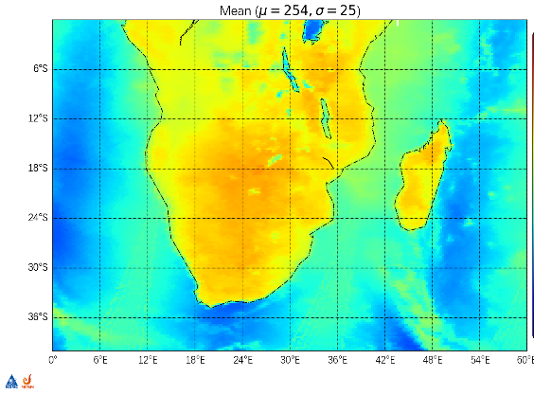
On-orbit instrument performance-MWTS-III
(1) NEDT
The quality of FY-3F MWTS-III such as NEDT, alignment accuracy and calibration accuracy are better than those of FY-3E.
(2) Alignment accuracy
Alignment deviation between ch 2 and ch 3 of FY-3E MWTS-III is 1.47 pixels, but that of FY-3F MWTS-III is 0.3 pixels.
Channel 2
Channel 3
Channel 2
Channel 3

Slide 10
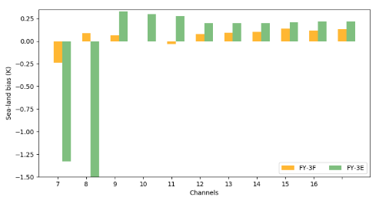
On-orbit instrument performance-MWTS-III
(3) Sea-Land contrast bias in sounding channels
Sea-land contrast bias comparison
FY-3F MWTS-III improves the out-of-band response for channels 6-8 and crosstalk on channels 7-17, and significantly mitigates the sea-land contrast bias.
(4) Calibration Accuarcy
Compared to the BTs simulated using RTTOV and ERA5, the deviations of FY-3F MWTS-III are smaller than those of FY-3E MWTS-III.

Slide 11
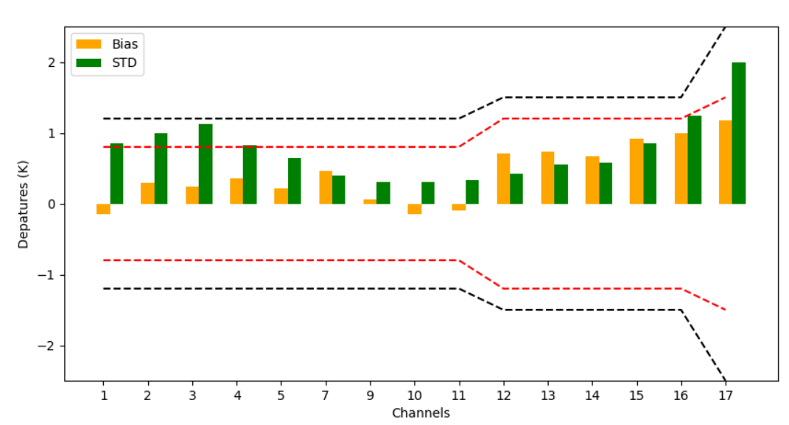
On-orbit instrument performance-MWTS-III
(4) Calibration Accuarcy
Data : 2023.10.9—2023.11.20
Key match-up conditions
Difference of observing times < 20 minutes
Nadir two pixels
Distance < 20 km
Uniformity check : STD (3×3 pixels BT) < 1 K
Comparison Data:
Band 1-5 (near surface channels) : BT_MWTS-BT_ATMS
Band 7-17 (sounding channels): OMB_MWTS-OMB_ATMS
OMB: Observation-simulation(RTTOV+ERA5)
Compared to JPSS-1 ATMS
MWTS-III |  |  | ATMS
Center frequency (GHz) | No. | Polarization | No. | Polarization
23.8 | 1 | QH | 1 | QV
31.4 | 2 | QH | 2 | Qv
50.3 | 3 | QV | 3 | QH
51.76 | 4 | QV | 4 | QH
52.8 | 5 | QV | 5 | QH
53.246±0.08 | 6 | QV
53.596±0.115 | 7 | QV | 6 | QH
53.948±0.081 | 8 | QV
54.40 | 9 | QV | 7 | QH
54.94 | 10 | QV | 8 | QH
55.50 | 11 | QV | 9 | QH
57.290344(fo) | 12 | QV | 10 | QH
fo±0.217 | 13 | QV | 11 | QH
fo±0.3222±0.048 | 14 | QV | 12 | QH
fo±0.3222±0.022 | 15 | QV | 13 | QH
fo±0.3222±0.010 | 16 | QV | 14 | QH
fo±0.3222±0.0045 | 17 | QV | 15 | QH
The biases for channels 1-16 are lower than 1K, while that for channel 17 is 1.12K.
The STDs for sounding channels 7-15 are lower than 1K.

Slide 12
Summary
The in-orbit behavior of MWHS-II and MWTS-III evaluated by SNO with ATMS and the difference between O-B.
Lunar microwave calibration group
National Satellite Meterological Cente
CMA
National Space Science Cente
Chinese Academy of Sciences
Sun Yat-sen University
National Satellite Meterological Cente
CMA
Fudan University
National Satellite Meterological Cente
CMA

Slide 13
Thank you for your attention
Email：guoyang@cma.gov.cn
hujy@cma.gov.cn

