Slide 1
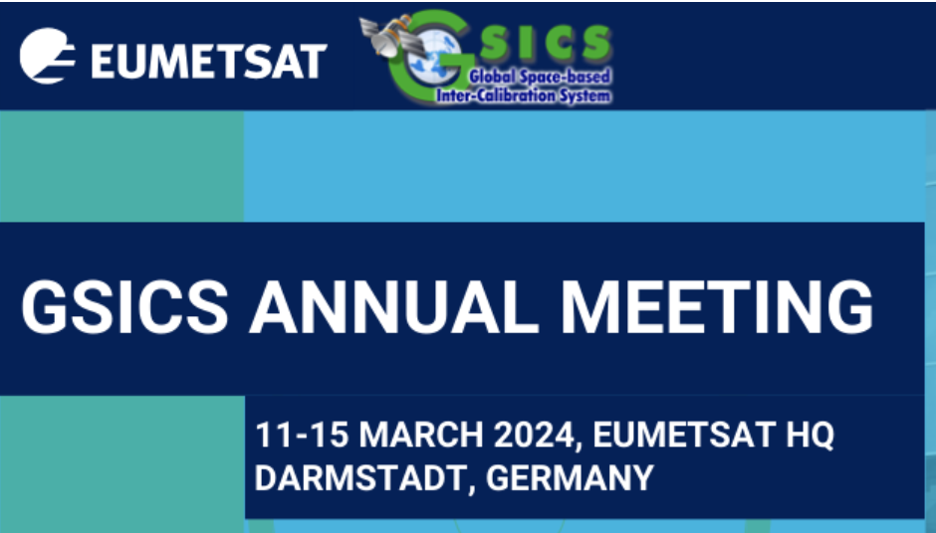
Modelling the Microwave Radiation of the Moon
Thomas Müller¹ (tmueller@mpe.mpg.de), Martin Burgdorf² & H. Yang³
¹Max-Planck-Institut für extraterrestrische Physik, Garching, Germany
²Meteorologisches Institut, Universität Hamburg, Germany , ³University of Maryland
Goal: to find a thermophysical model (TPM) solution which can predict the disk-integrated flux (radiance, brightness temperature) of the Moon, in the microwave (MW) regime, and over a phase angle range between -90 ∘ (waxing) and +90 ∘ (waning Moon) with high accuracy.
Purpose:
To allow for the inter-comparison of the (absolute) calibration of instruments, satellites
To validate (or establish) the absolute instrument calibration
To look into aging/degradation effects
To test technical aspects (pixel FOV, straylight, detector linearity, saturation levels, etc.)
Building up on work by Yang, Burgdorf, et al. (2018, 2020, 2022) …
Notes:
T_{B} [K], radiance [MJy/sr], flux [Jy]

Slide 2
Modelling the Microwave Radiation of the Moon
Thomas Müller¹ (tmueller@mpe.mpg.de) & Martin Burgdorf²
¹Max-Planck-Institut für extraterrestrische Physik, Garching, Germany
²Meteorologisches Institut, Universität Hamburg, Germany
Based on a well-tested thermophysical model (TPM) adopted for the Moon (Müller et al. 2021)
About 30 years of experience using TPM predictions of selected well-known asteroids for calibration of IR/submm/mm ground, airborne and space observatories (ISO, Spitzer, Herschel, AKARI, ALMA, SOFIA, partially also JWST)
The focus is on the interpretation of “disk-integrated” signals (not so much on disk-resolved 2-D maps) in the 89-190 GHz regime
Tested for a restricted lunar phase angle range from -90∘ (waxing) ≦ 𝜶 ≦ +90∘ (waning), including opposition (𝜶 = 0∘)
Building up on work by Yang, Burgdorf, et al. (2018, 2020, 2022) …
Notes:
T_{B} [K], radiance [MJy/sr], flux [Jy]

Slide 3
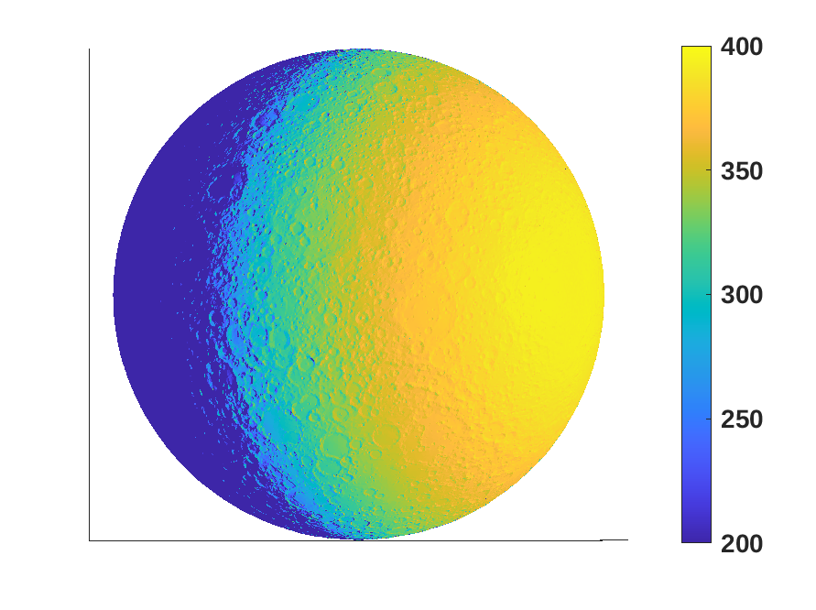
Thermophysical Model (TPM)
Model references:
Lagerros (1996, 1997, 1998); Müller & Lagerros (1998, 2002); Müller (2002)
Müller, Burgdorf et al. (2021): “The Moon at thermal infrared wavelengths: a benchmark for asteroid thermal models”, A&A 650, A38
Model aspects:
uses the true illumination and observing geometry (as seen from satellite)
considers 1-d heat conduction, shadowing and self-heating
Moon is modelled as an oblate spheroid with r_{equ}=1738.1 km and r_{pol}=1736.0 km (r_{equ}/r_{pol} = 1.0012), spin pole at (𝜆,𝛽)_{ecl} = (88.43∘, 214.45∘), P_{syn} = 29.530589 days, with a thermal inertia of 55 tiu (Hayne et al. 2017), and a surface roughness of 32∘ (Rozitis & Green 2012; Bandfield et al. 2015), absolute magnitude of -0.089 mag (Bowell et al. 1989), and a phase integral of q=0.43 (Muinonen et al. 2010), visual geometric albedo 0.12 (NASA Moon factsheet)
Bolometric and spectroscopic (hemispherical) emissivities
What is less important for disk-integrated TPM predictions in the MW regime?
Details of the surface (structural details like craters, maria/highlands, compositional details, albedo variations)
Roughness (very low influence in the micro-wavelength regime)
Temperature [K]
Notes:
What kind of predictions are possible: T, TB, radiance, in-band flux, FD, …
Effective temperature (maps) and brightness temperatures, disk-integrated in-band fluxes, monochromatic flux densities, radiance; spectral energy distributions, thermal lightcurves, (disk-integrated) linear polarization, …
Wavelength/frequency: mid-/far-IR, submm/mm,cm (100 THz…3000 MHz
Roughness only plays a very minor role (level of roughness, roughness model implementation): 1-2 % at max.

Slide 4
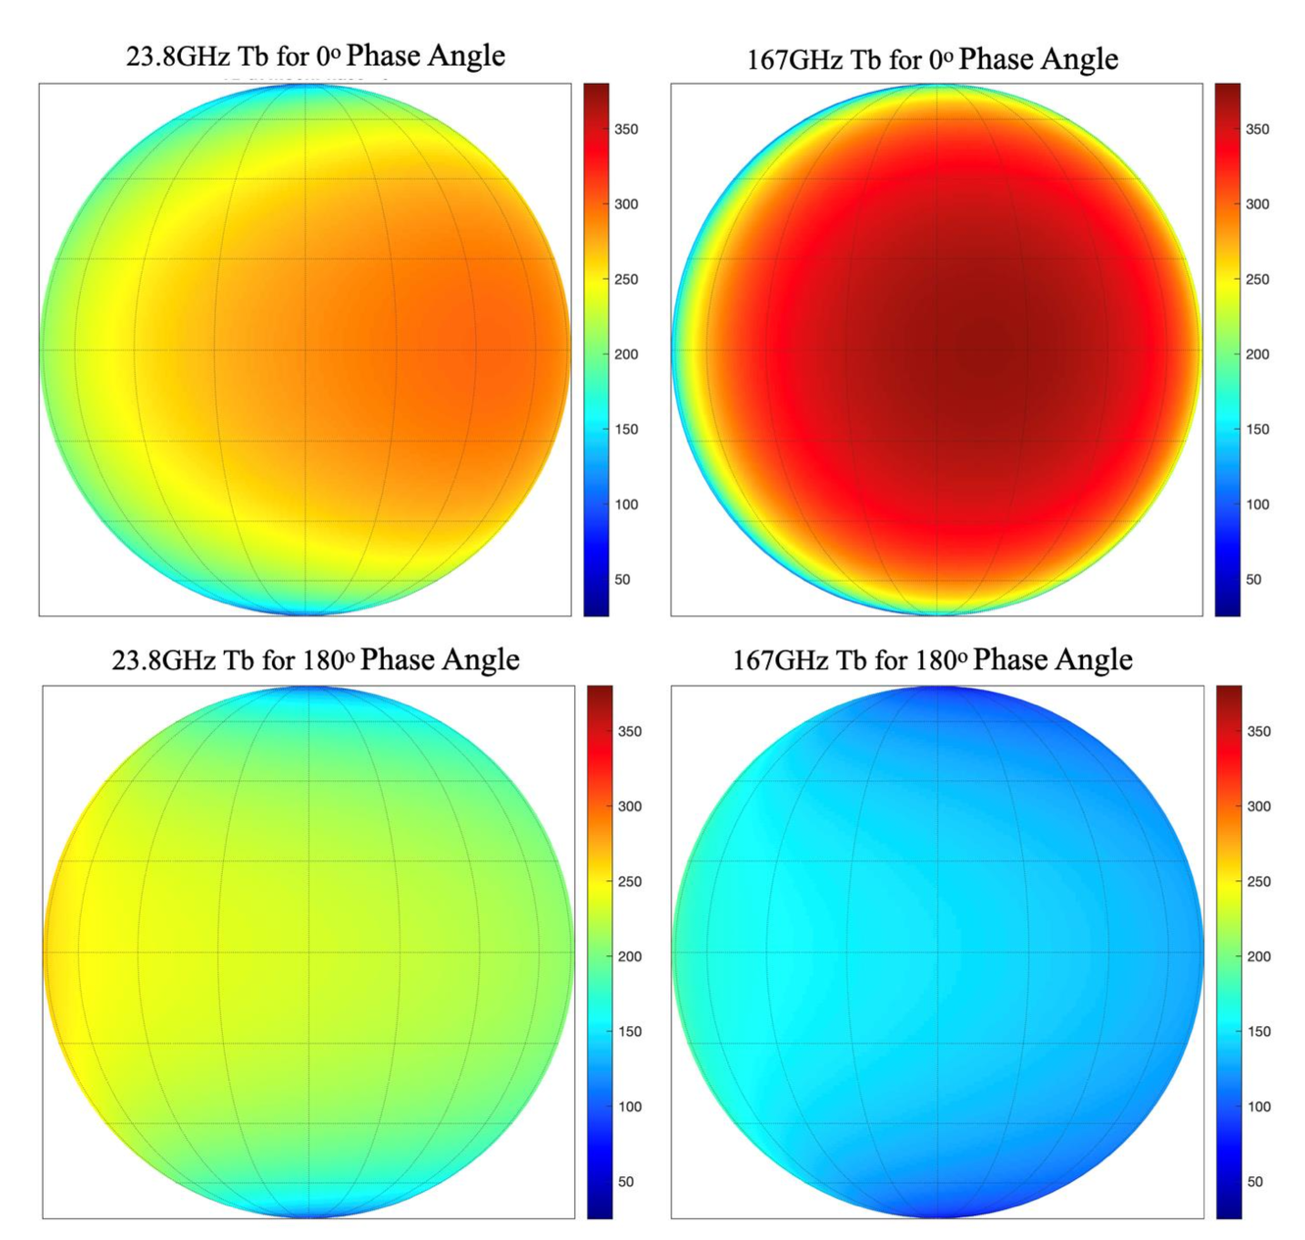
Model (RTM) by Tiger Yang
Model references:
Yang et al. (2018): “Developing Vicarious Calibration for Microwave Sounding Instruments Using Lunar Radiation”, IEEE GeoSci & Rem.Sens 56
Yang & Burgdorf (2020): “A Study of Lunar Microwave Radiation Based on Satellite Observations”, Remote Sensing 12, 1129
Yang & Burgdorf (2022): “A Calibrated Lunar Microwave Radiative Transfer Model Based on Satellite Observations”, Remote Sensing 14, 5501
Model aspects:
Simulated results from the calibrated lunar RTM model
Originally developed by Keihm in 1984
Calibrated with NOAA-20 ATMS observations (in the 0 ∘ - 34 ∘ deg range?)
Yang & Burgdorf (2022), Fig 2

Slide 5
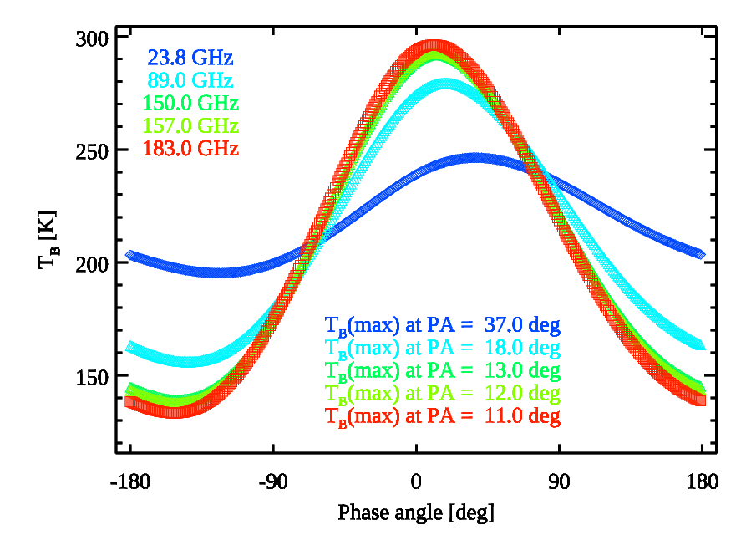
RTM simulations based on Yang & Burgdorf (2022)

Slide 6
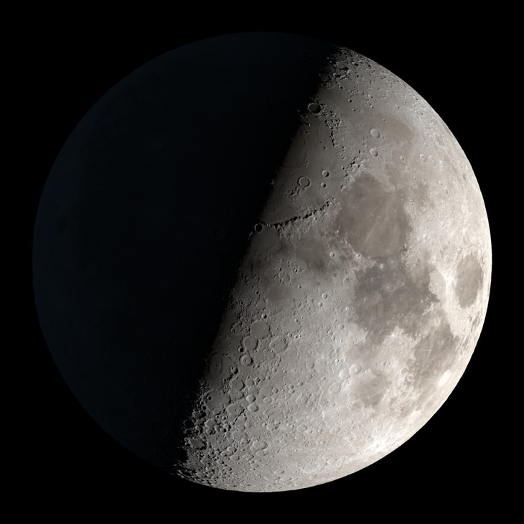
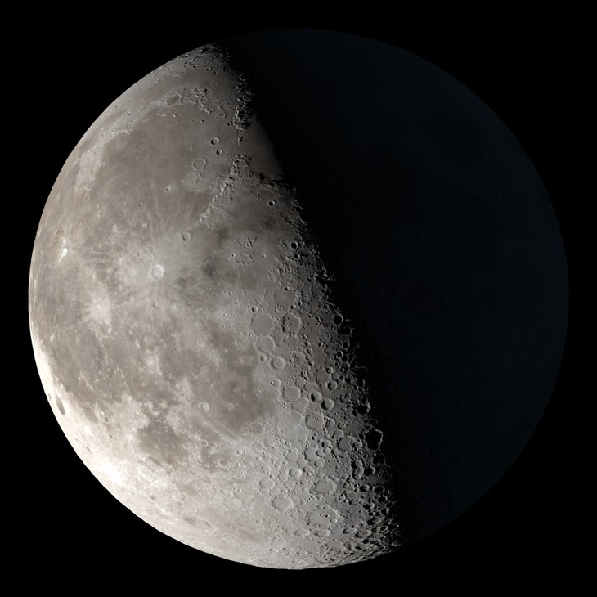
Microwave measurements
Which MW data were used? (provided by Martin Burgdorf)
NOAA-15, NOAA-16, NOAA-17: AMSU-B at 89 (ch16), 150 (ch17), 183 GHz (ch18/19/20)
NOAA-18, NOAA-19: MHS at 89 (H1), 157 (H2), 183 (H3,H4), 190 GHz (H5)
Metop-A, Metop-B, Metop-C: MHS at 89 (H1), 157 (H2), 183 (H3,H4), 190 GHz (H5)
384 data points at 89 GHz, 88 at 150 GHz, 293 at 157 GHz, 691 at 183 GHz, 298 at 190 GHz, ∑ = 1754 individual points
Observing geometries:
Covering the time period between Jan 2001 to Sep 2022
Phase angle: -84.0∘ (waxing) ≦ 𝜶 ≦ +75.9∘ (waning)
Moon’s heliocentric distance: 0.9838 au < r_{helio} < 1.0181 au,
Moon’s geocentric distance (apparent size in arcsec): 356999 km < Δ < 406164 km
Apparent size: 1764.6 arcsec < ∅ < 2007.7 arcsec
Aspect angle: 83.3∘ (including North pole) < 𝛾 < 96.7∘ (including South pole)
Measured quantities: radiance [MJy/sr] or [Wm⁻²Hz⁻¹sr⁻¹], translated into brightness temperature T_{B} [K] and in-band flux [Wm⁻²μm⁻¹] or monochromatic flux density [Jy]

Slide 7
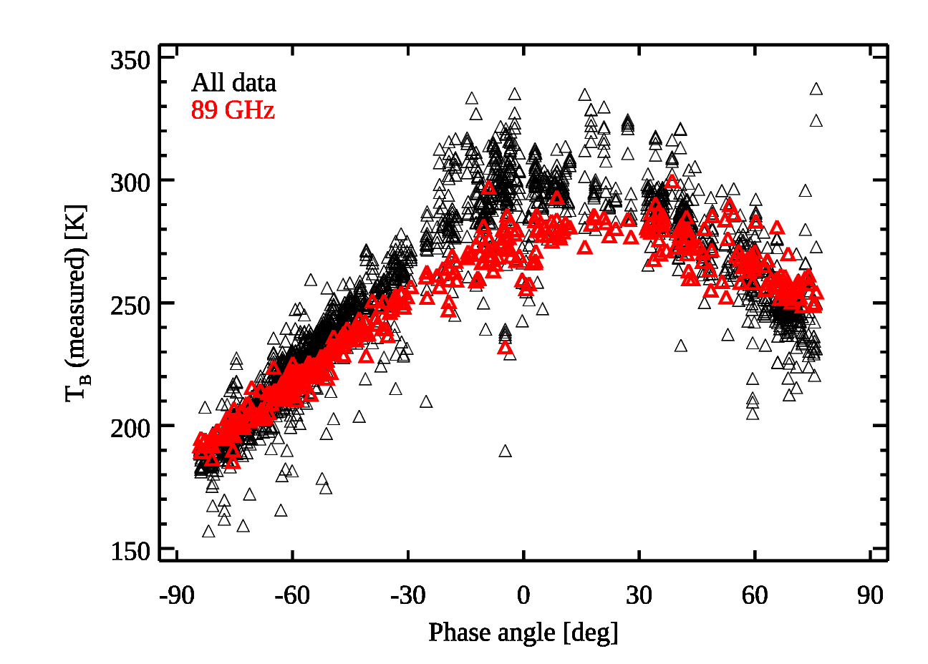
Notes:
Asymmetry; Fits to the T_{B} vs phase angle 𝜶 plots (at 89, 150/157, 183/190 GHz) give T_{B}(max) phase angles of about 13∘…25∘ deg (30-60 hours after full moon)

Slide 8
Microwave measurements at 89 GHz

Slide 9
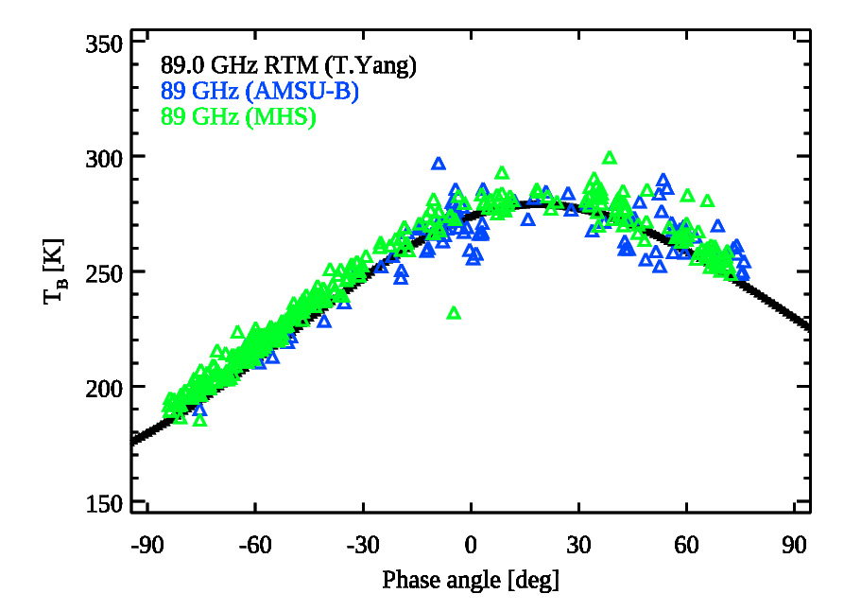

Slide 10
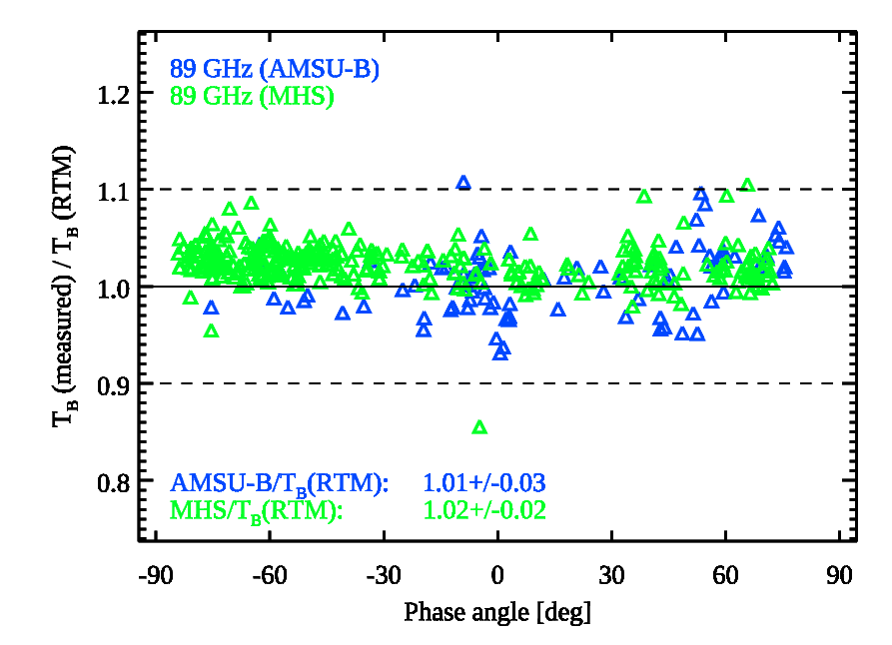

Slide 11
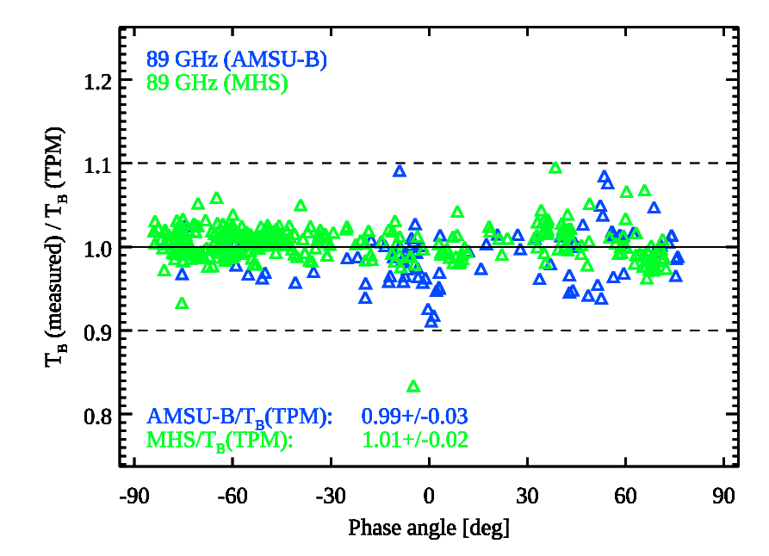

Slide 12
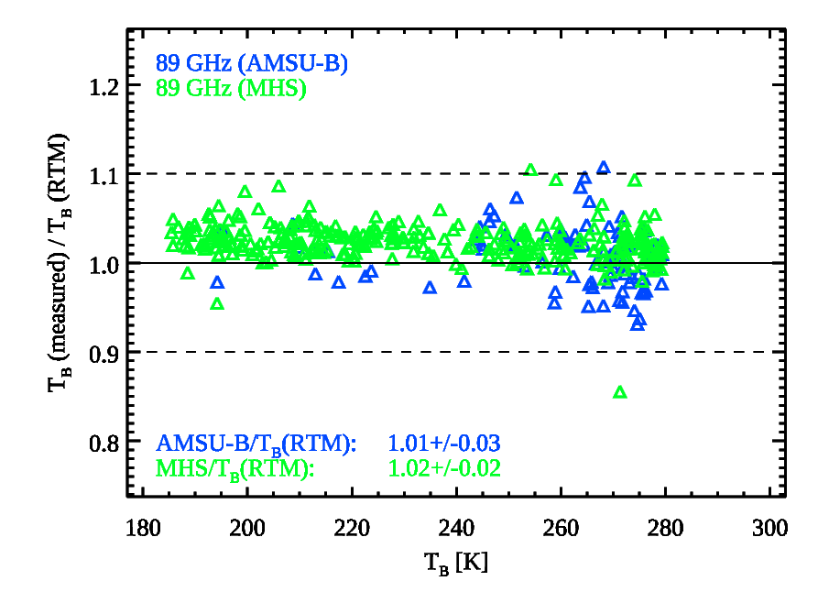

Slide 13
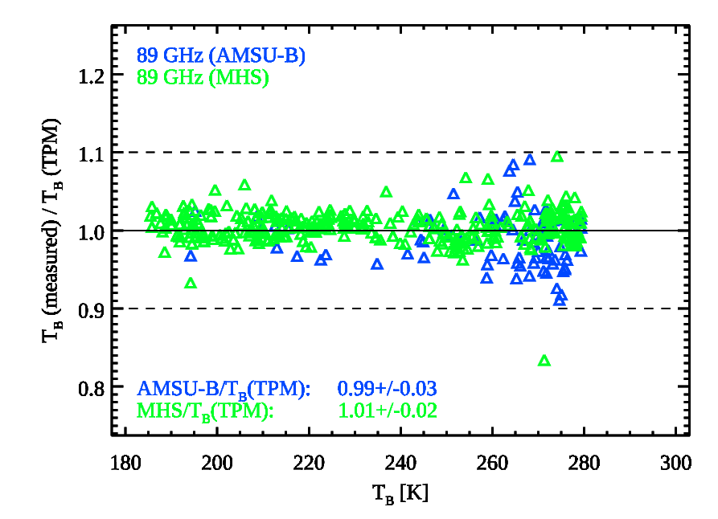

Slide 14
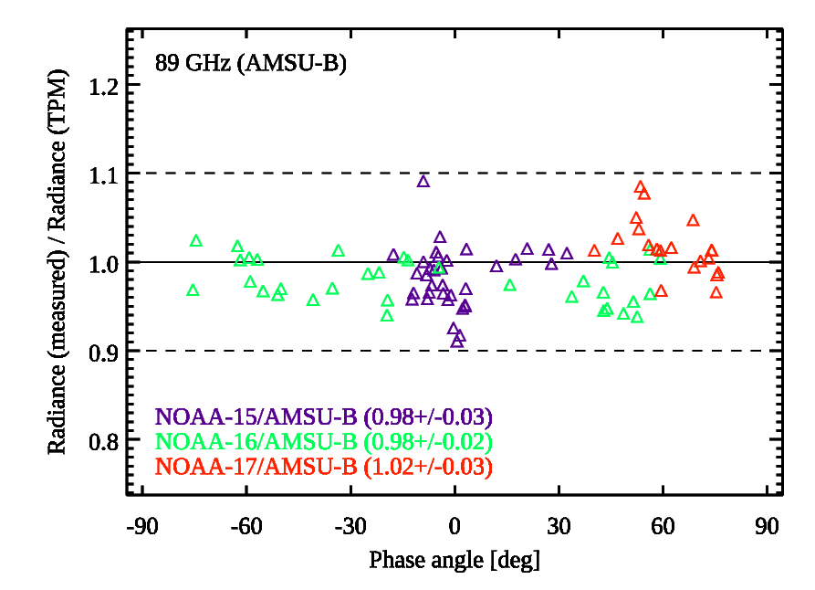

Slide 15
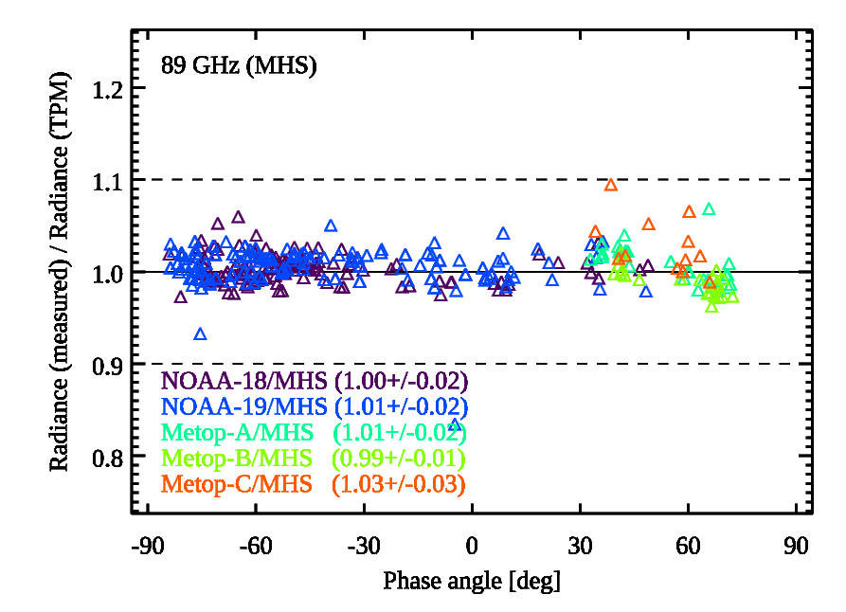

Slide 16
Microwave measurements at 157 GHz

Slide 17
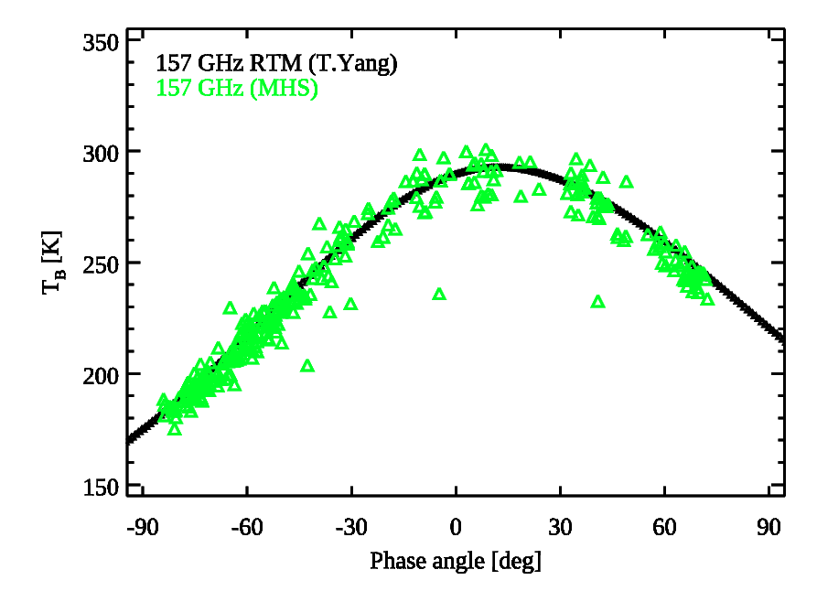

Slide 18
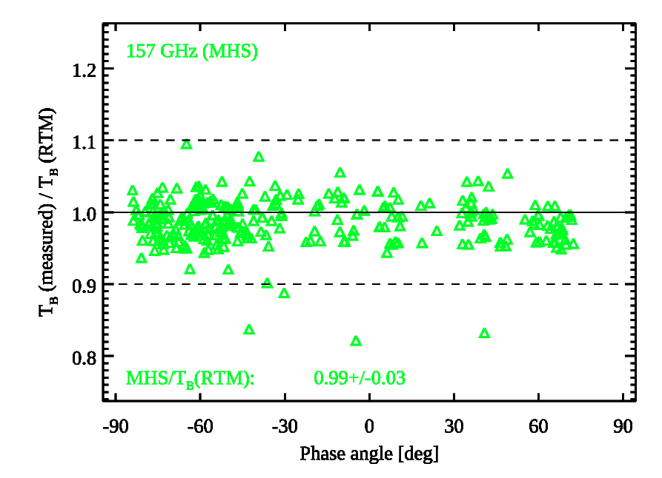

Slide 19
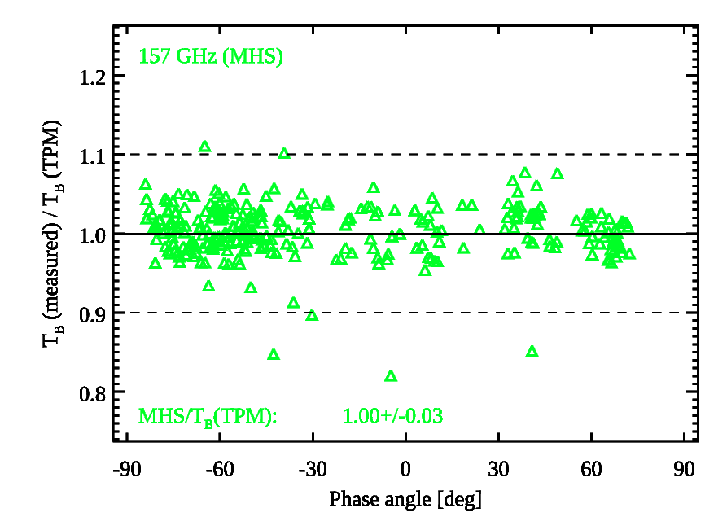

Slide 20
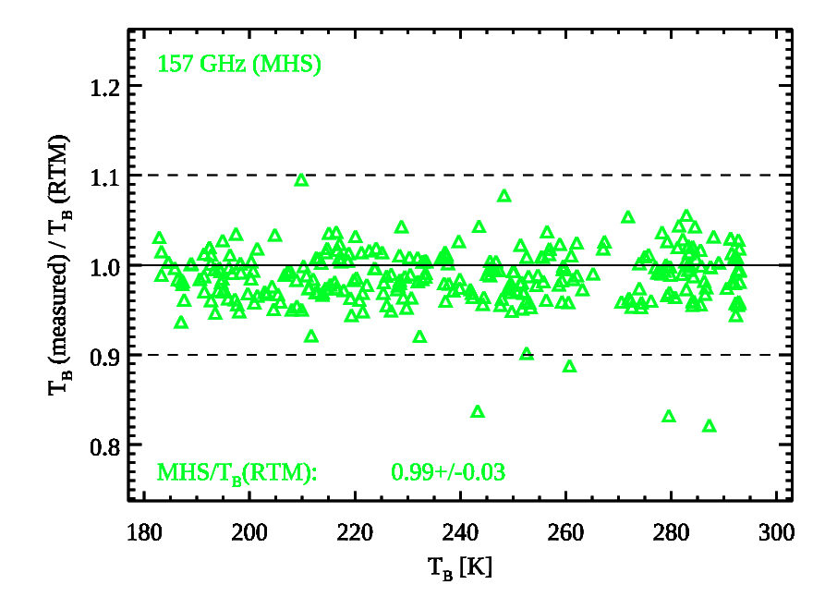

Slide 21
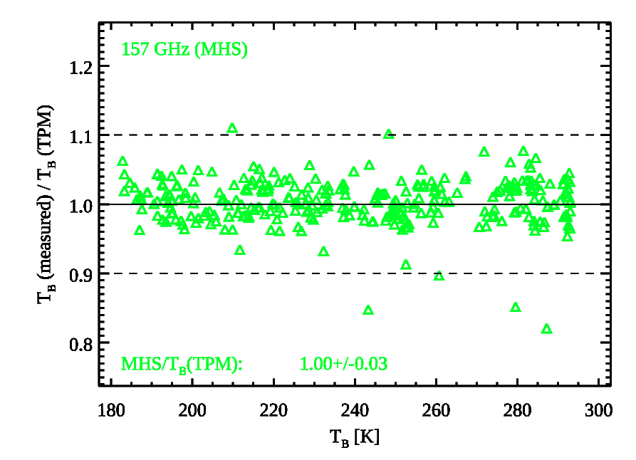

Slide 22
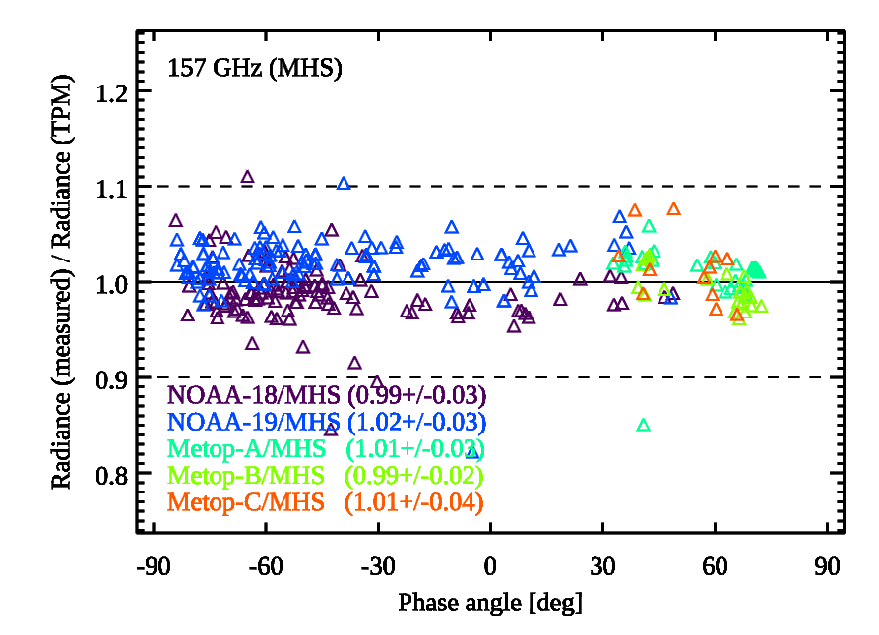

Slide 23
Microwave measurements at 183 GHz

Slide 24
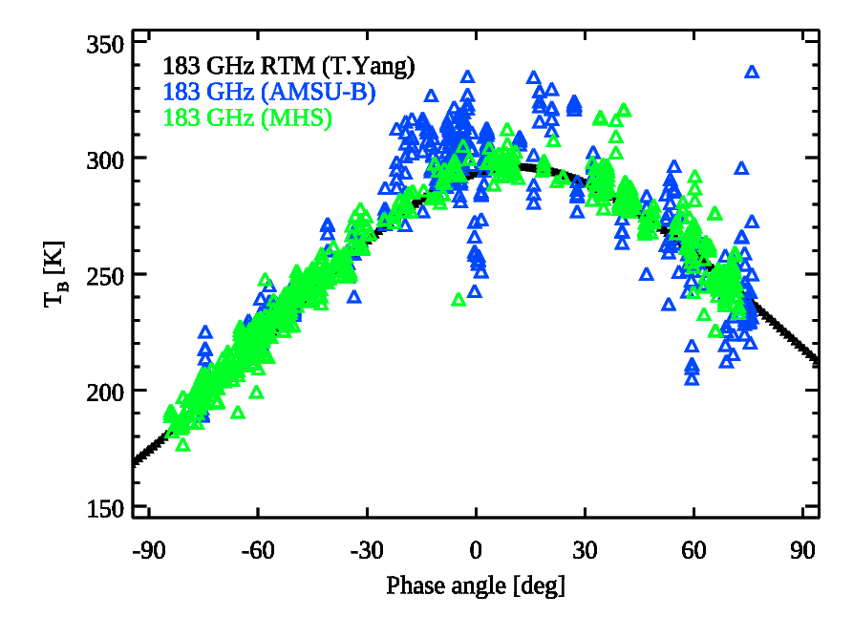

Slide 25
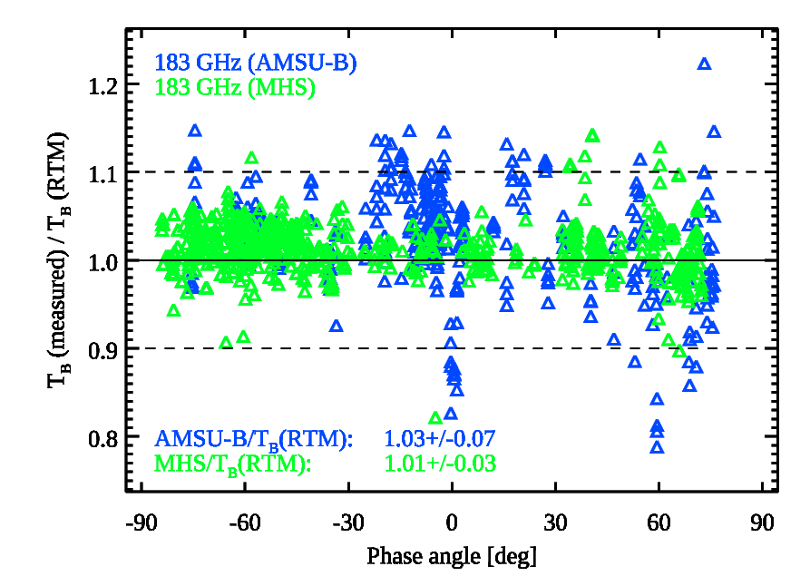

Slide 26
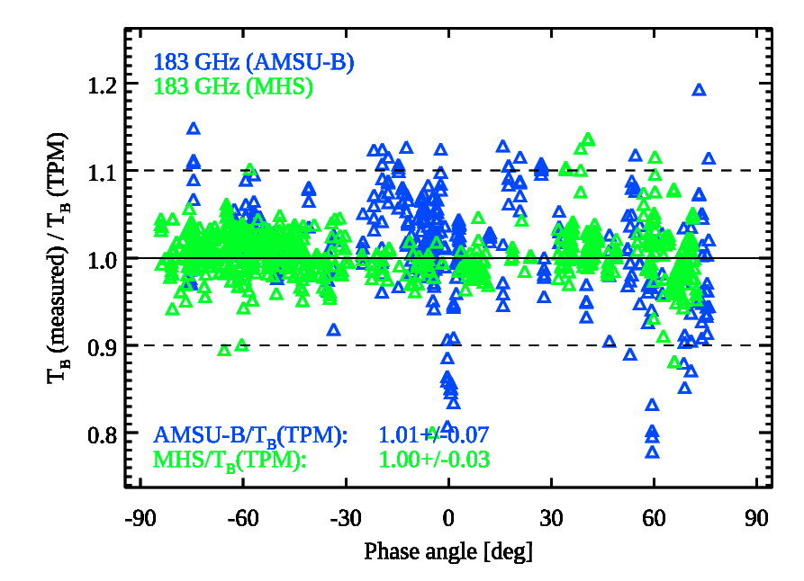

Slide 27
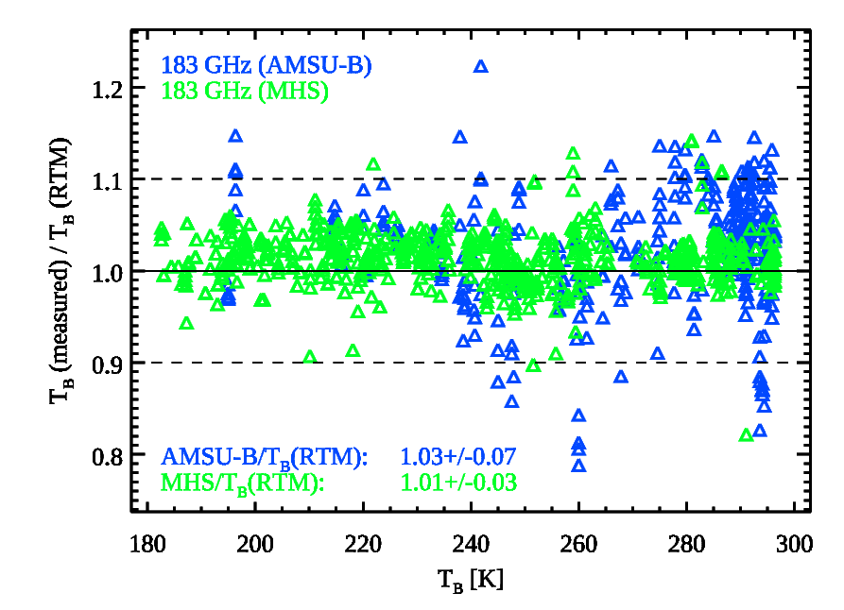

Slide 28
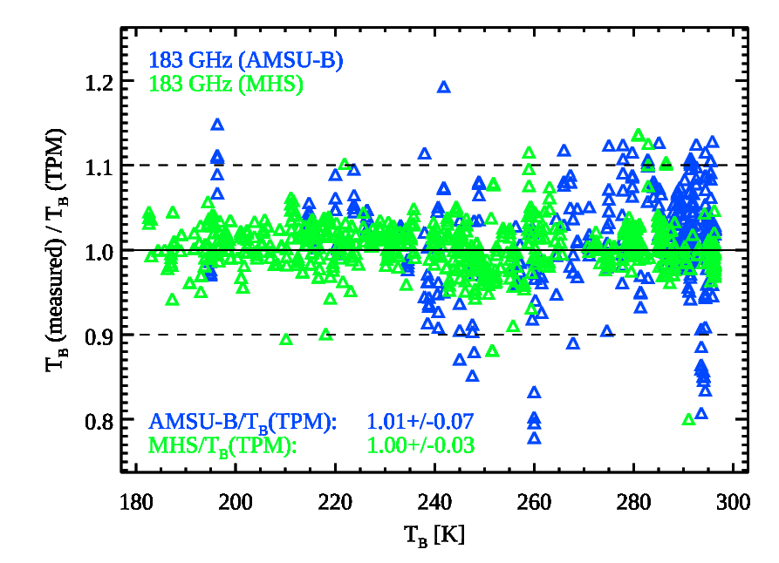

Slide 29
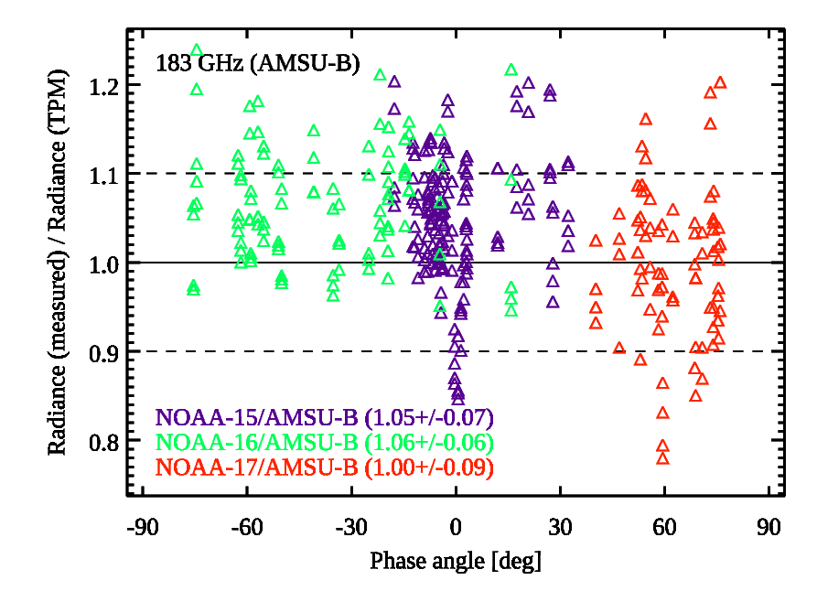

Slide 30
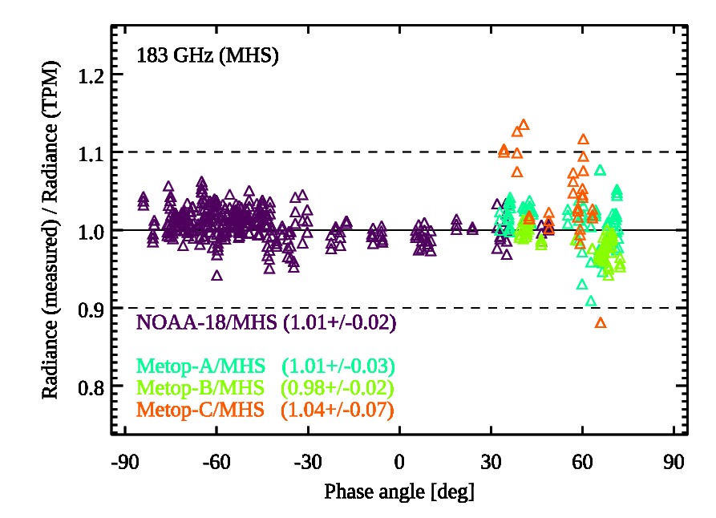

Slide 31
Summary
We used AMSU-B (NOAA-15/16/17) and MHS (NOAA-18/19, Metop-A/B/C) data to test two different lunar microwave models (RTM by T. Yang et al., TPM by T. Müller et al.)
Both models explain the available data over a wide range of observing geometries, and over a phase angle range between -84.0∘ (waxing) ≦ 𝜶 ≦ +75.9∘ (waning)
There is a small systematic difference: the T_{B} values from the RTM (validated against NOAA-20 ATMS data?) are about 1-2% lower than the T_{B} values from the TPM (validated against AMSU-B and MHS data)
The measured T_{B} values divided by the TPM prediction show a scatter (standard deviation) of 1-3%. A 1% scatter translates to a 1% error in T_{B}, i.e., about 1.8 K at T_{B}=180 K and about 2.8 K at T_{B}=280 K, errors are dominated by measurement (or extraction?) error
The ATMS measurements were not available for this exercise
Are there any „ground truth“ lunar measurements in the microwave regime (or at least with known very small absolute calibration error)?

