Slide 1
Establishing a MW sensor uncertainty framework
Department of Meteorology
Jonathan Mittaz
University of Reading/National Physical Laboratory, UK

Slide 2
A Metrological framework
Emma Woolliams present this framework at the last (2023) GSICS meeting
Over the last ten years or so attempts have been made to apply metrological principles to EO data
E.g. QA4EO principles defined in 2010
H2020 project FIDUCEO (vis, IR, MW broadband sensors) finished 2019
Now supported by CEOS/QA4EO
Ongoing work in a number of projects
Extension to active sensors e.g. Altimetry
Continuing work in broadband historic sensors
SITSats e.g. TRUTHS, CLARREO (in-orbit SI traceable hyperspectral visible sensors)
Uses the GUM (Guide to the expression of Uncertainty in Measurement) as a reference
Obtaining traceable uncertainties is critical
Gives rigorous uncertainties that should include all known sources of error
And provides estimates of error correlation scales
Use law of propagation of uncertainties including correlation terms
Vocabulary important
Error is not the same thing as uncertainty

Slide 3
Latest QA4EO principles
QA4EO has now defined 5 key steps to undertaking a metrological analysis
Define the measurand and measurement equation
Establish the traceability using a diagram
Evaluate each source of uncertainty and fill out an effects table
Calculate the data product and uncertainties
Record information about the uncertainty analysis for long term data preservation purposes (implicit above) and summarise for today’s users
Note this is a bottom-up approach tracing uncertainties up through all processes from the known fundamental sources of error
Validation at higher levels can feed back if obvious instrument errors can be seen in data
Not GSICS like in that you are looking at (and potentially modifying) the measurement equation itself rather than modelling ‘error’ at calibrated level 1
Deals with error at source
But can use GSICS intermediate products (e.g. matchups) for Harmonisation processes with uncertainties

Slide 4
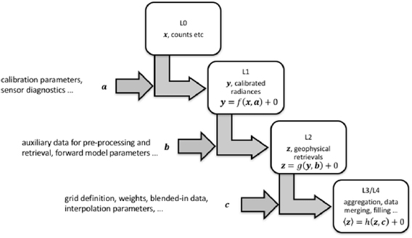
Applicable across multiple data levels
The methodology is intended to propagate uncertainties through different levels
At each level above Level 0 uncertainties are added together with extra uncertainties due to each process
Note there can be feedback to Level 1 from higher Levels
e.g. SST vs insitu etc.

Slide 5
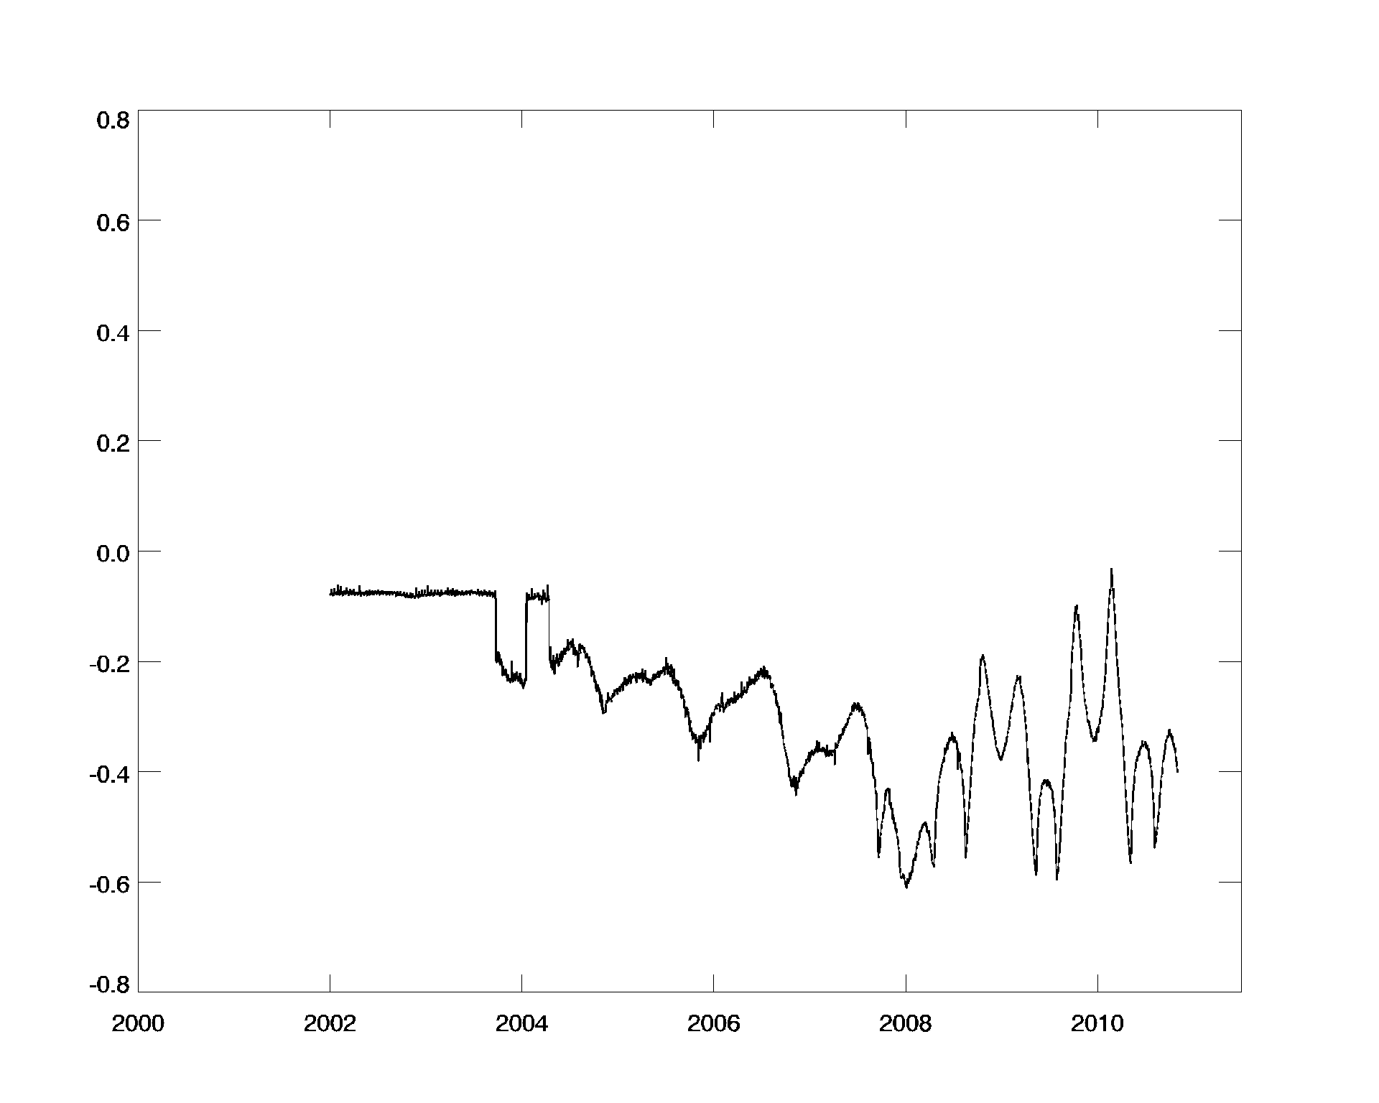
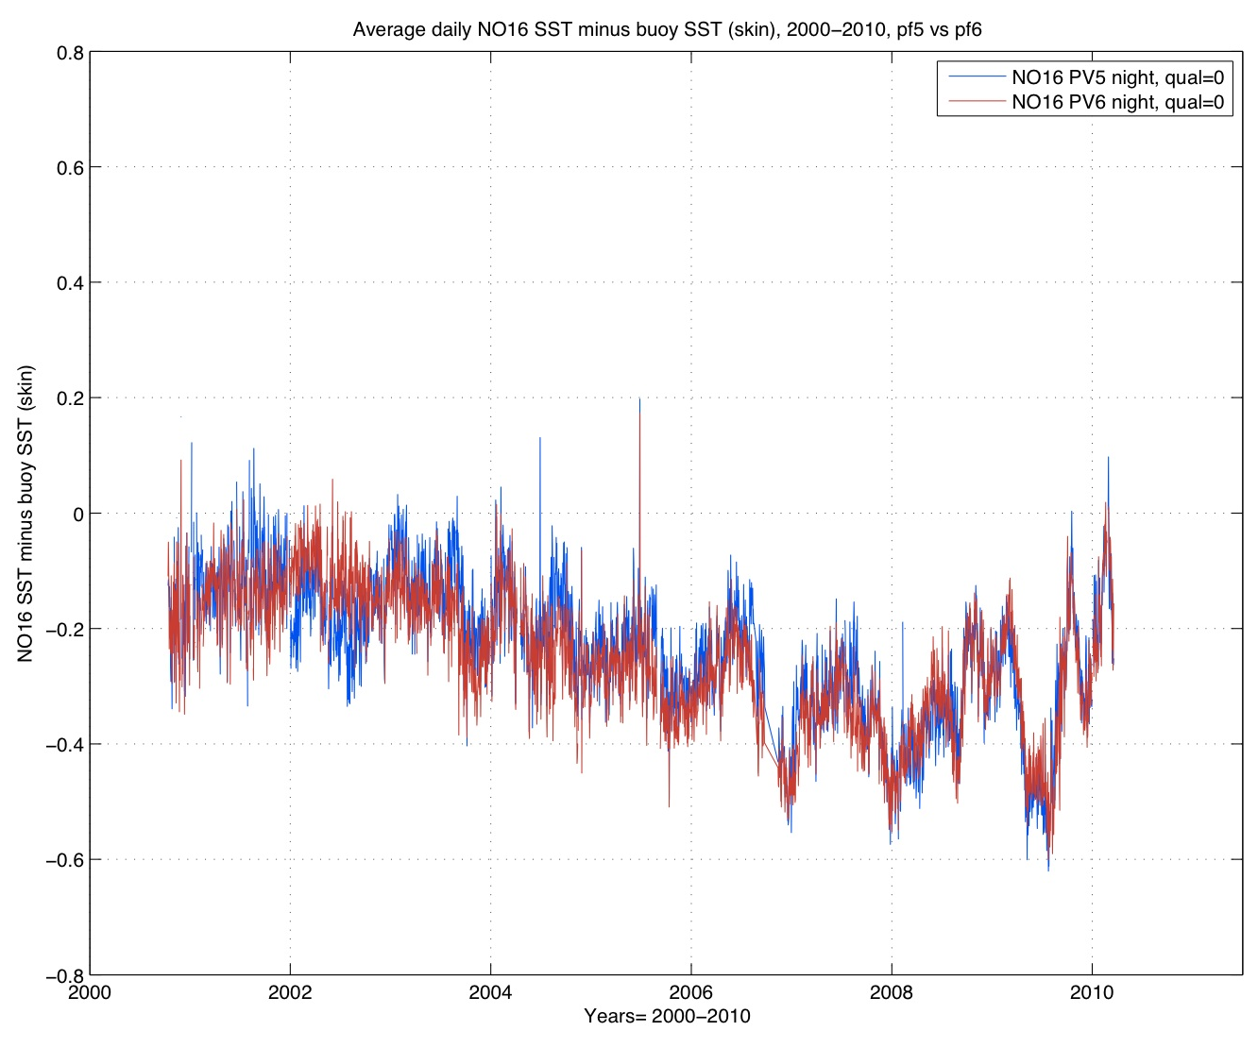
Not MW but IR example of Level 2 feedback (SST)
Used Pathfinder retrieval algorithm form and estimated error in SST from instrument dependent BT errors and compared with Pathfinder V6 errors
Related to instrument temperature
Overlay matches many of the features (after adding in a shift of 0.1K).
Plot taken from Evans et al. (2011), “Characterizing and comparison of uncertainty in the AVHRR Pathfinder Versions 5 & 6 SST field to various reference fields”, GHRSST DV-HL-STVAL workshop 2011 held in Boulder

Slide 6
1) Define the measurand and measurement equation
While at Level 1 the measurand is normally well defined, at higher processing levels it can be complicated
E.g SST has to be defined regarding different depths of measurement
The measurement equation is, of course, critical to the process but:
Is it optimal/physically reasonable?
At level 1 should use physics knowledge as the baseline
Are all error effects included in the measurement equation at whatever level in the process?
Note that in the processing there may be multiple measurement equations
From the GUM (Section 3.2.4):
It is assumed that the result of a measurement has been corrected for all recognized significant systematic effects and that every effort has been made to identify such effects.
May need to modify the measurement equation to remove ‘systematic components’ to the best we can do
Must make sure the equation(s) are correct and include all sources of error to the best of your ability

Slide 7
An MW example from MSU
There are many different measurement equations that have been proposed
$C^{′}=\sum_{0}^{2}{d_{i}C^{i}}$ ; $N_{E}=N_{sp}+\frac{N_{sp}−N_{T}}{{\overline{C^{′}}}_{sp}−{\overline{C^{′}}}_{T}}({C^{′}}_{E}−{C^{′}}_{sp})$ Original calibration
$N_{E}=N_{T}+\frac{C_{E}−{\overline{C}}_{T}}{G}+Q$ ; $G=\frac{{\overline{C}}_{T}−{\overline{C}}_{S}}{N_{T}−N_{S}}$ ; $Q=u\frac{(C_{E}−{\overline{C}}_{T})(C_{E}−{\overline{C}}_{S})}{G^{2}}$ Mo 2001 variable u (using Dicke temperature)
$T_{Meas}=T_{0}+A_{i}+α_{i}T_{Target,i}+β_{i}T_{Scene}+ε_{i}$ Operational plus UAH corrections ($T_{0} is true value)$
Corrections including diurnal corrections from RSS
$N_{E}=N_{S}+S\left(C_{E}−{\overline{C}}_{S}\right)+uZ−δR$ ; $S=\frac{N_{T}−N_{S}}{{\overline{C}}_{T}−{\overline{C}}_{S}}$ ; $Z=S^{2}(C_{E}−{\overline{C}}_{T})(C_{E}−{\overline{C}}_{S})$ Zou calibration like equation 2 but constant u (latest NOAA CDR)
$\begin{aligned}N_{E}=\frac{\left(N_{S}−N_{T}(T_{Target})\right)−b_{0}−b_{1}N\left(T_{Target}\right)−u\left(C_{S}^{2}−C_{T}^{2}\right)}{\left(C_{S}−C_{T}\right)}\left(C_{E}−C_{S}\right)+ \\ u\left(C_{E}^{2}−C_{S}^{2}\right)+N_{S}+a_{0}+a_{1}N(T_{Target})\end{aligned}$ ; AVHRR like (built in constant non-linearity) just assuming a quadratic non-linear term
And others (e.g. NCEI CDRs)…
Plus combinations of above e.g. 2 + $T_{Meas}$ from 3 and/or add in T_{inst} terms to gain
Which one should be used??
Are they complete??

Slide 8
Find a reference to check a measurement equation
To understand the errors and uncertainties for any measurement equation you need
A reference to:
Understand likely patterns of error
This needs a relatively stable reference but does not need to be SI traceable
For example, NWP/RTM gives good coverage
Used to investigate error patterns and possible missing error components
Fix uncertainties to a reference for sensor-to-sensor uncertainties
E.g. current FCDR for MSU use one sensor (e.g. NOAA-10) in a series as a ‘reference’
‘Inter-comparison’ not ‘inter-calibration’
Note this is not GSICS like but can use GSICS matches to a reference to determine updated calibration
Need uncertainties on the matchups
Ideally traceable to the SI
Unbroken chain back to the SI via SI traceable standards if possible
Some radiosondes are SI traceable (GRUAN)
Radio Occultation measurements are SI traceable
An SI traceable BB for the MW is/has been developed (NIST)
But an SI traceable BB alone does not necessarily mean your instrument is itself fully SI traceable e.g. straylight components, non-linearity characterization etc.
Care needs to be taken and uncertainties understood…

Slide 9
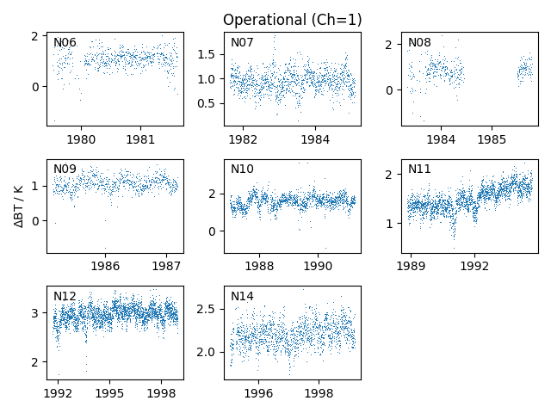
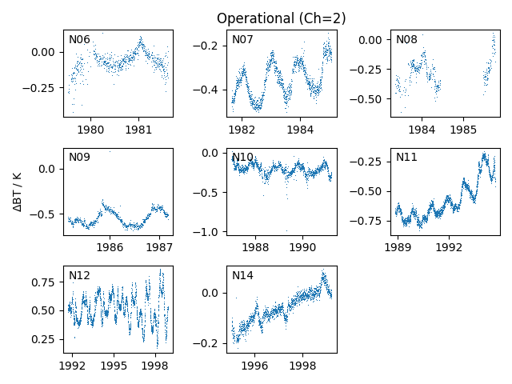
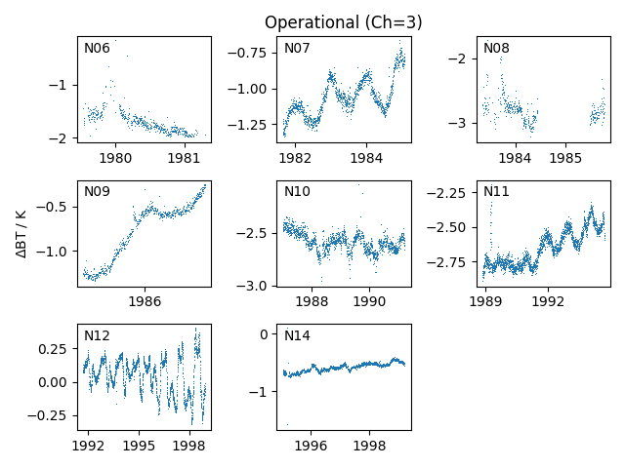
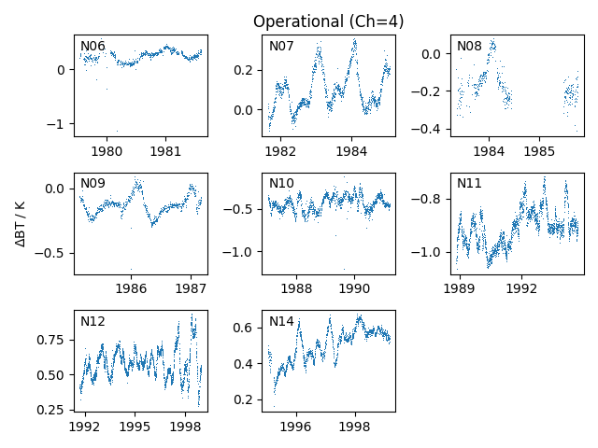
An MSU example – error patterns
Ch 1
Ch 2
Project to look at reducing variational bias correction for ERA6
Compared to ERA5/RTTOV as the reference
Note MSU is ingested into ERA5 so not independent
BUT get lots of data to look for error patterns
This example operational calibration
Quite a lot of structure, some of it instrumental…
Ch 3
Ch 4

Slide 10
An MSU example – error patterns
Ch 1
Ch 2
Project to look at reducing variational bias correction for ERA6
Compared to ERA5/RTTOV as the reference
Note MSU is ingested into ERA5 so not independent
Get lots of data to look for error patterns
This example operational calibration
Quite a lot of structure, some of it instrumental…
Ch 3
Ch 4

Slide 11
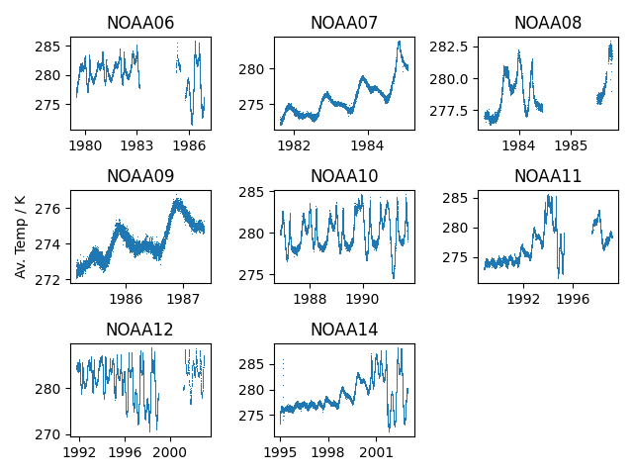
An MSU example – error patterns
Ch 1
Ch 2
Project to look at reducing variational bias correction for ERA6
Compared to ERA5/RTTOV as the reference
Note MSU is ingested into ERA5 so not independent
Get lots of data to look for error patterns
This example operational calibration
Quite a lot of structure, some of it instrumental…
Ch 3
Ch 4

Slide 12
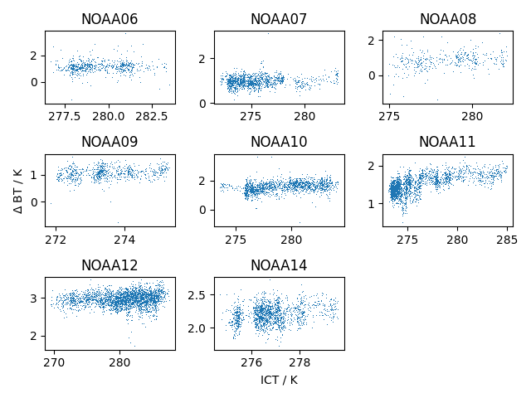
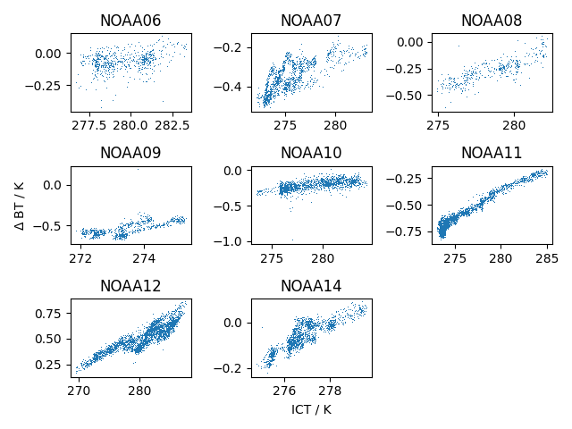
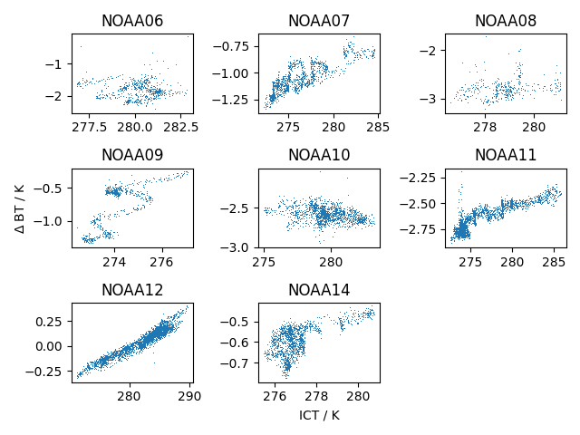
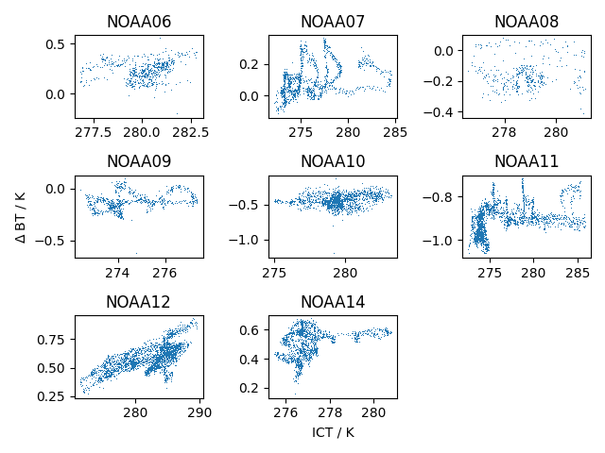
An MSU example – missing component
There are cases where there are strong correlations between the O-A values and the instrument temperatures
Seen before (e.g. Christy et al.) but very obvious here
Look into additions to the measurement equation…
Including platform radiance to space, ICT and Earth view

Slide 13
2) Establish the traceability using a diagram
Layout all the equations/processes in diagrammatic form
Every term needs an associated uncertainty branch
Each measurement equation has a +0 (or +𝝳) term
Represents known possible issues or things from which the associated uncertainty is not derived from direct measurements
Ideally these effects will be zero in the mean (hence a +0 (or +𝝳))
Trace back to original sources of error
Includes sensitivities which allow the tracing of uncertainties through to the measurand
Try an included all known sources of error reducing

Slide 14
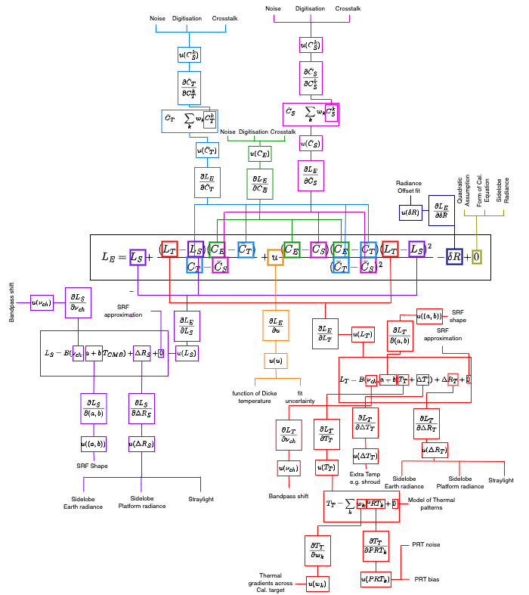
MSU Uncertainty Tree
This is the AMSU measurement equation
Note every term has a ‘branch’ leading either to another process or to the underlying source of error
Plus a sensitivity needed to propagate the uncertainty (so a traceable uncertainty)
Sub processes also have branches
All processes have a +0 (or +𝝳) term
Trying to force thinking about assumptions and/or missing components
E.g. sidelobe issues?

Slide 15
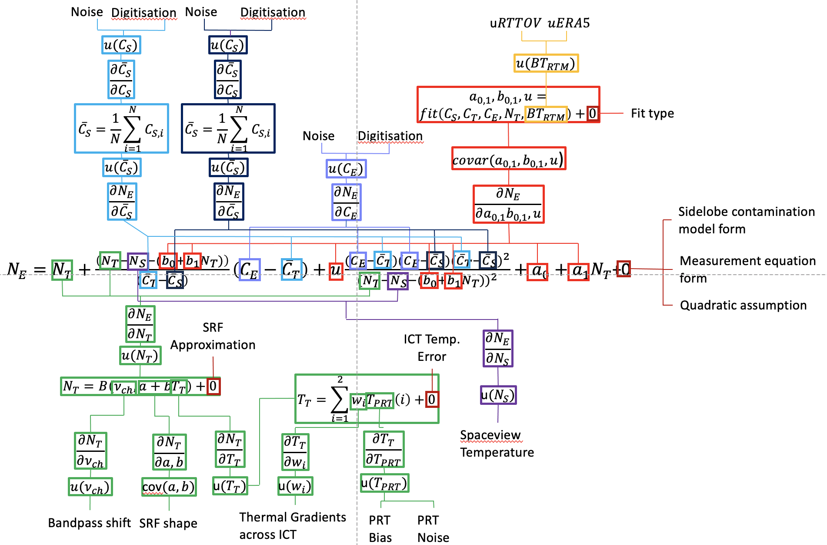
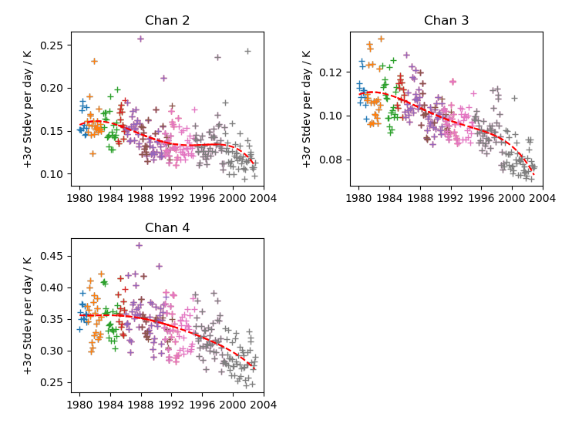
Updated uncertainty tree
Or use GSICS data
Added in a linear model of platform temperature for all views
Earth, ICT and space
Parameters fitted to ‘reference’
Uncertainties derived but will be missing model error

Slide 16
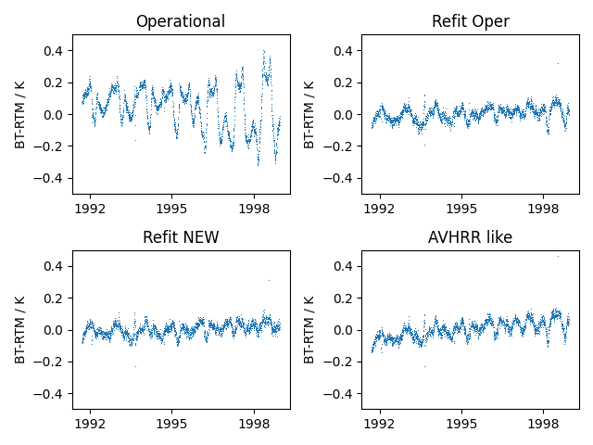
Measurement equation change
NOAA12, Channel 3 example
Added in platform radiance to both Earth view and into gain calculation (space, ICT)
Significantly reduces large, rapid variations
AMSU

Slide 17
3) Associated effects tables
For all sources of uncertainty create an effects table
E.g. Noise case
Note the error correlation sections
Important for subsequent processing to higher levels
Noise estimated using the Allan deviation
Table Descriptor
Name of effect |  | Noise | Digitisation | Noise | Digitisation
Effect Identifier |  | C_{E} | C_{E} | C_{T,S} | C_{T,S}
Affected term in measurement equation |  | $$C_{E}$$ | $$C_{E}$$ | $$C_{T,S}$$ | $$C_{T,S}$$
Maturity of analysis | Maturity of uncertainty estimate | 2 | 3 | 2 | 3
 | Maturity of correlation scales | 3 | 3 | 3 | 3
 | For low maturity is effect negligible
Correlation type and form | Time | Random | Random | Random | Random
 | Along track | Random | Random | Triangle Relative | Triangle Relative
 | Across track | Random | Random | Rectangle Absolute | Rectangle Absolute
 | Orbit | Random | Random | Random | Random
Correlation scale | Time | 0 | 0 | 0 | 0
 | Along track | 0 | 0 | -12/+12 | -12/+12
 | Across track | 0 | 0 | -∞/+∞ | -∞/+∞
 | Orbit | 0 | 0 | 0 | 0
Uncertainty | PDF shape | Gaussian | Gaussian | Gaussian | Gaussian
 | Units | Counts | Counts | Counts | Counts
 | Magnitude | Allan deviation of space view | $$\frac{1}{\sqrt{3}}$$ | Allan deviation of space view averaged | $\frac{1}{\sqrt{3}}$ averaged
Channels affected | List of channels | All | All | All | All
 | Error correlation coefficient | Identity matrix – no correlation | Identity matrix – no correlation | Identity matrix – no correlation | Identity matrix – no correlation
Sensitivity coefficients |  | $$\frac{∂N_{E}}{∂C_{E}}$$ | $$\frac{∂N_{E}}{∂C_{E}}$$ | $$\frac{∂N_{E}}{∂C_{T,S}}$$ | $$\frac{∂N_{E}}{∂C_{T,S}}$$

Slide 18
Error correlation between Averaged Measurements
E.g. Calibration averaging
Averaged Measurements
“Raw” Measurements
e.g. Scanlines

Slide 19
Averaged Measurements
“Raw” Measurements

Slide 20
Averaged Measurements
“Raw” Measurements

Slide 21
Averaged Measurements
“Raw” Measurements
Error correlation
present

Slide 22
Form of correlation function
$$1$$
Fraction of measured values in common
$$\frac{2}{3}$$
Triangle Relative Correlation
$$\frac{1}{3}$$
$$0$$
$$−3$$
$$−2$$
$$−1$$
$$0$$
$$1$$
$$2$$
$$3$$
Averaged Value Separation

Slide 23
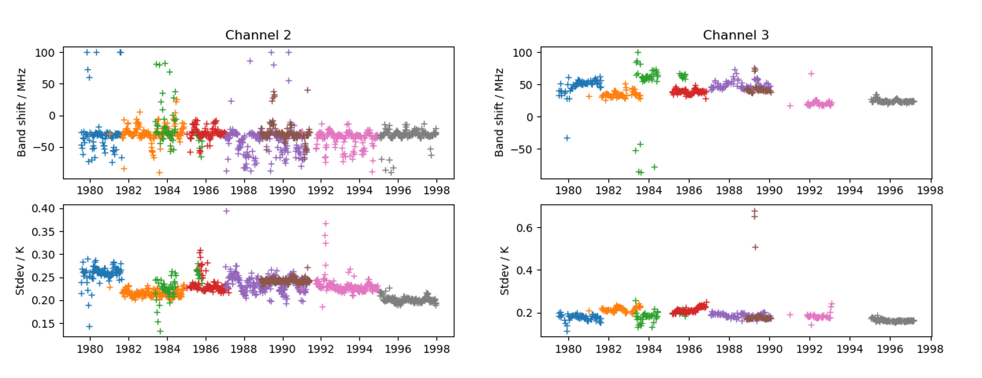
E.g. MSU Bandpass shifts
Lu & Bell (2014) suggested the need for bandpass shifts
Redone including modifications to the non-linearity
Systematic (fully correlated) effect
Table Descriptor
Name of effect |  | Bandpass shifts
Effect Identifier |  | SRF freq
Affected term in measurement equation |  | $$ν_{C}$$
Maturity of analysis | Maturity of uncertainty estimate | 1
 | Maturity of correlation scales | 2
 | For low maturity is effect negligible
Correlation type and form | Time | Rectangular Absolute
 | Along track | Rectangular Absolute
 | Across track | Rectangular Absolute
 | Orbit | Rectangular Absolute
Correlation scale | Time | -∞/+∞
 | Along track | -∞/+∞
 | Across track | -∞/+∞
 | Orbit | -∞/+∞
Uncertainty | PDF shape | Gaussian
 | Units | MHz
 | Magnitude | See Table 9
Channels affected | List of channels | All
 | Error correlation coefficient | Identity matrix – no correlation
Sensitivity coefficients |  | $$\frac{∂N_{E}}{∂ν_{C}}$$

Slide 24
Some other error correlation types
Calibration parameters (pre-launch or in-orbit)
Errors correlate over period of use and over the whole globe
So these uncertainties won’t average down
Channel to channel correlations
All channels which use the same calibration target will have error correlation between channels (IR example)
For MSU correlations will be between Ch 1&2 and Ch 3&4

Slide 25
MSU Effects Tables
Currently have 7 effect tables
Noise
Random plus error correlation on scanline times
PRT uncertainties
Systematic, fully correlated
Thermal gradients across ICT
Systematic, correlation scale approx. orbital
Bandpass shifts
Systematic, fully correlated
SRF shape
Systematic, fully correlated
Fit parameters
Systematic, fully correlated
Channel-to-channel correlations
Covariance function of pixel level uncertainties
+0 terms
Form of equation, quadratic non-linearity, sidelobe correction form

Slide 26
A whole range of uncertainties
RANDOM
SYSTEMATIC
The Errors-in-Satellite-Data “Zoo”
Traditional
“Noise/Bias”
classification
Two-part
taxonomy
NOISE … ERM, NOT QUITE SURE WHAT TO CALL THIS ... BIAS
INDEPENDENT STRUCTURED STRUCTURED COMMON
RANDOM RANDOM SYSTEMATIC SYSTEMATIC
INDEPENDENT
STRUCTURED
COMMON
Can be further described by the nature of the error
correlations caused by the structure … if necessary!

Slide 27
FIDUCEO defined a FCDR format
Three components of uncertainty in those radiances
independent
per-pixel uncertainty from random errors with no spatio-temporal correlation between pixels
structured
per-pixel uncertainty from errors from either random or systematic processes that display spatio-temporal correlation between pixels in an image
per-image element-wise and line-wise mean correlation length-scales for the combined structured effects
common
uncertainty in the overall calibration of radiances (harmonisation uncertainty) present in all images across a whole mission
Cross-channel error correlation matrices for independent and structured effects (per image)
Universal simplified flags, metadata e.g. for SRFs, (improved) geolocation

Slide 28
SUMMARY
There does exist a metrological framework for uncertainty generation
Can be applied to MW sensors
It is primarily a bottom-up approach
Describes the fundamental sources of error and propagates them through to the measurand using GUM principles
Also includes correlated error terms
Method also forces a consideration of possible problems with the measurement equation
Range of techniques can be used e.g. to NWP/RTM to understand patterns of error
Can improve the calibration at source
Can deal with calibration errors on all timescales/spatial scales
GSICS can feed into process by providing matches to a reference with uncertainties
To the SI preferably or to a community standard
Can be used to refine measurement equation to a reference
Fit measurement equation parameters to make a FCDR

