Slide 1
Microwave Radiometer Direct Inter-Calibration (“SNO”) Method Focus Group
Tim Hewison (EUMETSAT)
Yang Guo (CMA)
EUMETSAT

Slide 2
Presentation Overview
Aims of Focus Group
Algorithm comparison
Developing common algorithms
SNO
SCO (High angle SNO)
OCTM method (Opportunistic Constant Target Matching)
Integrating uncertainty framework
Develop calibration corrections
Develop calibration monitoring tools
Way of Working

Slide 3
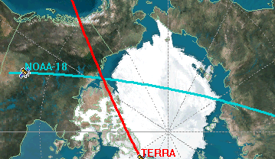
Simultaneous Nadir Overpass (SNO)
Reference Instrument Selection
Channel-dependent
Interaction with all Microwave Sub-Group
Channel Selection
Definition of Spectral Band Adjustment Factors (SBAFs)
Criteria for SNO
Maximum Viewing angle
Viewing Angle Difference
Time Difference
Spatial Difference
SNO target area – single pixel or “Super-Ob” -
Filtering
Outlier removal
Comparison
Regression? Weighed?
Form of correction function – bias / gain / linear / quadratic
Uncertainty framework
Characterising sensitivity of scene variability

Slide 4
Simultaneous Conical Overpass (SCO)
As SNO, but…
SNO by definition uses (near-) nadir observations
It is not applicable for conically-scanning microwave imagers
Method could be extended to high viewing angles
Needs additional attention on:
Viewing Angle Differences
Parallax issues
FOV differences
Polarisation Differences
Characterising any scan-angle calibration variations

Slide 5
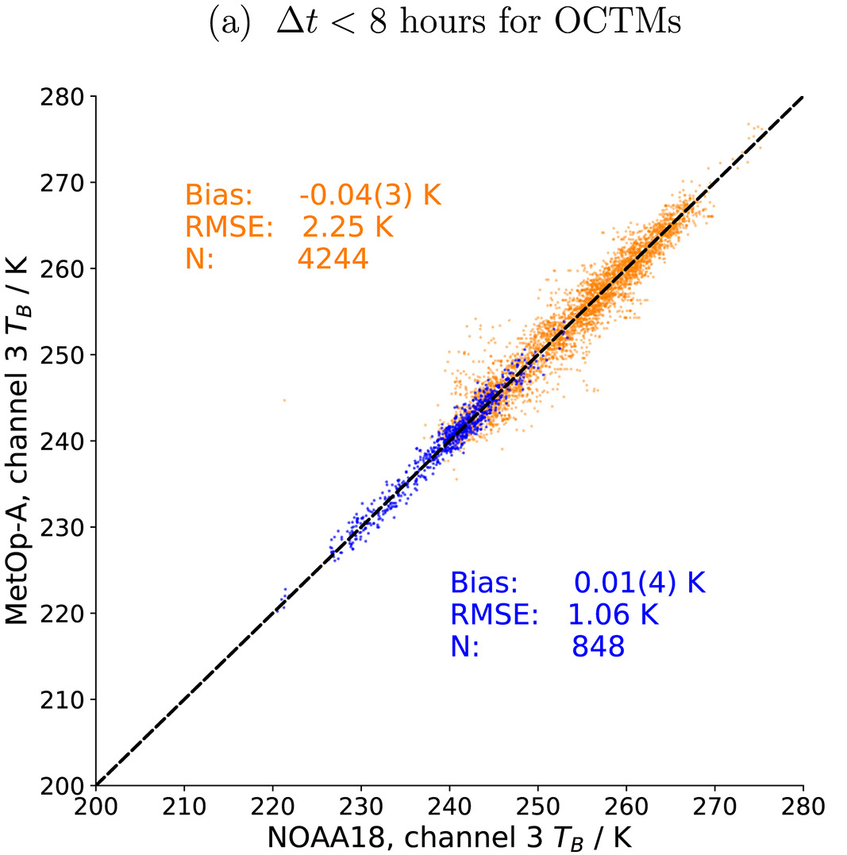
Inter-Calibration Algorithm - OCTM
Opportunistic Constant Target Matching (Buehler et al. 2020)
Aims to improve dynamic range of SNO method
By identifying stable conditions
E.g. in sub-tropic subsidence zones
where time window can be extended to many hours +
Based on analysis of geostationary imager data
Relatively immature – but Highly Promising
Applied only to microwave humidity sounders so far
Applicable to temperature sounding channels?
e.g. Using 13.3µm CO2 channel – or IRS – or WV channels?
Needs further development
to identify channels with similar weighting functions,
implement, tune collocation criteria
and conduct an uncertainty analysis
Matchup scatterplot of MHS 183±1GHz on NOAA 18 v. Metop A Orange points mark OCTMs. Blue points mark classic SNO matchups. (From Buehler et al. 2020)

Slide 6
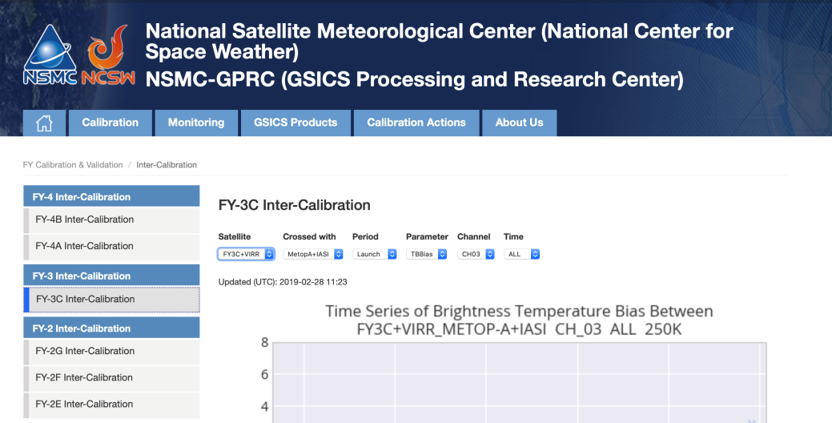
Calibration Monitoring Tools
http://gsics.nsmc.org.cn/portal/en/fycv/index.html
Instrument Performance - Parameters indicating the data quality
Observing system: such as, frequency locker, Receiver;
Temperature: such as, PRT, instrument temperature;
Antenna: such as, cold space starting/end angle, warm load starting/end angle, earth scene starting/end angle;
Auxiliary information: time, volt, gain
Calibration Results
Satellite
Instrument
Auxiliary information: time, channel, reference instrument

Slide 7
Proposed Way of Working
Regular Web Meetings
Review existing algorithms
Identify issues
Conduct analysis to optimise algorithms
Integrating uncertainty framework
Combine algorithms for robust coverage over full dynamic range
Apply algorithm variants to different instruments
Compare experiences
Learn!
Aim to define
Common baseline algorithm
Common calibration correction function
Common monitoring framework
e.g. define standard Tb scenes to evaluate radiance-dependent bias
Timescale?
Focus Group Members Cheng-Zhi Zou (NOAA)
Flavio Iturbide (NOAA)
Siena Iacovazzi (GST @ NOAA)
Tim Hewison (EUMETSAT)
Yang Guo (CMA) + Your contributions are welcome!

