Slide 1
Vicarious Calibration Focus Group
Shengli Wu, Siena Iacovazzi
March 14, 2024

Slide 2
Outline
Motivation
Unique Aspects
Risk Reduction
Examples
Members

Slide 3
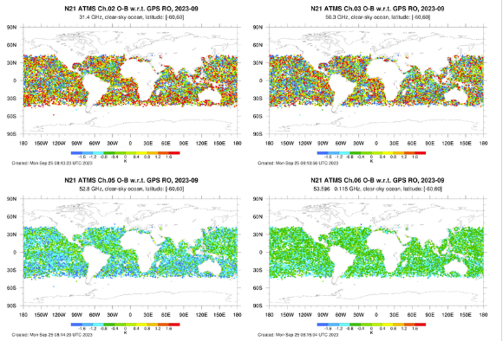
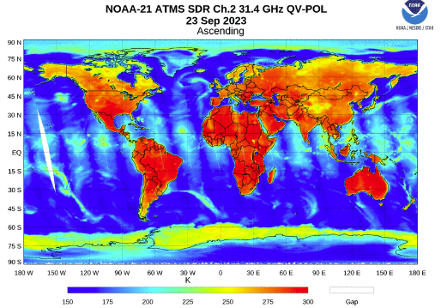
Motivation to Apply Earth Target Vicarious Calibration to MW Sensors
Limitations to current globally generated single-sensor O-B Ta/Tb biases, and inter-sensor Ta/Tb biases formed from single-sensor O-B Ta/Tb bias double differences, derived using ERA5 or other data input, especially for windows channels.
  Land surface emission simulation algorithm of MW band need to be improved;
  Some calibration parameters cannot be get very accurate value during ground test;
  Vicarious calibration is the bridge between on-orbit sensor and reference.

Slide 4
Unique Aspects About Vicarious Calibration
Relative long-term stability of land surface emissivity, for example over very dry land sites or moist dense rainforest canopy.
Cold, warm and hot sites that radiate with limited temperature range in associated with the instrument response low-, mid- and high-range can be chosen to help resolve any residual instrument non-linearity.
For Earth targets with similar meteorological characteristics over daily to monthly time intervals, and that are relatively spatially homogenous, a 24 hour time separation and a spatial difference between GNSS RO soundings and ATMS data will not gravely impact the analysis.
  Allow for many more measurements to be considered for the analysis
  Opens the analysis to smaller and more distinct vicarious calibration sites
Carefully chosen calibration targets can eliminate scan-angle dependent surface emissivity impacts on Tb measurements.
  Thus, when measurements from different scan angles are subtracted from each other, this can help isolate phenomena such as diurnal cycle dependent calibration anomalies, since each scan position samples a different local time of the same earth scene.
Inter-sensor Ta/Tb biases based on single-sensor O-B Ta bias double differences have more reliable and stable results. This is because RTM-simulated MW Tb anomalies, driven by systematic, region-dependent, sounding errors, are no longer relevant.

Slide 5
Risk Reduction to Applying Earth Target Vicarious Calibration to MW Sensors
Limited number of samples, as the satellite ground track repeat cycles can be less than bi-weekly for a given scan angle. For example,
  Metop ~ 29 days
  S-NPP and JPSS-1,-2 required to be <20 days within 20 km @ equator
  This risk is reduced by 1) using relatively large and homogeneous sites (Amazon, Sahara and Taklimakan desert, Oceanic Subsidence Zones, High Altitude Lakes) relative to the footprint size, and 2) Performing statistics over several days
  Note that this may not be a problem over the polar regions.
Surface emissivity anomalies
  Spatial inhomogeneity over the large MW FOVs – e.g., shorelines of high altitude lakes
  Risk of short-term, seasonal-scale anomalous surface emissivity changes related to atypical precipitation patterns over desert, dry periods over tropical rainforest canopy, and wind, precipitation, and ice over ocean
  Careful screening may eliminate these issues

Slide 6
Difference with Inter-Calibration
Inter-Calibration focus to “reference sensor”, the reference sensor should be more stable and longer in-orbit time, to overlap with more sensors (e.g. SSMIS onboard DMSP-F13);
While Vicarious-Calibration focus to “true radiation”, try to fine out the reason of bias for different earth emission target(lunar is also a good target for vicarious calibration) and so the new\more accurate sensor observation and better simulation result could be used in vicarious-calibration to get better observation of other sensors;
The final aim of Vicarious-Calibration is improve the calibration algorithm itself, especially for some antenna parameters which cannot be accurate measured in ground test.

Slide 7
Examples – X-Cal

Slide 8
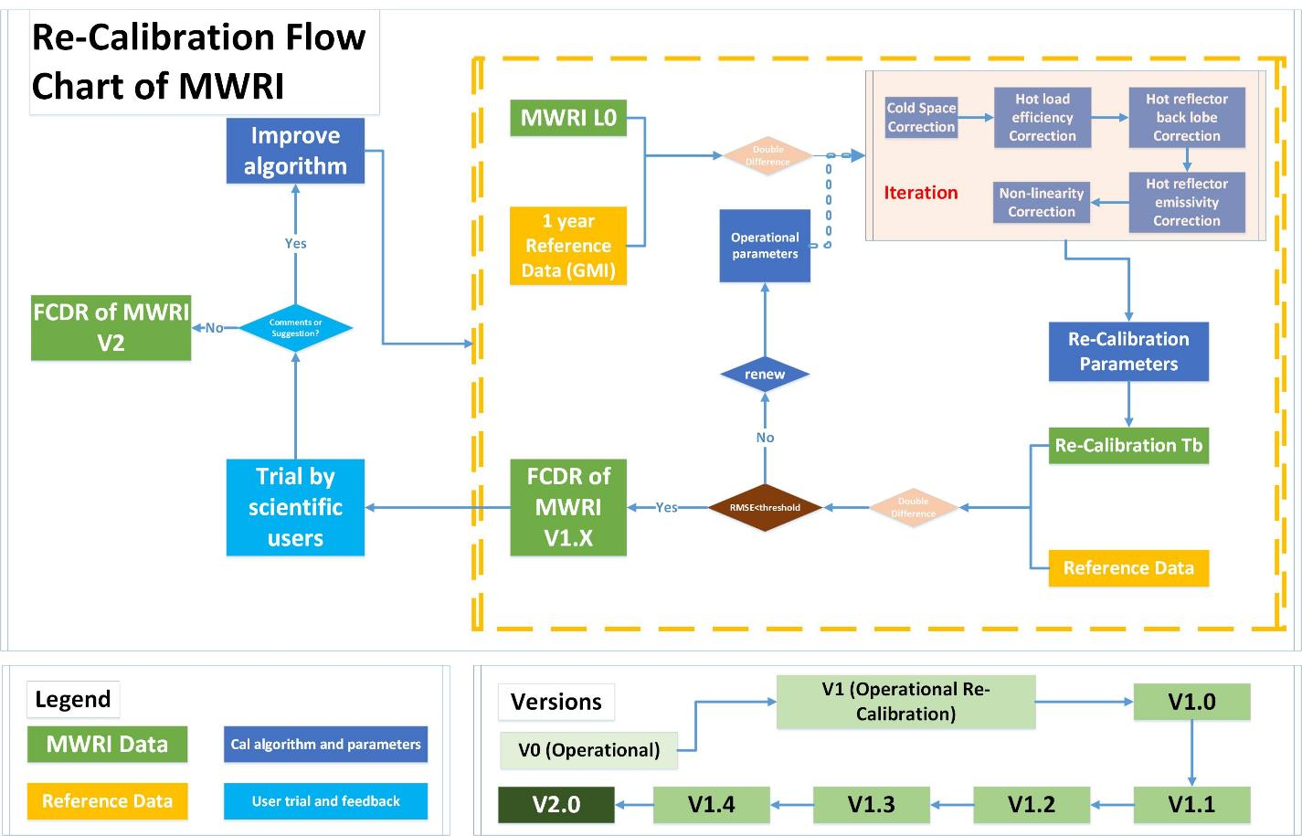
Examples – Re-Cal of MWRI

Slide 9
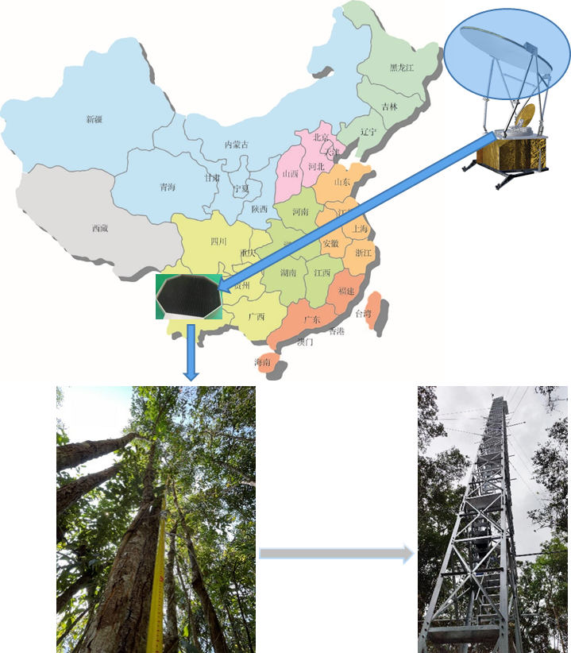
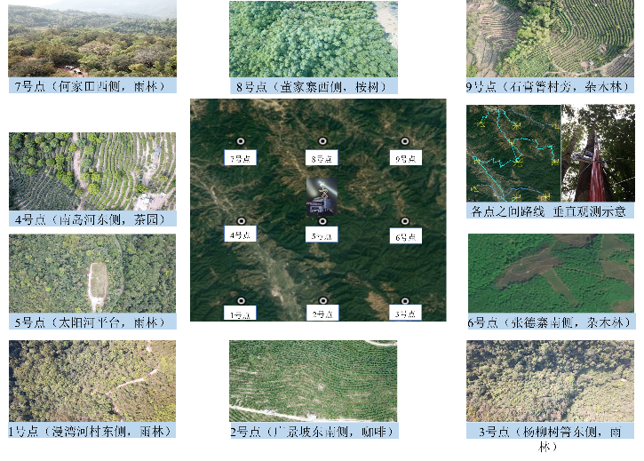
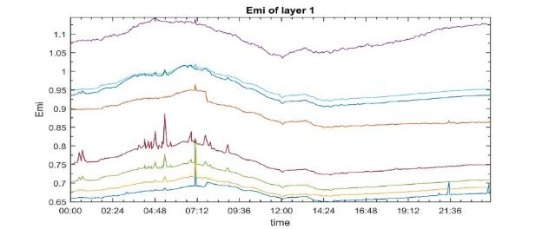
Examples – Rain forest modeling and measurement

Slide 10
Members and Plan
Raffaele Crapolicchio - ESA
Siena Iacovazzi - NOAA
Shengli Wu - CMA
Jun Zhou - UMD
Karsten Fennig - DWD
……
2-4 Group meetings per year
Attend Microwave workshop

Slide 11
Thank You

