Slide 1
GRWG Report
Fangfang Yu, GRWG Chair
and Mounir Lekouara, incoming GRWG Chair
15.03.2024

Slide 2
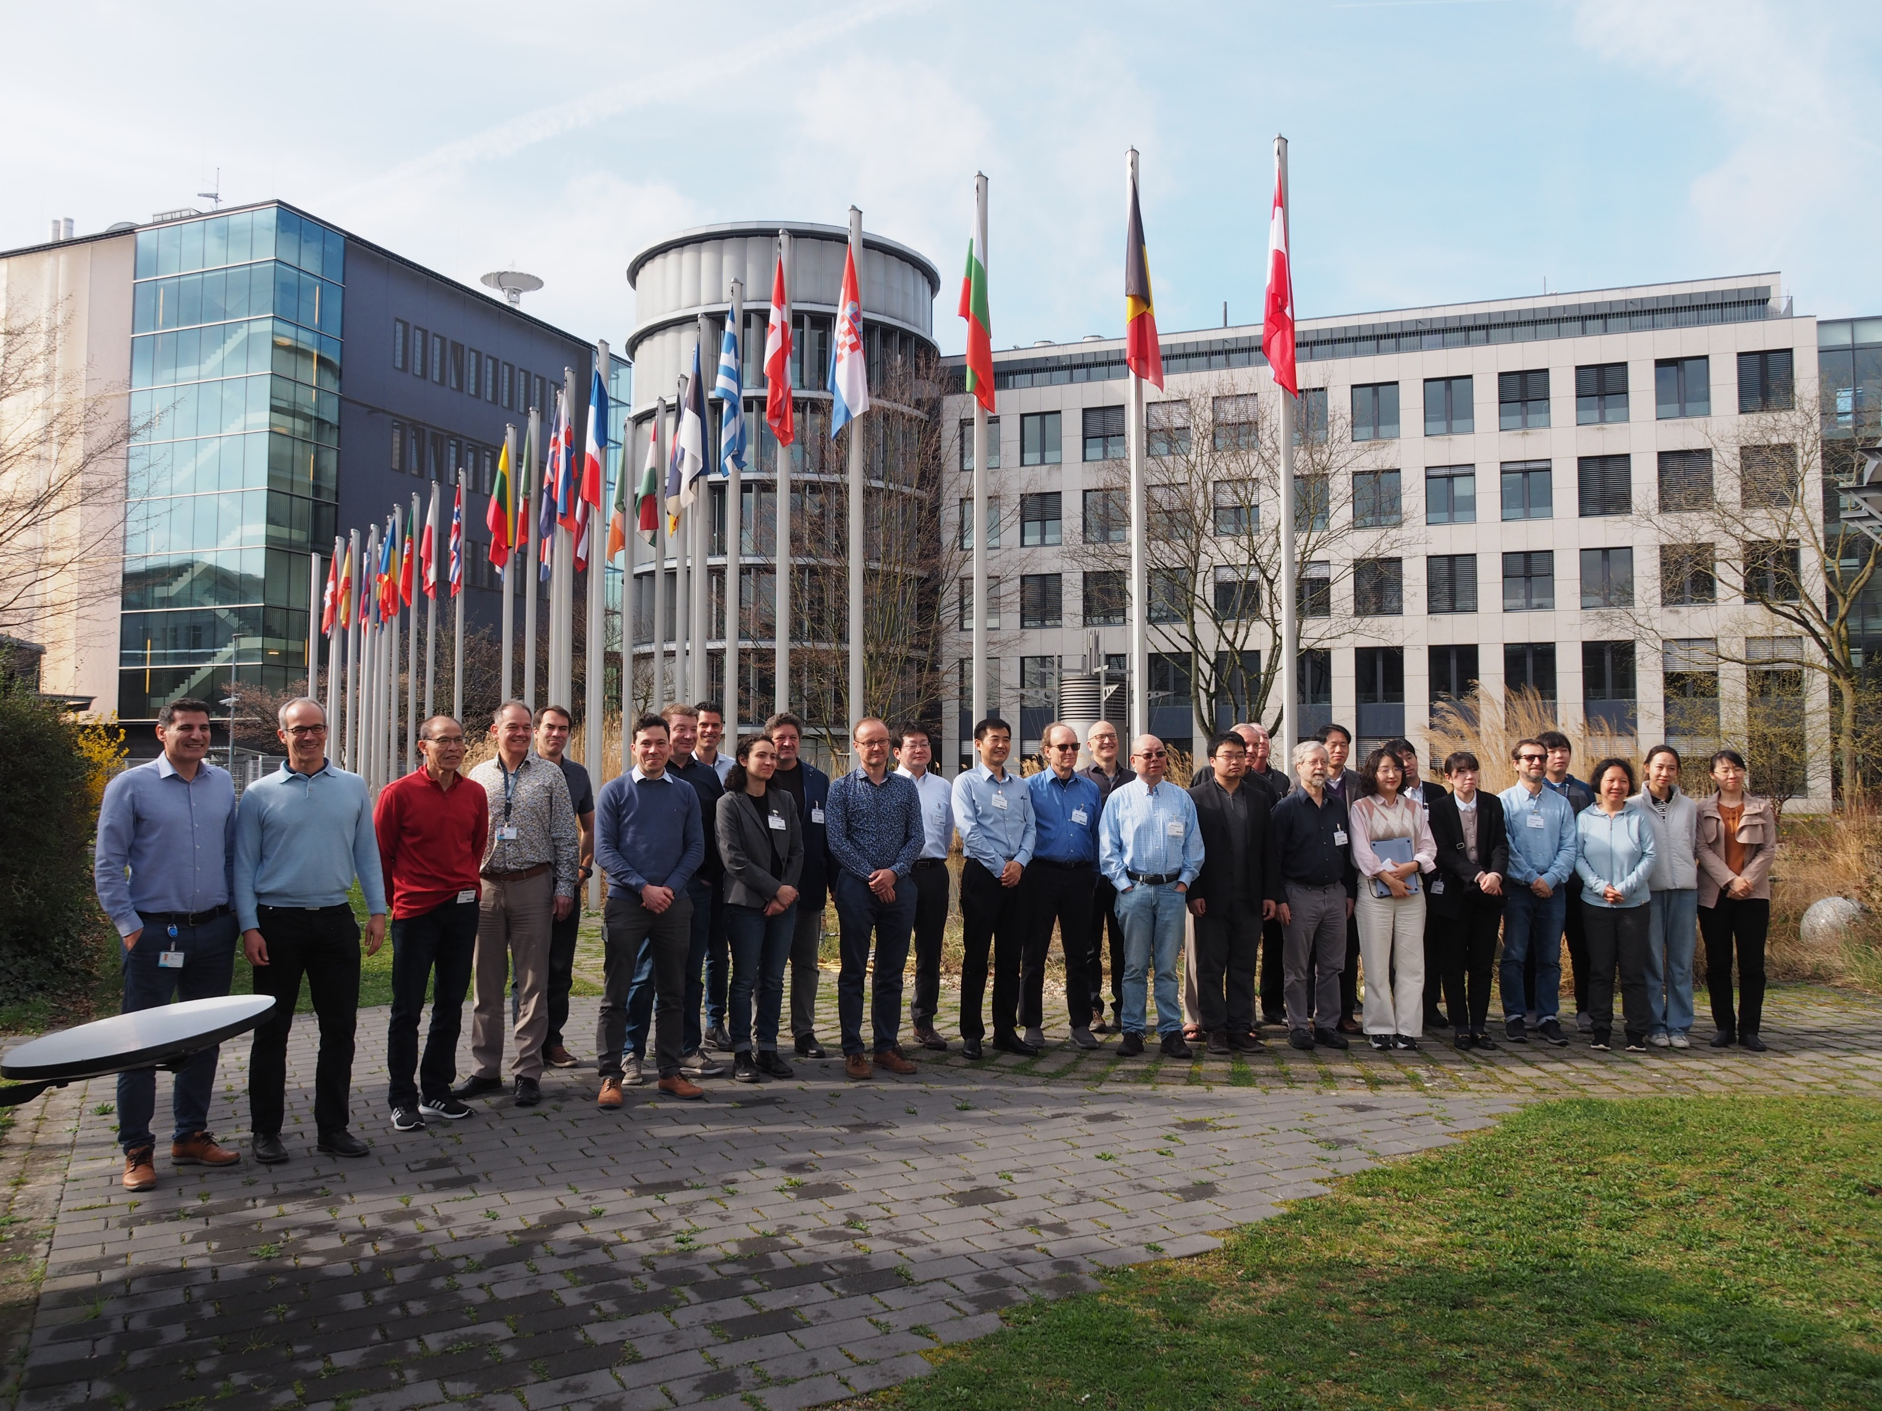
2024 Annual GSICS meeting in EUMETSAT
58 onsite and 85 online participants
140 talks, 15 agencies
11-15 March 2024, Darmstadt, Germany
See wiki page with all the presentations

Slide 3
Mini conference
Mini Conference
9:35 | Mini Conference introduction | Mounir Lekouara (EUMETSAT) | 1c
9:45 | MTG missions status | Jochen Grandell (EUMETSAT) | 1d
10:15 | EPS-SG mission status and MW missions | Thierry Marbach and Christophe Accadia (EUMETSAT) | 1e
10:45 | Break
11:20 | Sentinel-3 calibration at EUMETSAT … from L1 to L2 and back | Ali Mousivand (EUMETSAT) | 1f
11:40 | Intercalibration of polarimeters | Bertrand Fougnie (EUMETSAT) | 1g
12:00 | overview of FY-3G Rainfall Satellite | Jian Shang (CMA) | 1h
12:20 | Indian OC-3 mission | Pradeep Thapliyal (ISRO) | 1i
12:40 | Intro to Himawari-10 and inter-calibration approach | Masaya Takahashi (JMA) | 1j
13:00 | Lunch
14:00 | Advances in lunar calibration (WS outcomes) | Tom Stone/Sebastien Wagner | 1k
14:20 | Using commercial data in an operational environment - e.g. RO | Bojan Bojkov (EUMETSAT) | 1l
14:40 | Towards a constellation of thermal infrared sensors for wildfire detection: On the inter-calibration of Forest-2/SAFIRE-2 TIR data | Fatima Kahil (Ororatech) | 1m
15:00 | Disussion / Spare Mini Conference slot |  | 1n
15:20 | Break

Slide 4
Mini conf: MTG mission status
MTG-I1 launched on 13 December 2022.
Special Test dissemination of FCI data started on 31 October 2023, first to SAFs and NMHS; This data is not yet providing an optimal radiometric quality and Image Navigation accuracy.
An anomaly on the FCI is delaying the completion of the FCI commissioning and entering into operations.
Lightning Imager L2 pre-operational dissemination is expected to start in April 2024 (after yaw-flip).
The 2nd satellite in the MTG series, MTG-S1 is to be launched in 2025, with two sounding instruments: IRS and UVN.
By Jochen Grandell (EUMETSAT)

Slide 5
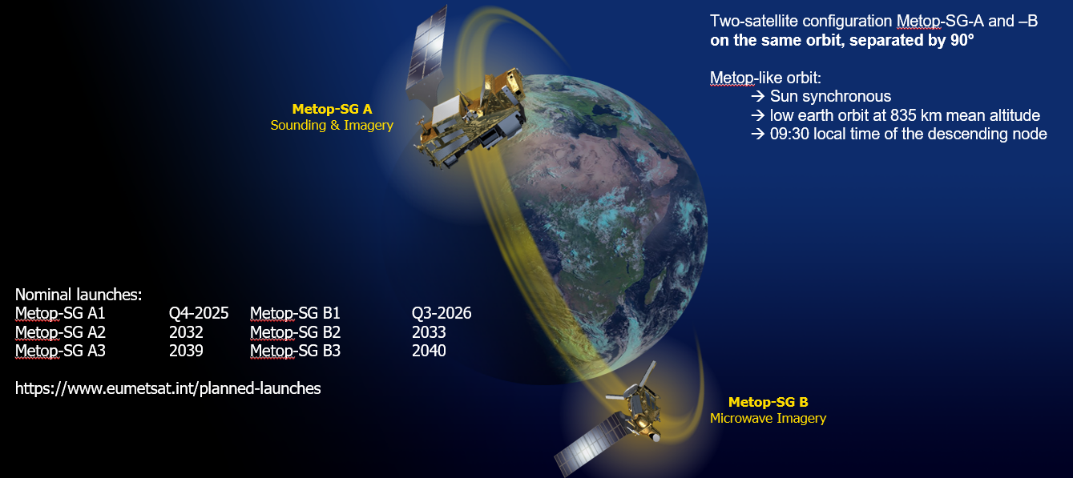
Mini conf: EPS-SG mission status
By Thierry Marbach and Rosemary Munro (EUMETSAT)

Slide 6
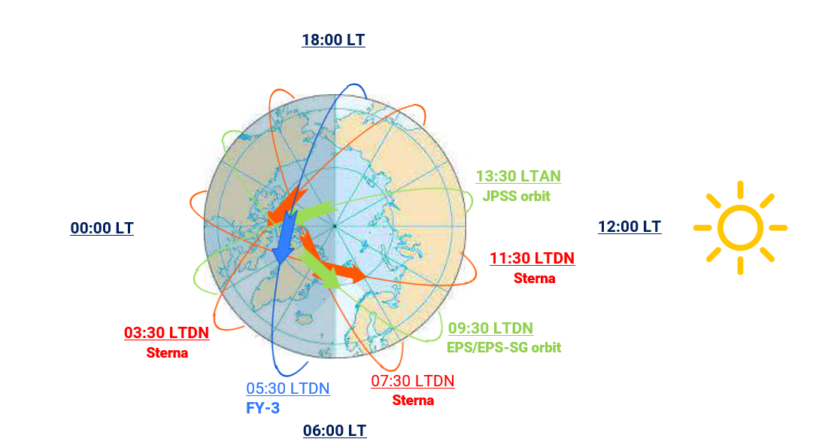
Mini conf: EUMETSAT Sterna mission status
Small microwave sounding satellites complementing the reference EUMETSAT Polar System (EPS-SG) /Microwave Sounder (MWS) is a potential additional EUMETSAT contribution to the realisation of the WIGOS Vision 2040 and is in line with objective four of the EUMETSAT strategy “Destination 2030”
EPS-Sterna will be a constellation of small microwave sounding satellites which will complement observations from other core missions such as EPS-SG, the NOAA JPSS satellites and the Chinese FY satellites.
EPS-Sterna space segment will capitalise on the experience from the ESA mission “Arctic Weather Satellite (AWS)” which is a technology demonstrator to be flown this year in the June-July timeframe.
A successful outcome of the AWS in-orbit demonstration in 2024-2025 would represent an opportunity for EUMETSAT to expand the products’ envelope of the EPS-SG mission for its users, by implementing the EUMETSAT Polar System Sterna.
EPS-Sterna overall operational mission duration will be 13 years
with the initial constellation expected in 2029.
By Christophe Accadia (EUMETSAT)

Slide 7
Mini-conf: S3 calibration from L1 to L2 … to L1
By Ali Mousivand, Anne O’Carroll, Ewa Kwiatkowska and Julien Chimot, (EUMETSAT)

Slide 8
Mini conf: intercalibration of polarimeters
Very High demand involving all GSICS agencies
EUMETSAT Workshop with targeted experts
Exhaustive brainstorming on in-flight approaches & their performances
3 needs:
Evaluation of performance (commissioning)
Monitoring
Inter-calibration assessment
Outcomes: recommendation for implementation and developments
GSICS: structure the interaction within a VISNIR sub-group?
Discuss a set of common references or methodologies
RTM, PICS reference BPDF, lunar polarisation model….
Moving toward inter-calibration of the polarisation
Special role for polariser equipped with on-board polarisation calibration systems
Later: identify if some approaches can be implemented as GSICS references for operational missions
By Bertrand Fougnie, (EUMETSAT)

Slide 9
Mini conf: FY-3G rainfall mission
By Jian Shang (CMA)

Slide 10
Mini conf: Himawari-10 and inter-calibration approach
JMA has been operating GEO satellites at around 140 E° over 40 years
Current Himawari-9 will be operated until JFY 2029 (Himawari-8 is in-orbit backup).
JMA contracted manufacturing of Himawari-10 in March 2023, with initiation of operation scheduled for JFY 2029.
Himawari-10 is scheduled to carry a VIS/IR imager (GHMI), an IR sounder (GHMS) and a space environmental suite.
GHMI: 18-band imager, same concept w/ GeoXO/GXI
GHMS: FTS, similar observation capability w/ MTG-S/IRS and GeoXO/GXS
Consideration of inter-calibration approach for GHMI and GHMS was just started at JMA.
GSICS member agencies’ ongoing cal/val activities and discussions on future GSICS inter-calibration algorithms would be definitely helpful for JMA.
By Masaya Takahashi (JMA)

Slide 11
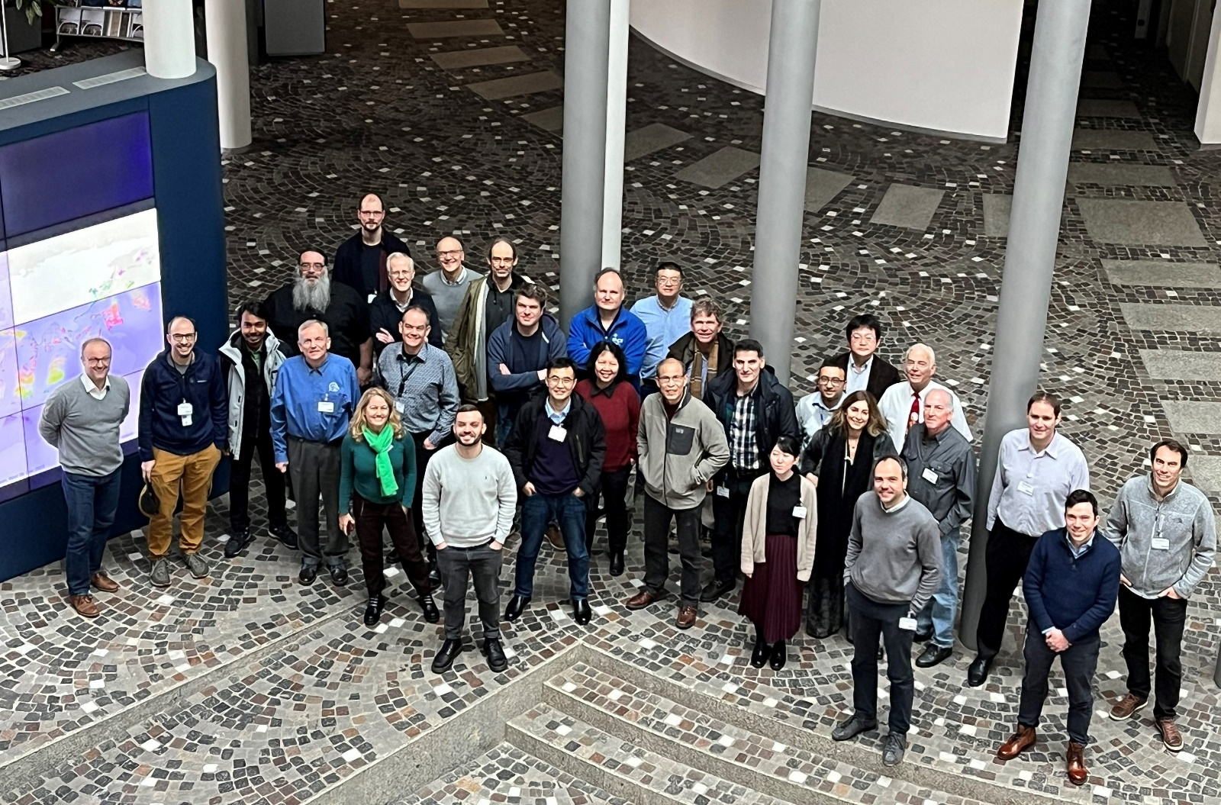
Mini-conf: lunar WS outcomes
5-day meeting from 4th Dec till 8th Dec 2023 in EUMETSAT HQ
Attendees: ~35 participants on site + 40 participants online
More than 30 agencies / institutes / companies
Sessions on:
Lunar measurements (for model derivation)
Lunar models and their development
Instrument monitoring
Thermal infrared and microwave
Alternative usages of lunar imagery
Proposed creation of a GSICS subgroup on
Lunar calibration to increase the visibility
Development of a New Module-Based Reference System
Lunar Spectral Irradiance Calibration System (LSICS) for generating lunar irradiance
R&D advances of the radiance models both in VIS-NIR and IR
By Tom Stone (USGS) and Sebastien Wagner (EUMETSAT)

Slide 12
Mini Conf: EUMETSAT lessons learnt from commercial data usage
In the New Space arena, RO data has become the most mature commercial offering of meteorological data, because instruments are simple, RO is well understood, has a high impact, and more of it is needed.
Both EUMETSAT and NOAA have begun to procure commercial RO data in an operational context
Experiences so far:
To ensure consistent data characteristics, both EUMETSAT and NOAA take care of processing, validation, quality control and monitoring of commercial data, requiring significant RO expertise in these organisations.
While a commercial data provider demonstrated high levels of reliability in Europe, the US suffered several issues with data availability from the commercial sector.
Transparency can be obtained by formulating contracts appropriately and by having sufficient expertise on the buyer side.
For observation techniques other than RO, topics like reference instruments and backbone missions require careful consideration.
By Bojan Bojkov and Christian Marquardt, (EUMETSAT)

Slide 13
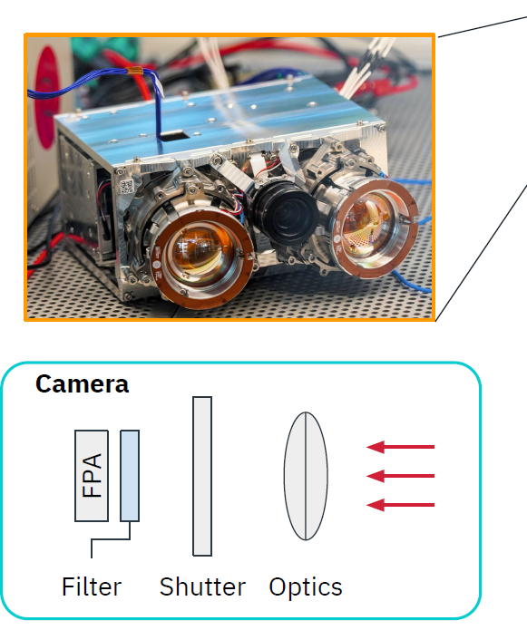
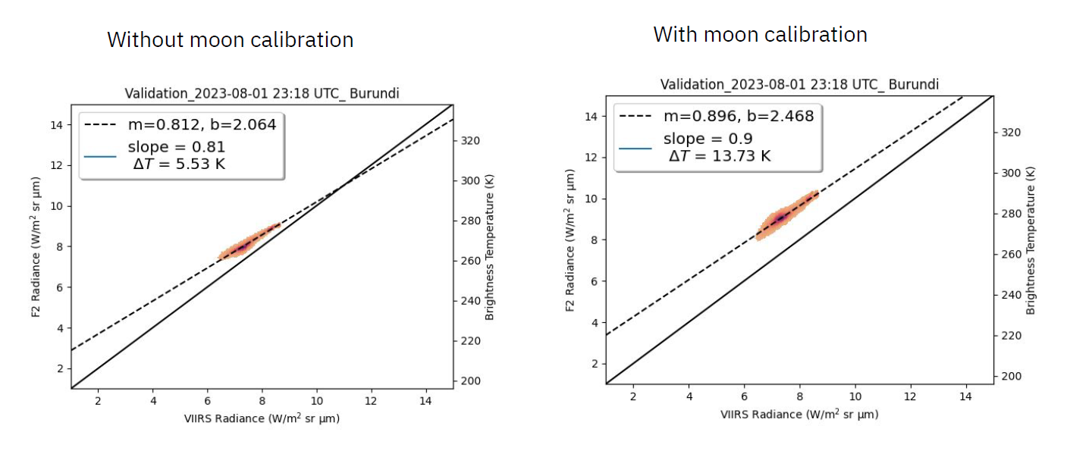
Mini Conf: inter-calibration of Forest-2/SAFIRE-2 TIR data
By Fatima Kahil (Ororatech)

Slide 14
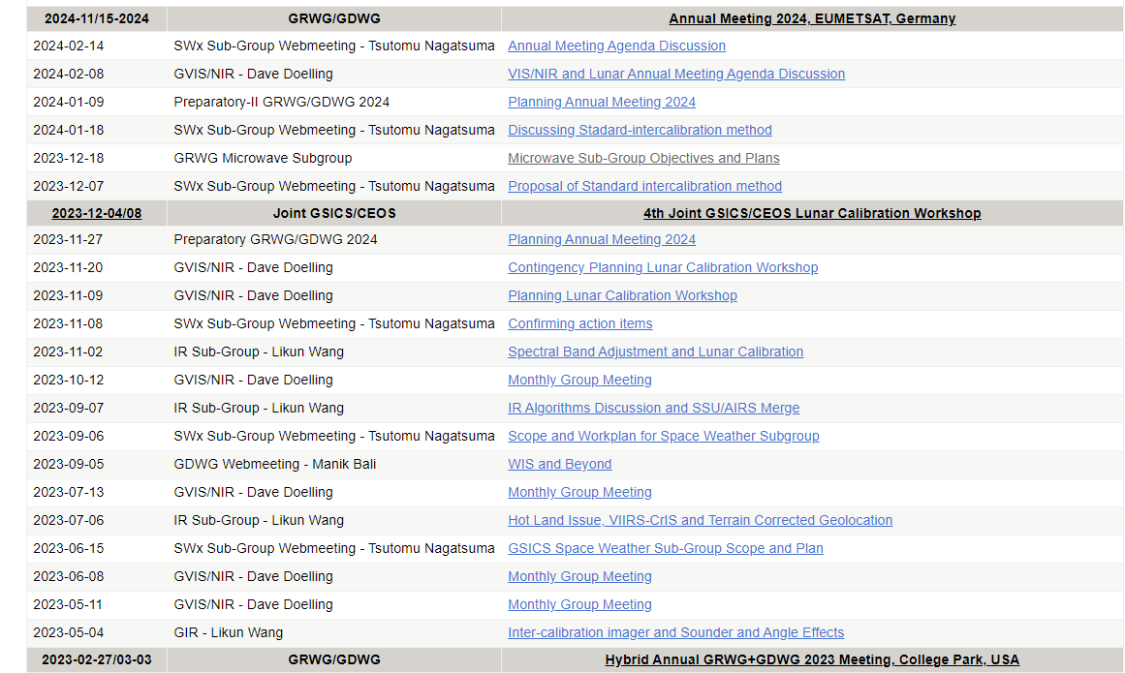
Meetings Organized/Supported in 2023
Organized 24 Web-meetings
VNIR (7), SW (6), IR (4), GRWG (3),WM (1)
See presentations in wiki page
Supported the 2023 EP meeting
29-30 June 2023, Tokyo, Japan
Attended CEOS WGCV IVOS 35 meeting (virtually)
25 – 29 Sept, 2023

Slide 15
New Products and Product Promotions
Four new GEO-LEO IR products generated by KMA GPRC in the Demo phase
GK2 AMI vs. SNPP/N20 CrIS and Metop-B/C IASI
Passed GCC GPPA review and approved by GCC director into the monitoring catalog
Four SEVIRI/IASI-B products generated by EUMETSAT GPRC being promoted to operational phase
Passed the GCC GPPA review as a “family instrument”

Slide 16
Update of Chairpersons
GRWG Chairs
Mounir Lekouara (EUMETSAT): 2024 –
Fangfang Yu (UMD@NOAA) will step down from the sitting chair position after the 2024 annual/EP joint meeting
Space-Weather (SWx) Subgroup
Tsutomu Nagatsuma (NICT): the first SW subgroup chair, after his interim term in 2022
Microwave (MW) subgroup
New elected co-chairs: Flavio Iturbide (NOAA) and Shengli Wu (CMA), 2023 -
Quanhua “Mark” Liu (NOAA) and Qifeng Lu (CMA): stepped down in 2023
Infrared (IR) subgroup
Chengli Qi (CMA): candidate for the incoming IR subgroup chair

Slide 17
A New GRWG Subgroup Is Proposed
GSICS Exec Panel
GSICS Coordination Centre
GSICS Research Working Group
Chair: Fangfang Yu (UMD@NOAA)
Incoming Chia: Mounir Lekouara(EUM)
GSICS Data Working Group
Space Weather Sub-Group
Chair: Tsutomu Nagatsuma (NICT)
UVN Spectrometer Sub-Group
Chair: Lawrence Flynn (NOAA)
VIS/NIR Sub-Group
Chair: David Doelling (NASA)
IR Sub-Group
Chair: Likun Wang (NOAA)
MW Sub-Group
Co-chairs: Shengli Wu(CMA)
Flavio Iturbide (NOAA)
Lunar Calibration
Sub-Group
Interim Chair: Tom Stone (USGS)
A new subgroup is being developed using the Moon and extra-terrestrial targets as the reference

Slide 18
Cooperations
In the spirit of GSICS, a number of activities have been coordinated between the agencies for the benefit of all users, e.g.
Lunar models: LSICS developments, ROLO-GIRO alignments, HAOC lunar acquisitions, microwave
IR inter-calibration: refinements of the method over hot and cold scenes
VIS-NIR inter-calibration: two new methods were described
Interest of CMA and JMA for hyperspectral-hyperspectral inter-comparison algorithms exchanges
Developing microwave inter-calibration algorithms, establishing 6 new focus groups
The cooperative spirit extended to constructive brainstormings on the calibration studies results

Slide 19
SITP/CAS participation to sub-groups
Shanghai Institute of Technical Physics (CAS) provided a useful agency report but do not participate to the sub-groups meetings

Slide 20
Summary
It was a productive year marked by full resumption of activities, facilitating discussion and collaborations
Continue enhancing GSICS products and deliverables through inter-calibration/cross-calibration/inter-comparison activities
Continue the ongoing active collaborations with CEOS/WGCV and other key communities
Continue growing in size and influence with the establishment of new Space Weather subgroup, the upcoming lunar calibration subgroup and the new focus on GHG sensors and polarimetry.
Thank you Fangfang !

