Slide 1
GRWG IR Session of GSICS Annual Meeting
Likun Wang
ESSIC/Univ. of Maryland; wlikun@umd.edu
2024 GSICS Annual Meeting, Darmstadt, Germany, EUMETSAT; March 13 2023

Slide 2
Outline
Scope of IR Subgroup
IR Group Activities in FY23
Agenda and Discussion
Future Direction and Plans

Slide 3
Review Scope of the IR Sub-Group
Counterpart of VIS/NIR, Microwave and UV Sub-Groups
  For satellite instrument channels in thermal infrared
  For Hyperspectral instruments
To establish user requirements for inter-calibration
Cooperate with instrument calibration groups
  To communicate relevant information to the users
  To help them understand the root cause of observed biases and develop fixes
Review existing, or develop new inter-calibration
  Algorithms, procedures, corrections, collocation, spectral-gap filling etc.
  Using NWP, ground-based, near-space measurements, etc.
To define and promote calibration standards, tools and datasets, and best practices
  Including selection of inter-calibration reference
Chair: Likun Wang (NOAA affiliation, Since 2018) with the help from Tim Hewison

Slide 4
Four Web Meetings in 2023
The IR group is active as usual. Four web meetings have been organized. 05/04: Inter-calibration imager and Sounder and Angle Effects
  07/06: Hot Land Issue, VIIRS-CrIS and Terrain Corrected Geolocation
  09/07: IR Algorithms Discussion and SSU/AIRS Merge
  11/02: Spectral Band Adjustment and Lunar Calibration
The topics includes inter-calibration algorithms improvements, development of climate data records, and using the moon for IR inter-calibration.
These web meetings are very important to keep the team members communicate and exchange information. We should continue it. Please let new chair know if you or someone you know like to present.

Slide 5
IR Session in 2024 GSICS Annual Meeting
8:30 | Welcome Remarks and Review for IR Groups | Likun Wang
8:50 | HIRAS and GIIRS data quality analysis using PC technics and comparisons to IASI | Shin Koyamatsu
9:10 | GOES ABI IR midnight calibration variation detected with GEO-GEO Inter-calibration | Fangfang Yu
9:30 | On-orbit characteristics monitoring and analysis of Fengyun-4 AGRI infrared channels | Xingwei He (remotely)
9:50 | Assessment and Dynamic Correction of Spectral Calibration of FY-3D/HIRAS | Chengli Qi
10:10 | 20 Minutes Coffee Break
10:30 | FY-4B GIIRS / Metop-IASI Inter-comparison | Pierre Dussarrat
10:50 | Thermal radiance model for Moon and Mercury | Kay Wohlfarth (remotely, check)
11:10 | Checking the radiometric stability of CrIS with the Moon | Martin Burgdorf
11:30 | Re-calibration results of COMS/MI and GK2A/AMI | Euidong Hwang
11:50 | Merging of SSU Observations with AIRS toward Extending Stratospheric Temperature Climate Data Records | Likun Wang
12:10 | Improvements in the Current SNO method for Long-Term monitoring of CrIS Inter-sensor Radiometric Biases with ABI within the NOAA ICVS Framework | Xin JIn (remotely)
12:30 | Discussion of GSICS GSICS SOS Reports | All
12:50
 | Lunch Time (1300-1400)
14:00 | Review of Inter-calibration Algorithm issues | Tim Hewison
14:20 | Ongoing GEO-LEO IR algorithm studies - Insights on FCI | Vincent Debaecker
14:40 | Revisit to AHI GEO-LEO-IR Regression | Masaya Takahashi
15:00 | Defining Warm Radiance Scenes and simple model for Parallax Uncertainty | Tim Hewison
15:20 | Summary on Angle errors, parallax, and proposed resolutions | Likun Wang
15:40 | 20 Minutes Coffee Break
 | Group Discussion
16:00 | Algorithms Improvements and the way forward | All
16:30 | Chair Transition and Plan for next year | All
Research topics: New sensor calibration results, climate data records, reprocessing, lunar model
Inter-calibration calibration improvements: regression, angle effects, interpolation GEO, warm scenes, uncertainty analysis
15 minutes for talk and 5 minutes for questions; I will remind you during the talk

Slide 6
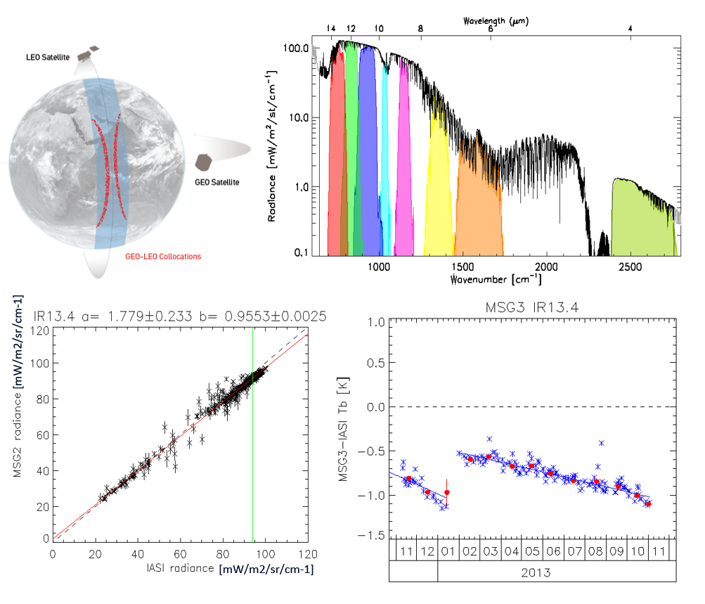
Algorithms Improvements
Review of issues and progress
  Tim Hewison (EUMETSA)
Regression methods
  Masaya Takahashi (JMA)
Collocation Smoothing Window Period
  Xin Jin (NOAA affiliate)
  Vincent Debaecker (EUMETSAT)
High angles and Parallax effects
  Likun wang (UMD)
  Tim Hewison (EUMETSAT)
Define Standard scenes
  Tim Hewison (EUMETSAT)
Other issues
  Multiple References/Diurnal Variations
  Gap fillings

Slide 7
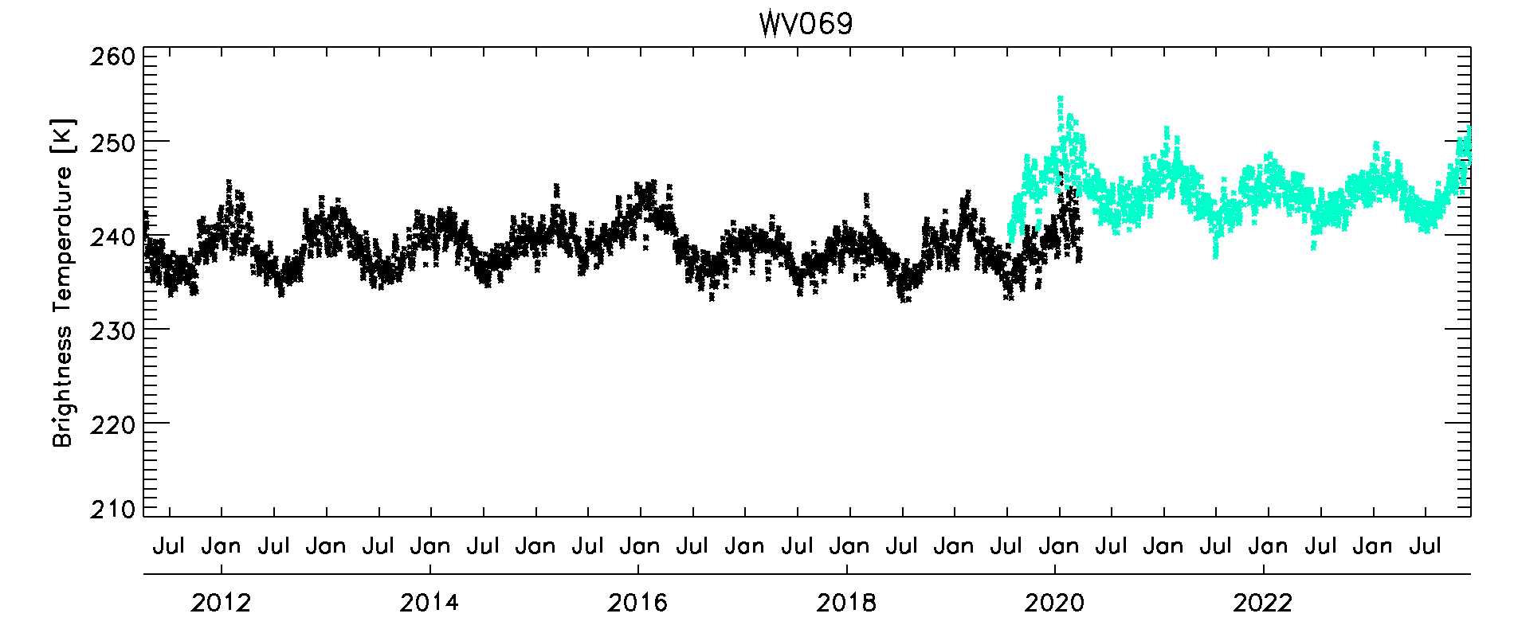
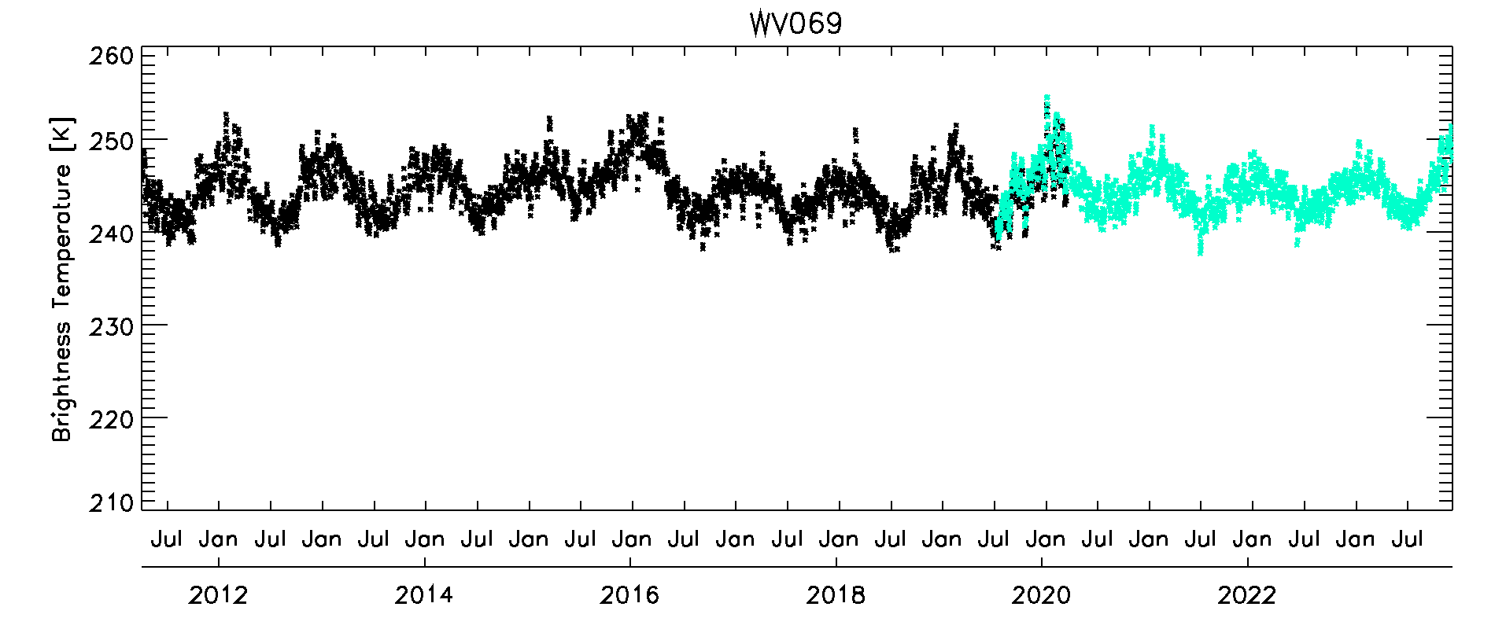
Recalibration and CDR
Using the GSICS GEO-LEO IR algorithm to recalibrate KMA COMS/MI and GK2A/AMI
  Euidong Hwang (KMA)
  COMS : 2011.04. ~ 2020.03., GK2A: 2019.07. ~
  Re-calibration results show stability and consistency.
The efforts has been made to bridge the SSU and hyperspectral sounders extend climate data records for stratospheric temperature monitoring
  Likun Wang (UMD)
  A method is being developed to convert AIRS hyperspectral data into equivalent SSU observations.
Original TB
WV069
Recalibrated TB
(Applying SBAFs)
From Euidong Hwang

Slide 8
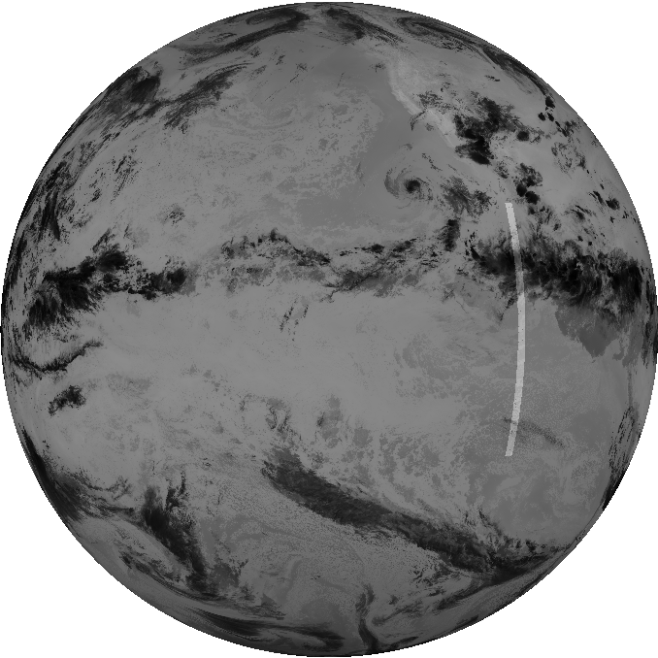
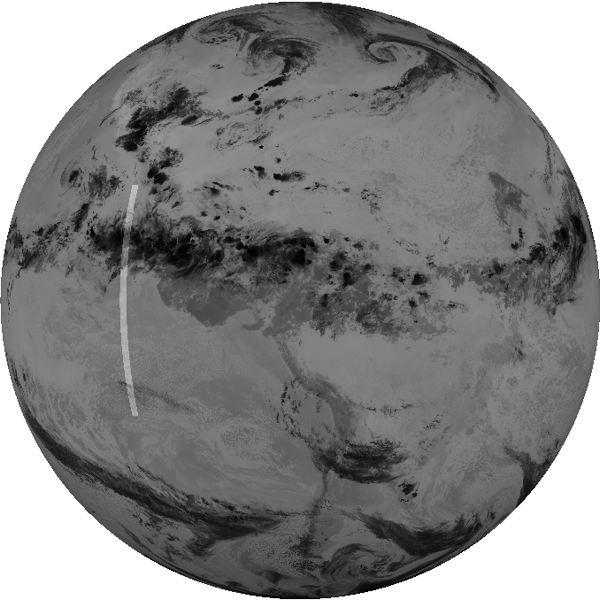
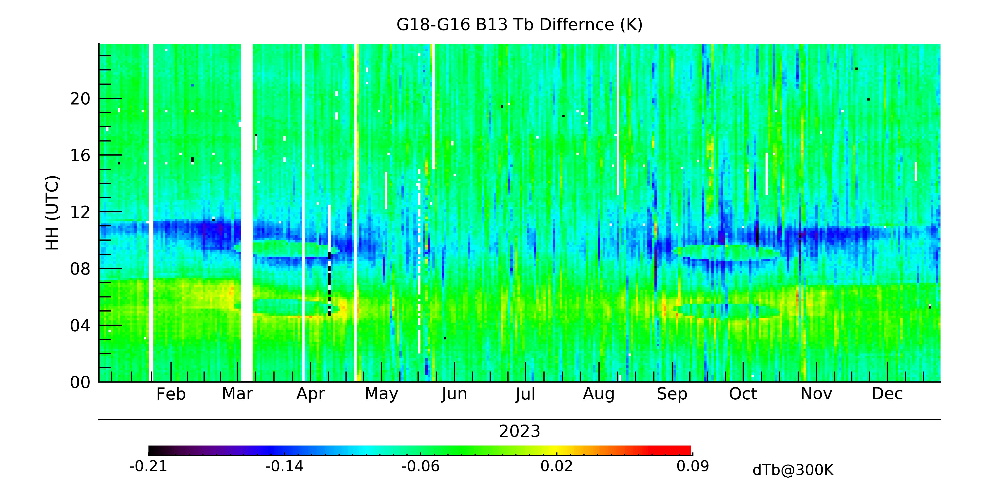
GEO-GEO Inter-calibration
With its high temporal resolution and precision, the GEO-GEO inter-comparison is a powerful tool to detect potential calibration change between the matched sensors
The spectral match, parallax effects, and scene uniformity must be carefully addressed.
Time-series of ABI GEO-GEO inter-comparison, due to its high temporal scale, is sensitive to small change in the radiance difference between the two satellites
  A powerful tool to detect possible calibration anomaly
GEO-GEO for GOES-East and GOES-West is able to detect subtle fluctuations around satellite midnight .
G17/G18
G16
G18 satellite midnight
G16 satellite midnight
From FangFang Yu

Slide 9
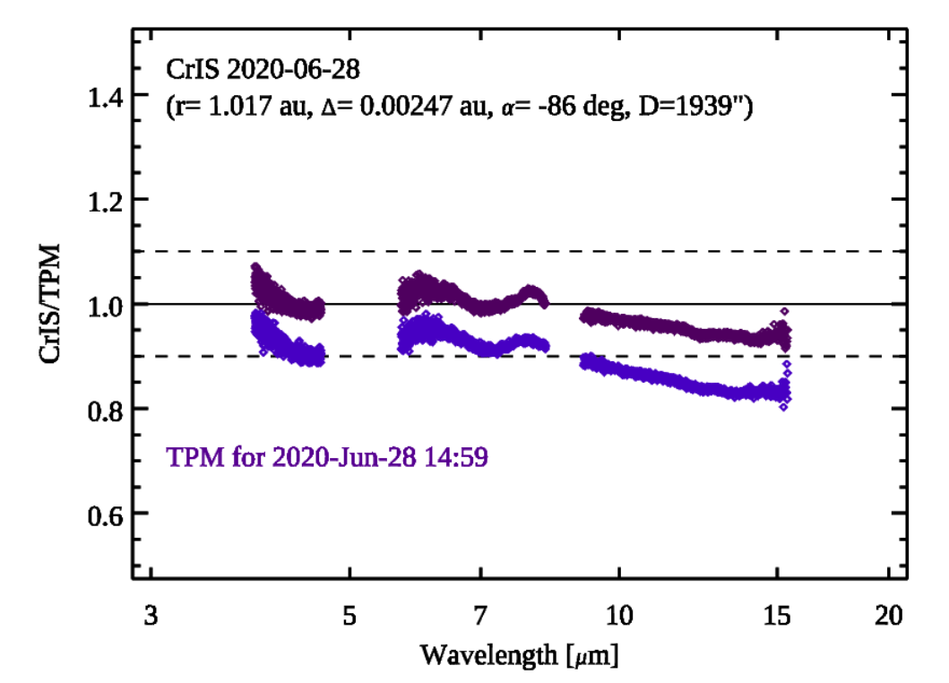
Lunar Calibration
Moon potentially serve as a stable target to inter-calibrate IR sensors when the Moon was within their FOVs.
A model of the IR irradiance of the disk-integrated Moon is available.
Disk-integrated infrared observations of the Moon was compared with the model and the results agree each other.
Two Talks:
  Kay Wohlfarth: Thermal Lunar Model
  Martin Burgdorf: CrIS for Lunar calibration
  From Martin Burgdorf

Slide 10
New Sensors, Inter-Calibration, and Studies
Calibration updates on CMA FY/ARGI and HRAS
  Chengli Qi (CMA)
  Xingwei He (CMA)
Using PCA analysis for calibration diagnose and Inter-calibration
  Shin Koyamatsu (JAM visiting EUMETSAT)
  Pierre Dussarrat (EUMETSAT)
Inter-calibration study for GEO-LEO Hyperspectral Sounders
  Pierre Dussarrat (EUMETSAT)

Slide 11
Three Discussion
Discussion 1 : GSICS SOS Reports
  12:30 – 12:50
  Hosted by Tim Hewison
Discussion 2: Algorithms Improvements and the way forward
  16:00-16:30
  Hosted by Tim Hewison and Likun Wang
Discussion 3: Chair Transition and Plan for next year
  16:30-17:00
  Hosted by Tim Hewison and Likun Wang

Slide 12
Actions

Slide 13
New Actions During IR Sesstions
Action: A.GIR.2024.5m.1: Dave Doelling to provide feedback from cloud retrieval team on treatment of solar differences in 3.8µm channel during day/night.
A.GIR.2024.5p.1: Tim Hewison (EUMETSAT) to further investigate standard scene definition using 50% percentile and report back to the team in the GSICS IR group web meeting.
G.GIR.2024.5q.1: Likun Wang to compare LOS approach with different vector angles and RAA<50° in terms of dynamic range and number of collocations.

Slide 14
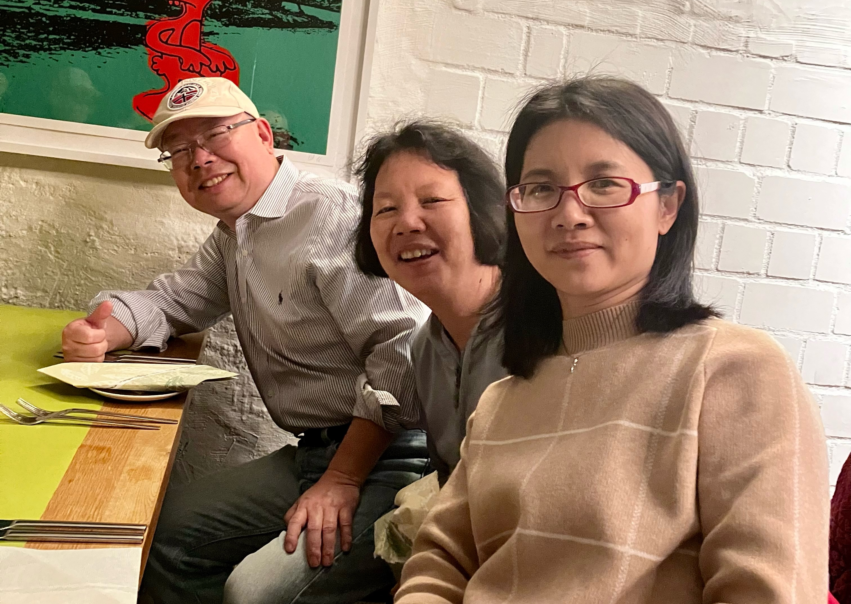
New Chair: Chengli Qi
Moving Behind but always supporting as needed
Moving front as an
official IR chair

Slide 15
2024 Plan
Monthly or bi-monthly web meeting, keep energetic status
Comunication topics
- Algorithms improvements for inter-calibration, instrument calibration,
- Development of climate data records,
- Using the moon for IR inter-calibration.
- AI tenique application in calibration
- New IR instruments concept and applicaion potential...
Inter-calibration algorithms improvements
- Avoid parallax effects
- Time difference bias over hot land
- Instrument depent Quality control
- Regression, Uncertainty analysis
Standard process
- Stand scene radiance which the bias statistis @.
- SOS report finalize contribution and 1st report output.
- LEO-LEO, hyperspectral instruments comparison...

Slide 16
Cooperation
Cooperate with instrument calibration groups
  To communicate relevant timely information to the users
  To help them understand the root cause of observed biases and develop fixes
  To promote reprocessing of instruments
  VIS/NIR, Microwave and UV Sub-Groups
  Support more cross-community efforts,
  Dialogue between GSICS with ISSCP-NG, NWP community, CEOS WGCV/IVOS subgroup
  Support climate application
  Support radiance reference transfering model
  Encourage more experts involved in the IR group
  Updates on new instrument, methods, and datasets and application for the IR group
  Instrument observation simulation to characterise error
  Share the tools and codes, knowledge Exchange memo
  GitHub or GSICS wiki may be the best host place

