Slide 1
GRWG Space Weather Sub-group Report
Mar 15, 2024

Slide 2
History
The cross-calibration of high energy electron sensor at GEO have been discussed in Space Weather Coordination Group (SWCG) in The Coordination Group for Meteorological Satellites (CGMS).
The Task Group in SWCG submitted a white paper about the cross-calibration of high energy electron sensor to Executive Panel of Global Space-based Inter-Calibration System (GSICS-EP). GSICS-EP endorsed to establish GRWG space weather subgroup in 2022.
The 1st Kick-off meeting (remote) was held in Dec. 14, 2022.

Slide 3
Scope of GRWG space weather sub-group
As experts in space environment measurement, its application, and understanding user’s requirements, members of the SW sub-group will carry out the following activities.
Discussion and coordination on research, development and implementation of inter-calibration for space environment sensors, initially focusing on high-energy electron sensor in geostationary orbit
Analysis of the characterization (sensitivity, secular variation, etc.) of individual sensor and publication of the outcomes (product), and consideration of its implementation in the framework of GSICS
Examination and documentation of standardization (data format, data exchange, inter-calibration, etc.)
Examination of developing a standard products (near-real time bases, and post-data analysis bases) that integrates multiple satellite data

Slide 4
Working Plan
Initially focus on high-energy particle sensors on GEO
Proposing application produced from multiple satellite data
Proposing method of near-real time and archival inter-calibration
Harmonizing data levels
Defining GSICS products and tools for space weather sensor

Slide 5
GRWG SWx Sub-group Membership
Followings are the members from task group on intercalibration of high energy electron sensor
CMA Cong Huang
ESA Piers Jiggens, Hugh Evans, Juha-Pekka Luntama
EUMETSAT Andrew Monham
KMA Dohyeong Kim , Daehyeon Oh
NICT Tsutomu Nagatsuma (Chair)
NOAA Elsayed Talaat, Brian Kress, Juan Rodriguez, Christian Naylor, and Athanasios Boudouridis, Jim Spann
SPARC Ingmar Sandberg
WMO Jesse Andres
We are welcome to join the members from other organization including ET-SWx, WMO, and non-member organization to provide specialist expertise.

Slide 6
Breakout session (Mar. 12, 2024) [1/2]
On-orbit cross-comparison results of electron flux from Fengyun-4B, GOES-16, and Himawari-8 (Jingtian Lv, CMA)
Calibration of radiation belt electron data observed by Arase satellite using Geant4 simulation (Inchun Park, NICT)
GOES-R satellites radiation belt electron calibration (Athanasios Boudridis, NOAA NCEI)
GOES solar energetic particle instruments cross calibrations (Brian Kress, NOAA NCEI)
Cross-calibration schemes and recent results (Ingmar Sandberg, SPARC)
PRBEM standard data analysis procedure (Antoine Brunet, ONERA)

Slide 7
Breakout session (Mar. 12, 2024) [2/2]
Short review of PRBEM document (Data Analysis Procedure) from each organization
CMA (Cong Huang)
KMA (Daehyeon Oh)
NOAA (Brian Kress)
ESA (Hugh Evans)
NICT (Tsutomu Nagatsuma)
(ROSHYDROMET (Kirill Kholodkov)
We have realized that current condition of L* and α_{eq} described in the document is too strict for GEO observation. And the document itself is old (published in 2012). The reference satellite is already retired (Electron: CREES MEA, Proton: GOES-8 SEM).
Based on our discussion, we will ask PRBEM members to arrange the meeting with us. One candidate is COSPRR meeting in July.

Slide 8
Highlights (1/2)

Slide 9
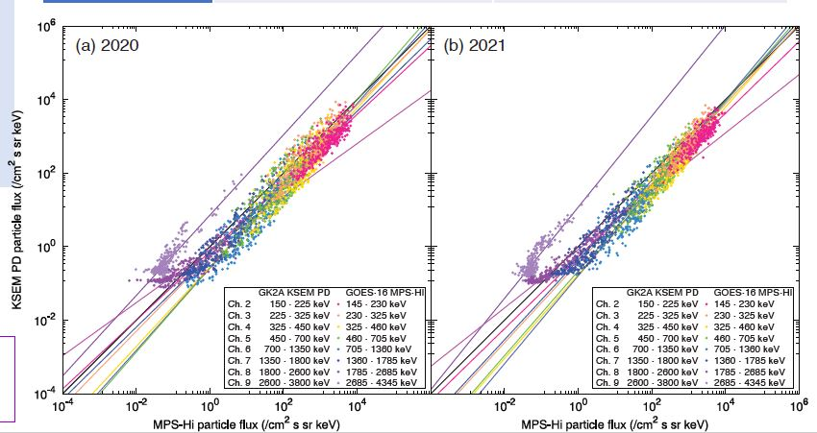
Highlights (2/2)

Slide 10
Action items
We have been asked to contribute to the GSICS quarterly newsletter in a special issue on the cross-calibration of SWx instruments due to the great progress since its start in GSICS. By end of March, each organization think about the kind of articles to submit to the newsletter.
We will ask PRBEM members to arrange the meeting with us. One candidate is COSPRR meeting in July.
Next subgroup meeting will be arranged by email.

