Slide 1
Report on UVN-S Session
L. Flynn (NOAA) and R. Lindstrot (EUMETSAT)
15 March 2024

Slide 2
Disclaimer
"The contents of this presentation are those of the authors and do not necessarily reflect any position of the US Government or the National Oceanic and Atmospheric Administration."

Slide 3
UVN-S Session Agenda
7.a GOSAT Update | cr Kei Shiomi (JAXA)
7.b Current Status of Geostationary Environment Monitoring Spectrometer (GEMS) | c Kyunghwa Lee (NIER)
7.c Inflight Performance of the FY-3F OMS instruments | c Qian Wang (CMA)
7.d Status & calibration concepts of the CO2I/NO2I instrument of the Copernicus CO2M mission | c Bernd Sierk (Eumetsat)
7.e Current status of GOME-2 and outlook for Sentinel-4 & Sentinel-5 | c Rasmus Lindstrot (Eumetsat)
7.f TropoMI SWIR Validation | cr Tim van Kempen (SRON)
7.g TSIS-1 Solar Reference Validation Study | cr Julian Gröbner (PMOD/WRC)
7.h TEMPO Calibration | cr Heesung Chong (SAO)
7.i Deep Convective Cloud Monitoring for OMPS | cr Ding Liang (GSTI)
7.j Enterprise V8TOz as a Transfer Standard | c Larry Flynn (NOAA)
7.k TropoMI UVN | c Erwin Loots (KNMI)
7.l OCO-2 and OCO-3: Mission Status and Calibration Improvements | cr Rob Rosenberg (NASA)
7.m OCO-3 Oxygen A-Band In-Band Spectral Shape Corrections | cr Graziela Rodrigues (NASA)
7.n FDR4ATMOS Project | c Günter Lichtenberg (DLR)
Discussion | All

Slide 4
Planned Activities
GHG Missions next quarterly meeting: 12-13UTC, Friday, April 26, 2024
Three planned UVN-S Topical Meetings (fifth Thursday of the month)
  Evaluating and modeling solar measurements
    Diffuser degradation
    Instrument throughput degradation
    Solar activity
    Wavelength shifts and Bandpasses
    Stray Light
  Matchup Intercomparisons for LEO/GEO, LEO/GEO/Lagrange-1, LEO/LEO
    SNO
    Ray tracing
    Using RT Forward models to account for viewing differences (V8TOz examples)
  Use of Targets and Statistical approaches
    Ice Radiances
    Open Ocean
    Land (PICS, etc.)
    Deep Convective Clouds
    Aerosol Indices

Slide 5
Overview of presentations
14 talks with over 50 attendees, 20+ in person.
Presentations are linked to the agenda.
  https://umd0-my.sharepoint.com/:x:/g/personal/mbali_umd_edu/EdGasPet3EZCroCqS4TtxXkBV6crWjaU20Azred9gn7e0w?rtime=vbD6UwpE3Eg
Minutes are extensive and in revision.
  https://umd0-my.sharepoint.com/:w:/g/personal/mbali_umd_edu/EQGYXlBLzARFunxaK6N79akBnDEkH0qrs313zT9vAlzMxA

Slide 6
7g. Validation of TSIS-1 HSRS in the range 300 nm to 1700 nm using ground-based SI-traceable spectral solar irradiance measurements.
U⁹⁵_{QASUME}=1.6%
Agreement with TSIS-HSRS: 1% outside of strong atmospheric absorption bands

Slide 7
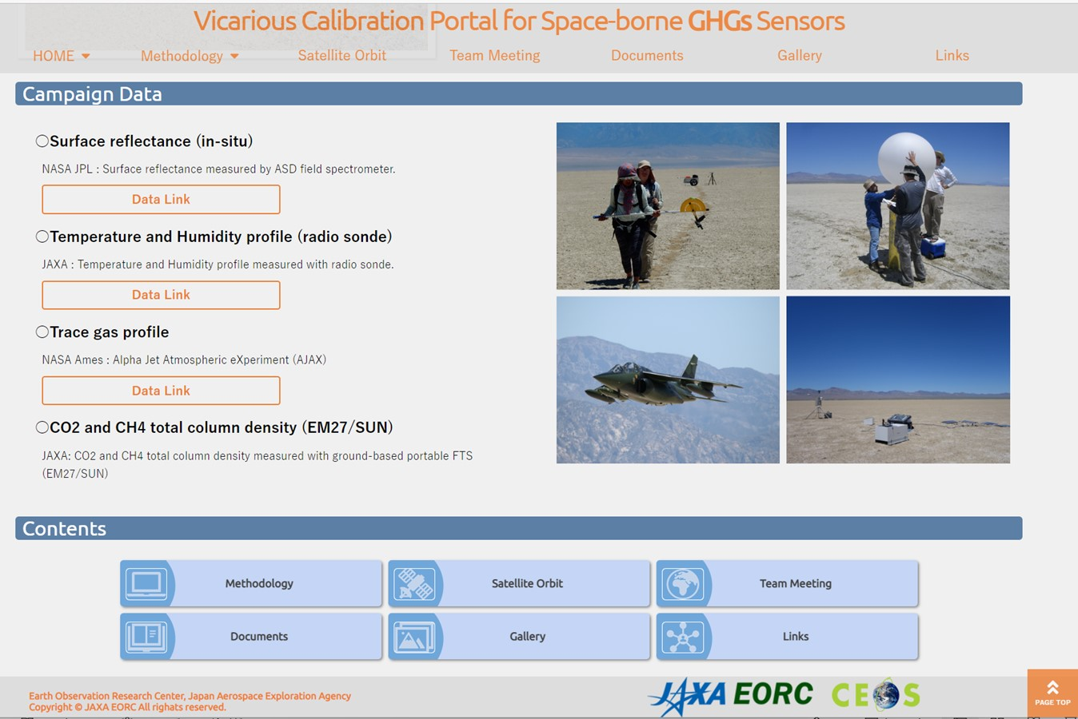
7a. GOSAT and GOSAT-2 update
GOSAT has been operated normally over 15 years since 2009, GOSAT-2 over 5 years since 2018.
GOSAT and GOSAT-2 have been currently operated the on-orbit radiance calibrations by solar diffuser and lunar calibration, respectively.
Vicarious calibration has been conducted at Railroad Valley in collaboration with OCO team and TROPOMI.
https://www.eorc.jaxa.jp/GOSAT/GHGs_Vical/index.html
The Railroad Valley field data are available from VCAL portal site.
VCAL team meeting is held every 3-4 months. Next meeting: 12-13UTC, Friday, April 26, 2024.
RRV Campaign 2024: TEMPO team will be joined. OCO-3 will be back from ISS storage.
7

Slide 8

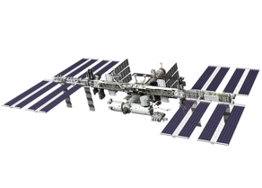
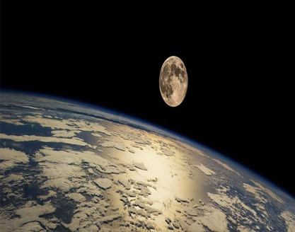
7l. OCO-2 & OCO-3: Mission Status & Calibration Improvements
Consistently accurate calibration is vital for carbon cycle science
As record lengthens, reprocessing campaigns cost more, take longer, and are less frequent
Continuing to monitor detector health using daily dark & lamp measurements, very stable
Maturing analysis techniques & extending time series for vicarious calibration, simultaneous nadir overpasses, and lunar calibration
Data accessible to the public:
https://disc.gsfc.nasa.gov/
L1B ATBD updated Feb 6. 2024

Slide 9
7m. OCO-3 Oxygen A-Band In-Band Spectral Shape Corrections
In OCO-3, contaminant accumulation imparts a S-like shape to the A-Band spectra.
In Build 11, we derive the spectral shape of inflight gain degradation in the A-band directly from observations of clear ocean scenes.
The new calibration of the A-band drastically reduced the curvature of spectral residuals between model and science observations, which previously had a strong footprint dependence.
EOFs associated with curvature derived from Build 10 products explained up to 9 % of the variance. This dropped to less than 1 % in Build 11, where curvature related EOFs are no longer removed.
In Build 10, the curvature artifact manifested itself in the form of a slow drift of XCO₂, from February 2020 to January 2021, with respect to models, TCCON, and OCO-2, which was corrected during the post-processing step.
The slow drift in XCO2 was significantly reduced to less than 1 ppm in Build 11.

Slide 10
7f. TROPOMI-SWIR: Performance & L1b Validation

Slide 11
7d. Status & Calibration Concepts of the CO2M mission
Summary and Outlook
CO2M mission for monitoring of anthropogenic greenhouse gas emissions
  Multi-instrument payload with combined retrieval of CO2 (and CH4)
    CO2I/NO2! pushbroom imaging spectrometer for measurement of XCO2 and XCH4
    Multi-Angle Polarimeter (MAP for Aerosol measurement
    Cloud Imager (CLIM) for sub-sample cloud flagging/characterisation
CO2I/NO2I “special features”
  Fibre-based slit homogenizer with implications on (un-)binning strategy
  Detector lag/persistence/memory effects require detailed models and corrections
    Development of correction algorithms are on-going, to be implemented in operational L1b processor
CO2M is “on course” for launch in 2026
  Space segment development led by ESA
    Payload CDR kicked of end of March, to be completed in June
  Ground segment development led by EUMETSAT
    Instrument Processing Facility with operational L1 and L2 processor, CDR to be kicked off April

Slide 12
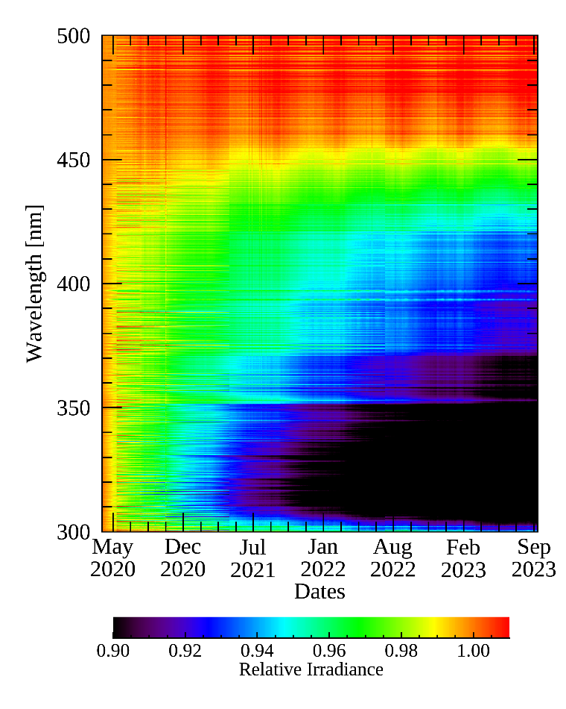
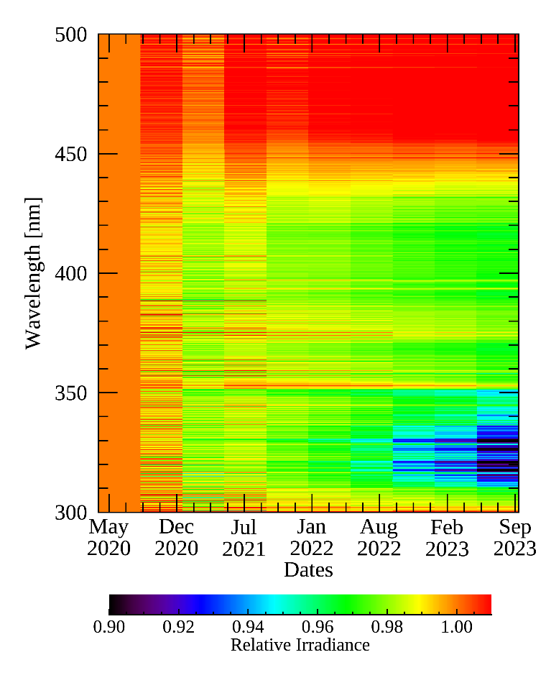
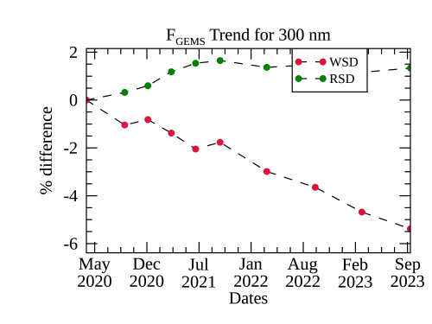
7b. Current Status of Geostationary Environment Monitoring Spectrometer
Monitoring long-term GEMS data
☯ Working solar diffuser (WSD) and reference solar diffuser (RSD)
Degradation of the diffuser and throughput occurs as observation time increases
WSD
RSD
1,201 times of exposure
10 times of exposure
GEMS covers the equatorial region, which makes it possible to have GEO-LEO SNO-type comparisons. This is a unique opportunity.

Slide 13
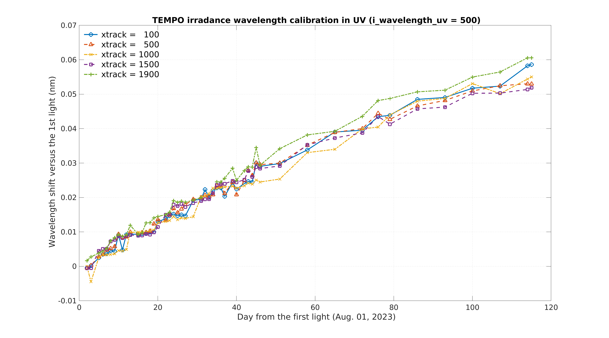
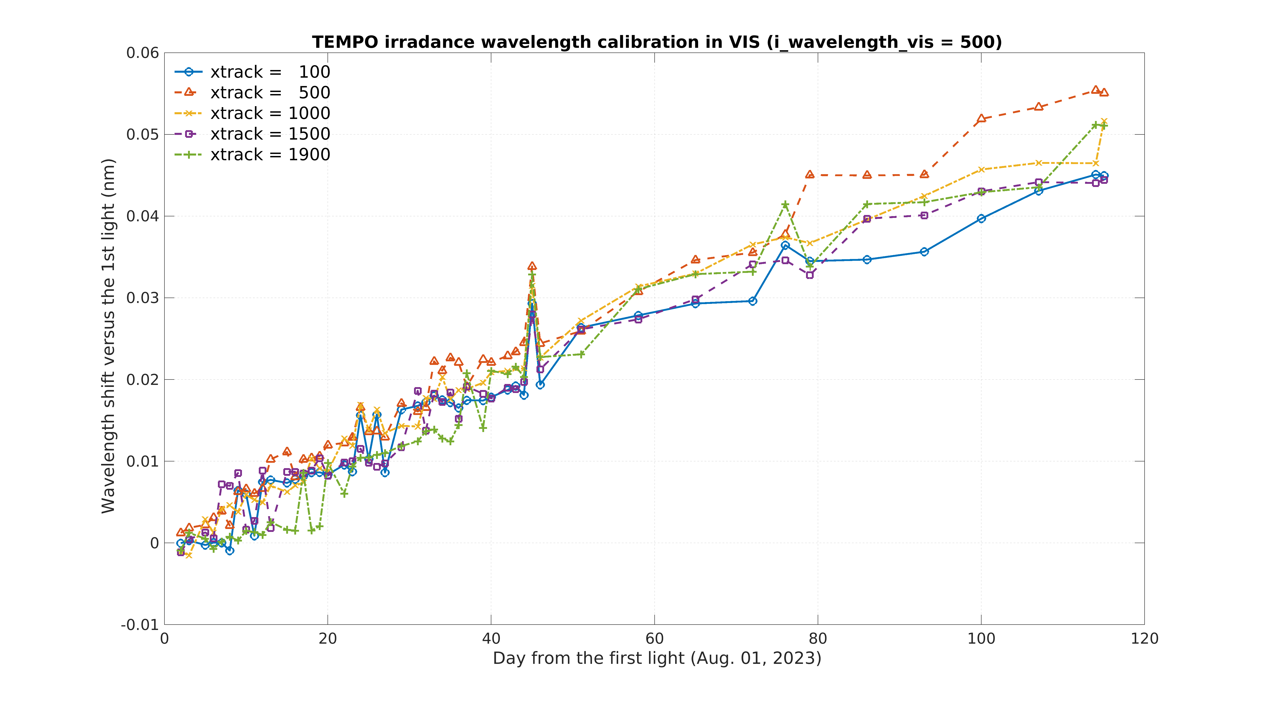
7h. TEMPO Calibration
Spectral calibration (trending wavelength shifts)
[Credit: Weizhen Hou]
Different spatial indices
UV
VIS
Wavelength shift [nm]
Wavelength shift [nm]
Days since the first-light (August 1, 2023)
Increasing wavelength shifts in solar irradiance measurements since the first-light
Version 2 release
- Date: February 26, 2024
- Collection name (Validation status): BETA
- Continuous data production onward from the release date + Reprocessing ongoing
- User Guide available online, Version 1.0 ATBD available upon request
(https://www.earthdata.nasa.gov/learn/articles/new-beta-level-1-tempo-products)

Slide 14
7e. Current status of GOME-2 & outlook for Sentinel-4 & Sentinel-5
Sentinel-4 and Sentinel-5 Cal/Val Objectives
Assess and establish initial post-launch data quality of mission products
Support consolidation of processors by identifying and fixing bugs in algorithms and processor implementations, by providing a basis for the fine-tuning of algorithm settings, and by identifying and handling potential unexpected post-launch instrument features
Verify that mission products meet performance requirements and can be released to the users
Monitor data quality on long-term operational basis. Support maintenance and evolution of processors throughout mission lifetime
EUMETSAT and ESA/ESTEC are preparing an Announcement of Opportunity (AO) call for the support of Sentinel 4 and 5 Cal/Val, to be published in the first half of 2024.
to trigger & coordinate nationally funded Cal/Val activities
Aiming at Objectives A, B, C
Complementing planned commissioning phase activities verifying PFM instruments, L1b and L2
Complementing long-term Cal/Val activities by EUMETSAT aiming at Objective D

Slide 15
7k. TROPOMI L1b: UV, VIS, NIR modules: in-flight calibration status
Changes in measured irradiance: related features
What | Where | Magnitude of effect | Estimated residual in data | Corrected in L1b Processor | Remarks
1) Electronic gain drift | All UV, VIS and NIR bands. SWIR not affected | 0.1% | Up to 0.1% during gain jumps | Yes, for almost all orbits. Extrapolation error in recent orbits. | Drifts are per band →spectral jumps at central column
2) Optical degradation | Stronger for short wavelengths, spectral /spatial smooth | 0-12% | <0.7% | Yes, small extrapolation error in recent orbits
3) Day-to-day variation in measurements ‘Hiccups’ | Spat/spec smooth, per detector, UV, VIS, NIR, SWIR | 0.2% UV/SWIR 0.4% VIS/NIR | 0.2% UV/SWIR 0.4% VIS/NIR | No, appear as residuals in the optical degradation derivation | Caused by diffuser or folding mirror mechanism; not deterministic
4) Detector bleaching/ageing | Band 2 (UV) (318-330nm), spatially smooth | 0-14% | <1.5% | Yes, but accidentally also corrects extra SL in band 1 (should be additive not multiplicative) | Correlated with signal magnitude (strongest at 317nm)
5) Changing straylight | Band 1 most affected, spat/spec smooth, also bands 2-4 | 2000e-/s | 30% UV, 6% UVIS of the on-ground straylight | Not yet, testing. Should replace bleaching correction in band 1. | If not corrected: additive error and peaks in FL (280nm)
6) Solar variation | Only around 280,285,288 nm in band 1 | Increasing, now 15% | n/a | No | Correlates with Sun spot counts
7) Spectral stability | All detectors, strongest in SWIR |  | 2-50pm shift | No. L1 does no calibration only annotation | Correlates with grating T for SWIR
8) Detector “scratch” | Band 3, some curved, but only locally | 1% |  | Not yet, testing

Slide 16
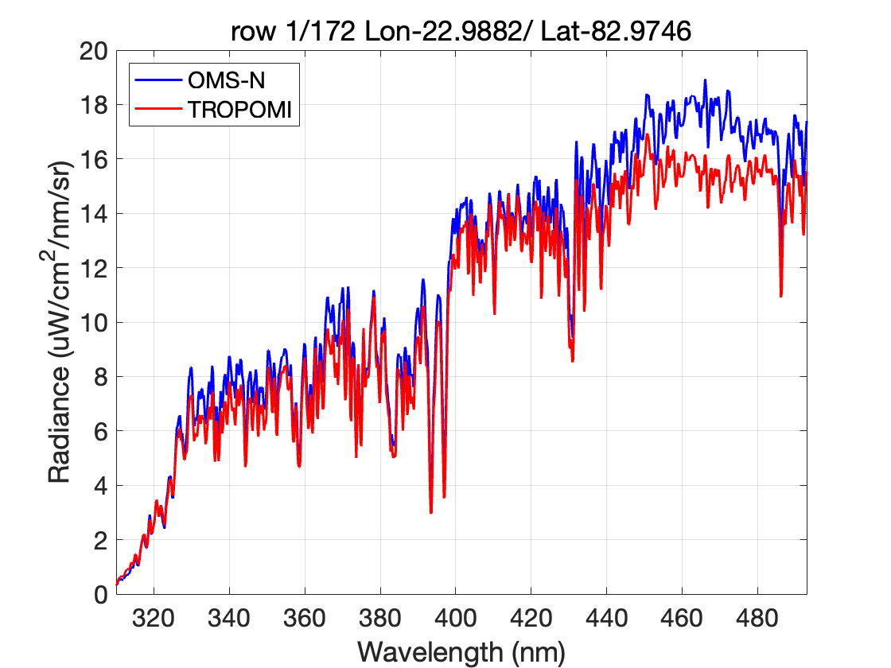
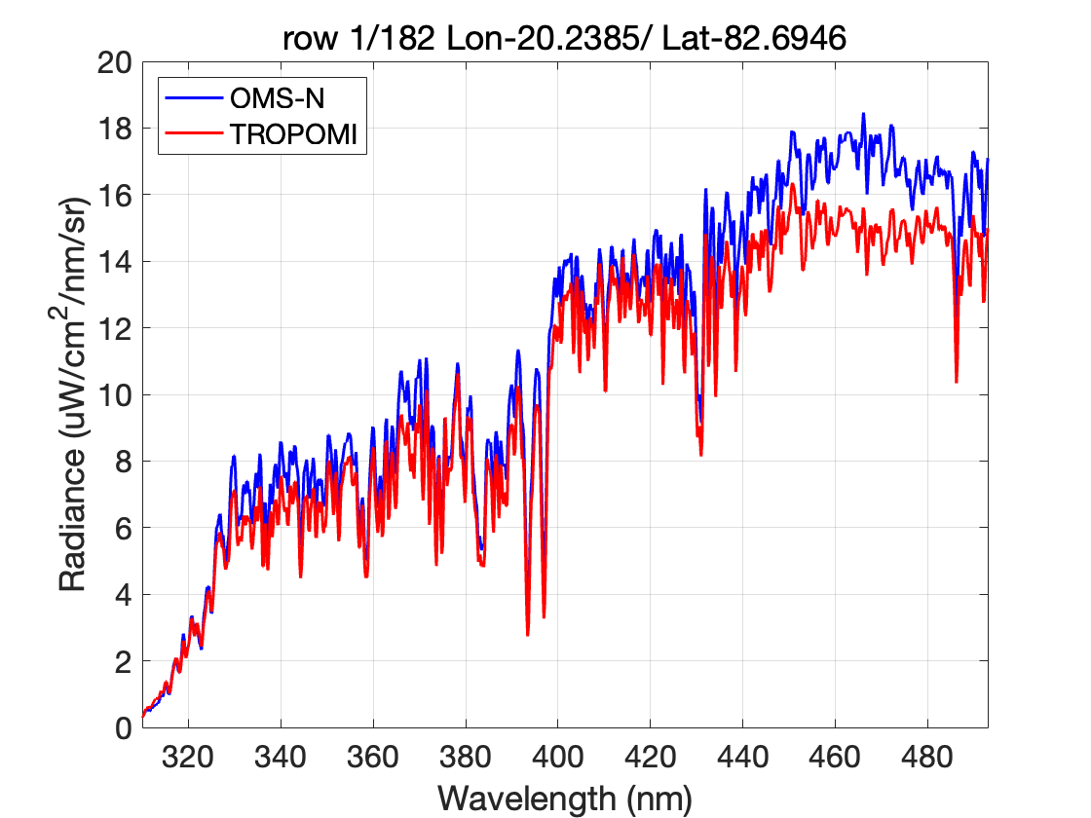
7c. Preliminary Performance of the Ozone Monitoring Suite -Nadir (OMS-N) on FY-3F
L1 product—— OMS-N vs. TROPOMI (SNO)
Earth measurements （Antarctica 20240211）
OMS-N earth radiance is higher than TROPOMI measurement in VIS band, especially for bright targets.
The radiance difference becomes larger at around 430~493nm.

Slide 17
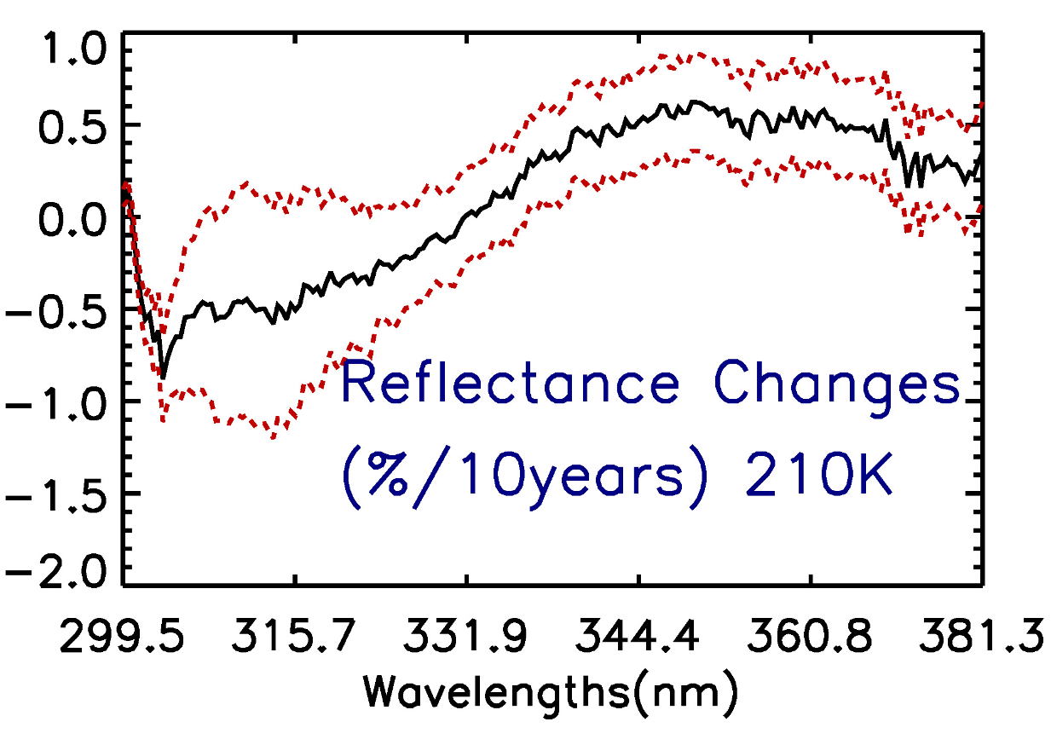
7i. Assessment of OMPS Nadir Mapper SDR Reflectance Using Deep Convective Clouds As Calibration Targets
Reflectance changes over ten years with 1-sigma uncertainty vs wavelength:
Mean DCC reflectance is stable with 10-year changes well within 2% requirement;
Positive reflectance changes for wavelength > 330nm;
Reflectance changes increase with wavelength and them decrease with wavelength;
Max reflectance changes is ~0.6%/ 10years.
Figure. 8 S-NPP OMPS-NM DCC mean reflectance changes over ten years with 1-sigma uncertainty vs wavelength when threshold is 210K.

Slide 18
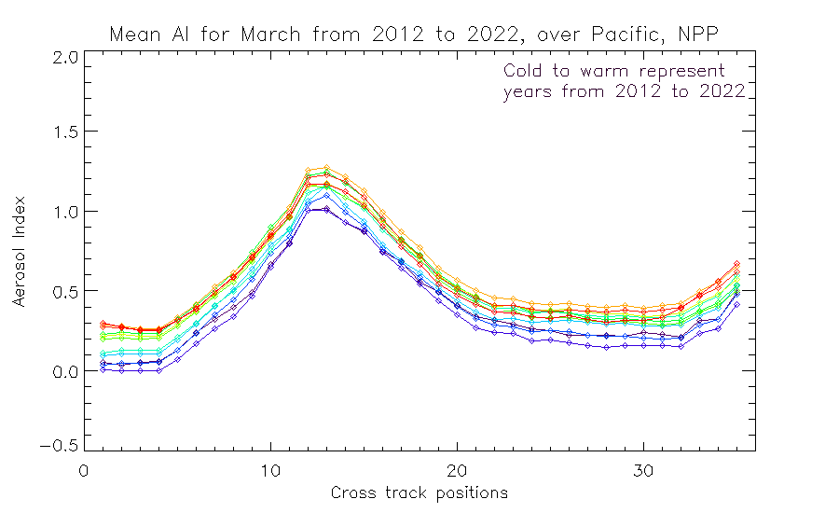
7j. Calibration of UV/Vis Spectrometers for Aerosol Products
UV Aerosol Index
331/360 nm Pair
Trend over
11 years.
Sun Glint Geometry
Colors are time-sorted Cold to Warm
2012 2013 2014 2015 2016 2017 2018 2019 2020 2021 2022 2023
Cross-Track Viewing Position # (#18 is Nadir)
Cross-track dependence over the Equatorial Pacific of the Aerosol Index for S-NPP for March for 11 years Cold to Warm.
The cross-track pattern for the Aerosol Index is also very stable year-after-year and the absolute values are stable at the 0.4 level. The figure on the slide before does show (two ⃝‘s) a trend in the instrument throughput for the 360 nm channel relative to 331 nm which has not been adjusted in any calibration, so some time dependence in this figure is not unexpected.

Slide 19
7n. FDR4ATMOS Phase 1 Results and outlook to Phase 2
FDR added value
  GOME-1 SMR harmonised to independently validated SCIAMACHY SMR
  SCIAMACHY data scaled to minimum integration time in band
  Reflectances directly available in FDR
  GOME-1 UV viewing angle dependency mitigated
  Level 1 errors were thoroughly analysed an decomposed into systematic/random components
Open:
  Time dependency GOME-1 is the same as in original data (reflectance degradation)
  Reason for unusable ocean scenes
Open points will be addressed in Phase 2 together with the incorporation of GOME-2 data

