Slide 1
SI-Traceable Satellite (SITSat) Task Group
(supported by WGCV and GSICS members)
Co-lead : Nigel Fox (UKSA)
Yolanda Shea (NASA)

Slide 2
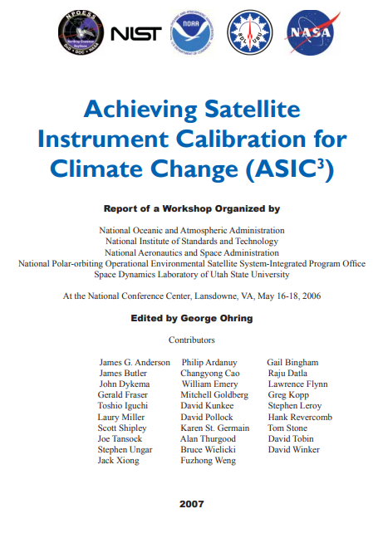
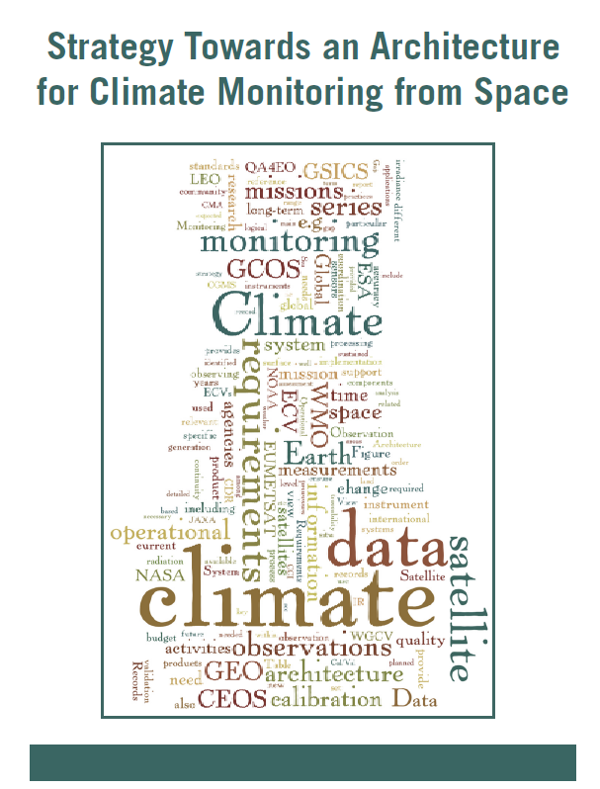
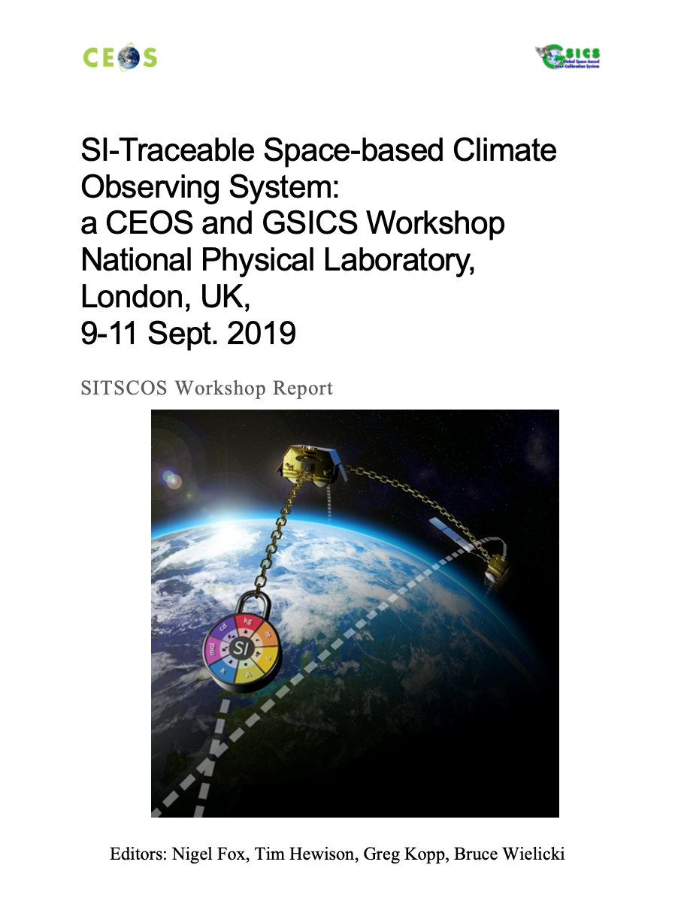
Background
International activities around SI-Traceable data for Climate Monitoring from Space, including plans to launch SITSats

Slide 3
What is a SITSat ?
A SITSat is a satellite-based sensor which can provide and verifiably evidence, in a fully open and transparent manner, all significant contributions to the uncertainty of its measurements, metrologically traceable to the international system of units, SI, at the location and time from where they are made. In addition, this uncertainty must be at a level that is considered by the community to be of ‘Fiducial reference’ quality, i.e., that for a defined spectral domain/application it can be considered ‘state-of-the-art’ and able to unequivocally serve as a reference for similar measurements from other sensors. The uncertainty of a SITSat should be expected to reach or at least approach that required for key climate science objectives such as those identified in the “SI-Traceable Space-based Climate Observing System: a CEOS and GCICS Workshop” ( https://doi.org/10.47120/npl.9319 ). When used as a reference a SITSat would be expected to have a measurement uncertainty of <0.5 compared to that of its non-SITSat peers.
Note:
1/ If used as a reference, the method used to compare with other sensors and its associated uncertainty to SI, should also be fully documented and evidenced.
2/ The nominal threshold uncertainty to be considered a SITSat for a particular type of measurement/application may increase or reduce over time commensurate with scientific consensus, currently this requires 2-10x improvement over current sensors. Although desirable in the long-term, it is not essential to have a SITSat for all applications and sensor domains and thus the assignment of the classification to a sensor should only be made when the maturity and technology of a particular domain justifies it.
3/ A SITSat peer group would constitute ALL sensors making similar measurements (e.g., spatial and spectral range)

Slide 4
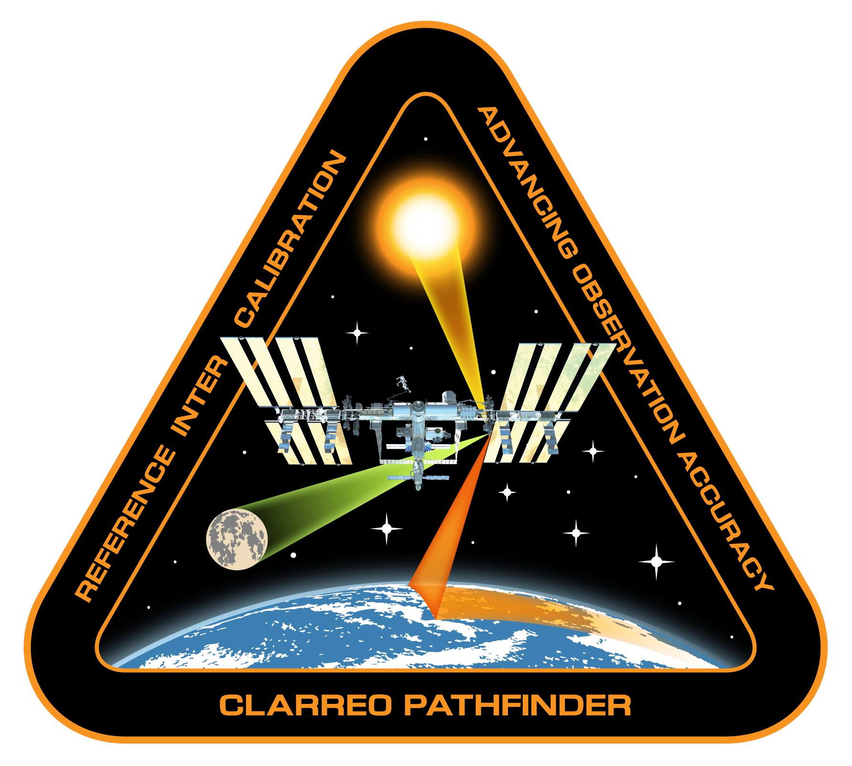
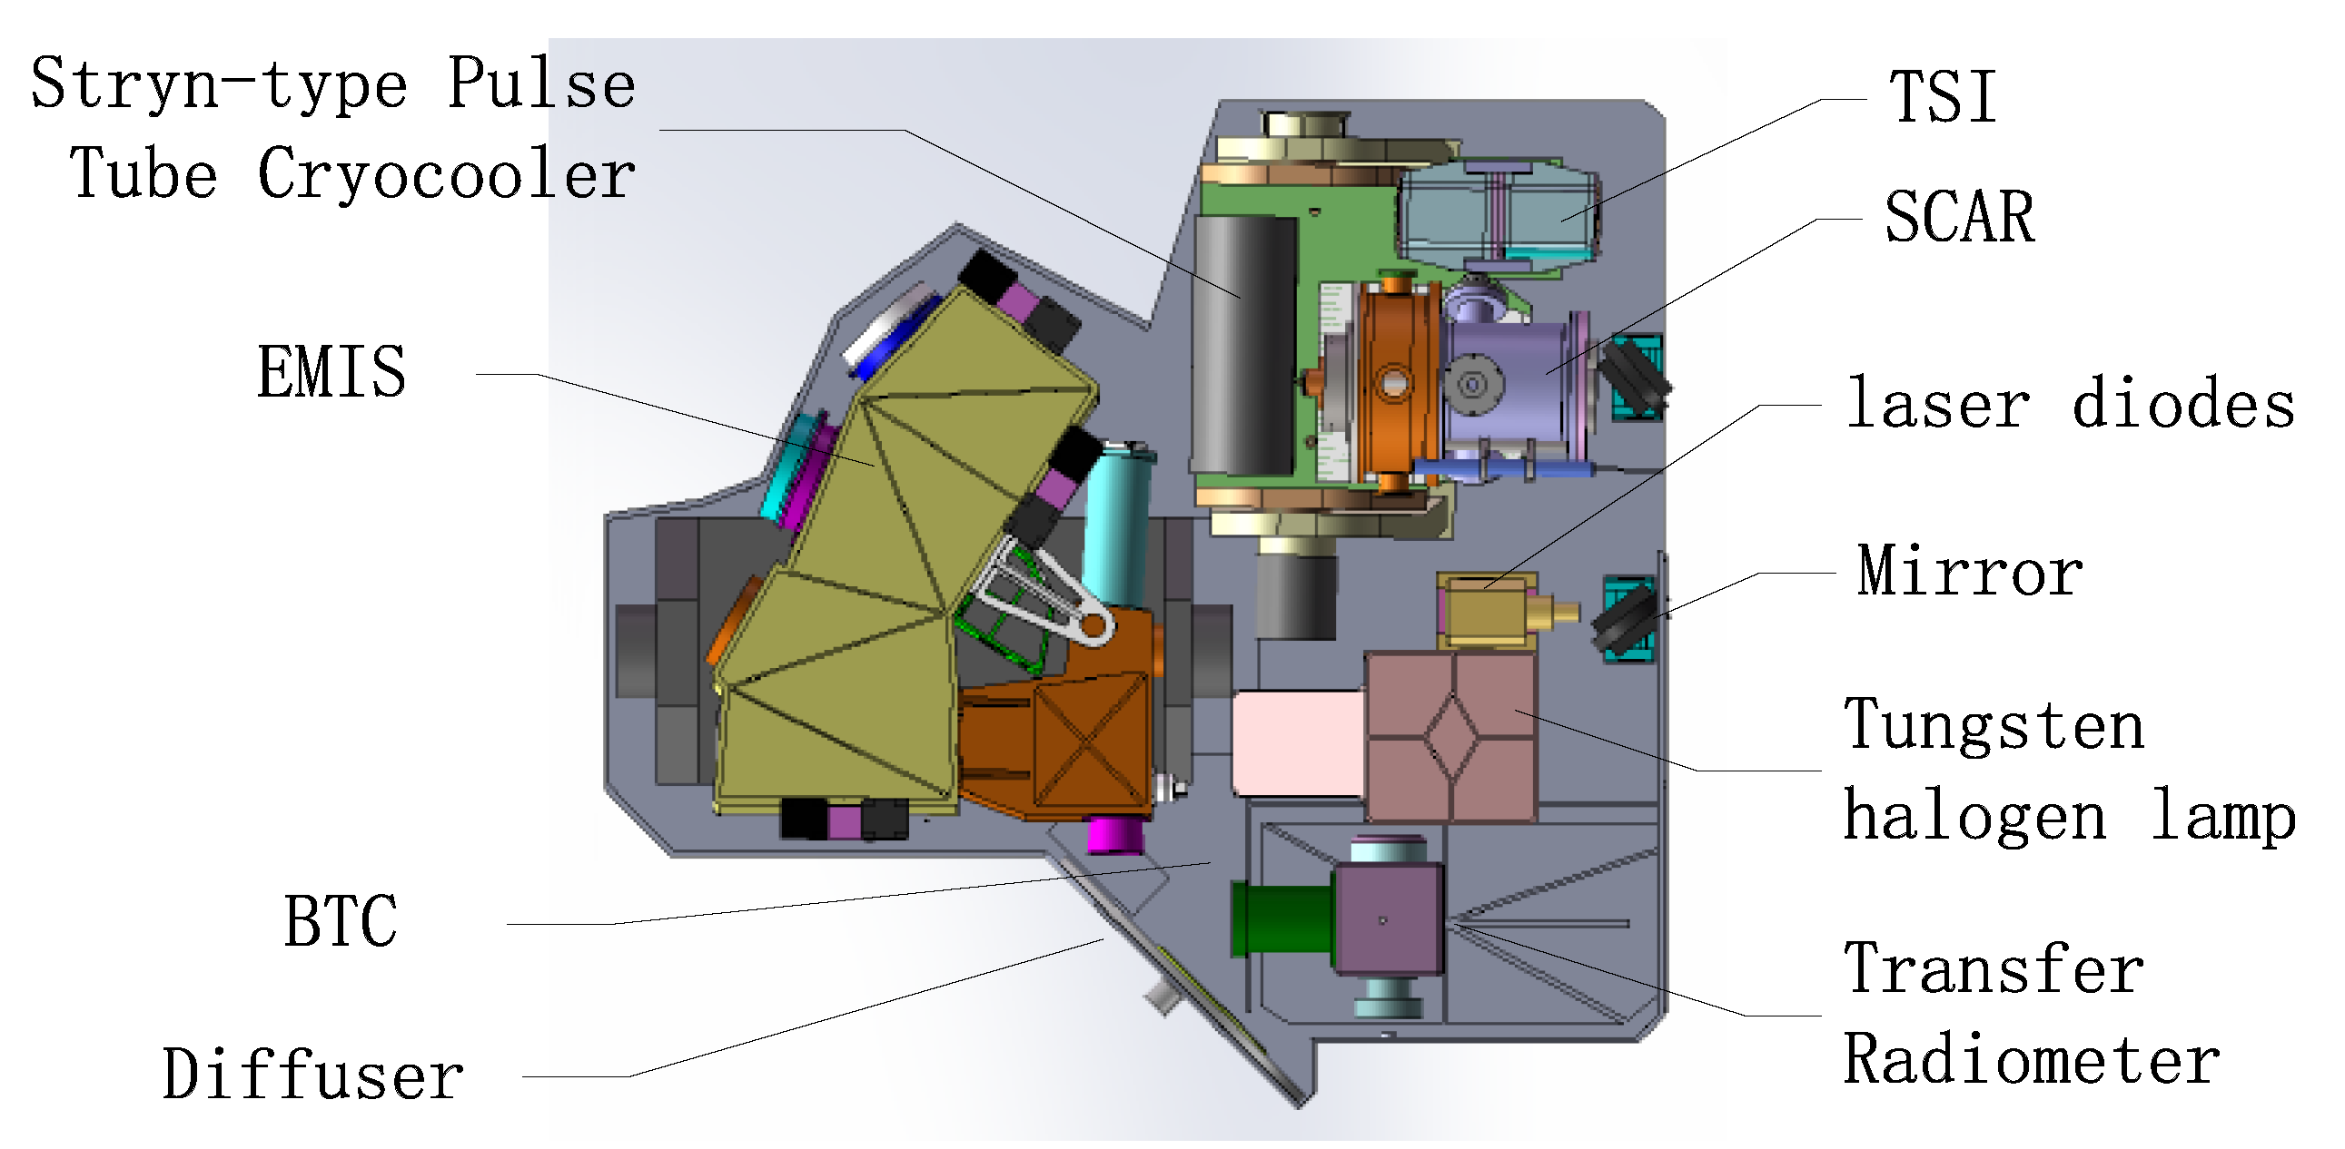
SITSats in Development: Solar Reflective
CLARREO PATHFINDER - NASA
TRUTHS - ESA
LIBRA - CMA

Slide 5
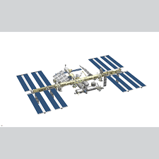
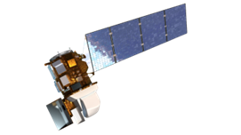
Motivation for SITSats
Desire for ‘Reference/Fiducial’ data that enable unequivocal change detection in relatively short time-scales and mitigate ‘data gaps’ (particularly for climate)
- Robust, transparent quantified evidence of traceability to a reference (ideally SI) - ‘QA4EO’
- Small comprehensively evaluated uncertainties
- Allowing ‘stability’ criteria for climate to be robustly tied to invariant reference (SI)
‘System of systems’ Integrated EO data, interoperable/harmonised
knowledge of/removal of biases
- ARD
- SI-Traceability provides unambiguous trust, space agency agnostic, longevity
New space – reliance on post-launch calibration, no on-board calibration
- Reduced cost, complementary observations (temporal/spatial coverage)
- Level playing field, maximal utilisation of investments and assets
CEOS/GSICS initiatives to establish international references and SI-Traceability
- Coherent, comprehensive/flexible, reliable anchor to well-established methods
- Mimics calibration methodologies of all terrestrial ‘industries’
- Provides a clear label of a specific sensor property but generic to ‘application’
Space-based Intercalibration

Slide 6
Rationale for Task Group
Recognition, visibility of the new class of Instrument to senior levels in space agencies & EO community
- Noting at least 3 SITSats are currently under-development from different continents
Similar to CEOS-VCs – coordinate, where appropriate, to facilitate commonality of purpose (shared vision)
- Maximal utilisation of resources
- Continuity of ‘service’ (data, coordination of launches)
- Internationally integrated ‘users’, data source agnostic tools
- Advocacy from an international ‘multi-agency’ perspective
- Lessons learnt – enabling new missions/agencies
- Value > sum of parts
Establish an agreed minimal set of definitions and principles to distinguish SITSats and their utilisation
- Independent of application domain or technology
Seek to build a common user/customer base, transcending individual missions
- Value/necessity for achieving GEOSS ‘fit for purpose’ solutions to needs of climate & society

Slide 7
Task Group Objectives
Establish clear definitions of what constitutes a SITSat and the minimal requirements needed to evidence this status
Serve as a forum for agencies developing/planning SITSat missions to share experiences and knowledge
Discuss collaboration opportunities, joint cal/val activities, campaigns, and data sharing
Provide an opportunity for mission coordination, gap analyses, efficient tasking, and acquisition planning
Facilitate coordination on technical topics, reporting of uncertainty and traceability information, interoperability, and methods of dissemination
Aim for a systems-based approach along the lines of a CEOS Virtual Constellation, rather than missions being developed and operated in isolation

Slide 8
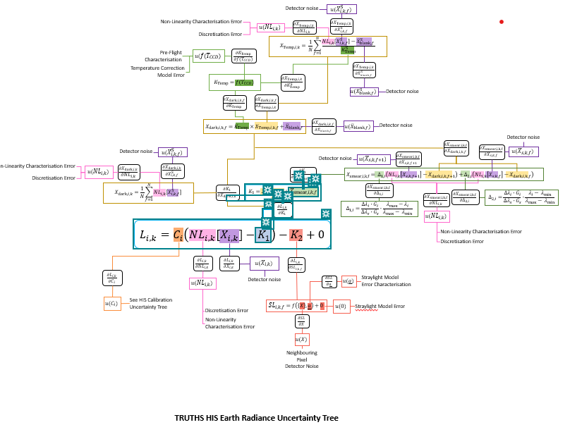
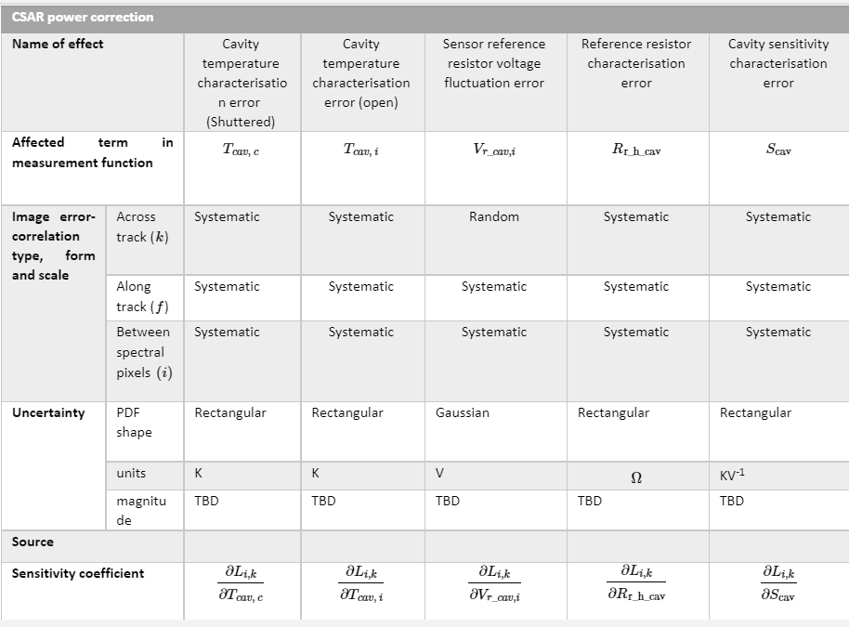
Evidincing Traceability/Uncertainty
FIDUCEO-like – TRUTHS Radiance
‘effects table’ for each error source
Fiduceo like analysis of end to end traceability and uncertainties – A potential example

Slide 9
Task Group Deliverables
Establish a clear definition of what constitutes a SITSat and minimal requirements needed to evidence this status
- How and what to present as Uncertainty/SI-traceability evidence (standardized content and/or format)
Develop a roadmap (whitepaper) of what a SITSat enabled observing system looks like
Data sharing based on a systems approach
- Common (interoperable?) reporting/archive grid for climate? (Spectral/spatial)
- Common Grid for S2S calibration?
- Format – what info to report and how?
- Mirrored data stores/access?
- Minimal set of common ‘targets’ (comparison/gap filling etc)
Communications strategy for awareness raising / key messages / utility for observing system / integrated multi-SITSat observing system

Slide 10
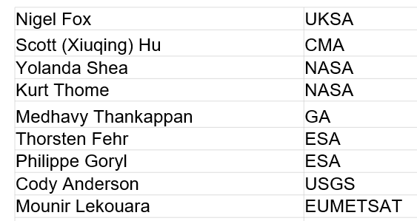
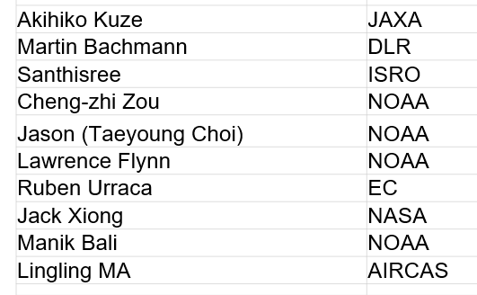
Task Group Members

Slide 11
Communications: CEOS Cal/Val portal SITSat group page
Potential Content
Define SITSats and why they are important for global climate observing system
How to evidence it is a SITSat – Traceability & Uncertainty
How they can transfer calibrations – Link to full cal val architecture – expected performance improvement
What they don’t do i.e. cannot correct without assumptions of sensor under test
Purpose of the SITSat group
SITSat group members & how to contact the group
Overview of SITSats in development/planned & expected operational timeframes
Future: Past and upcoming group activities (meetings, etc)
Future: Relevant Documentation (To be created by this group)
General
Key simple common messages for end of a talk or opportune meeting
Poster for common useage

Slide 12
Next steps
Approx 3 Virtual 0.5 day meetings a year + 1 in person (tied to other event if possible)
Establish CalVal portal page and wiki for common development by team
Membership (CEOS/GSICS agencies or representatives of)
No critical urgency to deliver objectives but Communication strategy relatively high priority
- clarity on what a SITSat is! and what differentiates it from other satellites
- common simple key messages
- maximise short term opportunity to coordinate (CPF & TRUTHS in particular)
- Develop white paper on what a SITSat enabled observing system looks like

