Slide 1
Harmonizing the use of GSICS products using Pytroll/Satpy?
Sauli Joro
Optical Imagery Competence Area Manager
GSICS Annual meeting, 11-15 March 2024
Darmstadt, Germany

Slide 2
Agenda
GSICS products at EUMETSAT
SEVIRI L1.5 and FCI L1c products
What is Pytroll/Satpy?
Short introduction to Pytroll and Satpy
How Satpy can help?
Example of applying and using GSICS calibration with SEVIRI data
Conclusions and outlook

Slide 3
GSICS products at EUMETSAT
MSG SEVIRI
SEVIRI L1.5 files provide GSICS calibration coefficients in data header
References:
MSG Level 1.5 Image Data Format Description
https://www-cdn.eumetsat.int/files/2020-05/pdf_ten_05105_msg_img_data.pdf
User Guide for EUMETSAT GSICS Corrections for inter-calibration of Meteosat-SEVIRI with Metop-IASI
https://www-cdn.eumetsat.int/files/2020-08/User%20Guide%20for%20EUMETSAT%20GSICS%20Corrections%20for%20inter-calibration%20of%20Meteosat-SEVIRI%20with%20Metop-IASI.pdf
15_DATA_HEADER/RadiometricProcessing/MPEFCalFeedBack/GSICSCalCoeff
15_DATA_HEADER/RadiometricProcessing/MPEFCalFeedBack/GSICSOffsetCount

Slide 4
GSICS products at EUMETSAT
MTG FCI
FCI L1c files have a <place_holder> for GSICS calibration coefficients in data trailer, coefficients shall be provided in the first years of operations
Reference:
MTG FCI L1 Product User Guide [FCIL1PUG]
https://www-cdn.eumetsat.int/files/2020-07/pdf_mtg_fci_l1_pug.pdf
/data/<channel_group>/external_calibration_coefficients
GSICS products are also available online
- Near Real Time Corrections (NTRC)
- Re-Analysis Corrections (RAC)
Reference:
https://gsics.eumetsat.int/thredds/eumetsatProducts.html

Slide 5
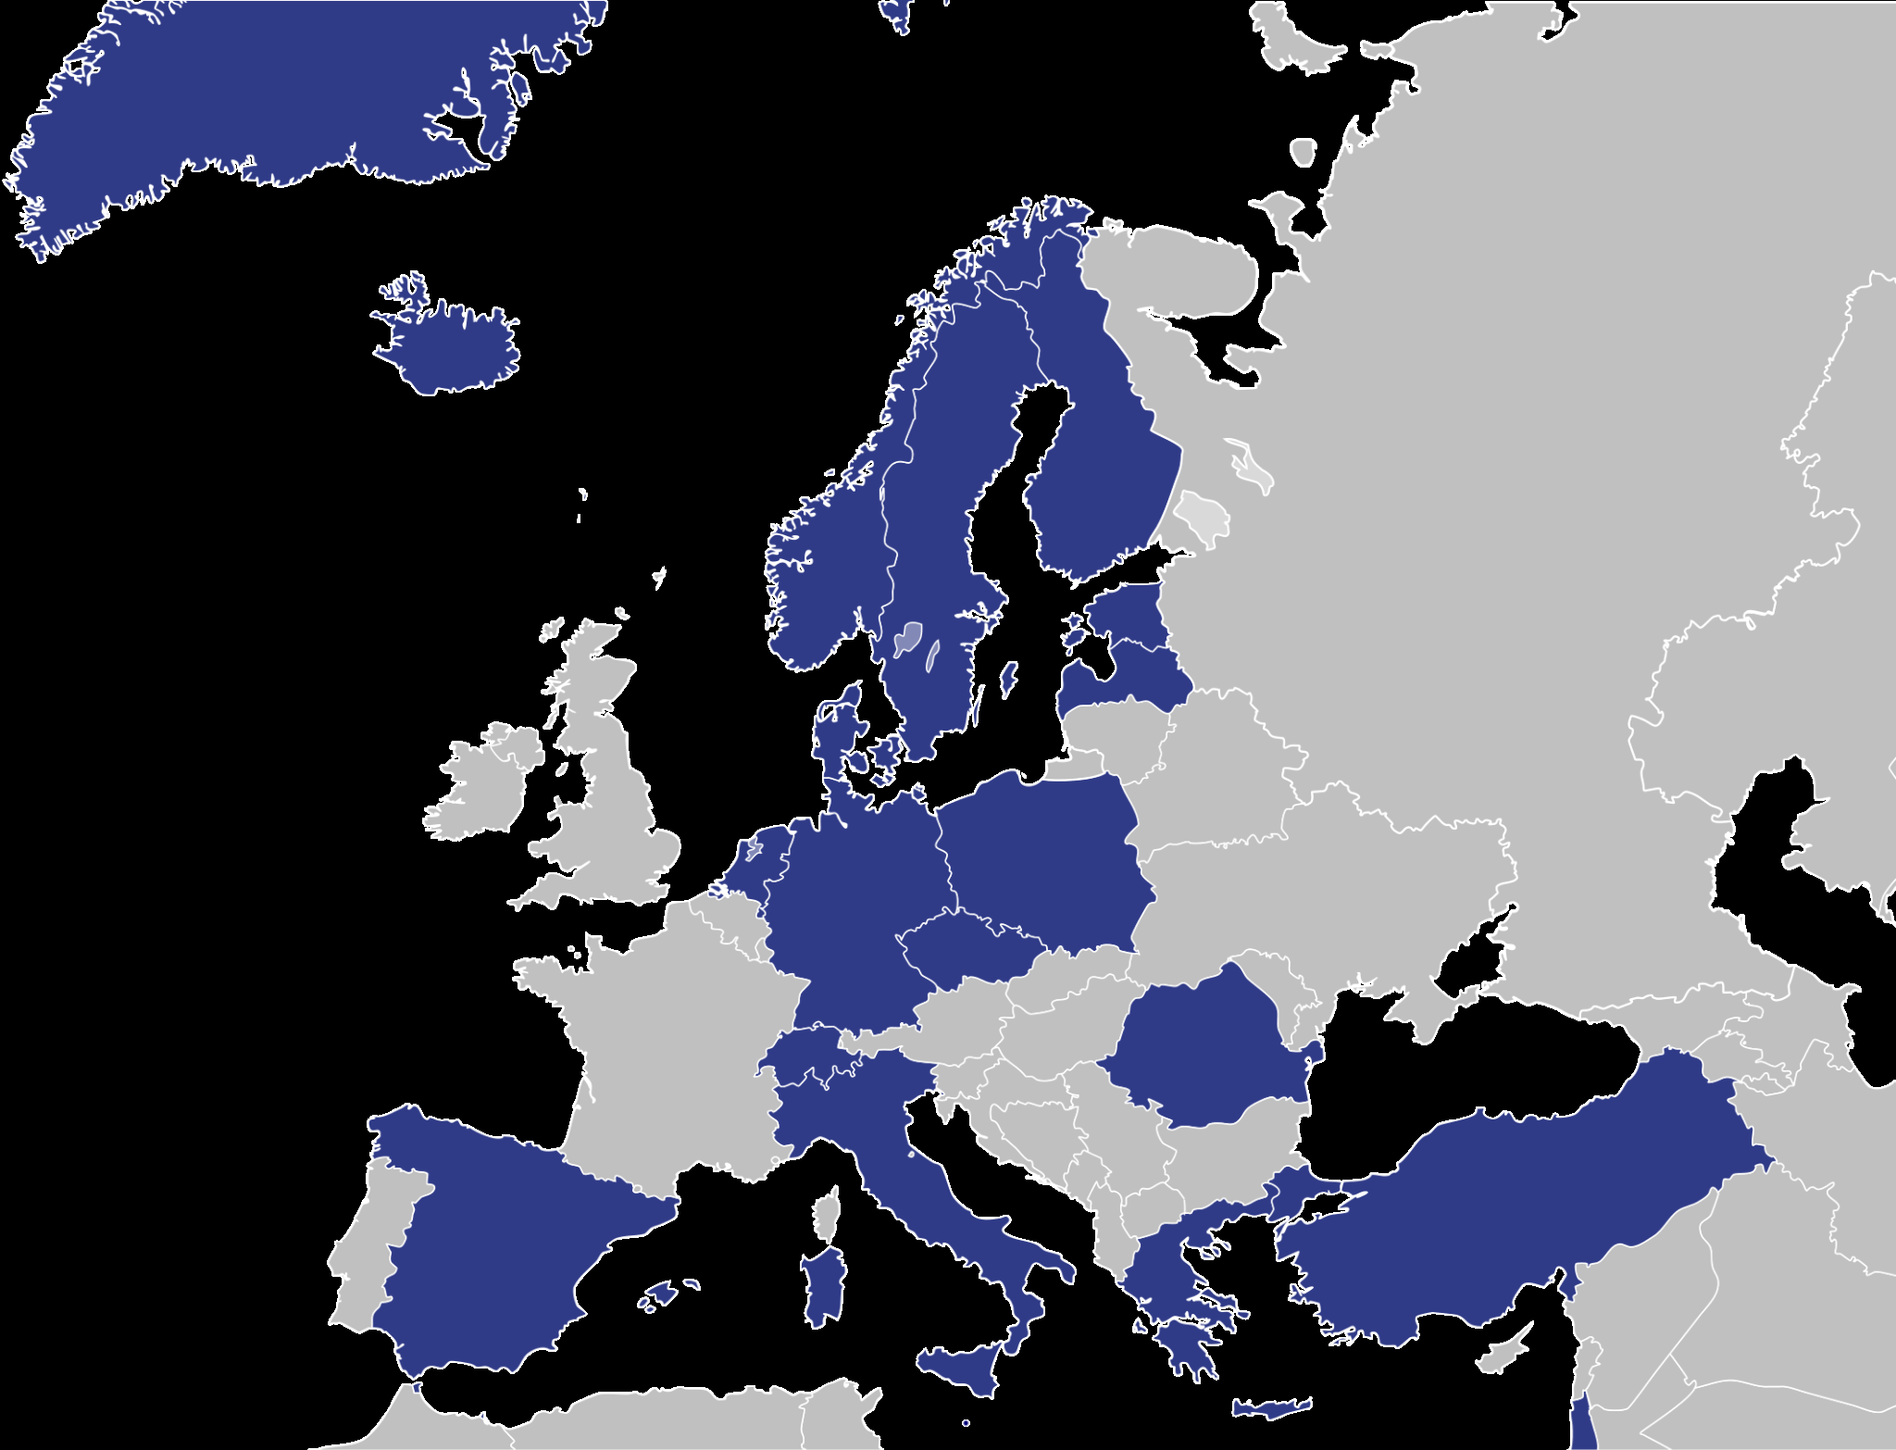
What is Pytroll/Satpy?
Pytroll
Easy to use, modular, free and open source python framework for the processing of earth observation satellite data
Provided python packages are designed to be used both in R&D environments and in 24/7 operational production
Operationally used in many institutes and organizations across Europe and North and South America
Keys to success:
Friendly and active community (no explicit funding)
“Memorandum of Understanding” signed by:
SMHI, FMI, KNMI, DWD, MeteoSwiss, MET Norway
- Any contribution(s) to the project is highly valued
Reference:
https://pytroll.github.io/

Slide 6
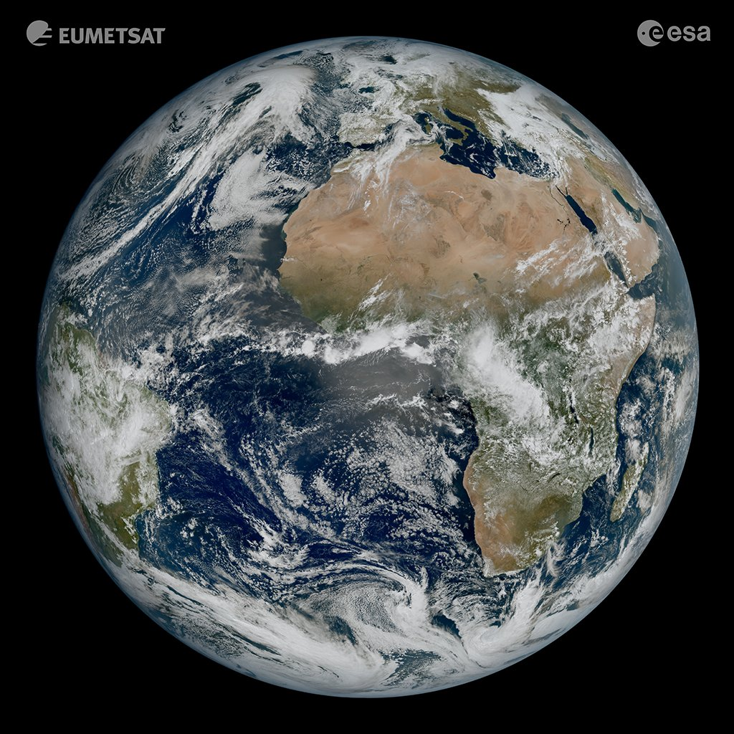
What is Pytroll/Satpy?
Satpy
Pytroll package providing high level interface for satellite data processing supporting
Any type of satellite mission, i.e. GEO, LEO and HEO
More than 90 satellite data formats, including many mission specific binary formats, e.g. SEVIRI
Reading and processing remote files
Many built in composites and corrections for, e.g. atmospheric and geometric effects
Resampling data to any PROJ.4 projection
And more… contributions are welcome!
FCI “first image” was processed using Satpy
Reference:
https://satpy.readthedocs.io/
FCI True Color
18 March 2023 11:50 UTC

Slide 7
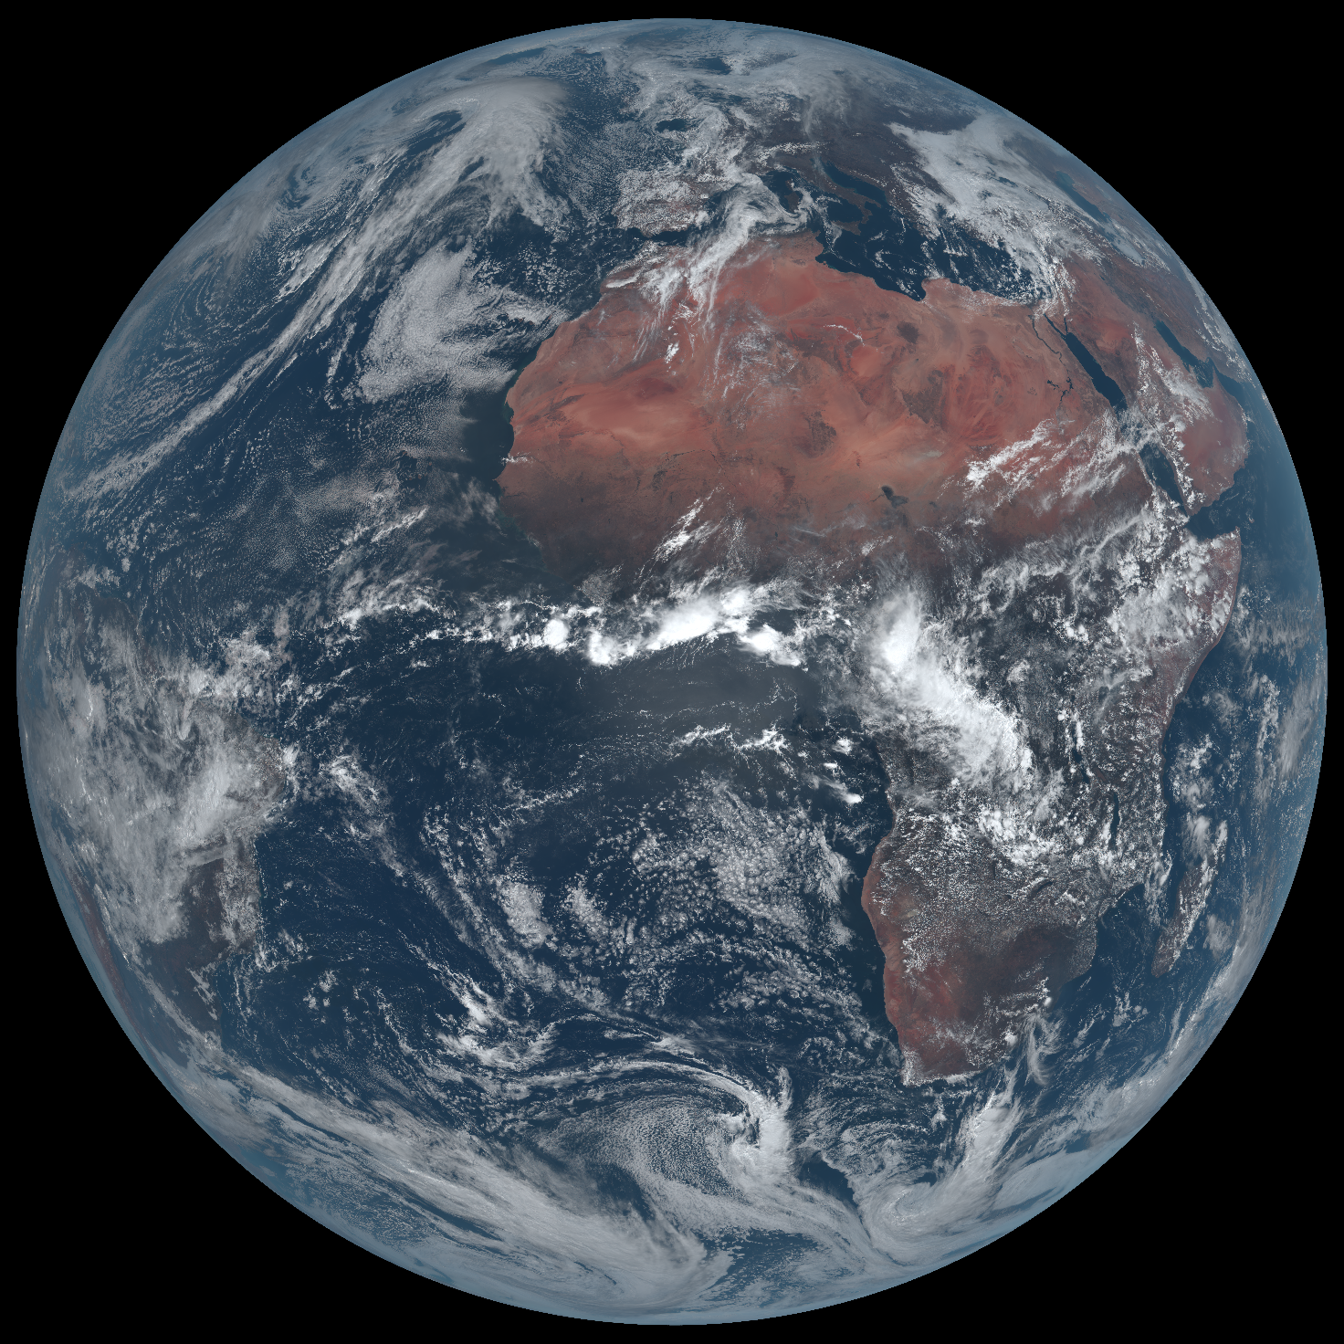
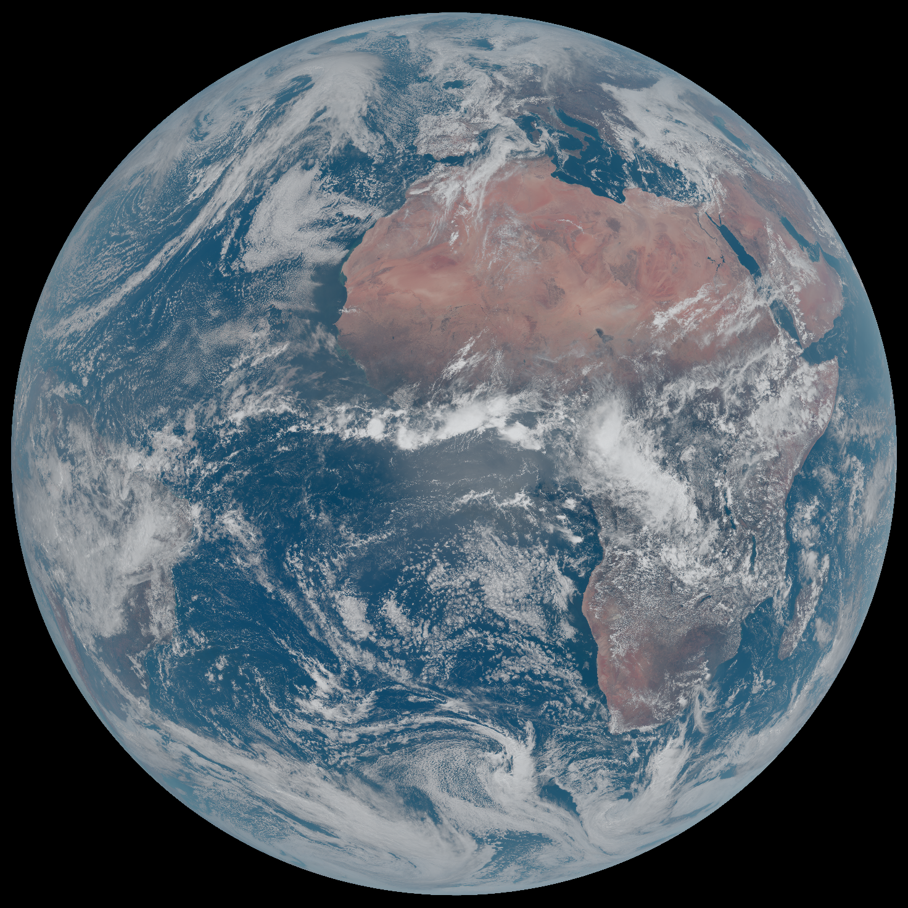
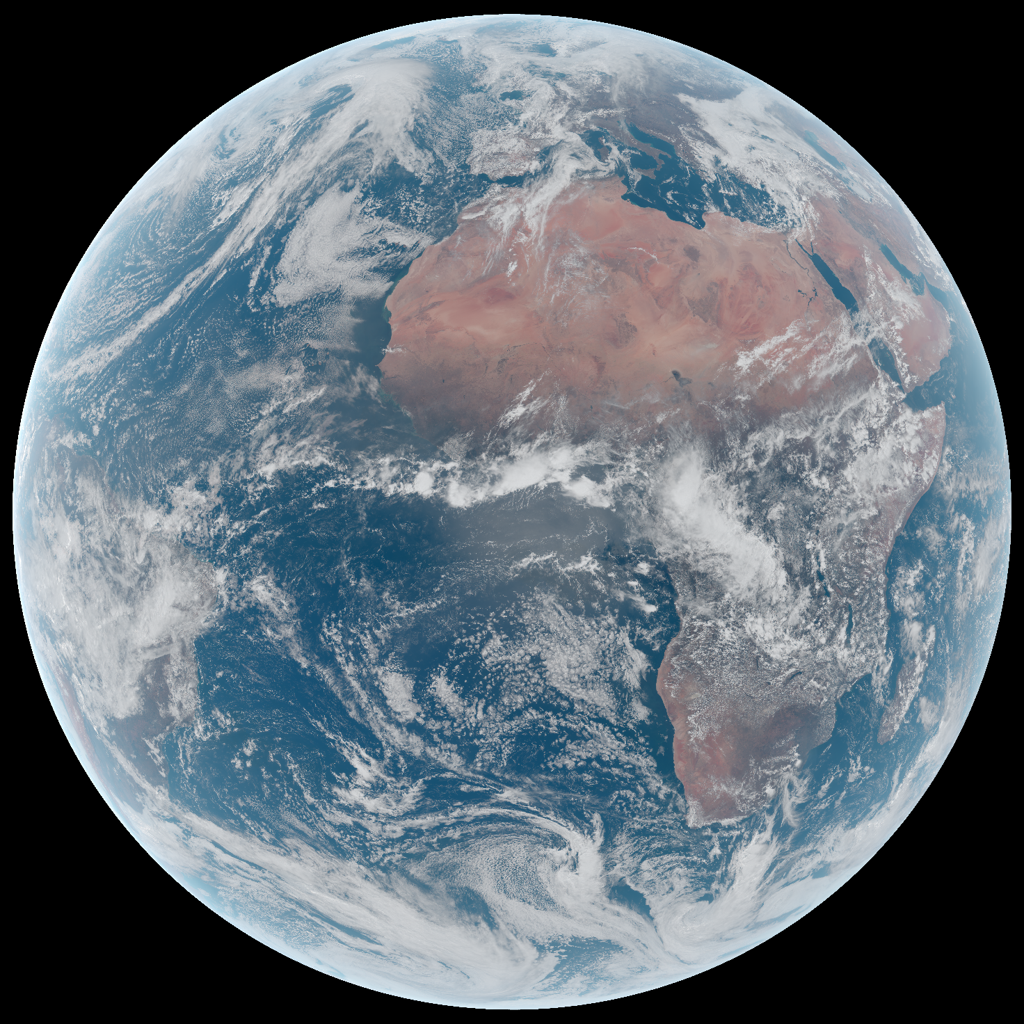
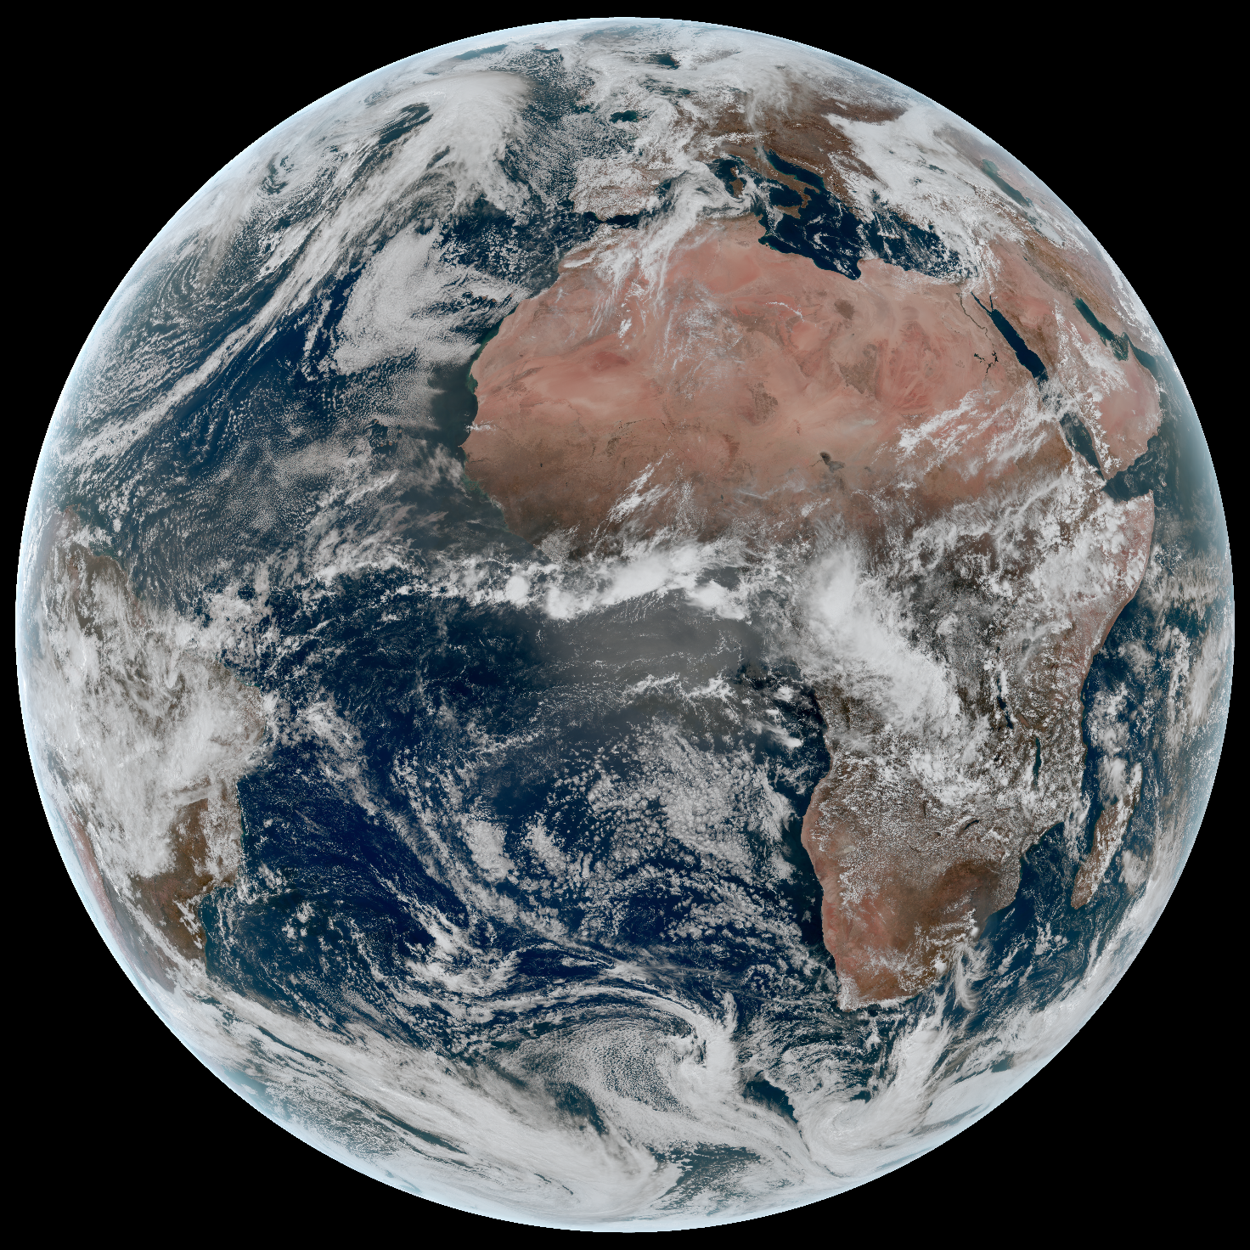
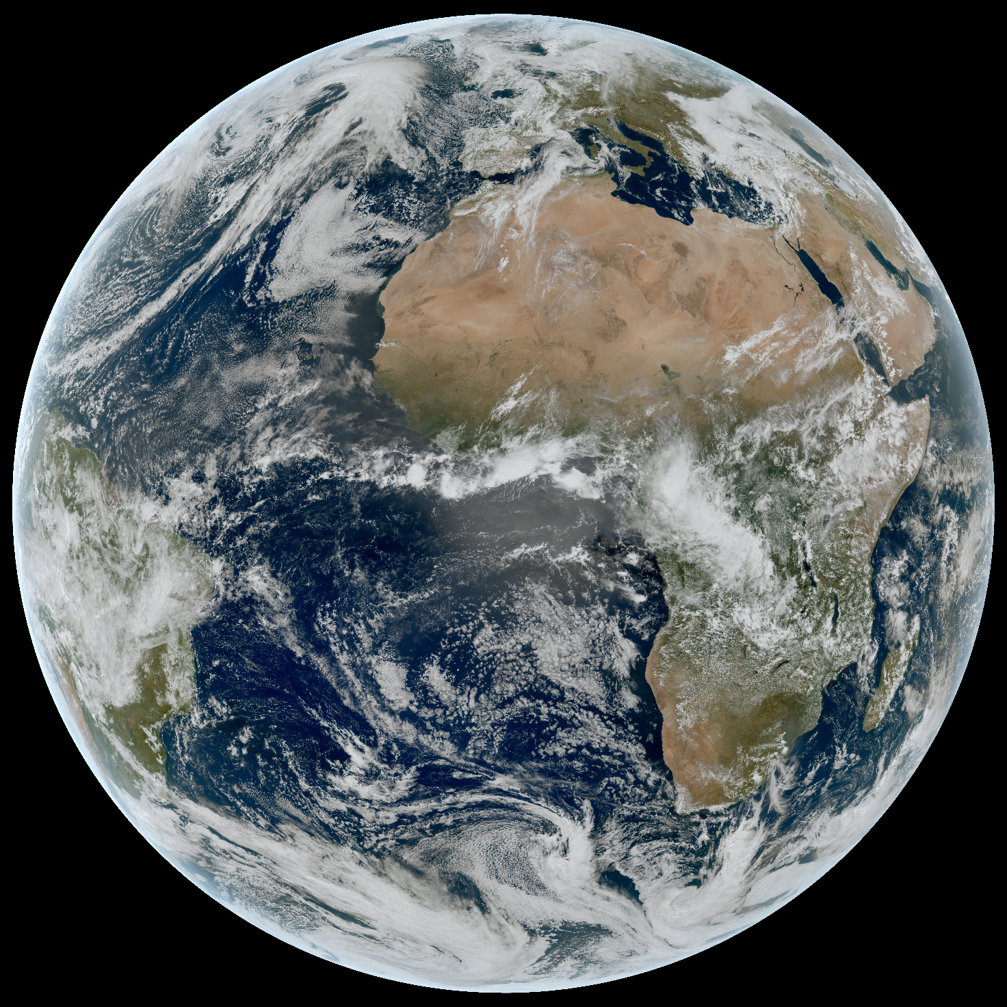
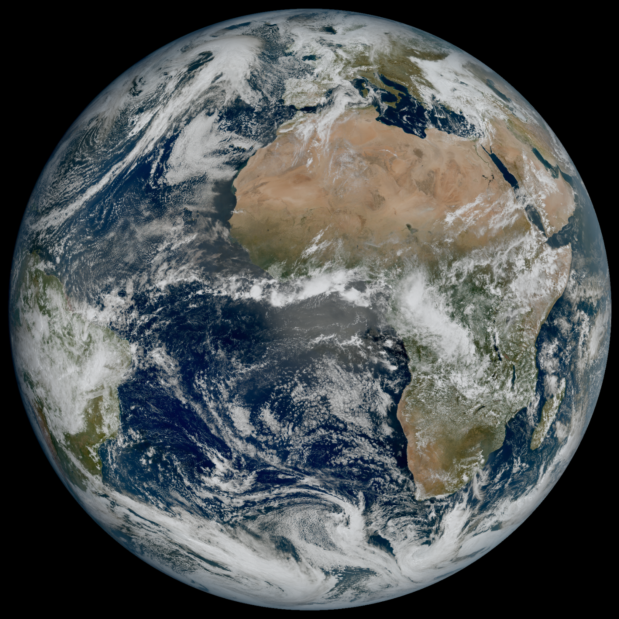
How the image was made? – Satpy modifiers
Level-1 Data Package processed by TAS/ESA and delivered to EUMETSAT for scientific processing
Step 1: Raw RGB
Step 2: Log Scaling
Step 3: Sun Zenith Correction
Step 4: Rayleigh Correction
Step 5: NDVI Hybrid Correction
Step 6: Sun Zenith terminator reduction

Slide 8
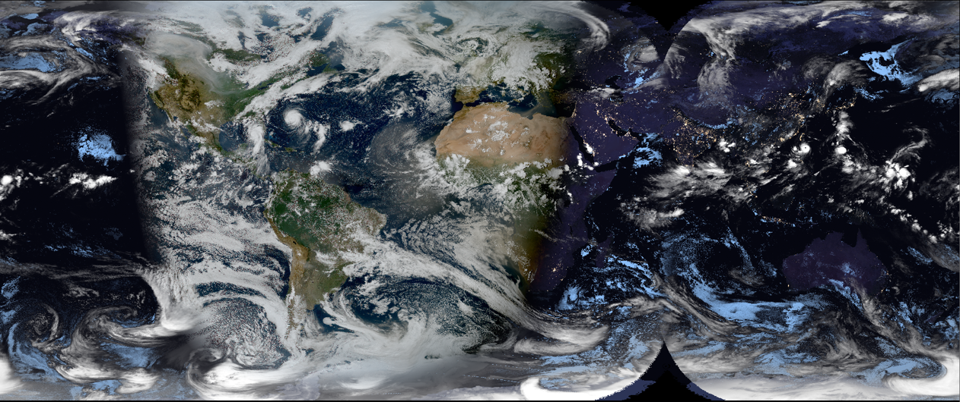
How Satpy can help?
Change management and coordination between institutes and organizations is easier for software, especially for open source software, than for ground segment processing facilities and product format specifications
Satpy provides unified interface for satellite data processing regardless of the file format (netCDF, BUFR, GRIB, HDF5, binary, etc…) or data location (local files, cloud)
Use of GSICS calibration coefficients is already available for MSG SEVIRI and GEO-Kompsat AMI readers, same concept can be used for other instruments and readers
GeoColor world composite using ABI, FCI, and AHI – processed with Satpy

Slide 9
Satpy example – Using GCIS calibration
import dask.array as da
from satpy import Scene
# Define path to data and select desired datasets
path = "/path/to/data"
filename = [f"{path}/MSG3-SEVI-MSG15-0100-NA-20240313115741.601000000Z-NA.nat"]
datasets = ["VIS006", "VIS008", "IR_108", "IR_134"]
# Create Scene-object using GSICS calibration
scn = Scene(filenames=filename, reader="seviri_l1b_native",
reader_kwargs={"calib_mode": "GSICS"})
# Load and show data
scn.load(datasets, upper_right_corner="NE")
scn.show("IR_134")
Reference:
https://satpy.readthedocs.io/en/stable/reading.html#calibration

Slide 10
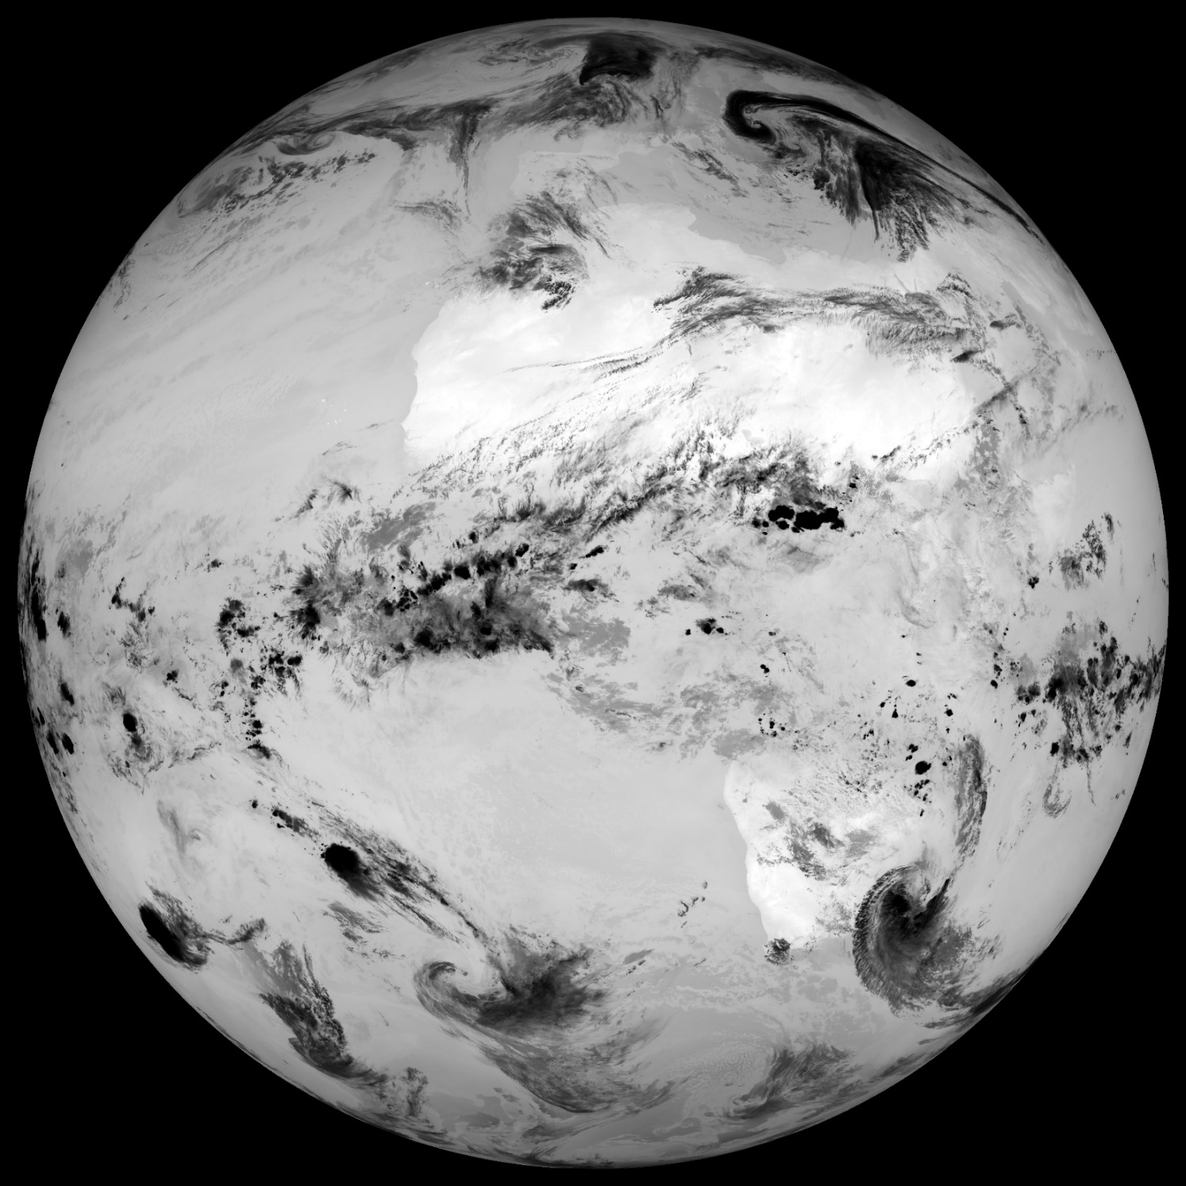
Satpy example – IR13.4 channel with GSICS
SEVIRI IR13.4
GSICS calibration
13 March 2024 11:45 UTC

Slide 11
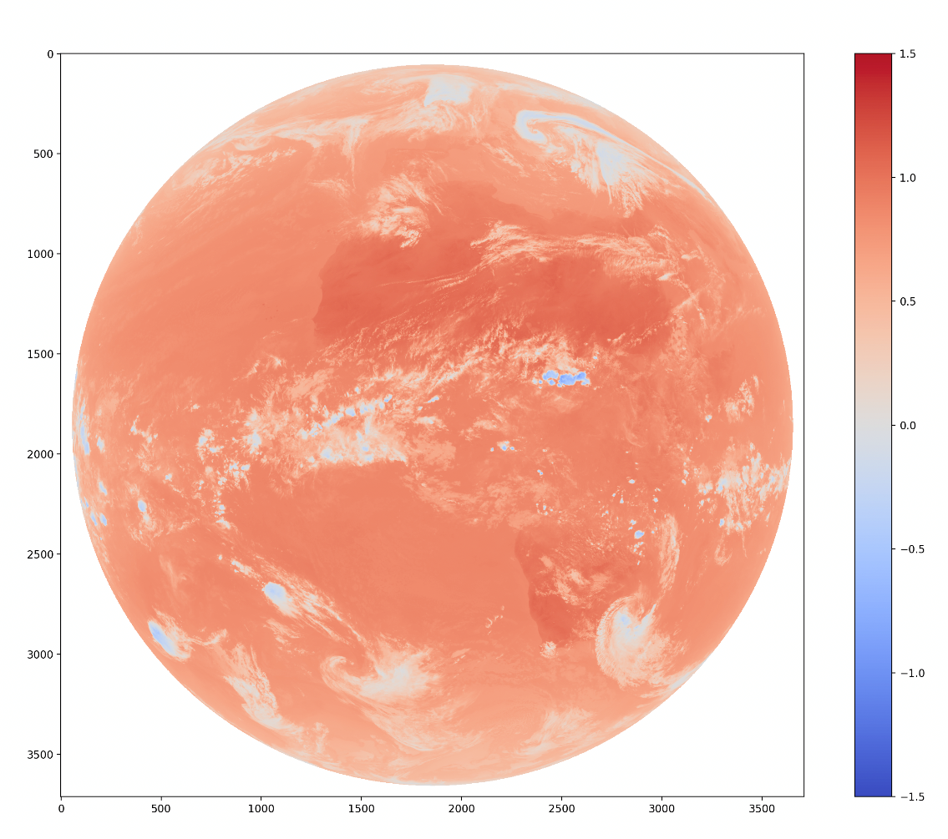
Satpy example – Calibration comparison
SEVIRI IR13.4
Nominal calibration
13 March 2024 11:45 UTC
SEVIRI IR13.4
Difference: GSICS - Nominal
13 March 2024 11:45 UTC
SEVIRI IR13.4
GSICS calibration
13 March 2024 11:45 UTC
min: 181.48, max: 288.00, mean: 259.38
min: -1.08, max: 1.11, mean: 0.71
min: 180.40, max: 289.11, mean: 260.09

Slide 12
Satpy example – Continued workflow
import dask.array as da
from satpy import Scene
# Define path to data and select desired datasets
path = "/path/to/data"
filename = [f"{path}/MSG3-SEVI-MSG15-0100-NA-20240313115741.601000000Z-NA.nat"]
datasets = ["VIS006", "VIS008", "IR_108", "IR_134"]
# Create Scene-object using GSICS calibration
scn = Scene(filenames=filename, reader="seviri_l1b_native",
reader_kwargs={"calib_mode": "GSICS"})
# Load and show data
scn.load(datasets, upper_right_corner="NE")
scn.show("IR_134")
# Python workflow for further processing
ir134 = scn[("IR_134"]
minv = da.nanmin(ir134).compute()
print(f"stats: {minv = }")
# Or save the data to CF-compliant netCDF and continue with
# your preferred software
scn.save_datasets(writer='cf', datasets=datasets, filename='seviri_test.nc',
exclude_attrs=['raw_metadata'])
Reference:
https://satpy.readthedocs.io/en/stable/api/satpy.writers.cf_writer.html#module-satpy.writers.cf_writer

Slide 13
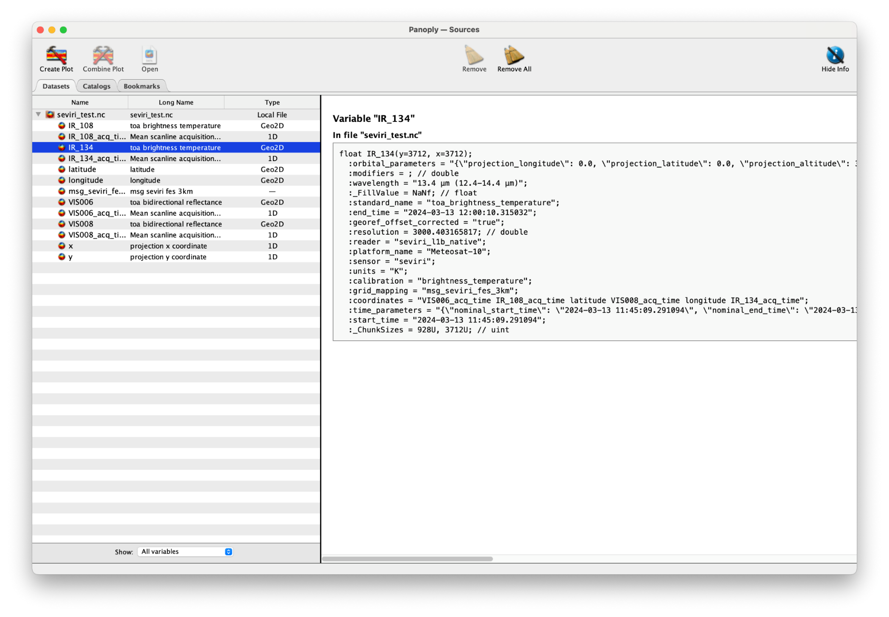
Satpy example – CF compliant netCDF

Slide 14
Conclusions and outlook
Satpy
Offers a simple, easy to use interface to read and process satellite data
Use of external/GSICS calibration already implemented in some readers, same concept and logic could be extended to other readers
If needed, can be used “only” as pre-processing step and save to CF-compliant netCDF-file for further processing
Recommendations
GSICS products/coefficients should preferably be provided within L1-files
+ eliminates user confusion and ambiguity
+ usage is very easy to implement at software level
- what if reprocessing is needed?
…or via clearly defined service/API
+ agencies can recommend a GSICS product for a given L1 product
over a given period
- L1 metadata needs to be "comprehensive" so that an accurate query can
be constructed
- requires internet connection?
- speed if/when processing large datasets?

Slide 15
Thank you!
Questions are welcome.

Slide 16
Satpy example – Calibration comparison
import matplotlib.pyplot as plt
import dask.array as da
from satpy import Scene
from satpy.dataset import combine_metadata
path = "/path/to/data"
filename = [f"{path}/MSG3-SEVI-MSG15-0100-NA-20240313115741.601000000Z-NA.nat"]
datasets = ["VIS006", "VIS008", "IR_108", "IR_134"]dset = "IR_134"
datasets = ["VIS006", "VIS008", "IR_108", "IR_134"]
dset = "IR_134"
scn_nominal = Scene(filenames=filename, reader="seviri_l1b_native")
scn_nominal.load(datasets, upper_right_corner="NE")
scn_gsics = Scene(filenames=filename, reader="seviri_l1b_native", reader_kwargs={"calib_mode": "GSICS"})
scn_gsics.load(datasets, upper_right_corner="NE")
diff = scn_gsics[dset] - scn_nominal[dset]
diff.attrs = combine_metadata( scn_gsics[dset], scn_nominal[dset])
scn_gsics["diff"] = diff
plt.figure()
plt.imshow(diff, cmap="coolwarm", vmin=-1.5, vmax=1.5)
plt.colorbar()
plt.show()

