Slide 1
GSICS State of Observing System (SOS) Reports – Proposed Revisions following 2024 Annual Meeting agenda items 2d + 5l discussions Content agreed during discussion in black Items open for Exec Panel guidance in red
Tim Hewison (EUMETSAT) Manik Bali (UMD@NOAA)
Fangfang Yu (UMD@NOAA)

Slide 2
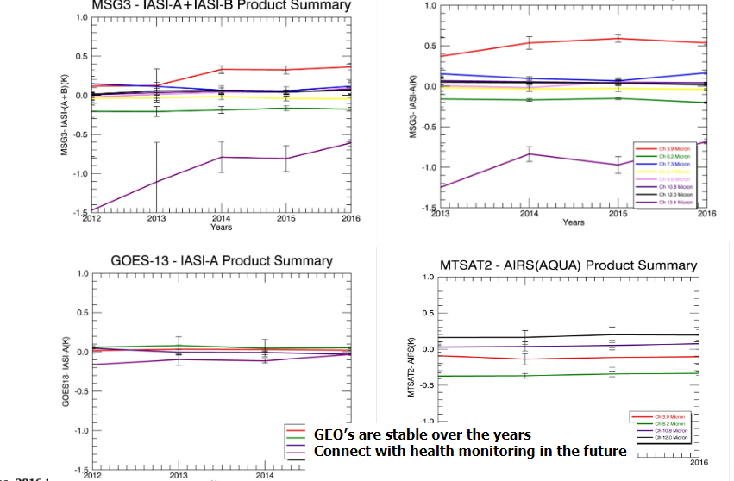
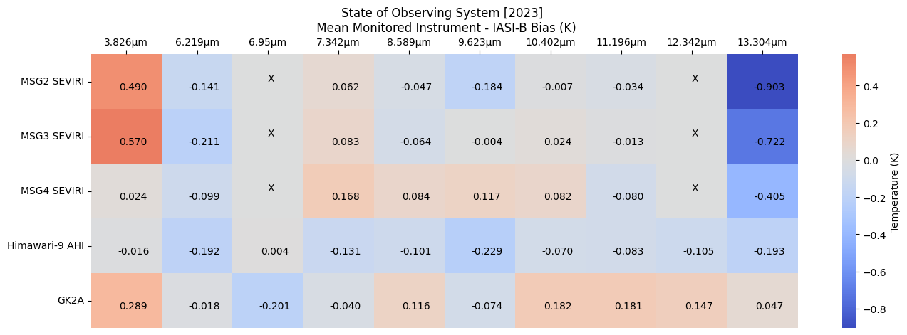
State of Observing System Report
Initial Concept GCC EP-Report 2016
Contemporary SOS Report
EP-18.A03:
Goal: to expand set of instruments and give a comprehensive view of the Instrument performance across wide range of space agencies
While the report was widely appreciated, it involved significant efforts on GRWG as well as agencies to collect bias summaries from agencies.
Instruments performance summaries in multiple wavelengths across agencies were difficult to present, follow and provide conclusions.
Limited Instruments picked up from Product Catalog
Simplify charts and automate bias collection
Python script collects biases from GPRC and Product Catalog
Ideas in SOS Special Issue of GSICS Newsletter

Slide 3
State of Observing System Reports
Types of SOS Report
Monitored Instruments - Instruments monitored with the GSICS references
Generated by Agency operating instrument/response for L1 data
GSICS references – based on inter-comparisons with other references
Generated by Agency operating instrument/response for L1 data
Summary of bias for all monitored instruments in a class (e.g. GEO imagers IR)
“Heat Map” – generated by GCC, based on inputs from agencies SOS Reports
Period = Calendar Year
allows time to generate report by annual meeting + more useful for users
Publication
EP chair recommends transferring GSICS SOS report to document format (open action)
Link from GSICS Product Catalog + Instrument Landing Pages
On GCC webpage?

Slide 4
State of Observing System Report
Instrument/activity status report
Operational periods
Major events (changes/outages)
Summarize the accuracy over the past year:
Mean Bias
with respect to GSICS reference(s) of GPRC choice
Include link to Reference SOS Report
Variance (Standard Deviation)
Uncertainty (typical value/median) – typically << variance
Optionally:
Provide the drift rate, if it exists
Time Series to visualise calibration stability over mission lifetime

Slide 5
Example SOS Reports
EUMETSAT MSG-2/SEVIRI IR channels wrt IASI-B

Slide 6
Satellite/Instrument Summary - GEO
Hyperlinks on instrument names navigate to the Calibration Landing Page
Satellite (status) |  | Location | Launch date | EO instruments
Meteosat-9 | Op | 45.5°E | 2005-12-21 | SEVIRI | GERB
Meteosat-10 | RSS | 9.5°- 0°E | 2012-07-05 | SEVIRI | GERB
Meteosat-11 | Op | 0 - 9.5°E | 2015-07-15 | SEVIRI | GERB
MTG-I1 | P | 0.0°E | 2022-12-15 | FCI | LI
Satellite Status
 | Op = Operational
 | P = Pre-operational
 | B = Back-up, secondary
 | L = Limited availability
Instrument Status
 |  | Operational (or capable of)
 |  | Operational with limitations (or Standby)
 |  | Operational with Degraded Performance
 |  | Not Operational
 |  | Functional, Turned Off
Major calibration relevant events in 2023
Meteosat-10 & Meteosat-11 Swapped Full Disc – Rapid Scan 2023-03
EUMETSAT User Notification Service
No other events of interest in 2023

Slide 7
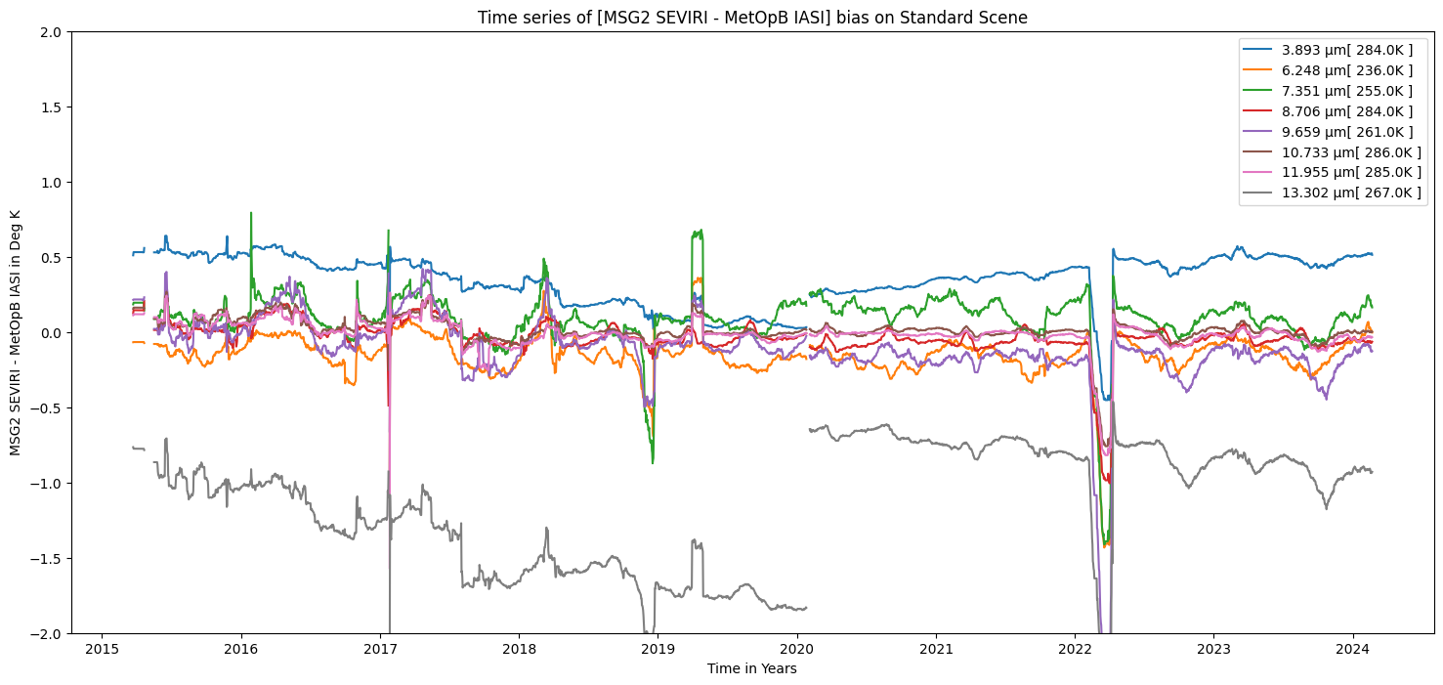
Calibration Performance: Meteosat-9/SEVIRI IR Bands
2023-01-01/12-31 | Summary Statistics of [MSG2 SEVIRI - MetOpB IASI]
 | IR3.9 | IR6.3 | IR7.2 | IR8.7 | IR9.7 | IR10.8 | IR12.0 | IR13.4
Standard Scene Temp (K) | 284.0 | 236.0 | 255.0 | 284.0 | 261.0 | 286.0 | 285.0 | 267.0
Tb Bias (K) | 0.49 | -0.14 | +0.06 | -0.04 | -0.18 | -0.01 | -0.03 | -0.90
Std Dev (K) | 0.03 | 0.08 | 0.08 | 0.04 | 0.09 | 0.04 | 0.04 | 0.09
Drift (K/Yr) | -0.07 | -0.14 | -0.17 | -0.06 | -0.19 | -0.08 | -0.08 | -0,24
Statistics over 2023 of bias at standard scenes
from Operational GSICS Re-Analysis Correction
and time series plots over lifetime of product
Calibration is now stable
Instrument Calibration Landing Page: https://www.eumetsat.int/seviri-instrument-status-calibration
GSICS Products for Meteosat/SEVIRI IR:
https://user.eumetsat.int/resources/user-guides/inter-calibration
Content generated with customised copy of GCC Colab tool
1. Summary Statistics over previous year
3. Optional Comments on Performance
4. Links (how to correct, if needed)
2. Visualise biases over mission lifetime

Slide 8
Generation of GSICS SOS Reports
Automate where possible – make it simple to generate
Encourage GPRCs to generate GSICS products for all instruments to be monitored
Even if they do not need to apply corrections (insignificant biases)
Allow use of GCC-derived Google colab tool to generate Charts & Tables
Where not possible, agencies requested to provide spreadsheet of instruments’ daily biases
A.GDWG. 20240313.6: Manik Bali to propose CF 1.6 compliant variables to agencies for storing daily biases on GPRC
Consider defining a Word template for SOS Reports
Pre-populated with tables and graphs from above tools + areas marked out for free text

Slide 9
Example Heat Maps to compare common channels of multiple instruments
Also stability?
(But to 2 d.p. + bigger fonts) Users can see which instruments/channels meet their needs

Slide 10
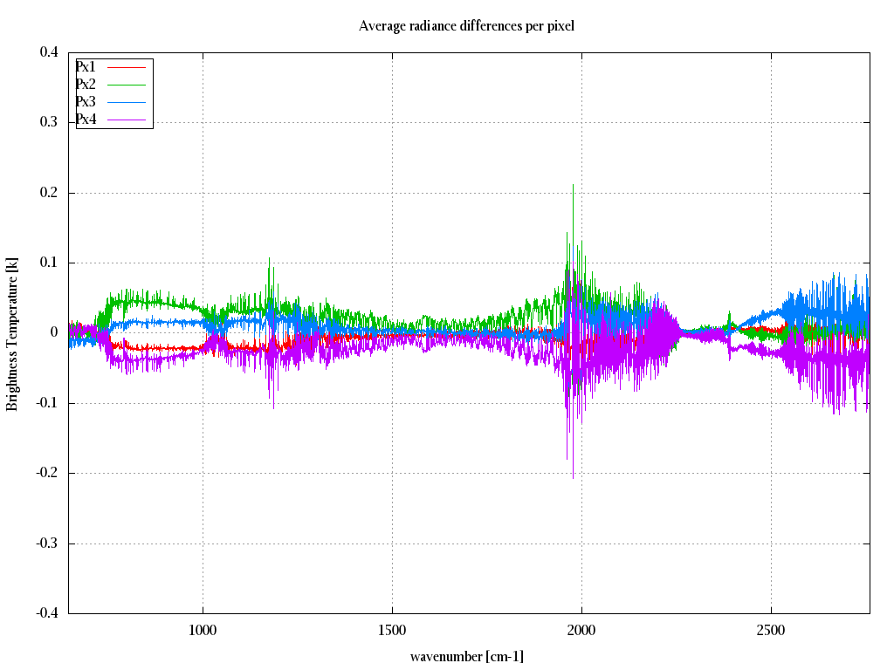
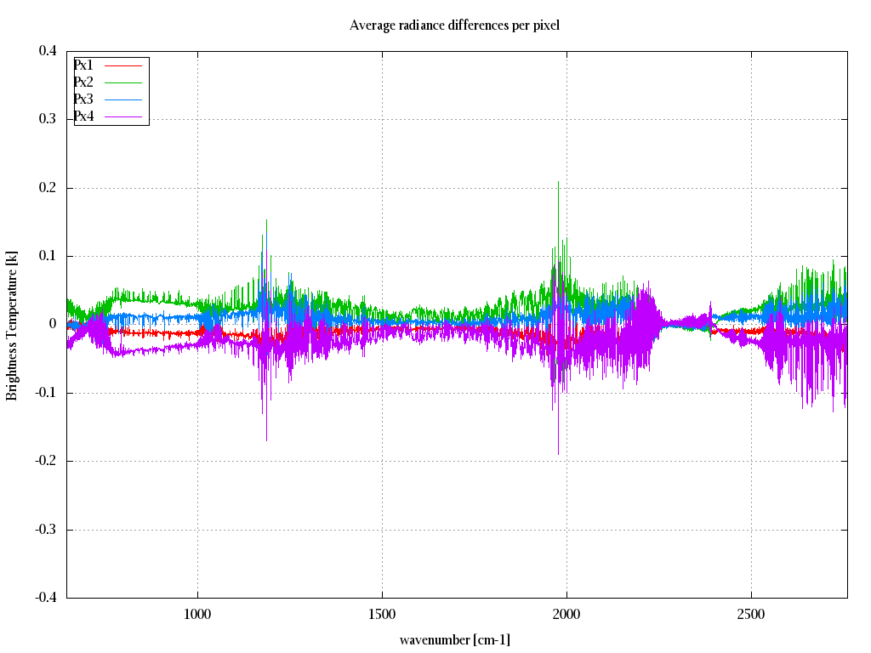
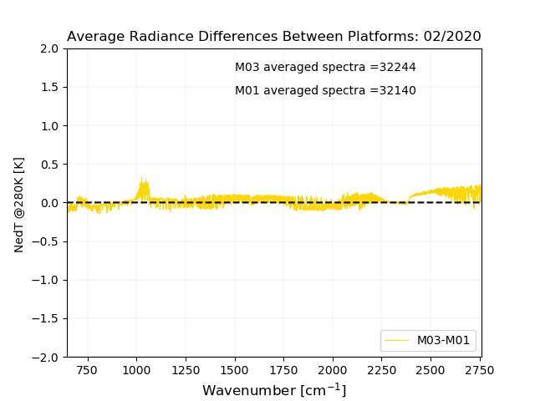
Satellite/Instrument Summary – EPS/ IASI-B and C
Both IASI instruments inter-pixel consistency in 2023 continues to be better than 0.1 K
The noise remains within 0.5K as expected
The consistency between the two instruments is better than 0.1K
IASI-B annual inter-pixel stability
IASI-C annual inter-pixel stability
(IASI-C-IASI-B) for 1 month
0.1K
-0.1K
Instrument Calibration Landing Page:
https://www.eumetsat.int/iasi-instrument-status-calibration

Slide 11
SOS Reports for GSICS Reference Instruments
To be decided by agencies generating SOS Reports for Reference Instruments:
Common algorithm(s) to compare reference instruments
E.g. SNO, Double Difference from GEO-LEO or NWP, …
Common channels to be reported
E.g. 3 selected channels per spectral band
Standard scene radiances to report biases (e.g. 1976 US Standard Atm + RTM)
Selection of Anchor Reference
Reference of Preference

Slide 12
Feedback from Exec Panel
Approval of concept, content and approach
Publication of GSICS SOS Reports on GCC website?
(in addition to Instrument Landing Pages)
Common References
Consider defining a Word template for SOS Reports
Common comparison reports - Centrally generated by GCC
For all monitored instruments in a class
e.g. Heat Maps - Mean Bias during Year + Stability?
Proposed Decision:
Agencies to provide biases of their monitored instruments in agreed format

