Slide 1

GSICS Agency Report
2024
Caroline Bès
Contributions from CNES colleagues: Aimé Meygret, Sébastien Marcq, Camille Desjardins, François Bermudo, Olivier Vandermarcq, Dimitrios Kilymis, Elsa Jacquette, Denis Jouglet, Philippe Landiech, Thierry Amiot, Christel Guy, Adrien Deschamps
CNES

Slide 2
Presentation Overview
IASI status and on-going studies
IASI-NG development status
C²OMODO : French contribution to AOS
MicroCarb
TIRCalNet
MUSCLE-NEO Multi Sensor Calibration Environment
MAGIC campaign

Slide 3
IASI status and on-going studies
IASI-B and IASI-C instruments are currently operational and stable.
Radiometric inter-comparisons are routinely performed at CNES between IASI-B, IASI-C and CrIS/NOAA-20.
  Stable and very good bias between IASI-B and IASI-C ≤ ± 0.1 K
  Bias between IASI and CrIS/NOAA-20 ≤ ± 0.15 K

Slide 4
IASI status and on-going studies
Comparisons with CrIS/NOAA-21 have started since October 2023
  First preliminary results look very good (≤ ± 0.2 K) and with a similar trend with respect to comparisons with CrIS/NOAA-20. But the numbers of CNO are low. Inter comparison results to be consolidated in Q2 2024.
  Planned activities for 2024 : re-integration of available spectral bands of CrIS/SNPP to our comparisons and preparation of integration of IASI-NG products in our intercomparison software

Slide 5
IASI status and on-going studies
IASI-A: End of Life (EOL) tests analysis has been completed. A paper on the results is under preparation by the IASI Science working group (ISSWG).
IASI-B: last out of plane manoeuver of MetOp-B performed in September 2022. The orbit plane started to drift slightly since. Preparation of the IASI-B EOL tests under way.
Validation of the EUMETSAT post-processing of IASI non-linearities (new release of IASI Level-1 CDR)
  See EUMETSAT presentation “IASI L1 CDR new release” of the 2023 GSICS annual meeting (item 5j) for the recall of the context.
  Post-processed products up to 30/09/2019 for IASI-A and up to 02/08/2017 for IASI-B are expected to be made available by EUMETSAT this year.

Slide 6
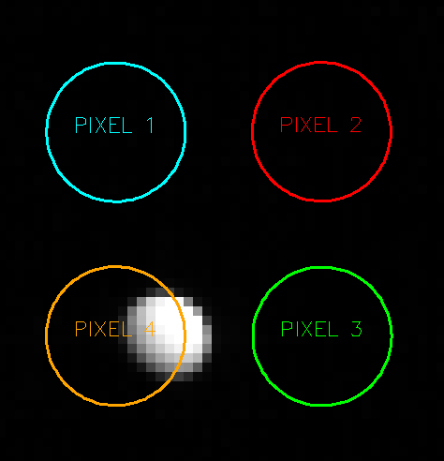
IASI status and on-going studies
The potential of the Moon as a calibration source for IASI observations in thermal infrared has been studied, using lunar data acquired by IASI-B and IASI-C sounders first in 2019 and then each month in 2021.
  An accurate radiometric infrared model was developed.
  Results give an accuracy of ~2.5K in absolute and 0.5‒1K in relative values.
    Absolute results are dominated by the model (directional emissivity),
    and relative results by the imager-sounder colocation uncertainties
    Solving these two identified sources would allow to approach the results to the Earth-view based performance
  The modeling remains complex in the infrared domain too !
Study presented by Bojan Sic (NOVELTIS) at the 4th Joint GSICS / IVOS Lunar Calibration Workshop, 4-8 December 2023, Darmstadt, Germany.
  The IASI lunar dataset is under preparation to be distributed in the coming weeks
  A paper is also under preparation

Slide 7
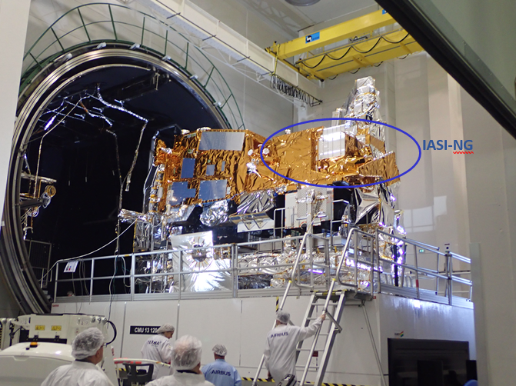
IASI-NG Program Status : Instrument Activities
The Thermal Vacuum test campaign of the IASI-NG instrument Proto Flight Model onboard Metop SG A1 Satellite was successfully performed .
This important milestone allowed to qualify the thermal control of the Metop SG Satellite and to check that the performances of IASI-NG are not disturbed by the Satellite thanks to a complex test set up of black bodies and gas cell ( Cf. Photo)
A particular attention has been paid on the vibrations generated by the two-axis pointing mechanism of the satellite’s Ka-band data transmission antenna.
A Satellite System Verification Test was also successfully performed : flight procedures validation with remote control of the Satellite from EUMETSAT ground segment
Start of the preparation of the launch campaign for a launch with Ariane 6 from CNES Guyana Space Center in 2025

Slide 8
IASI-NG Program Status :
System & Ground Segment Activities
L1CPOP V2’s full version (complete science algorithms processing) under development for delivery early 2025 for integration in the EUMETSAT PDAP (Payload Data Acquisition & Processing)
IASTEC (IASI-NG Technical Expertise Center) :
  a V1 version delivered in January 2024 for System Verification and Validation tests with EUMETSAT EPS SG System.
  Cal/Val tools will be gradually integrated, among them inter-calibration tools for IASI-NG comparisons with IASI and CrIS.
Post-Launch Verification activities preparation started with the System In Orbit Validation and Calibration/Validation plan under consolidation
Current launch date in Q4 2025 for Metop SG A1

Slide 9





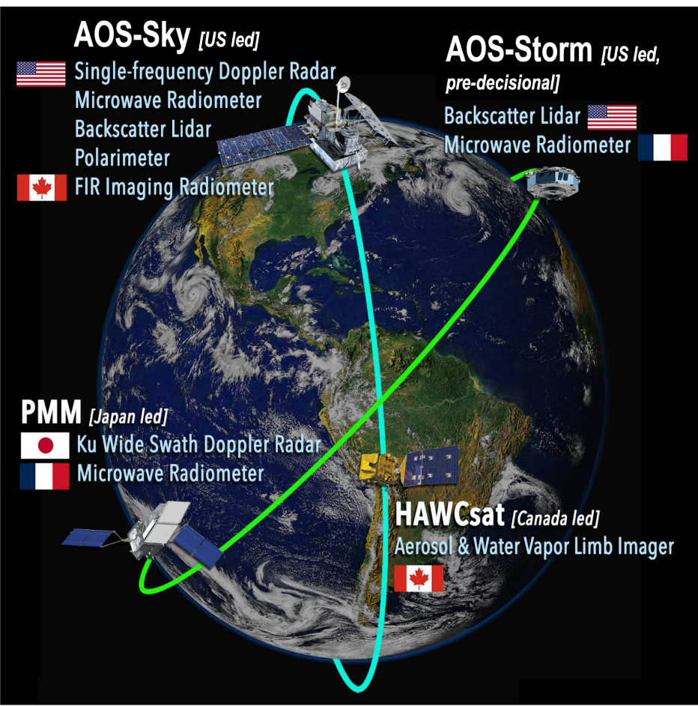
NASA program Atmosphere Observing System (AOS) to characterize and link aerosols, clouds and precipitations, storms and convection
For meteorological and air quality forecasting, for climate change assessment
Cooperation between major space agencies:
NASA, CSA, JAXA, CNES, DLR
Orbital system with 4 satellites on 2 orbits
  AOS-Storm (NASA) and PMM (JAXA) on inclined orbit,
  carrying a tandem of French radiometers => C²OMODO mission
  AOS-Sky (NASA) and HAWCsat (CSA) on polar orbit
  Start of BCD phase in 2024, launches planned in 2029 and 2030
Suborbital program to complement orbital system
  In-situ measurements (airborne, balloons…)
  For CAL/VAL of spaceborne data and for additional data
@NASA

Slide 10

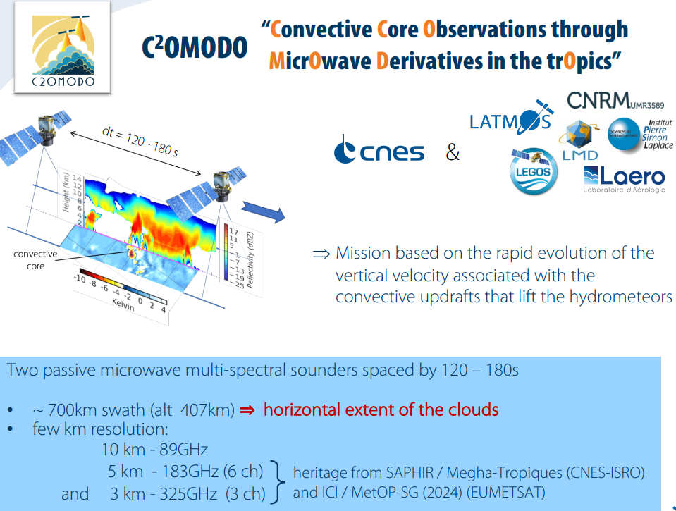
C²OMODO (Convective Core Observations thrOugh Microwave Derivatives in the trOpics)
  Based on a tandem of microwave radiometers aboard AOS-Storm (NASA) and PMM (JAXA)
  To observe deep convection
Operational processing chains for level-1 products provided to NASA and JAXA mission centers
Processing and distribution of level-2 (and higher) products by French AERIS mission center
Participation to sub-orbital activities
C²OMODO instrument functional diagram
C²OMODO for deep convection characterization

Slide 11
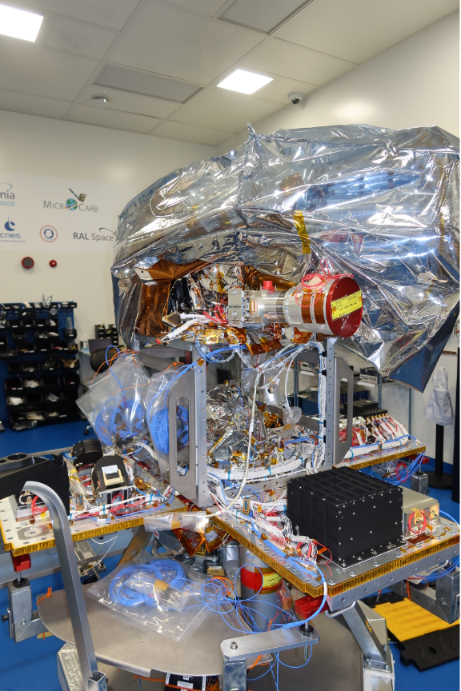
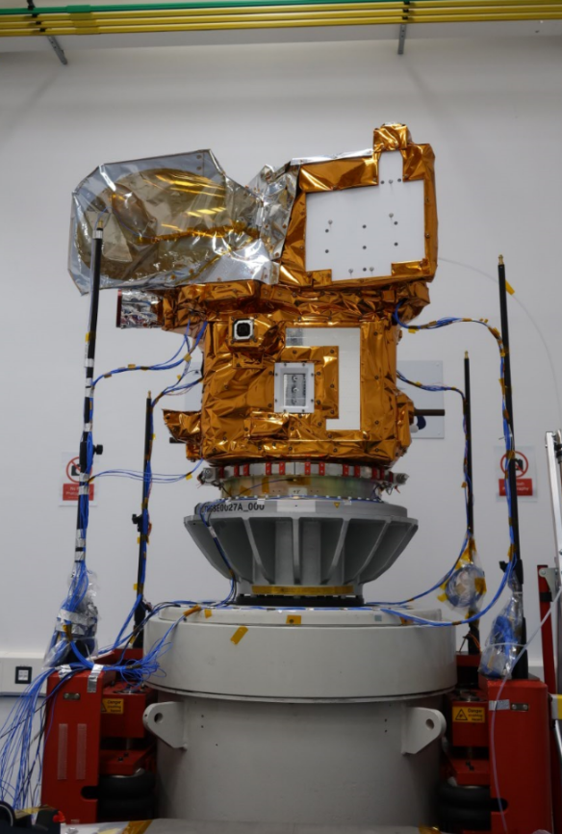
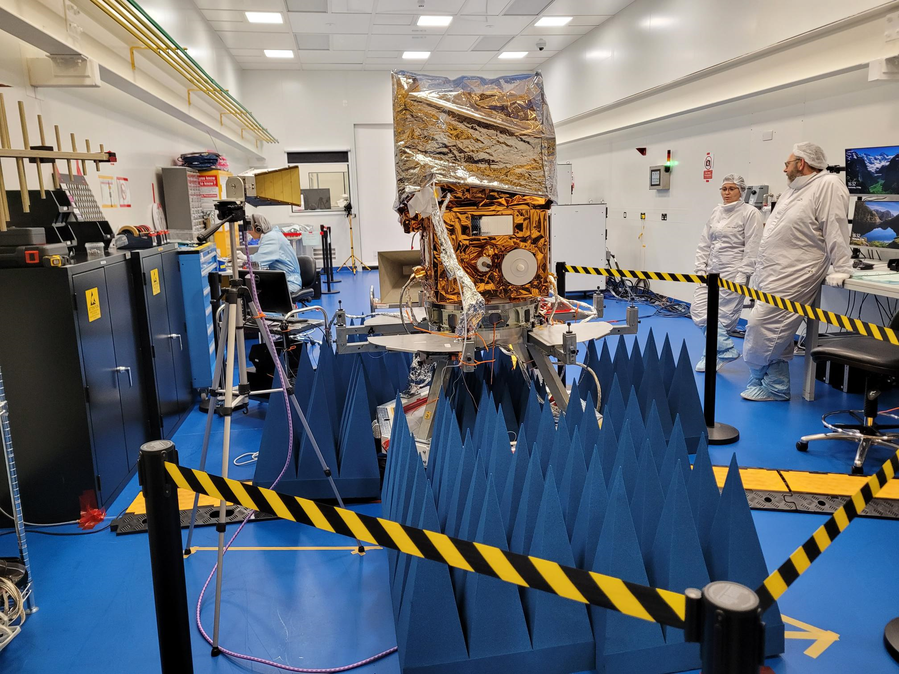
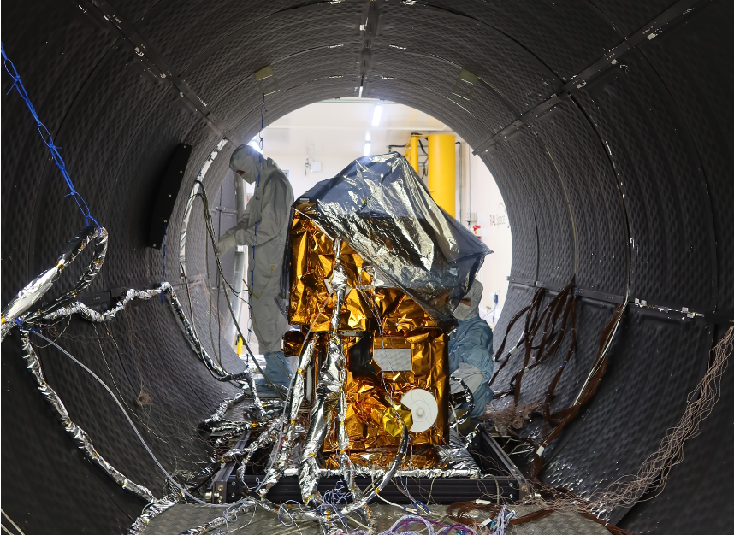
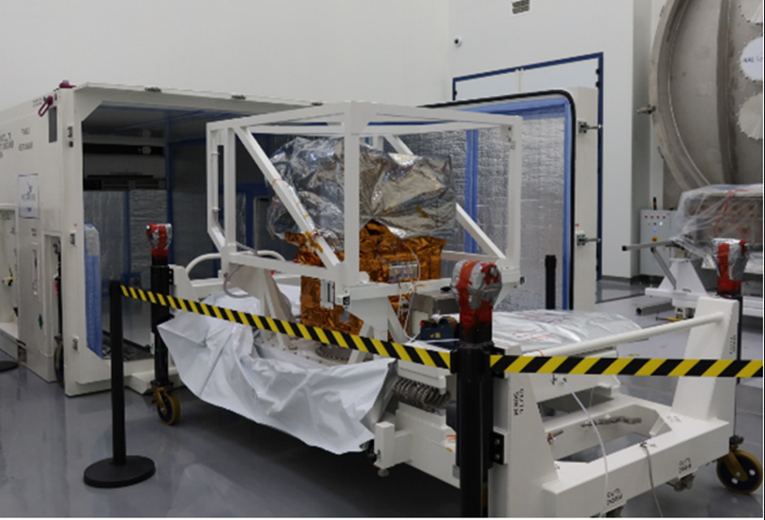
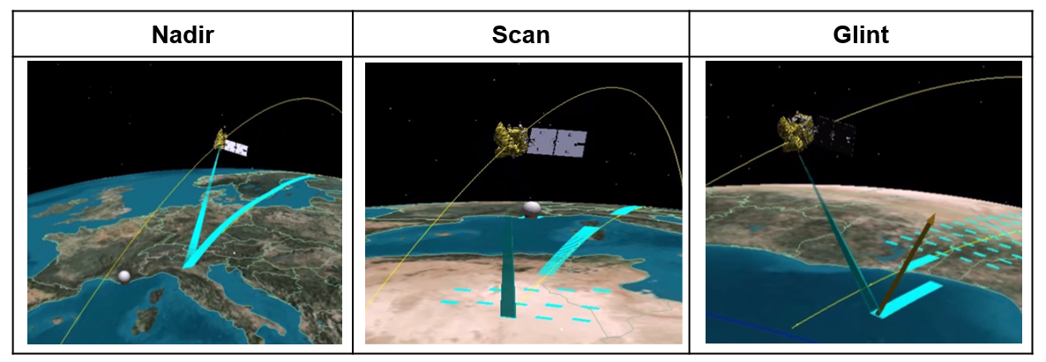
MicroCarb Status, launch preparation
Satellite Integration Status:
  Completed in January 2024.
  Currently under storage post transport from UK to France.
Launch Perspective:
  Planned on VEGA-C in mid-2025, as the 2nd flight post VEGA-C return to flight mission.
Operation Center Readiness:
  Prepared for various operation modes.
  Mission data processing chains tested and Mission Center infrastructure ready >3000 computers cluster at EUMETSAT
Open data distribution through AERIS portal after CALVAL.
Satellite AIT major steps:
instrument integration,
mechanical qualification,
EMC,
Thermal Vacuum
Satellite storage configuration

Slide 12
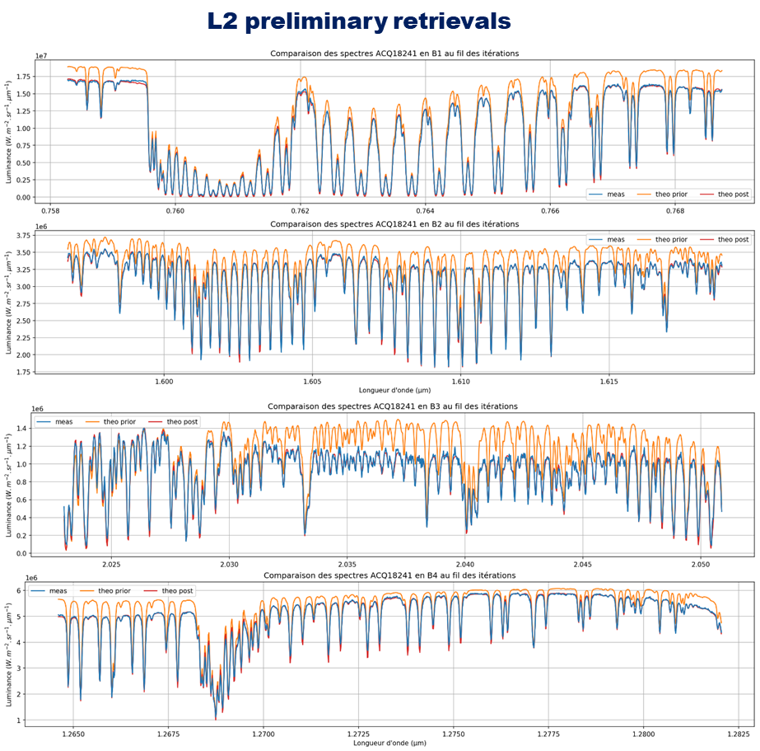
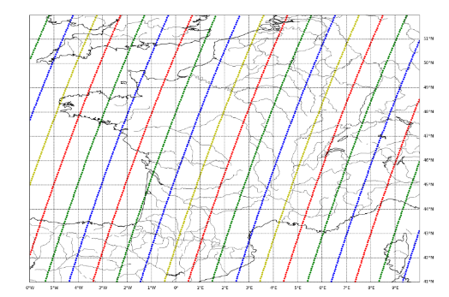
MicroCarb Calibration and Validation Strategy
Continued Work on Algorithms: L1 calibration and L2 CO2 inversion algorithm inversion
  Collaboration with Airbus, scientific labs, and CNES mission performance team.
  Mission Performances Update Key point scheduled June 2024
Post processing of instrument direct sun exposures while in thermal vacuum using roof telescope
Calibration/Validation Strategy – 1 year schedule
  Three scales
    Massive operational comparisons.
    Casual manned measurements.
    Campaigns (e.g., MAGIC 2025 in France) :
Everybody (French labs, abroad entities) is invited to contribute to measurements and analysis
    CNES will support and participate

Slide 13
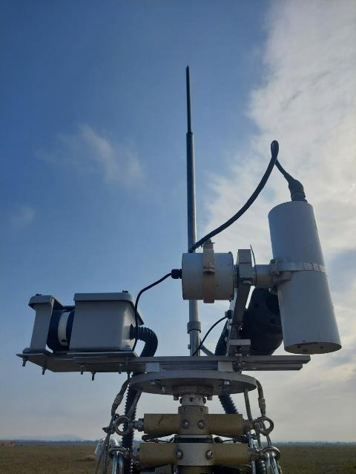
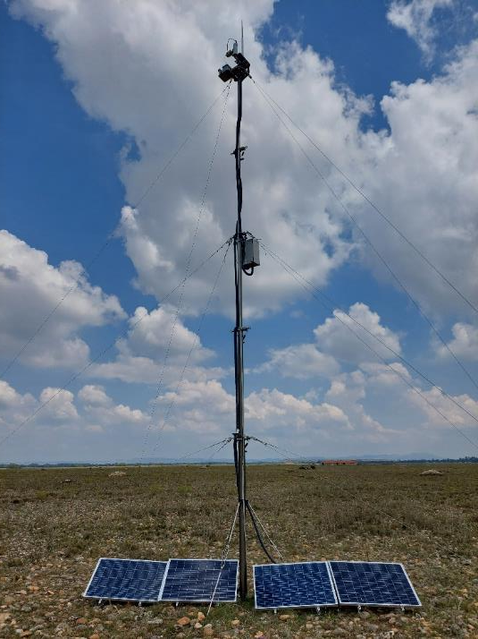
TIRCalNet Overview and Next Steps
TIRCalNet:
  CEOS/WGCV/IVOS Working Group led by ESA and CNES
  Aims to provide TOA Brightness Temperature signals with ~0.5K uncertainty propagated from BOA measurements
  Study done by CNES for La Crau, Gobabeb, Lake Tahoe and Lake Constance sites
  Confirmation that the main impact on TOA Brightness Temperature is the uncertainty on the ground emissivity. Uncertainties on the atmospheric profiles is an issue but of lesser impact.
  Atmosphere tends to compensate errors on surface emissivity
Next Steps at CNES:
  Enhance surface emissivity characterization at La Crau:
    Deploy and compare dedicated instrumentation for Temperature/Emissivity separation:
      CIMEL CE312 (6 spectral bands)
      4 KT 15 (with TRISHNA like bands)
    Construct an emissivity box
  Assess performance of a radiance-based method pushing TOA the BOA surface radiance measured by in situ radiometers without retrieving Temperature and Emissivity

Slide 14
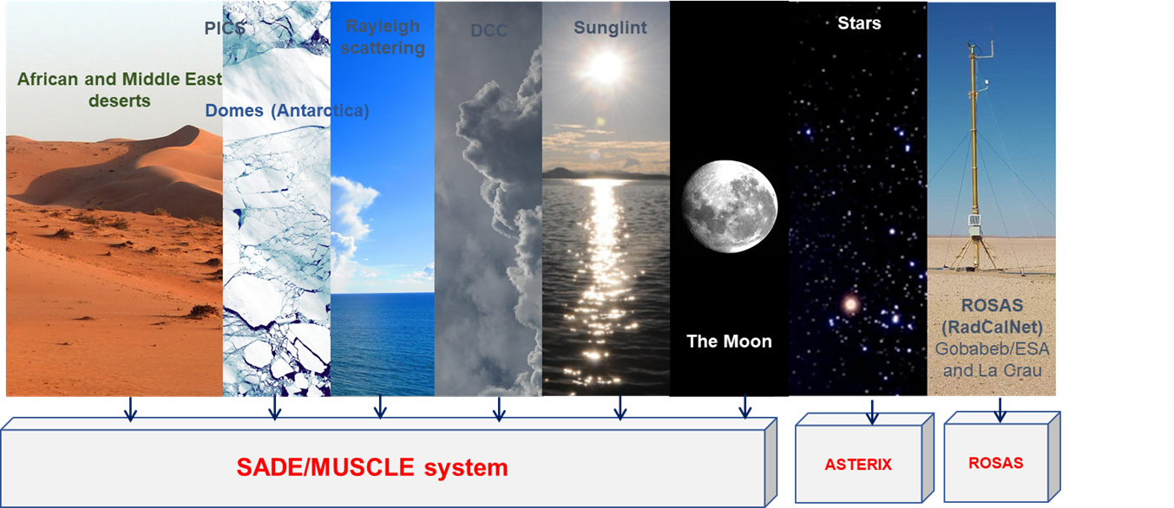
Vicarious calibration: MUSCLE (MUlti Sensor CaLibration Environment)
Different methods based on various natural targets for VNIR/SWIR sensors calibration
Several methods to uncorrelate the different contributions to the TOA reflectance simulation and avoid bias

Slide 15
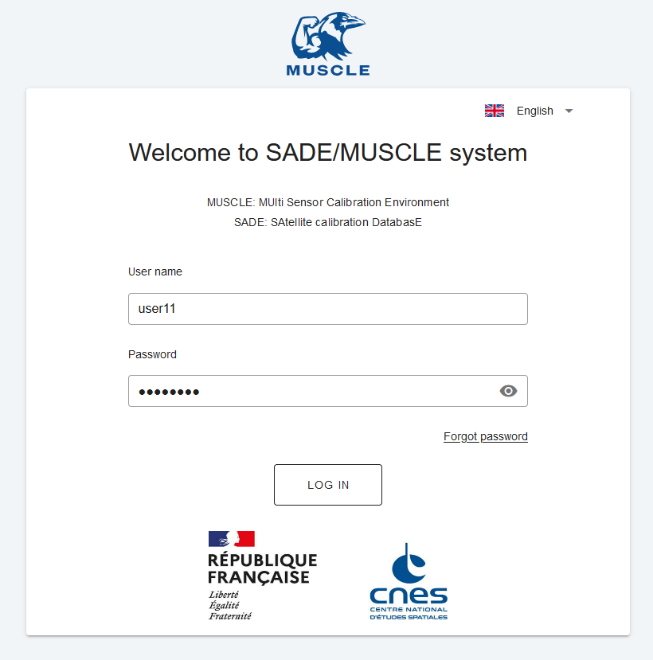
Vicarious calibration: MUSCLE-NEO
Objectives:
  Address current maintenance limitations.
  Incorporate new requirements: polarization, hyperspectral & TIR sensors, GEO.
  Enhance operability and provide external access to partners like EUMETSAT for 3MI.
Timeline:
  Version 1 (Mid-2024): Similar calibration algorithms to MUSCLE.
  Version 2 (Q2 2025): Improved algorithms and expanded external access.

Slide 16

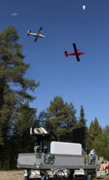









Cal/Val – MAGIC 2023
Objectives :
  To better understand atmospheric distribution and emissions of CH₄, CO₂ and related variables
  To validate current space missions (e.g. OCO-2, GOSAT-2, S5P, IASI)
  And prepare validation of the future ones (e.g. MicroCarb, Merlin, IASI-NG)
How?
  By organizing annual campaigns and network measurements and building numerical tools.
  Multi-instruments campaigns : By combining ground-based (EM27), airborne (aircraft, balloon)
  and satellite observations.
  By testing satellite airborne demonstrators.
Co-organisation CNRS (PI Cyril Crevoisier LMD) – CNES : once by year since 2018
and several partners
Monitoring of Atmospheric composition and Greenhouse gases through multi-Instruments Campaigns
ATR42
BSO
Cessna
TwinOtter
FTS

