Slide 1
Using Commercial Data in an Operational Environment – Radio Occultations
C. Marquardt and B. R. Bojkov
Remote Sensing and Products Division
GSICS Annual Meeting, 11 February 2024

Slide 2
Agenda
New Space and commercial data
And why RO is in the middle of it right now.
Lessons learned
Various aspects of commercial data.
Summary
Short description for third agenda point.

Slide 3
New Space
It has never been so “cheap” to launch a (small) satellite into a Low Earth Orbit.
Companies try to monetise scientific experience in Earth Observation – and sometimes with the support of scientists frustrated by the lack of sufficient public funding opportunities.
Examples (incomplete) of flying or planned commercial EO missions:
Spire (US & Europe; GNSS-RO, GNSS-PRO, GNSS-R, Hyperspectral MW)
PlanetIQ (US; GNSS-RO, GNSS-PRO, GNSS-R)
Muon Space (US; GNSS-R, GNSS-RO, IR)
Tomorrow.IO (US; Radar (precip), MW)
GHGSat (Ca, US, UK; Fabry-Perot (Methane & CO2))
Tianmu (China: GNSS-RO, GNSS-R)
Yunyao (China: GNSS-RO)
Probably more…
Governments and space agencies are interested in commercial opportunities → NOAA, NASA, NRL, ESA, EUMETSAT, CMA, … have purchased data and/or partnered up with commercial companies

Slide 4
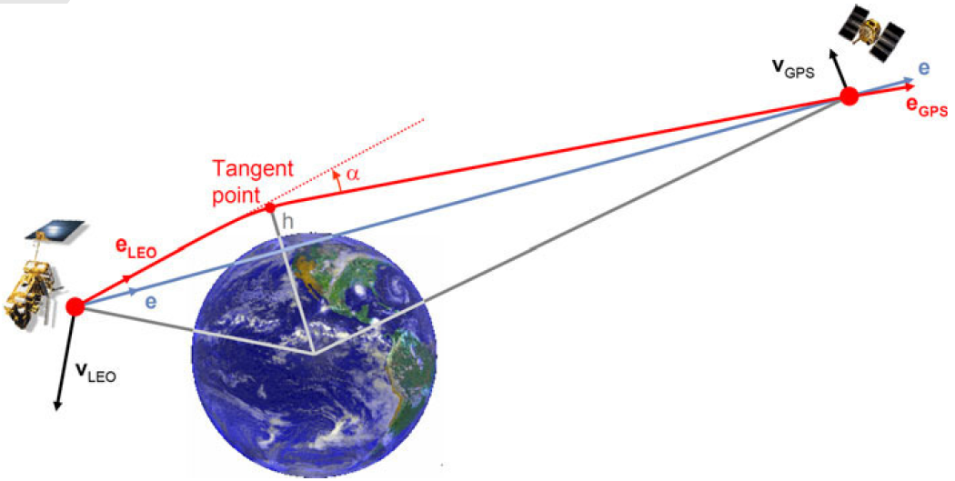
Why GNSS-X, particularly -RO (= Radio Occultations)?
RO is, by now, an established, high-impact observation type in operational NWP.
Provides information on Temperature, Moisture (troposphere), electron density (ionosphere).
Calibration-free, weather-independent, no known instrument drifts, traceable to SI standards, high vertical resolution.
High accuracy in the upper troposphere and stratosphere.
Anchors bias correction schemes for MW and IR instruments in NWP.
Limb sounding exploiting GNSS signals (GPS, Galileo, GLONASS, Beidou, QZSS).
Instruments are simple Software Defined Radios with lots of signal processing, but:
no optics or movable parts
no calibration targets or blackbodies required
Small; eg 3U cubesats (Spire)

Slide 5
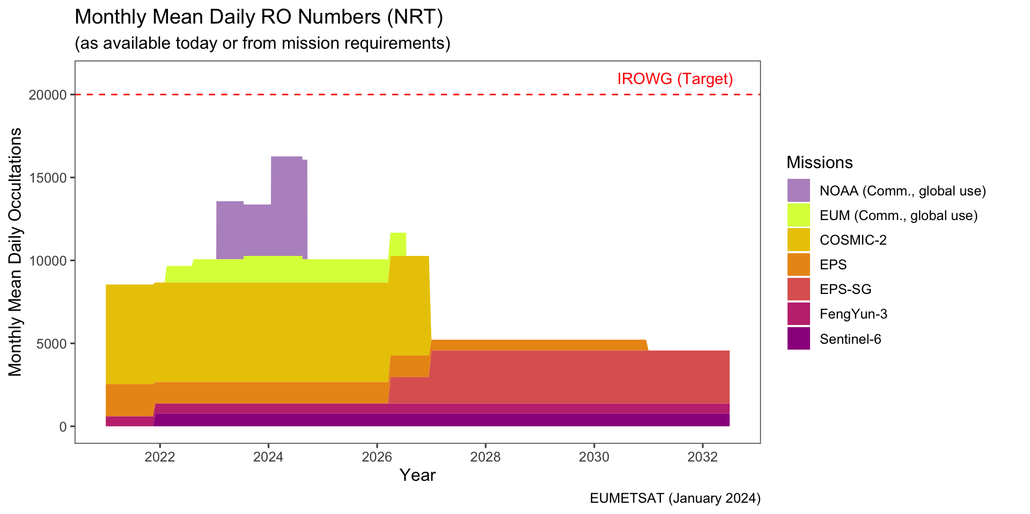
The need for more RO
In 2014, the International Radio Occultation Working Group (IROWG) recommended 20.000 daily occultations as a target for CGMS agencies based on an ECMWF simulation study.
This number is not met, even when including current operational GNSS-RO data buys.
CGMS identified the drop in occultation numbers at the end of COSMIC-2 (nominally 2027/28) as significant risk.
Note: the ROMEX initiative will analyse and assess the impact of the number of RO on NWP.
Notes:
The figure only shows
CGMS missions with secured funding covering NRT operations (no research or might-have projects)
Commercial missions with signed contracts – there is more data available, but so far nobody purchased it
Numbers mostly based on requirements; e.g. COSMIC-2 might live longer than 2027
Some smaller and best-effort missions are left out as they usually only provide a few hundred occultations, so don’t change the overall picture (examples: Kompsat-5, Tandem-X, TerraSar-X, PAZ)

Slide 6
Data Quality, Processing, Validation
At both EUMETSAT and NOAA, low-level data is processed inside the agency to ensure consistent data quality and characteristics across all RO missions.
NB, level 1b or level 2 data are not procured from vendors.
EUMETSAT supported ESA and NOAA in evaluating commercial RO data through various studies and collaborations → We found undesired use of climatology in some vendors’ data and even provided a slightly better impact at ECMWF with EUMETSAT processed data.
Since the beginning of the EUMETSAT data buy, we have seen data from 41 satellites (and instruments), 17 of which were newly launched during the data buy → EUM can validate new satellites within 2-4 weeks before disseminating data to our users.
Commercial data buys require a high level of expertise on the buyer/agency side for evaluating, processing and validating data products to relieve users from these tasks (and to ensure consistent data quality).

Slide 7
Reliability of Vendors
The initial EUMETSAT data buy demonstrated that a reliable operational NRT service can be build with commercial RO data.
So far, EUM’s sole supplier has fulfilled the contracted Service Level Agreement in both latency and the number of occultations; they also react quickly to our requests.
This being said, we see an impact of other contractual obligations the company has: In Jan 2024, the number of occultations delivered to EUMETSAT dropped slightly when a provider started to provide data to NOAA (but is still above their formal commitment; they had over-delivered before to compensate for quality issues).

Slide 8
Reliability of Vendors (cont’d)
NOAA had a somewhat different experience:
For their current delivery order, 6000 occultations/day were committed to by the vendor, but only 3000-4000 occultations/day are available (until new satellites are launched in June).
In the past, the vendor operated ~25 satellites with RO capability, but it reconfigured more than half of them for other purposes when it lost the previous NOAA Delivery Order to a competitor.
Apparently, some of those satellites experienced a shorter-than-expected lifetime.
Two other vendors could not fulfil their contractual commitments to NOAA in the past due to losing a satellite.
These companies only operate 2 or 3 satellites, so losing a spacecraft is more catastrophic for their service.

Slide 9
Other Aspects of Commercial Data
Transparency
Commercial vendors do not provide all information on instruments and platform characteristics upfront.
Expertise on the buyer’s side is required to raise the right questions. So far, we have received all the information we needed for (re-) processing and evaluating commercial data, but only because we knew what to look (and ask) for. Contracts need clauses that all relevant information needs to be provided, at least on request.
User preparation
Commercial vendors try to sell data; they do not support a user community to learn what to do with it.
Public funding for development, e.g., for forward operators and the technology to assimilate new data types, is still required. Point in case: GNSS-PRO, GNSS-R, Hyperspectral MW,…

Slide 10
Other Aspects of Commercial Data
Cal/Val
Commercial Vendors do a minimum of Cal/Val
It requires expertise and resources on the buyer's side to perform such activities at the same level as we are used to for public missions. This will be even more relevant for EO techniques that require cross-calibration with other sensors.
Time scales
Changes in commercial data occur within months, not years.
NOAA changes their provider every 6-9 months, with a notification time of two weeks
Some vendors launch new satellites every 3-6 months
Buyers and users of commercial data need to find ways to adapt to such quick changes; at present, public agencies and weather services are used to a different level of agility.

Slide 11
Other thoughts
For remote sensing types other than RO (when calibration is required), should we distinguish between:
Reference missions to serve as gold-standard for the calibration of other instruments, operated by public agencies to ensure long-term availability and transparency;
Backbone missions to satisfy basic needs of NWP and climate monitoring; this could be a mixture of public and commercial missions, or public data only;
Additional (commercial) data further enhance NWP and other applications (as funding allows).
China currently creates large RO capabilities (Tianmu & Yunyao Aerospace aim at providing 80.000 – 100.000 occultations per day by 2025)
Our initial analysis indicates that this data has similar quality as other commercial RO data.
Questions: Is China willing to make the data available under a Global license? What would an amount of RO data likely to be available from China do to the commercial RO market?

Slide 12
Summary
In the New Space arena, RO data has become the most mature commercial offering of meteorological data, because instruments are simple, RO is well understood, has a high impact, and more of it is needed.
Both EUMETSAT and NOAA have begun to procure commercial RO data in an operational context, although the political backgrounds are somewhat different.
Experiences so far:
To ensure consistent data characteristics, both EUMETSAT and NOAA take care of processing, validation, quality control and monitoring of commercial data, requiring significant RO expertise in these organisations.
While a commercial data provider demonstrated high levels of reliability in Europe, the US suffered several issues with data availability from the commercial sector.
Transparency can be obtained by formulating contracts appropriately and by having sufficient expertise on the buyer side.
Change happens on time scales of months, not years.

Slide 13
Summary (cont’d)
For observation techniques other than RO, topics like reference instruments and backbone missions require careful consideration.
In China, commercial companies will generate vast amounts of good-quality (RO—) data, potentially disrupting the current commercial (RO—) data activity in Western countries. However, the politics regarding these data is currently uncertain.

Slide 14
Thank you!
Questions are welcome.

