Slide 1
Evaluation of High-Resolution Solar Reference Spectrum
Mina Kang, Myoungh Hwan Ahn, Xiong Liu, Yeeun Lee

Slide 2
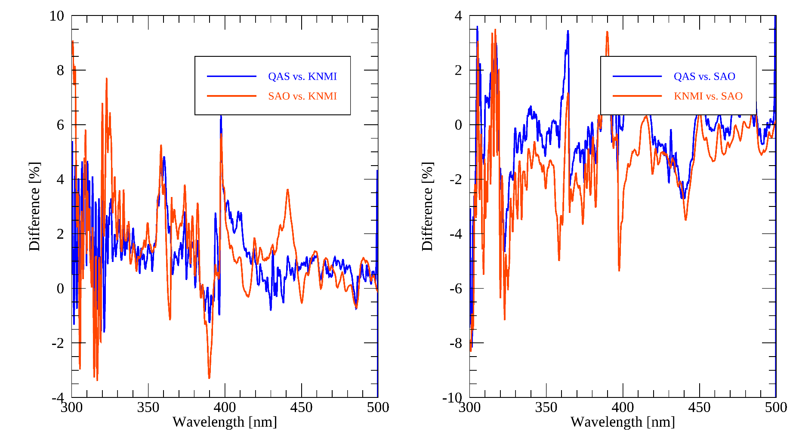
Comparison btw Reference Spectra
(TSIS-KNMI)/KNMI*100
(SAO-KNMI)/KNMI*100
(TSIS-SAO)/SAO*100
(KNMI-SAO)/SAO*100
Average difference is less than 1.4%
Significant differences of up to 8% at shorter wavelengths

Slide 3
Selection of High-Resolution Solar Reference Spectrum
Low resolution solar reference spectra
Coddington et al 2016
Guey et al 2003
Thuiller et al 2004
Weber et al 2014
Skupin et al 2005
Woods et al 2009

Slide 4
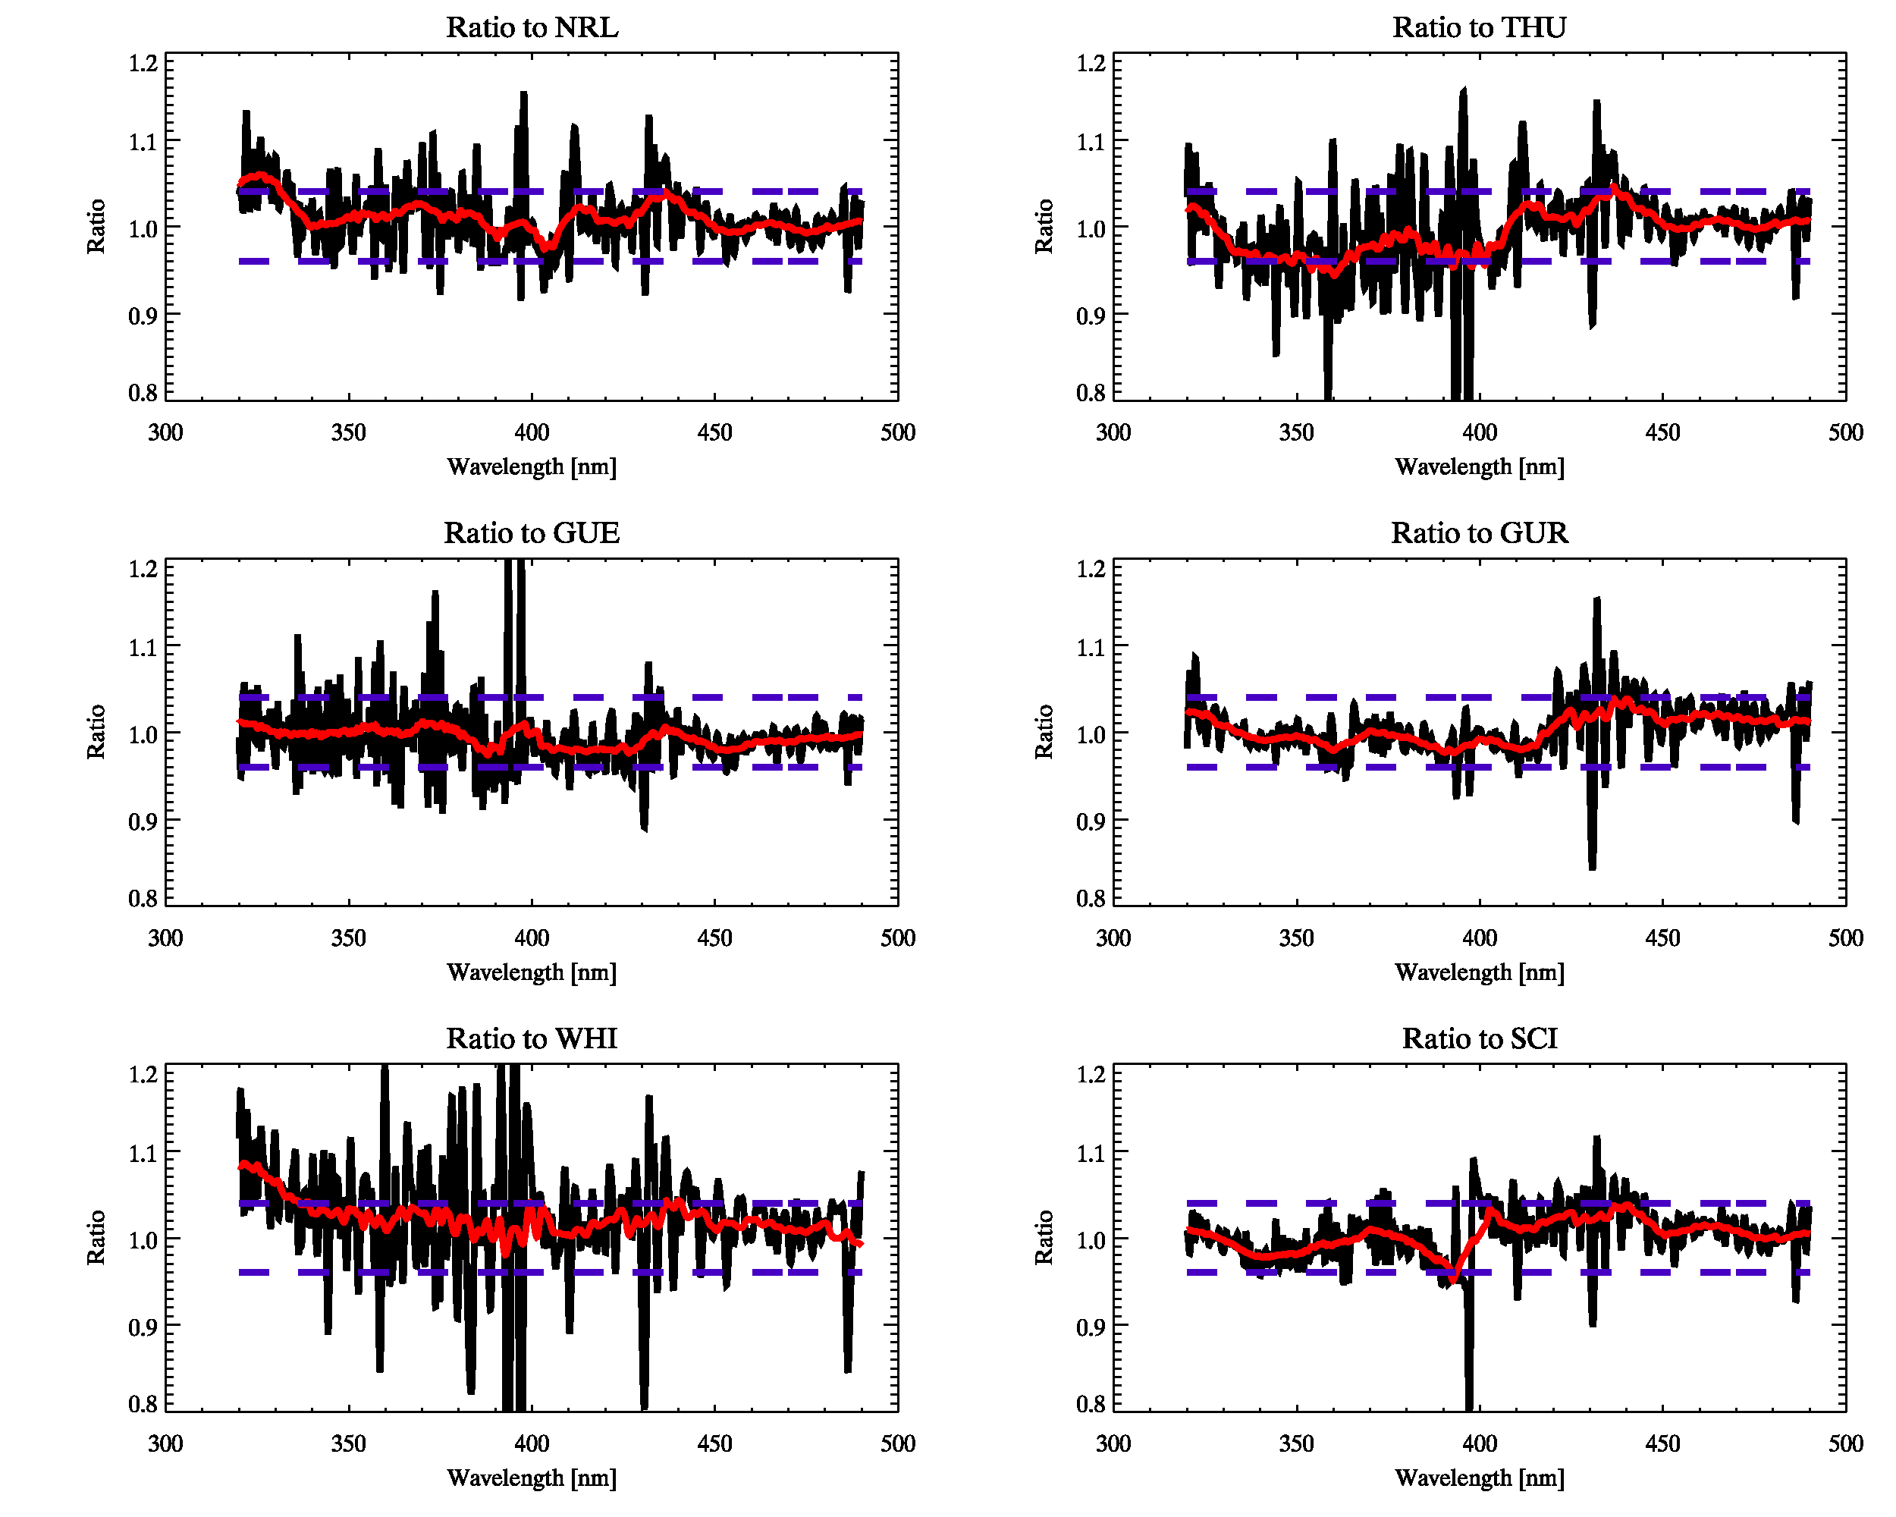
Selection of High-Resolution Solar Reference Spectrum
References vs. KNMI
GEMS Radiometric uncertainty: < 4%
Mean Difference: 1.10 %
Mean Difference: 0.74 %
Mean Difference: 0.65 %
Mean Difference: 0.35 %
Mean Difference: 2.25 %
Mean Difference: 0.32 %

Slide 5
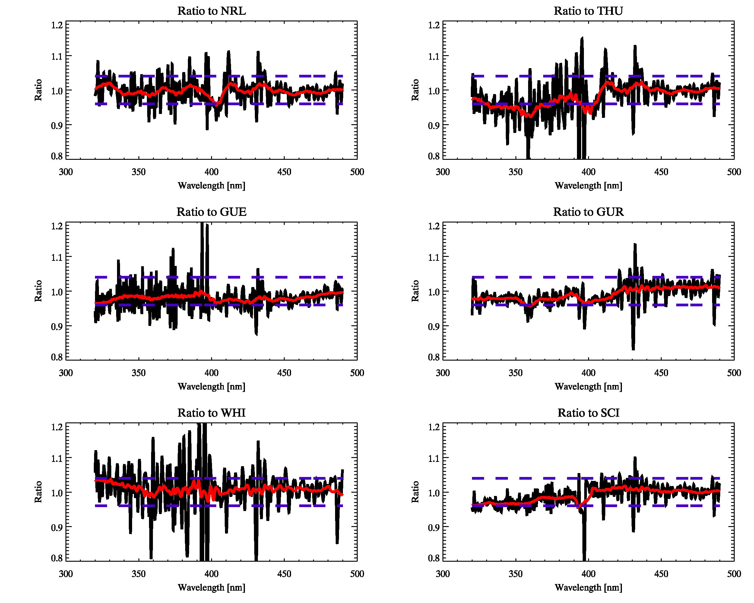
Selection of High-Resolution Solar Reference Spectrum
References vs. SAO2010
GEMS Radiometric uncertainty: < 4%
Mean Difference: 0.29 %
Mean Difference: 2.09 %
Mean Difference: 2.02 %
Mean Difference: 1.02 %
Mean Difference: 0.85 %
Mean Difference: 1.06 %

Slide 6
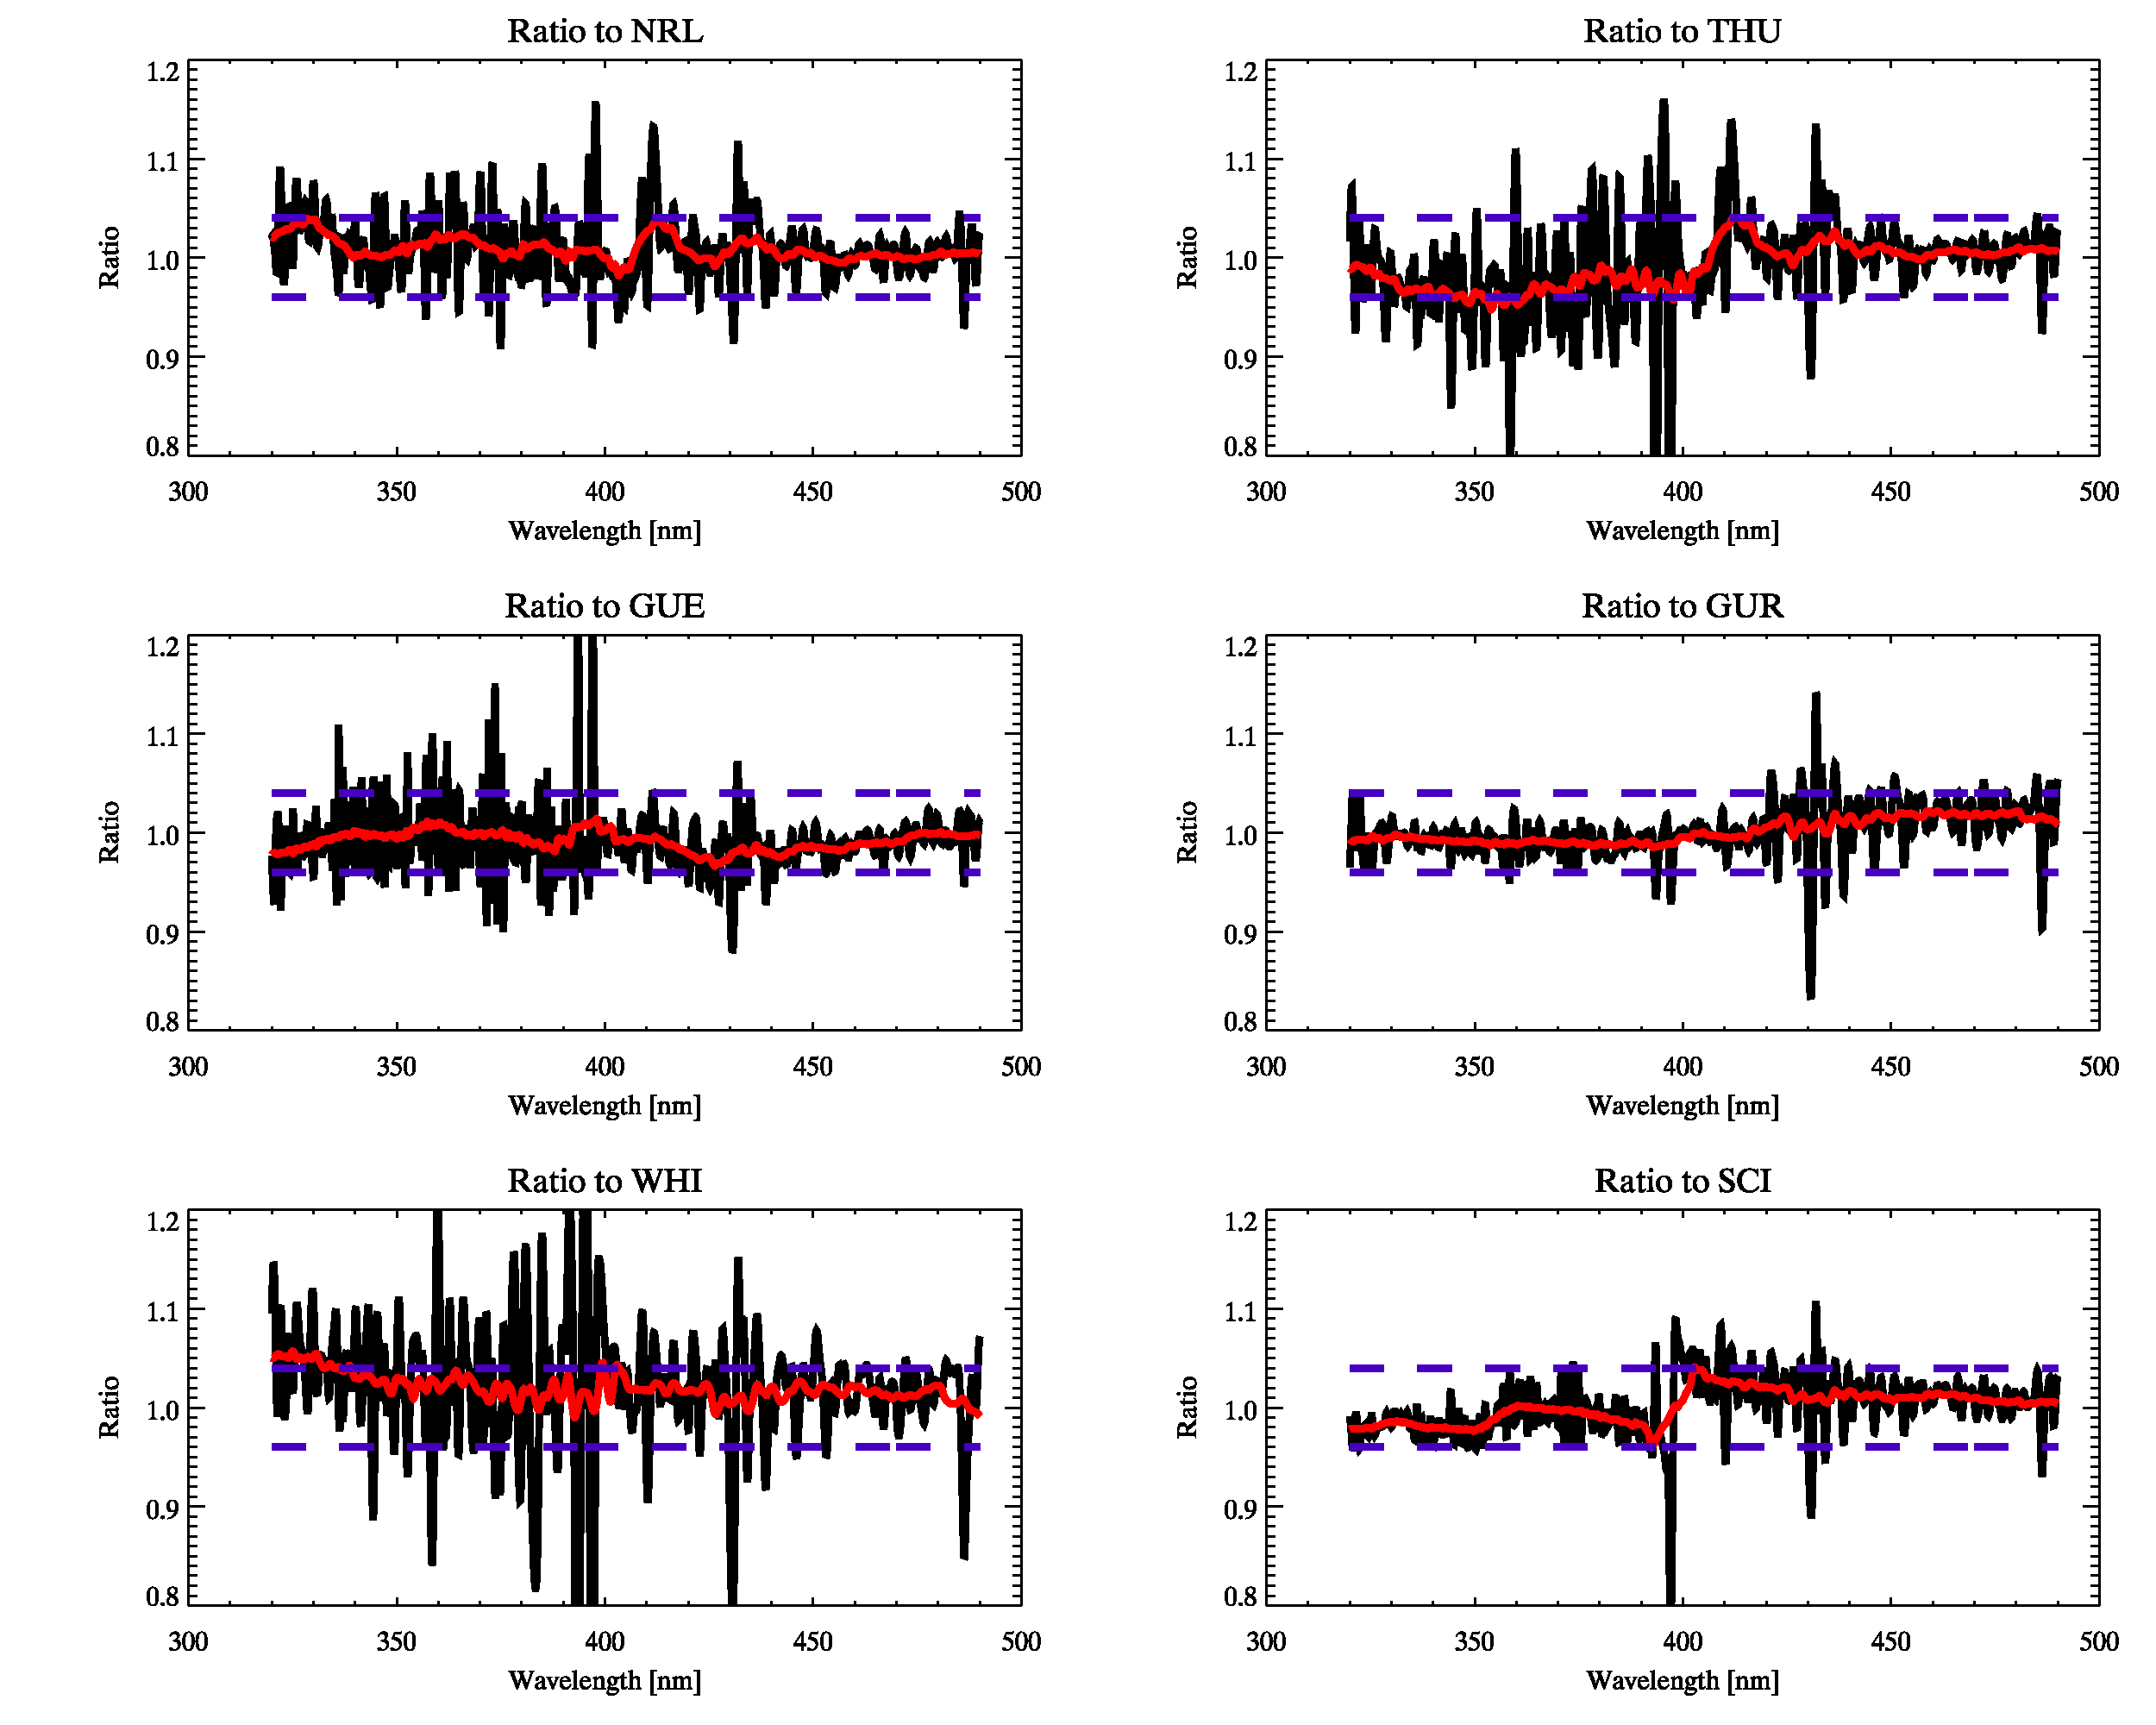
Selection of High-Resolution Solar Reference Spectrum
References vs. TSIS
GEMS Radiometric uncertainty: < 4%
Mean Difference: 0.90 %
Mean Difference: 0.94 %
Mean Difference: 0.85 %
Mean Difference: 0.15 %
Mean Difference: 2.04 %
Mean Difference: 0.12 %

Slide 7
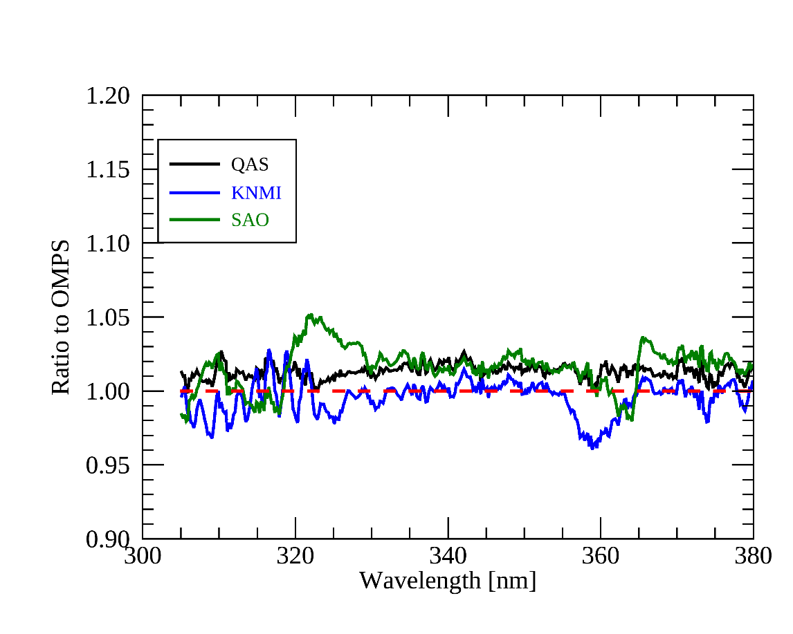
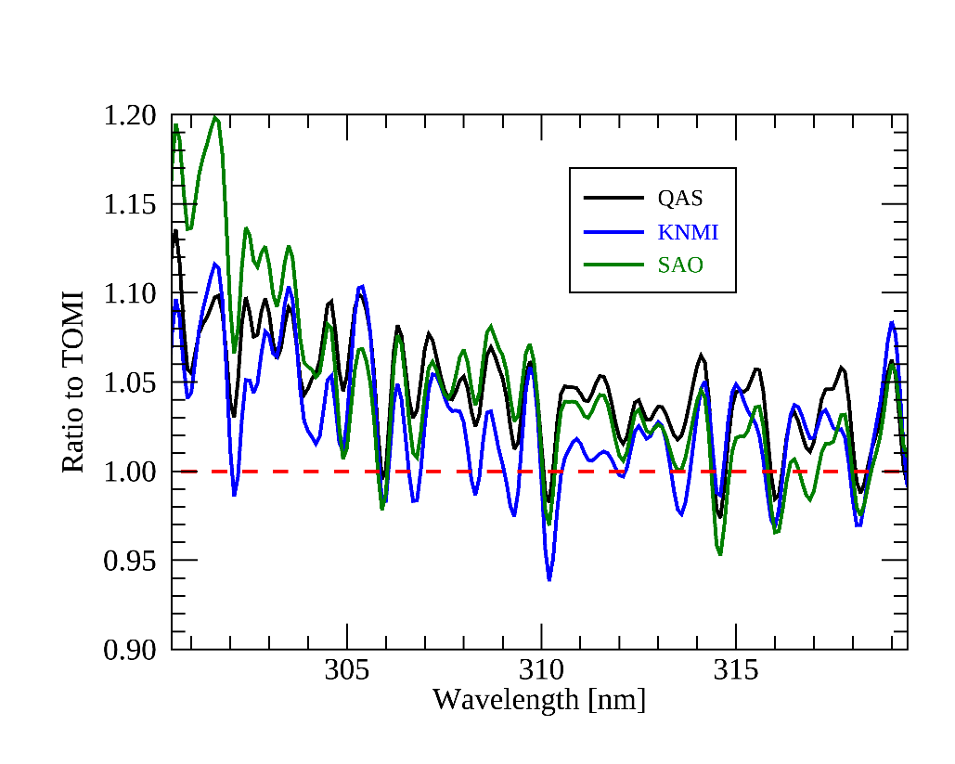
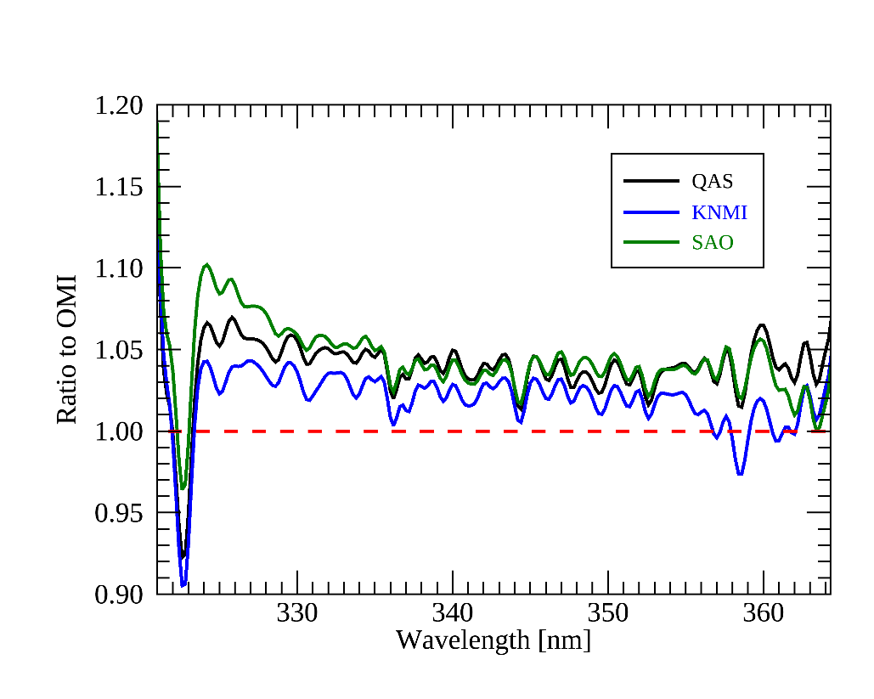
Selection of High-Resolution Solar Reference Spectrum
Solar measurements vs. Candidate spectrum
De-trended OMPS, TROPOMI, and OMI solar irradiances are used
Comparison with OMPS
Comparison with TROPOMI (UV)
Comparison with OMI (UV)
TSIS
KNMI
SAO
Mean ratio
1.01, 1.00, 0.98
Mean ratio
1.04, 1.03, 1.05
Mean ratio
1.04, 1.02, 1.04
OMPS (20120301 to 20200921)
OMI (20120101 to 20200921)
TROPOMI (20180701 to 20200921)

Slide 8
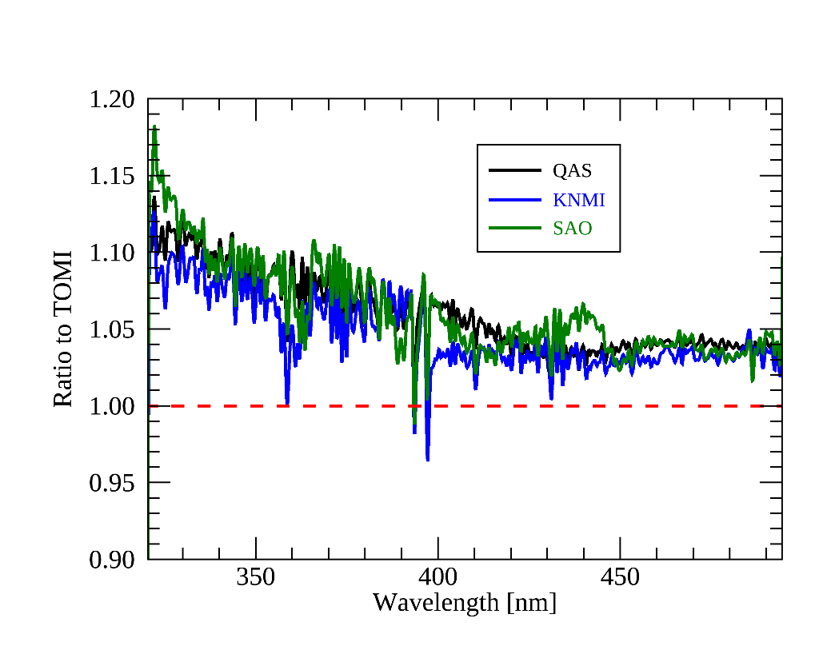
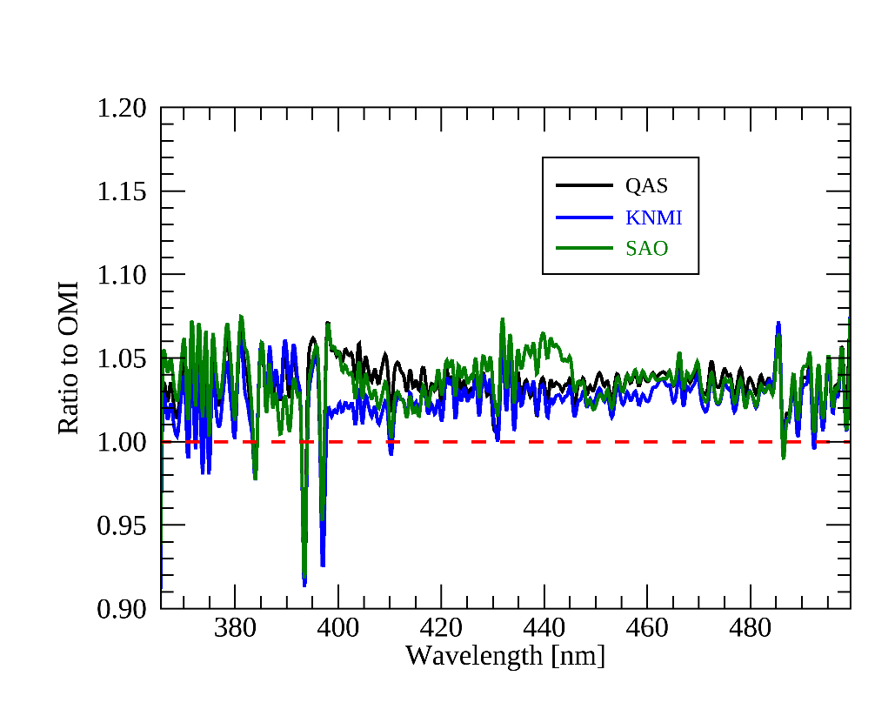
Selection of High-Resolution Solar Reference Spectrum
Solar measurements vs. Candidate spectrum
De-trended OMPS, TROPOMI, and OMI solar irradiances are used
Comparison with OMPS
Comparison with TROPOMI (Vis)
Comparison with OMI (Vis)
TSIS
KNMI
SAO
Mean ratio
1.01, 1.00, 0.98
Mean ratio
1.06, 1.05, 1.06
Mean ratio
1.02, 1.01, 1.02
OMPS (20120301 to 20200915)
OMI (20120101 to 20200915)
TROPOMI (20180701 to 20200915)

Slide 9
Thank you for your attention

