Slide 1
Toward the Consolidation of Standards and Metrics for Optimized Applications: Efforts for Microwave Sensors in CEOS WGCV
Xiaolong DONG
(National Space Science Center, Chinese Academy of Sciences)
Microwave Sensors Subgroup
CEOS Working Group on Calibration and Validation
GSICS Annual Meeting-Microwave Subgroup Breakout Meeting (Virtual)
March 17th , 2022

Slide 2
CEOS, WGCV and MSSG
CEOS: Committee on Earth Observation Satellites
CEOS ensures international coordination of civil space-based Earth observation programs and promotes exchange of data to optimize societal benefit and inform decision making for securing a prosperous and sustainable future for humankind.
CEOS Virtual Constellations
-- coordinate space-based, ground-based, and/or data delivery systems to meet a common set of requirements within a specific domain.
Atmospheric Composition (AC-VC)
Land Surface Imaging (LSI-VC)
Ocean Colour Radiometry (OCR-VC)
Ocean Surface Topography (OST-VC)
Ocean Surface Vector Wind (OSVW-VC)
Precipitation (P-VC)
Sea Surface Temperature (SST-VC)

Slide 3
CEOS, WGCV and MSSG
CEOS Working Groups
WGCapD: The Working Group on Capacity Building & Data Democracy
WGClimate: The CEOS/CGMS Working Group on Climate
WGCV: The Working Group on Calibration & Validation
WGDisasters: The Working Group on Disasters
WGISS: The Working Group on Information Systems & Services
WGCV: Working Group on Calibration and Validation
The mission of the CEOS Working Group on Calibration & Validation (WGCV) is to ensure long-term confidence in the accuracy and quality of Earth Observation data and products and to provide a forum for the exchange of information about calibration and validation, including the coordination of cooperative activities.

Slide 4
CEOS, WGCV and MSSG
CEOS WGCV Subgroups
The CEOS Working Group on Calibration & Validation (WGCV) supports six Subgroups that operate as individual entities and focus on specific technical areas related to calibration and validation.
Atmospheric Composition (ACSG)
Infrared Visible Optical Sensors (IVOS)
Land Product Validation (LPV)
Microwave Sensors (MSSG)
Synthetic Aperture Radar (SAR)
Terrain Mapping (TMSG)
MSSG: Microwave Sensors Subgroup
The Microwave Sensors Subgroup Mission is to foster high quality calibration and validation of microwave sensors for remote sensing purposes. These include both active and passive types, airborne and space-borne sensors operating in the microwave spectral range, except SAR.

Slide 5
Objectives of MSSG
The objectives of the Microwave Sensors Subgroup, beyond those of the WGCV, are to:
Facilitate international cooperation and coordination in microwave sensor calibration/validation activities by sharing information on sensor development and field campaigns
Promote accurate calibration and validation of microwave sensors through the standardization of terminology and measurement practices
Provide a forum for the discussion of current issues and for the exchange of technical information on evolving technologies related to microwave sensor calibration/validation

Slide 6
Recent Focuses and Tasks of MSSG
MSSG covers EO sensors operated in microwave spectrum, except SAR
MWR, SCAT, ALT
  Microwave Radiometers (sounders, imagers) (MWR)
  Radar Scatterometers (surface and volume) (SCAT)
  Radar Altimeters (ALT)
  GNSS-RO and reflectrometry
With current emphasis on
  Radar Scatterometers (Active Microwave)
  CEOS task CV-20-05: Standards and Metrics for Scatterometers and Wind Retrievals
  Microwave Radiometers (Passive Microwave)
  ISO TC211 project:
  Geographic information – Calibration and validation of remote sensing imagery sensors and data– Part 4: Space-borne Microwave Radiometers (ISO TS 19159-4:202X)

Slide 7










CEOS Task CV-20-05:
Standards and Metrics for Scatterometers and Wind Retrievals
Xiaolong Dong (NSSC, CAS), Paul S. Chang (NOAA NESDIS), Ad Stoffelen (KNMI), Marcos Portabella( ICM-CSIC), Raj Kumar (ISRO), Stefanie Linow (EUMETSAT), Juhong Zou (NSOAS), Wenming Lin (NUIST)
Created in 2020
Target completion: 2021 Q4, extended to 2022 Q4 due to COVID-19

Slide 8
Introduction
IGARSS-2021
Spaceborne scatterometers are well-established instruments that provide ocean surface wind products efficiently with high and stable accuracy, as well as large swath coverage.
Scatterometers operated by different space agencies form the virtual constellation. The instruments provide near real-time observations with spatial and temporal continuity and internal physical consistency in time and space.
Scatterometer observations have been available for decades, and many more missions are prepared to be launched in the future.
Inter-calibration/comparison can offer spatial and temporal characteristics of the observing systems to enable the consistency.
-01-

Slide 9
Main objective:
To develop the standard and guideline for the requirement, procedure, processing and assessment for the spaceborne radar scatterometer measurement calibration, wind retrieval approaches, wind data validation and assessment for OSVW, which will be used to assure the consistency of the data quality of these satellites and instruments are the prerequisite for related scientific researches and applications.

Slide 10
Main Tasks
To develop the standard and metrics of spaceborne radar scatterometer backscattering measurement calibration, wind retrieval approaches, wind data validation and assessment for ocean surface vector winds.
The main scope of the standard and metrics cover:
    Calibration, including cross-calibration of L1 and L2 data;
    Validation of scatterometer wind data;
    Quality indices of L1 and L2 data.
Identifying and organizing collocation data
Demonstration of applications and establishment of portal

Slide 11
The Scatterometer Virtual Constellation for
Ocean Surface Vector Wind
 | Instrument | Satellite | System | Orbit | 2018 | 2019 | 2020 | 2021 | 2022 | 2023 | 2024 | 2025 | 2026 | 2027 | 2028 | 2029 | 2030 | 2031 | 2032 | 2033 | 2034 | 2035 | 2036 | 2037 | 2038
C-band | ASCAT | Metop-A | fixed fan beam | 08:46 desc | launch 19 Oct 2006
 | ASCAT | Metop-B |  | 09:30 desc | launch 17 Sep 2012
 | ASCAT | Metop-C |  | 09:30 desc
 | SCA | Metop-SG-B1 |  | 09:30 desc
 | SCA | Metop-SG-B2 |  | 09:30 desc
 | SCA | Metop-SG-B3 |  | 09:30 desc
C-/Ku-band | WindRAD | FY-3E | conical scanning | 05:30 desc
 | WindRAD | FY-3I |  | 05:30 desc
Ku-band | SCAT (CFOSAT) | CFOSAT | rotating fan beam | 07:00 desc
 | SCAT (CFOSAT) | CFOSAT follow-on |  | 07:00 desc
 | SCAT (HY-2) | HY-2A | conical scanning | 06:00 desc | launch 15 Aug 2011
 | SCAT (HY-2) | HY-2B |  | 06:00 desc
 | SCAT (HY-2) | HY-2C |  | 66 °
 | SCAT (HY-2) | HY-2D |  | 66 °
 | SCAT (HY-2) | HY-2E |  | 06:00 desc
 | SCAT (HY-2) | HY-2F |  | 66 °
 | OSCAT | OceanSat-3 |  | 12:00 desc
 | OSCAT | ScatSat-1 |  | 08:45 desc | launch 26 Sep 2016
 | operational
 | commissioning
 | planned
 | considered
(Revised from Paul Chang etal, IGARSS 2021)

Slide 12

Characterization of the Instruments
Data sets contributed by the member groups for implementation of the task:
  Type:
    - Long term L2 wind products;
    - L1 NRCS data products;
    - Buoy data.
  Data Contribution:
  - Global climate data record of L2 winds：
    ESCAT (ERS), QSCAT(Seawinds), ASCAT(Metop-A), OSCAT-2(Oceansat-2);
    - Global Near Real Time L2 winds;
    OSCAT (Scatsat-1), HSCAT(HY-2B), CSCAT(CFOSAT);
    Global in situ buoy winds;
    Global L1 data for specified period:
    CSCAT L1B data; HY-2B/HSCAT-2 L1A

Slide 13
Expected Outcomes
Expected Outcomes :
    - The CEOS guidelines/international standards for calibration (L1)
    - Validation retrieval guidelines (L1 and L2);
    - Best practices of calibration and validation data sharing and collaborations.

Slide 14
Main tasks and Assignments
Sub-task 1:
Development and validation of algorithms and methods for calibration of Sigma 0 using different reference or metrics
  (1) Documentation of the calibration process and the data properties;
  (2) Evaluation and assessment:
    Active calibrator (EUMETSAT):
  -calibration requirements, methodology and procedure;
    Global ocean data methodology and procedure, quality control
-Cone metrics: fixed fan-beam and rotating beam (KNMI);
-NWP (KNMI, NUIST);
    Natural terrestrial targets (ISRO, NOAA, NUIST, NSOAS, KNMI)
-methodology and procedure;
-C and Ku band standard data and standard variation curves;
-Data quality control.

Slide 15
Main tasks and Assignments
Sub-task 2:
Standardization/best practices of retrieval approaches of ocean surface winds (L2b data) by radar scatterometer data and guidelines to users (leading: KNMI, NSOAS, ISRO, ICM, NOAA)
  -GMF;
  -Auxiliary data;
  -Retrieval and direction ambiguity-removal algorithms;
  -Quality control.

Slide 16
Main tasks and Assignments
Sub-task 3:
Development of guidelines/standards of validation of ocean surface winds (L2b data) by radar scatterometer data
(leading: NOAA, ICM, KNMI, ISRO)
  -Reference, auxiliary data and data quality control;
  -Methodology and procedure;
  -Evaluation criteria;
  -Evaluation and error assessment.

Slide 17
Summary
The project of CEOS WGCV and OSVW-VC by contributions and cooperation from teams of 8 agencies (NSSC, NOAA, KNMI, ICM, ISRO, EUMETSAT, NSOAS, NUIST) to implement.
The requirements for realizing the objectives proposed are data processing, reprocessing and calibration methods.
The outcomes can assure the consistency of the data quality of these satellites and instruments are the prerequisite for related research and operational applications.

Slide 18
  ISO TC211 Project:
  Geographic information – Calibration and validation of remote sensing imagery sensors and data– Part 4: Space-borne Microwave Radiometers (ISO TS 19159-4:202X)
Project proposal accepted: 2019Q2
Target completion: 2022 Q3

Slide 19
ISO 19159 Series
Developed by ISO TC211 WG6
Defines the calibration and validation of airborne and spaceborne remote sensing imagery sensors.
The term “calibration” refers to geometry, radiometry, and spectral, and includes the instrument calibration in a laboratory as well as in situ calibration methods.
The validation methods address validation of the calibration information (which is different from the CEOS definitions)
ISO/TS 19159-1:2014 “Calibration and validation of remote sensing imagery sensors – Part 1: Optical sensors”
ISO/TS 19159-2:2016 “Calibration and validation of remote sensing imagery sensors –Part 2: Lidar”
ISO/TS 19159-3:2018 “Calibration and validation of remote sensing imagery sensors –Part 3: SAR/InSAR”
ISO/TS 19159-4 “Calibration and validation of remote sensing imagery sensors –Part 4: Space-borne passive microwave radiometers” (under development)
…

Slide 20
ISO TS 19159-4
Development time line
Date | Stage | Activity
2019-03-05 | 10.00 | Proposal for new project registered
2019-03-06 | 10.20 | New project ballot initiated
2019-07-08 | 10.99 | New project approved
2019-07-08 | 30.00 | CD study/ballot initiated
2019-10-31 | 30.20 | WD1
2020-4-15 | 30.20 | WD2
2020-11-03 | 40.00 | DTS approved
2021-12 | 50.00 | FDTS
2022-07-04 ~ 2023-01-05 | 60.60 | International Standard published limit date

Slide 21
ISO TS 19159-4
Scope:
This Technical Specification defines the calibration of space-borne microwave radiometers and validation of the calibrated information.
  Define the calibration of space-borne microwave radiometers and validation of space-borne microwave radiometers calibration information.
  Address in-orbit calibration, rather than prelaunch calibration.
  Specify the terms used in the microwave radiometers calibration procedures.
  Address also the metadata related to calibration and validation.

Slide 22
Procedures in developing 19159-4
The flow chart of radiometer calibration is drawn and the generic technologies are extracted.
Seven classes are abstracted, addressing the key stages or elements in the calibration procedure.
Every class is descried by class diagrams using UML tools.
Every attribute in the classes are described in some detail data in the dictionary.
An abstract test suite which shall be passed by any implementation claiming conformance with 19159-4 is designed. The attached xml schema definition files are consistent with the UML diagram and data dictionary.

Slide 23
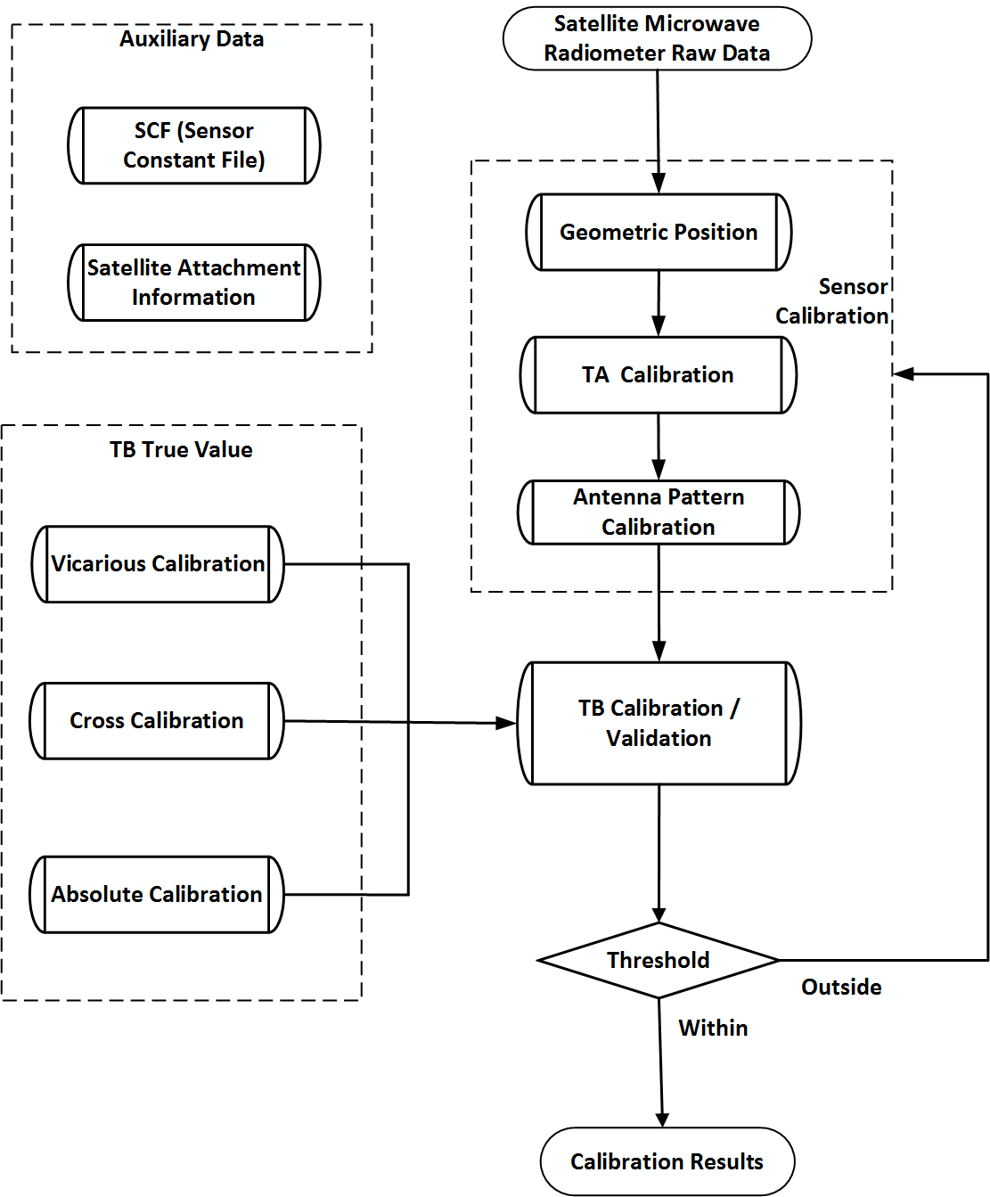
Flow chart of microwave radiometer calibration
Calibration begins with “sensor calibration” using “Satellite Microwave Radiometer Raw Data”；Sensor calibration is implemented for producing the TB products
  Geometric Position
  TA calibration
  Antenna Pattern Calibration
Afterwards, “TB True Value” serves as input for module “TB Calibration / Validation” to calibrate TB, and the results will be assessed
  If the assessments are within the “Threshold”, the calibrated TB will be outputted as “TB Product”
  Otherwise (outside), three main processing in the “Sensor Calibration” will be followed for correcting the errors

Slide 24
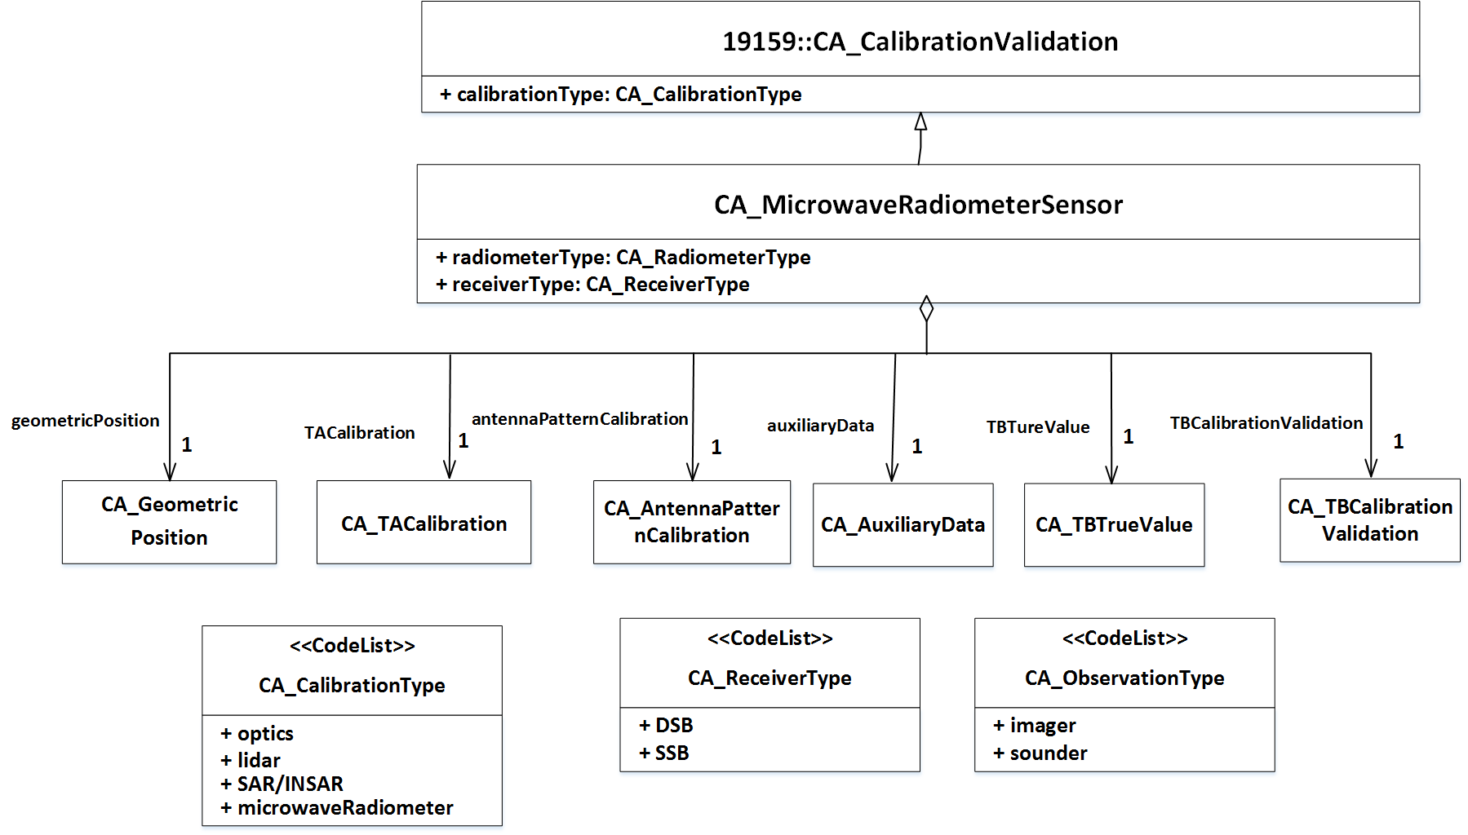
19159-4 top level UML class diagram
Class CA_MicrowaveRadiometerSensor is the top-level class in 19159-4.
It aggregates five classes including sensor calibration, TB cal/val and auxiliary data.

Slide 25
Three main stages of sensor calibration
The sensor calibration is described by three cascading classes to fulfil the following functions.
Geometric position: position the satellite measurements to the scene on earth, and get the latitude, longitude, elevation angle and azimuth angle of every pixel.
TA calibration: calibration on the receiver to acquire the antenna temperature, features in receiver (e.g., receiver temperature, nonlinearity and spectral response function) are considered.
Antenna pattern calibration: calibration of the antenna pattern, in which antenna pattern side-lobe and cross-polarization should be corrected for deriving more accurate TB of the scene.

Slide 26
Three main methods for TB calibration/ validation
The “true value” class lies in the core of the TB cal/val. Different method gives different TB true value as the reference for TB comparison.
Vicarious calibration: validation using well-characterized, stable Earth targets.
  Cold-end usually relies on measurements over calm oceans under cloud free skies and very low humidity
  Hot-end often makes use of a large isothermal blackbody extending over the scene, such as the rain forest.
Cross calibration: relate the measurements of one instrument to those of a high-quality, well-calibrated instrument. The two instruments operating during the same period requires careful geographic collocation.
Absolute calibration (OMB method): derive the difference between simulated (established from the radiative transfer model, which include the effects of ocean or land surface and atmosphere parameters) and measured TB (from radiometer to be calibrated).

Slide 27
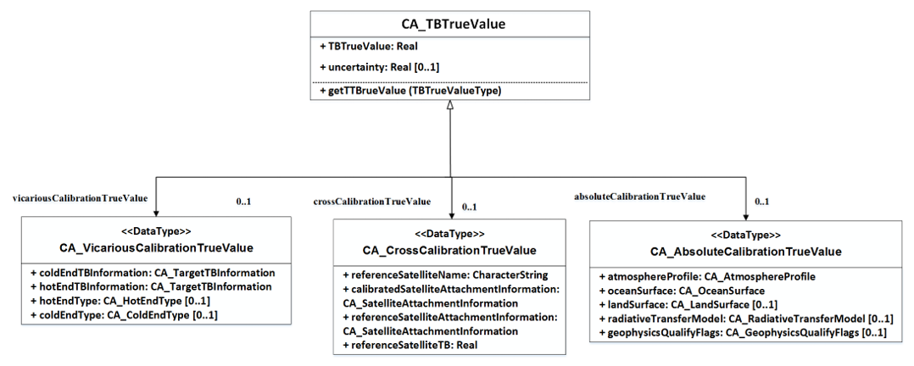

Slide 28
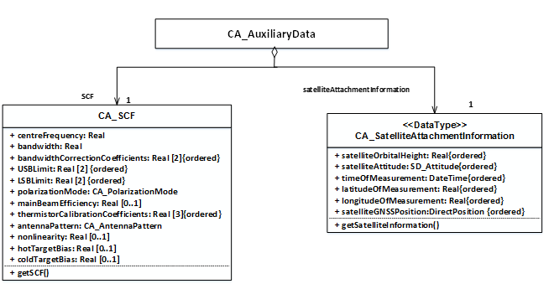
Auxiliary data
Auxiliary data required in the procedure of microwave radiometer calibration/ validation. It has two subclasses:
  SCF: the sensor constants needed in the sensor calibration.
  Satellite attachment information: the information of the platform (satellite) for geometric position and cross calibration.

Slide 29
Summary and Future
CEOS WGCV Microwave Sensor Subgroup is working on development and consolidation of standards and metrics for optimized applications, main efforts is toward the best practices;
Two focuses on radar scatterometry for ocean surface vector wind and the calibration of spaceborne microwave radiometers;
CAL/VAL of other types of microwave sensor for atmospheric, oceanic and land surface applications, are under consideration.
Thanks for your attention!

