Slide 1
CMA GDWG ANNUAL REPORT 2021
XU Zhe, Tian Lin
CMA GDWG
2022-3-16 WEBEX

Slide 2
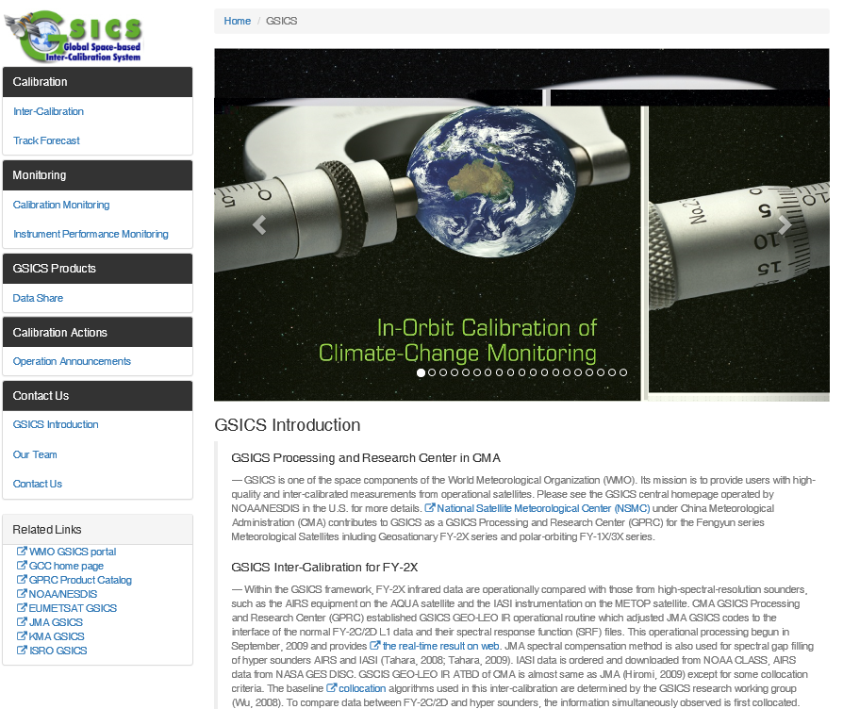
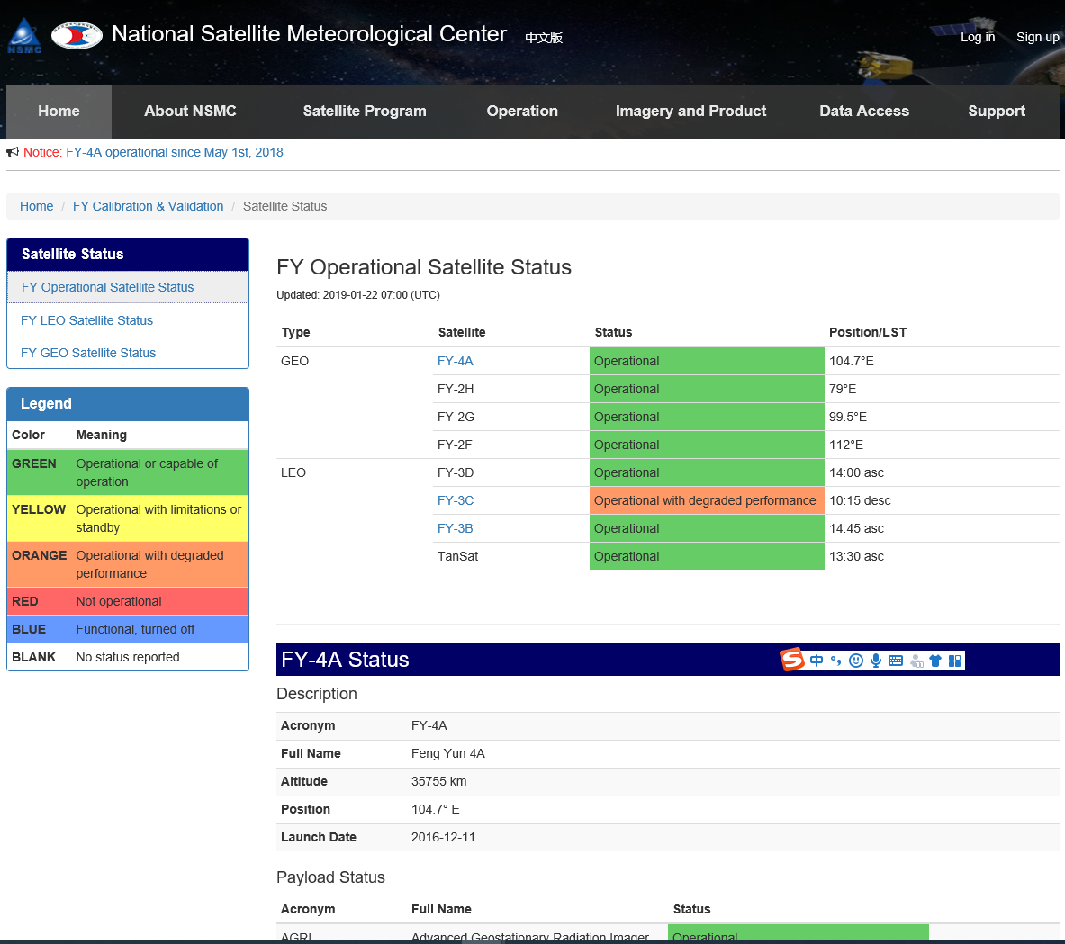
CMA GDWG TASK: CMA GPRC Website Operation
Keep CMA GPRC Website Content updating:
GPRC Information
CMA GSICS product sharing (Thredds)
FengYun Satellites Instrument Operation Status (Landing Page）
CMA GDWG: Website construction and maintain
Notes:
GSICS Processing and Research Centres (GPRC)
Content: GPRC Information, CMA GSICS product sharing, Instrument Operation Status
CMA GRWG: Content provider
CMA GDWG: Website construction and maintain

Slide 3
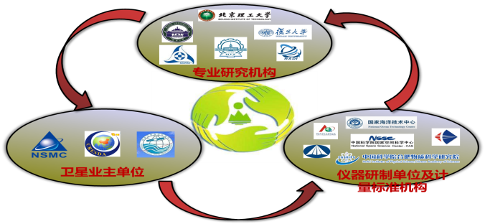
CMA GDWG TASK: Supporting RICH-CEOS Program
RetrospectIve Calibration of Historical Chinese Eerth Observation Satellite Data (RICH-CEOS)
National Key R&D Program of China Founded since 2018
18 Institutions Involved
National Satellite Meteorological Centre (NSMC)
RICH-FY ： Chinese Meteorological Satellites
RICH-ZY : Chinese Land Resources Satellites
RICH-HY : Chinese Marine Satellites
National Satellite Ocean Application Center (NSOAC)
China Center for Resources Satellite Date and Application (CRESDA)

Slide 4
CMA GDWG TASK: Supporting RICH-CEOS Program

Slide 5
Reprocessing Dataset: Overview
Dataset
Satellite | Instrument | Data Level | Temporal | Available period (yyyy/mm/dd)
FY-1C | VIRR | L1&OLR | Orbit(L1) OLR(Daily) | 2000/01/18-2004/06/30
FY-1D |  |  |  | 2002/06/25-2012/01/13
FY-3A |  |  |  | 2008/11/12–2014/05/04
FY-3B |  |  |  | 2010/12/05–2019/12/31
FY-3C |  |  |  | 2013/10/18–2019/12/31
FY-3B | IRAS | L1 | Orbit | 2010/11/12–2019/07/03
FY-3C |  |  |  | 2013/09/29–2020/02/04
FY-3B | MWRI | L1 | Orbit | 2010/11/11–2019.08.19
FY-3C |  |  |  | 2013/09/29–2020.02.04
FY-3D |  |  |  | 2017/11/25-2020.12.31
FY-3A | MWTS | L1 | Orbit | 2008/07/01-2013/05/06
FY-3B |  |  |  | 2010/11/11-2014/02/21
FY-3C |  |  |  | 2013/09/30-2015/02/28
FY-3D |  |  |  | 2017/11/25-2020.12.31
Data accesse
http://www.richceos.cn

Slide 6
Reprocessing Dataset: Data Format and File naming convention
Data Format
The file format of FY-3/MWRI FCDR is HDF5, including global attribute, private attribute, and SDS.
File naming convention
FY1X_VIRRX_GBAL_L1_YYYYMMDD_HHmm_3300M_MS.HDF
FY3X_VIRRX_GBAL_L1_YYYYMMDD_HHmm_1000M_MS.HDF
FY3X_IRASX_GBAL_L1_YYYYMMDD_HHMM_017KM_MS.HDF
FY3X_MWRIX_GBAL_L1_YYYYMMDD_HHmm_010KM_MS. HDF
FY3X_MWTSX_DG_nadir_L1_YYYYMMDD_Ascending.HDF
FY3X_MWTSX_DG_nadir_L1_YYYYMMDD_Dscending.HDF
FY1X: Satellite (including FY1C and FY1D);
FY3X: Satellite (including FY3A, FY3B, FY3C and FY3D);
VIRRX, IRASX, MWTSX, MWRIX: Instrument name (VIRR, IRAS, MWTS, MWRI);
GBAL, DG_nadir: Data area (global, gridded data_sub-satellite data);
L1: Data level (level 1);
YYYYMMDD_HHmm: Data time (year, month, day, Hour, minutes);
3300M, 1000M, 017KM, 010KM: Resolution (3.3km, 1km, 17km, 10km);
MS: Ground station (Multi-stations);
Ascending, Dscending: ascending data, descending data

Slide 7
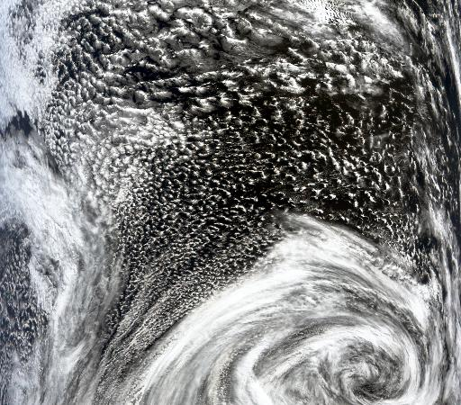
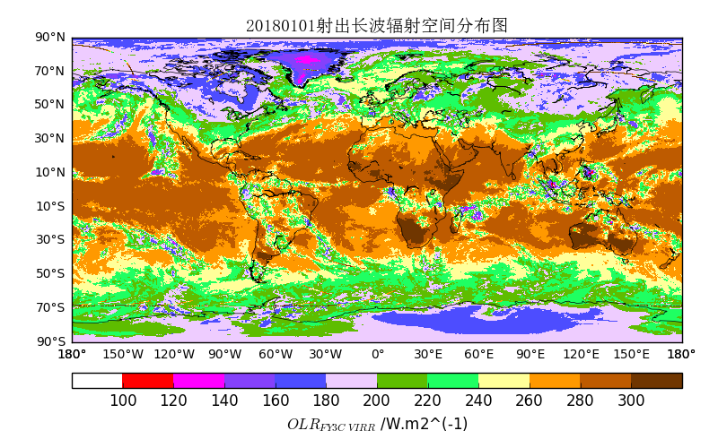
Reprocessing Dataset: FY1X/VIRR & FY3X/VIRR_OLR
VIRR
The main payload of Fengyun polar orbit satellites, FY-1 and FY-3 series (covering VIS, NIR, TIR);
Available period: 2000/01/18 - 2019/12/31 (20 year);
SDS: Reflectance, Radiance, Brightness Temperature, Latitude, Longitude, Solar and Satellite Observation Angles;
Validation (VIRR vs MODIS, IASI, AIRS): Relative Difference<5%(Ref) Relative Difference<0.5K (Emissive)
FY3C/VIRR Oribt Image
OLR
The energy density of thermal radiation emitted by the Earth’s atmospheric system to the outer space at the top of the atmosphere (meteorological monitoring, climate models, precipitation, etc);
Available period: 2008/11/12 - 2019/12/31 (Daily mean product);
SDS: OLR_DAY, OLR_NIG;
Validation (VIRR_OLR vs CERES_OLR):RMSE=8-9W/m² , correlation coefficient=0.98;
FY3C/VIRR OLR Product

Slide 8
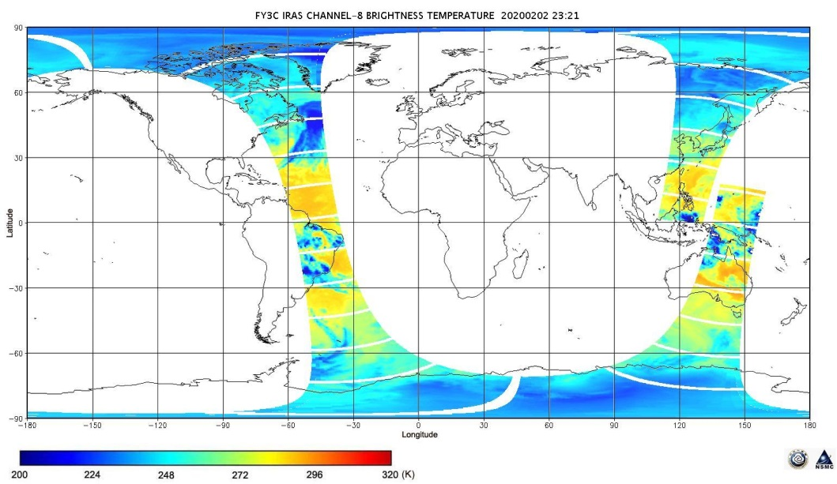
Reprocessing Dataset: FY3X/IRAS
IRAS
The first infrared atmospheric sounding instrument on the FY-3 series (visible to infrared wavelengths; global numerical weather forecast data assimilation, atmospheric temperature and humidity profile inversion, ozone content and cloud parameters inversion, etc);
Available period: 2010/11/12 - 2020/02/04 (10 years);
SDS: Brightness Temperature, Latitude, Longitude, Solar and Satellite Observation Angles, DEM, LandSeaMask, LandCover;
Validation (IRAS vs IASI): The deviation characteristics of each channel are improved;

Slide 9
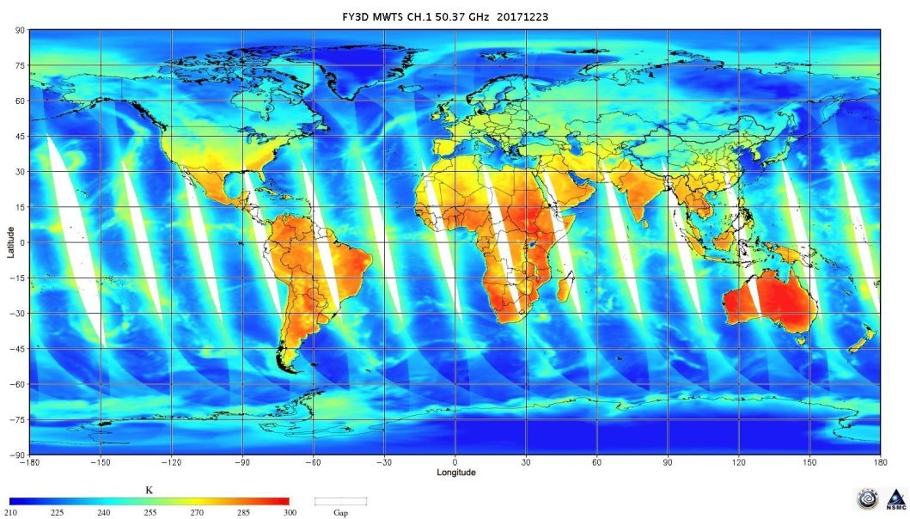
Reprocessing Dataset: FY3X/MWTS
MWTS
Microwave thermometers (MWTS) on FY-3A/B/C/D probe the atmospheric temperature by receiving microwave radiation from the 50-60GHz oxygen absorption band (penetrate non-precipitation clouds to obtain all-weather atmospheric temperature profiles, providing irreplaceable information for numerical weather prediction, disaster monitoring and climate change, etc);
Available period: 2008/07/01 - 2020.12.31 (10 years);
SDS: Earth Observation Brightness Temperature, Latitude, Longitude, Sensor Zenith, Day count, Milliseconds count;
Validation (MWTS vs NPP/ATMS, Standard Atmospheric temperature dataset): RMSE<1K;

Slide 10
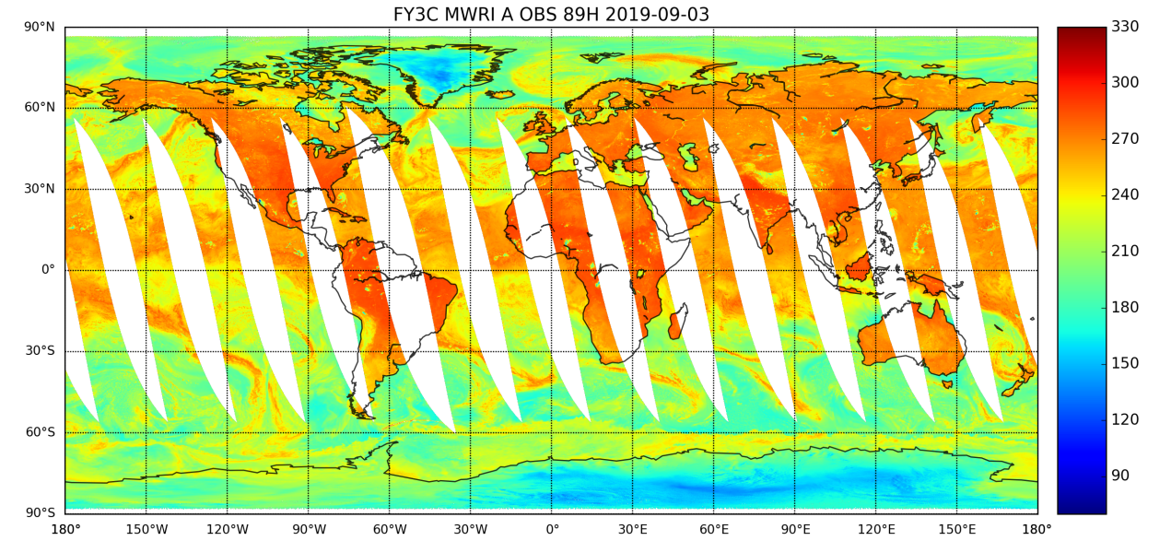
Reprocessing Dataset: FY3X/MWRI
MWRI
MWRI (FY-3A/B/C/D) is a 10-channel, total power radiometer, observing the land, ocean, and atmosphere in conically scanning mode with a 45 degree viewing angle in ~870 km sun-synchronous orbit (Soil moisture, Snow depth, Sea ice concentration, Ocean wind speed, Land surface emissivity, Ocean surface temperature, Land surface temperature, Precipitation water, Cloud water content, Precipitation, etc);
Available period: 2008/06/03 - 2020.12.31;
SDS: 10-89GHz Earth Observation Brightness Temperature, Latitude, Longitude, Solar and Satellite Observation Angles, DEM, LandSeaMask, LandCover;
Validation (MWRI vs GMI): RMSE=0.94-1.34K;

Slide 11
Thank you for your attention
WMO GSICS Portal
http://gsics.wmo.int
GSICS Coordination Centre http://www.star.nesdis.noaa.gov/smcd/GCC/index.php
GSICS Product Catalog https://www.star.nesdis.noaa.gov/smcd/GCC/ProductCatalog.php
GSICS Wiki
http://gsics.atmos.umd.edu/wiki/Home

