Slide 1
EUMETSAT Agency Report
2022
Tim Hewison, Sébastien Wagner, Viju John, Dorothée Coppens, Ali Mousivand, Rose Munro, Simon Elliot, Bertrand Fougnie, Christophe Accadia
Notes:
Quick update on some of the highlights of EUMETSAT‘s contributions to GSICS over the last year
Thanks to my collagues, who are actively involved in these activities…

Slide 2
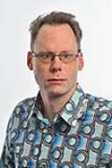
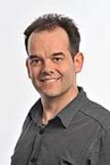
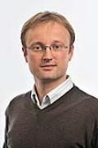
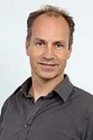
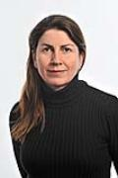
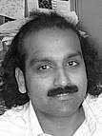
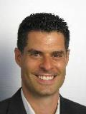
Current official EUMETSAT support for GSICS (bold = formally nominated members)
Executive Panel
Vacant | EUMETSAT representative
Data Working Group
Peter Miu | Not Available
Simon Elliott | Formats Expert
Research Working Group
Tim Hewison | Vice-chair IR sub-group + MW Sub-Group PoC
Sébastien Wagner | VIS/NIR + Lunar calibration
Rob Roebeling | Climate records + SCOPE-CM + Event logging
Rosemary Munro | Chair UV sub-group
Dorothée Coppens | Hyperspectral IR expert
Christophe Accadia Vinia Mattioli | Microwave Sub-Group Members
Supported by
Viju John | Infrared (Meteosat - HIRS) + MW
Ali Mousivand | Radiative Transfer Modelling + Desert Calibration
Rüdiger Lang | UV/VIS/SWIR Spectrometers
Bertrand Fougnie | VIS/NIR polarimetry
Point of Contact for Operational Matters
Harald Rothfuss

Slide 3
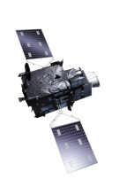
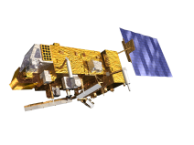
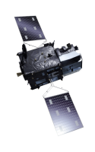
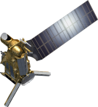
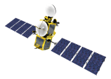
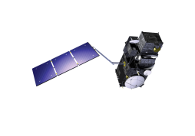
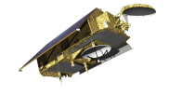
EUMETSAT Mission Planning
YEAR...
03
04
05
06
07
08
09
10
11
12
13
14
15
16
17
18
19
20
21
22
23
24
25
26
27
28
29
30
31
32
33
34
35
36
37
38
39
40
METEOSAT SECOND GENERATION
Meteosat-8 End of Life tests 2022 – including extended Moon scans
Meteosat-9 move to 45.5°E Feb-April 2022 to replace Meteosat-8
METEOSAT-8
METEOSAT-9
METEOSAT-10
METEOSAT-11
MTG-I1 Launch 2022-12
METEOSAT THIRD GENERATION
MTG-I-1 : IMAGERY
Mandatory Programmes
MTG-S-1: SOUNDING
EUMETSAT POLAR SYSTEM (EPS)
MTG-I-2: IMAGERY
METOP-A
MTG-I-3: IMAGERY
METOP-B
MTG-S-2: SOUNDING
METOP-C
MTG-I-4: IMAGERY
EUMETSAT POLAR SYSTEM SECOND GENERATION (EPS-SG)
METOP-SG A: SOUNDING AND IMAGERY
METOP-SG B: MICROWAVE IMAGERY
JASON (HIGH PRECISION OCEAN ALTIMETRY)
JASON-3
COPERNICUS
Optional and Third Party
Programmes
SENTINEL-6 Michael Freilich
SENTINEL-6B
SENTINEL-3 A/B/C/D
SENTINEL-4 ON MTG-S
SENTINEL-5 ON METOP-SG A
YEAR...
03
04
05
06
07
08
09
10
11
12
13
14
15
16
17
18
19
20
21
22
23
24
25
26
27
28
29
30
31
32
33
34
35
36
37
38
39
40

Slide 4
Current Status of EUMETSAT GSICS Products
Monitored Instrument | Product Type / Band | Reference Instrument | GSICS NRT Correction | GSICS Re-Analysis Correction | GSICS Bias Monitoring
Meteosat-8-11 SEVIRI | GEO-LEO IR | Metop-B/IASI Metop-C/IASI | Operational | Operational | Plots RAC
Meteosat-8-11 SEVIRI | GEO-LEO IR Prime | IR Anchor |  | Demo | Plots RAC Need to plot Double Diffs
Meteosat-8/10/11 SEVIRI | GEO-LEO VIS (VIS0.6) | Aqua/MODIS | Demo | Demo | Need to plot RAC
Meteosat-8/10/11 SEVIRI | GEO-LEO VIS/NIR (warm channels) | SNPP/VIIRS | In development | In development | In development
Sentinel3-A, -B SLSTR | LEO-LEO IR | Metop-B/IASI Metop-C/IASI | Assessing Requirement | Assessing Requirement | In development
To be retired
Notes:
Current GSICS Products

Slide 5
Support to GRWG Activities – IR
GSICS IR:
GEO-LEO IR:
Updated Guidelines for Application of GSICS Corrections for Meteosat Imagers – web meeting 2021-12-02
Lessons learned from the transition of IASI-A to IASI-B – web meeting 2021-10-07
Analysis of SNOs during Metop-A End of Life - IASI and/or GOME2 – IR session 2022-03-16
Preparing new reprocessing to remap nonlinearity for old IASI-A – IR session 2022-03-16
Analysis of Metop-A Space View Manoeuvre - IASI/AMSU/MHS/AVHRR (IASI - limb views) - later
GEO-GEO IR:
Implemented GEO-GEO inter-comparison algorithm for FCI-SEVIRI – to be presented later
as part of MICMICS
Including addition of sun-glint filter for RSB channels

Slide 6
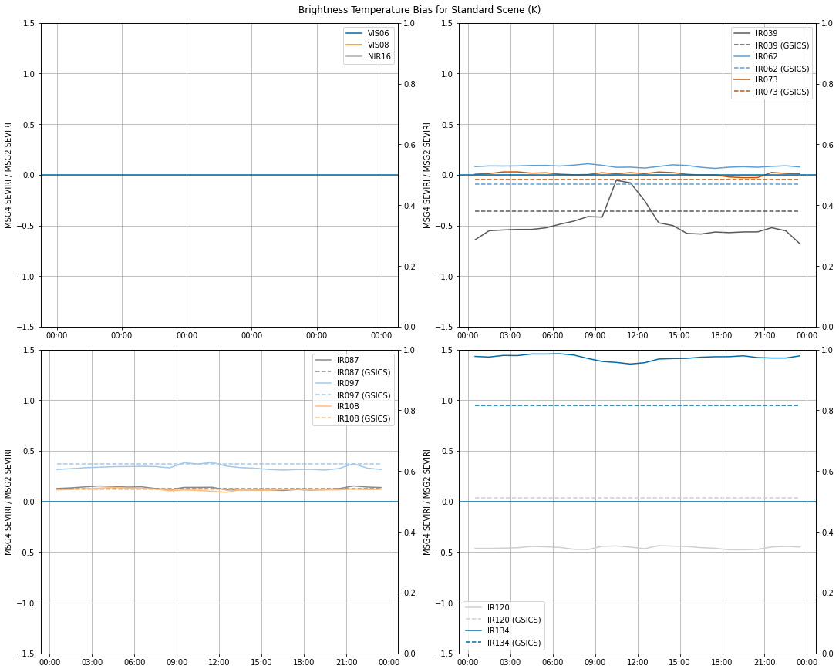
SEVIRI Diurnal Variations between Meteosat-11/-9
Updated GEO-GEO Algorithm:
Added sun-glint filter
Includes VIS/NIR channels (same algorithm)
Reduced VZA threshold to reduce parallax
Updated GEO-GEO results
for MSG4-MSG2 (solid lines)
diurnal averages in good agreement with operational GSICS products (MSG4-IASIC)-(MSG2-IASIC) - dashed lines
For all IR channels
Except IR12.0 and IR13.4
(-/+0.5K difference resp)
IR3.9 still shows variations during day
Even with sun-glint filter

Slide 7
Support to GRWG Activities – VIS/NIR
GSICS VNIR:
Lunar Calibration:
Lunar Model Inter-Comparison Exercise (to be continued in 2021)
GIRO: liaising with USGS to work on traceability to the ROLO
GLOD still to be consolidated
Coordinating monthly lunar manoeuvres for Sentinel-3
DCCs:
Demo products for Meteosat-8 (41.5° E) & Meteosat-11 (0°)
Developments for VNIR (RSB) monitoring:
Development of DCC calibration based on reference RTM simulations
Changing GSICS DCC reference to NOAA-20 VIIRS
Lunar inter-calibration
Preparation of FCI lunar calibration
Developing Rayleigh Calibration method – VIS/NIR Session
Traceability
Participation in TRUTHS MAG
Agency CLARREO Objectives
Extract from OLCI Moon image
SLSTR quick look

Slide 8
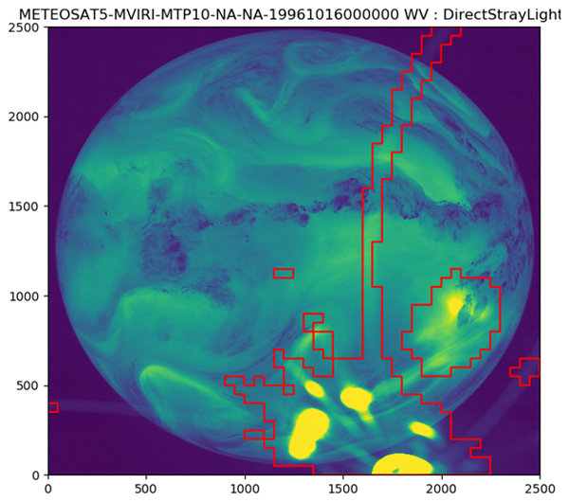
New MVIRI FCDR (R2) with image anomaly info
Anomalies have been detected in Level 1.0 (unrectified images)
Anomaly images have been constructed at L1.0 grid
Anomaly images are then rectified in the same way as normal images
Anomaly images are included as new variables in the FCDR
Anomaly images are available per channel – VIS, IR, and WV
Working to apply the same methodology to the record from the whole GEO-ring
L1.5 Image
Anomaly Image
L1.5 Image – Anomaly Removed
MET5 – 1996-10-16 00:00 – WV Channel

Slide 9
Support to GDWG Activities
No progress to report on GSICS Data Working Group
Peter Miu is not able to support GDWG in 2022
Due to other commitments
EUMETSAT hope to resume normal GDWG service in 2022

Slide 10
Update on EUMETSAT 2021 GSICS Actions
Action Id | Summary | Expected Completion | Actual Completion | Deliverable Usage | Status
R.GIR.20210113.1 | The IASI SDR instrument team from EUMETSAT and CNES is recommended to draft a memo on how the IASI general data quality flag is generated and explain why IASI have negative radiance values at the SW region. Based on this, a best practice on how to handle IASI negative radiance values will be recommended to the team. (Circulated by email 2021-01-14 | 2022-03-01 | 2021-04-08 (Presentation at annual meeting) |  | Closed

Slide 11
Update on EUMETSAT 2020 GSICS Actions
Action Id | Summary | Expected Completion | Actual Completion | Deliverable Usage | Status
A.GIR.20200319.1 | Sebastien Wagner (EUMETSAT) and Vinia Mattioli (EUMETSAT) to consider renaming the microwave session of the 3rd Lunar Calibration Workshop to include the TIR. | 3/1/2021 |  | Wiki | Closed
A.GIR.20200319.8 | Dorothee Coppens (EUMETSAT) to send notifications of IASI status updates impacting its calibration to the GSICS developers mailing list | 3/1/2021 |  | Announced on Google Group | Closed
A.GVNIR.2020.16f.1 | EUMETSAT (S. Wagner) to liaise with USGS (T. Stone) to realign the GIRO with respect to the last version of the ROLO model. | 3/1/2021 |  |  | Open (ongoing)
A.GVNIR.2020.16f.2 | EUMETSAT (S. Wagner) to propose letter of recommendation by GSICS to NASA to highlight the benefits to continue the Air-LUSI campaigns to lunar calibration. | 3/1/2021 | 3/1/2021 | NASA does not accept recomendation letters | Closed
A.GVNIR.2020.19g.3 | EUMETSAT (S. Wagner) to propose letter of recommendation by GSICS to NASA to highlight the benefits of ARCSTONE project for GSICS activities and its members | 3/1/2021 |  | NASA cannot accept such a letter | Closed
A.GWG.2020.1e.1 | Create a GSICS Meeting to discuss GSICS input and what we would like to learn to guide participation in the ECMWF/EUMETSAT Workshop on characterizing random and systematic errors in satellite data assimilation for NWP | 30/09/2020 | 06/08/2020 | See meeting 2020-06-08 | Closed
A.GWG.20200416.1 | Dorothee Coppens (EUMETSAT) to circulate plans for Metop-A End Of Life testing, which is expected for 2021Q3/Q4 for IASI | 3/1/2021 |  | Announced on Google Group | Closed
A.GWG.2020.1f.1 | GSICS will hold a web meeting in June to establish a Task Force from GSICS and ISCCP-NG to identify requirements and set up pilot programs before a meeting at EUMETSAT in September | 3/1/2021 |  | See meeting 2020-08-12 | Closed

Slide 12
Update on EUMETSAT 2020 GSICS Actions - continued
Action Id | Summary | Expected Completion | Actual Completion | Deliverable Usage | Status
A.GVNIR.2020.18g.1 | UMD (Hu Tiger Yang) to coordinate with EUMETSAT (Vinia Mattioli) to draft a note outlining possible further collaborations on microwave and thermal infrared lunar calibration activities. | Hu (Tiger) Yang | 3/1/2021 | memo was prepared and circulated to GSICS MW chairs + LC community | Closed
A.GVNIR.2020.16f.3 | EUMETSAT (S. Wagner) to report on the Model Inter Comparison Exercise at the next GSICS annual meeting + Lunar Calibration Community. | 3/1/2021 |  |  | Open
A.GVNIR.2020.16f.4 | EUMETSAT (S. Wagner) to check possibilities to create a distribution list for the Lunar Calibration Community. | 3/1/2021 |  |  | Open
A.GVNIR.2020.19g.2 | EUMETSAT (S. Wagner) to liaise with the participants to the Lunar Calibration Workshop to ensure a follow-on on the actions / recommendations | 3/1/2021 |  |  | Open
R.GVNIR.2020.16f.2: | EUMETSAT (S. Wagner) to investigate the possibility to revisit the mechanism to share the GIRO model, whilst respecting the existing license agreement | 3/1/2021 |  |  | Open (ongoing)
Notes:
Open Actions related to Lunar Calibration to be addressed by Seb in his presentation on Wednesday

Slide 13
Thank you for your attention
WMO GSICS Portal
http://gsics.wmo.int
GSICS Coordination Centre http://www.star.nesdis.noaa.gov/smcd/GCC/index.php
GSICS Product Catalog https://www.star.nesdis.noaa.gov/smcd/GCC/ProductCatalog.php
GSICS Wiki
http://gsics.atmos.umd.edu/wiki/Home

