Slide 1
USGS Agency Report to GSICS March 15, 2022
Tom Stone
– USGS Flagstaff Science Center
Cody Anderson
– USGS Earth Resources Observation and Science (EROS) Center

Slide 2
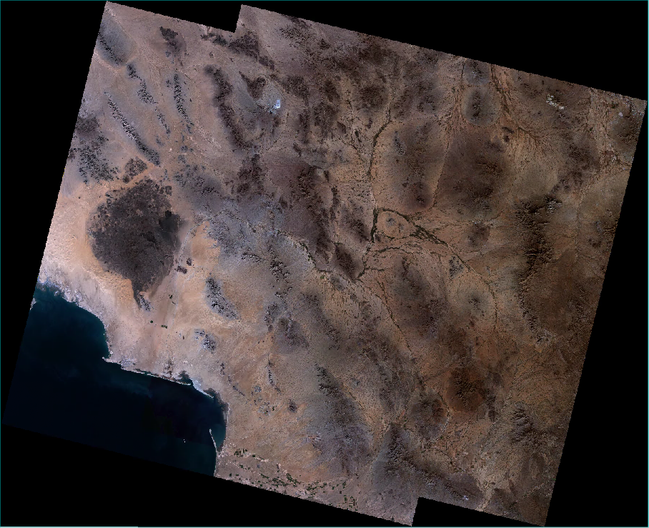
Observatory Updates — Landsat 9
Launched: September 27, 2021
Passed post-launch assessment review, operational: January 31, 2022
Landsat 9 data publicly available: February 10, 2022
Extensive post-launch calibration activities
ground campaigns and global underfly:
L8
Path 37 Row 38 – 2021/11/15
LC80370382021319LGN00
LC90370382021319LGN01
L9

Slide 3
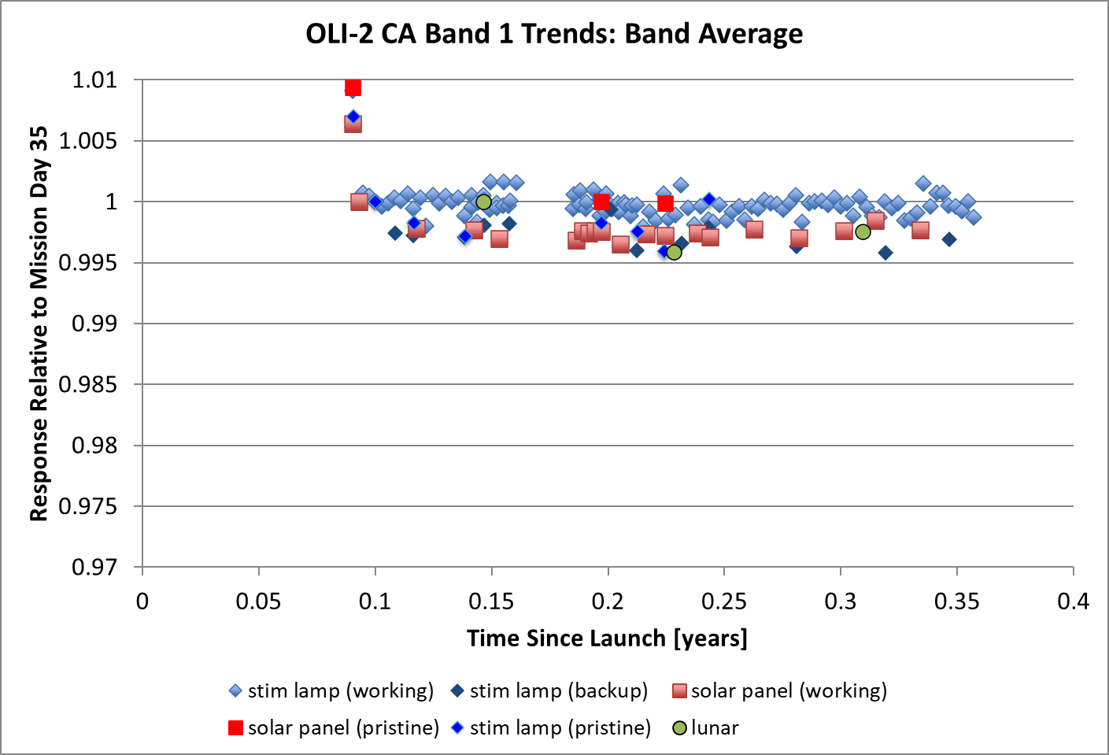
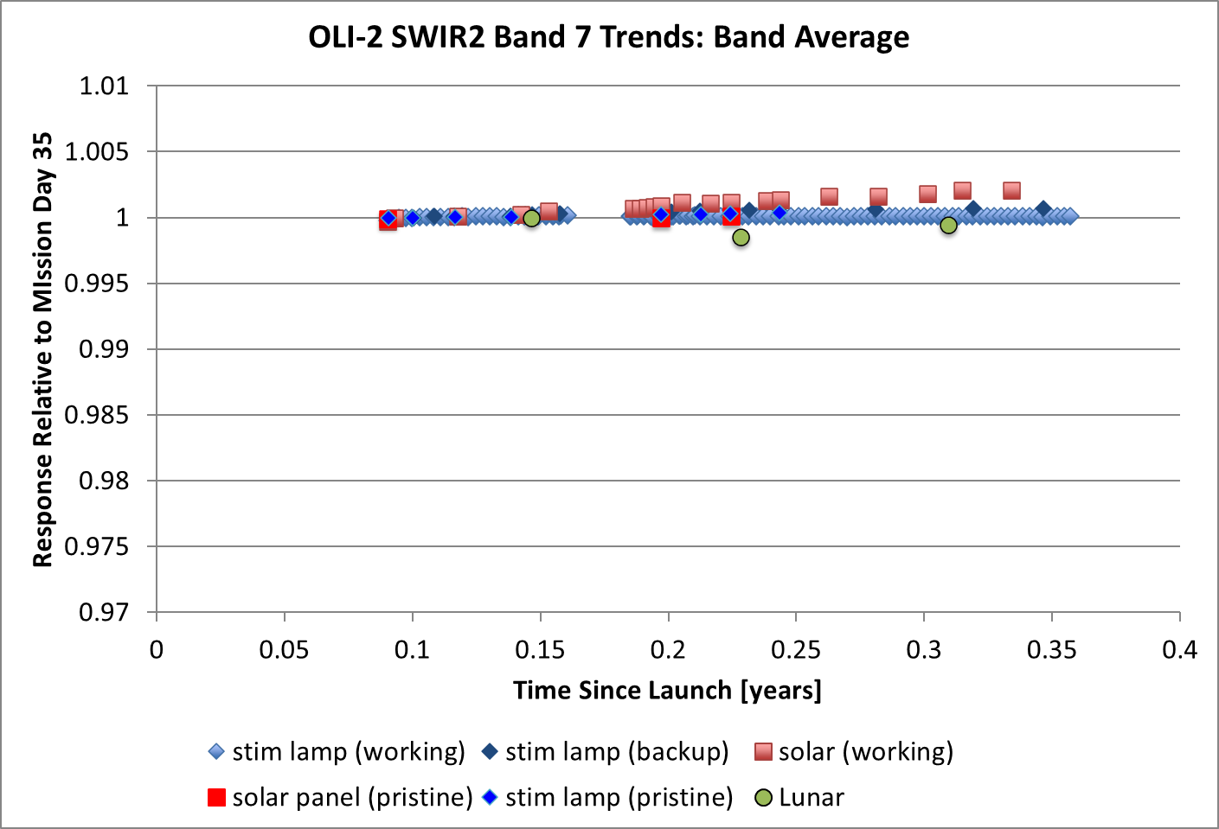
Landsat 9 — OLI-2 Radiometric Calibration
All on-board calibrators are in agreement and behaving similarly to Landsat 8
All sources are currently stable

Slide 4
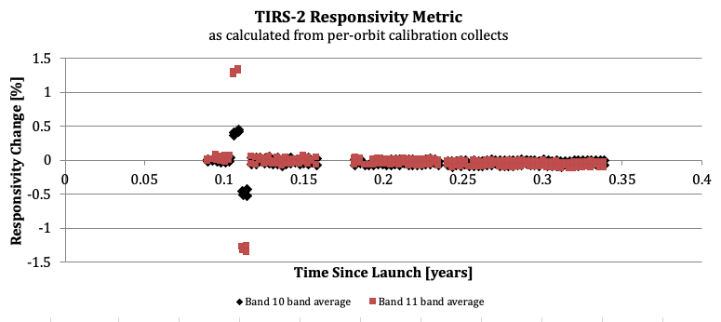
Landsat 9 — TIRS-2 Radiometric Calibration
On-board black-body responses are stable
L9 TIRS calibration collects are performed every orbit consistent with the original L8 Ops Con

Slide 5
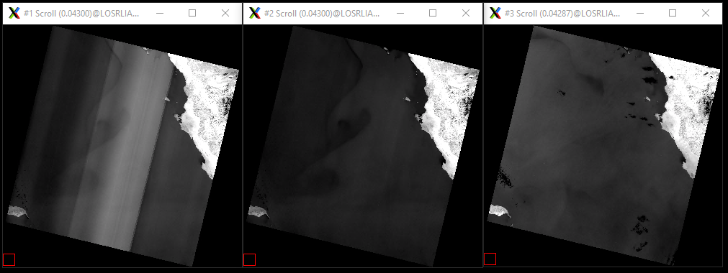
L9 TIRS Stray Light Improvement over L8
Band 11
L8*
L8
L9
*L8 Imagery without Stray Light correction
L8 Imagery with Stray Light correction (default product)
L9 Imagery without Stray Light correction (default product

Slide 6
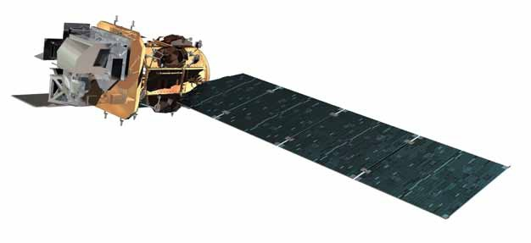
Observatory Updates — Landsat 8
Launched: February 11, 2013
8 years on-orbit
All systems still operating nominally
8-day global coverage with Landsat 9 (16-day coverage with single observatory)

Slide 7
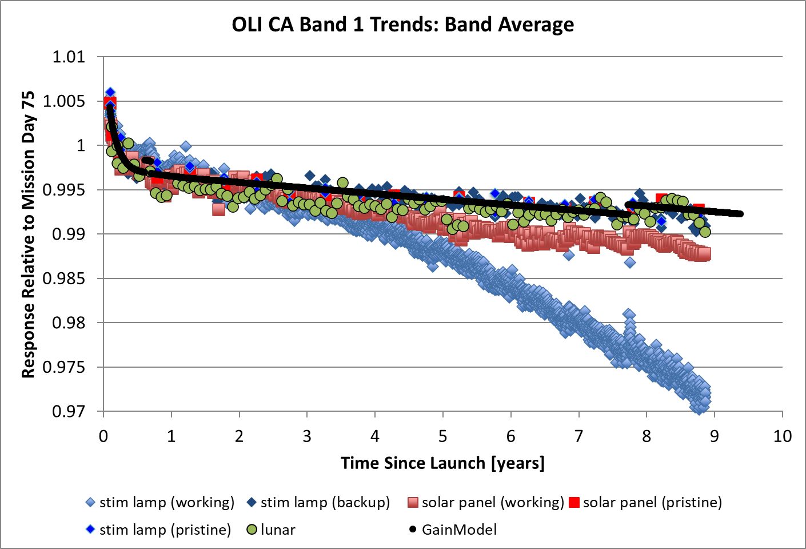
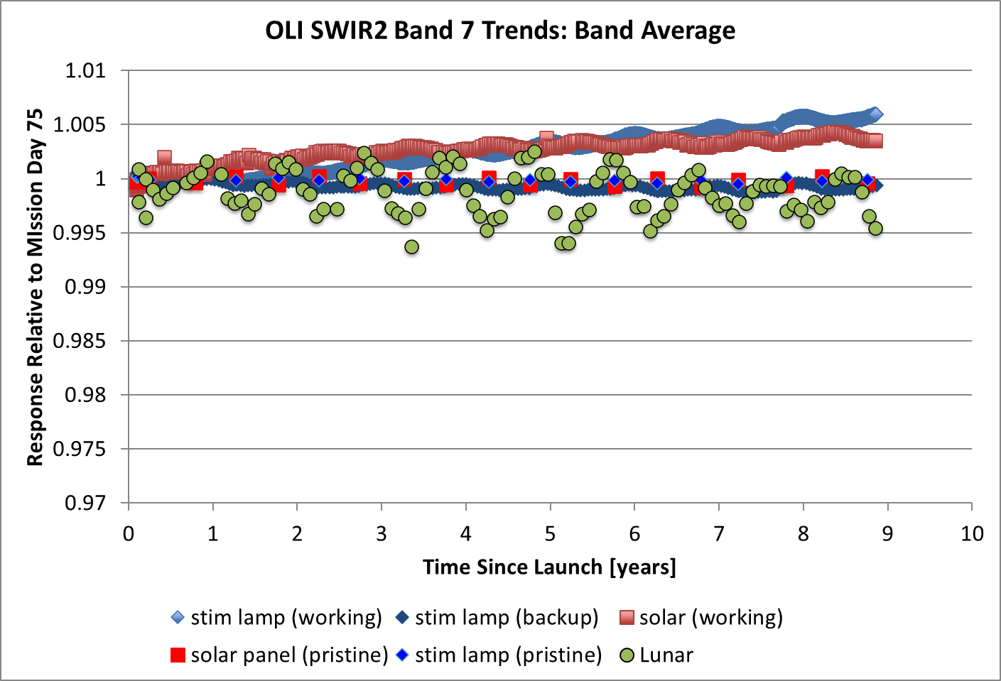
Landsat 8 — OLI Radiometric Calibration
Working lamp and working solar diffuser are not used in gain modelling

Slide 8
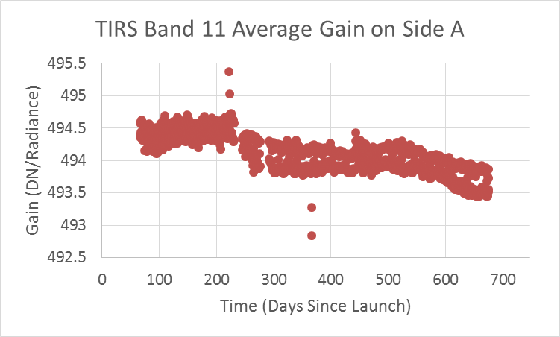
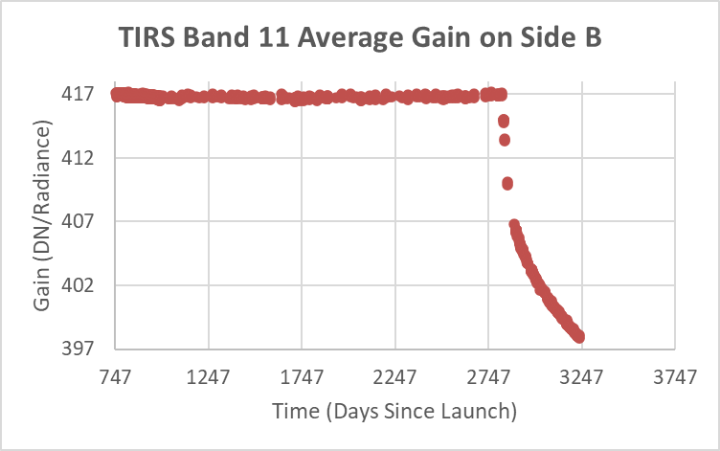
Landsat 8 — TIRS Radiometric Calibration
Nov. 2020 Safehold caused a shift in response
Change from Side A electronics to Side B electronics
Response after safehold continues drop, but at a slow rate (total drop ~4.5%)
All changes are corrected by calibration parameters, so data are consistent

Slide 9
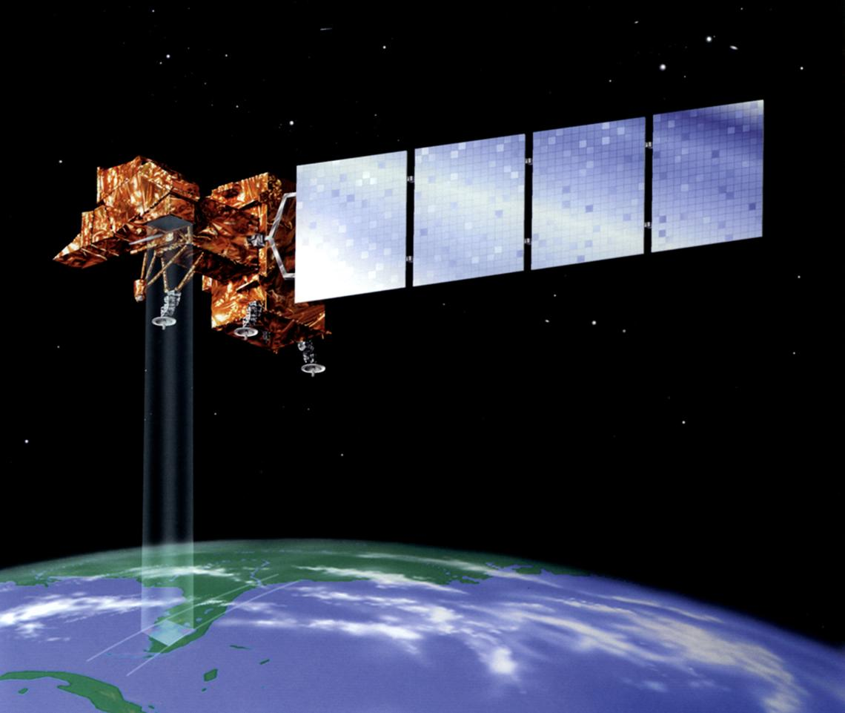
Observatory Updates — Landsat 7
Launched: April 15, 1999
almost 23 years on orbit, still collecting science data
Final orbit correction burn: February 7, 2017
node crossing time has drifted to earlier than 09:00 (from nominal 10:00)
publication on impact on science: doi.org/10.1016/j.srs.2021.100026
Orbit-lowering maneuver planned to support on-orbit servicing/restoration mission
Science imaging to continue over CONUS

Slide 10
USGS Activities of Interest to GSICS
EROS Cal/Val Center of Excellence (ECCOE) lunar calibration working group
Efforts on two tracks:
Refine and reprocess the ROLO dataset, to support advanced lunar modeling and redeveloping the lunar calibration reference (irradiance model)
Develop new image processing techniques for deriving lunar irradiance measurements from OLI line-scanned images of the Moon
L8 and L9 are collecting lunar images monthly
Satellite Cross-calibration Radiometer (SCR) mission under development with Australia: Geoscience Australia, the Australian Space Agency and CSIRO
On-orbit hyperspectral cross-calibration mission

Slide 11
Thank you!

Slide 12
USGS Personnel Supporting GSICS
Tom Stone — GRWG
USGS lunar calibration lead, co-developer of the ROLO model
key collaborator on development of the GIRO
Cody Anderson — GRWG
USGS EROS Cal/val Center of Excellence (ECCOE) lead
Greg Stensaas — EP
USGS Remote Sensing Technologies, RCA-EO Program Manager
no GDWG representative – USGS is open to discussion of need

