Slide 1
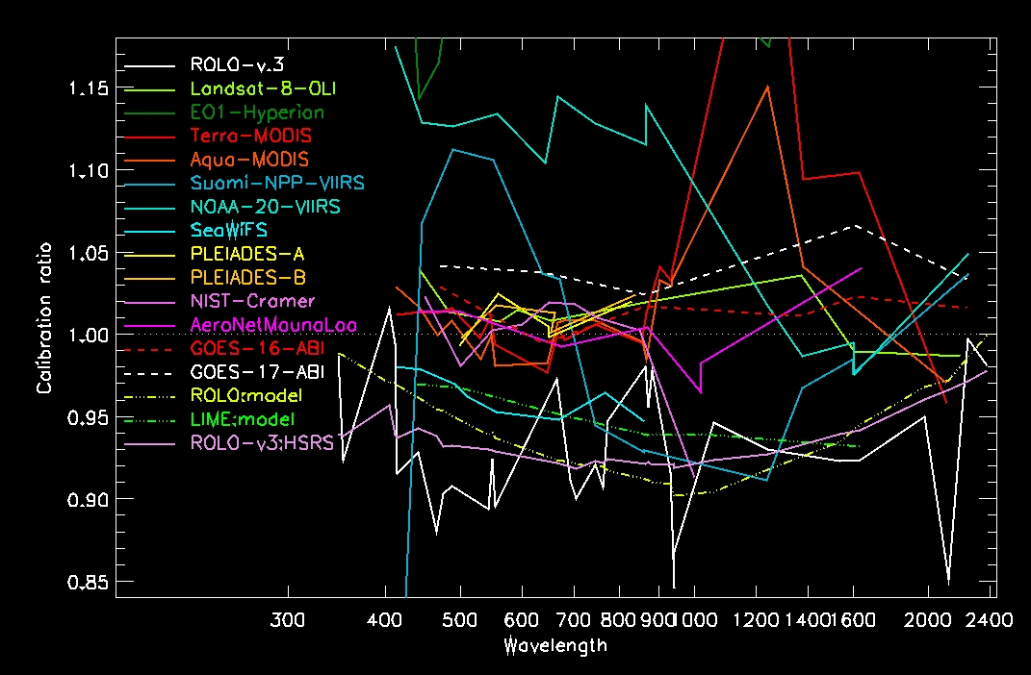
Discussion on Lunar Calibration Comparisons Between Instruments
Motivated by results from the SLIMED lunar model, developed by Hugh Kieffer
Comparisons to SLIMED for several instruments' lunar measurements and 2 models
The instruments are not this different, and the lunar model is not this inaccurate. There must be another explanation.

Slide 2
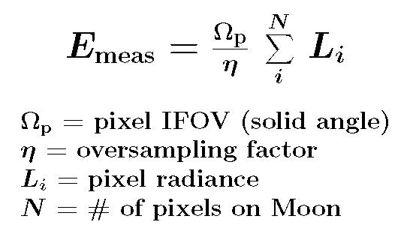
Some considerations for discussion:
Need: careful and accurate extracting lunar irradiances from images:
especially for line-scanning imagers
this requires accurate evaluations of:
solid angle of pixel FOV (different from GSD)
oversampling factor
dark level subtraction
Recommended: to acquire Moon observations as close as practical to the operational observation configuration
viewing the Moon in nadir-viewing optics is preferable, but requires satellite attitude maneuvers
understanding optical response differences for different viewing configurations
Critical need: high-accuracy lunar irradiance measurements, to use as reference for models
active projects to acquire these: air-LUSI (operational), MLO-LUSI (in development), ARCSTONE (in development)

Slide 3
Comparisons to SLIMED for several instruments' lunar measurements and 2 models

Slide 4
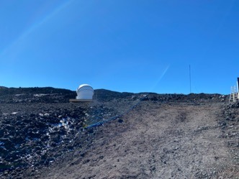
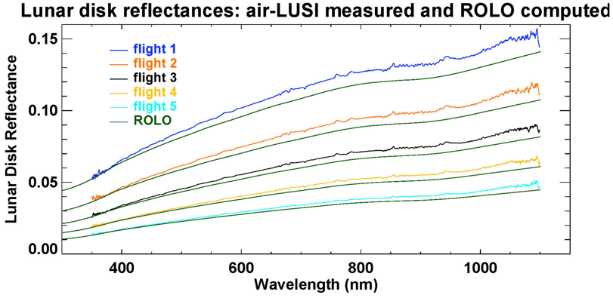
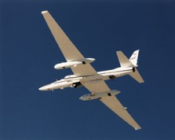
Updates on the LUSIs
MLO-LUSI – NIST (Maxwell, Woodward)
Goal: Acquire long-term (3-5 year) dataset of lunar spectral irradiance from Mauna Loa Observatory using state-of-the-art calibration methodology
Status:
Observatory Dome and Calibration Lab are installed at the site and have electrical power.
Telescope is installed in observatory dome
Major equipment on site and tested
Next trip to site is planned May to June 2022 to begin system integration and automation
air-LUSI (NASA/NIST/UMBC/McMaster. PI –Turpie)
Goal: Acquire a set of 10-30 measurements lunar spectral irradiance from above 95% of the atmosphere on NASA’s ER-2 using state-of-the-art calibration methodology
Status:
Data collected during Demonstration flights 2019 (5 nights), Operational flights Mar 12-16, 2022 (4 nights).

Slide 5
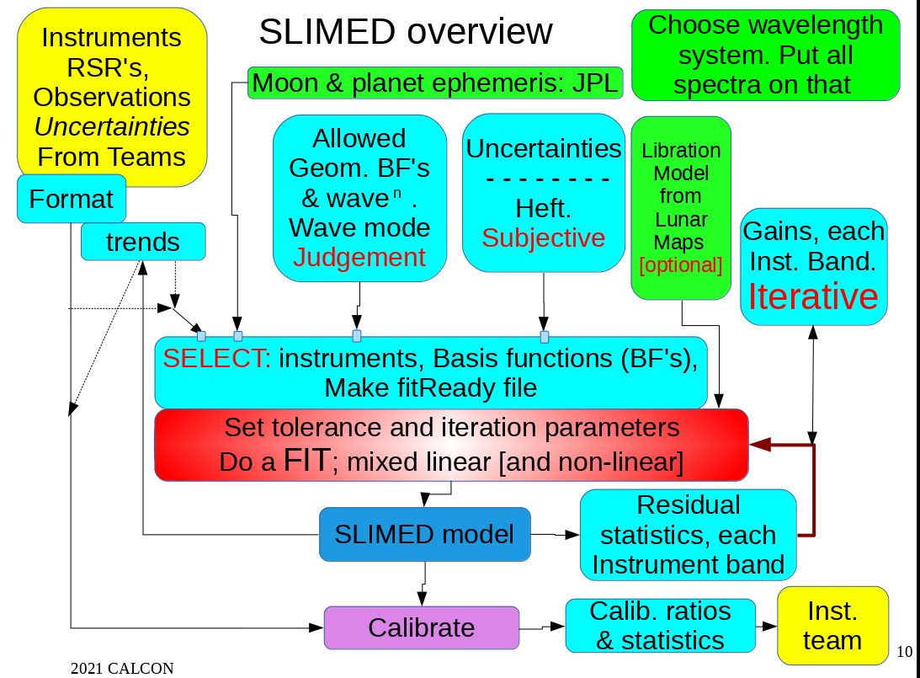
Diagram of SLIMED model development

Slide 6
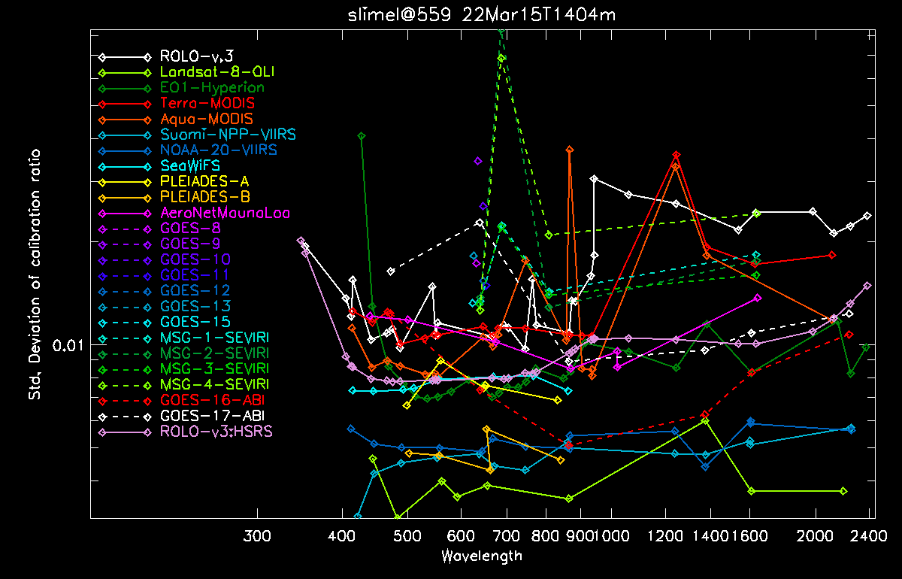
Variances of input data used for SLIMED model development

