Slide 1
GSICS Agency Report
2022
Clémence Pierangelo
Contributions from : Laura Le Barbier (CNES), Olivier Vandermarcq (CNES), Yannick Kangah (SPASCIA), François Bermudo (CNES), Aimé Meygret (CNES), Sébastien Clerc (ACRI)
CNES

Slide 2
Presentation Overview
IASI main events and status
IASI-NG activities
CNES activities for imagers
Report on Copernicus Cal/Val Solutions study

Slide 3
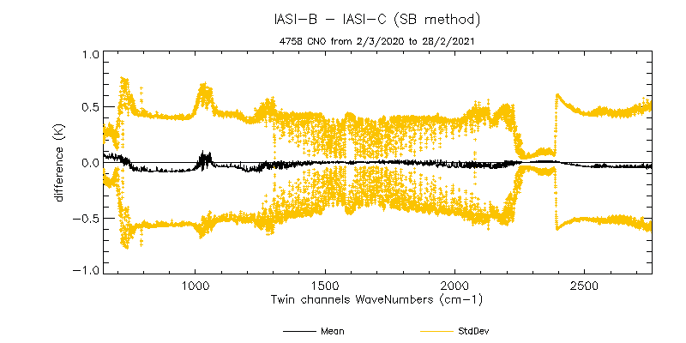
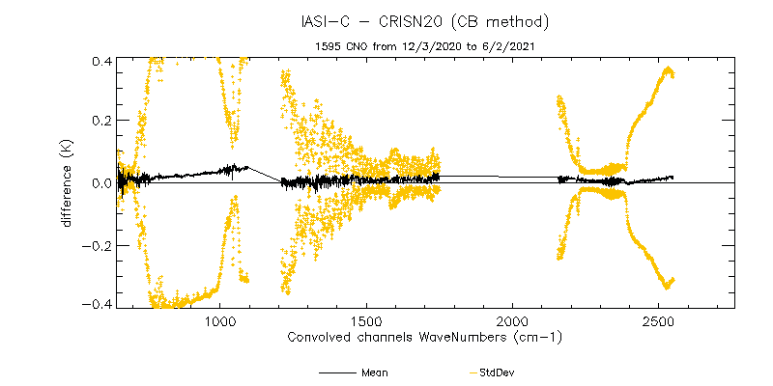
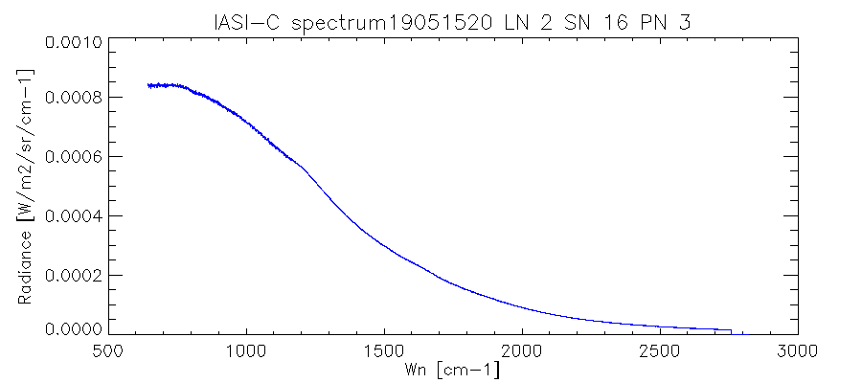
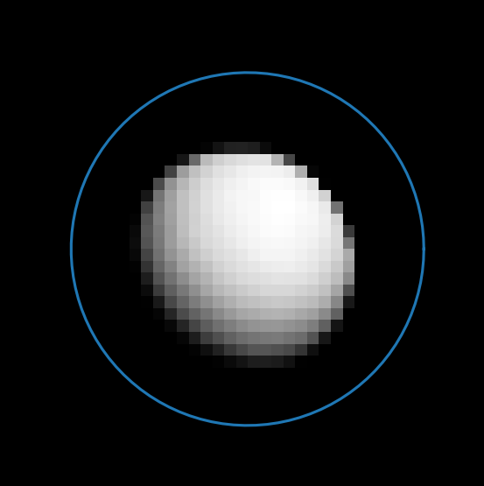
IASI Main events & Status
General status
  IASI-B and IASI-C instruments are stable
  IASI-A : Operational service stopped on the 15th of October 2021 – EOL test campaign from Sept. to Nov. 2021
Radiometric inter-comparaisons
  Very good ≤ ± 0,1 K (bias)
Specific point
  Lunar data acquired each month in 2021 by IASI-B and IASI-C
  Potential interest as a complementary radiometric source for inter comparisons of hyperspectral IR sounders – Phase 2 study started – Final results expected mid 2022.
Example of a Moon spectrum by IASI-C
for a centred pixel configuration

Slide 4
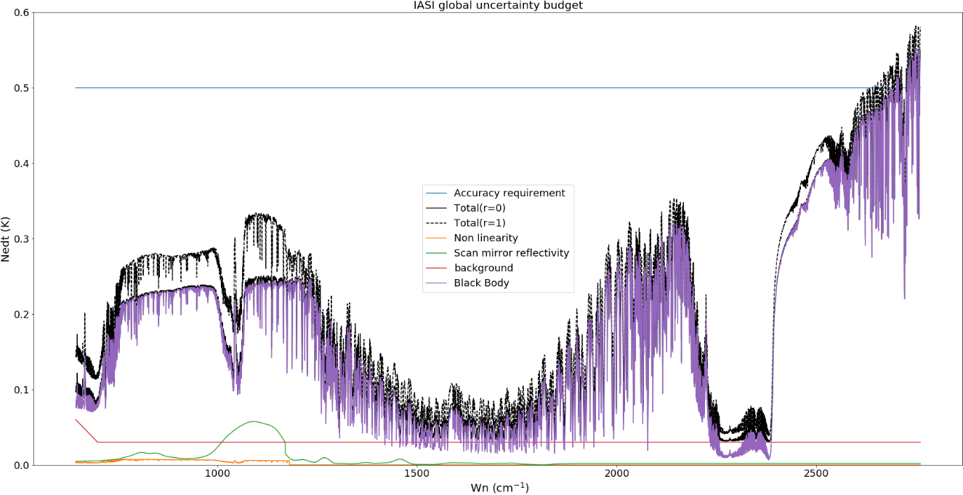
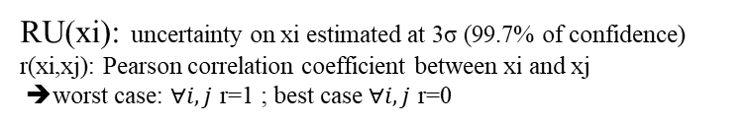

IASI radiometric budget
The main contributors :
  Non linearity (knowledge error and stability)
  Black Body (BB) (temperature and emissivity knowledge and stability)
  Background temperature (stability)
  Scan mirror reflectivity (stability)
Method and preliminary results:
  $GRU=\sqrt{\sum_{i=1}^{n}{{RU(x_{i})}^{2}}+2×\sum_{i=1}^{n−1}{\sum_{j=i+1}^{n}{r(x_{i},x_{j})RU(x_{i})RU(x_{j})}}}$
RU(xi): uncertainty on xi estimated at 3σ (99.7% of confidence)
r(xi,xj): Pearson correlation coefficient between xi and xj
➔worst case: $∀i,j$ r=1 ; best case $∀i,j$ r=0
Dominated by the BB temperature uncertainty with an additional impact of the scan mirror reflectivity errors. But these later are fully predictable and are regularly remove when they reach 0.1K
Dominated by the BB temperature uncertainty. Note that the impact of the filtering of radiometric coefficients and BB temperatures is not considered here.
  Other error sources (scan mirror temperature instability, scan angle knowledge error, interferogram phase instability) have negligible effects on radiometry.
  At the end of B3 band the BB temperature uncertainty induces uncertainties greater than 0.5 K (requirement) especially for warm tropical scenes (not shown). But the filtering effects would certainly mitigate the impact of the BB temperature uncertainty.

Slide 5
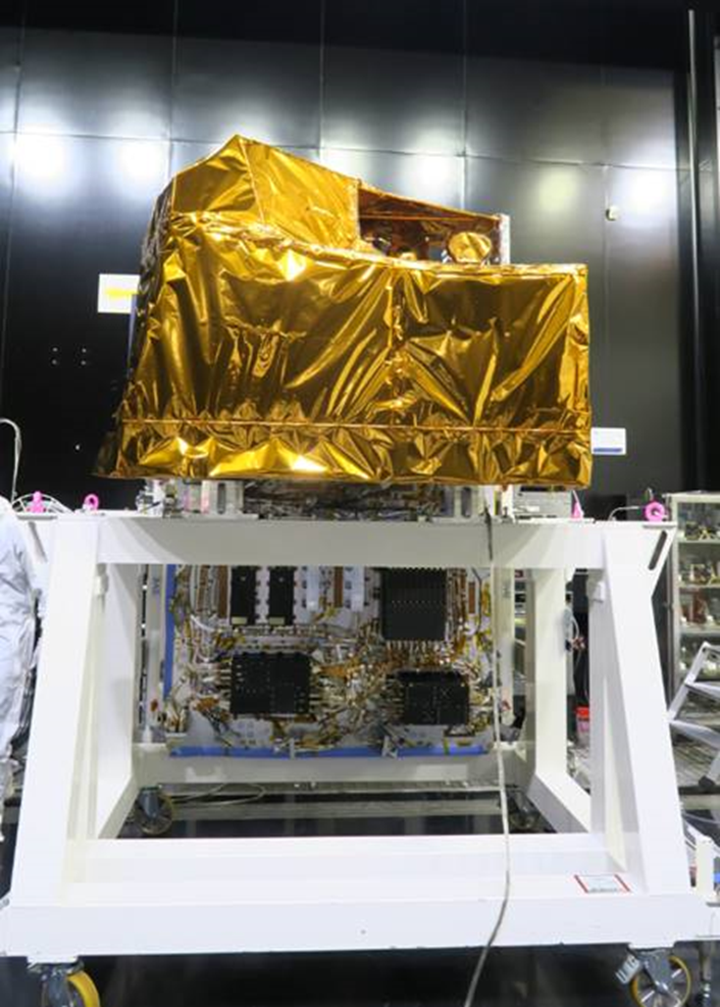
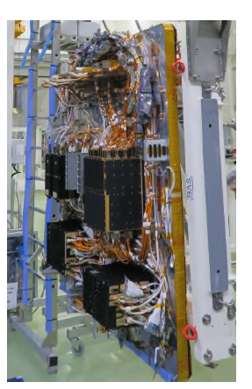
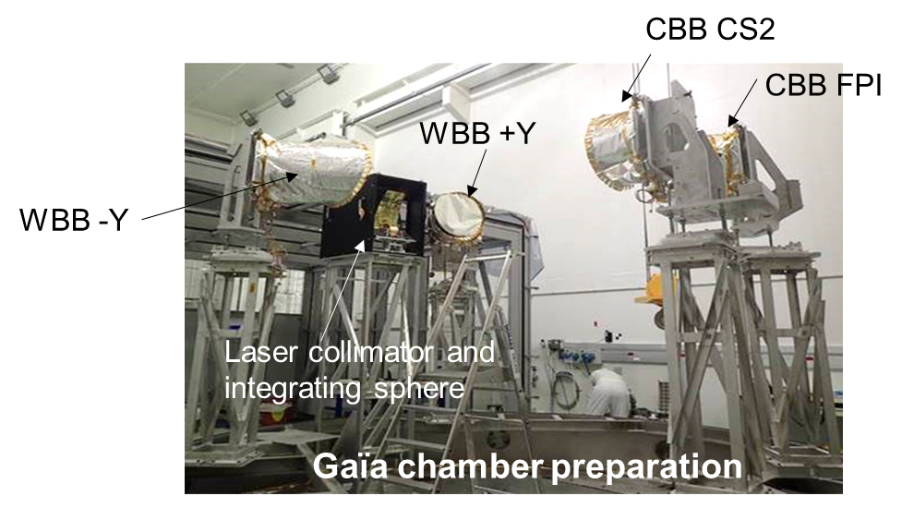
IASI-NG Program Status : Instrument Activities
  Intense activities of Integration and test on PFM instrument Model : I-OH (Optical Module ) and I-EM (Electrical Module) coupling activities on going
  Functional tests beginning this week
  TV chamber preparation on-going with BB OGSE installation for instrument performances Test
Module Optique
Module Electronique

Slide 6
IASI-NG Program Status : System & Ground Segment Activities
  Delivery date of the IASI-NG PFM to METOP-SG in August 2022
  L1CPOP V1 (part of science processing algorithms) completed and delivered in 2021 to EUMESAT : integration in PDAP (Payload Data Acquisition & Processing ) V2L on going
  L1CPOP V2 full version (complete science algorithms processing) under development for delivery date in September 2023 for integration in the PDAP V3A for launch
  METOP SG A1 Launch in summer 2024

Slide 7
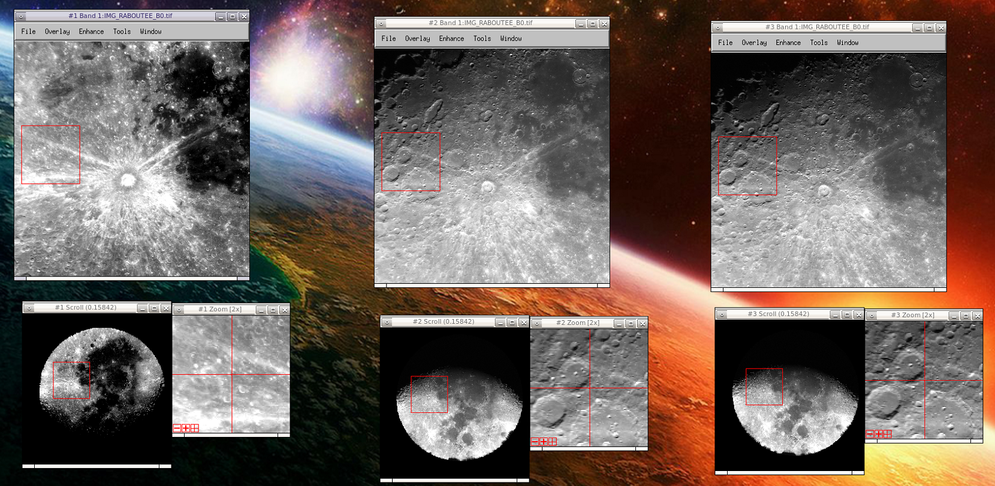
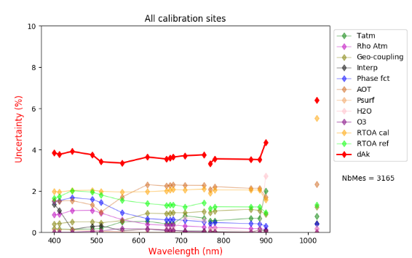
Calibration activities at CNES for imagers
Development of SUMULU : a simulator to generate « realistic » radiometric images of the Moon :
Cross-calibration method based on PICS: error budget tool updated and applied to SENTINEL-3 OLCI and SLSTR, and SENTINEL-2
Comparison exercise between RAL and CNES glint calibration methods for SLSTR (see dedicated presentation by ESA)
Next activities:
  Instrumentation of La Crau test site with TIR radiometer in preparation of TRISHNA CalVal (JPL/CNES collaboration)
  Ocean stand alone calibration method for TIR sensors
S3/OLCI-S2 Budget Uncertainty

Slide 8
The CCVS project
Objective of the H2020 Copernicus Cal/Val Solution project:
  To define a holistic Cal/Val solution for all Copernicus Sentinel missions to overcome current limitations of Calibration and Validation (Cal/Val) activities.
Project duration:
  Dec. 2020 to Nov. 2022
Project website
  https://ccvs.eu
Contact us
  contact@ccvs.eu
First phase completed
  Cal/Val requirements for all Sentinel Missions
  Survey of existing Cal/Val reference sources
  Project workshop October 2021
Second phase in progress
  Recommendations for technology development and R&D activities, measurement sites and field campaigns deployment
  Implementation roadmap and coordination with stakeholders

Slide 9
Preliminary list of recommendations relevant for GSICS
Maintain effort to manage measurement uncertainties and SI traceability at all levels
  From satellite data to in-situ and collocation uncertainty
Sustain operational in-situ data provision at global level
  Transition from research to operational framework needed
Improve inter-operability
  Generalize tandem phases for constellation missions
  Develop cross-sensor validation approaches
  Maintain alternative processing chains and inter-compare results
  International coordination with India/China on inter-calibration of altimetry missions
  Inter-compare vicarious models (lunar, DCC) – develop lunar thermal model

Slide 10
Thanks for your attention!

Slide 11
Additional Slides Not Presented
Introduce the Agency’s Personnel Supporting GSICS
  Executive panel : Adrien Deschamps replaces Pierre tabary
  GRWG members : Aimé Meygret (VIS), TBD (IR)
Agency’s GSICS activities to be discussed in this joint meeting
  Presentation dedicated to IASI End-of-Life tests

Slide 12
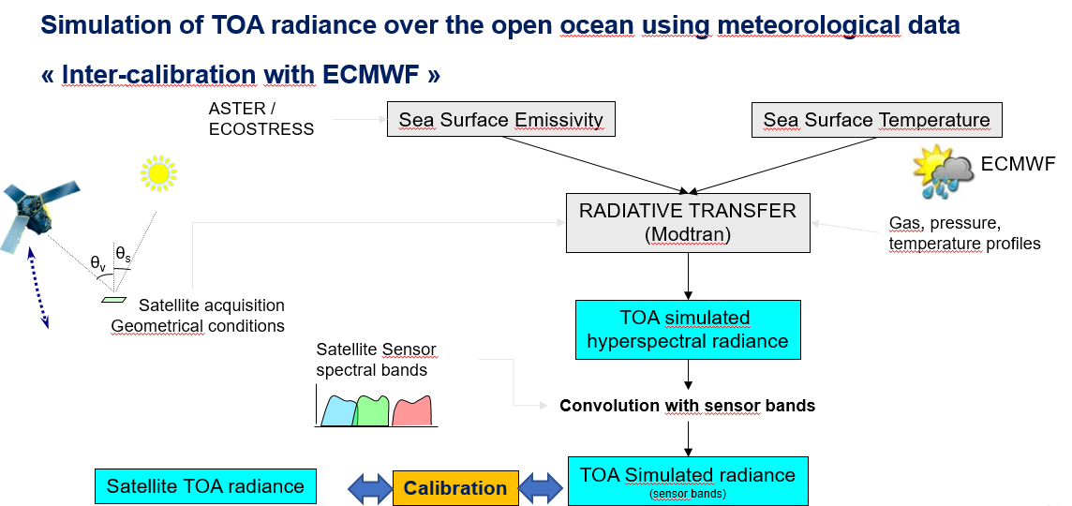
Calibration activities at CNES for imagers
Development of SUMULU : a simulator to generate « realistic » radiometric images of the Moon – on going activity:
  Orthorectification of PLEIADES images of the moon (several complete moon cycles observed, 1250 images) in a selenographic reference frame to register them with the objective to retrieve the BRDF of the full moon disk and to improve our radiometric simulations
  Application to calibration, but also to linearity, non uniformity, straylight and MTF assessment
Cross-calibration method based on PICS: error budget tool updated and applied to SENTINEL-3 OLCI and SLSTR, and SENTINEL-2
Comparison exercise between RAL and CNES glint calibration methods for SLSTR (see dedicated presentation by ESA)
Next activities:
  Instrumentation of La Crau test site with TIR radiometer in preparation of TRISHNA CalVal (JPL/CNES collaboration)
  Ocean stand alone calibration method for TIR sensors (used for IASI and updated for TRISHNA): error budget study on going
S3/OLCI-S2 Budget Uncertainty

Slide 13
IASI-NG Program Status : System & Ground Segment Activities
  Delivery date of the IASI-NG PFM to METOP-SG in August 2022
  L1CPOP V1 (part of science processing algorithms) completed and delivered in 2021 to EUMESAT : integration in PDAP (Payload Data Acquisition & Processing ) V2L on going
  L1CPOP V2 full version (complete science algorithms processing) under development for delivery date in September 2023 for integration in the PDAP V3A for launch
  METOP SG A1 Launch in summer 2024

