Slide 1
GSICS State of Observing System Report 2021
Tim Hewison, Sebastien Wagner
EUMETSAT

Slide 2
Satellite/Instrument Summary - GEO
Hyperlinks on instrument names navigate to the Calibration Landing Page
Satellite (status) |  | Location | Launch date | EO instruments
Meteosat-8 | Op | 41.5°E | 2002-08-28 | SEVIRI | GERB
Meteosat-9 | B | 3.5°E | 2005-12-21 | SEVIRI | GERB
Meteosat-10 | RSS | 9.5°E | 2012-07-05 | SEVIRI | GERB
Meteosat-11 | Op | 0.0°E | 2015-07-15 | SEVIRI | GERB
Satellite Status
 | Op = Operational
 | P = Pre-operational
 | B = Back-up, secondary
 | L = Limited availability
Instrument Status
 |  | Operational (or capable of)
 |  | Operational with limitations (or Standby)
 |  | Operational with Degraded Performance
 |  | Not Operational
 |  | Functional, Turned Off
Major calibration relevant events in 2021
None
EUMETSAT User Notification Service
Other events of interest in 2021
During 2021-11-10/12-07 Meteosat-9, -10 and -11 all operated in Full Earth Scanning (FES) mode with L1.5 data rectified to the operational 0.00°E grid

Slide 3
Calibration Performance: Meteosat/SEVIRI Visible Bands 2021
Summary Statistics of Meteosat/SEVIRI VIS/NIR Calibration Performance (All Uncertainties are k=1)
Channel Name |  | VIS0.6 | VIS0.8 | NIR1.6 | HRV | Units
Meteosat-8 | Mean Bias (DCC-SSCC) | +13.6 ± 2.3 |  |  |  | %
 | Annual Drift (DCC) | -0.54 ± 0.02 |  |  |  | %/yr
 | Annual Drift (SSCC) | -0.55 ± 0.03 | -0.56 ± 0.02 | -0.05 ± 0.02 | -0.55 ± 0.03 | %/yr
 | Annual Drift (LCS) | -0.58 ± 0.01 | -0.56 ± 0.01 | -0.04 ± 0.02 | -0.55 ± 0.02 | %/yr
Meteosat-9 | Annual Drift (SSCC) | -0.58 ± 0.06 | -0.57 ± 0.05 | -0.05 ± 0.05 | -0.57 ± 0.05 | %/yr
 | Annual Drift (LCS) | -0.56 ± 0.01 | -0.52 ± 0.01 | -0.01 ± 0.02 | -0.55 ± 0.01 | %/yr
Meteosat-10 | Annual Drift (SSCC) | -0.60 ± 0.08 | -0.63 ± 0.06 | -0.05 ± 0.06 | -0.65 ± 0.07 | %/yr
 | Annual Drift (LCS) | -0.70 ± 0.02 | -0.69 ± 0.01 | -0.04 ± 0.04 | -0.76 ± 0.06 | %/yr
Meteosat-11 | Mean Bias (DCC-SSCC) | +10.21 ± 1.4 |  |  |  | %
 | Annual Drift (DCC) | -0.55 ± 0.01 |  |  |  | %/yr
 | Annual Drift (SSCC) | -0.50 ± 0.17 | -0.44 ± 0.15 | -0.04 ± 0.15 | -0.52 ± 0.16 | %/yr
 | Annual Drift (LCS) | -0.53 ± 0.05 | -0.45 ± 0.04 | -0.10 ± 0.15 | -0.56 ± 0.12 | %/yr

Slide 4
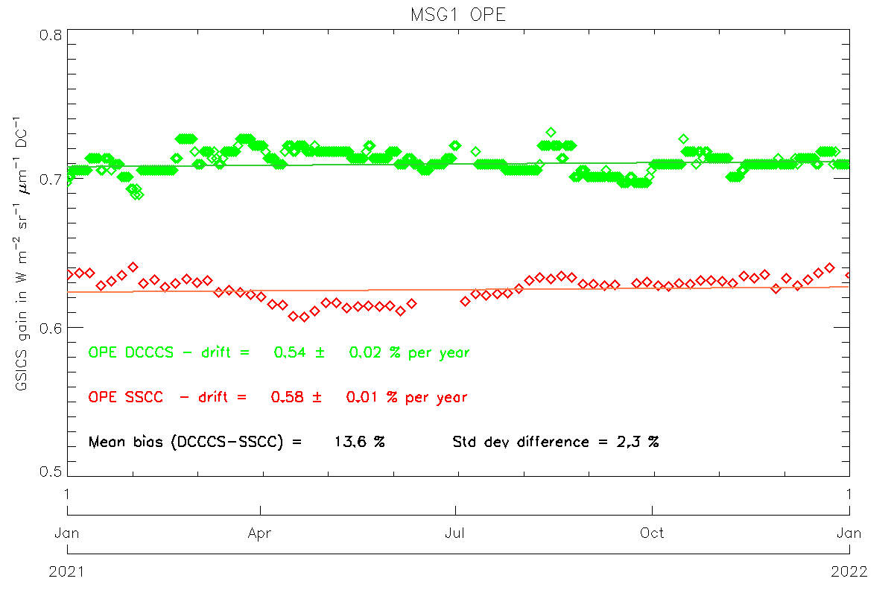
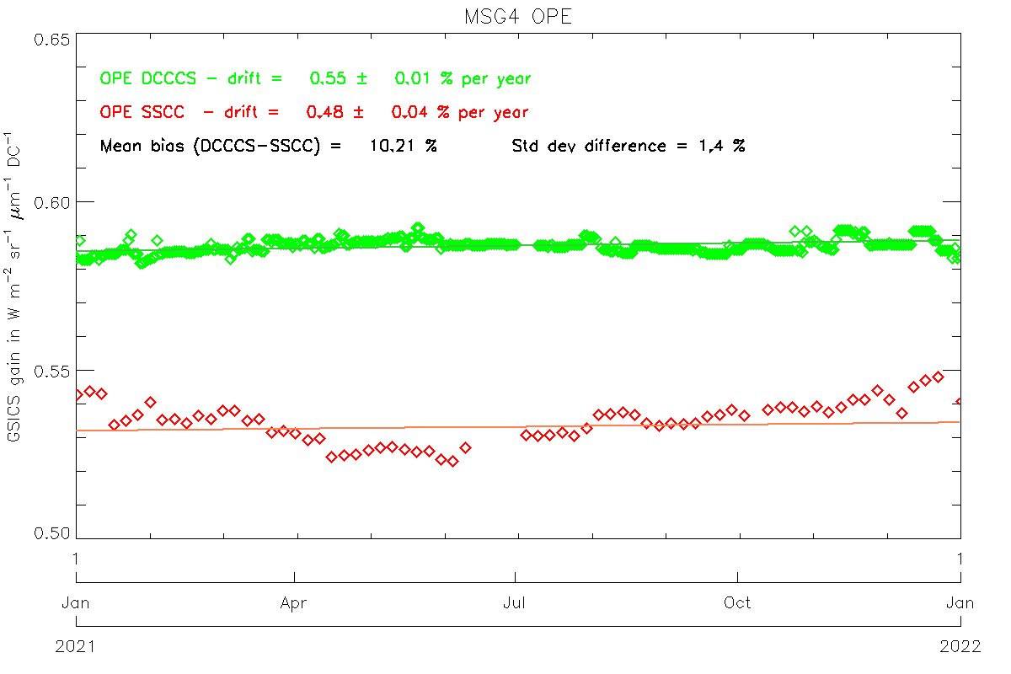
Calibration Performance: Meteosat/SEVIRI Visible Bands - 2021
Mean Bias: Mean and SD of difference of DCC from operational (SSCC) calibration for all 2021 pentad results
Annual Drift: Mean gain drift and uncertainty calculated from DCC and operational (SSCC) over each satellite life
DCC: Demonstration GSICS Deep Convective Cloud inter-calibration, with respect to Aqua/MODIS
SSCC: SEVIRI Solar Channel Calibration System = vicarious calibration used operationally for SEVIRI
Time Series of gains derived for Meteosat-8 (MSG1) and -11 (MSG4) VIS0.6 channel SSCC (red), DCC (green).

Slide 5
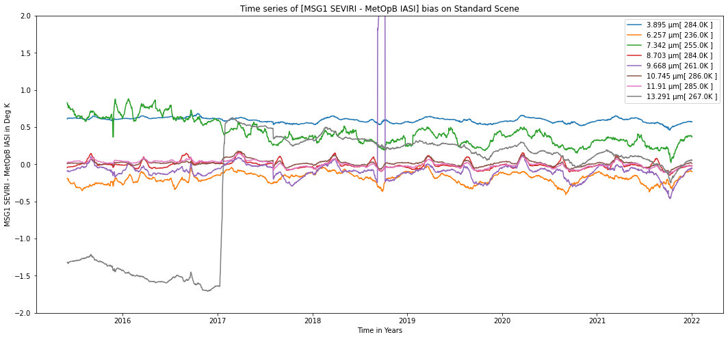
Calibration Performance: Meteosat-8/SEVIRI IR Bands
Statistics over 2021 of bias at standard scenes
from Operational GSICS Re-Analysis Correction
and time series plots over lifetime of product
Instrument Calibration Landing Page: https://www.eumetsat.int/seviri-instrument-status-calibration
2021-01-01/12-31 | Summary Statistics of [MSG1 SEVIRI - MetOpB IASI]
 | IR3.9 | IR6.3 | IR7.2 | IR8.7 | IR9.7 | IR10.8 | IR12.0 | IR13.4
Standard Scene Temp (K) | 284.0 | 236.0 | 255.0 | 284.0 | 261.0 | 286.0 | 285.0 | 267.0
Tb Bias (K) | 0.57 | -0.21 | 0.28 | -0.02 | -0.13 | -0.01 | -0.03 | 0.05
Std Dev (K) | 0.04 | 0.07 | 0.08 | 0.05 | 0.11 | 0.05 | 0.04 | 0.10
Drift (K/Yr) | -0.10 | -0.06 | -0.10 | -0.07 | -0.25 | -0.09 | -0.09 | -0.27

Slide 6
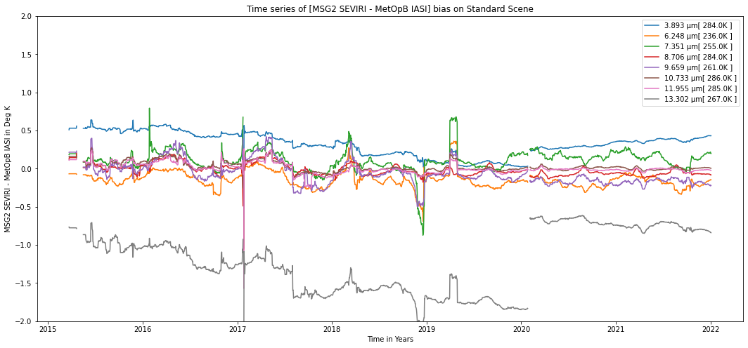
Calibration Performance: Meteosat-9/SEVIRI IR Bands
Statistics over 2021 of bias at standard scenes
from Operational GSICS Re-Analysis Correction
and time series plots over lifetime of product
Meteosat-9 operated in Rapid Scan Service during most of this period, which increases the bias uncertainties
Instrument Calibration Landing Page: https://www.eumetsat.int/seviri-instrument-status-calibration
2021-01-01/12-31 | Summary Statistics of [MSG2 SEVIRI - MetOpB IASI]
 | IR3.9 | IR6.3 | IR7.2 | IR8.7 | IR9.7 | IR10.8 | IR12.0 | IR13.4
Standard Scene Temp (K) | 284.0 | 236.0 | 255.0 | 284.0 | 261.0 | 286.0 | 285.0 | 267.0
Tb Bias (K) | 0.37 | -0.17 | 0.14 | -0.06 | -0.17 | 0.00 | -0.02 | -0.76
Std Dev (K) | 0.02 | 0.07 | 0.08 | 0.04 | 0.04 | 0.02 | 0.02 | 0.04
Drift (K/Yr) | 0.06 | -0.18 | -0.14 | 0.02 | 0.01 | 0.00 | -0.00 | -0.04

Slide 7
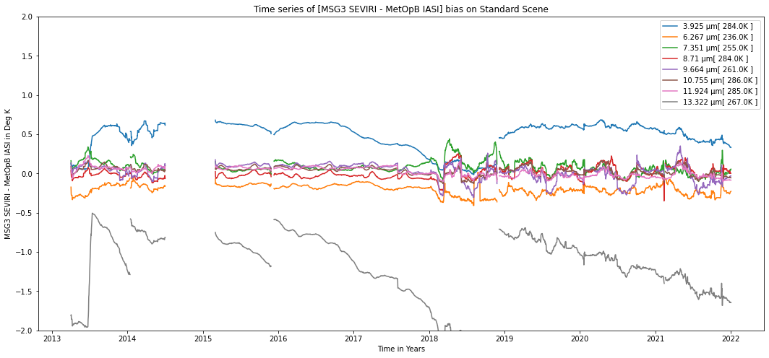
Calibration Performance: Meteosat-10/SEVIRI IR Bands
Statistics over 2021 of bias at standard scenes
from Operational GSICS Re-Analysis Correction
and time series plots over lifetime of product
Instrument Calibration Landing Page: https://www.eumetsat.int/seviri-instrument-status-calibration
2021-01-01/12-31 | Summary Statistics of [MSG3 SEVIRI - MetOpB IASI]
 | IR3.9 | IR6.3 | IR7.2 | IR8.7 | IR9.7 | IR10.8 | IR12.0 | IR13.4
Standard Scene Temp (K) | 284.0 | 236.0 | 255.0 | 284.0 | 261.0 | 286.0 | 285.0 | 267.0
Tb Bias (K) | 0.46 | -0.23 | 0.02 | 0.04 | -0.02 | 0.00 | -0.02 | -1.44
Std Dev (K) | 0.06 | 0.07 | 0.06 | 0.07 | 0.13 | 0.06 | 0.06 | 0.12
Drift (K/Yr) | -0.19 | -0.14 | -0.06 | -0.06 | -0.26 | -0.07 | -0.06 | -0.39

Slide 8
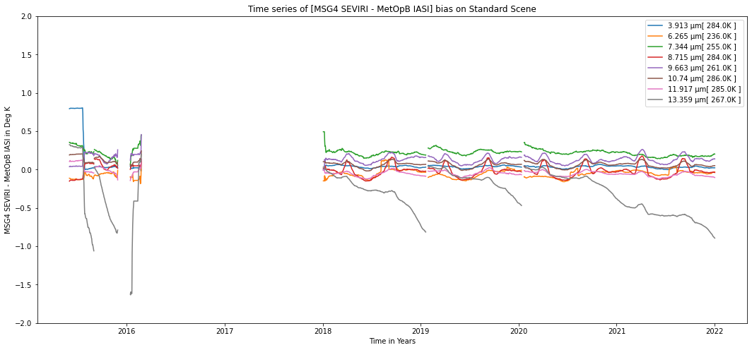
Calibration Performance: Meteosat-11/SEVIRI IR Bands
Statistics over 2021 of bias at standard scenes
from Operational GSICS Re-Analysis Correction
and time series plots over lifetime of product
Instrument Calibration Landing Page: https://www.eumetsat.int/seviri-instrument-status-calibration
2021-01-01/12-31 | Summary Statistics of [MSG4 SEVIRI - MetOpB IASI]
 | IR3.9 | IR6.3 | IR7.2 | IR8.7 | IR9.7 | IR10.8 | IR12.0 | IR13.4
Standard Scene Temp (K) | 284.0 | 236.0 | 255.0 | 284.0 | 261.0 | 286.0 | 285.0 | 267.0
Tb Bias (K) | 0.03 | -0.03 | 0.18 | -0.02 | 0.14 | 0.06 | -0.07 | -0.59
Std Dev (K) | 0.01 | 0.03 | 0.02 | 0.08 | 0.05 | 0.03 | 0.03 | 0.11
Drift (K/Yr) | -0.02 | -0.02 | -0.03 | -0.02 | -0.02 | -0.03 | -0.02 | -0.35

