Slide 1
GRWG IR Sub-Group Briefing Report
Likun Wang
ESSIC/Univ. of Maryland; Likun.Wang@noaa.gov
2022 GSICS annual meeting, March 17 2022

Slide 2
Outline
Scope of IR Subgroup
IR Group Activities
GSICS GEO-LEO IR Product Status
Future Direction and Plans
Conclusion and Issue to EP

Slide 3
Review Scope of the IR Sub-Group
Counterpart of VIS/NIR, Microwave and UV Sub-Groups
  For satellite instrument channels in thermal infrared
  For Hyperspectral instruments
To establish user requirements for inter-calibration
Cooperate with instrument calibration groups
  To communicate relevant information to the users
  To help them understand the root cause of observed biases and develop fixes
Review existing, or develop new inter-calibration
  Algorithms, procedures, corrections, collocation, spectral-gap filling etc.
  Using NWP, ground-based, near-space measurements, etc.
To define and promote calibration standards, tools and datasets, and best practices
  Including selection of inter-calibration reference
Chair: Likun Wang (NOAA affiliation, Since 2018) with the help from Tim Hewison

Slide 4
Instruments and Measurements
Hyperspectral IR Sounders
  AIRS (CHIRP product)
  IASI (A, B, C)
  CrIS (SNPP and N20)
  IRAS (FY3D, E)
  GIIRS (Geostationary FY4)
  IKFS-2
Narrow-band sounders
  HIRS (1979 – current MetOp-B)
  GOES Sounders
IR channels of broad- or narrow band imagers
  GEO imagers:
    ABI, AHI, AMI, AGRI, CMOS-MI, MVIRI/ SEVIRI, NSAT-3D
  LEO imagers:
    MODIS, VIIRS, AVHRR, SENTINEL-3 SLSTR, MERSI
NWP RTM simulations, Ground-based measurements, Lunar (Mercury) etc .

Slide 5
Current Sub-Group Activities (i)
Instrument specification, pre-launch characterization, Cal/Val Testing, Operational Calibration Support
  Thomas (NASA/JPL), Dave (UW), Chengli, Lu Lee (CMA)
Hyperspectral instrument calibration and inter-comparison
  Likun (NOAA), Dave (UW), Larrabee (UMBC), Clemence P., Laura B. (CNES), Chengli Q. , (CMA), Dorothee C. (EUMETSAT), Flavio (NOAA)
Promote GEO-LEO IR products to Operational + Support & Further Development
  Tim (EUMETSAT), Arata (JMA), Minju (KMA), Fred, Banghua, Fangfang (NOAA), Na (CMA), Pradeep (ISRO)
Development of LEO-LEO Inter-calibration between imager and hyperspectral sounders
  Likun, Banghua (NOAA), Jack X. (NASA)., Dave T. (UW), Hanlie (CMA), Alessandro B. (EUMETSAT)
Deployment of Prime GSICS Corrections
  Tim (EUMETSAT), Arata (JMA), Fangfang & Fred (NOAA), Minju (KMA), Na (CMA)
Diurnal calibration variations for GEO-LEO inter-calibration
  – Arata (JMA) , Fangfang(CMA), Minju (KMA)
Instrument Calibration or Inter-calibration Error Budget Analysis
  Chengli Q. (CMA), Arata (JMA)

Slide 6
Current Sub-Group Activities (ii)
Development of NWP inter-calibration method
  – Roger & Tim (EUMETSAT), Su Jeong Lee (Ewha Woman‘s Univ.), Kozo Okamoto (JMA)
GEO-GEO comparisons
  Dave (NASA), Hidehiko (JMA), Hyeji Yang, Minju (KMA) , Fangfang, Likun, Fred (NOAA), Tim (EUMETSAT), Alexey Rublev (ROSCOSMOS)
Broadband Reference IR inter-calibration (e.g., reprocessing using HIRS )
  – Dave (NASA), Rob (EUMETSAT), Masaya (JMA), Hanlie, Xiuqing (CMA)
Collocation Improvements
  – Likun (NOAA), Qiang (CMA), Alessandro (EUMETSAT)
Using the Moon (or other celestial object) for IR Inter-Calibration
  Clemence P., Laura B. (CNES), Martin Burgdorf (Univ. of Hamburg), Yong Zhang (CMA), Denis Tremblay (NOAA)
Interaction with other communities – NWP & ISSCP-NG
  Tim (EUMETSAT), Fred, Likun (NOAA), Dave (NASA)

Slide 7
Five Web Meeting in 2021-2022
GEO-LEO Inter-calibration (04/21/2021)
Discussion of Algorithms Improvements and Newsletter (05/06/2021)
FY4 Inter-calibration and CrIS/SNPP Status (07/08/2021)
SNPP/N20 CrIS Transition (10/07/2021)
Lake Qinghai campaign and GSICS Correction (12/02/2021)

Slide 8
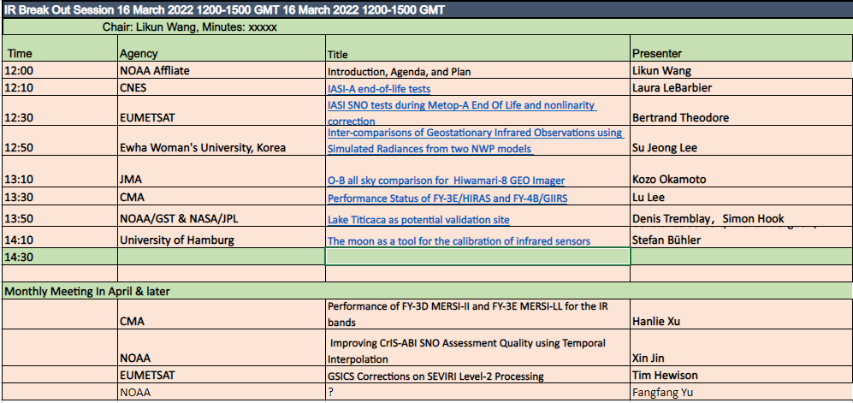
Presentations in Annual Meeting

Slide 9
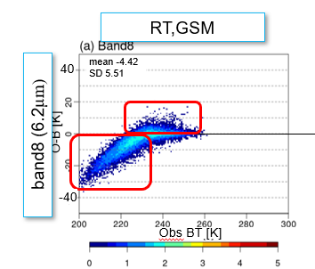
Highlights:
NWP O-B method helps for calibration
Infrared observations from instruments are compared with the simulations using NWP+RTM method.
NWP O-B method can benefit the IR instrument calibration because NWP and RTM improvements.
  Characterizing instrument features (e.g., stripes)
  Spectral response error
  Monitor instrument calibration change
  Bias diagnosis
Limitation should be clearly acknowledged.
  RTM bias
  Model Bias
  3D effects
SuJeong Lee 2022
Kozo 2022

Slide 10
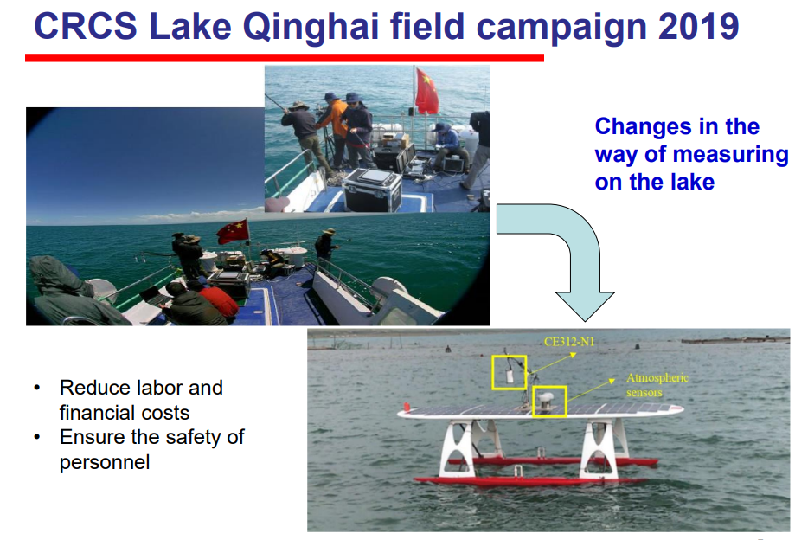
Highlights:
Vicarious Calibration for IR sensors
In-Situ Measurements during field campaign were used to evaluate the absolute radiometric calibration accuracy of passing over IR sensors.
  Lake Qinghai: FY-3D MERSI and FY-4A AGRI
  Lake Titicaca: VIIRS
RTM was used to simulate path radiance and transmittance propagated from land surface targets to satellite instrument entrance aperture.
Uncertainties should be fully understood and documented.
Moon potentially serve as a tool to inter-calibrate IR sensors.
Yong Zhang 2021
Constanze Seibert 2022

Slide 11
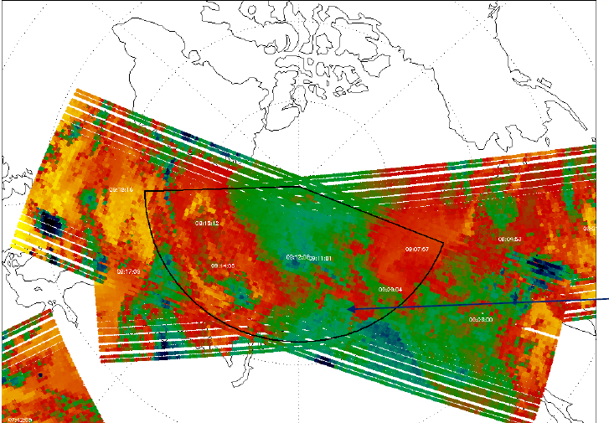
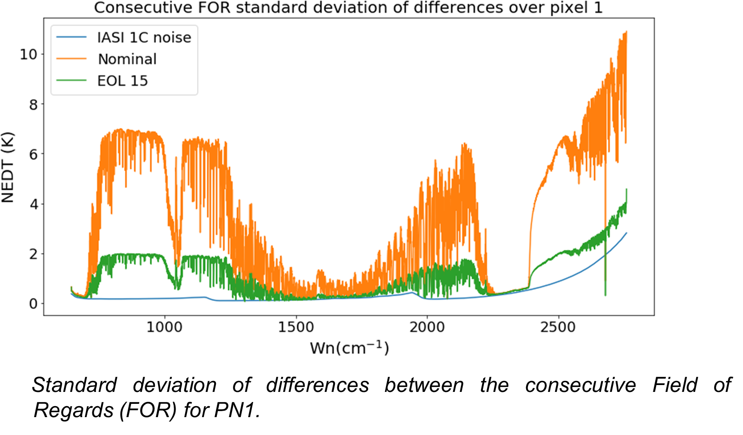
Highlights:
IASI-A End Of Life tests
Seven(7) IASI-A End Of Life tests were performed during the deorbiting campaign from 07/09/2021 to 28/11/2021.
The test data are very important to understand and improve the calibration accuracy of hyperspectral IR sounders.
The first ever direct IASI-A and IASI–B SNOs were collected, which will help to characterize their radiometric and spectral differences.
Théodore 2022
Yannick Kangah 2022

Slide 12
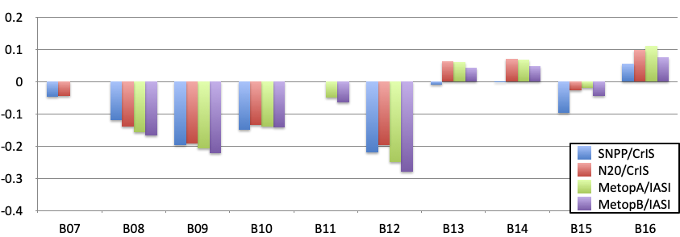
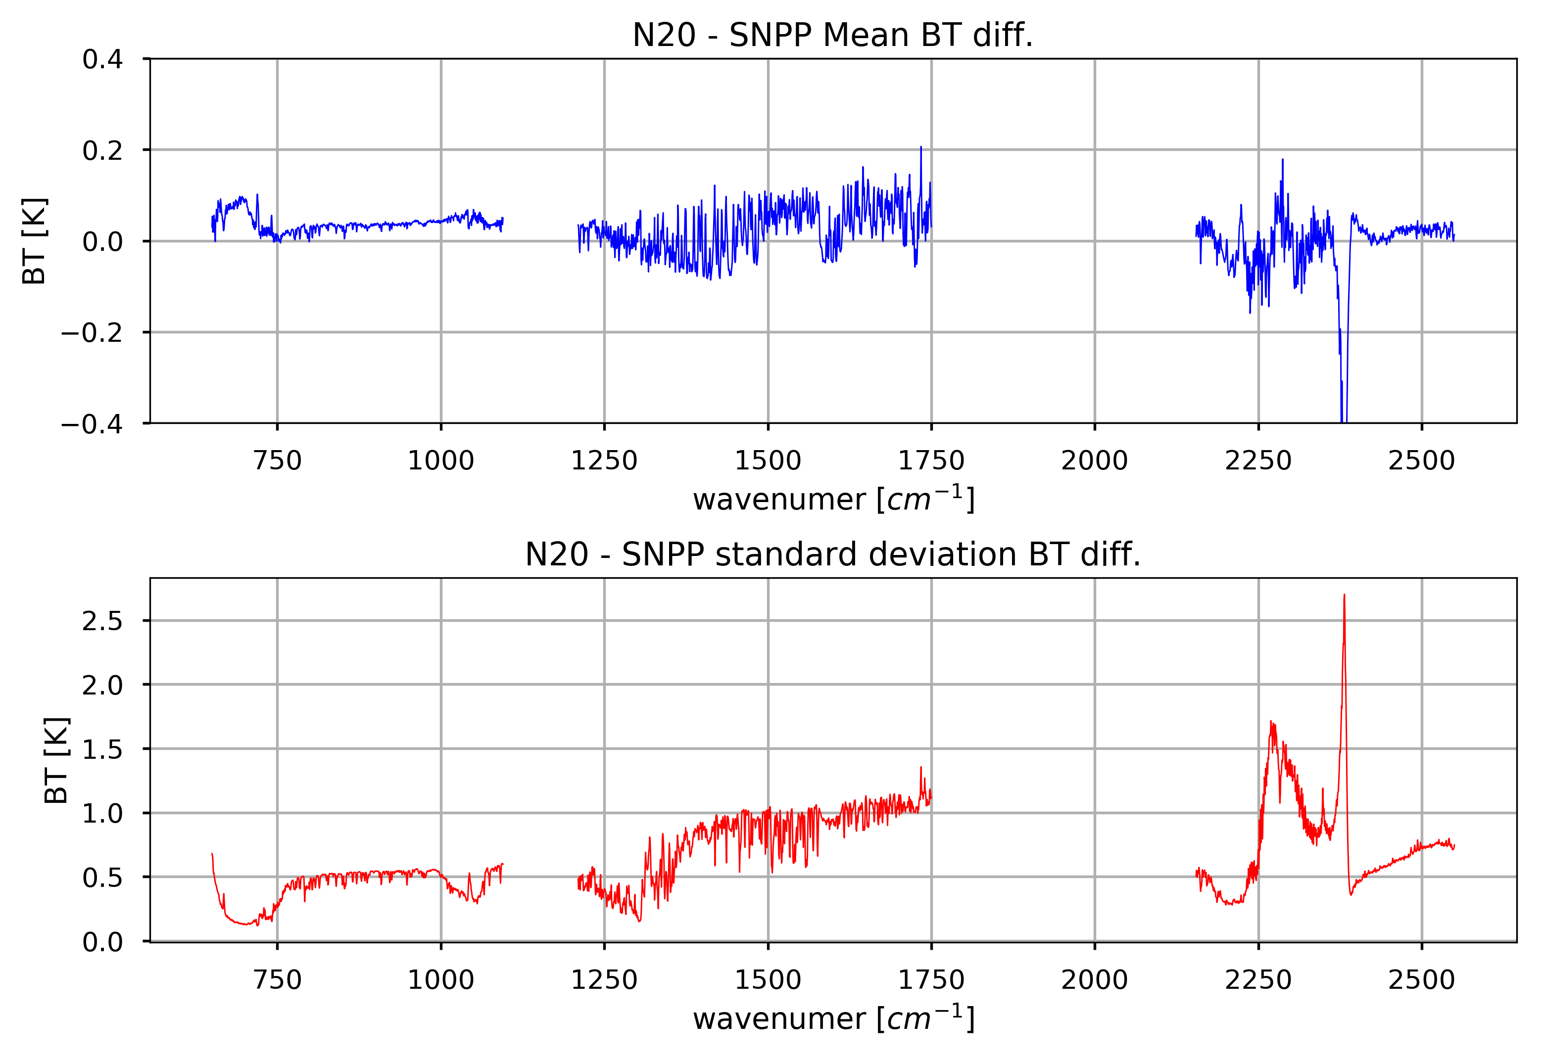
Highlights:
Transition from SNPP to NOAA 20/CrIS
Different methods have been used to identify the radiometric differences between SNPP and NOAA-20 CrIS.
  Direct comparison
  Double Difference
The radiometric differences between SNPP and NOAA-20 CrIS are well documented and understood.
The transition from SNPP/CrIS to NOAA-20/CrIS is highly recommended in the GSICS IR group.
Arata 2021
Wang 2021

Slide 13
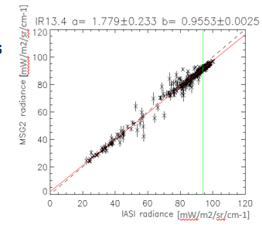
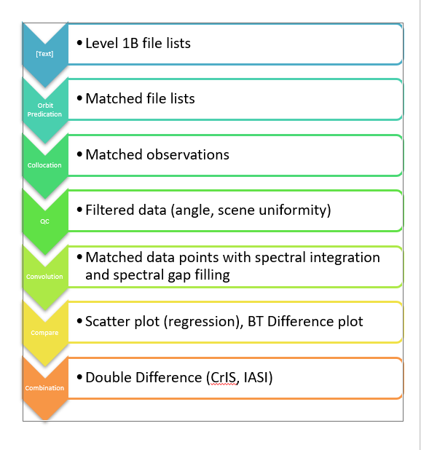
Highlights:
Improving GSICS GEO-LEO Algorithms
Several web meetings were (will be hosted) to improve GSICS inter-calibration algorithm and correction.
Several issues are identified from current GSICS GEO-LEO products.
Agreements on the GSICS correction in the IR group are not achieved yet and the team members will continue to work on it.
  Interactive ISSCP-NG group
Hewison 2021
Wang 2021

Slide 14
GSICS GEO-LEO IR Product Status 2020-21
GPRC | Monitored Instrument | Reference Instrument | GSICS NRT Correction | GSICS Re-Analysis Correction | GSICS Bias Monitoring
EUMETSAT | Meteosat-8-11/SEVIRI | Metop-A/IASIv2 Metop-B/IASI Metop-C/IASI Prime | Operational Operational Operational - | Operational Operational Operational Demo | RAC Plotting Tool ProductCatalogImages
JMA | MTSAT-2 Imager Himawari-8/AHI (Himawari-9/AHI) | IASI-A+B+AIRS (CrIS SNPP) | Demo (Ready for GPPA) | Demo | RAC Plotting Tool JMA Web ProductCatalogImages
NOAA | GOES-11-12 Imager GOES-15 Imager GOES-16-17/ABI | IASI-A+B+C CrIS-SNPP+N20 | - - - | Demo Pre-Op Pre-Op | NOAA GOESCAL
CMA | FY2C,D,E,F,G/VISSR FY4A/AGRI FY4A/GIIRS (Plan) | IASI-A+B + AIRS+CrIS+HIRAS | Development | Development | CMA Web CMA Web Cloud (Plan)
KMA | COMS KOMPSAT-2A? | IASI-A+B AIRS+ CrIS SNPP+N20 | Demo | Demo | KMA Web ProductCatalogImages
ISRO | INSAT-3D/Imager INSAT-3D/Sounder INSAT-3R | IASI-A | Demo | Demo | ISRO Web
Full GSICS Product Catalog available at http://www.star.nesdis.noaa.gov/smcd/GCC/ProductCatalog.php

Slide 15
Discussion for Future Plans and Issues
New IR chair is needed (2018-now, three years’ term is full)
monthly or bi-monthly web meeting
  Plan on Thursday for the first week of each Month
Support more cross-community efforts,
  Dialogue between GSICS with ISSCP-NG, NWP community, CEOS WGVS
Encourage more experts involved in the IR group
  Updates on new instrument, methods, and datasets for the IR group
Share the tools and codes, knowledge Exchange memo
  GitHub or GSICS wiki may be the best host place
Other Items?

Slide 16
Summary
IR group is very active
Continued expansion of group
  From GEO/LEO inter-calibration to GEO/GEO, LEO/LEO, other datasets
  Imager/Sounder
  Hyperspectral Sounder inter-calibration
  Reprocessing, New Measurements, Gap Filling, Collocation
  More ideas, new collaborations, exploit other ongoing activities of relevance to GSICS
  Software, dataset, best practice, methods,
Sub-topical leads/formation
  Develop tasks, move forward with them
    References, Methods, Correction Tables, Tools …
  Taking a little longer than I had hoped…
Contributions to GSICS Newsletters and Observation system Report

