Slide 1
MW Subgroup Progress Report
Qifeng Lu, Quanhua (Mark) Liu, Robbie Iacovazzi and Shengli Wu
March 18, 2022

Slide 2
Outline
General Achievements and Progress
Web Meeting Summaries and Highlights
Actions
Planned Activities

Slide 3
General Achievements and Progress (1 of 2)
Microwave (MW) subgroup meetings
  2 Apr 2021 (Annual meeting)
  13 Jul 2021, 28 Oct 2021 and 17 Dec 2021 (Team meetings)
  28 Feb – 2 Mar 2022 (Technical workshop)
    Focus: “The Past History, Current Status, and Future Development of Satellite Microwave Remote Sensing”
GSICS Spectral Response Function (SRF) formats discussion and feedback
  JPSS-2 SRF format used to facilitate discussion: contents and format
  Feedback - Add “Frequency” parameter to improve format back compatibility, and using arrays to minimize the number of variables.
User Outreach
  The Technical Workshop brought together MW instrument developer, calibration, and data applications experts from earth-system satellite operations and space agencies, standards institutes, academia and numerical weather prediction (NWP) communities.

Slide 4
General Achievements and Progress (2 of 2)
MW calibration and geolocation approach improvements
  Physics-based ATMS noise computations improves performance and distinguishes thermal and 1/f^{α} (flicker) noise.
  Modifying the Backus-Gilbert Inversion (BGI) microwave data remapping algorithm to use an adaptive window and noise tuning method reduces scan-dependent remapping noise changes.
Instrument performance monitoring and uncertainty characterization improvements
  Harnessing COSMIC-2 Global Navigation Satellite System (GNSS) Radio Occultation (RO) measurements
    COSMIC-2 RO and Vaisala RS41 and RS92 radiosondes are compared to quantify the temperature and humidity biases among different radiosonde sensor types and different RO retrieval algorithms.
    Integrating COSMIC-2 soundings into NOAA’s CRTM-based MW sounder data quality monitoring significantly expands RO sounding population, and supports inter-satellite bias detection.
MW Subgroup Wiki updated and expanded to include all meetings

Slide 5
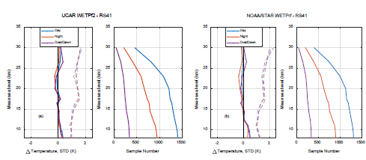
13 Jul Meeting Highlights:
COSMIC-RO and Radiosonde Inter-comparison
Independently-retrieved UCAR and NOAA/STAR COSMIC-2 RO temperature and humidity data are compared with in-situ Vaisala RS41 and RS92 RAOB data.
The height and day-night dependence of temperature and humidity biases are analysed using 7-months of collocated COSMIC-2 RO and RS41/RS92 RAOB data.
The RO vs. RAOB comparison helps quantify the temperature and humidity biases among different radiosonde sensor types and different RO retrieval algorithms.
Radiosonde station co-located with COSMIC-2 observations
Day and night temperature bias comparison: UCAR and NOAA-STAR COSMIC-2 temperature retrieval vs. RS41 measurement

Slide 6
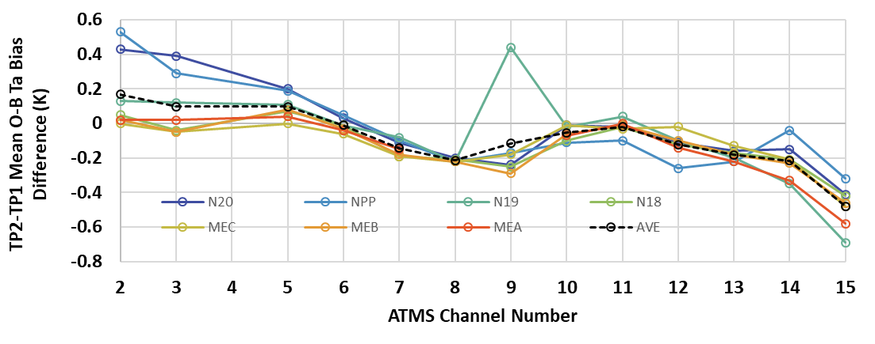
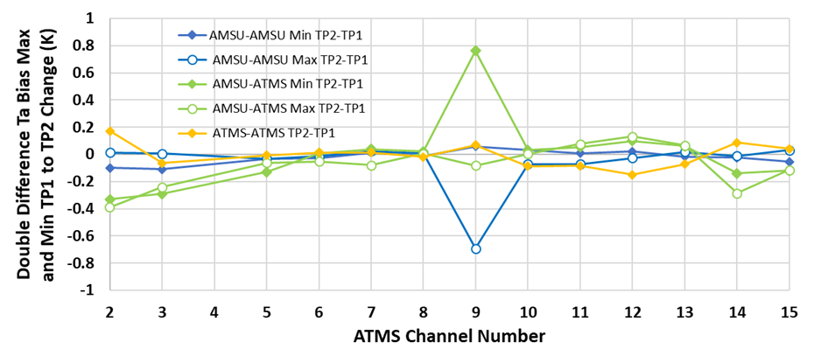
13 Jul Meeting Highlights:
COSMIC-2 Soundings Impacts on a RO-based NOAA MW Data Quality Monitoring System
Adding STAR COSMIC-2 (C2) RO data impacts the ICVS ATMS/AMSU-A monitoring system
Sample number increases by ~10X, and distribution shifts to the tropics and subtropics
Individual sensor changes in long-term mean observed minus CRTM-simulated (O-B) Ta bias are < 0.5K shift for all channels, but ATMS(AMSU-A) Ch 15(14) has a large 1.5 K semi-annual variability (not shown)
Inter-sensor double differences show very robust extensions for all monitored sensor pair groups
Post-C2 minus pre-C2 mean of global monthly mean O-B Ta bias values
Post-C2 minus pre-C2 mean of double-difference monthly inter-sensor Ta bias min and max

Slide 7
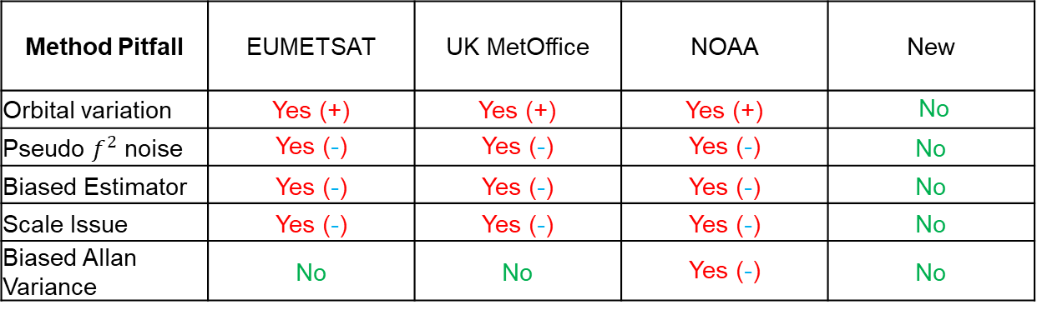
28 Oct Meeting Highlights:
New Algorithm for Determining MW Sensor NEDT
Method Pitfall | EUMETSAT | UK MetOffice | NOAA | New
Orbital variation | Yes (+) | Yes (+) | Yes (+) | No
Pseudo $f^{2}$ noise | Yes (-) | Yes (-) | Yes (-) | No
Biased Estimator | Yes (-) | Yes (-) | Yes (-) | No
Scale Issue | Yes (-) | Yes (-) | Yes (-) | No
Biased Allan Variance | No | No | Yes (-) | No
Red = issue found
Green = issue free
+=positive bias,
-=negative bias
Physics and mathematics based algorithm.
Issues identified in current algorithms.
The validation and comparison are implemented with TVAC and simulation.
The new algorithm exhibits superior performance at all channels, including the G-band, which is prone to 1/f noise and is severely underestimated by old algorithms.

Slide 8
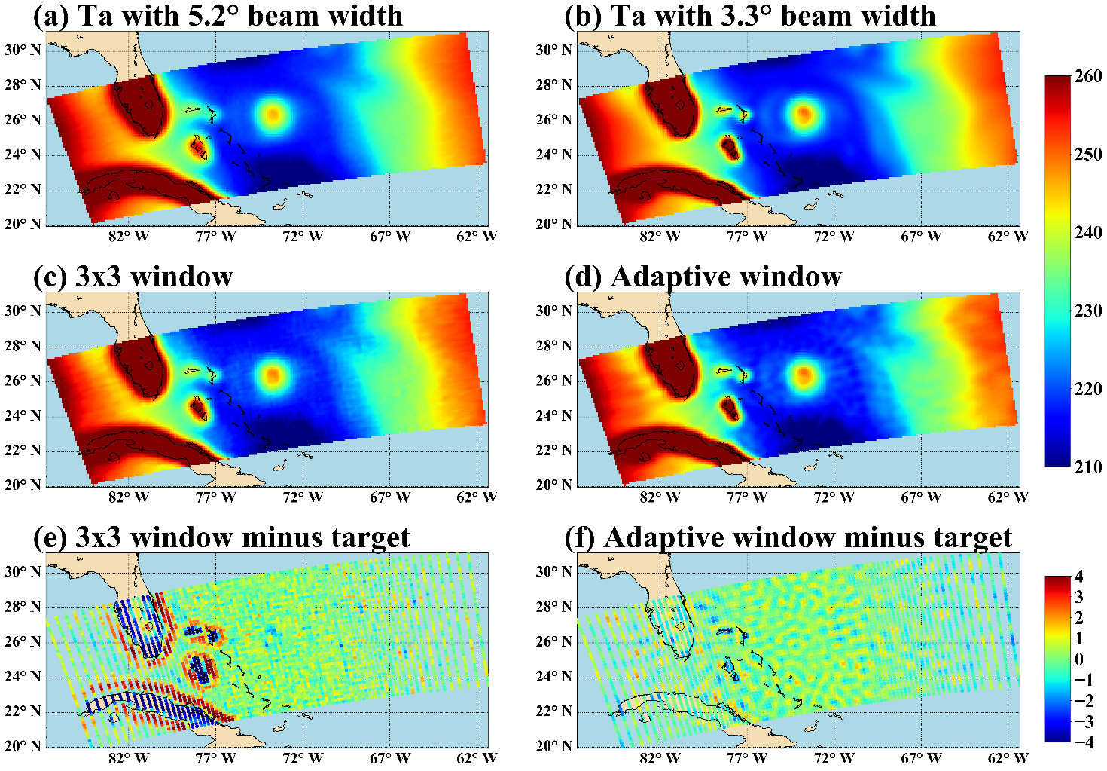
28 Oct Meeting Highlights:
Improving ATMS Remapping Accuracy Using Adaptive Window Method
Backus-Gilbert Inversion (BGI) algorithm resolution enhancement issues are alleviated using an adaptive window to increase subfootprint scale information.
A new noise tuning method based on tradeoff curves eliminates the FOV-dependent feature of the noise caused by the sensor’s cross-track scanning manner.
Application to simulations and actual data demonstrates that the new method can effectively improve ATMS remapping accuracy while maintaining the noise at a stable and acceptable level.
Simulation results with the fixed 3° x 3 °window & the adaptive window

Slide 9
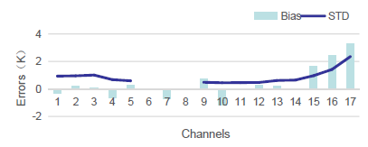
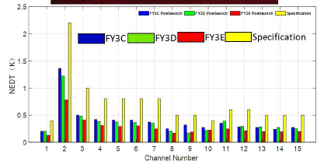
17 Dec Meeting Highlights:
CMA Status
FY-3D (2017-~) Afternoon orbit
  MWRI, MWTS and MWHS are in good condition
  FCDR of MWRI has been released to some scientific users for evaluation
FY-3E (2021-~) Early morning orbit
  Launched in July 5th, 2021
  MWHS, MWTS and WindRAD show good performace
  In-orbit test of MWHS, MWTS and WindRAD are still ongoing
FY-3F ( 2022-~) Morning orbit
  Ground test of Flight model (MWRI-II, MWHS and MWTS)
FY-3G (2022-~) Drift orbit
  Ground test of Flight model (MWRI-II and DPR)
FY-3 MWRI ASI Sea Ice Concentration
FY3E MWTS-III vs JPSS-1 ATMS
FY-3C/D/E MWHS-II NEDT

Slide 10
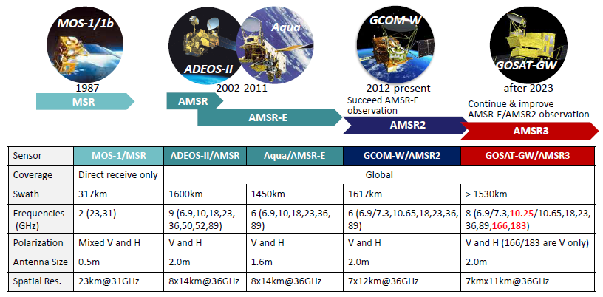
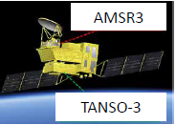
17 Dec Meeting Highlights:
JAXA Status
GCOM-W/AMSR2
  Nominal mission operations
  New research products released, and updated Precipitation product (Ver.3) and further research products planned for release (JFY2021)
GOSAT-GW/AMSR3
  Algorithm and ground systems (e.g., Mission Operation System) development ongoing
  RFI detection method for X-band (10.25/10.65 GHz) is being discussed based on that for C-band
  Cross-calibration plan, especially for new high-frequency channels with GMI, is also being discussed
  AMSR3 development to be completed in the second half of JFY2022, and launch of GOSAT-GW Satellite in JFY2023
JAXA Efforts to Establish Continuous Passive Microwave Observations
JAXA-led AMSR3 adds new high-frequency channels for solid precipitation retrievals and NWP water vapor analysis

Slide 11
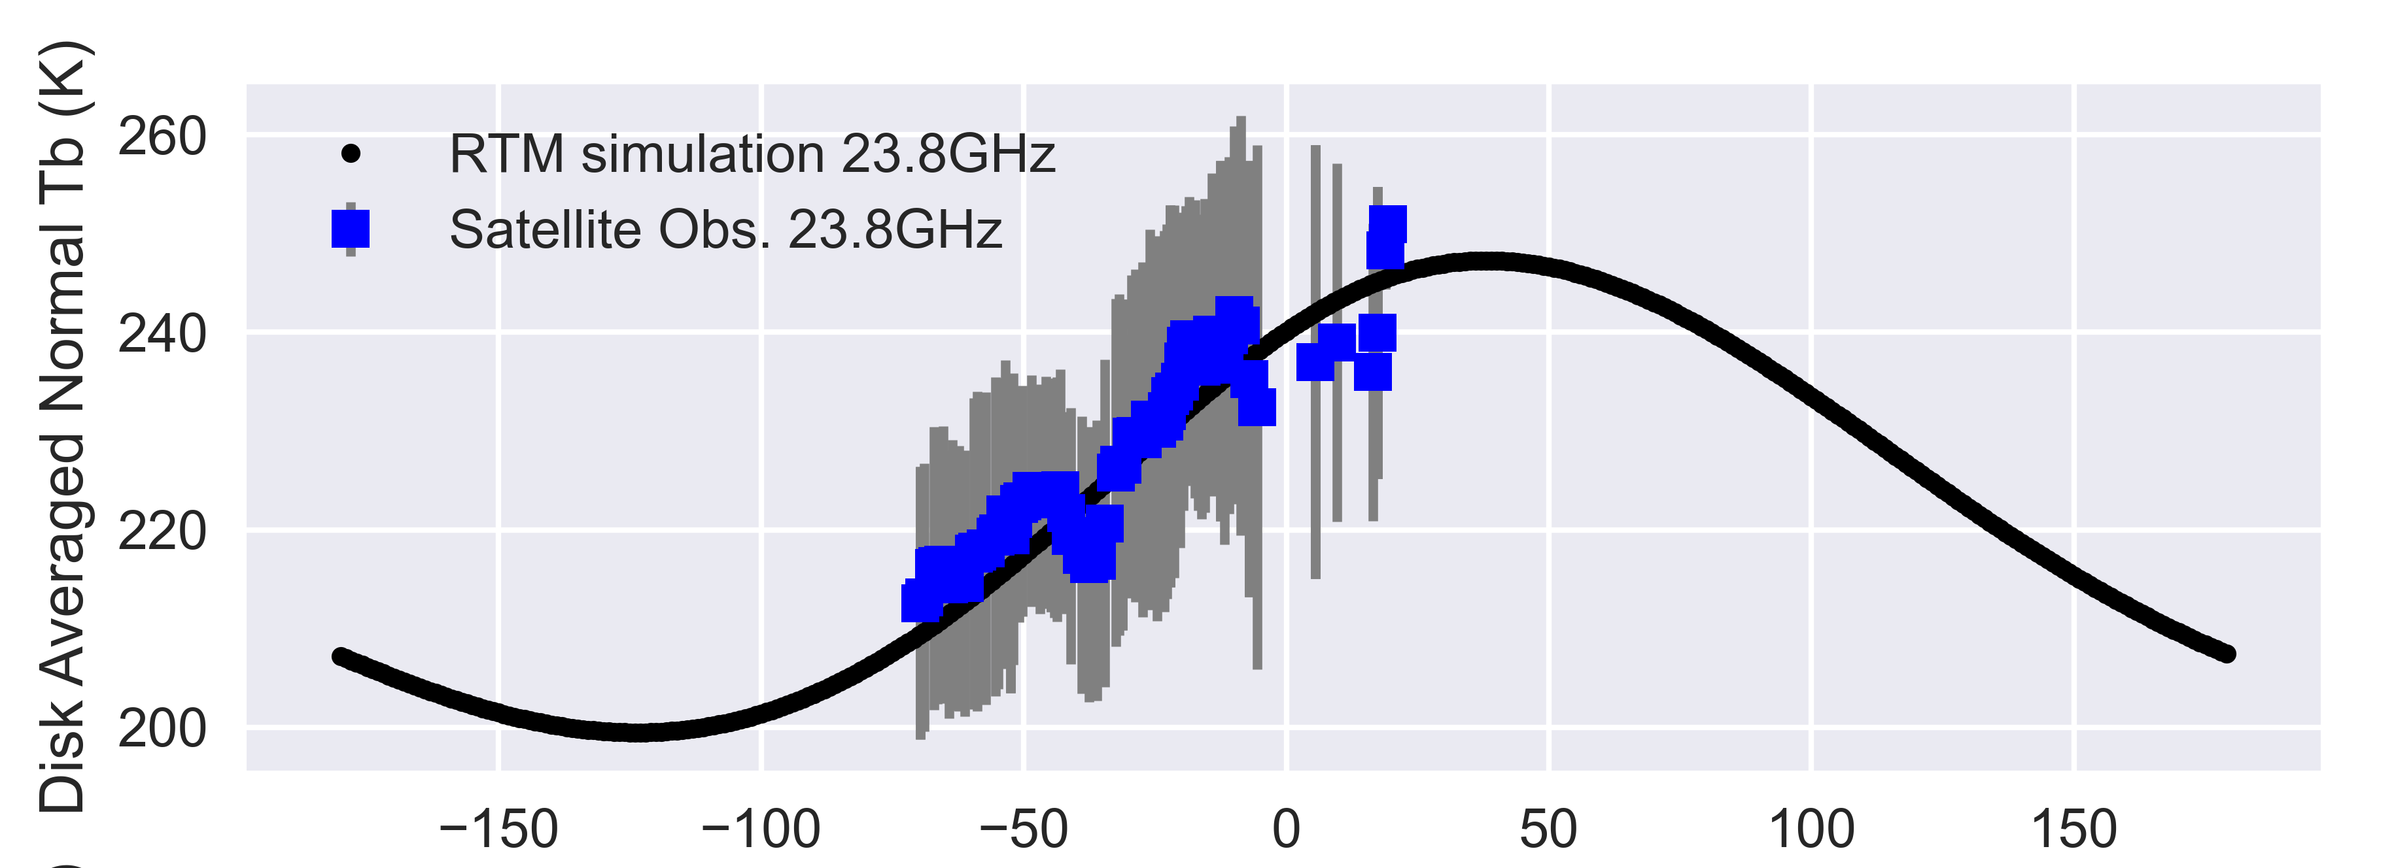
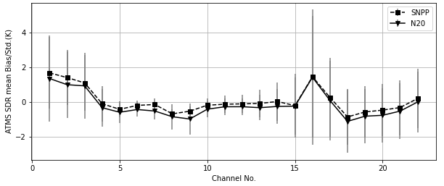
17 Dec Meeting Highlights:
NOAA Status
NOAA ATMS radiance calibration algorithm updates and beam pointing/geolocation error evaluation
New NEDT estimation method
NOAA operational MW instrument data performance evaluation updates
  Lunar validation
  Monitoring with COSMIC-2 soundings
Other
  Improving ATMS remapping accuracy using adaptive window and noise-tuning method in the BGI method
  The ATMS Reference Library
  GSICS MW Subgroup Wiki updates
Satellite-observed lunar Tb shown to be highly consistent with model simulations after corrected for the impact of lunar surface emissivity in lunar RTM model.
NOAA-20 and S-NPP ATMS global mean O-B Tb bias for the nadir position (after 10/15/2019)

Slide 12
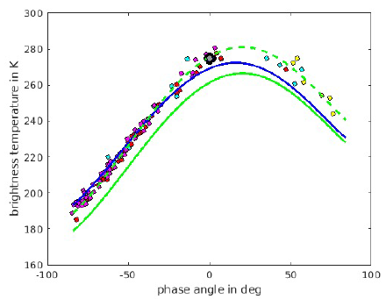
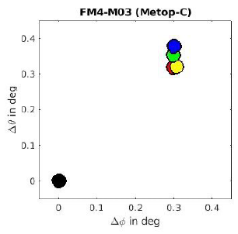
17 Dec Meeting Highlights:
Univ. of Hamburg Status
Establishing the Moon as reference for climate data from MW sensors
Moon Signal In The Deep Space View (DSV)
  Task 1: Preparatory Work - Work Package 3: Analysis of all Moon intrusions in the DSV
  Task 2: New Model Of Lunar Radiance - Work Package 3: Comparison with a total eclipse of the Moon
  Task 3: Application Of The New Lunar Model - Work Package 1:Calibration check of MW instruments
Lunar disk Tbs from NOAA-18 (red), NOAA-19 (magenta) MHS and NOAA-20 ATMS (gray circle - Yang et al., 2020) 89 GHz measurements.
Model predicted Tbs are from Keihm (1984) (blue line) and Liu and Jin (2020) (solid green line)
Black: actual Moon position
Color-coded: Moon position deduced from Metop-C MHS channels
Burgdorf et al., 2021

Slide 13
GSICS MW Subgroup Technical Workshop (28 Feb – 2 Mar) General Synopsis
Workshop Theme: “The Past History, Current Status, and Future Development of Satellite MW Remote Sensing”
Topics
  MW Remote Sensing Past History
  Past, Current, and Future MW Instruments, Data Applications, MW Standards and SmallSats/CubeSats
Attendance
  30-35 participants each day
  MW instrument developer, calibration, and data applications experts from earth-system satellite operations and space agencies, standards institutes, academia and NWP communities
Workshop GSICS Wiki Link to Agenda and Presentations: http://gsics.atmos.umd.edu/bin/view/Development/2022_MWSG_TechnicalWorkshop

Slide 14
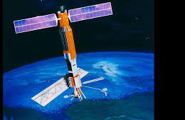
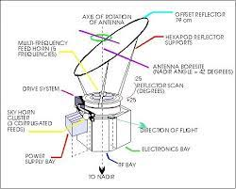
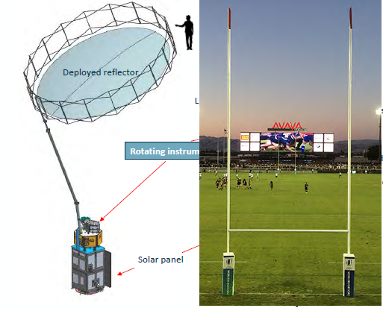
GSICS MW Subgroup Workshop (28 Feb – 2 Mar) Day 1 Highlights
Keynote Address (Frank Wentz): A Personal History of MW Remote Sensing and the People Along the Way (1971-2022)
Past, Current, and Future MW Instruments Topics
  Progress on MW sensors of FY satellites
  Introduction of the MW Instrument Calibration Processing System (MICalPS) software package [NOAA]
  Developments and future plans of Water-related Microwave Missions in Japan [JAXA]
  NOAA-20/JPSS1 ATMS performance and RFI plans for future NOAA sounders [NASA]
  The MWR at ESA : toward CIMR [ESA]
  SMOS Brightness Temperature calibration metrics and results from last 3rd mission reprocessing campaign [ESA]
Artist rendition of SeaSat
SMMR (1978)
NASA/JPL SeaSat opened the door in 1978 to Microwave Remote Sensing of the oceans.
CMA FY-3/MWRI (2012+)
ESA CIMR (2028+)

Slide 15
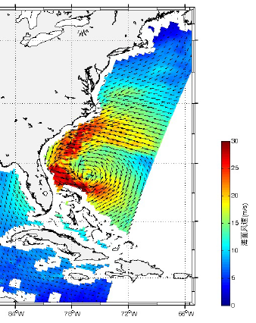
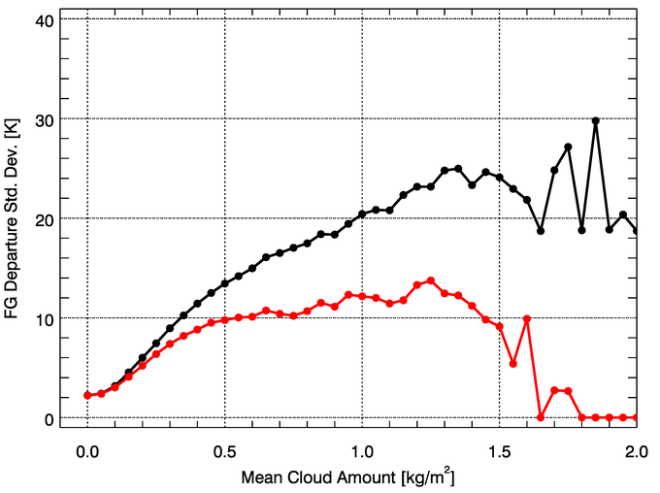
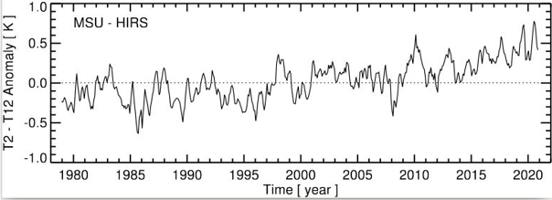
GSICS MW Subgroup Workshop (28 Feb – 2 Mar) Day 2 Highlights
Past, Current, and Future MW Instruments Topics (continued)
  Satellite Observations for Global Water Cycle [NSSC-CAS]
  Past, Current, and Future of EUMETSAT MW Radiometers [EUMETSAT]
Past, Current, and Future Applications of MW Data
  Microwave soundings in NWP at the Met Office: experience and suggestions for future systems [MetOffice]
  Direct assimilation of MW observations in the CMA-GFS system [CMA]
  Space-based MW Remote Sensing: Quantitative Techniques and Development in China [NSSC]
  A Revised All-sky Radiance Assimilation Framework in the NCEP Global Model [NCEP]
  Past, current, and future of NOAA MW FCDR’s [NOAA]
  Efforts at EUMETSAT on the generation of FCDRs from MW sounders [EUMETSAT]
Before QC
Error Model
After QC
Oct 27, 2012, wind observation of Hurricane Sandy by CNSA HY-2A SCAT
NCEP All-Sky Observation Error before and after precipitation screening
EUMETSAT Upper troposphere moistening evident from the MW 53.596 ± 0.115 GHz minus HIRS 6.52 micron channel trend

Slide 16
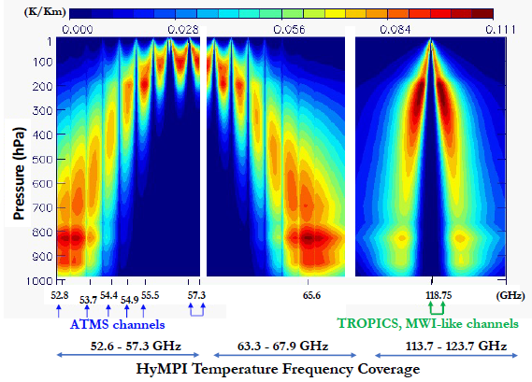
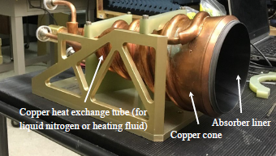
GSICS MW Subgroup Workshop (28 Feb – 2 Mar) Day 3 Highlights
Past, Current, and Future MW Instruments Topics (continued)
  Past, Current, and Future of Russian MW Radiometers [PLANETA]
Future of Microwave Remote Sensing: MW Standards
  Electromagnetic Measurement Techniques for Materials in the Microwave and Millimeter-Wave Frequency Range [NIM]
  Full waveform metrology methods with frequency field techniques [NIM]
  Microwave Remote-Sensing Standards at NIST [NIST]
Future of MW Remote Sensing: SmallSats or CubeSats
  Photonic Integrated Circuits (PICs) in Space: The Hyperspectral MW Photonic Instrument (HyMPI) [NASA]
  The NASA Compact Ocean Wind Vector Radiometer (COWVR) Instrument [JPL]
  The NASA Temporal Experiment for Storms and Tropical Systems - Demonstration (TEMPEST-D) Instrument [CSU]
NIM Quasi-optical high-Q resonator—characterize low loss (<10-4) materials such as antenna reflectors
NASA HyMPI Brightness Temperature Sensitivity Analysis to Temperature
NIST Standard Blackbody

Slide 17
GSICS MW Subgroup Workshop Discussion/Question Highlights (1 of 2)
Maximizing Use of Current MW Sensor Calibration Technology and Data for Inter-calibration
  Could tools such as the NOAA MW Instrument Calibration Processing System (MICalPS) be adopted as GSICS products or tools?
    There is interest only if distribution is limited within GSICS.
  Would lunar MW measurements such as those from NSSC’s Chang-E 1 and 2 be useful for MW lunar calibration?
    There is interest in acquiring such data.
    Subgroup members working on lunar calibration are encouraged to participate in the GSICS VIS/NIR Lunar Cal Work Area.
  Does the GSICS MWSG need to encourage agencies to extend the on-orbit lifetime of their MW sounders, which is a priority for NWP?
    This is a CGMS focus, and the NWP community raises this issue every year.
    The subgroup could request CGMS status updates regarding this subject. This gives the subgroup opportunities to track progress, and provide input into the CGMS process.

Slide 18
GSICS MW Subgroup Workshop Discussion/Question Highlights (2 of 2)
Encouraging/Adopting Calibration Best Practices and Standards
  ESA and EUMETSAT analyses incorporate guidelines to express measurement uncertainty developed by standards institutes. Can the subgroup encourage/adopt similar guidelines to harmonize data analysis within GSICS? If so, how?
Exploiting New MW Sensor Technology and Lessons-Learned for Inter-Calibration
  What role can the subgroup play in providing information about inter-calibration that supports the development of new MW sensors and their calibration?
    We can request data from new MW instruments such as HyMPI, COWVR, and TEMPEST-D, and provide input regarding lessons-learned about inter-calibration.
Building Relationships with the MW User Community
  How can the subgroup enhance the working relationship between MW instrument developers, operators, and NWP center or satellite application facility developers?
    Sending GSICS members to collaborate with the International TOVS Working Group (ITWG) was suggested.

Slide 19
MW Subgroup:
2021 Planned Activities, and Past & Potential Future Actions

Slide 20
Past Action Items (1 of 3)
Action Item: A.GMW. | Description | Status
20191119.2 | Wes Burg to hold a dedicated workshop to explore the implementation of the GPM XCAL algorithms to inter-calibrate other microwave imagers. This potentially could be implemented in Q4 after the 2020 EUMETSAT Conference. | CLOSED Some studies already completed.
20210121.3 | Paul Poli would like information about SSMT2. May have SSMT2 information in desk at NASA. Paul to send a reminder email to Ed to look for it.. | OPEN Waiting for COVID-19 mandatory telework to end, so Ed can go back to NASA to look for documentation.
20210121.5 | All Subgroup Members working on FCDRs please provide input about using FCDRs as a community reference to Manik. | OPEN Manik Bali is working this action item.
20210318.1 | Contact Timo Hanschmann to discuss the use of reprocessed ATMS data in ERA-6. | CLOSED STAR and JPSS discussed the use of reprocessed ATMS data with EUMETSAT colleagues. High-level managers will decide.
20210330.1 | Get in touch with Xiaolong Dong to start a potential collaboration with the CEOS WGCV microwave subgroup. | CLOSED Xiaolong presented “Space-based Microwave Remote Sensing: Quantitative Techniques and Development in China” at Workshop

Slide 21
Past Action Items (2 of 3)
Action Item: A.GMW. | Description | Status
20210330.1 | Get in touch with Xiaolong Dong to start a potential collaboration with the CEOS WGCV microwave subgroup. | CLOSED Xiaolong presented “Space-based Microwave Remote Sensing: Quantitative Techniques and Development in China” at Workshop
20210330.2 | Consider the GRWG desire that the Microwave Subgroup focus on 1) the development of MW GSICS standard products – e.g., O-B and SNO for the microwave sounders, GNSS-RO and microwave imagers, and 2) in the near future the definition of reference instruments and sharing of SNO common codes. | OPEN Completed for Microwave Spectral Response Function (SRF). CMA FY-3E related information, such as SRF, is not currently available to all users. Some users that apply to gain access can acquire some sample applications.
20210330.3 | Get the GDWG presentation so that the group has the links to the GRWG software tools | CLOSED Link available from GSICS Wiki page for 2021 Annual Meeting
20210330.4 | Steven Maxwell to connect Robbie with the NIST microwave group. | CLOSED Dazhen Gu is now the NIST representative to the subgroup. He gave the presentation “Microwave Remote-Sensing Standards at NIST” at the workshop.

Slide 22
Past Action Items (3 of 3)
Action Item: A.GMW. | Description | Status
20210330.5 | From Action A.GIR.2020319.7 - Manik Bali (NOAA) to review guidance in the definition of time coverage start and end variables in the GSICS netCDF convention needs to be considered by all Subgroup Chairs. | CLOSED Qifeng and Mark discussed and responded to Manik
20210330.6 | Need to update our action items in the Annual Meeting agenda under the GW Breakout tab. | CLOSED
20210330.7 | Add more info of about Focal Points – e.g., specialty of individuals - on the Focal Point List in the GSICS WMO Web Site. The process for each GPRC is to contact the GRWG Chair with a list of GRWG members and information about their specialties. | CLOSED (Manik) “Some agencies prefer that everything goes through their POC and dont prefer a direct contact with individuals listed here. So, we are sticking to that.”
20210330.8 | Spectral Response Functions: Subgroups need to consider what spectral response information that they need and what they are willing to work with in terms of formats. | CLOSED Requested feedback from subgroup in June 2021. Analysis of NOAA JPSS-2 ATMS SRF formats was performed and distributed to the group for feedback in November 2021. Feedback was captured in emails.

Slide 23
MW Subgroup Planned Activities
Meetings 2022
  Web Meetings : To Be Determined
  Workshop (3 days) : The desire for 2nd workshop will be determined after Workshop Survey.
Possible Collaborative Activities (Within MW Subgroup or with other groups)
  MW lunar calibration and geolocation assessment
  Inter-calibration of SmallSat/Cubesat data from TROPICS, TEMPEST-D with operational MW sounders.
  NWP sensitivity analysis from MWTS-III FY-3E early morning orbit data
  Obtain TROPICS CubeSat lunar data obtained from its “sky-scan,” as these data are not available elsewhere.
Possible Deliverables
  Data base associated with the lunar disk-average brightness temperature for the MW frequency range between 23 and 183 GHz
  Inter-calibration statistics between operational MW sounders and SmallSat/CubeSat L1b products
  GSICS Products - MW FCDR time series.
    Often FCDR time series can be developed by updating calibration, and not by determining bias coefficients.

Slide 24
Potential Action Items 2022
Action Item: A.GMW. | Description | Status
20220317.1 | Share the lunar disc-average brightness temperature data base for the microwave frequency range between 23 and 183 GHz (Yang and Burgdorf)
20220317.2 | Determine the feasibility of using MW FCDRs as GSICS Products (Iacovazzi and John)
20220317.3 | Obtain the lunar data acquire from TROPICS from MIT. (Yang)
20220317.4 | Perform O-B analysis on SmallSat/CubeSat data, such as TROPICS or TEMPEST-D. (NOAA)
20220317.5 | Obtain and share NWP results regarding the use of the MWTS-III from FY-3E. (CMA)
 | ......

Slide 25
Back Up Slides

