Slide 1
MW Subgroup Workshop 2022 Summary
Qifeng Lu, Quanhua (Mark) Liu, Robbie Iacovazzi and Shengli Wu
March 17, 2022

Slide 2
GSICS MW Subgroup Technical Workshop (28 Feb – 2 Mar) General Synopsis
Workshop Theme: “The Past History, Current Status, and Future Development of Satellite MW Remote Sensing”
Topics
  MW Remote Sensing Past History
  Past, Current, and Future MW Instruments, Data Applications, MW Standards and SmallSats/CubeSats
Attendance
  30-35 participants each day
  MW instrument developer, calibration, and data applications experts from earth-system satellite operations and space agencies, standards institutes, academia and NWP communities
Workshop GSICS Wiki Link to Agenda and Presentations: http://gsics.atmos.umd.edu/bin/view/Development/2022_MWSG_TechnicalWorkshop

Slide 3
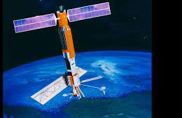
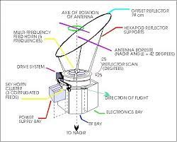
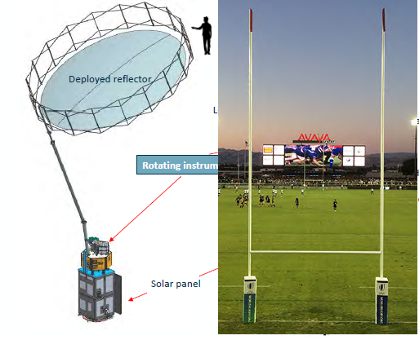
GSICS MW Subgroup Workshop (28 Feb – 2 Mar) Day 1 Highlights
Keynote Address (Frank Wentz): A Personal History of MW Remote Sensing and the People Along the Way (1971-2022)
Past, Current, and Future MW Instruments Topics
  Progress on MW sensors of FY satellites
  Introduction of the MW Instrument Calibration Processing System (MICalPS) software package [NOAA]
  Developments and future plans of Water-related Microwave Missions in Japan [JAXA]
  NOAA-20/JPSS1 ATMS performance and RFI plans for future NOAA sounders [NASA]
  The MWR at ESA : toward CIMR [ESA]
  SMOS Brightness Temperature calibration metrics and results from last 3rd mission reprocessing campaign [ESA]
Artist rendition of SeaSat
SMMR (1978)
NASA/JPL SeaSat opened the door in 1978 to Microwave Remote Sensing of the oceans.
CMA FY-3/MWRI (2012+)
ESA CIMR (2028+)

Slide 4
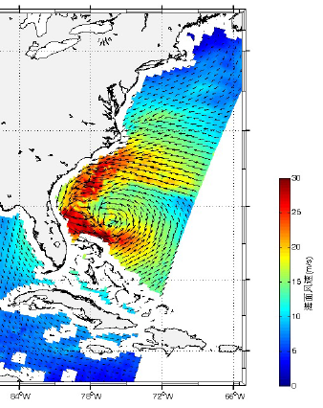
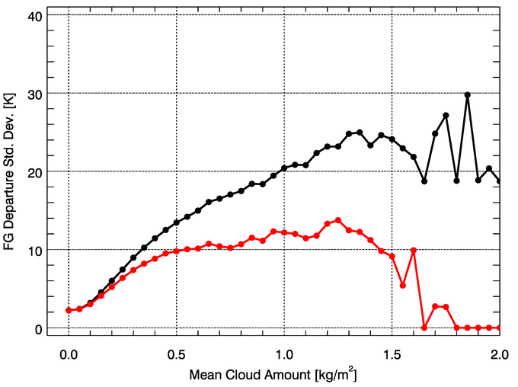
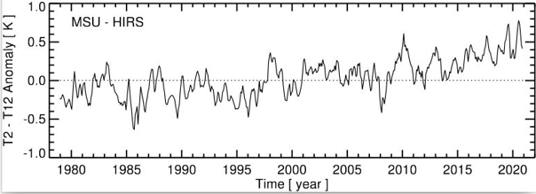
GSICS MW Subgroup Workshop (28 Feb – 2 Mar) Day 2 Highlights
Past, Current, and Future MW Instruments Topics (continued)
  Satellite Observations for Global Water Cycle [NSSC-CAS]
  Past, Current, and Future of EUMETSAT MW Radiometers [EUMETSAT]
Past, Current, and Future Applications of MW Data
  Microwave soundings in NWP at the Met Office: experience and suggestions for future systems [MetOffice]
  Direct assimilation of MW observations in the CMA-GFS system [CMA]
  Space-based MW Remote Sensing: Quantitative Techniques and Development in China [NSSC]
  A Revised All-sky Radiance Assimilation Framework in the NCEP Global Model [NCEP]
  Past, current, and future of NOAA MW FCDR’s [NOAA]
  Efforts at EUMETSAT on the generation of FCDRs from MW sounders [EUMETSAT]
Before QC
Error Model
After QC
Oct 27, 2012, wind observation of Hurricane Sandy by CNSA HY-2A SCAT
NCEP All-Sky Observation Error before and after precipitation screening
EUMETSAT Upper troposphere moistening evident from the MW 53.596 ± 0.115 GHz minus HIRS 6.52 micron channel trend

Slide 5
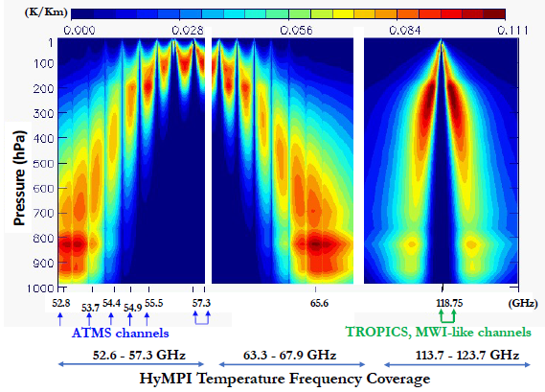
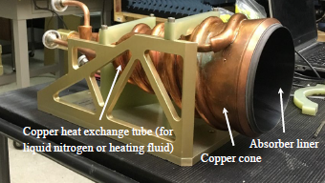
GSICS MW Subgroup Workshop (28 Feb – 2 Mar) Day 3 Highlights
Past, Current, and Future MW Instruments Topics (continued)
  Past, Current, and Future of Russian MW Radiometers [PLANETA]
Future of Microwave Remote Sensing: MW Standards
  Electromagnetic Measurement Techniques for Materials in the Microwave and Millimeter-Wave Frequency Range [NIM]
  Full waveform metrology methods with frequency field techniques [NIM]
  Microwave Remote-Sensing Standards at NIST [NIST]
Future of MW Remote Sensing: SmallSats or CubeSats
  Photonic Integrated Circuits (PICs) in Space: The Hyperspectral MW Photonic Instrument (HyMPI) [NASA]
  The NASA Compact Ocean Wind Vector Radiometer (COWVR) Instrument [JPL]
  The NASA Temporal Experiment for Storms and Tropical Systems - Demonstration (TEMPEST-D) Instrument [CSU]
NIM Quasi-optical high-Q resonator—characterize low loss (<10-4) materials such as antenna reflectors
NASA HyMPI Brightness Temperature Sensitivity Analysis to Temperature
NIST Standard Blackbody

Slide 6
GSICS MW Subgroup Workshop Discussion/Question Highlights (1 of 2)
Maximizing Use of Current MW Sensor Calibration Technology and Data for Inter-calibration
  Could tools such as the NOAA MW Instrument Calibration Processing System (MICalPS) be adopted as GSICS products or tools?
    There is interest only if distribution is limited within GSICS.
  Would lunar MW measurements such as those from NSSC’s Chang-E 1 and 2 be useful for MW lunar calibration?
    There is interest in acquiring such data.
    Subgroup members working on lunar calibration are encouraged to participate in the GSICS VIS/NIR Lunar Cal Work Area.
  Does the GSICS MWSG need to encourage agencies to extend the on-orbit lifetime of their MW sounders, which is a priority for NWP?
    This is a CGMS focus, and the NWP community raises this issue every year.
    The subgroup could request CGMS status updates regarding this subject. This gives the subgroup opportunities to track progress, and provide input into the CGMS process.

Slide 7
GSICS MW Subgroup Workshop Discussion/Question Highlights (2 of 2)
Encouraging/Adopting Calibration Best Practices and Standards
  ESA and EUMETSAT analyses incorporate guidelines to express measurement uncertainty developed by standards institutes. Can the subgroup encourage/adopt similar guidelines to harmonize data analysis within GSICS? If so, how?
Exploiting New MW Sensor Technology and Lessons-Learned for Inter-Calibration
  What role can the subgroup play in providing information about inter-calibration that supports the development of new MW sensors and their calibration?
    We can request data from new MW instruments such as HyMPI, COWVR, and TEMPEST-D, and provide input regarding lessons-learned about inter-calibration.
Building Relationships with the MW User Community
  How can the subgroup enhance the working relationship between MW instrument developers, operators, and NWP center or satellite application facility developers?
    Sending GSICS members to collaborate with the International TOVS Working Group (ITWG) was suggested.

