Slide 1
TROPOMI L1b: toward collection 3
Erwin Loots ^{1 ,} Antje Ludewig ¹, Mirna van Hoek ¹, Emiel van der Plas ¹, Nico Rozemeijer ², Simon Spronk ², Quintus Kleipool ¹
¹KNMI, Royal Netherlands Meteorological Institute, De Bilt, The Netherlands,
²TriOpSys B.V., Utrecht, The Netherlands

Slide 2
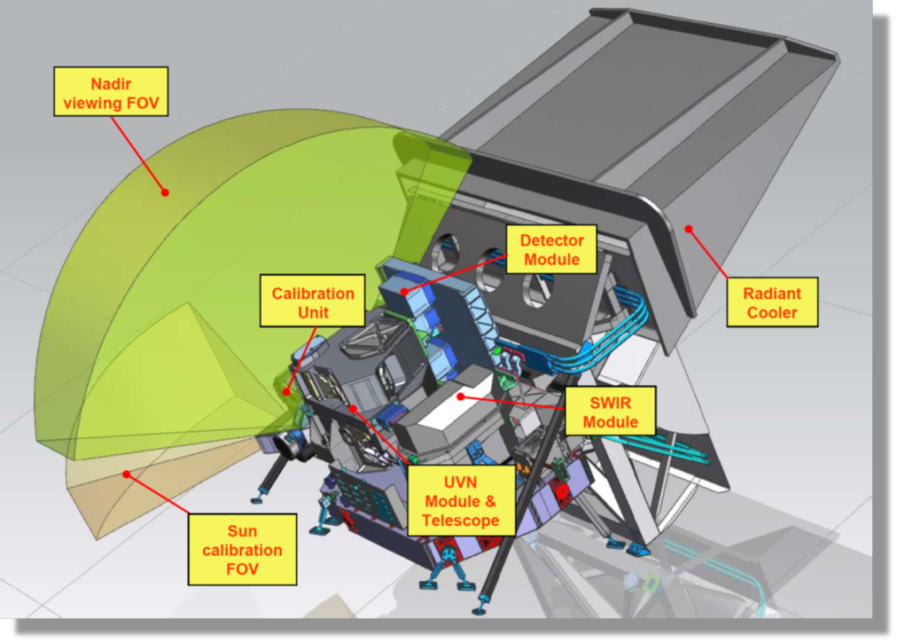
TROPOMI on-board Sentinel-5 Precursor
Single payload
Hyperspectral imager with 4 spectrometers
Sun synchronous orbit (MLTAN 13.30)
Pushbroom with ~ 2600 km swath
High spatial sampling (down to 5.5 km x 3.5 km)
Daily measurements of the Sun via Sun port
Launched 10/2017
Nominal operations since 30/4/2018
TROPOMI spectral bands – based on calibration data
Spectrometer | UV |  | UVIS |  | NIR |  | SWIR
Band ID | 1 | 2 | 3 | 4 | 5 | 6 | 7 | 8
Spectral range [nm] | 267-300 | 300-332 | 305-400 | 400-499 | 661-725 | 725-786 | 2300-2343 | 2343-2389
Spectral resolution [nm] | 0.45 - 0.5 |  | 0.45 - 0.65 |  | 0.34 - 0.35 |  | 0.227 | 0.225
Spectral sampling [nm] | 0.065 |  | 0.195 |  | 0.126 |  | 0.094
Spatial sampling [km²] | 5.5 x 28 | 5.5 x 3.5 | 5.5 x 3.5 |  | 5.5 x 3.5 |  | 5.5 x 7
Detector binning factor | 16 | 2 | 2 | 2 | 2 | 2 | 1 | 1

Slide 3
Current status
Nominal operations (E2) from 2018.04.30: coll 1
From 2019.08.07: smaller ground pixels
From 2021.07.01: coll 2:
  Improved absolute irradiance UV, UVIS
  Irradiance drift correction
  Electronic gain drift correction
From 2022.07.xx: coll 3:
  Transient pixel flagging improved
  Radiance drift correction

Slide 4
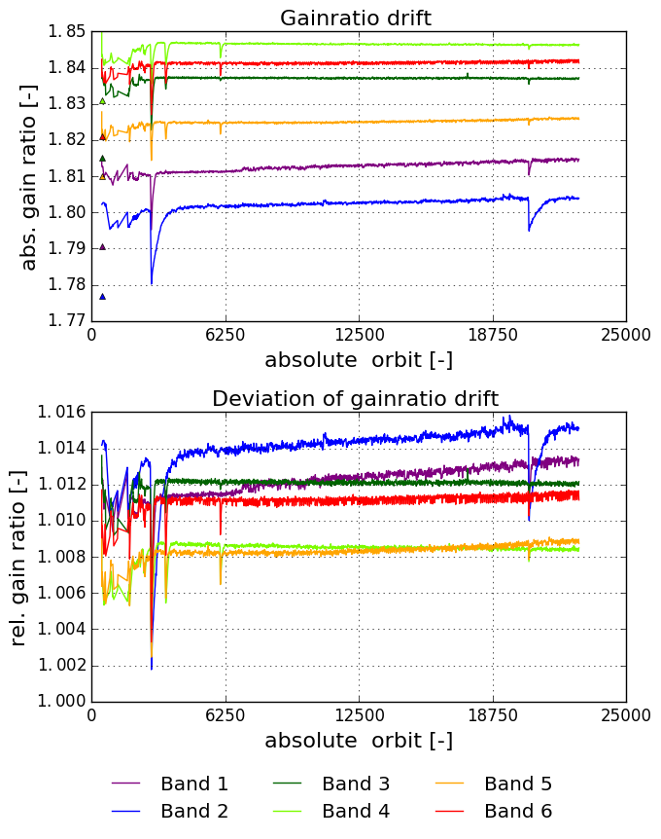
Electronic gain drift
Instabilities in CCD output node cause jumps in absolute electronic gain per band…
… causing signal jumps across center detector column, and drifts in absolute radiometry.
Daily monitoring of CCD output node gain ratio is used to correct for the drift
Correction in L01b Processor per static CKD, so jumps are uncorrected until next CKD update:
Band-2 jump of 0.5% in 2021.09.22 was therefore not corrected for; effect lasted until January, 2022.

Slide 5
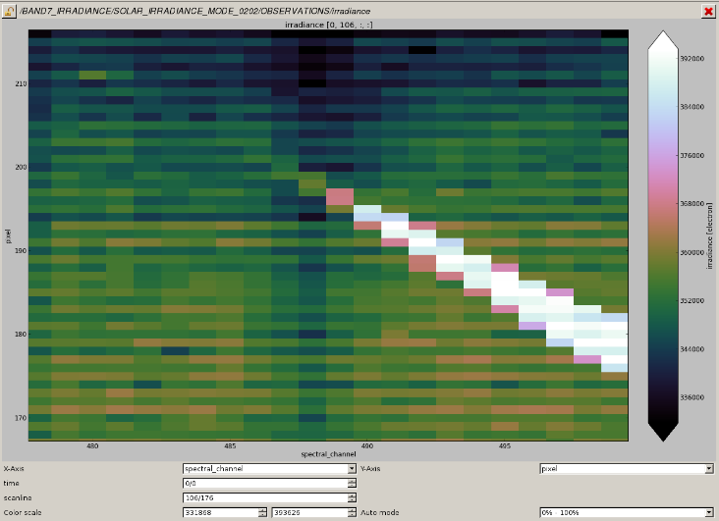
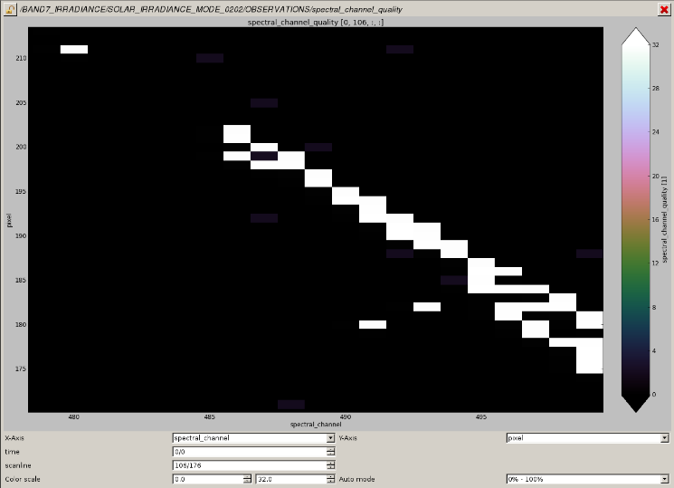
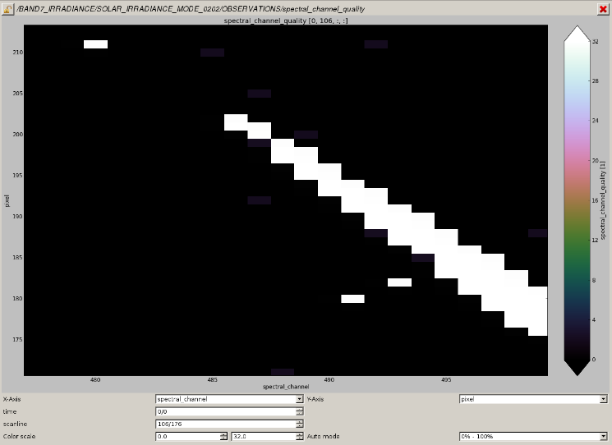
Transient pixel flagging
cosmic particle(s) hitting a detector pixel
  protons, electrons..
mainly in SAA region
  also in some polar regions
causing an additive increase in signal
short in duration
  one measurement
usually small in size
  but can cover multiple adjacent pixels
causes invalid data
  pixels need to be flagged and excluded from L2 processing
Coll-1: no correction
Coll-2: implemented
Coll-3: major revision
irradiance signal
Transient flags: coll 2
coll 3

Slide 6
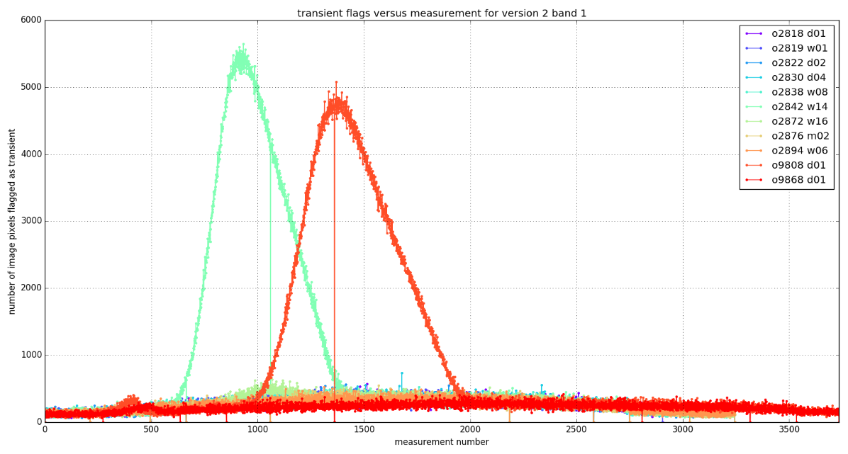
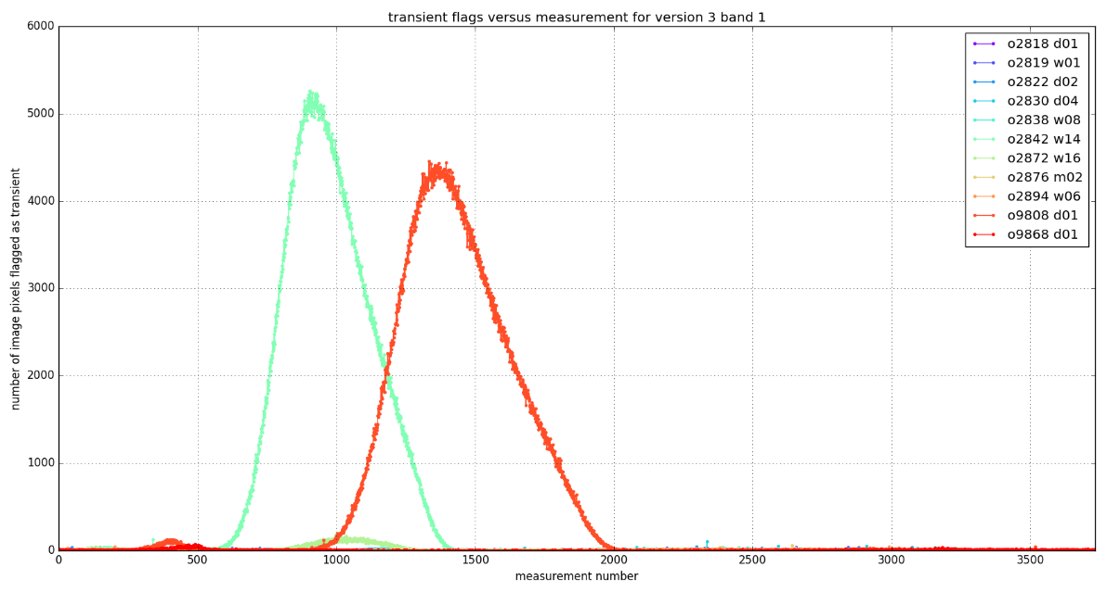
Transient pixel flagging
Example: number of flagged transient pixels per msmt, for selection of orbits (including two SAA orbits)
  Less false positives in coll-3
  No problems with ICID changes
  Better flagging statistics
coll2
coll3

Slide 7
Optical paths in TROPOMI
Sun
Earth
Diffusers QVD1 or QVD2
Folding mirror
Telescope + Spectrometers
radiance optical path
irradiance optical path

Slide 8
Calibration key data from irradiance measurements
Sun
Earth
irradiance optical path
UV only:
spectral
ageing CKD
- “common” irradiance CKD
- CKD QVD1
- CKD QVD2
Diffusers QVD1 or QVD2
Folding mirror
Telescope + Spectrometers
radiance optical path

Slide 9
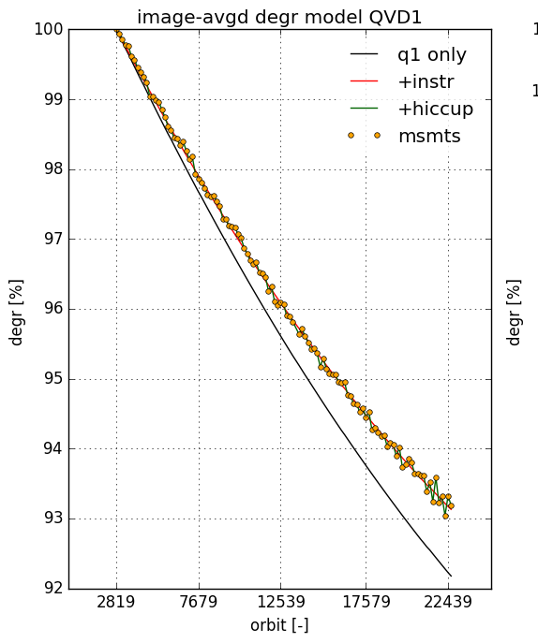
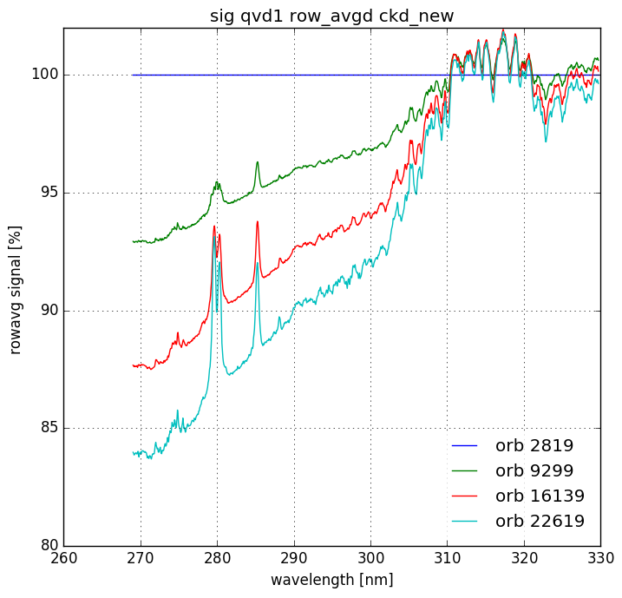
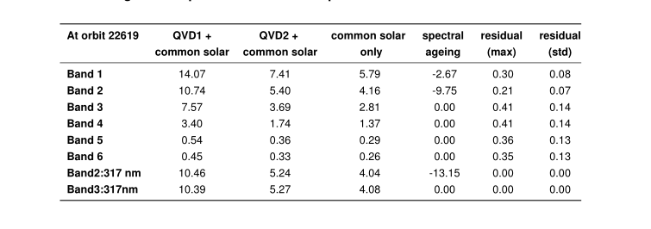
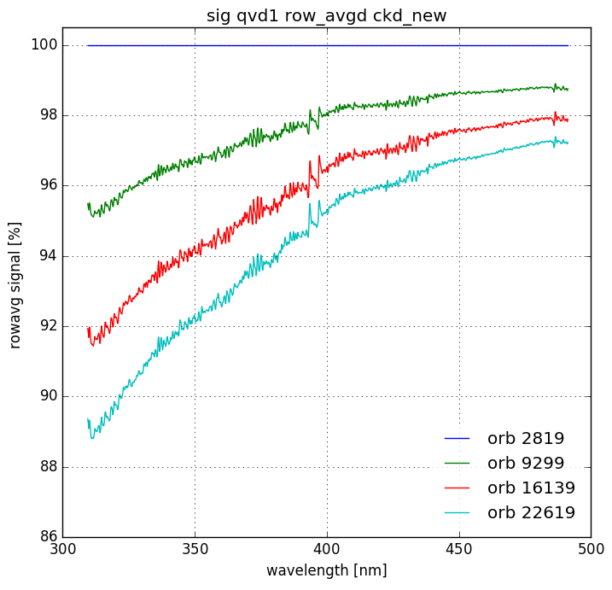
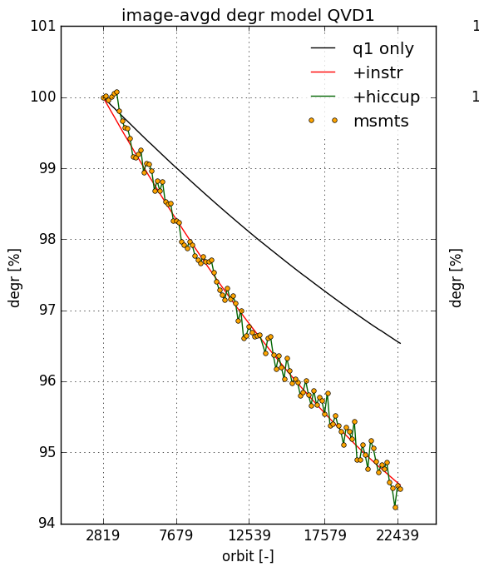
QVD and common degradation
QVD + common derived from irradiance data
Spectral ageing in UV counteracts degradation
Degradation (QVD+common) in irradiance is now up to 14% (10%) for UV (UVIS)
Common (instr) can contain spectrometer/telescope degradation
UV
UVIS

Slide 10
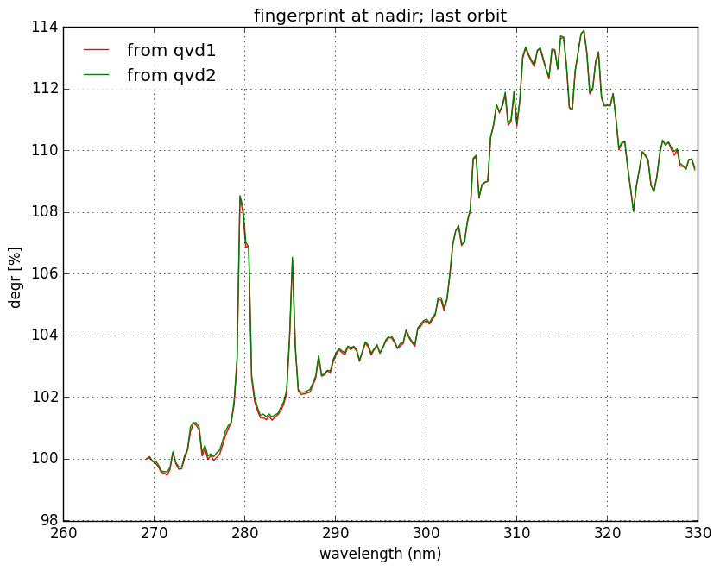
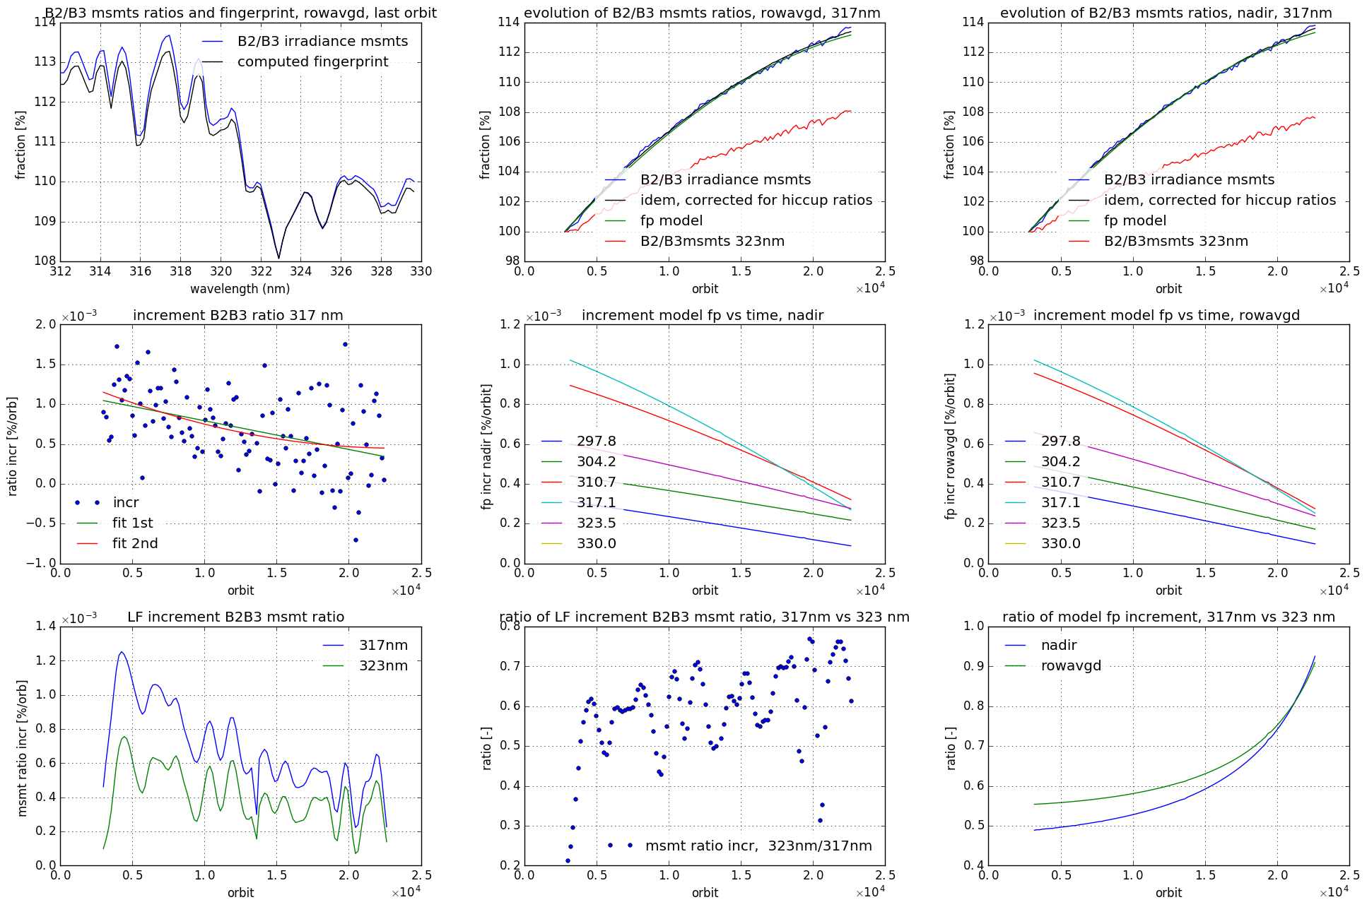
Spectral ageing UV (“fingerprint”)
Degradation with strong spectral features
Features correlate with solar spectrum
“Bleaching” – signal increases over time
Coating of detector or lens before detector suspected
Correction derived from irradiance data
Applied to radiance and irradiance (from coll-2 onward)
Within one year, partial stabilization (see growth at 317nm)is expected → regularly re-assessing the assumptions on degradation model.

Slide 11
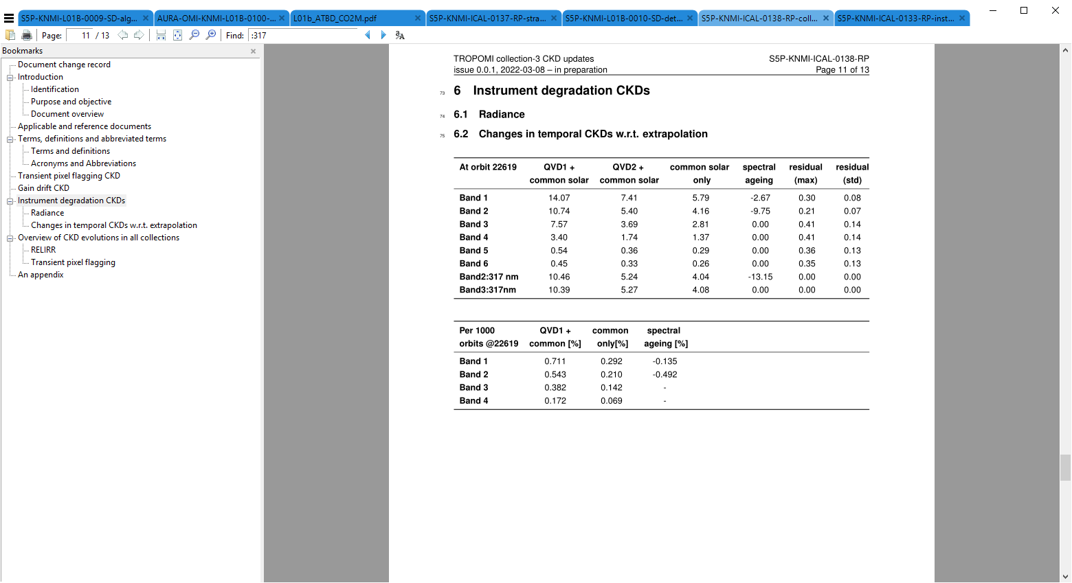
Keydata from radiance?
Sun
Earth
Diffusers QVD1 or QVD2
Folding mirror
Spectrometers
?
!
Finally, after studying radiance time series, enough confidence to attribute ‘common’ to spectrometer → radiance correction

Slide 12
Keydata from radiance!
Sun
Earth
Diffusers QVD1 or QVD2
Folding mirror
Spectrometers
!
!
Finally, after studying radiance time series, enough conifidence to attribute ‘common’ to spectrometer → radiance correction

Slide 13
Conclusion & future work
Collection 3 addresses most of the known instrument and calibration features
Irradiance degradation corrects for most of the observed L2 degradation
Correction key data for radiance degradation now in processor
(Ir)radiance degradation now includes 1-year model extrapolation
L01b Collection 3 expected to be operational in summer 2022
Reprocessing due to start end of 2022
Of course, some instrument features remain (UVIS scratch, short term irradiance fluctuations,…)
Until reprocessing has finished, we are in a hybrid situation with:
  Uncorrected (too low) (ir)radiance in coll-1
  Uncorrected (too low) radiance (too high reflectance) in coll-2

Slide 14
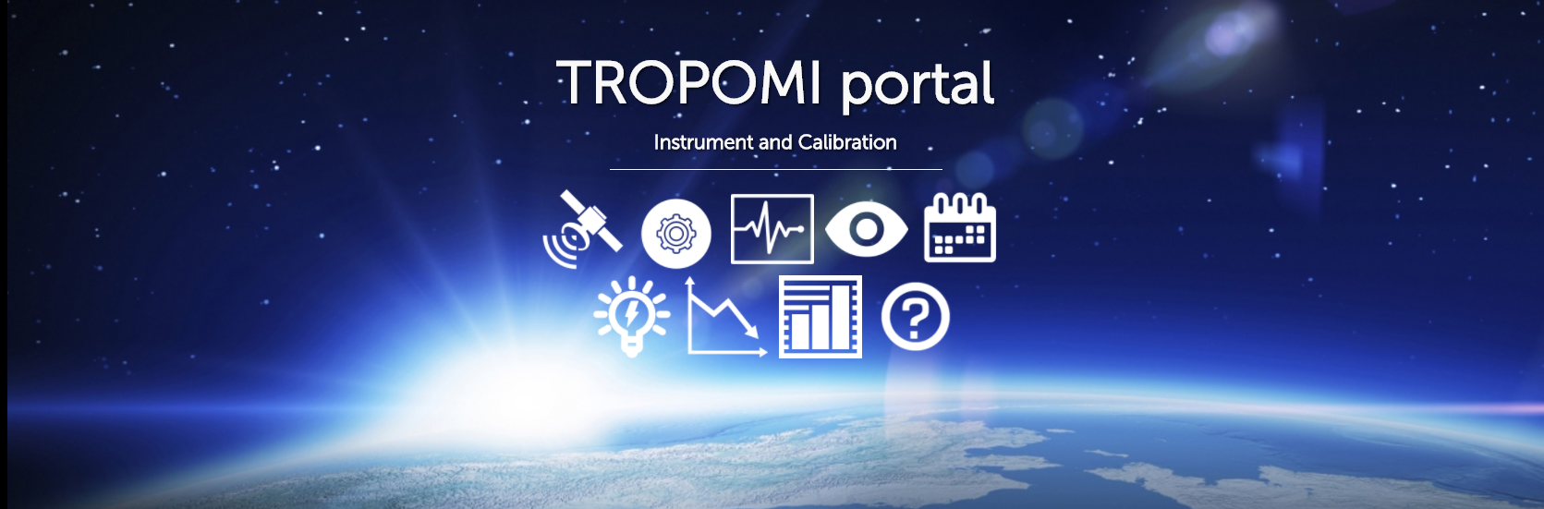
Thank you!
general information: http://www.tropomi.eu/
more on TROPOMI calibration: Kleipool et al. 2018 https://doi.org/10.5194/amt-11-6439-2018
Ludewig et al. 2020 https://doi.org/10.5194/amt-2019-488
Acknowledgement: Sentinel-5 Precursor is a European Space Agency (ESA) mission on behalf of the European Commission (EC). The TROPOMI payload is a joint development by ESA and the Netherlands Space Office (NSO). The Sentinel-5 Precursor ground-segment development has been funded by ESA and with national contributions from The Netherlands, Germany, and Belgium.

Slide 15
Backup

Slide 16
Most relevant CKD updates in V2
Time dependent electronic drift UVN (bands 1-6)
Time dependent diffuser degradation (until now bands 1-6)
Time dependent UV spectral ageing correction (bands 1-2)
Absolute radiometry irradiance bands 1 to 4 (not needed for 5 to 8)
Extended on-ground PRNU / RELRAD to cover more CCD pixels
Small bugfix in on-ground radiometry irradiance and radiance
New fix for spectral features in on-ground ABSRAD / BSDF calculation all bands
Cross-track radiometry irradiance (spot-map)
Relative angular radiometry irradiance
UV slit irregularity anomaly (bands 1-2)
Wavelength annotation (UV,UVIS, SWIR)

Slide 17
L01b version 2 algorithm updates
Most relevant updates:
  CCD blooming detection and flagging
  Transient signal detection and flagging
  Degradation correction radiance and irradiance possible for all bands
  Electronic drift correction
  UV spectral ageing correction
  Monitoring algorithms for wavelength and degradation
  Instrument thermal instability warning and flagging
  Fixed scanline handling for partially missing scanlines

