Slide 1
Outline ATBD to Combine Methods for GSICS inter-calibration of solar channels
Describes process of defining combination of multiple methods
Tim Hewison, Marianne König & Sebastien Wagner (EUMETSAT)

Slide 2
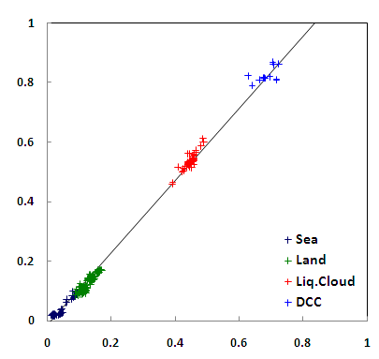
Combination of Methods
Combining results from
Direct Ray-matched Comparison
Different Invariant Targets
Spans observational range
of Reflectance/Radiance
Combine in linear regression
Weighted by methods’ uncertainty
Similar concept used to MSG VIS
Automatic, routine processing
Provide daily/monthly cal updates
Error budget for each method
Also assess: Independence, Stability, Availability, Latency and Cost
Reference Reflectance
Observed Reflectance
Comparison of Reflectance from Monitored Instrument and Reference for 4 different invariant targets Land Surfaces may cover much larger range
Plus direct ray-matched comparisons (grey cloud)
Regression provides inter-calibration function

Slide 3
Overview
Sensitivity Analysis
Define smoothing period
Uncertainty Assessment of each Method
Select methods for calibration/validation
Define weightings for each method
Construct weighted regression
Derive coefficients for GSICS Corrections
Test & Revise
Write up ATBD & Uncertainty Assessment
Submit to GPPA!

Slide 4
1. Analysis of Individual Methods
Analyse individual methods’ results to ascertain
Sensitivity of relative bias to variables such as:
Date, Time of Day,
Latitude, Longitude
Geometry: Solar & Viewing Zenith & Azimuth Angles
RTM & RTM inputs: Model coefficients, etc.
Others?
Ensure inter-calibration method represents these
(See other presentation on this topic)
Stability of monitored instrument
i.e. What is the maximum period over which we can average comparisons to capture calibration variations?

Slide 5
2. Uncertainty Assessment of each Method
Conduct theoretical uncertainty analysis
Validate the total random component of this
with statistics of time series of practical evaluations
Adjust theoretical uncertainty analysis
to match practical evaluations
By adding random component to represent unknown error sources?? [Rüdiger??]
Repeat validation to ensure match

Slide 6
3. Select Combinations of Methods
Based on uncertainty analysis and quantitative assessment of all methods:
Select methods for each VIS/NIR band:
for combination as inter-calibration
Must be:
Cover range of reflectances
Stable – with low systematic uncertainties
for validation of above
Others

Slide 7
4. Define weightings for each method
Based on uncertainty analysis and quantitative assessment of all methods:
Define relative weights of individual samples to combine in weighted regression
Based on number of samples available per period
And the total uncertainty of each method
To ensure correct ratios of total uncertainty from all methods
Process will need refinement

Slide 8
5. Construct weighted regression of sampled reflectances
Check linearity of selected combination
Define form of GSICS Correction:
Linear/quadratic/cubic…
Sensitivity to other functions
Standard off-the-shelf weighted regression
Of all samples’ reflectances
Of all selected invariant targets/collocations
Measured by Monitored & Reference instruments
Over smoothing period

Slide 9
6. Derive coefficients for GSICS Corrections
Regression Coefficients are the coefficients of the GSICS Correction
Update daily by repeating the regression
Using symmetric smoothing period
For GSICS Re-Analysis Correction
By combining only most recent results (asymmetric)
For GSICS Near Real-Time Correction

Slide 10
7. Test & Revise
Apply GSICS Corrections to test datasets
Check corrected reflectances are as expected
Check quoted uncertainties are as expected
Check impact on selection of L2 products
Check GEO-GEO consistency in L2 product space (in cooperation with Users/SCOPE-CM/…)
Switch off different component methods
Investigate stability of results & consistency
Revise any of the above steps
to ensure stability and consistency

Slide 11
8. Write up ATBD & Uncertainty Assessment
Write ATBD describing combination of methods
Referencing ATBDs of each individual method
Version of combined master ATBD should reflect version of all constituent methods
Write uncertainty assessment of combined method
Referencing those of each individual method
Submit end product to GPPA!

Slide 12
Summary
Sensitivity Analysis
Define smoothing period
Uncertainty Assessment of each Method
Select methods for calibration/validation
Define weightings for each method
Construct weighted regression
Derive coefficients for GSICS Corrections
Test & Revise
Write up ATBD & Uncertainty Assessment

