Slide 1

Paul Poli, Timo Hanschmann, Viju John, Joerg Schulz (EUMETSAT)

Slide 2
SSM/T-2 instrument
Mounted on
3 block 5D-2 satellites (F11, F12, F14) and
the 1st block 5D-3 satellite (F15)
First instrument to routinely observe the 183 GHz band
(3 channels: 183.31 GHz ± 1, ± 3, ± 7 GHz)
“Reference article” for this instrument: I. Galin, D.H. Brest, and G.R. Martner, 1993: DMSP SSM/T-2 microwave water vapor profiler, Proc. SPIE 1935, Microwave Instrumentation for Remote Sensing of the Earth. doi: 10.1117/12.152603.

Slide 3


SSM/T-2 FDR Release 2
Heritage
SSM/T-2 from FIDUCEO project
Difference with respect to previous release
Collocation with CM-SAF HOAPS 4.0
SSM/I retrievals over ice-free oceans,
and aggregation of matching retrievals
Flagging of scenes believed to be affected by rain/cloud contamination, where HOAPS rain rate or total water path exceed thresholds
Flagging of scan positions affected by glare obstruction bracket (GLOB)
Output product: FDR Release 2
  Includes all the information above
doi:10.15770/EUM_SEC_CLM_0046
doi:10.5676/EUM_SAF_CM/HOAPS/V002
doi:10.15770/EUM_SEC_CLM_0050

Slide 4
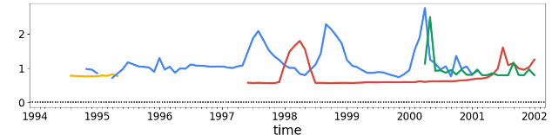
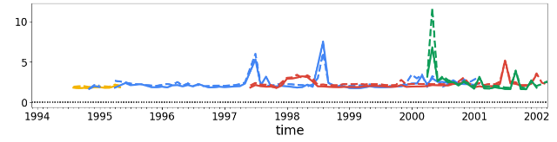
SSM/T-2 Uncertainties
3 components of uncertainty: independent, structured, common
SSM/T-2 channel 183 ± 7 GHz (lower tropospheric humidity)
DMSP F11
DMSP F12
DMSP F14
DMSP F15
FIDUCEO total
uncertainty (K)
Std. dev. of differences between FCDR and radiative transfer simulations (K)
ERA-Interim
ERA5

Slide 5
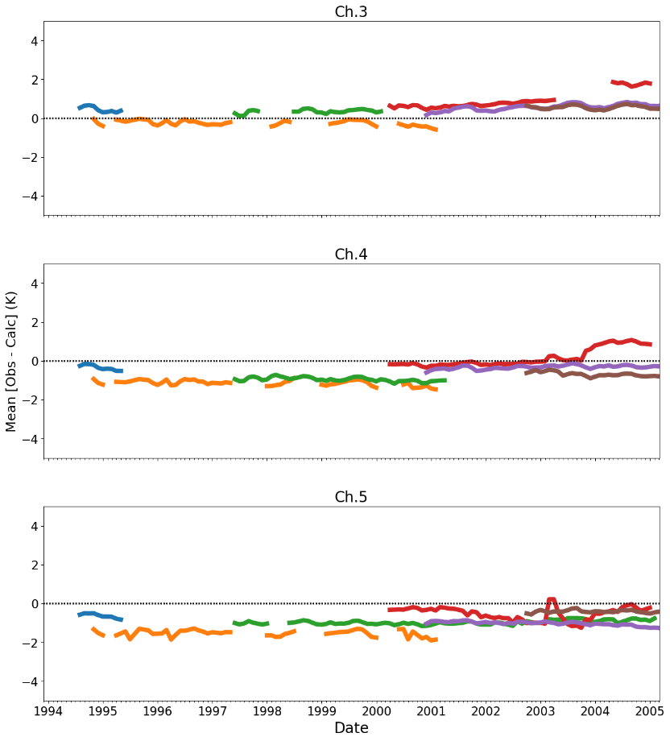

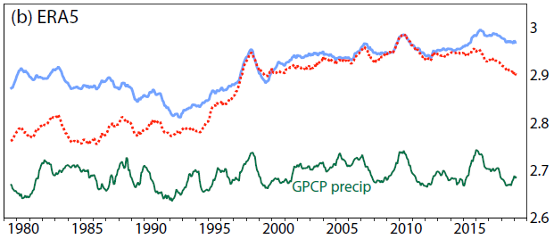
Mean differences with ERA5
183.31 ± 1.00 GHz ~Upper-Tropos. Hum.
SSM/T-2 F11
SSM/T-2 F12
SSM/T-2 F14
SSM/T-2 F15
① [SSM/T-2 FCDR] minus
[clear-sky radiative transfer simulations (running NWP-SAF RADSIM & RTTOV, using ERA5 atmospheric profiles) for scenes believed to be clear of cloud/rain effects, after removing noisy events based on FIDUCEO total uncertainty]
①
AMSU-B
NOAA-16
AMSU-B
NOAA-17
②
183.31 ± 3.00 GHz ~Mid-Tropos. Hum.
② ERA5 observation data assimilation feedback, for AMSU-B data actively assimilated in ERA5
~ 0
P
183.31 ± 7.00 GHz ~Lower-Tropos. Hum.
E
mm/day
Fig. 23 excerpt from Hersbach et al. (2020, doi:10.1002/qj.3803)

Slide 6
Thanks for your attention!

Slide 7
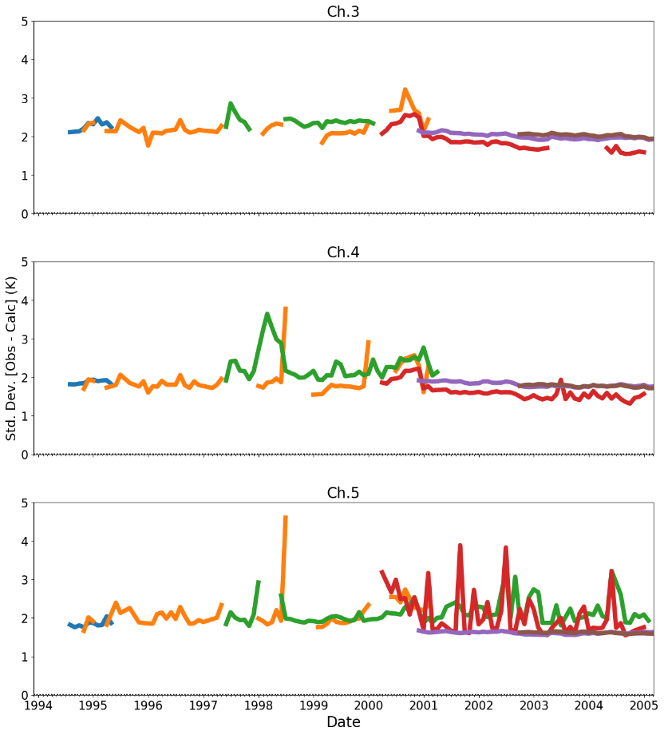
Std. dev. differences with ERA5
183.31 ± 1.00 GHz ~Upper-Tropos. Hum.
SSM/T-2 F11
SSM/T-2 F12
SSM/T-2 F14
SSM/T-2 F15
① [SSM/T-2 FCDR] minus
[clear-sky radiative transfer simulations (running NWP-SAF RADSIM & RTTOV, using ERA5 atmospheric profiles) for scenes believed to be clear of cloud/rain effects, after removing noisy events based on FIDUCEO total uncertainty]
①
AMSU-B
NOAA-16
AMSU-B
NOAA-17
②
183.31 ± 3.00 GHz ~Mid-Tropos. Hum.
② ERA5 observation data assimilation feedback, for AMSU-B data actively assimilated in ERA5
183.31 ± 7.00 GHz ~Lower-Tropos. Hum.

