Slide 1
SMOS-SMAP Inter-comparison activities over Antarctica and wind measurement
Raffaele Crapolicchio
ESA ESRIN
31/03/2021

Slide 2
Content
Soil Moisture Ocean Salinity (SMOS) mission overview
Microwave Imaging Radiometer using Aperture Synthesis (MIRAS) instrument
MIRAS calibration
Inter-comparison context: Expert Support Laboratories and Quality Working Group
Brightness Temperature (Level 1) inter-comparison
  Domex radiometer experiment
  MIRAS - Domex inter-comparison over Antarctica
  MIRAS – SMAP inter-comparison over Antarctica
Sea surface wind speed (Level 2) inter-comparison
  MIRAS – SMAP inter-comparison over global Ocean
Conclusion

Slide 3
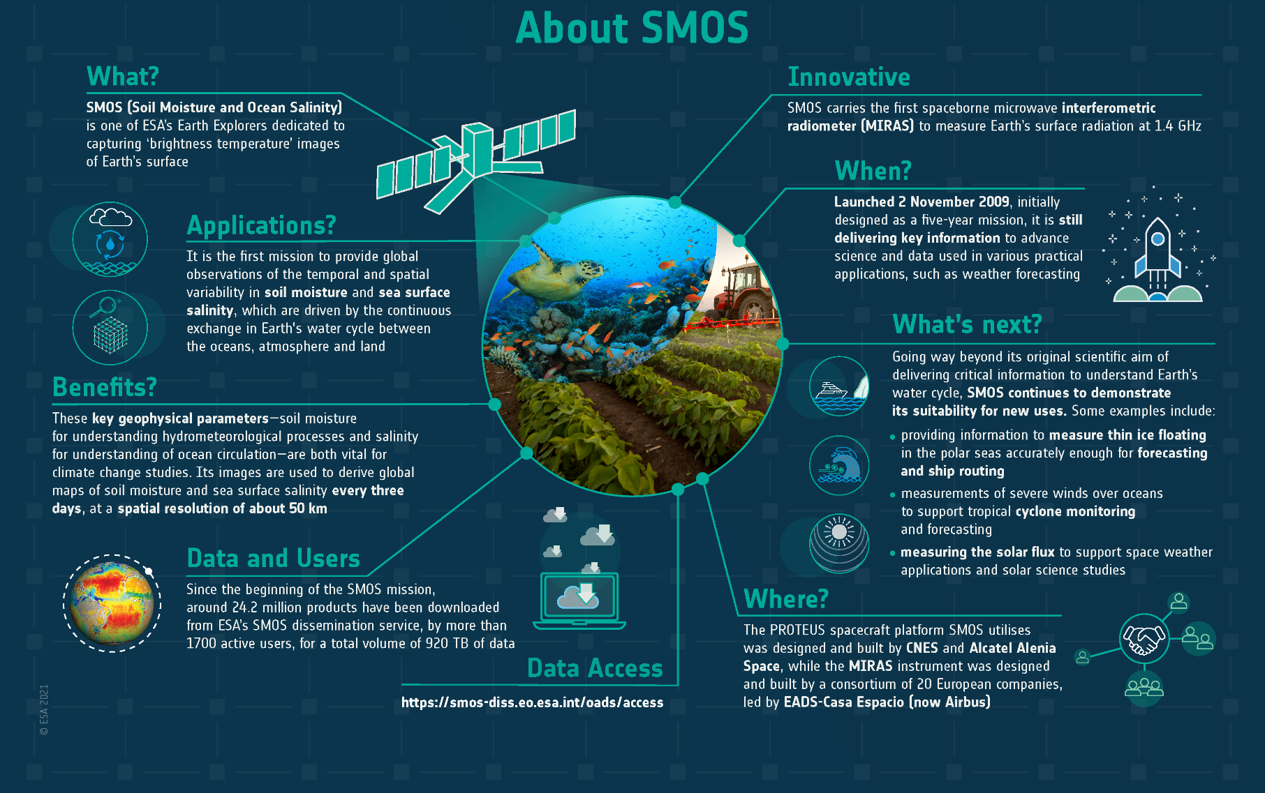
SMOS Mission overview
Land products:
soil moisture,
soil state (freeze/thaw),
vegetation optical depth (*)
Sea products:
sea surface salinity,
sea ice thickness,
sea surface wind speed
cyclone wind radii
Space weather products:
Solar flux (*)
(*) under development

Slide 4
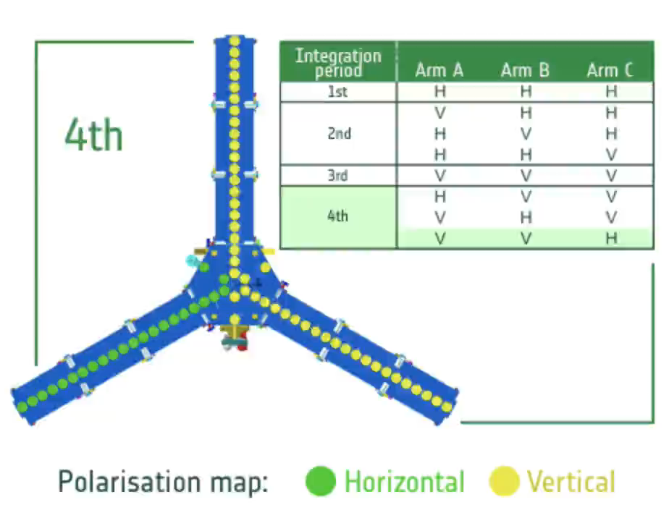
MIRAS instrument
The payload of SMOS consists of the Microwave Imaging Radiometer using Aperture Synthesis (MIRAS) instrument, a passive microwave 2-D interferometric full polarization radiometer, operating at 1.413 GHz (wavelength of 21 cm) within the protected 1400-1427 MHz band.
A full polarimetry measurement is acquired in four integration period i.e. 4.8 seconds.

Slide 5
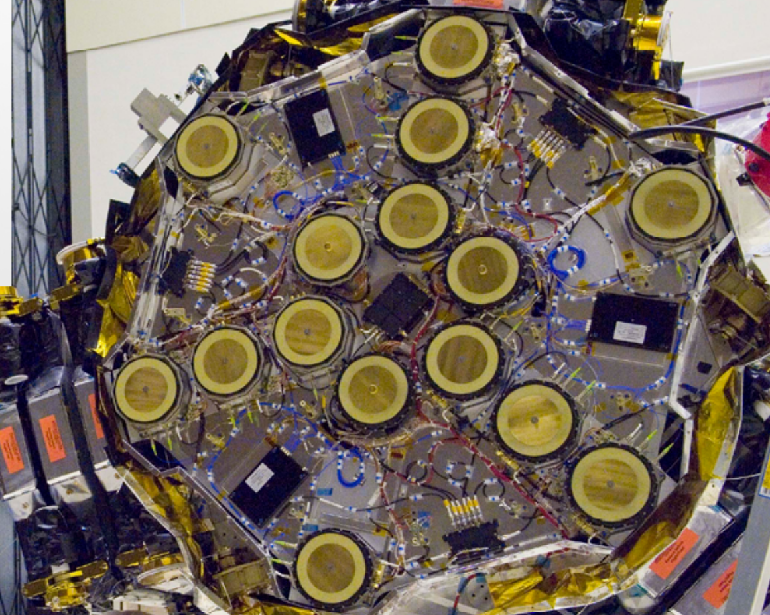
MIRAS instrument
The MIRAS instrument antenna array is formed by three arms 120° apart, with 23 equally spaced LICEF (Lightweight Cost-Effective Front-end) receivers each.
Due to antenna size (diameter equal to 16.5 cm) and frequency wavelength (21 cm at L-band) the instrument’s field of view (FoV) is large and includes full Earth-disk and part of the surrounding Sky.
The Y-array configuration leads to an hexagonal sampling of the space in front of the sensor.

Slide 6
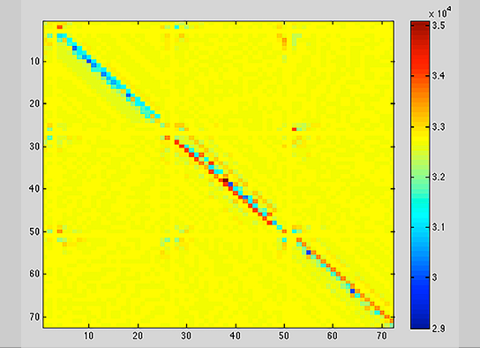
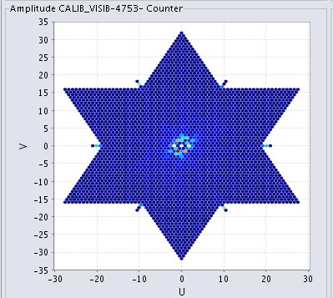
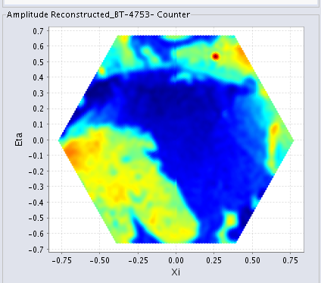
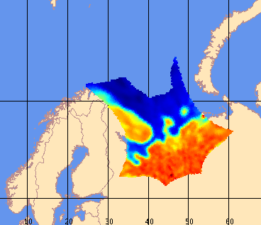
MIRAS calibration
MIRAS data calibration requires to convert the digital correlation counts (L0) integrated over 1.2 second interval into calibrated visibility function (L1A). N.B. L1A product contains the sensor calibrated measurement.
Image retrieval requires to invert the MIRAS instrument transfer function (which is not a simple IFT) to convert calibrated visibility into Brightness Temperature calibrated image at antenna frame (L1B) and Earth geolocation (L1C). N.B. L1C contains the sensor calibrated measurement + result of the image reconstruction algorithm
Level 0
Level 1A
Level 1B
Level 1C

Slide 7
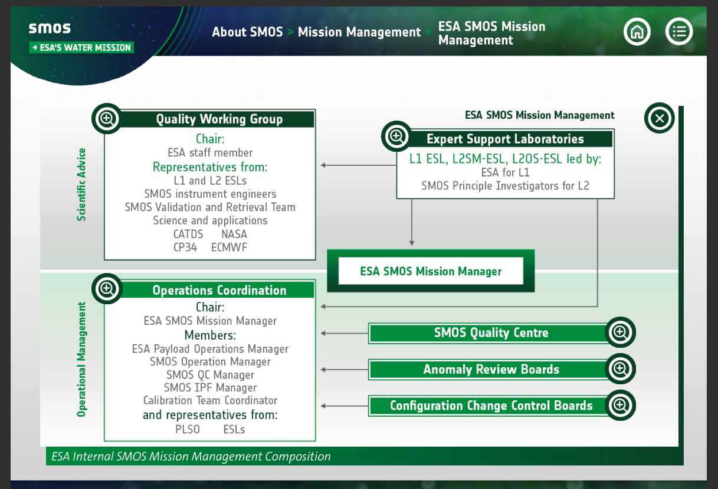
Inter-comparison context
The Expert Support Laboratories (ESLs) are groups of experts that provide scientific support and expertise to the SMOS mission. Product/sensor calibration and inter-comparison activities are carried out within this group to form the basis of Level 1 processor (calibrated brightness temperature) and Level 2 processor update.
ESL supporting inter-comparison: CESBIO, IFAC, IFREMER.
The Quality Working Group (QWG) provides ESA with scientific recommendations to update or improve the SMOS mission, data quality and applications.
Figure from ESA SMOS multimedia book

Slide 8
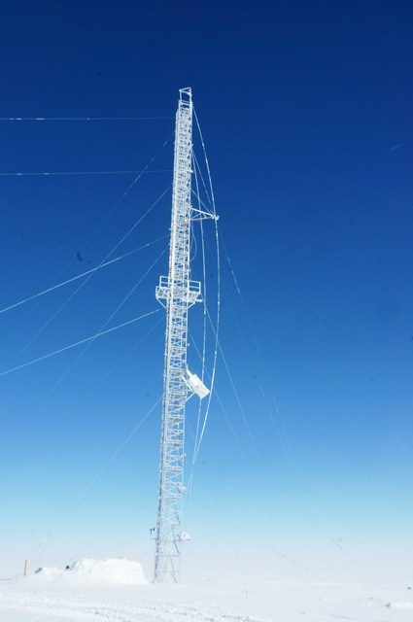
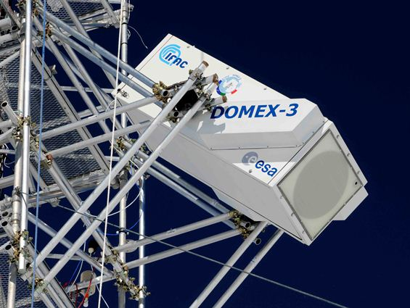
DOMEX experiment
For high brightness temperature values (i.e. higher than 150 K) measured by SMOS, the East Antarctic Plateau, in particular the area of Dome-C near the Italian-French base of Concordia, is used as one of the most suitable long-term test sites.
Full time series of brightness temperature values measured by DOMEX radiometer in the area of Dome-C are available from December 2012 to December 2020 (and beyond).
Figures credits: IFAC

Slide 9
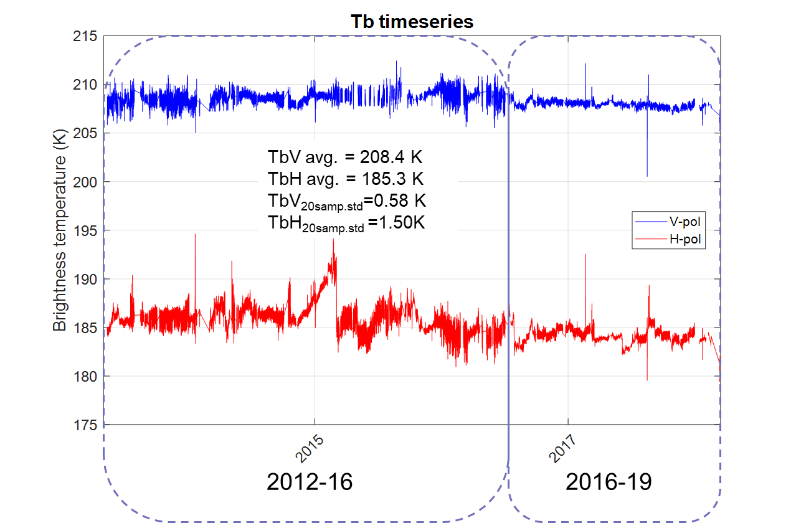
DOMEX experiment
Few hardware changes and improvements in calibration strategy between 2012-16 time series and 2016-19 time series required a realignment of the dataset.
Figure on the left shows the brightness temperature at 42 deg. incidence angle (BoA) after realignment (antenna pattern not deconvoluted).
Stability within 0.5K for V-pol and 1K for H-pol
(Figure credits IFAC)
NO DATA

Slide 10
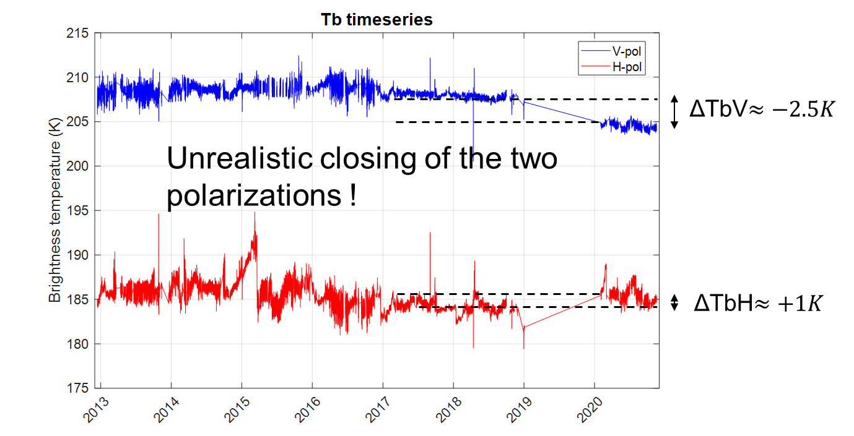
DOMEX experiment
Time series realignment between 2012-19 and 2020 is ongoing. Points to be considered:
System remained switched off (but heated) for around 1 year
Antenna cables were inverted at the receiver inputs
Some manipulations (screw/unscrew) between antenna, cable and receiver inputs were carried out
Set-points and thermal regulation was modified
(Figure credits IFAC)

Slide 11
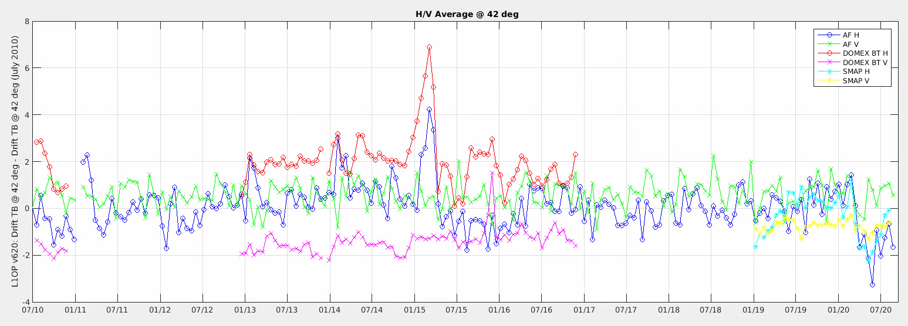
SMOS/DOMEX Inter-comparison
SMOS V-pol ToA @42 deg
SMOS H-pol ToA @42 deg
Domex V-pol ToA @42 deg
Domex H-pol ToA @42 deg
June 2010 SMOS Ref Values V620:
H: 187.2971
V: 212.1379
Time-series is averaged over a period of 18 days (SMOS satellite sub-cycle). Domex deconvoluted. Bias of few Kelvin between SMOS V6 and Domex to be understood. H-pol variation clear seen by SMOS and Domex. (Figure credits ESA/CEC)

Slide 12
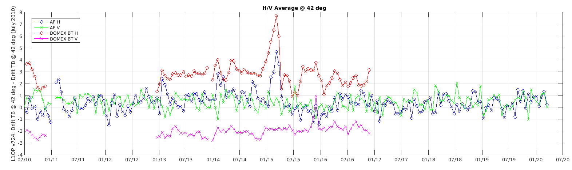
SMOS/DOMEX Inter-comparison
June 2010 SMOS Ref Values V724:
H: 186.4750
V: 212.7121
SMOS V-pol ToA @42 deg
SMOS H-pol ToA @42 deg
Domex V-pol ToA @42 deg
Domex H-pol ToA @42 deg
SMOS V-pol ToA @42 deg
SMOS H-pol ToA @42 deg
Domex V-pol ToA @42 deg
Domex H-pol ToA @42 deg
June 2010 SMOS Ref Values V620:
H: 187.2971
V: 212.1379
Time-series is averaged over a period of 18 days (SMOS satellite sub-cycle). Domex deconvoluted. SMOS V7 dataset cooler in H-pol and slightly warmer in V-pol. (Figure credits ESA/CEC)

Slide 13
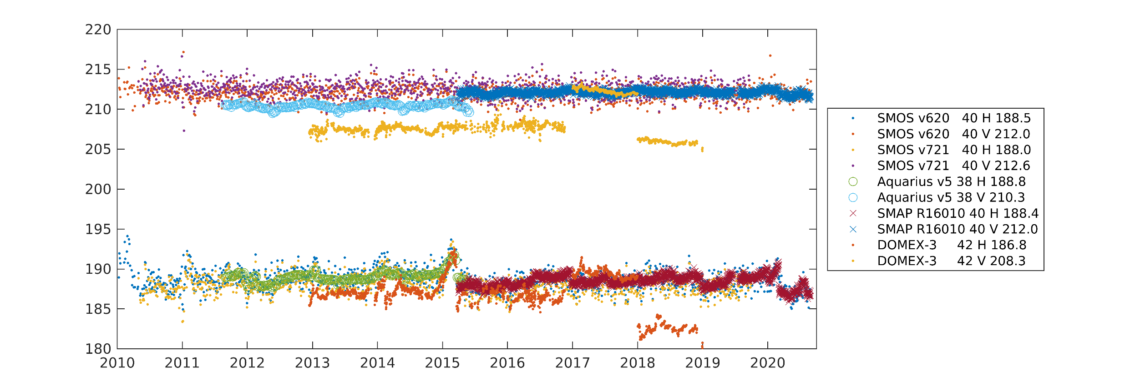
SMOS – SMAP Inter-comparison (Antarctica)
June 2010 SMOS Ref Values V620:
H: 187.2971
V: 212.1379
SMAP R16010
Processing includes careful filtering and SMOS reconstruction to match SMAP footprint at 40 deg. incidence angle
SMAP data release R16010. SMOS – SMAP H@40 -0.4K; V@40 0.0K (Figure credits CESBIO)

Slide 14
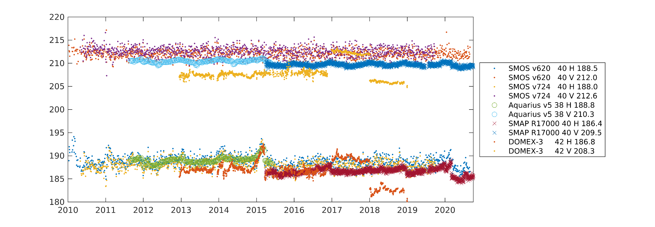
SMOS/SMAP Inter-comparison (Antarctica)
SMAP R17000
Processing includes careful filtering and SMOS reconstruction to match SMAP footprint at 40 deg. incidence angle
SMAP data release R17000. SMOS – SMAP H@40 1.6K; V@40 3.1K (Figure credits CESBIO)

Slide 15
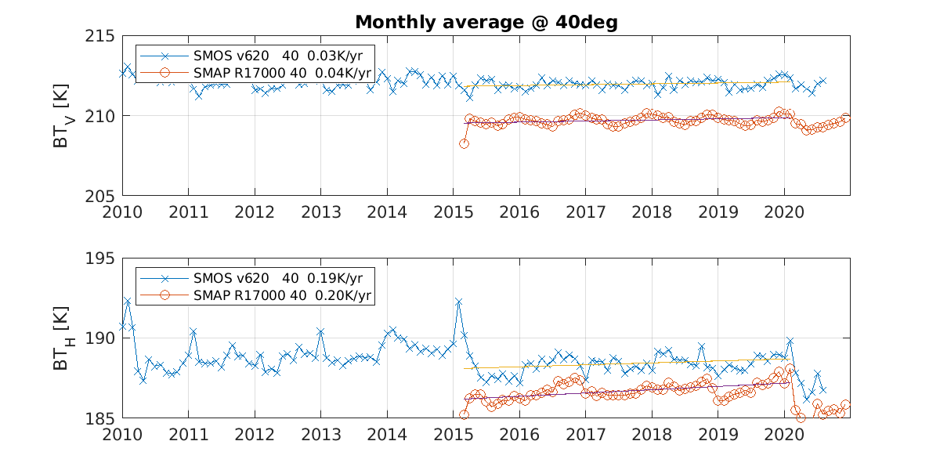
SMOS/SMAP Inter-comparison (Antarctica)
SMAP R17000
SMOS and SMAP show same trend over past 5 years. (Figure credits CESBIO)

Slide 16
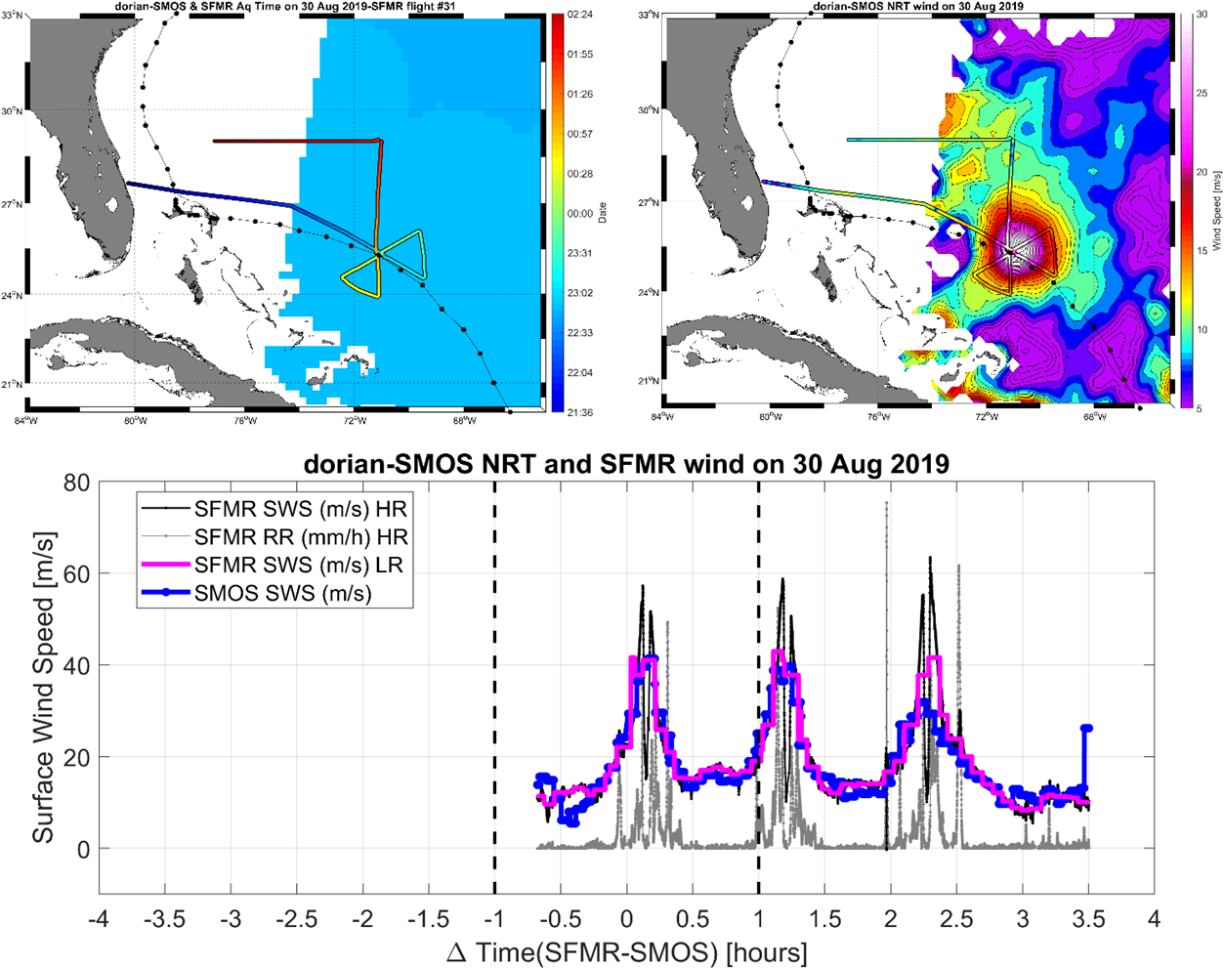
SMOS/SMAP Inter-comparison level 2
L-band emissivity strong increases under high wind condition due to foam formation on sea surface.
This phenomena makes possible reliable estimation of wind speed under tropical cyclone condition.
Level 2 inter-comparison takes into account both sensors calibration and Geophysical Model Function
(Figure credits IFREMER)

Slide 17
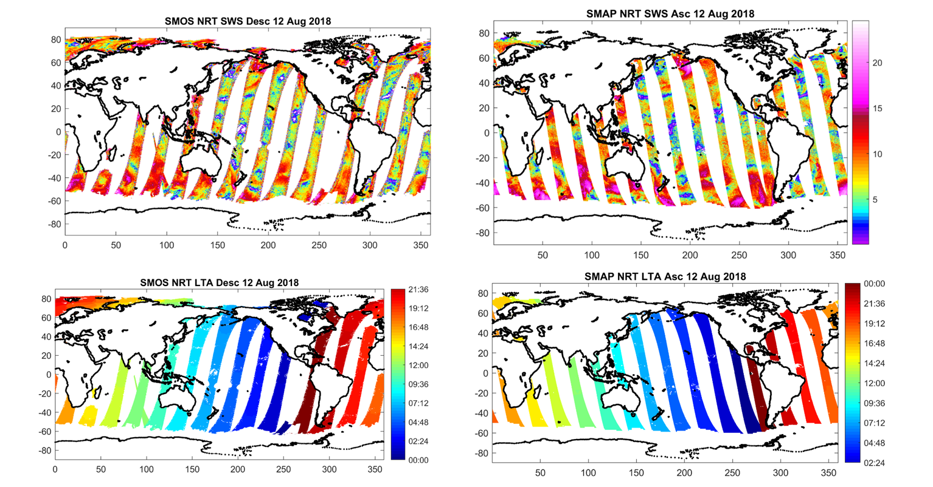
SMOS/SMAP Inter-comparison
SMAP R17000
Wind speed
Local Time
Look for intercepts such that |∆t|<1 H (Figure credits IFREMER)

Slide 18
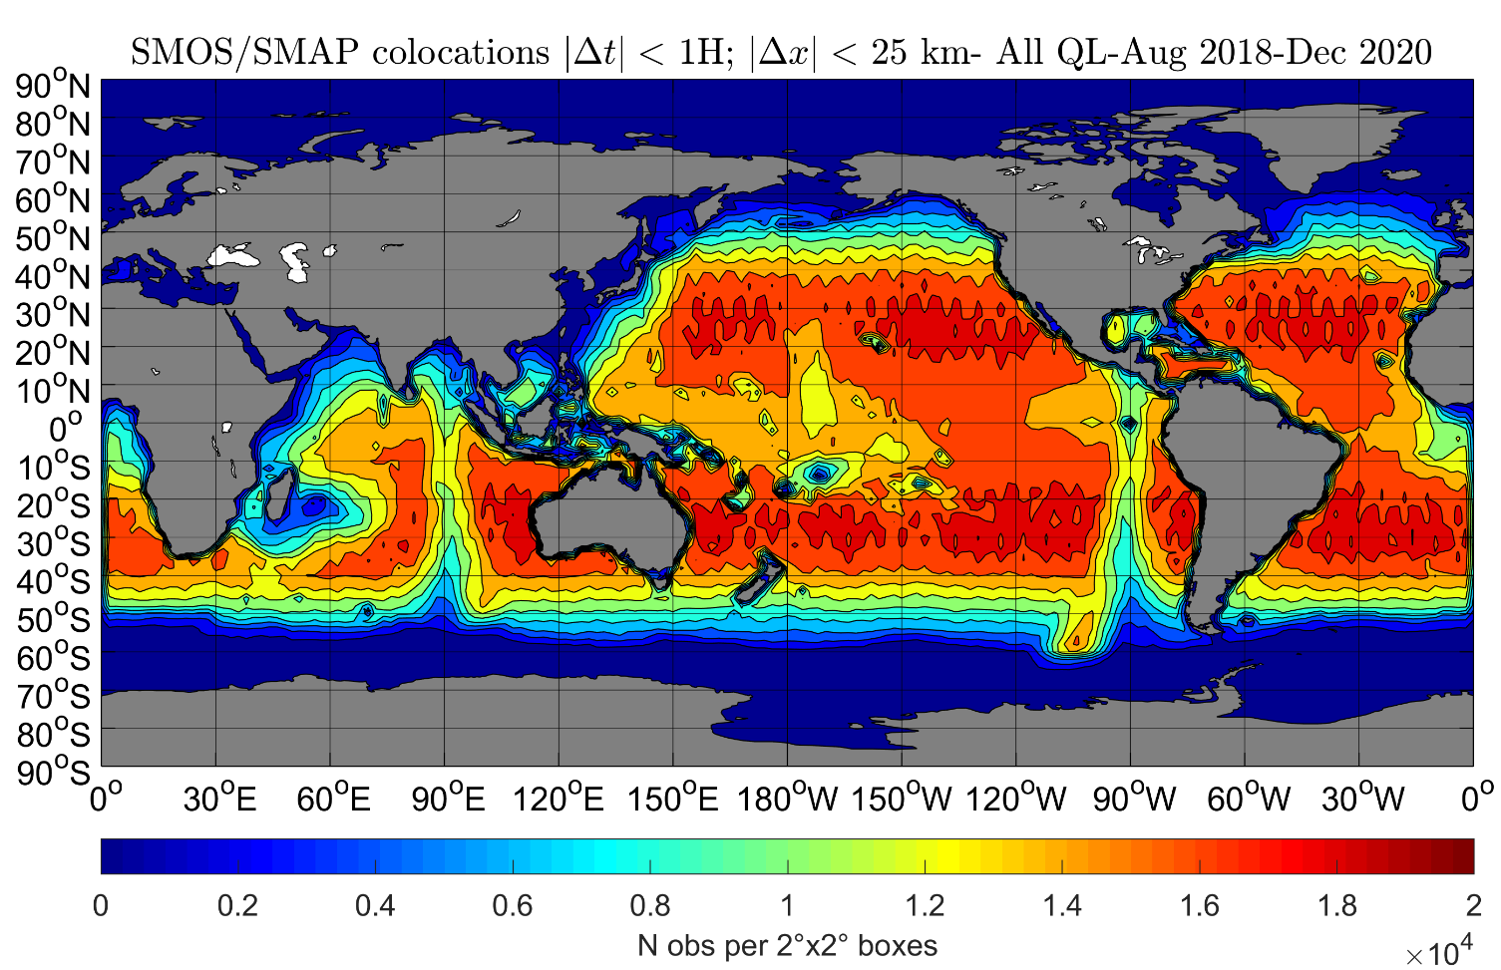
SMOS/SMAP Inter-comparison (match-ups)
SMAP R17000
Number of co-localized measurements for the period August 2018 – December 2020 (Figure credits IFREMER)

Slide 19
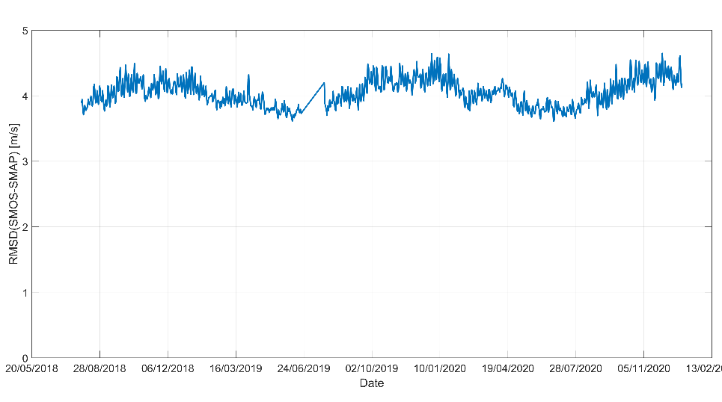
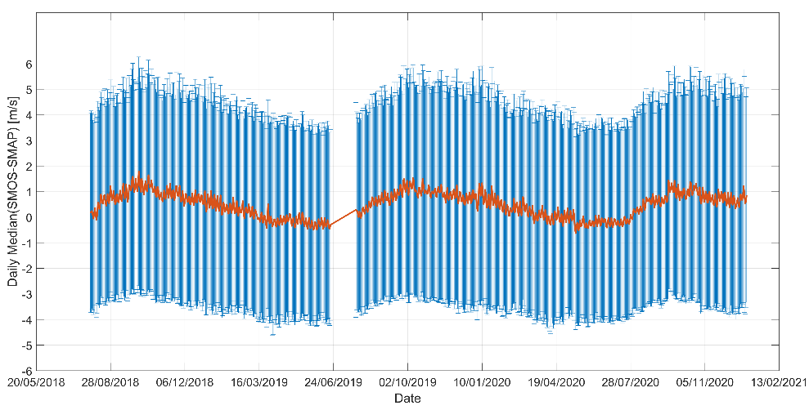
SMOS/SMAP Inter-comparison (sea surface wind speed)
SMAP R17000
SMAP missing data
Daily mean wind speed differences (SMOS-SMAP) within +/- 1 m/s
Daily RMSD wind speed (SMOS-SMAP) stable around 4 m/s
SMOS operational dataset (all quality level)
Long-term evolution performances are stable. (Figure credits IFREMER)

Slide 20
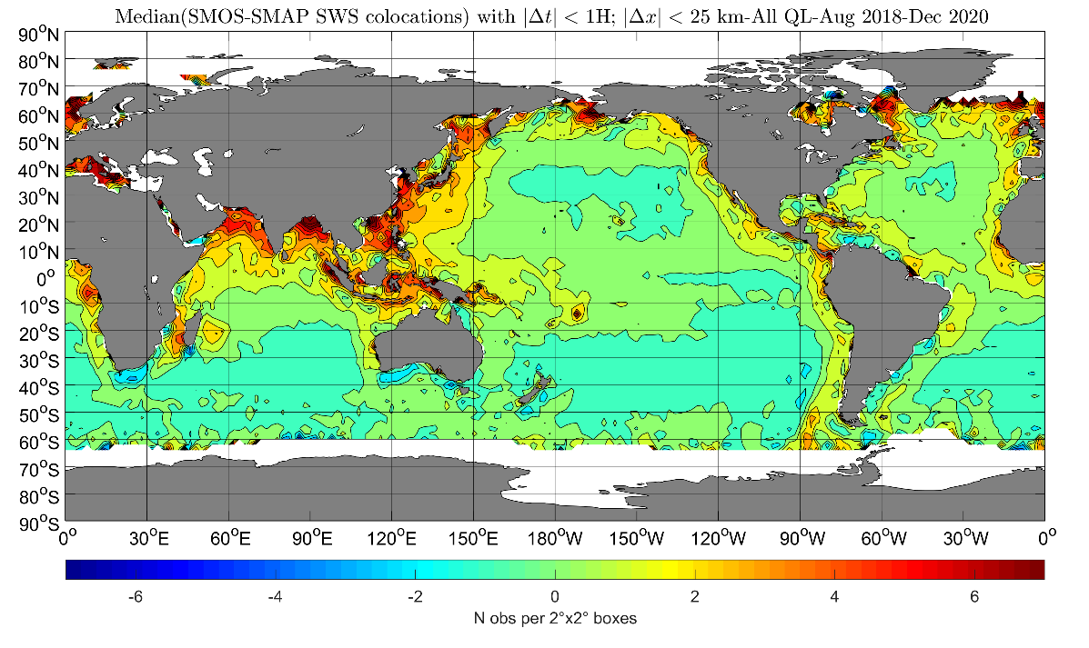
SMOS/SMAP Inter-comparison (sea surface wind speed)
SMAP R17000
Spatial patterns bias: large difference in coastal area (Figure credits IFREMER)

Slide 21
SMOS/SMAP Inter-comparison (sea surface wind speed)
SMAP R17000
New Processor from May 2021
Spatial patterns bias: NEW L2 processor mitigates difference in coastal area (Figure credits IFREMER)

Slide 22
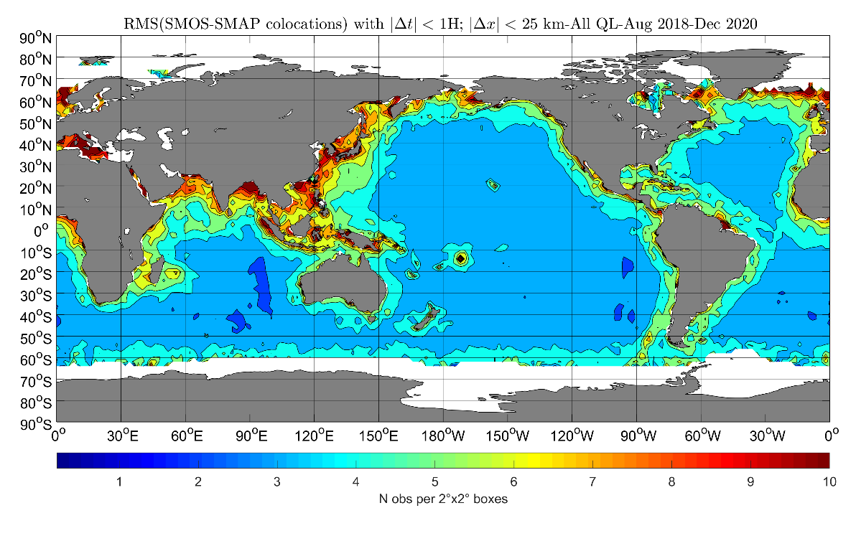
SMOS/SMAP Inter-comparison (sea surface wind speed)
SMAP R17000
Spatial patterns RMSD: large difference in coastal area (Figure credits IFREMER)

Slide 23
SMOS/SMAP Inter-comparison (sea surface wind speed)
SMAP R17000
New Processor from May 2021
Spatial patterns RMSD: significate reduction (Figure credits IFREMER)

Slide 24
SMOS/SMAP Inter-comparison (sea surface wind speed)
SMAP R17000
QL=0 QL=1 QL=2
QL=0 QL=1 QL=2
Bias = -0.1 m/s
RMSD = 2.3 m/s
Bias = 0.9 m/s
RMSD = 3.5 m/s
Bias = 1.2 m/s
RMSD = 4.7 m/s
Bias = -0.2 m/s
RMSD = 1.7 m/s
Bias = -0.1 m/s
RMSD = 2.0 m/s
Bias = 0.2 m/s
RMSD = 2.1 m/s
Operational baseline
New Processor from May 2021
Global statistic shows improvements for all quality level (QL) (Figure credits IFREMER)

Slide 25
Conclusion
An overview of the SMOS (Soil Moisture Ocean Salinity) mission and MIRAS instrument has been presented.
SMOS/SMAP Inter-comparison activities are performed as part of the SMOS Quality Working group and the Expert Support laboratories: IFAC, CESBIO, IFREMER.
L1 inter-comparison
  L-band Brightness Temperature reference (DOMEX) has been established over Antarctica Dome-C for the period Dec-12 – Dec-18. 2019 data gap is due to radiometer failure. 2020 dataset under recalibration
  SMOS/DOMEX dataset agree within +/- 2K. SMOS calibration stable.
  SMOS/SMAP (old calibration) dataset good agreement within 0.5K
  SMOS/SMAP (new calibration) dataset agree within 3K
L2 inter-comparison surface wind speed
  SMOS (operational) / SMAP differences within +/- 1 m/s, RMSD 4 m/s
  SMOS (new version) /SMAP differences within +/- 0.2 m/s, RMSD 2 m/s
Inter-comparison is challenging (define a reference; interferometer vs radiometer; in-situ vs satellite measurements; different geophysical model function) nevertheless it is necessary to establish metrics for products improvements.

