Slide 1
User Feedback Questions
Manik Bali, Lawrence E Flynn, Tim Hewison
GSICS Users Workshop
Sept 22, 2015, Toulouse, France

Slide 2
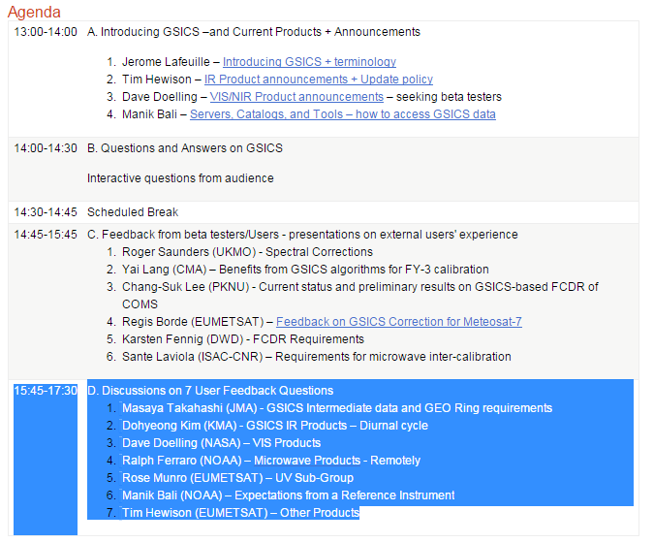
Agenda of the Discussion on User feedback

Slide 3
Introd
Outline
Introduction
Masaya Takahashi(JMA)- GSICS Intermediate data and GEO Ring requirements
Dohyeong Kim(KMA) –GSICS IR Products – Diurnal Cycle
Dave Doelling (NASA)– GSICS VIS Products
Ralph Ferraro(NOAA) - GSICS Microwave Products
Rose Munro(EUMETSAT) - GSICS UV Products
Manik Bali (NOAA) - Expectations from a Reference Instrument
Tim Hewison (EUMETSAT) -Other Products

Slide 4
Introduction
GSICS has 37 Inter-calibration products spanning IR and VIS wavelengths.
Products have bias, offset and uncertainty estimates.
Users of GSICS products play a central GSICS in defining GSICS current and future course of actions and we need their feedback from time to time to meet their requirements.
A survey was sent out to gather user expectations from GSICS
It can be accessed at here and we present here feedback we received so far

Slide 5
GSICS Intermediate and GEO Ring data

Slide 6
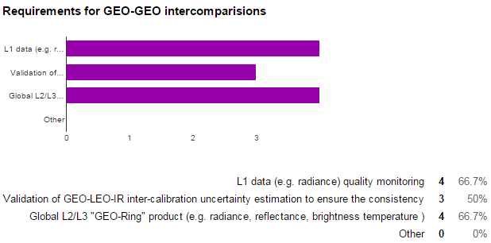
GSICS Intermediate and GEO Ring data

Slide 7
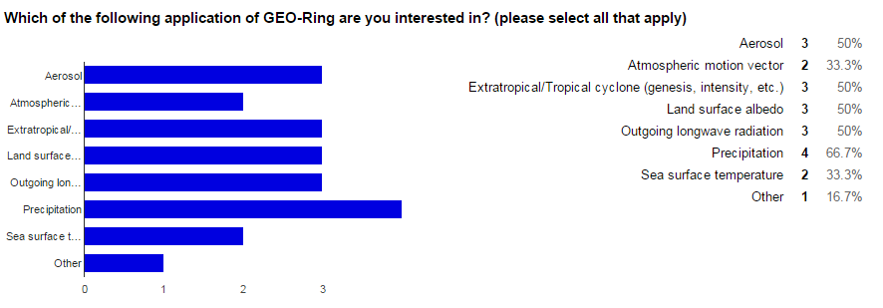
GSICS Intermediate and GEO Ring data

Slide 8
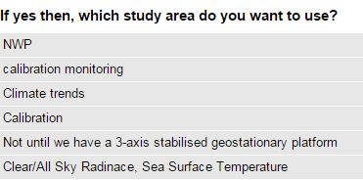
GSICS IR Products

Slide 9
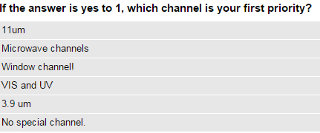
GSICS IR Products

Slide 10
VIS- GSICS Products
We use LUTs to retrieve L2 products. The LUT is created for each sensor spectral band. The observation data (digital count) is tied to radiance based on each sensor's calibration coefficients. So, the differences in sensor calibration and spectral band differences are considered by LUT and calibration coefficients.
I take it as that there are no differences in sensor calibration. About the differences of spectral band, I will use the linearity interpolation to get the spectral resolution I needed.
Frequently update calibration coefficients of each sensor.
Similar to GSICS IR's case, I need relationship between a target sensor and a common reference sensor such as AIRS or IASI in IR bands.
Yes. I think it's useful for calibration (e.g. inter-comparison) and product retrieval. Usually, we have a preferable radiance range for product retrieval or calibration. For instance, a calibration engeneer who adopt DCC as a reference doesn't care dark ocean surface. Such users will prefer SBAF optimised over specific Earth targets.
yes

Slide 11
VIS- GSICS Products
yes
I'm interested in it, because I don't know if the SBAF is effected by geometry angles or humidity. If the effect is negligible, I don't think it is necessary function for the Web site.
yes of course
It will be helpful because Aqua-MODIS and IASI is well calibrated sensor. What sensor will be the next reference after MODIS? VIIRS?
Not yet, that is the orient of our en devour
The scaled radiance is convenient to use multiple sensors, because we don't need to care difference of solar spectra profile between sensors. Thuillier, MODTRAN, new Kurucz, ...
yes

Slide 12
VIS- GSICS Products
yes
Same as above, but not mandatry.
The MODTRAN solar spectra were used as the reference. Providing the GSICS reference solar spectra are more convenient to my opinion
If GSICS decide a solar spectra as reference, the spectra should be the one accessible freely.
The sensor which has high accuracy onboard calibration, wide dynamic ranges, high spectral resolution is required besides MODIS.

Slide 13
GSICS Microwave Survey
GSICS MW Products
Real time use and/or climate use?
Latency vs. precision?
Different spectrum has different use and requirements
Potential application areas

Slide 14
Survey Results 6 responses as of 20 Sept 2015
GSICS MW Products

Slide 15
Survey Results 6 responses as of 20 Sept 2015
GSICS MW Products
Window Channels
Average ~ 0.4 K
O₂ Channels
Average ~ 0.3 K
H₂O Channels
Average ~ 0.4 K

Slide 16
Summary
GSICS MW Products -Summary
With only 6 responses, difficult to draw any conclusions from full community…however…
Mapping time series of similar sensors but from vastly different heritage (e.g., SSMT2 to AMSU-B) together is of low priority (Q1)
More precise, longer latency correction are preferred (Q2)
It does appear most users would look at time series for global trends (most likely the O₂ & H₂O bands) and use to derive geophysical parameters (most likely window & H₂O bands) (Q3)
The average desired accuracy of the corrections was on the order of 0.4 K (slightly less for the O₂ bands) (Q4)

Slide 17
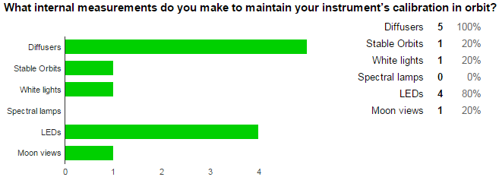
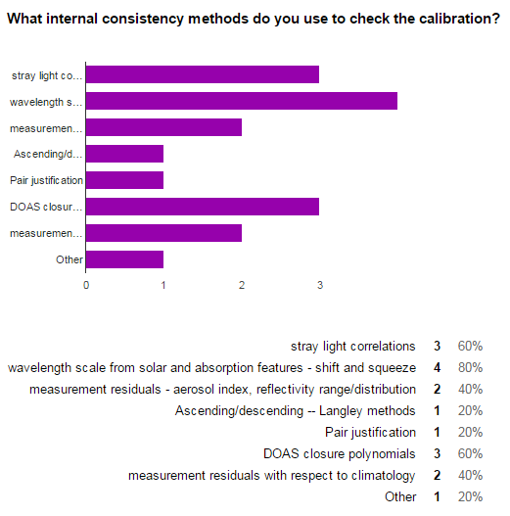
UV Products

Slide 18
UV Products

Slide 19
UV Products

Slide 20
UV Products

Slide 21
Expectation from a reference instrument

Slide 22
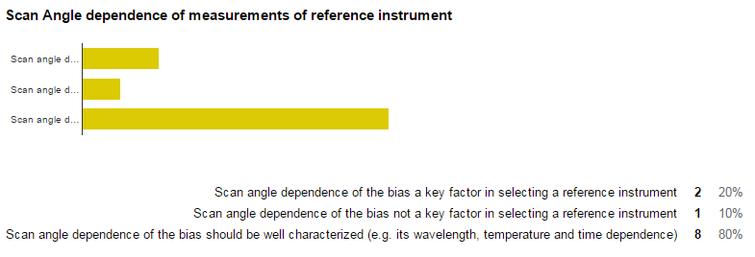
Expectation from a reference instrument

Slide 23
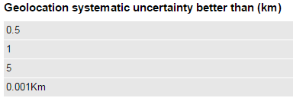
Expectation from a reference instrument

Slide 24
Other Inter-Calibration Products

Slide 25
Thank You

