Slide 1
GSICS Users Workshop Preparations
Lawrence E Flynn and Manik Bali
Aug 8, 2019

Slide 2
Outline
Introduction
Past GUWs – a review.
Agenda of past two GUW.
Lessons learnt.
Venue and Date of GUW 2019.
Aims and Proposed themes for 2019.
Suggestions.

Slide 3
Introduction
GSICS Users Workshop (GUW)
Encourage participation of user and receive their feedback.
Past GUW’s - A review
2009 Bath, UK (1 day, 17 + participants, Users gave plans)
2010 Cordoba, Spain (1 day, Needs of SCOPE-CM, Impact on UTH, CTH)
Showcase GSICS product demo ( Mitch Goldberg)
Interactions with Users ( Use of GSICS to Improve Op Calib, by Yu )
Product Development Plan (Tim Hewison, Likun W, S Ackerman)
2011 Oslo , Norway
Feedback on Current Products.
User Requirements for future products (Cooperation with CDR and NWP entities)

Slide 4
Introduction- Past GUWs- a review
2012 Sopot, Poland
Update on GSICS Product development
User feedback on demonstration GSICS products
GSICS data management and availability to users
Update on Instrument Event Logs
Plans for inter-comparison of Metop-B/IASI with Metop-A/IASI
Update on GSCIS developments concerning microwave sensors
Testing impact of GSICS Correction of GEO WV channels on Upper Tropospheric
Humidity
Interaction with GHRSST
GSICS scope, principles and vision
2013 NOAA, USA
Update on GSICS Product development * Users' feedback and requests on GSICS products * GSICS data management and availability to users * Future satellite inter-calibrations * Interaction with SCOPE-CM projects * Interaction with GHRSST * Debates on SSU measurements * Proba-V project * Users' feedback on GSICS vision

Slide 5
Introduction- Past GUW’s - A review
2014 Shanghai, China
GSICS User Workshop merged with Asia Oceania Met Users Conference.
Extended the outreach of GSICS products top

Slide 6
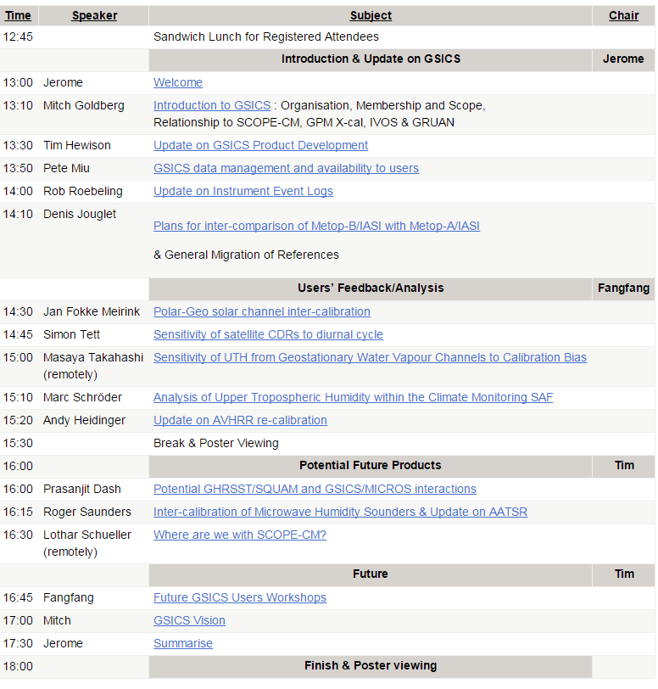
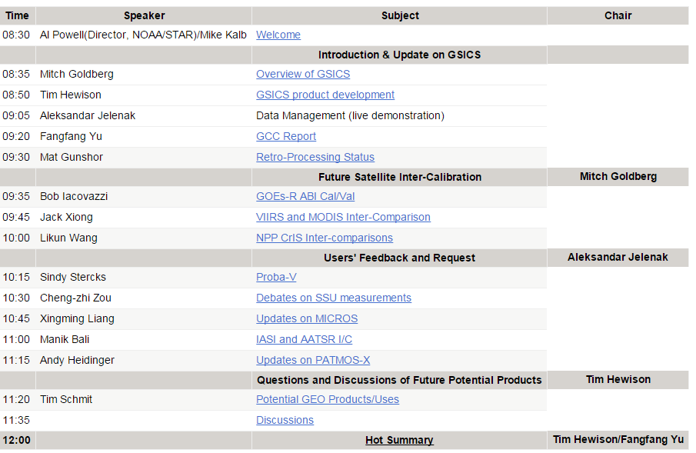
Format of Past two GUWs
EUMETSAT 2012
NOAA 2013
½ Day Session
16 Participants ( presentations ~15 Mins duration ) Cover 3-4 themes.

Slide 7
Lessons learnt
Topics to be presented by Invitees.
Agenda of the EUMETSAT Sat Meeting
Agenda that GSICS suggests
GUW agenda is at the intersection of …..
Agenda of the main conf.
Topic presented by invitees
GSICS suggested agenda
GUW Agenda
Lessons learnt…..
We may not get the agenda that we want.
GSICS is expanding, applications are more but no permanent users who participate in GUW.
Need to balance between discussion time and presentation time.

Slide 8
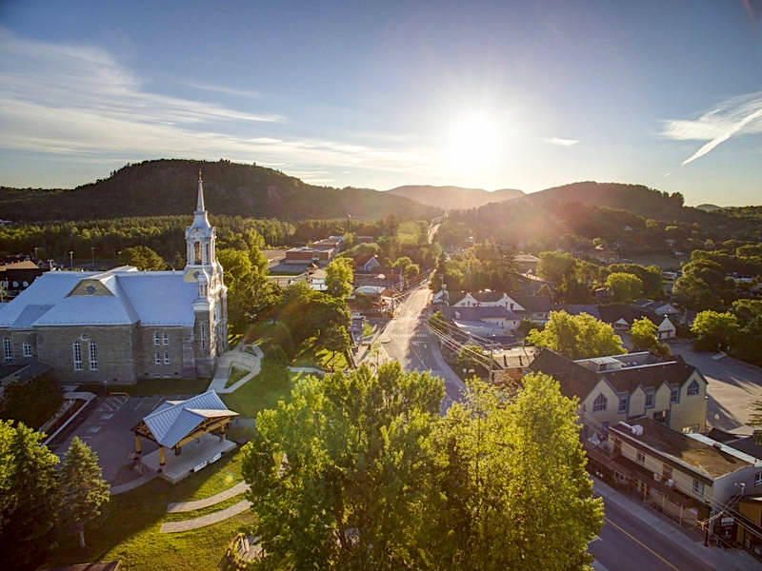
Venue and Date of GSICS Users Workshop 2019
The conference will be held at the Manoir Saint-Sauveur in Saint-Sauveur, Quebec, Canada and will be hosted by Environment and Climatic Change Canada in cooperation with CIMSS/SSEC/UW-Madison.
The 2019 GSICS Users Workshop (GUW) will be held as a component of the TOVS on 1 Nov 6:30-8:30 Pm

Slide 9
Logistics
Manik,
I just sent out the email about your workshop to everyone in the ITWG.
I won’t be able to join the telecon tomorrow. Here is what I can tell you about the logistics.
The workshop will be held in the main conference room at the Manoir Saint-Sauveur that we are using for ITSC-22, and it will seat up to 200 people in classroom format. We have penciled in the time for 6:30 - 8:30 pm on Friday night (Nov. 1). There will be the same AV system (projector, microphones) available that we use during the conference. We don’t have any special arrangements for remote participation during ITSC-22, but I’m assuming we could set up a Webex session using your Webex account and the WiFi available in the room.
We will arrange for some drinks and snacks for the participants.
I hope this helps.
Regards
Liam.

Slide 10
Tentative ITSC XXII Agenda
ITSC Agenda is under the following broad areas
Radiative Transfer Modelling
Satellite CAL/VAL
Building Climate Data Records
GUW Goals can be around the following topics, Take away for the ITSC
The GSCIS Newsletters are a good place to find out what’s new or to present what new https://www.star.nesdis.noaa.gov/smcd/GCC/newsletters.php
GSICS PRCs are good place to learn what individual agencies are doing. http://gsics.atmos.umd.edu/bin/view/Development/GprcWebsites
The GSICS Catalog is one stop shopping for GSICS Bias data products and supporting documents. (Plot??) https://www.star.nesdis.noaa.gov/smcd/GCC/ProductCatalog.php
Instrument landing pages are https://www.wmo-sat.info/oscar/instruments https://www.star.nesdis.noaa.gov/smcd/GCC/instrumentInfoKiosk.php
The GSICS Combined Annual Research and Data Working Groups meeting
Individual meetings and past agendas and presentations. http://gsics.atmos.umd.edu/bin/view/Development/MeetingsAndConferences
WIKI Sign up for notices? http://gsics.atmos.umd.edu/bin/view/Development/WebHome
Actions
GPPA ( Manik Bali, Lawrence E Flynn)
ICVS
Climate Data Records ( IMICA, Re-Calbration, FEDUCIO, Viju John)
Lunar ( Tiger )
Inter-Operability (GSICS-GRUAN-GNSS) ( Bomin, Xavier )
Suggestions / Recommendations
Ref: http://cimss.ssec.wisc.edu/itwg/itsc/itsc22/ITSC22_Program_20190801.pdf

Slide 11
Moving Ahead
To a large extent Attendees influence the final agenda
Web access and possibility to still make it to the ITSC conf gives a wider opportunity to participants.
Shall we have more discussions and less presentations ( or vice versa).
Whom to invite and topics to cover.
How much place do we have for posters.
Suggestions /ideas ??

Slide 12
THANK YOU

