Slide 1
GSICS Data Working Group Meeting 10/20/2020
Kamaljit Ray, MOES
(Ministry of earth Sciences)

Slide 3
Membership and recent GDWG activities
GDWG Members as of Sept 2020
Affiliation | First Name | Last Name
CMA | Zhe | Xu
CMA | Yuan | Li
CMA | Min | Min
CMA | Di | Xian
ESA | Paolo | Castracane
EUMETSAT | Peter | Miu
EUMETSAT | Simon | Elliott
IMD | R.K. | Giri
IMD/MoES | Kamaljit | Ray
ISRO | Nitant | Dube
JMA | Arata | Okuyama
KMA | Jin | Woo
KMA | Sung-Rae | Chung
NOAA | Manik | Bali
ROSHYDROMET | Sergey | Uspensky
WMO | Werner | Balogh
Recent GDWG activities
Websites
GSICS webpage at each agency
Updating new WMO GSICS Portal
GSICS Collaboration Servers
Defining GSICS Conventions for new GSICS Deliverables
Instrument Event Logging
Annual Calibration Report (GRWG/GDWG Chair)
Updating GSICS Plotting Tool
Use of GitHub for collaborative work
Action Tracking Tool (GCC+GDWG)
https://gsics.wmo.int/en/focal-points

Slide 4
Review of Actions of data working group as per the last meeting
A.GDWG.2019.9b.1: ISRO to work with KMA to upload their Plotting Tool code and configuration onto GDWG GitHub repository.
A.GDWG.2019.9b.2: ISRO to work with CMA to synchronise their RAC products between their servers to validate the synchronisation scripts.
A.GDWG.2019.9b.3: ISRO with support from EUMETSAT to update their THREDDS configuration such that it is in-line with the other collaboration services.
Action: A.GDWG.2019.9c.1 EUMETSAT to upload sync perl and shell scripts to GitHub.
Action: A.GDWG.2019.9p.1 Peter Miu (EUMETSAT) to create a user guide for GSICS THREDDS.
Action: A.GDWG.2019.9p.2 NOAA to provide EUMETSAT the download script for review to see if this can be provided to users to improve the downloading of GSICS products.

Slide 5
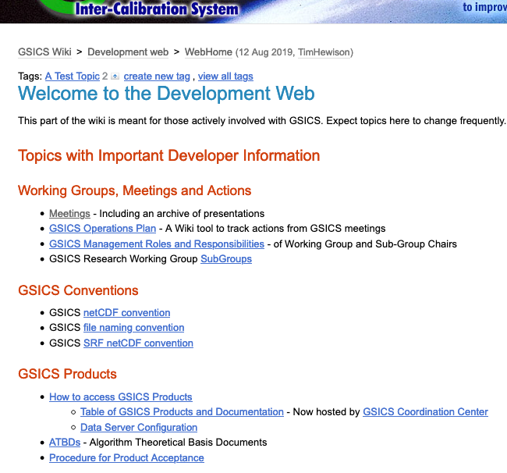
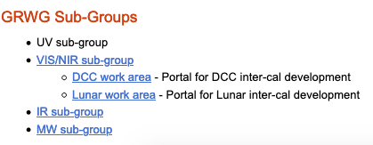
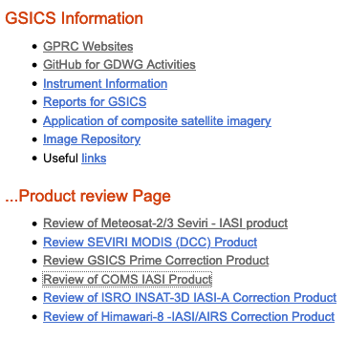
Information relevant to GDWG activities on GSICS Wiki
http://gsics.atmos.umd.edu/bin/view/Development/WebHome
Boxes in red: relevant to all GDWG members, in green: relevant to GDWG Chair
GSICS Procedure for Product Acceptance (GPPA): GDWG Chair is a member of review team (GPAT: GSICS Product Acceptance Team) for GSICS products

Slide 6
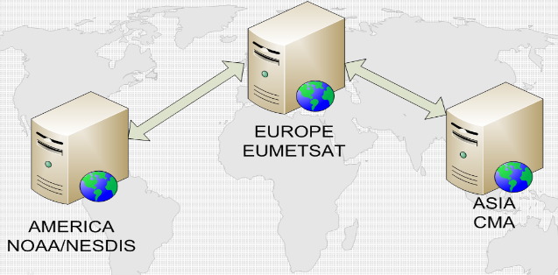
GSICS Collaboration Servers
One of the major activities of GDWG
Providing dataset supporting data exchange/access to GSICS Deliverables
GSICS Inter-calibration Products (GSICS Correction, netCDF)
Intermediate data to generate products (e.g. GEO-LEO-IR collocation netCDF)
Source dataset (inputs to inter-calibration ATBD, e.g. LEO L1 data)
3 servers at CMA/EUM/NOAA
KMA/JMA products: sent to EUM
Incorporation of ISRO to 4th Collaboration Server (incl. data synchronization among the servers) has been discussed

Slide 7
Defining GSICS Conventions for new GSICS Deliverables:
GSICS netCDF Convention for SRF
Action at GSICS-EP-21: To request CGMS Task Force on Satellite Data and Codes to review a proposal of adding SRF to International Data Subcategory of Common Table C-13 of WMO Manual on Codes for coordination with WMO IPET-CM.
Instrument’ spectral response function (SRF): characterizes the sensitivity of instrument’s each spectral band
SRF is not an output of GSICS activities, but fundamental info for (inter-)calibration
To support GRWG activities, a file format converter (python script) from individual SRF’s original format (depending on the mission) to netCDF was developed by GDWG
Convention proposed by GSICS is available on the Wiki, but there are remaining issues (this action is one of them)
Background/Past discussions/Proposals on GSICS’s SRF netCDF Convention
http://gsics.atmos.umd.edu/bin/view/Development/SrfNcdfConvention

Slide 8
GSICS Collaboration Servers
One of the major activities of GDWG
Providing dataset supporting data exchange/access to GSICS Deliverables
GSICS Inter-calibration Products (GSICS Correction, netCDF)
Intermediate data to generate products (e.g. GEO-LEO-IR collocation netCDF)
Source dataset (inputs to inter-calibration ATBD, e.g. LEO L1 data)
3 servers at CMA/EUM/NOAA
KMA/JMA products: sent to EUM
Incorporation of ISRO to 4th Collaboration Server (incl. data synchronization among the servers) has been discussed

Slide 9
Defining GSICS Conventions for new GSICS Deliverables:
GSICS netCDF Convention for SRF
Action at GSICS-EP-21: To request CGMS Task Force on Satellite Data and Codes to review a proposal of adding SRF to International Data Subcategory of Common Table C-13 of WMO Manual on Codes for coordination with WMO IPET-CM.
Instrument’ spectral response function (SRF): characterizes the sensitivity of instrument’s each spectral band
SRF is not an output of GSICS activities, but fundamental info for (inter-)calibration
To support GRWG activities, a file format converter (python script) from individual SRF’s original format (depending on the mission) to netCDF was developed by GDWG
Convention proposed by GSICS is available on the Wiki, but there are remaining issues (this action is one of them)
Background/Past discussions/Proposals on GSICS’s SRF netCDF Convention
http://gsics.atmos.umd.edu/bin/view/Development/SrfNcdfConvention

Slide 10
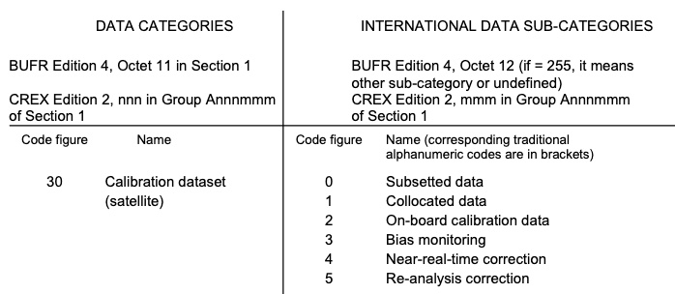
GSICS Filenaming Convention for SRF (2/2)
Current Convention:
W_XX-EUMETSAT-Darmstadt,VIS+IR+SRF,MSG1+SEVIRI_C_EUMG.nc
Proposal for GSICS Standard SRF:
W_XX-EUMETSAT-Darmstadt,SATCAL+SRF+VISIR,MSG1+SEVIRI_C_EUMG_20060119------_01.nc
DataDesinator
yyyyMMddhhmmss
versioning
In order to add “SRF” to DataDesinator (SATCAL+SRF+VISIR), a proposal to add “SRF” in Data Category: SATCAL of Common Table C-13 of the WMO Manual on Codes is needed.
Then, CGMS Task Force on Satellite Data and Codes (lead: Simon Elliot of EUMETSAT, GDWG member) would coordinate the proposal w/ WMO.
No need to interact with WMO to add yyyyMMddhhmmss and versioning because these are “free format” part
COMMON CODE TABLES TO BINARY AND ALPHANUMERIC CODES
https://www.wmo.int/pages/prog/www/WMOCodes/WMO306_vI2/LatestVERSION/WMO306_vI2_CommonTable_en.pdf
Page 64 of the document

Slide 11
Satellite/Instrument Event Logging (1/3)
Action at GSICS-EP-21: GDWG Chair and Rob Roebeling (EUMETSAT) to review existing event logging databases at each agency to ensure best practices are met.
White paper satellite instrument events - Standards and nomenclature, CGMS-45-EUMETSAT-WP-33 (2017)

Slide 12
Satellite/Instrument Event Logging (2/3)
Initiated as CGMS Task Team on Calibration Events Logging
Lead: Rob Roebeling (EUM), mainly composed of GDWG members
Goal: to develop a uniform approach for presenting, logging, and monitoring calibration information across satellite operators
White paper: submitted to CGMS-45 (2017)
https://www.cgms-info.org/Agendas/GetWpFile.ashx?wid=4dbc1757-2442-47c9-8689-6020926a8ad9&aid=a98d26c2-0664-4a2e-bc11-10a6923d340b
1st step: to create stable Landing Pages and linked from WMO OSCAR/Space
Good progress at member agencies
Space Agency | Representative | Landing Page
CMA | Dr. Li, Yuan | CGMS concept implemented
EUMETSAT | Mr. Miu, Peter | CGMS concept implemented
ESA | Dr. Philippe Goryl | CGMS concept implemented
IMD | Dr. A.K. Mitra | CGMS concept not implemented
JMA | Mr. Takahashi, Masaya | CGMS concept implemented
KMA | Ms. Woo, Jin | CGMS concept implemented
NASA | Mr. Dell, Gregory T. | CGMS concept not implemented
NOAA | Mr. Bali, Manik | CGMS concept not implemented
ROSHYDROMET | Dr. Zoya Andreeva, | CGMS concept implemented

Slide 13
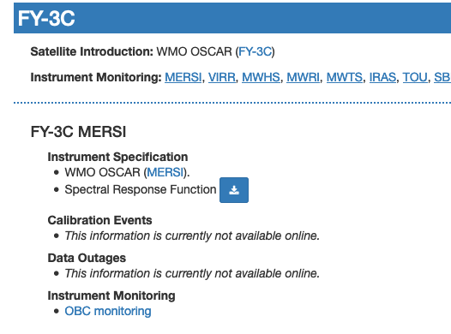
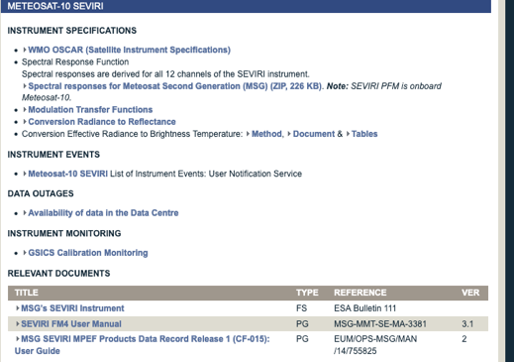
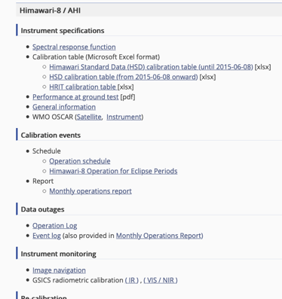
Satellite/Instrument Event Logging (3/3)
Landing Pages implemented at each agency
CMA EUMETSAT JMA
2nd step: to adopt nomenclature and standards for instrument events
Task Team proposed to establish a Technical Team with technical/database experts
Resources are needed if the current GDWG is asked to achieve the 2nd step
GSICS-EP has been asked to discuss this issue at CGMS meeting, but not solved yet

Slide 14
GSICS Annual Calibration Report (1/2)
Action at GSICS-EP-21: to develop a procedure on updating Annual GSICS Calibration Report.
Two GSICS reports
Agency Annual Report
Prepared/reported by all GSICS members
GSICS Annual Calibration Report
Starting with GEO instrument calibration in 2019
Same format/content using a template proposed by GRWG/GDWG Chairs
Submitted to GSICS-EP (and CGMS by EP Chair)
GRWG Chair/Vice-Chair (Scott Fu of CMA / Fangfang Yu of NOAA) are leading the current activity
Latest info and discussions (2020-04-16 web meeting)
http://gsics.atmos.umd.edu/bin/view/Development/20200416
2019 report at GSICS-EP-21 (2020)
https://wmoomm.sharepoint.com/:b:/s/wmocpdb/ETlEbfW0gLxDiUqMd8JqVecBzaC6GLv6-Dks6KeAMLdqcw?e=nVVkgL
2018 report (1st report) at GSICS-EP-20 (2019)
http://www.wmo.int/pages/prog/sat/meetings/GSICS-EP-20/documents/GSICS-EP-20_Doc_6.1p_GDWG.pptx

Slide 15
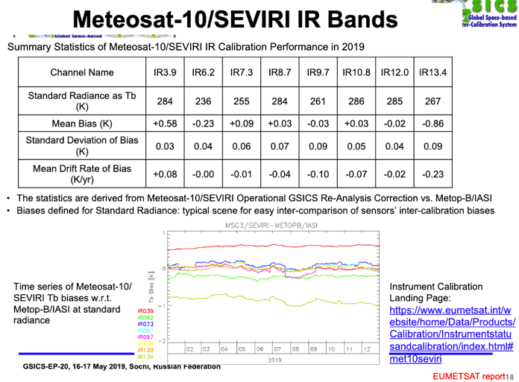
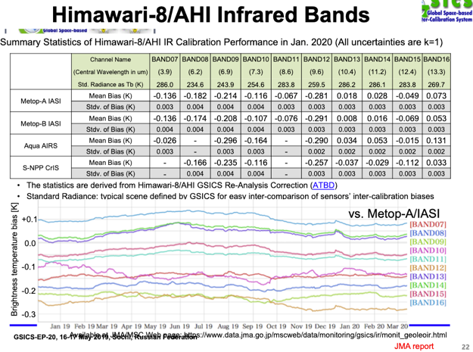
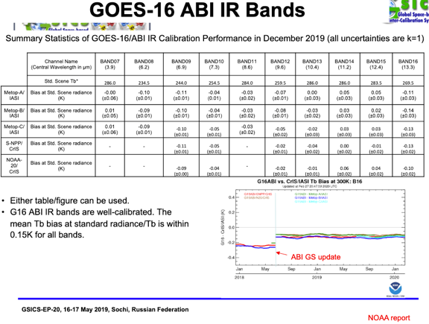
GSICS Annual Calibration Report (2/2)
EUMETSAT
JMA
NOAA

Slide 16
Suggested topics for discussion
Data Working Group activities of each agency
Discussion on Users feedback on collaborative server directory structure
To request CGMS Task Force on Satellite Data and Codes to review a proposal of adding SRF to International Data Subcategory of Common Table C-13 of WMO Manual on Codes for coordination with WMO IPET-CM.
Rob Roebeling (EUMETSAT) to review existing event logging databases at each agency to ensure best practices are met.
To develop a procedure on updating Annual GSICS Calibration Report.
GSICS Product Alert System and Support to GSICS ISCCP and IOGEO partnerships ( Manik Bali)
How to roll out changes to the GSICS conventions in the future - e.g. algorithm_version (Tim Hewison)

Slide 17
ISCCP-NG GSICS Wish List
We would like to have corrections as attributes in our L1g which operate on
Reflectances (0-1)
IR Radiance (standard unit for all sensors)
We would like to have corrections that are of the same form for all sensors.
We would like standard radiance to temperature parameters which we will include as attributes.
We would like to include in L1g the nominally calibrated reflectances and radiances (to which the GSICS corrections are applied).
If GSICS wants us to perform calibration corrections on brightness temperature (that is ok).
We think this will make ISCCP-L1G robust to calibration changes since we can updates the L1G attributes easily without regenerating from Level-1b.
We would like guidance on accessing the calibrations in an automated fashion.
A plan with deadlines that we can build around would be great. We understand that support for all channels used in ISCCP-NG will take time.

Slide 18
What ISCCP-NG Can Provide to GSICS
We do not have an ability to set accuracy requirements. But we are willing to try.
ISCCP-NG L1G should make test sensor-sensor consistency easier. We can help implement radiometric consistency checks using L1G.

Slide 19
THANK YOU

