Slide 1
GDWG Report from ESA GSCIS Data Working Group October 27th - 2022 Paolo Castracane

Slide 2
Table of Content
GSICS Action and recommendations
CEOS Cal/Val Portal activities:
GSICS Tools - links
TSIS-1 Hybrid Solar Reference Spectrum
Maturity Matrix for dataset evaluation (EDAP and WGISS)
GSICS and CEOS WGCV cooperation
Next steps and Plan

Slide 3
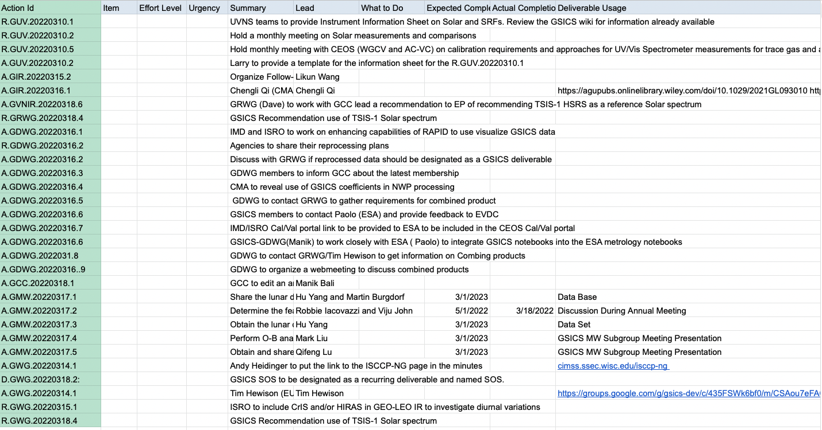
GSICS actions and recommendations

Slide 4
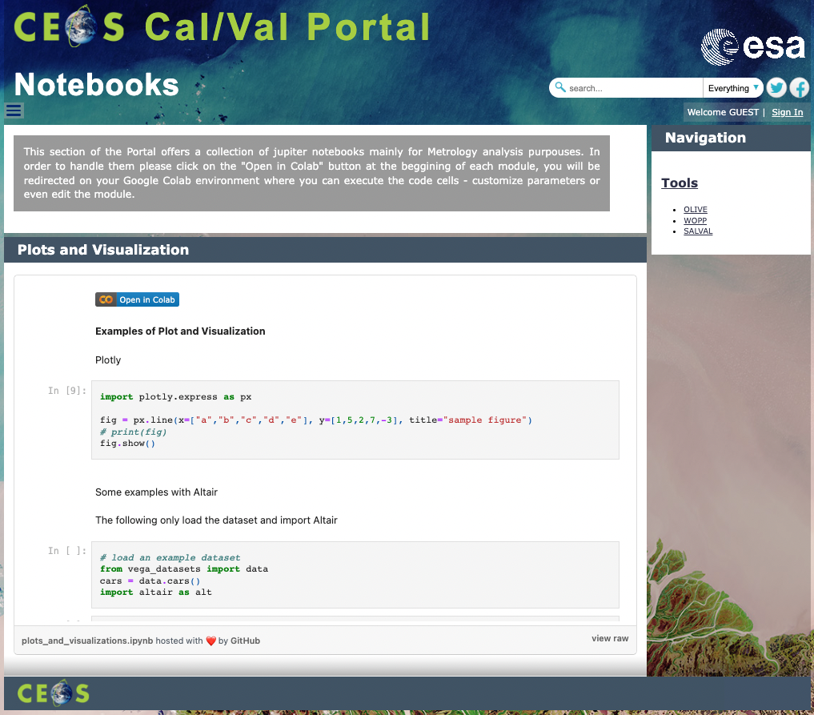
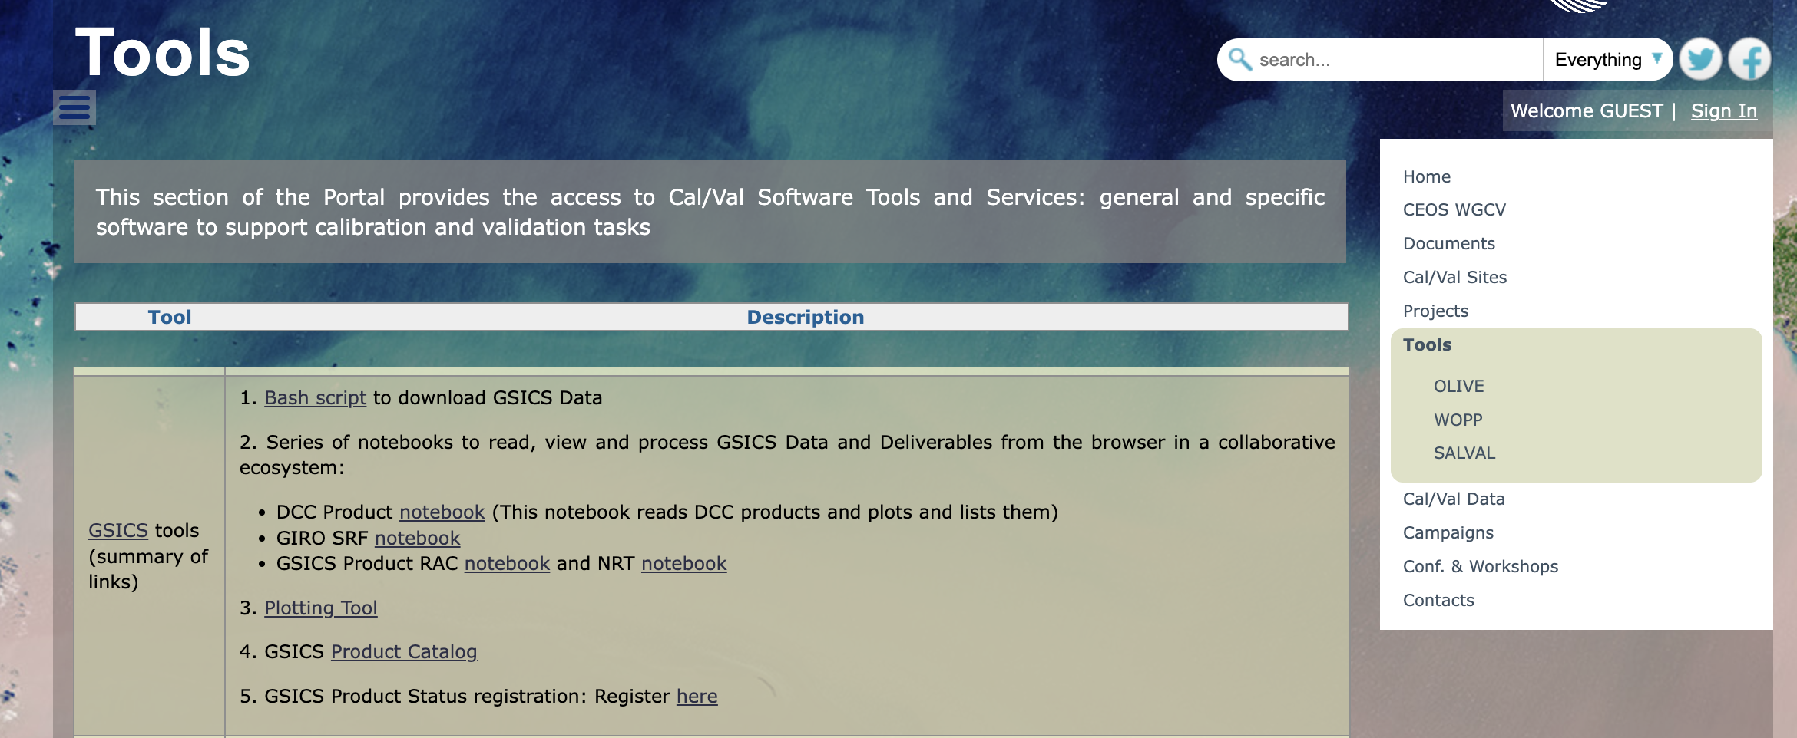
GSICS Tools – Links to CEOS Cal/Val Portal
In the contex of GSICS Group Data – relevant links to GSICS scripts and notebooks have been included in the Tools section – as well as – the link to RAPID (by Satellite Application Centre (SAC), ISRO in collaboration with India Meteorological Department IMD ).a web-based data analysis and visualization platform
The Cal/Val portal hosts notebooks via Google Colab for demos/exercises (in progress)

Slide 5
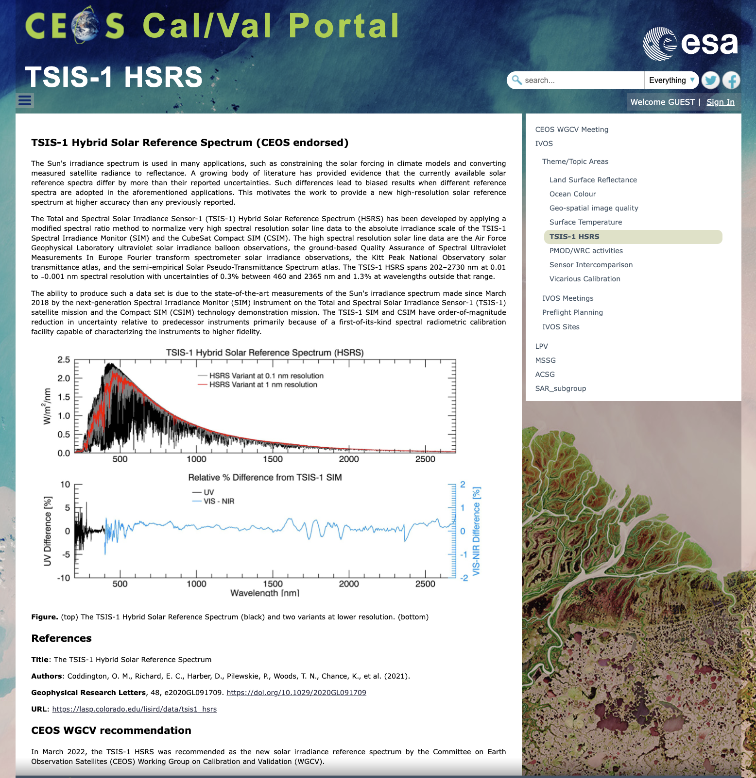
TSIS-1 Hybrid Solar Reference Spectrum
(CEOS endorsed)
References
Title: The TSIS-1 Hybrid Solar Reference Spectrum
Authors: Coddington, O. M., Richard, E. C., Harber, D., Pilewskie, P., Woods, T. N., Chance, K., et al. (2021).
Geophysical Research Letters, 48, e2020GL091709.
https://doi.org/10.1029/2020GL091709
URL: https://lasp.colorado.edu/lisird/data/tsis1_hsrs
CEOS WGCV recommendation
In March 2022, the TSIS-1 HSRS was recommended as the new solar irradiance reference spectrum by the Committee on Earth Observation Satellites (CEOS) Working Group on Calibration and Validation (WGCV).

Slide 6
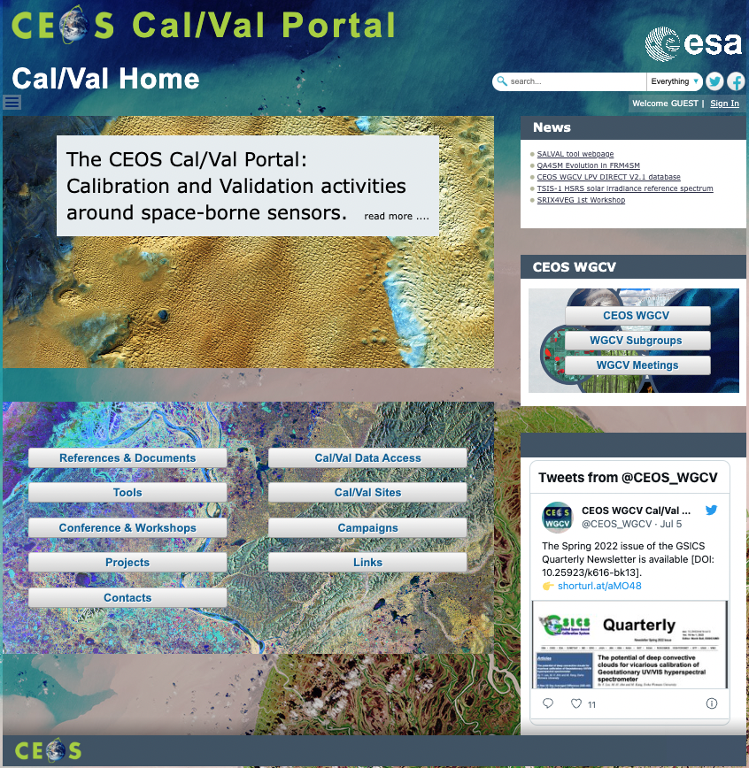
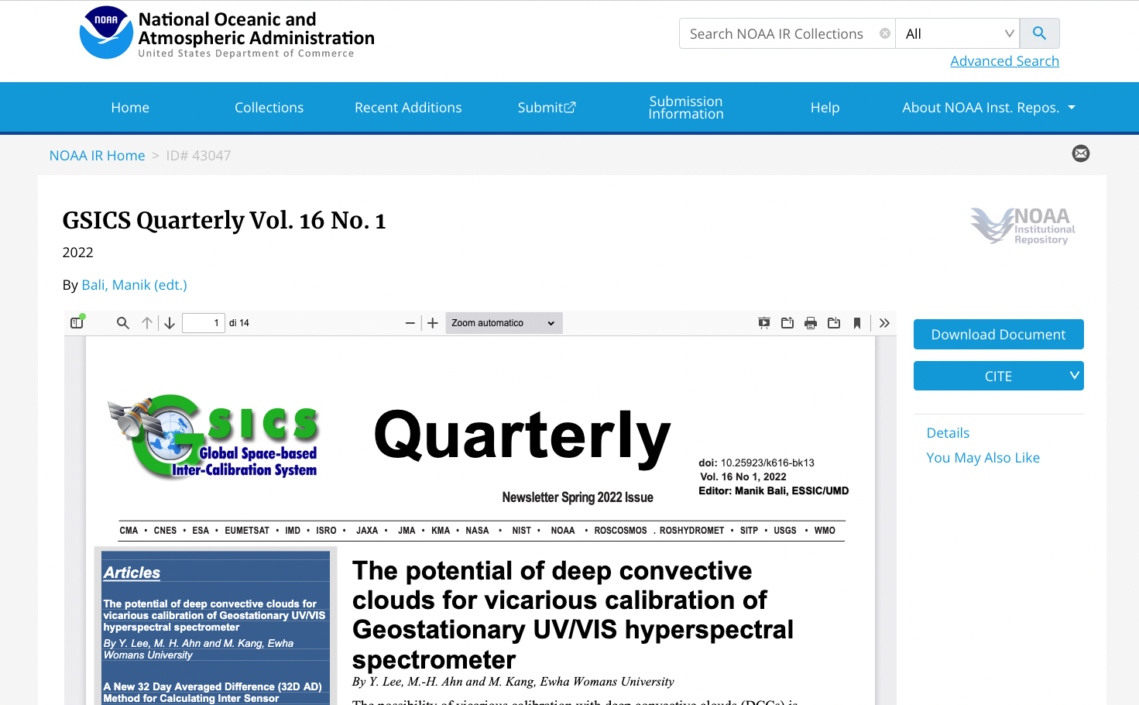
GSICS Quarterly Newsletter

Slide 7
Maturity Matrix
Mission success is dependent upon quality assurance. Data Quality adds significantly to the values of datasets.
Because the commercial satellite sector grow, space agencies identified the need for systematic evaluation of commercial satellite data to understand how it may be integrated into their programmes.
NASA launched the CSDA Project and ESA the EDAP project to meet this need.
NASA and ESA are working toward a comprehensive ESA-NASA Evaluation Framework that will include the utility of these data for Earth science research and applications
ESA Earthnet
NASA Commercial Smallsat Data Acquisition (CSDA) Program

Slide 8
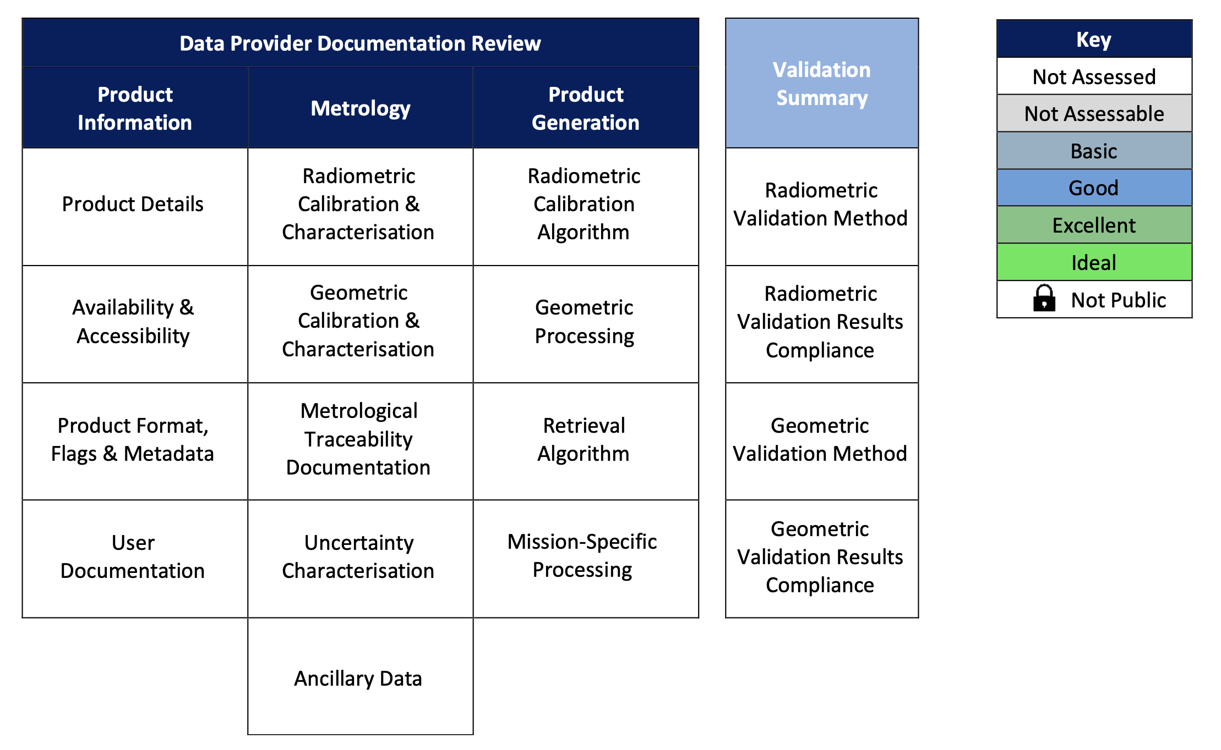
EDAP Cal/Val Maturity Matrix
References:
EDAP Best Practice Guidelines website https://earth.esa.int/eogateway/activities/edap/edap-best-practice-guidelines
EDAP Mission Quality Assessment Guidelines: Mission Quality Assessment Guidelines v2.1
EDAP Optical Mission Quality Assessment Guidelines: Optical Mission Quality Assessment Guidelines v2.1

Slide 9
CEOS WGISS Data Management & Stewardship Maturity Matrix
Reference:
http://ceos.org/document_management/Working_Groups/WGISS/Interest_Groups/Data_Stewardship/White_Papers/WGISS%20Data%20Management%20and%20Stewardship%20Maturity%20Matrix.pdf

Slide 10
Area of cooperation
WGCV and GSICS share methods and protocols (vicarious calibration)
WGCV and GSICS look for REFERENCE
SITSAT becoming reference from space SI traceable
co-organised the SITSCOS workshop https://calvalportal.ceos.org/sitscos-ws
Joint Organisation of the Workshop Calibration / Characterisation Pre-Flight
TO BE ORGANISED

Slide 11
Next Steps and Plan
To implement/finalize actions in progress:
To increment CEOS/GSICS interactions
To increase activities on twitter account: @CEOS_WGCV
Long term maintenance and support for the portals: CEOS Cal/Val Portal and EVDC
To promote data harmonization and Data Centre Interoperability
More and more users involvement
Get and implement users feedback
Follow us on twitter : @CEOS_WGCV; @evdc_team; @qa4eoCalVal

Slide 12
Thank you!

