Slide 1
ISCCP, GridSat and testing GSICS adjustments
Kenneth Knapp, NOAA/NCEI
ISCCP Team: Alisa Young, Anand Inamdar, Bill Hankins, Ken Knapp

Slide 2
outline
accessing GSICS information to compare with ISCCP
GridSat tests
ISCCP tests
the harmony of the GEOs
points for discussion

Slide 3
notes from accessing GSICS data files
Files behind a TDS are difficult to perform bulk downloads
It was not immediately clear what all the links were and which were useful and which were dead ends.
ATBDs are prominent but are less useful to end users (initially). User guides are especially helpful but are more difficult to access.
The adjustments provided do not also provide the calibration coefficients
Leaving the user wondering “Am I using the right calibration coefficients??”
The GSICS websites appear to be developed for GSICS contributors
not users.

Slide 4
GSICS data
by agency
Variables | GOES-13 | GOES-15 | MET-7 | MSG-3 | MTS-2
Wavenumber | x | x |  | x | x
Beta/B (rad/temp conv) | beta | beta | b | beta | beta
Alpha/A (rad/temp conv) | alpha | alpha | a | alpha | alpha
a1/a2/a3 (effective temp) | x | x |  |  | x
Central wavelength | x | x | x | x | x
Channel name | x | x | x | x | x
date | x | x | x | x | x
Validity period | x | x | x | x | x
slope | x | x | x | x | x
slope_Se | x | x | x | x | x
offset | x | x | x | x | x
offset_se | x | x | x | x | x
covariance | x | x | x | x | x
filter_integral |  |  | x
dn_offset (and _se) |  |  |  |  | x
dn_slope (and _se) |  |  |  |  | x
calibration_table |  |  |  |  | x
Calibration coefficients (original) |  |  |  |  | x
Easiest - MTS-2
JMA provides calibration table
Moderately easy - MSG-3
Calibration coefficients with image data
one GSICS file with all adjustments
Moderately difficult GOES 13/15
Cal. coeff. online
100s of GSICS files
Most difficult - MET-7
Cal. coef. used not online
One source was not the right one ended up with files from Viju that aren’t public

Slide 5
access: recommendations
Change from TDS to FTP or HTTPS - which allow easier bulk downloads.
Make user guides more prominent
NRTC/RAC/beta/pre operational operational
for each satellite, provide one set of links with Status: Satellite Status GOES-13 pre-operational Near real time data Reanalyzed data User guide Meteosat-10 beta Near real time data Reanalyzed data User guide …
Store calibration coefficients and calibration tables in the GSICS file
like what JMA is doing
Consider making a table of the above for each satellite reference (IASI-A, MODIS, Aqua AIRS, etc.)
Consider including period of record in the tables

Slide 6
GridSat B1 CDR - Gridded Satellite Data
IR window inter-calibrated using HIRS
Stores data in overlap regions
Performs GEO inter-calibration check during production

Slide 7
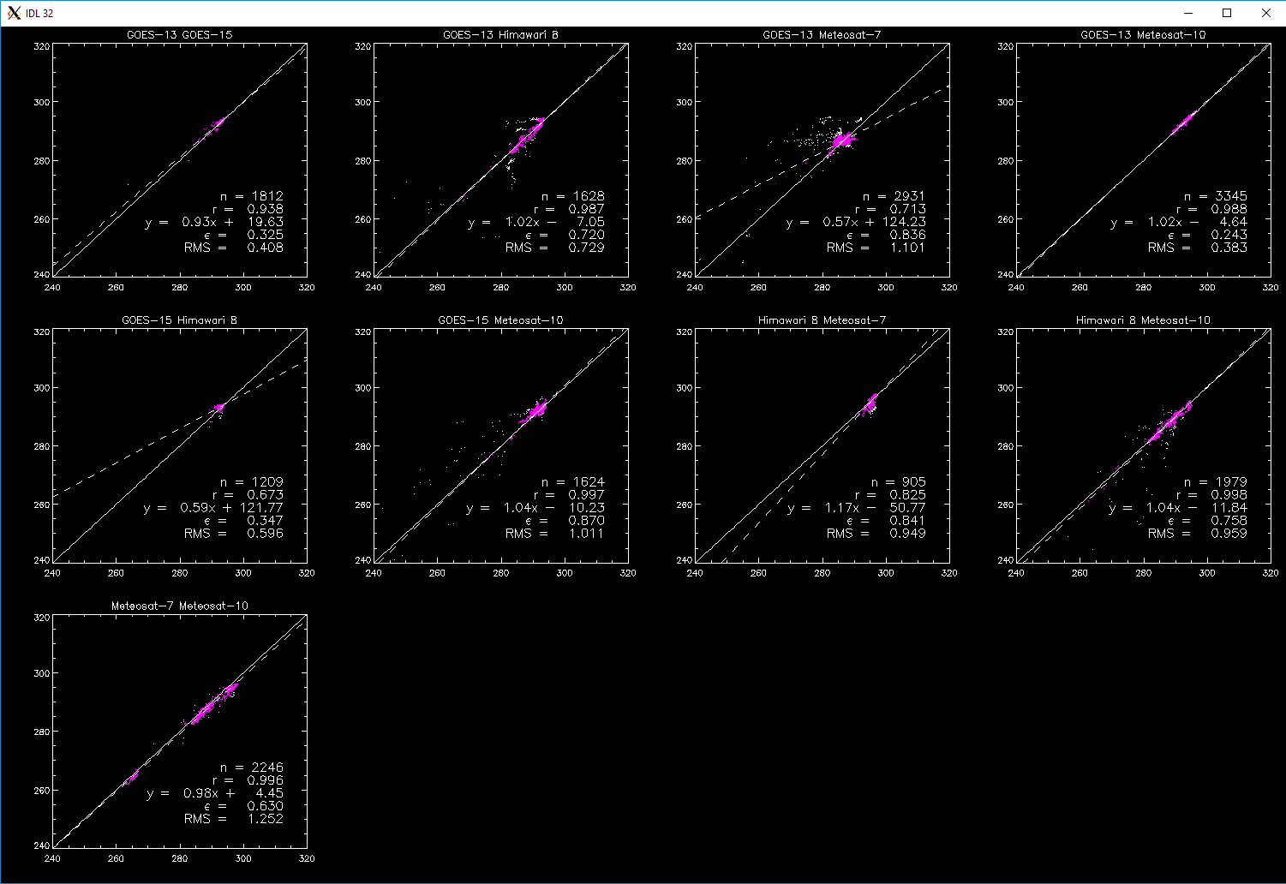
GridSat GEO intercalibration approach
Filter:
VZA < 85
| VZA-VZA | < 1.5
Spatially smooth
| Latitude | < 30
Each satellite is scored:
S = Σ |290 - (m*290 + b)|

Slide 8
GridSat baseline test
October 1, 2013
GOE-13 0.26
GOE-15 0.29
MTS-2 0.31
MET-7 0.49
MET-10 0.38
score represents difference mean difference between the given satellite and other satellites at 290 K

Slide 9
GridSat baseline test - Using GSICS adjustment
October 1, 2013
GOE-13 0.26 → 0.80
GOE-15 0.29 → 0.19
MTS-2 0.31 → 0.68
MET-7 0.49 → 1.77
MET-10 0.38 → 0.28
Conclusion:
No significant overall improvement compared to baseline HIRS intercalibration.

Slide 10
ISCCP Calibration - reminder
ISCCP Cal has 3 steps
Nominal - The operational calibration from the agency provider
Normal - The nominal calibration normalized to the present ISCCP AVHRR afternoon
Absolute - The nominal calibration adjusted for temporal drift of the current ISCCP AVHRR afternoon satellite.

Slide 11
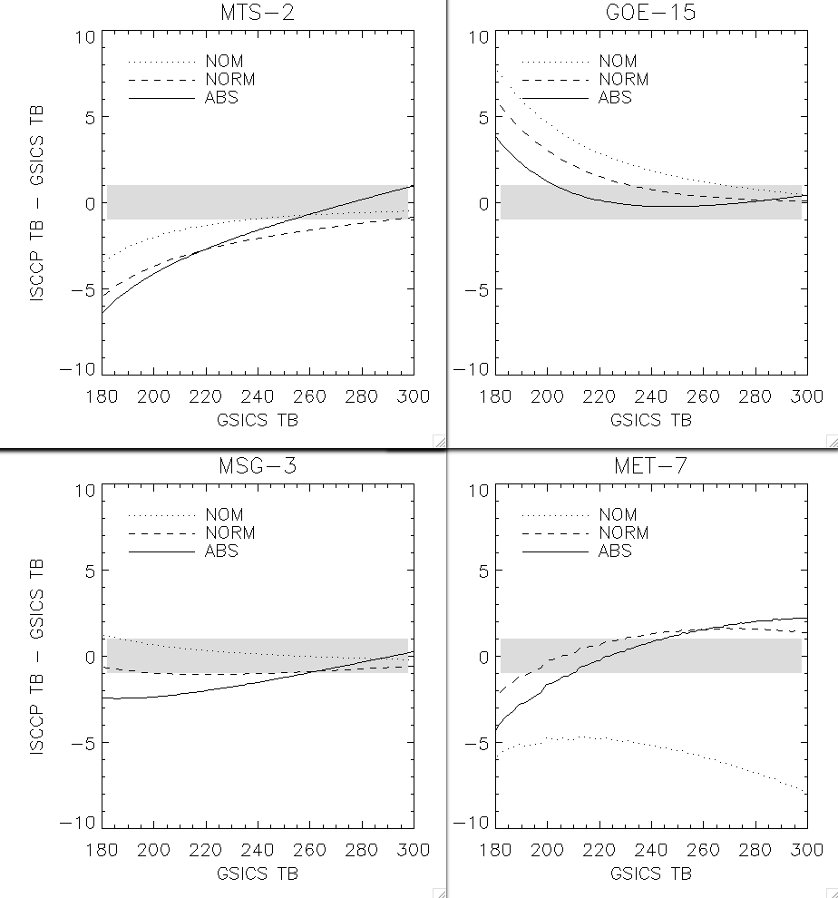
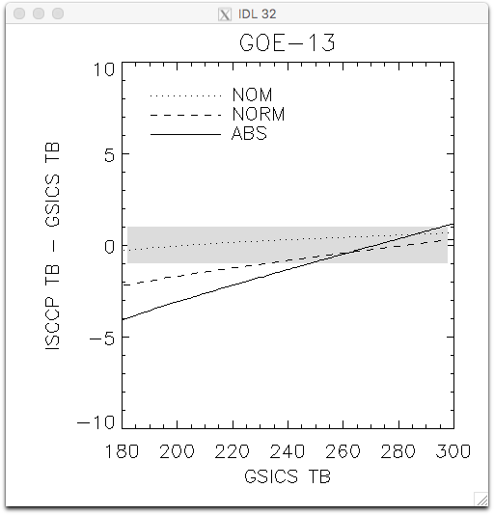
ISCCP testing
October 2013
GSICS - ISCCP differences are large Particularly for colder temps. Most are in the same direction

Slide 12
ISCCP next steps
Produce GSICS-based HBTS (calibration tables)
Run a month of ISCCP using these tables.
ISCCP intercompares GEOs using: - Retrieved surface temperature (TS) - Warm end - Retrieved cloud top temperature (TC) - Cold End
Are the differences smaller? Are the products more inter-consistent?
Will know in about 2 weeks.

Slide 13
Harmony
of the
GEOs
Number of connections? GOES 7,8 and MET-7 have most
Number of steps to ‘well calibrated’ sat? 7 steps: GOES-4 → GOES-16
Can this information be used to improve calibration? particularly in the VIS…

Slide 14
Discussion questions
Using GSICS data - Are users the ultimate goal?
If so, many agencies should include other parameters (e.g., match JMA parameters)
GSICS adjustments - Initial tests do not show significant improvement for GridSat
ISCCP comparisons - Testing still underway.
Initial comparisons imply the inter-GEO diffs will be larger, esp. for MTS-2 and GOE-15
GEO harmonization
Another aspect of reprocessing and recalibration
Visible data?

