Slide 1
ESA Atmospheric Validation Data Centre (EVDC): Orbit tool
Presenter
Paolo Castracane
Rhea System for ESA/ESRIN

Slide 2
Table of Contents
EVDC Overview
EVDC Orbit Tool functionalities:
Orbit Prediction and Visualization
Finding Overpass over AOIs
Cal/Val Networks overlay and info
Satellite footprint visualization
Overpass data download
Temporal Overpass

Slide 3
ESA atmospheric Validation Data Center (EVDC)
About EVDC https://evdc.esa.int
EVDC aims to be the main European source of access to the correlative data for validation of atmospheric composition products from satellite platforms.
The EVDC portal offers several tools supporting the user in terms of Cal/Val data query, data upload/download, format conversion (GEOMS conversion routines) and for production of ECMWF parameter’s maps. The EVDC platform also provides an access to satellite data for specific missions, in particular the system supports new atmospheric composition/dynamic missions namely: Sentinel-5P, Aeolus and EarthCARE in the next future.
The portal can be easily expanded to support new campaigns and satellite missions. Data exchange with the EVDC is regulated by a protocol with the aim to ensure data ownership, to prevent re-distribution to third parties and to protect intellectual properties
EVDC is an ESA funded project, the EVDC team is composed by: Skytek (Ireland), NILU (Norwegian Institute for Air Research) and ICHEC (Irish Centre for High End Computing)

Slide 4
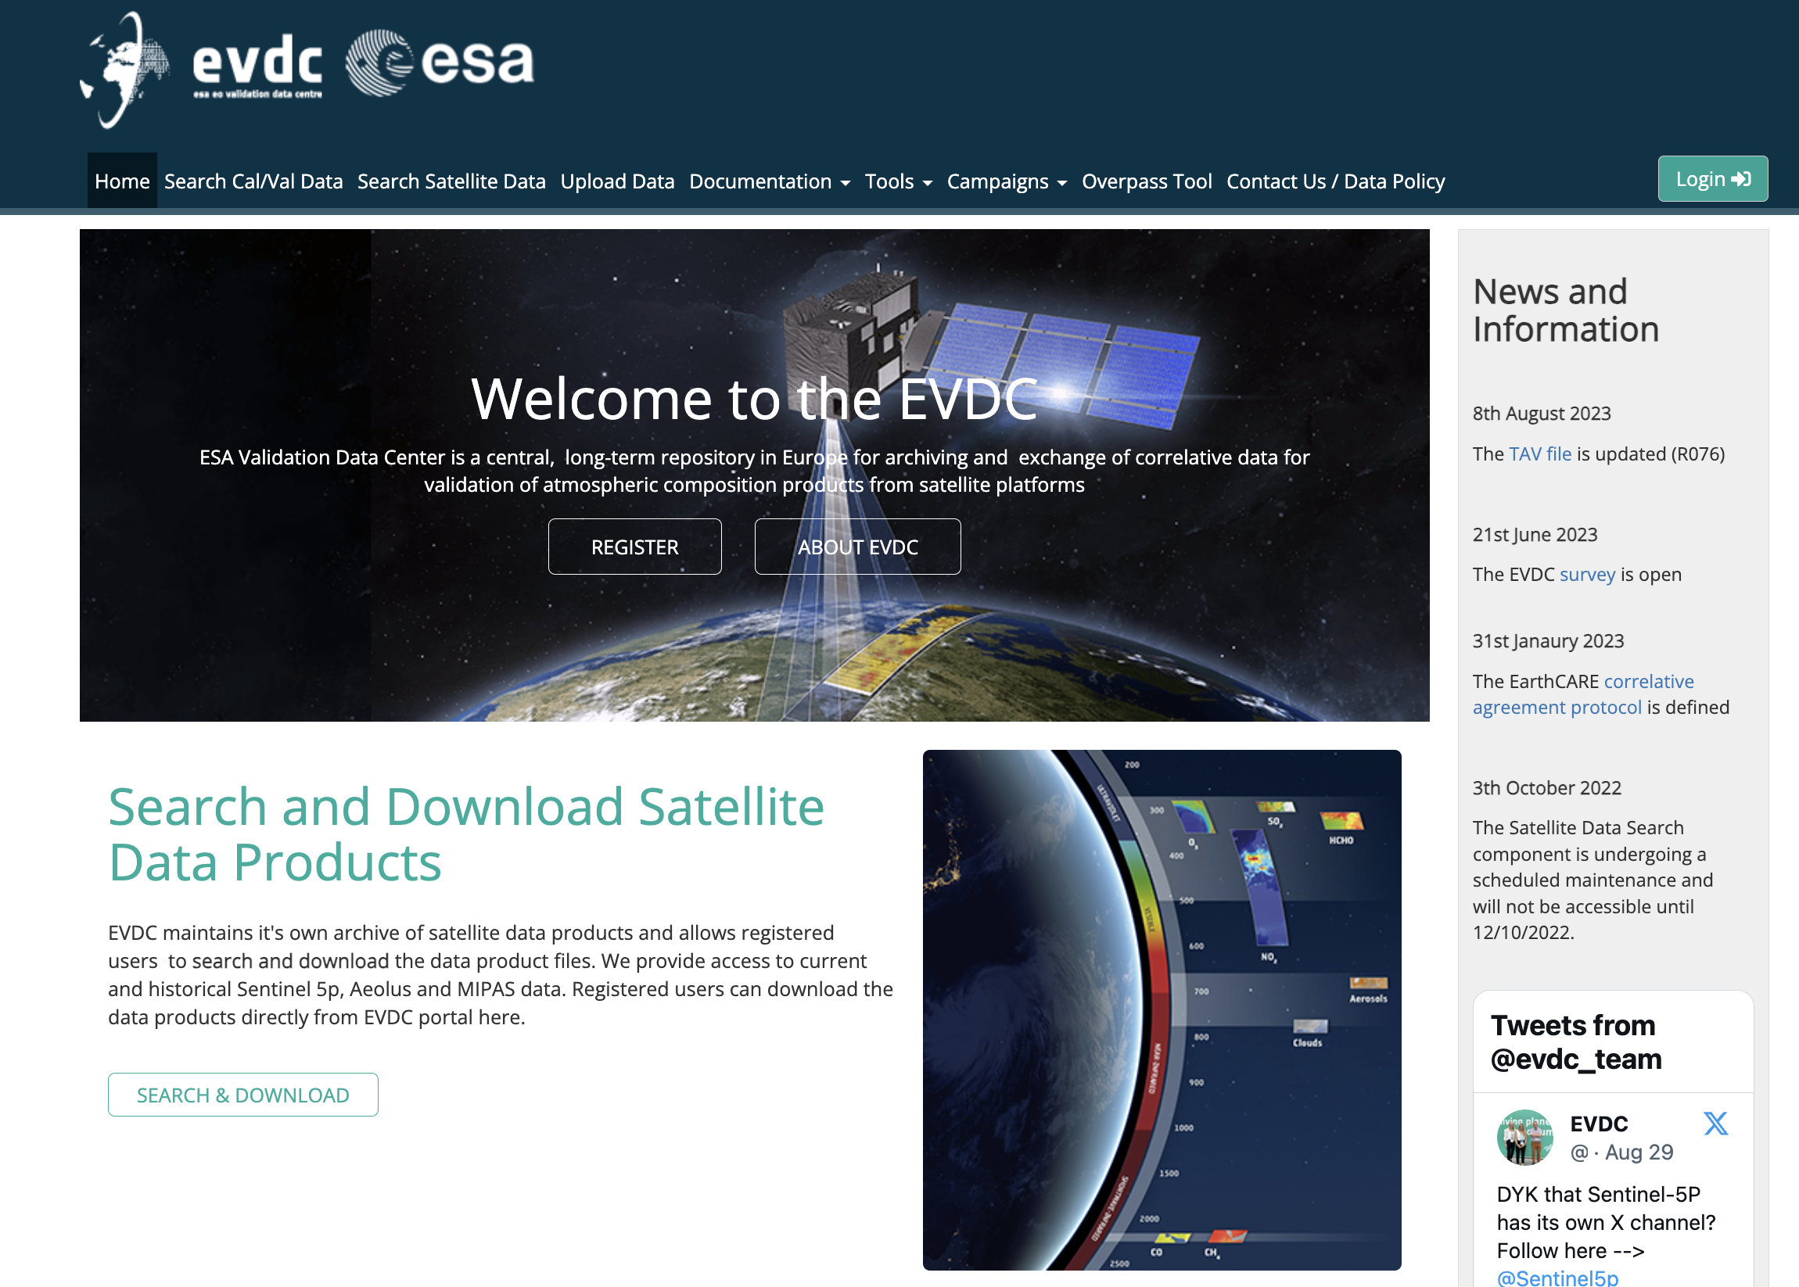
Information and tutorials
Currently available video tutorials
Click the links below to watch on YouTube:
EVDC Overview
How to search for Cal/Val data
How to search and process satellite data
How to work with Orbit Prediction Tool
How to find and extract atmospheric satellite data on EVDC platform - practical use case
How to find and explore atmospheric satellite data. Practical use case
EarthCARE webinar series
The presentation materials from all webinars in June 2023 are now available on ECVT Confluence:
https://ecvt.esa.int/confluence/display/ECAOPI/EarthCARE+webinar+series

Slide 5
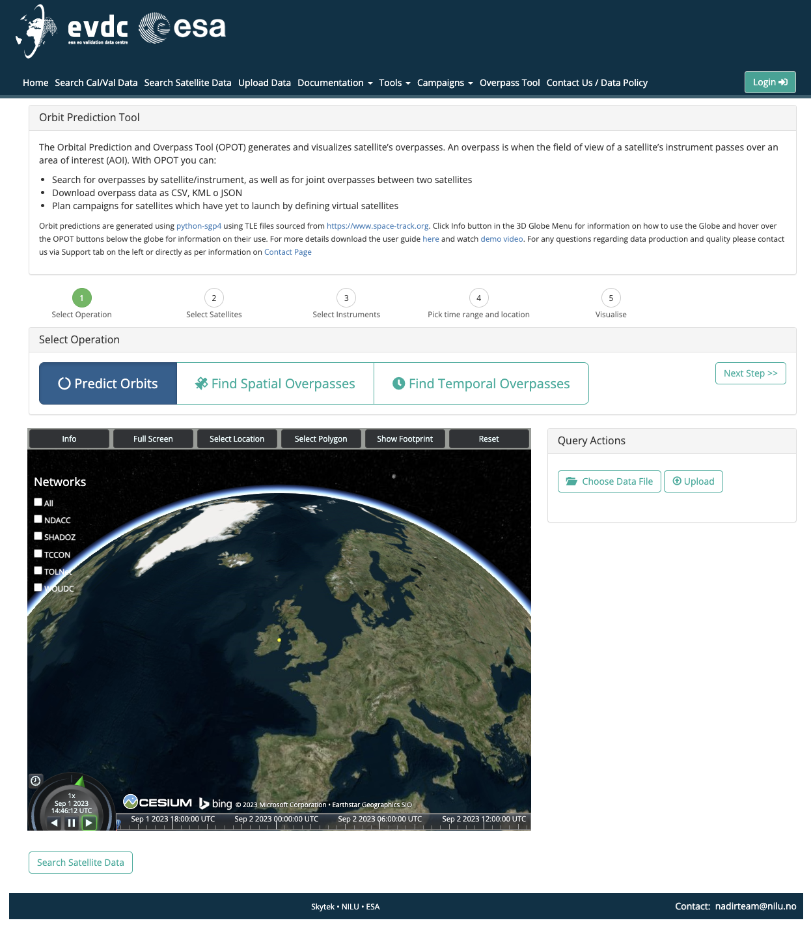
EVDC: Orbit Prediction and Overpass Tool
Orbit Prediction and Visualization
Finding Overpass over AOIs
Cal/Val Networks overlay and info
Satellite footprint visualization
Overpass data download
Temporal Overpass
Demo =>https://evdc.esa.int/orbit/

