Slide 1
Simon Elliott
Introduction to WIS 2.0
Presented to GSICS Data Working Group
5th September 2023

Slide 2
Agenda
Background
Reason for and purpose of the GTS to WIS2 transition
Architecture
High level view of the pub-sub architecture
Schedule
Overview of GTS to WIS 2.0 transition timeline
Latest news
An overview of the latest activities at EUMETSAT

Slide 3
WIS 2.0 background
GTS was a great idea but is old and has many drawbacks (e.g. message switch maintenance and abbreviated bulletin header management)
WMO created the WMO Information System (WIS) which became operational in 2012
WIS was build around the GTS and addressed issues of data access and discoverability
Fundamental concept unchanged – WMO decided to start from a clean slate … WIS 2.0
The Commission for Observation, Infrastructure and Information Systems (INFCOM-2) approved the technical specifications of WIS 2.0 as well as its implementation plan in October 2022. This was subsequently approved by WMO’s Congress in May 2023
GTS
WIS
WIS 2.0

Slide 4
Strategic aspects of WIS 2.0
WMO’s WIS 2.0 strategy is available here: https://library.wmo.int/records/item/56019-wmo-information-system-2-0-strategy
Some of the main benefits
Accessibility and interoperability – use of existing free open solutions (internet, MQTT, HTTP, et c.)
Visibility – data from trusted sources available to everyone
Cost effectiveness – no specialist skills or infrastructure
Some technical aspects
Open to common formats (e.g. netCDF, HDF, XML, JSON) as well as established standards (e.g. BUFR and GRIB)
Use of cloud computing (such as EWC) and web standards and services

Slide 5
WIS 2.0 concepts
SUPPLIER
Authoritative source providing data to the global community via WIS 2.0
CONSUMER
User of data acquired via WIS 2.0
GLOBAL BROKER
Coordinator of delivery of publication messages to consumers who have subscribed to a particular topic
GLOBAL CACHE
Consolidated repository of all core data available via WIS 2.0
TOPIC
Specification of the data using a hierarchical approach
Consumers can also be suppliers
Core data will come from a global cache, other data directly from the supplier
Topics can include wildcards

Slide 6
Architectural overview
Simple architecture: Illustrated here for core (essential) data, which will be available from a global cache. A similar mechanism will deliver recommended (additional) data directly from suppliers to consumers.
Supplier A
Global broker
Suppliers’ perspective:
Suppliers inform global broker of data availability
Global broker informs global cache of data availability
Global cache collects and caches the data from the suppliers
Supplier B
Supplier C
Global cache
Global broker
Consumer A
Consumers’ perspective:
Consumers request notification of data availability from global broker
Global broker informs consumers of data availability
Consumers collect data from the global cache
Consumer B
Global cache
Consumer C

Slide 7
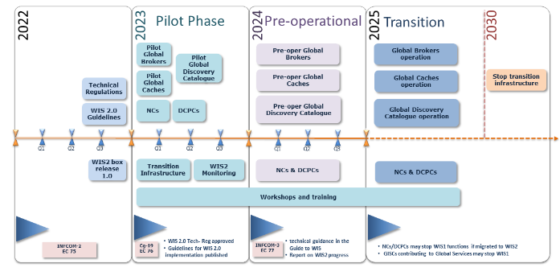
WMO Timeline & Project Lifecycle
WMO WIS 2.0 implementation timeline is as follows:
Global Telecommunication System (GTS) will be decommissioned by 2030.
NMHSs will use WIS2.0 platform for data exchange
During Transition period
Mix of centres operating WIS2.0 and WIS/GTS.
Some centres will be running both data-sharing frameworks simultaneously
GTS to WIS2.0 Transition Project

Slide 8
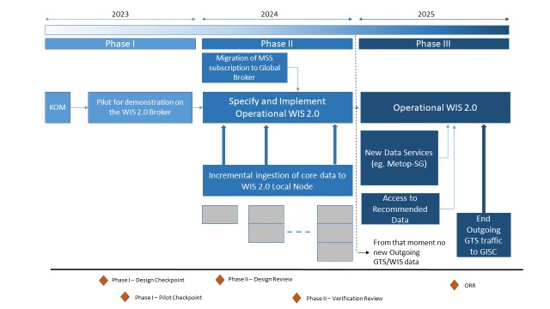
Project Lifecycle zoom-in

Slide 9
High level timetable
2023 project kick off – securing resources and visibility
prepare discovery metadata
activate pilot data provision
2024 specify and implement operational WIS 2.0 node
migrate MSS subscription to global broker
incrementally add existing core data to local node
2025 add new data services (eg Metop-SG)
add access to recommended data
end of outgoing GTS traffic to GISC

Slide 10
Progress at EUMETSAT
Close collaboration with DWD allowing i.a. distribution of core SEVIRI HRIT data via WIS 2.0 (by DWD playing role of EUMETSAT)
Participation in coordination of global pilot projects – EUMETSAT’s transition will be one of these
Collaboration with ESA/ESOC about a pilot WIS 2.0 service for space weather exchange
Explaining WIS 2.0 to core users at EUMETSAT delegate bodies, CGMS WGIV, ITSC, IROWG, CEOS/WGISS, and GSICS
Already running:
Global Broker (MF, Toulouse);
Global Cache (DWD, Offenbach);
Global Cache (JMA, Tokyo), and
Global Metadata Catalogue (CMA, Beijing)
There are plenty of data already available on WIS 2.0
EUMETSAT’s pilot broker is running pre-operationally since 07/07/2023– final verification testing campaign during September 2023

Slide 11
Slide used to indicate that the main presentation has ended
Thank you!
Questions are welcome.

Slide 12
Official project poem
The end of WMO’s GTS and advent of WIS 2.0
The GTS has served the world for years
But sure enough its glory days are done.
And as the end of store and forward nears;
Bulletin headers will set with the sun.
WIS2 will let the world collaborate
And share their data unreservedly.
The GTS will slowly hibernate
And close for good in twenty thirty-three.
(with scansion)
The G- | -TS | has served | the world | for years
But sure | enough | its glor- | -y days | are done.
And as | the end | of store | and for- | -ward nears;
Bullet- | -in head- | -ers will | set with | the sun.
WIS2 | will let | the world | collab- | -orate
And share | their da- | -ta un- | -reser- | -vedly.
The G- | -TS | will slow- | -ly hi- | -ber nate
And close | for good | in twen- | -ty thir- | -ty-three.

