Slide 1
Introduction to the 2023 GSICS mini-conference
Fangfang Yu
GRWG Chair

Slide 2
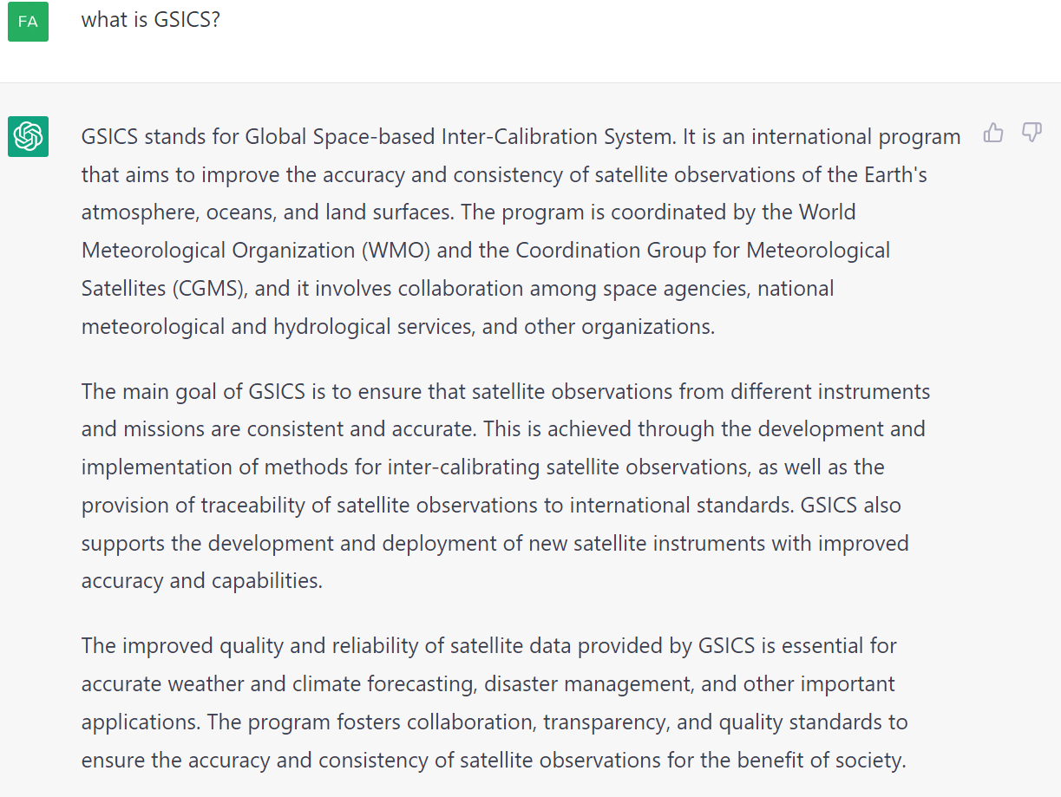
What is GSICS? – by ChatGPT

Slide 3
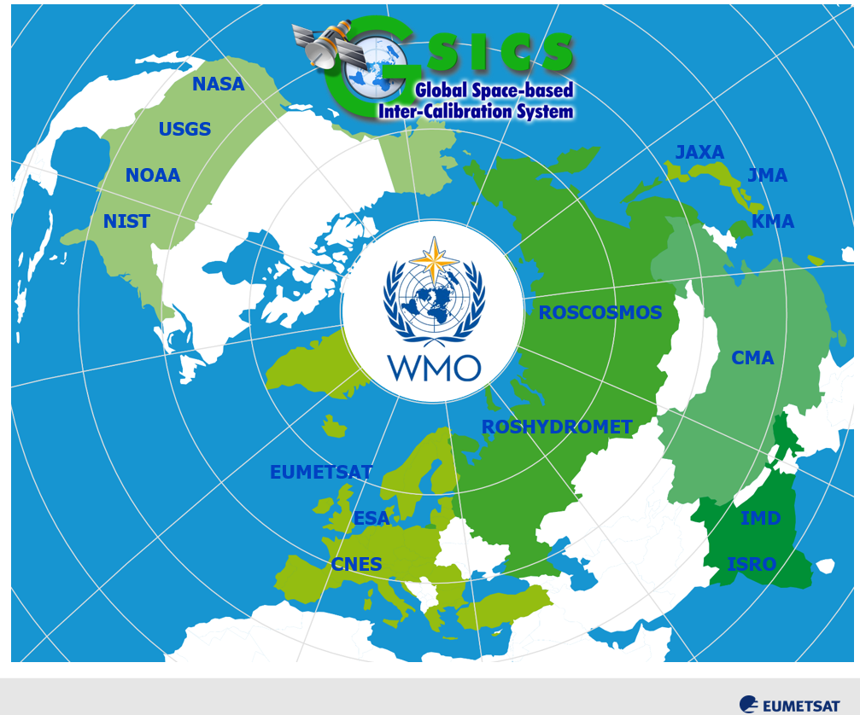
What is GSICS?
Global Space-based Inter-Calibration System
International collaborative effort initiated by WMO and CGMS in 2005
Goal
To produce consistent, well-calibrated data from the Earth Observing satellites
Members
Current 18 entities and one observer, https://gsics.wmo.int
Approaches
Best practices for inter-calibration algorithm/procedure
Community recommendation of common reference/standard
Traceability with unbroken uncertainty chain in products
Users
Satellite application communities
Satellite operators
from T. Hewison

Slide 4
GSICS Objectives
GSICS aims to ensure consistent accuracy among space-based observations worldwide for climate monitoring, weather forecasting, and environmental applications.
Ensure stable generation of L2+ products
Reduce bias between L1b products of series instruments via satellite inter-calibration
Improve instrument calibration accuracy
Improve consistency between instruments
Support prelaunch instrument characterization
Provide traceability of measurements
Actively perform and deliver GSICS products and deliverables
GSICS was selected as a stakeholder organization in the WMO-BIPM 2022 workshop on Metrology for Climate Action

Slide 5
GSICS Products and Deliverables
GSICS Products for users of satellite data, including calibration corrections/coefficients
GSICS Algorithms, which describe inter-calibration processes, (described by ATBD)
GSICS Monitoring Reports, assessments
GSICS Reference datasets, including Solar spectrum, …
GSICS Tools for use by inter-calibration developers, (GIRO, SBAF, …)
GSICS recommended standards, conventions and guidelines,
GSICS User Services, information
Pro- ducts corrections
Intercalib. Algorithms
Monitoring assessmentreports
Calibration datasets
Software and hardware tools
Standards, conventions,
Calibration references
(from T. Hewison)

Slide 6
GSICS to Improve Satellite Data Accuracy
Improvement of in-orbit instrument calibration accuracy with the inter-comparison or inter-calibration to the reference instruments
Detect the calibration anomaly
Assist the root cause investigation
Validate the ground segment updates
Reprocessing of archived data
Retrospective recalibration with improved instrument performance knowledge
Corrections for the known calibration errors, e.g. SRF, non-linearity, target measurements, straylight, geometric calibration error, and improvement of calibration algorithm, etc.
from L0 to L1b
Harmonization and GSICS correction products
Harmonize monitored instrument radiance to be consistently relative to reference datasets
L1b -> L1b
Inter-comparison between satellites also improves the geometric calibration accuracy
e.g. ABI vs. Landsat geometric inter-comparison

Slide 7
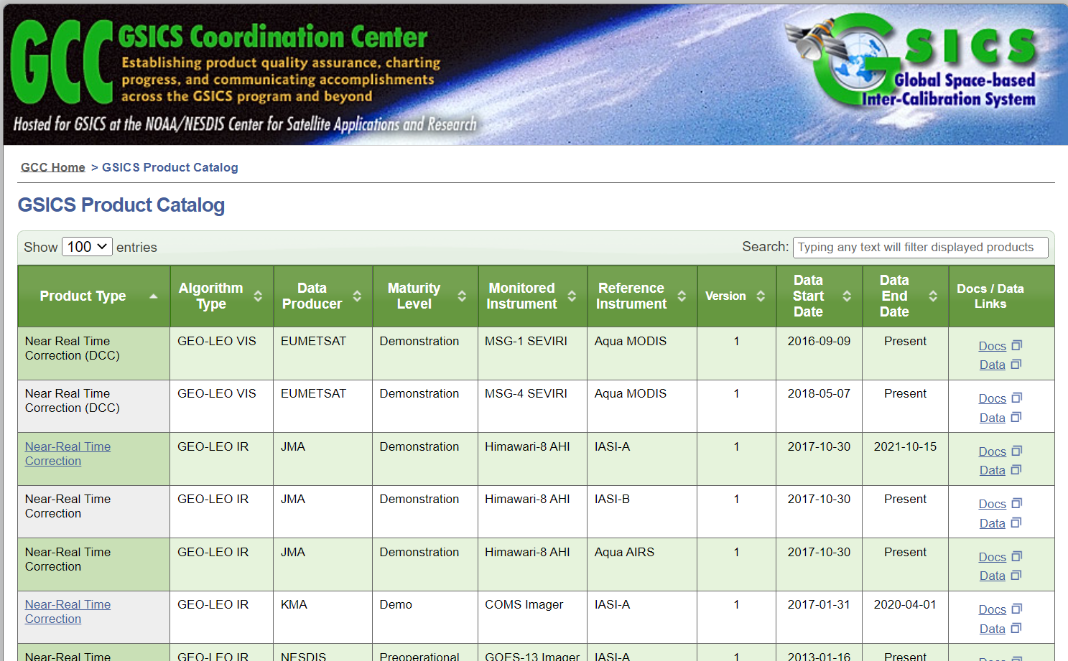
GSICS Products and New Deliverables
Over 21 GSICS products for the VIS/NIR instruments currently distributed via the GISCS Product Catalog
http://gsics.atmos.umd.edu/pub/Development/20210513/manik_noaa_visnir05132021.pdf
Free and open access
Adopting community standard
The Total and Spectral Solar Irradiance Sensor-1 (TSIS-1) Hybrid Solar Reference Spectrum (HSRS) is recommended as the new solar spectrum reference by the VNIR and UVNS subgroups in 2022
Continue exploring the new reference/inter-calibration algorithms
Improvement of GEO-LEO IR inter-calibration algorithm
Best practice/standard procedure for the instrument inter-calibration/inter-comparison
Reference characterizations, e.g. lunar calibration models
Others
https://www.star.nesdis.noaa.gov/smcd/GCC/ProductCatalog.php

Slide 8
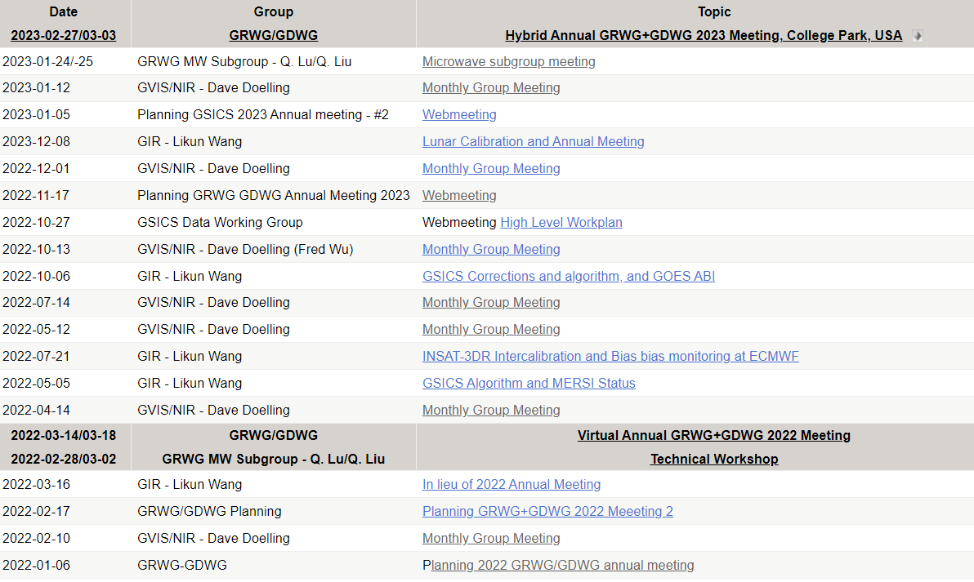
Extended Technical Discussions
Activities include but not limited to the following monthly web-meetings at the GSICS wiki website
http://gsics.atmos.umd.edu/bin/view/Development/MeetingsAndConferences

Slide 9
A New GRWG Subgroup Established
CGMS satellite operators
CGMS satellite operators
WMO
Satellite operators
GRWG subgroups evolve chronically from IR, VNIR, WV, UVN to recently new developed space weather (SW)
The kick-off meeting of the SW subgroup was held on Dec 14, 2022
GSICS Exec Panel
GSICS Coordination Center
GSICS Research Working Group
GSICS Data Working Group
Space Weather Sub-Group
IR Sub-Group
VIS/NIR Sub-Group
Microwave Sub-Group
UVN Spectrometer Sub-Group
Breakout sessions: SW and UVNS (in parallel): Tuesday afternoon; IR and MW (in parallel): Wednesday; VNIR: Thursday

Slide 10
Mini Conference Agenda
Time (EST) | Presenter | Topic | Organization
7:30 |  | Coffee, posters and orientation
8:30 | Mitch Goldberg | GSICS Welcome | NOAA NESDIS
8:40 | Doug Howard | NOAA Welcome | NOAA STAR
8:50 | Fangfang Yu | Intro. to Mini Conference | UMD
9:00 | Larry Flynn | Logistics information | NOAA STAR
9:10 | Fangli Dou | Monitoring of FY-3E Instruments' performances using RTM and NWP data | CMA (remotely)
9:30 | Robert Levy | Feedback MODIS to VIIRS L2 Products Continuity (TBD) | NASA
9:50 | Emma Woolliams | QA4EO : Applying metrological principles | UK NPL
10:10 | Coffee Break
10:40 | Emma Woolliams | Developing QA4EO: Comparisons as a system and steps towards metrological approaches | UK NPL
11:10 | Betsy Weatherhead | Planning Continuity for Critical Earth Observations | Jupiter
11:30 | Rob Rosenberg | OCO-2/3: Unique Challenges of Trace Gas Spectrometers | NASA
11:55 | Ruediger Lang | The CO2M mission - overview and status of Cal/Val planning | EUMETSAT (remotely)
 | Lunch Break & Picture
13:30 | Changyong Cao | NOAA-21 cal/val overview | NOAA
13:50 | Paolo Castracane | ESA Cal/Val Strategy for Optical Land-Imaging Satellites: Overall Approach and Pathway towards Interoperability | ESA
14:10 | Andrew Collard | The error budget for satellite radiance assimilation | NOAA
14:30 | Ben Johnson | CRTM science updates and accuracy improvements for satellite-based sensor simulation | NOAA
14:50 | Coffee Break
15:20 | Vladimir Kondratovich | Image Navigation and Registration Assessment for ABI at NOAA STAR | UMD/NOAA
15:40 | Betsy Weatherhead | Merging satellite data to create long-term records | Jupiter
16:00 | Mounir Lekoura | MICMICS: an advanced infrastructure dedicated to the radiometric monitoring of EUMETSAT-operated missions | EUMETSAT
16:20 | Andrew Heidinger | Feedback from ISCCP-NG | NOAA (Remotely)
 |  | DISCUSSION

Slide 11
Conclusions
The new space weather subgroup is established to join the GRWG team
IR, VNIR, MW, and UVN spectrometers and SW subgroups
GSICS continues
Evolving
Performing GSICS products
Developing new deliverables
Cooperating with related activities to integrate into WIGOS
Supporting architecture for climate monitoring from space
Today: Examples of interactions and cal/val activities
Rest of the week: focus on development of GSICS products and deliverables

Slide 12
Notes to Speakers
Each talk is 20 – 30 minutes
Please leave at least 5 minutes for questions
The chair will give a warning at the 5 minutes before the slot ends
The slides will be posted to the GSICS wiki webpage
Unless you tell me not to
File name conventions: 1x_GSICS_2023_PresenterLastName_KeyWords.
Thank you!

