Slide 1
NOAA-21 Cal/Val Overview
Changyong Cao
NOAA/NESDIS/Center for Satellite Applications and Research
Date: 2/27/2023
The scientific results and conclusions, as well as any views or opinions expressed herein, are those of the authors and do not necessarily reflect those of NOAA or the Department of Commerce.

Slide 2
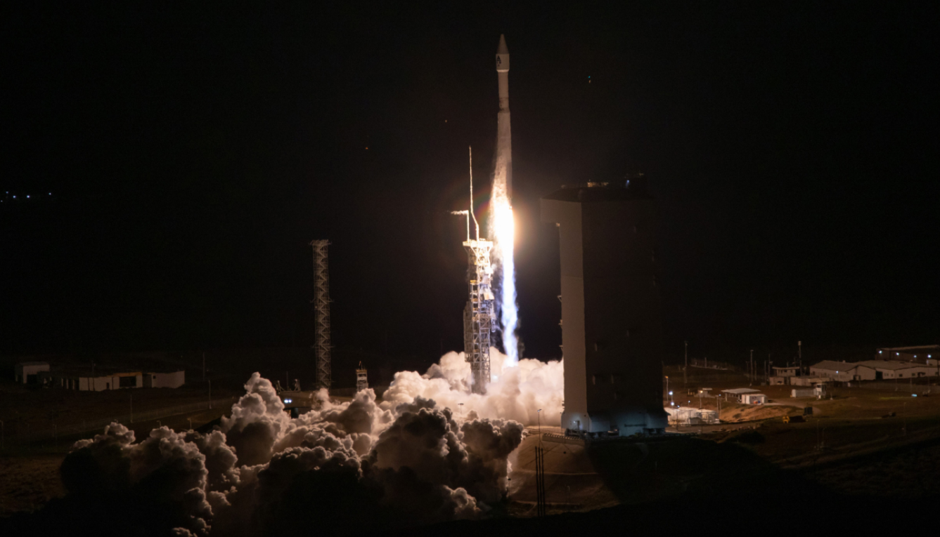
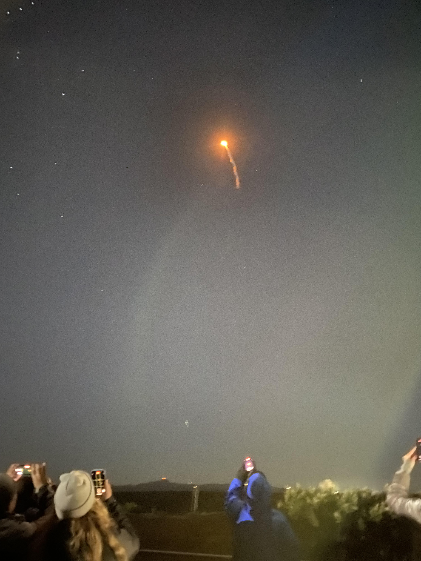
NOAA 21/J2 Successfully Launched on November 10, 2022
Vandenberg Space Force Base (Vsfb), California

Slide 3
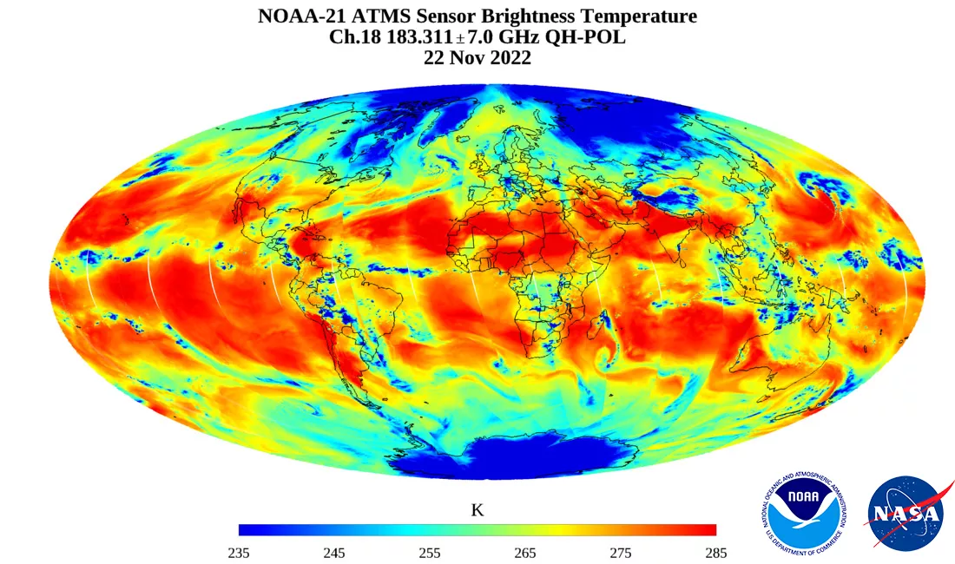

Slide 4
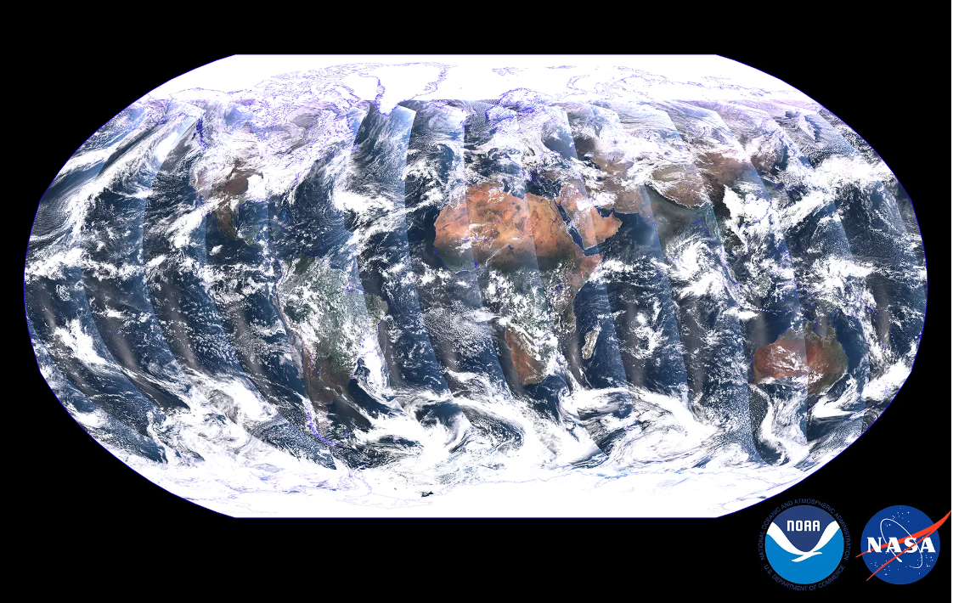
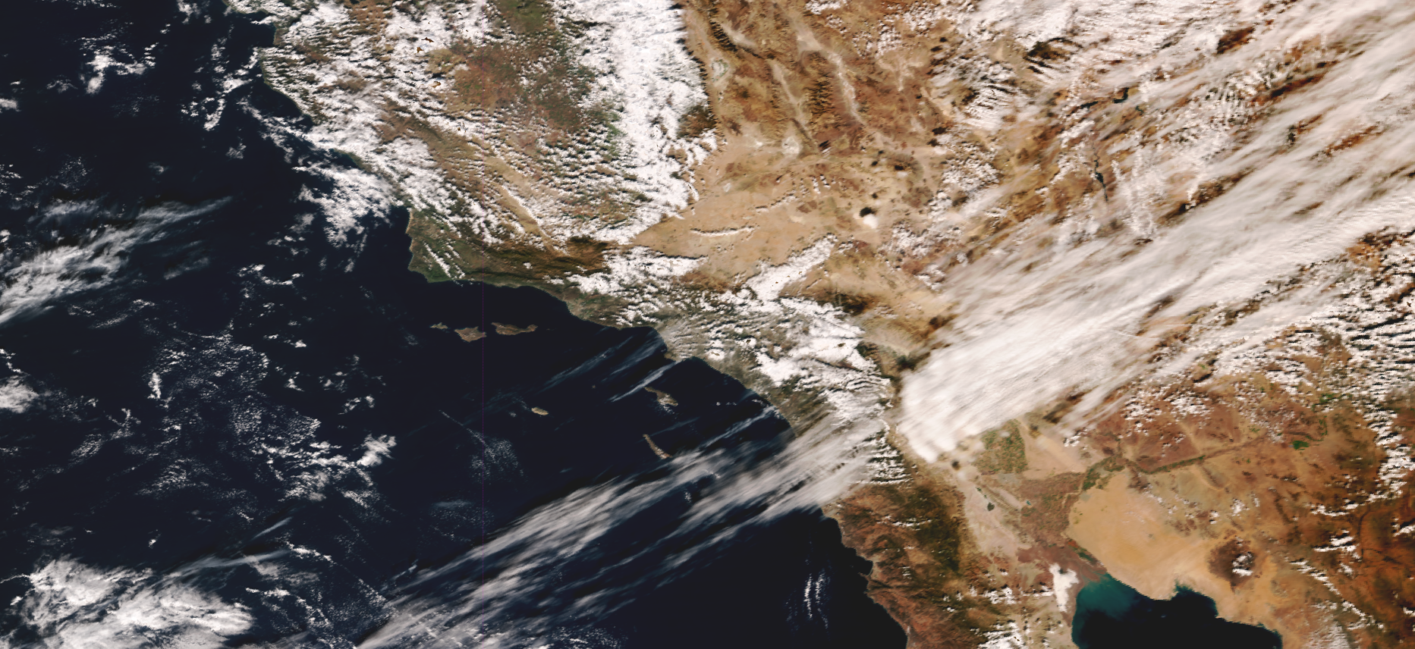
NOAA-21 VIIRS First Light Images: VIS/NIR Bands
Earth observations from NOAA-21 VIIRS started on December 5, 2022 with the first granule acquired at 17:33 UTC
NOAA-21 VIIRS first light true color global image from Dec. 5 and Dec. 6, 2022 prepared by STAR VIIRS SDR team and was selected in the NOAA/NESDIS public release
Bands M5, M4, M3 shown as RGB
High resolution version (120MB) available at:
https://ncc.nesdis.noaa.gov/NOAA-21/N21FirstVIIRSGlobalTrueColor.png
https://ncc.nesdis.noaa.gov/Regional/

Slide 5
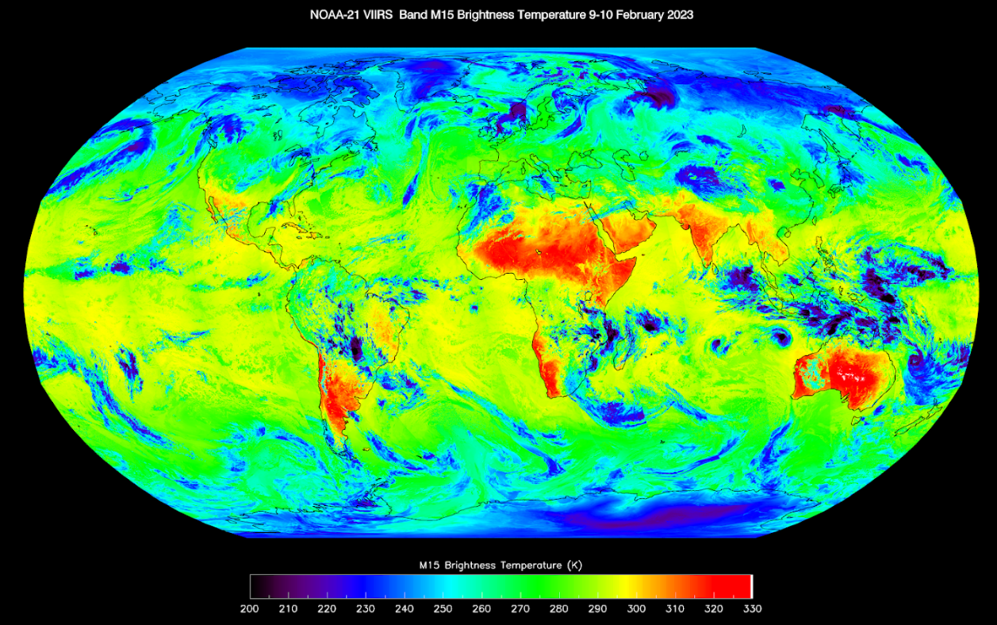
First Light Images: TEB
NOAA-21 VIIRS S/MWIR and LWIR bands CFPA (I3 to I5 and M8 to M16) reached operating temperature (82K) around 18:45 UTC on Feb. 10, 2023
All thermal bands are working nominally
Band M15

Slide 6
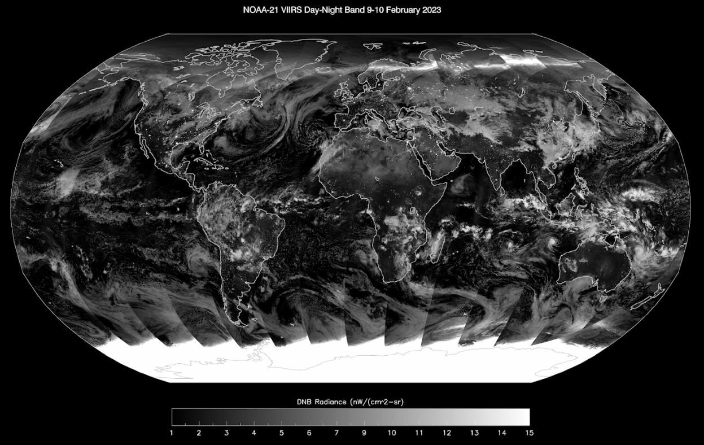
First Light Images: DNB
NOAA-21 VIIRS DNB images have been produced since February 9, 2023; DNB detectors reached operating temperature around 14:00 UTC on February 9, 2023.
No major artifacts observed on global image but requires further evaluation during new moon on 2/20.

Slide 7
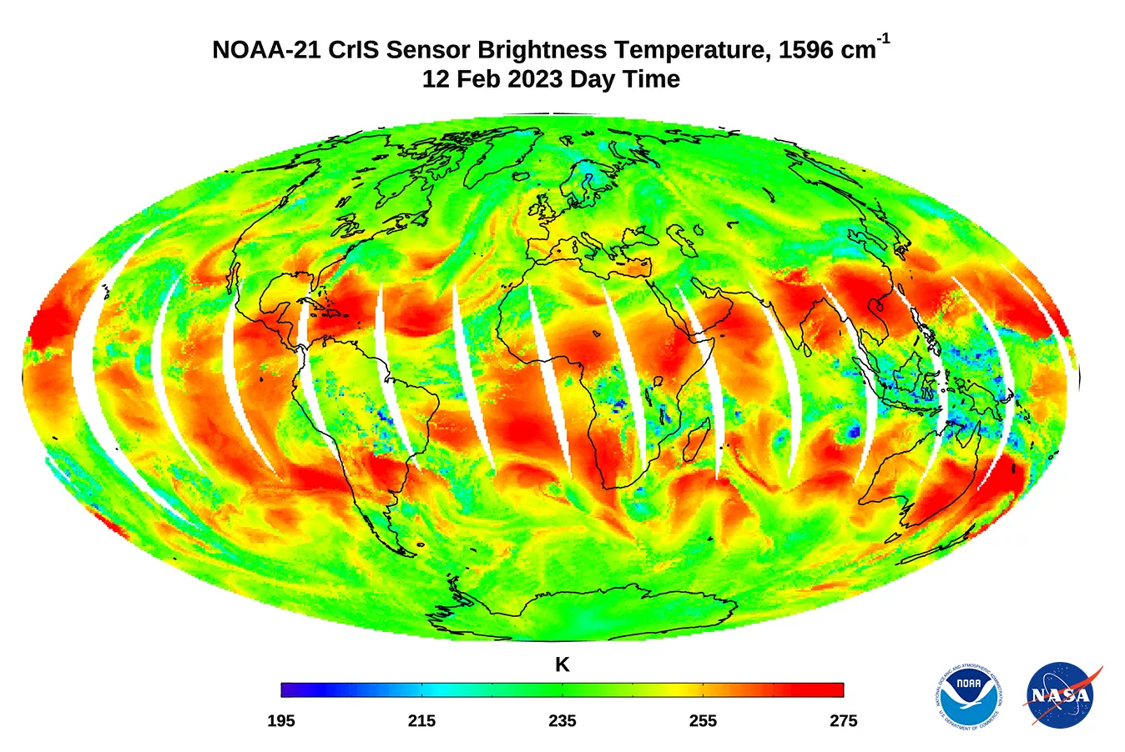

Slide 8
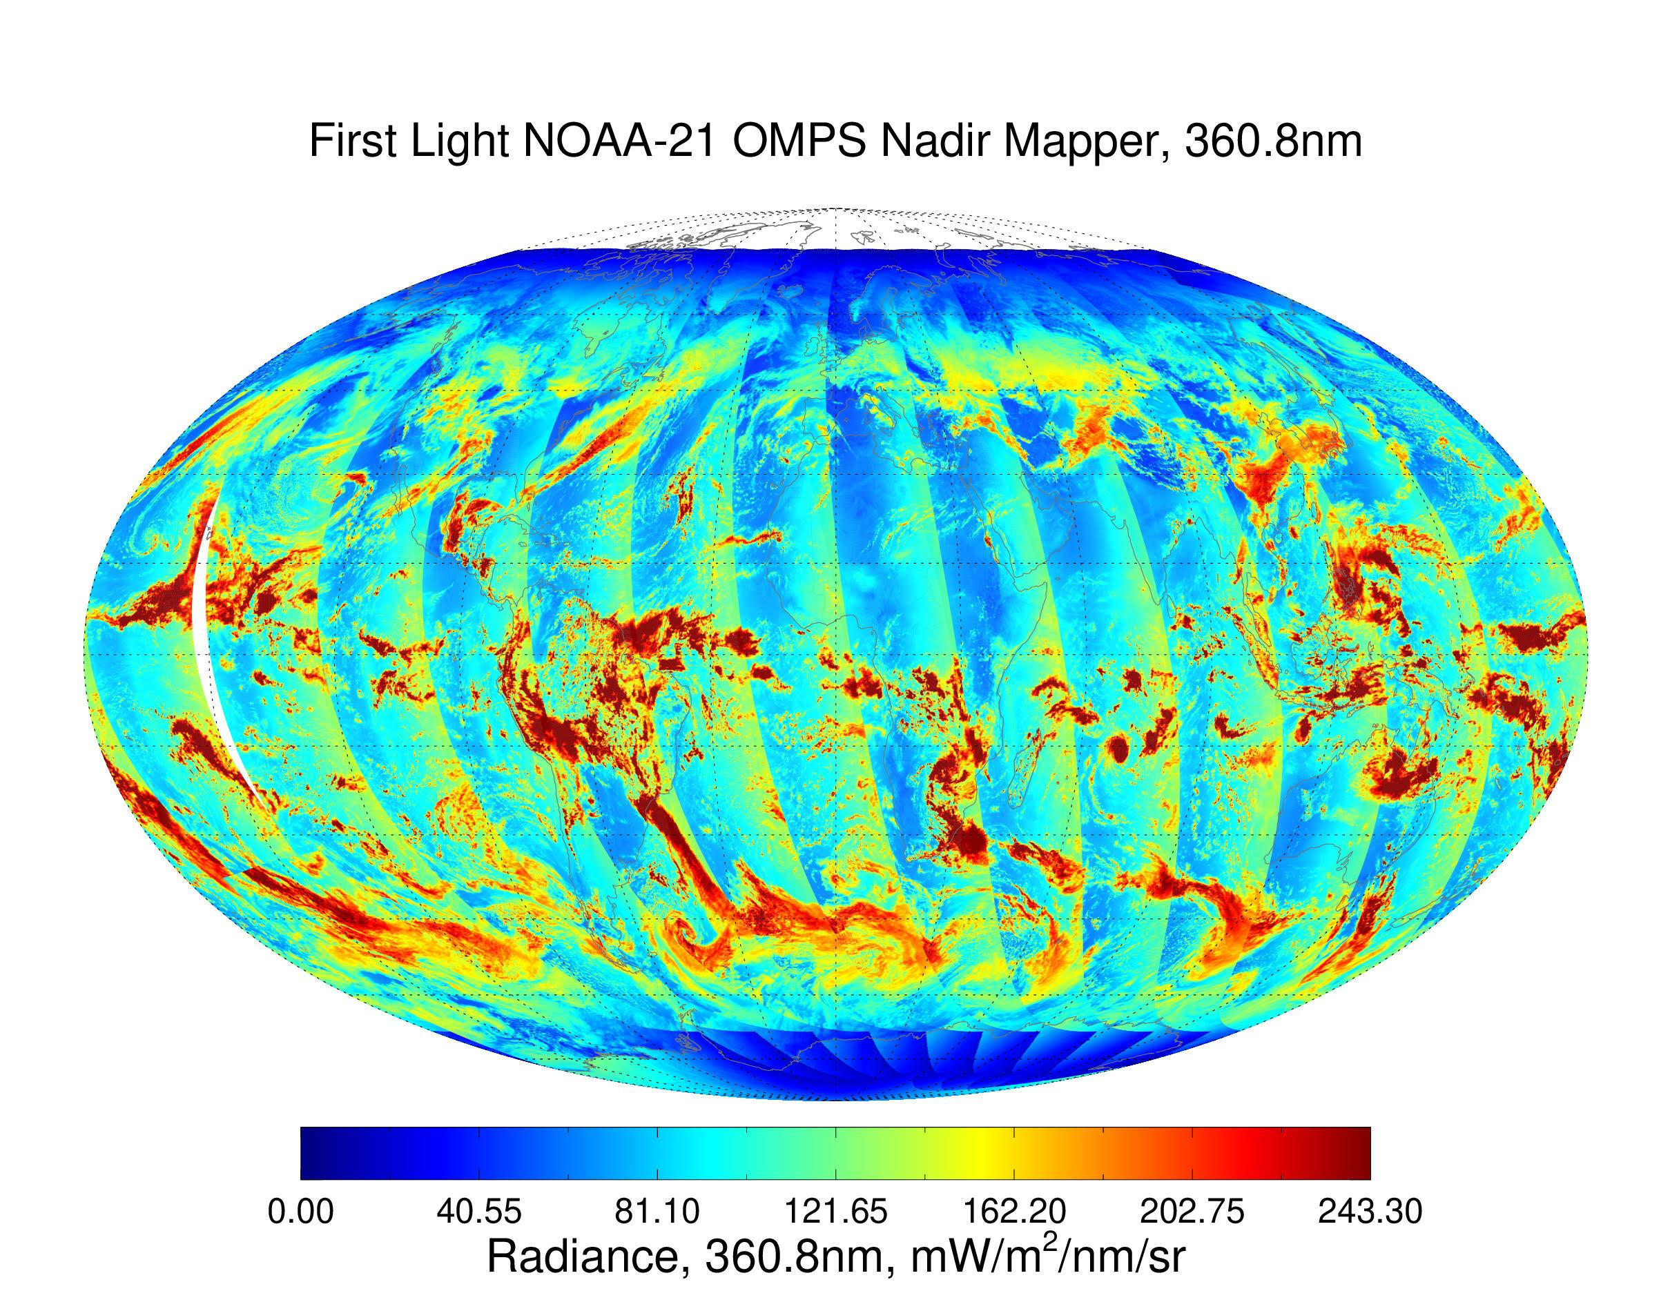
02/18

Slide 9
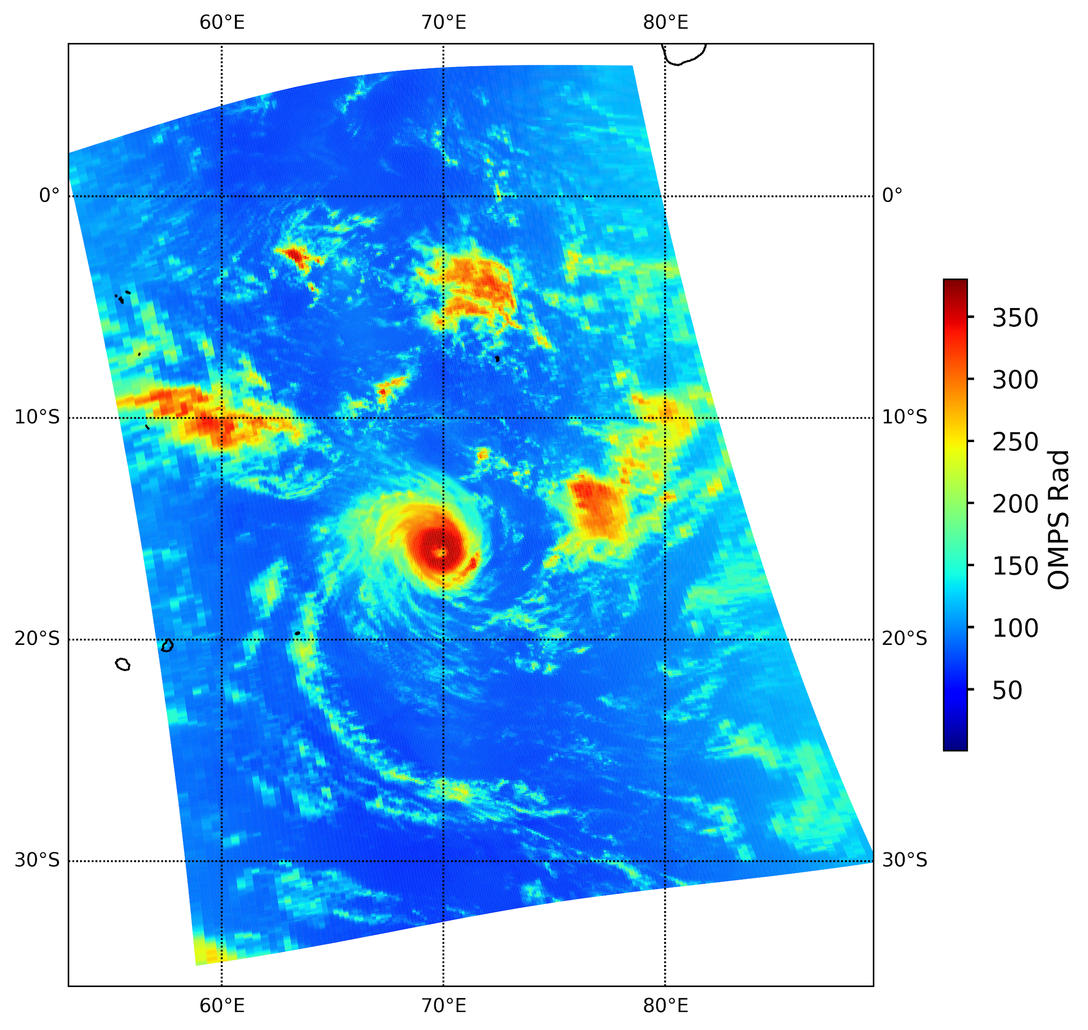
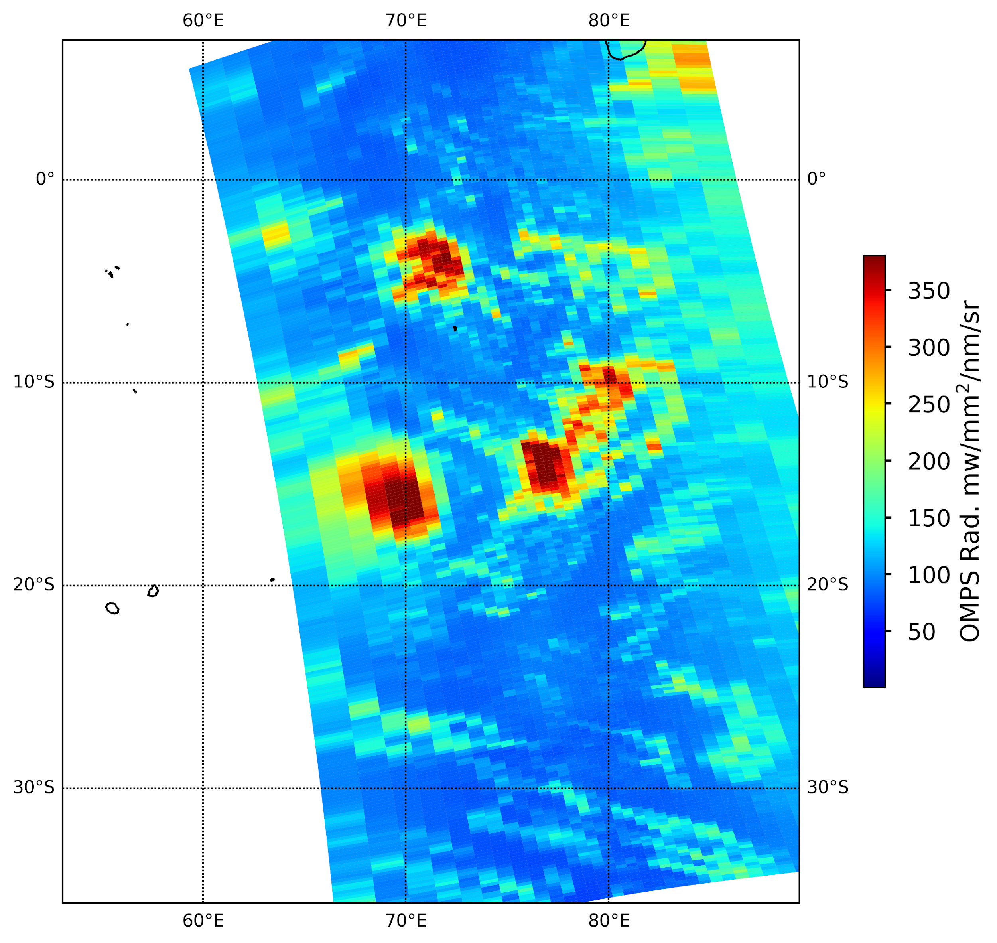
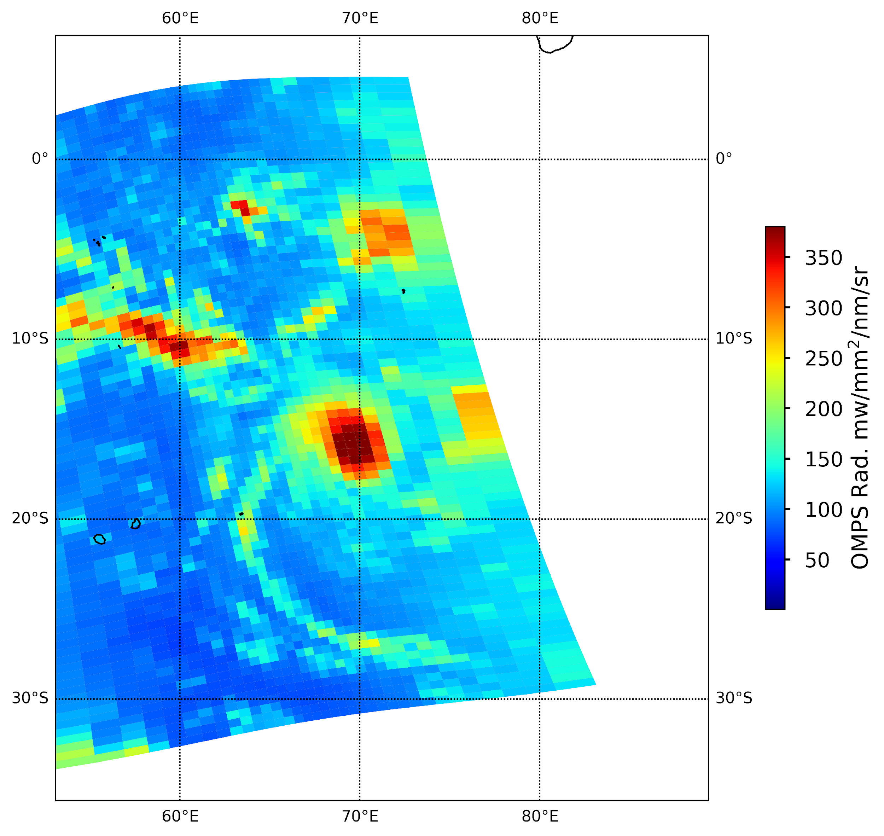
First Light NOAA-21 OMPS Nadir Mapper: Southern Hemisphere Cyclone, 380nm
02/18/2023:
second day
(a) NOAA-21
(b) NOAA-20
(c) SNPP
v
v
Radiance (mW\m²\nm\sr)
Clockwise rotation

Slide 10
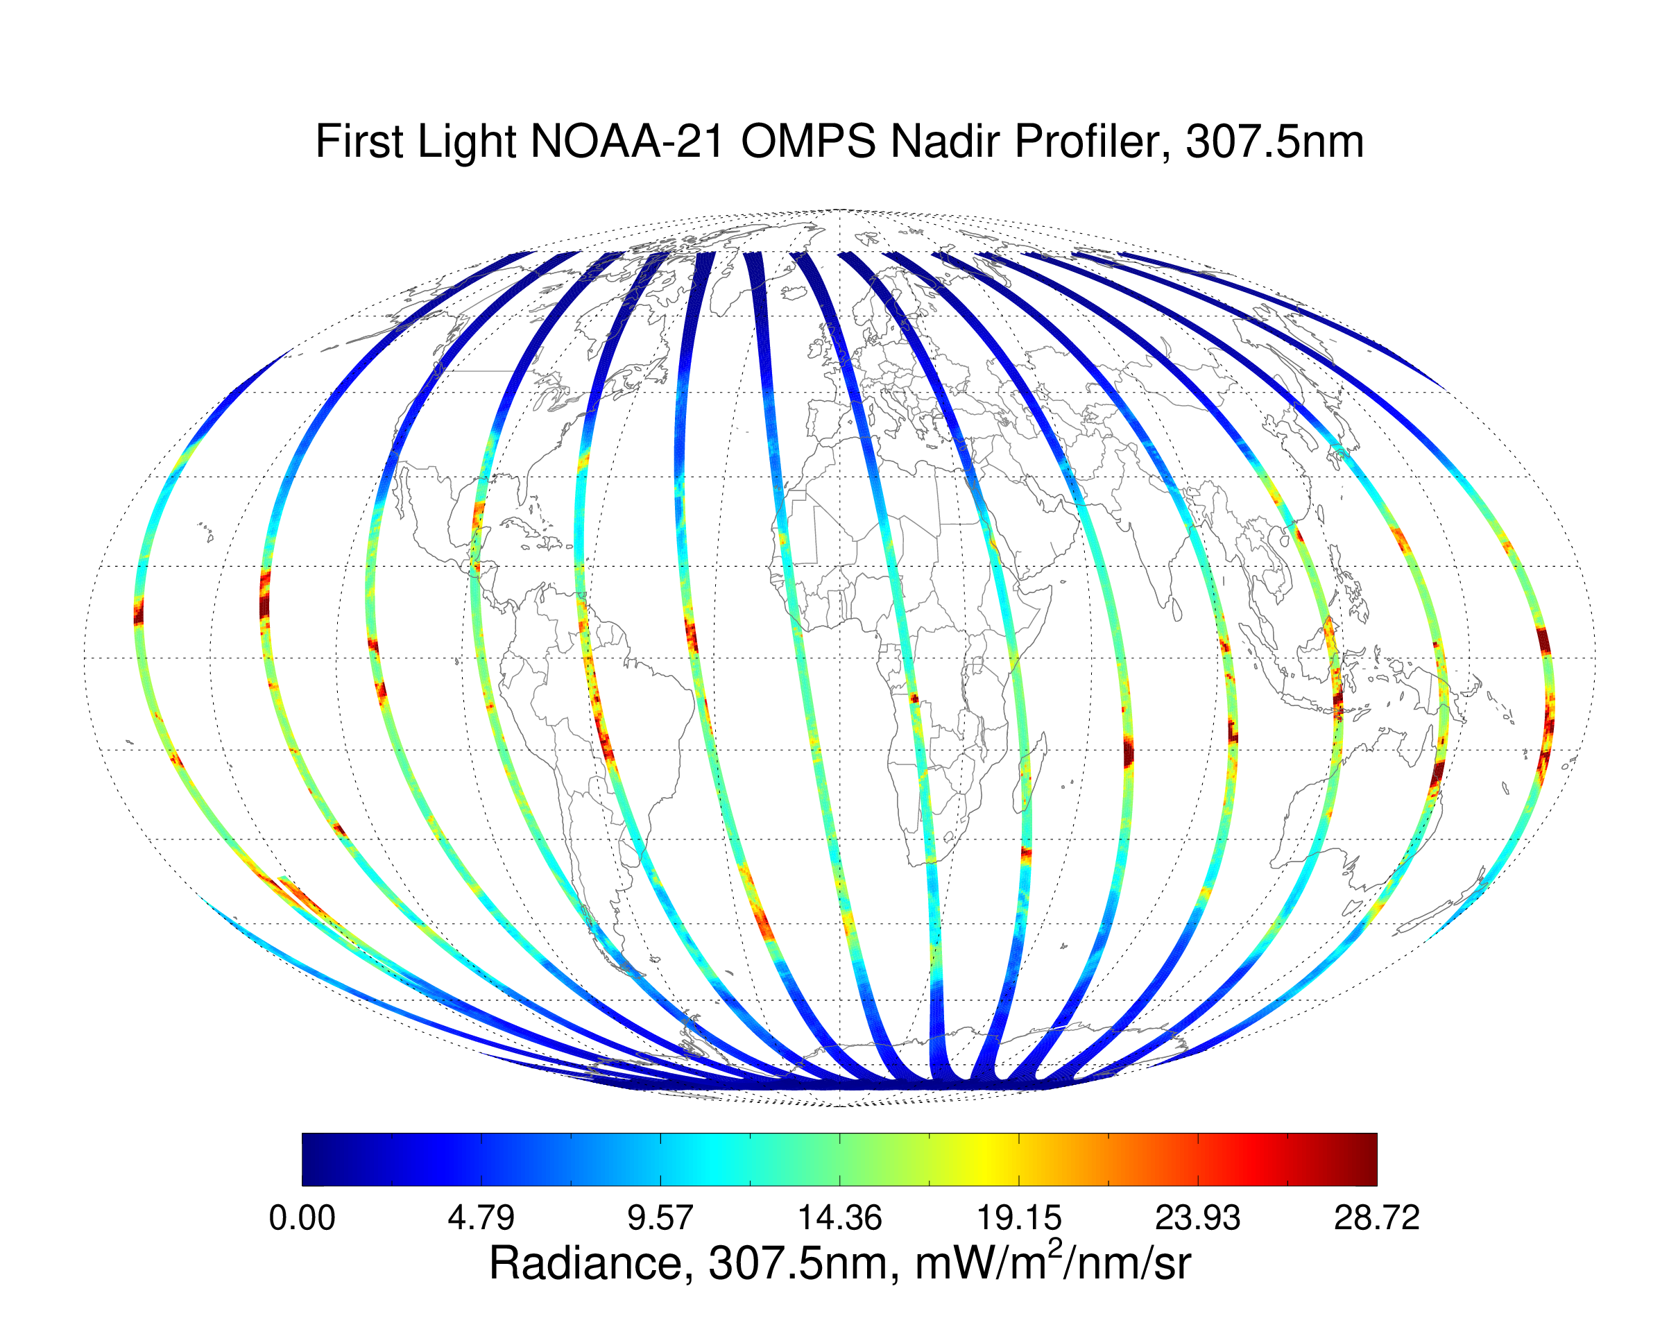
02/18

Slide 11
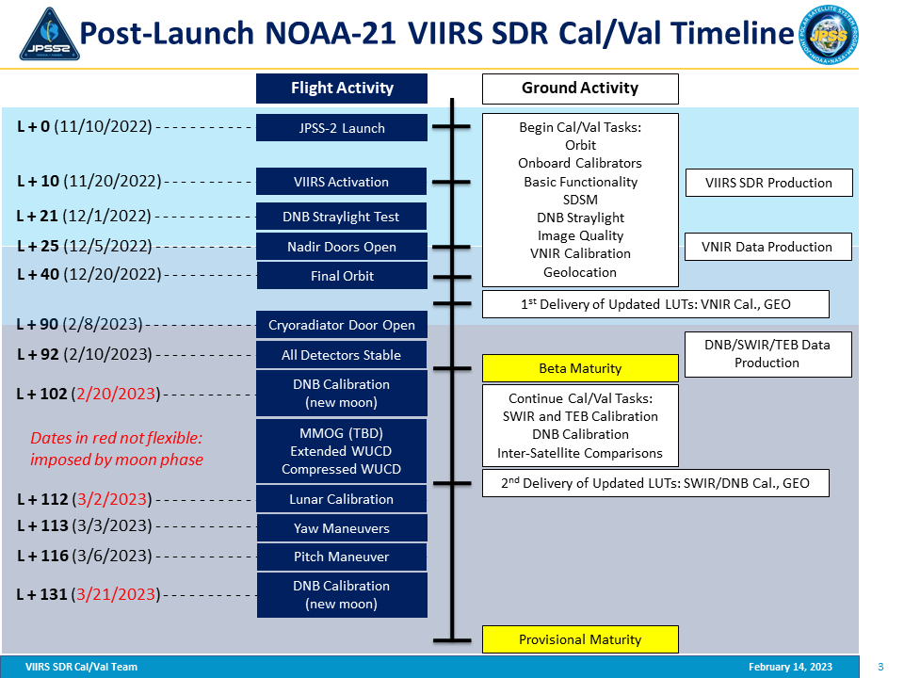
ATMS 1st Light Image
VIIRS 1st light image
CrIS, OMPS Nadir Door Open

Slide 12
JPSS 2 (J2) Instrument Improvement Highlights
ATMS:
Reduced noise correlation across channels, which will improve product quality
Instrument improvements reduce striping in water vapor channels
CrIS:
Comparable to J1
VIIRS:
DNB straylight reduction
DNB reduced nonlinearity
Reduced polarization sensitivity in RSB channels
M6 digital saturation instead of rollover
M13 Spectral Change
OMPS:
Limb profiler added
Higher spatial resolution with increased data rate

Slide 13
NOAA-21 VIIRS Instrument
VIIRS is a scanning imaging radiometer onboard Suomi NPP and JPSS satellites that produces global imagery and radiometric measurements of land, atmosphere, cryosphere, and oceans in the visible and infrared bands with moderate spatial resolutions at 22 spectral bands;
The operationally produced VIIRS data are widely used globally to monitor hurricanes/typhoons, cloud and aerosol properties, ocean color, sea and land surface temperature, ice motion and temperature, active fires, and Earth's albedo.
The VIIRS data support the operational production of at least 26 Environmental Data Records(EDRs);

Slide 14
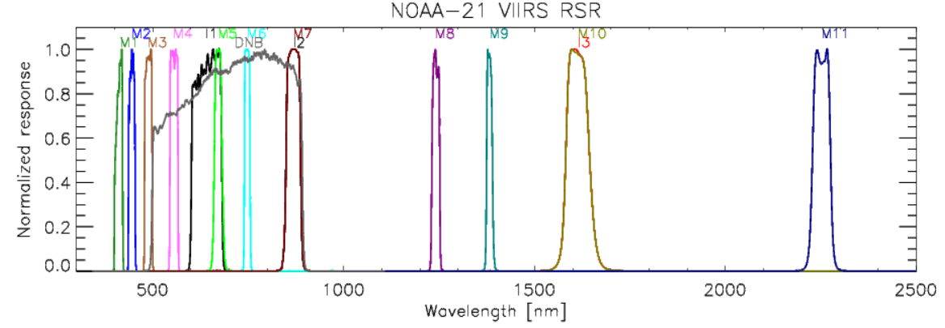
VIIRS Spectral Bands: Reflective Solar Bands (RSB)/ Day/Night Band (DNB)
Spectral Bands of VIIRS RSBs and DNB
RSBs cover a spectral range from 0.412 μm to 2.25 μm
There are 14 RSBs with 3 image bands (I1-I3) and 11 moderate bands (M1-M11)
RSB band calibration is dependent on Solar Diffuser (SD) and Solar Diffuser Stability Monitor (SDSM) observations
The required RSB calibration uncertainty is within 2%
DNB is a panchromatic band with spectral range 0.5μm - 0.9 μm

Slide 15
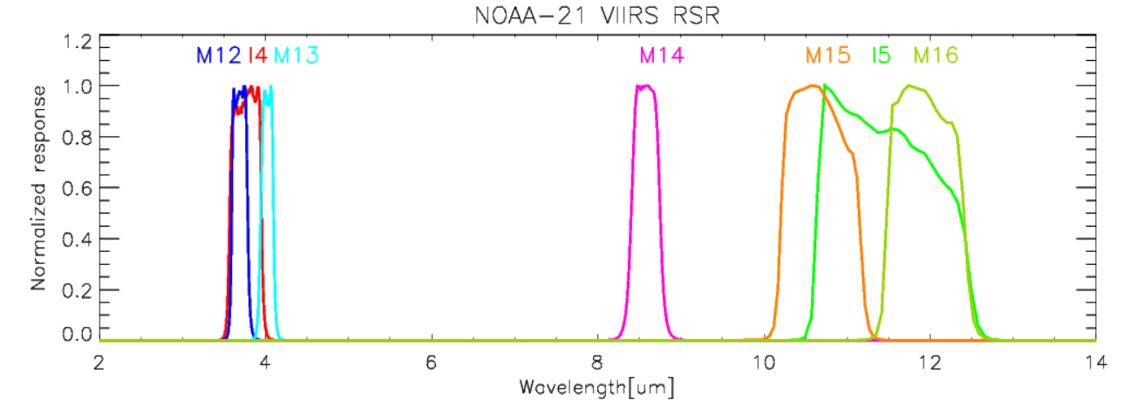
VIIRS Spectral Bands: Thermal Emissive Bands (TEB)
Spectral Responses of VIIRS TEBs
There are 7 bands with 2 image band (I4, I5) and 5 moderate bands (M12-M16)
Calibration sources are Onboard Blackbody (BB) with six thermistors and space view

Slide 16
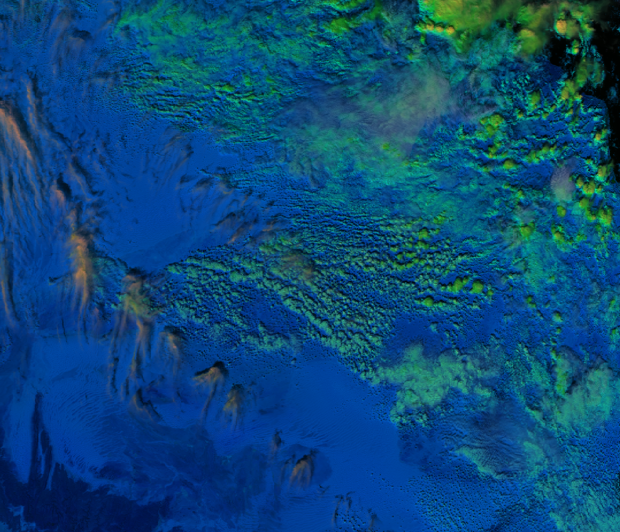
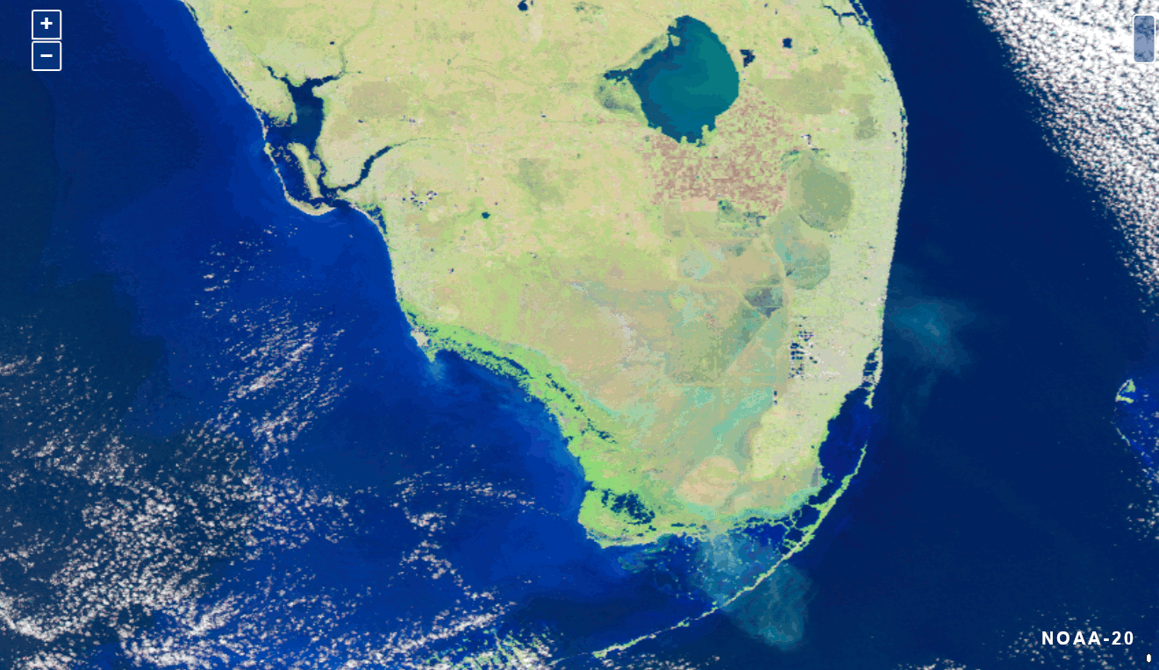
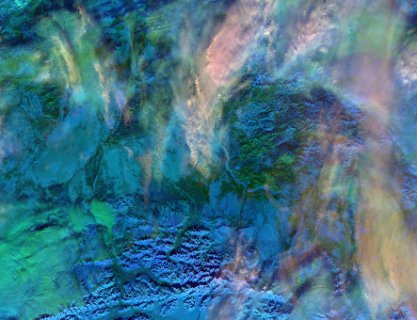
Image Quality: Short Wave InfraRed (SWIR) Bands
Tunisia, Feb. 13, 2023, 12:21 UTC
Bands M9, 5, 10 as RGB
(à la Day Cloud Type RGB)
Band I3, I2, I1 Composite
GReVS: https://ncc.nesdis.noaa.gov/Regional/
Fairbanks M9,10,5 as RGB

Slide 17
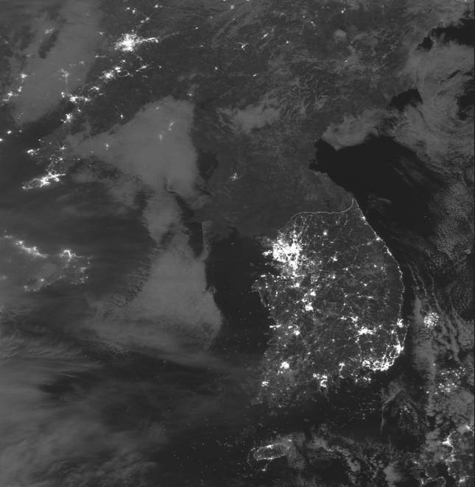
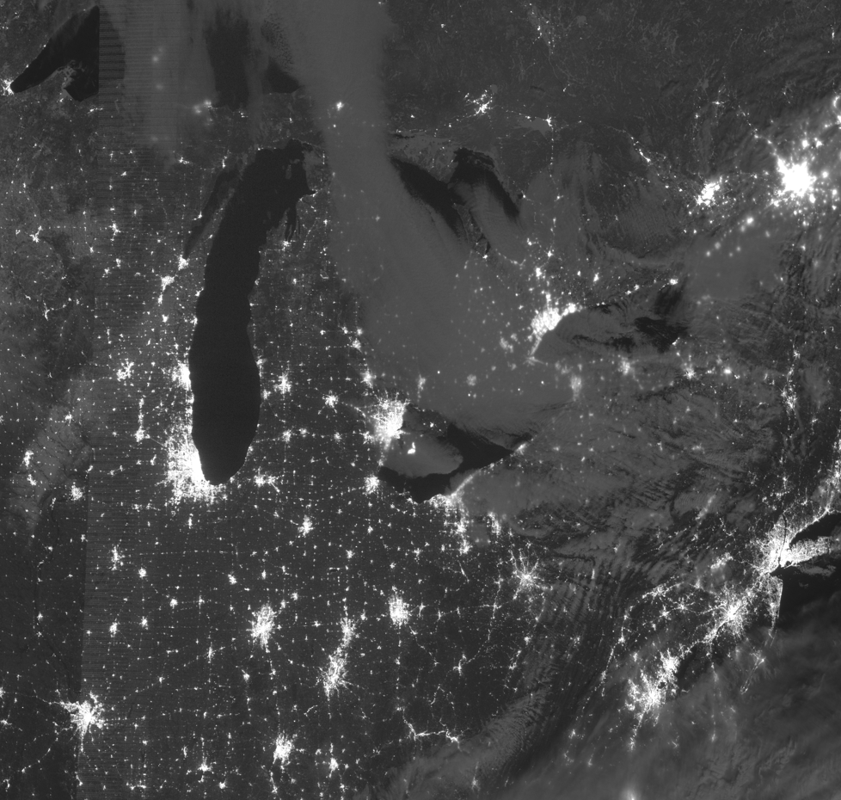
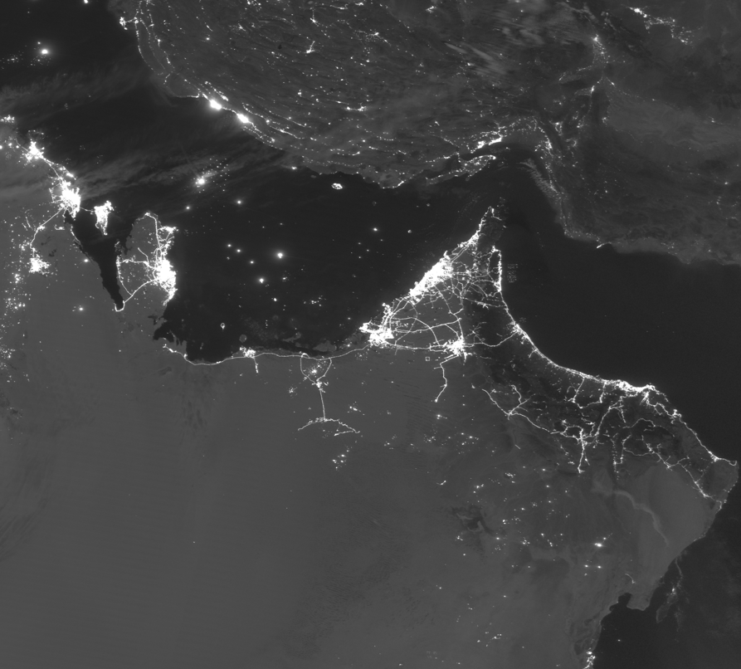
DNB Image Quality
East Asia
Great Lakes
Middle East
GReVS: https://ncc.nesdis.noaa.gov/Regional/

Slide 18
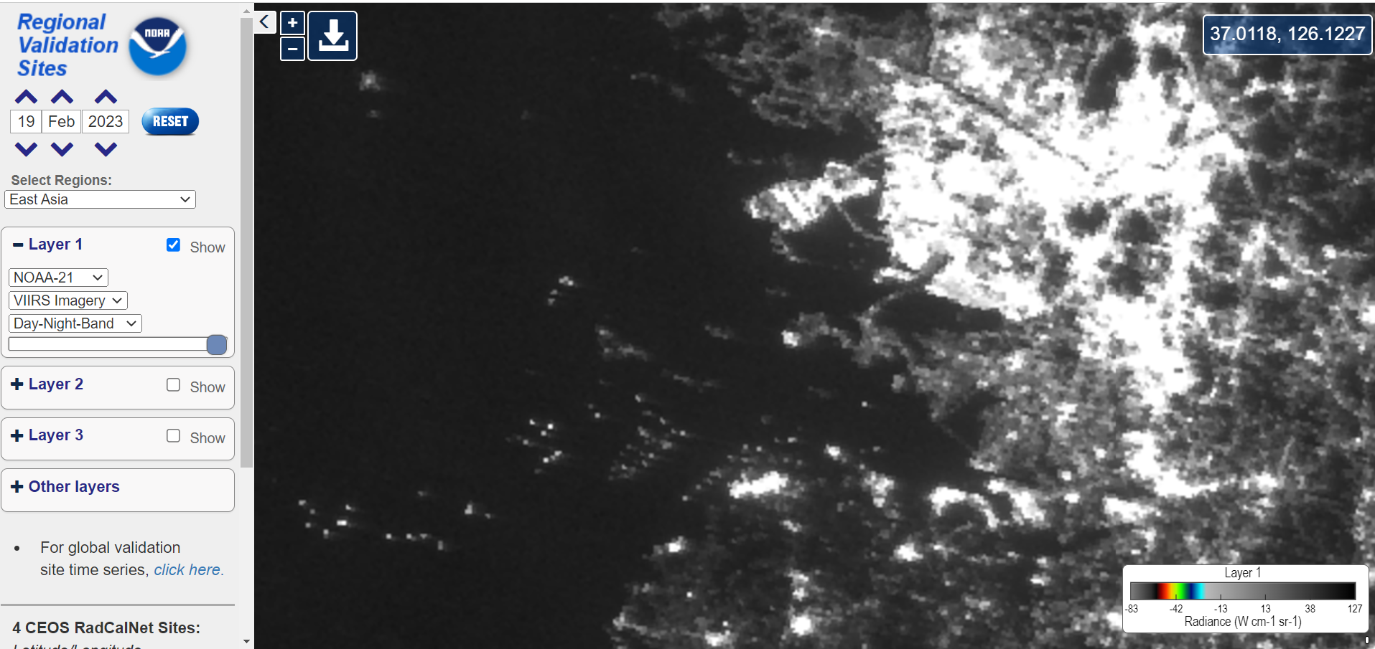
NOAA 21 VIIRS Images at the Regional Validation Sites (DNB)

Slide 19
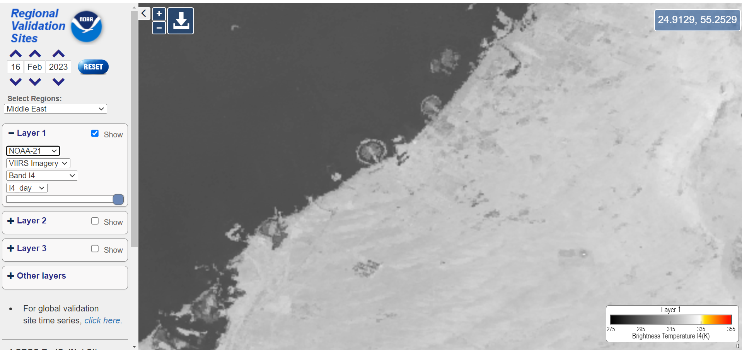
NOAA 21 VIIRS Images at the Regional Validation Sites (TEB)

Slide 20
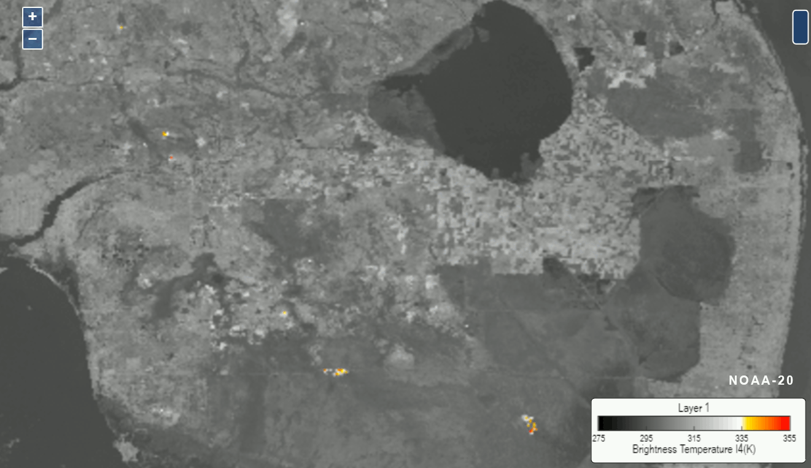
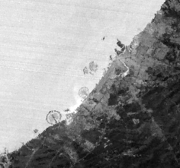
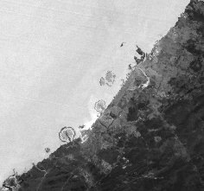
TEB Initial Assessment
SVI05_j02_d20230211_t2201174_e2202402
SVI05_j01_d20230211_t2137060_e2138305
Dubai (I-5 Comparison)
17 pixels
Source: GReVS https://ncc.nesdis.noaa.gov/Regional_test/
I-4 Day time comparison between NOAA 21 and 20
Hot spot check with Fire Masks provided by Ivan Csiszar

Slide 21
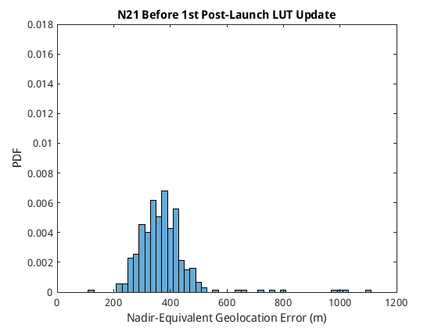
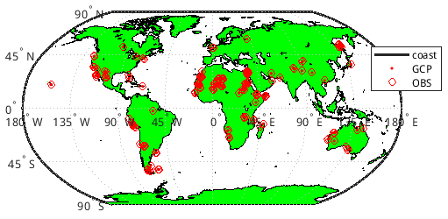
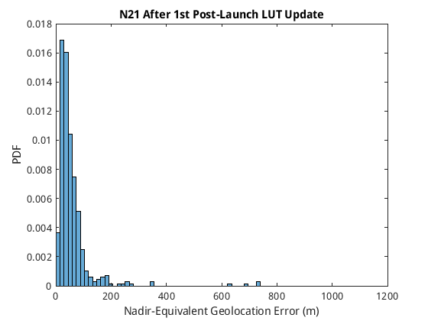
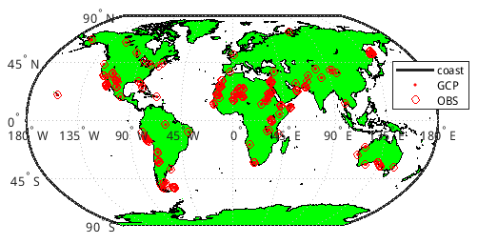
Geolocation Accuracy
The initial CPM-based evaluation with a limited number of ground control-point (GCP) matchups showed that the nadir-equivalent geolocation errors are approximately 400 m
Initial optimization of the mounting matrix reduced the geolocation errors from around 400 m to less than 200 m
Before
After

Slide 22
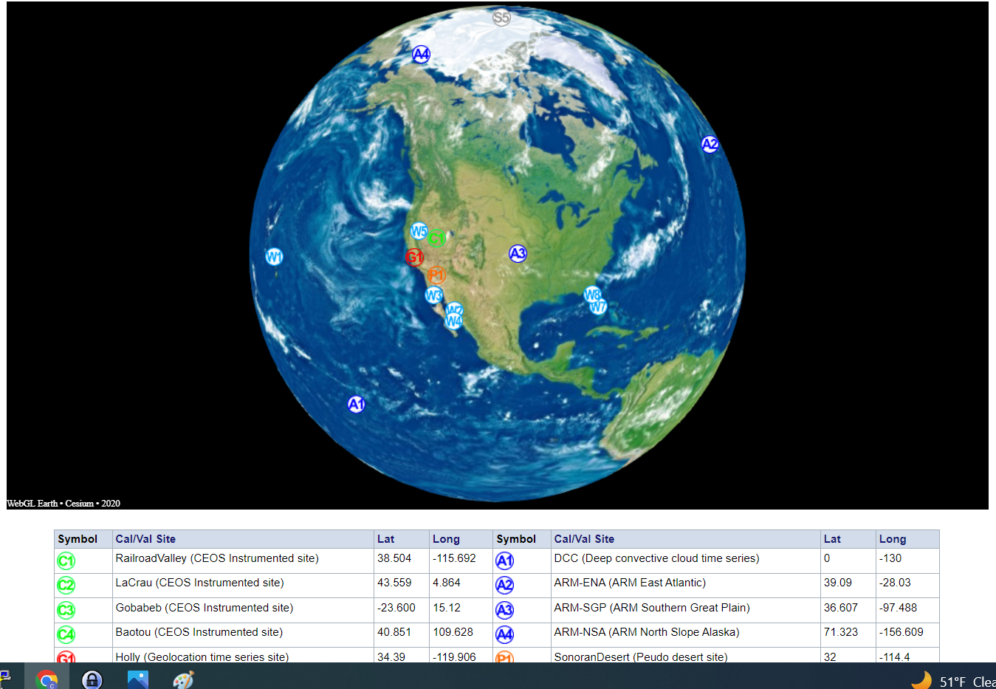
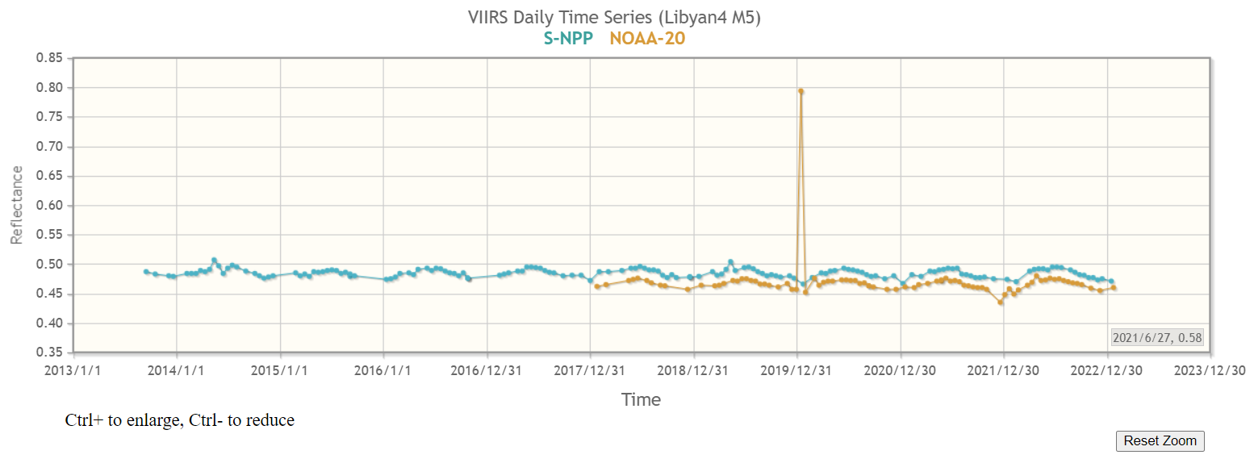
Global Validation Site TIme Series
https://ncc.nesdis.noaa.gov/Globe/

Slide 23
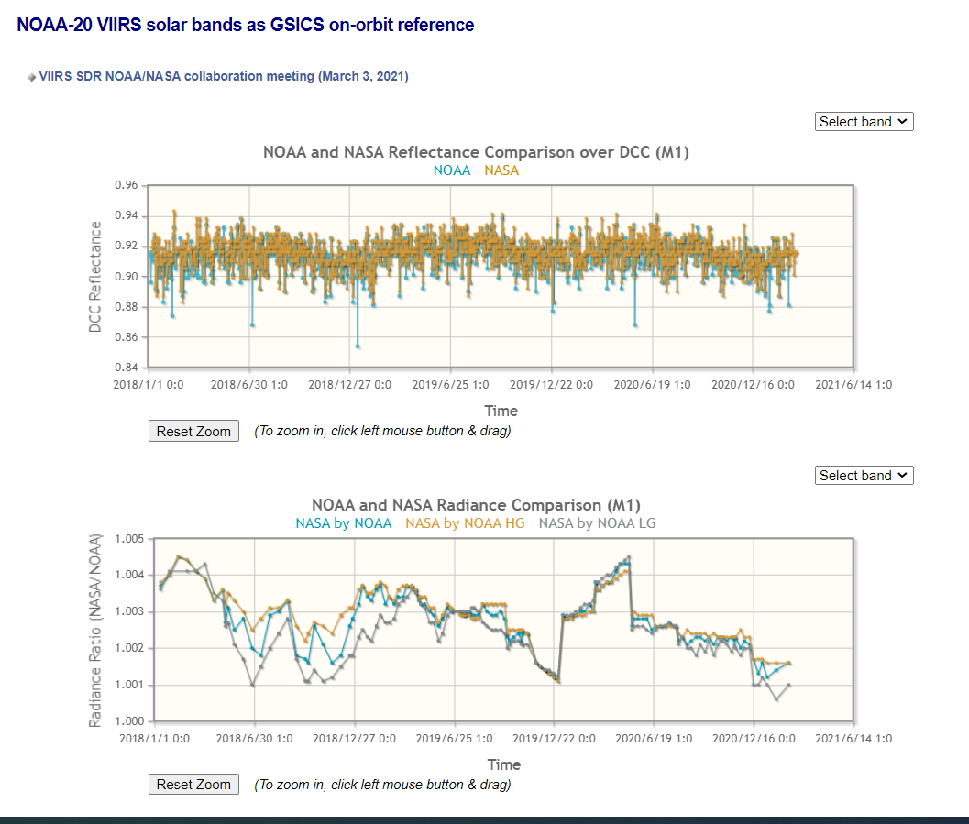
NOAA and NASA collaboration on VIIRS Calibration via GSICS
NOAA 20 calibration is very stable with little degradation
GSICS has endorsed NOAA 20 as on-orbit reference for reflective solar bands
NOAA and NASA have calibrated VIIRS independently
Results have been rigorously compared to analyze the small differences
The NOAA 21 calibration in the next few years will provide further opportunities for collaboration

Slide 24
Collaboration with EUMETSAT on Metop SG
 | NOAA 21 | Metop SG
Microwave Sounder | ATMS | MWS
Infrared Sounder | CrIS | IASI NG
Imaging Radiometer | VIIRS | METimage
Atmospheric Composition | OMPS | Sentinel 5
To hold Joint cal/val workshop Fall 2023

Slide 25
Danke schön!
Thank you!
ありがとう!
감사합니다!
धन्यवाद्!
Grazie!
Merci !
TAKK!
谢谢 !

