Slide 1

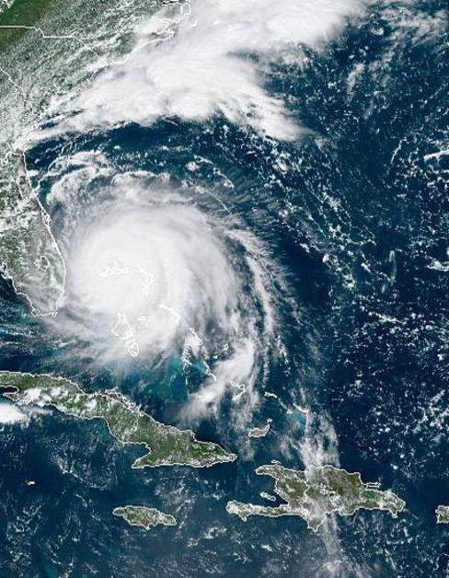


ISCCP-NG Feedback to GSICS
GSICS Annual Meeting
February 27, 2023
Andy Heidinger, NESDIS GEO Senior Scientist
ISCCP-NG L1G Team
GEWEX Data Analysis Panel
ICWG ISCCP-NG Topical Group
NOAA
National Environmental Satellite, Data, and Information Service

Slide 2
ISCCP-NG STATUS
ISCCP-L1G Demo Data has been released on a UW/CIMSS FTP
December 2018 has been generated to allow for comparison to ISCCP-Classic (which ends in 2018)
NOAA, EUMETSAT-CMSAF and ESA-CCI are making L2 cloud products and this is being managed by the CGMS/ICWG.
EUMETSAT and NESDIS are collaborating on the GEO-RING and ISCCP-NG is part of that. We need to decide on how we process L1G (each space agency or at a single location).

Slide 3
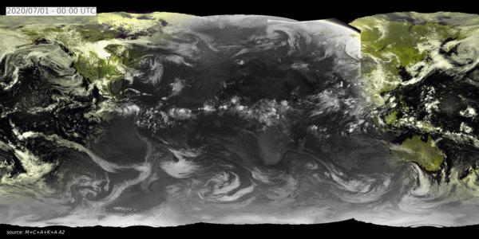
ISCCP-NG L1G Prototypes
Using the SatPy tools, an L1g prototype code ha been developed and made available via git
Sample Data for 2020 processed and available on ftp.
Website provides links to code and data (cimss.ssec.wisc.edu/isccp-ng)
Default resolution is all channels (19 max), 0.05º, 30 minutes. Final values are TBD (user selectable).
Overlapped data is kept similar to NOAA GridSat (stereo applications).
Daytime RGB + Nighttime IR window for one day of ISCCP-NG L1g from GOES-17, GOES-16, Meteosat-11, Meteosat-8 and Himawari-8. (Martin Stengel/DWD). Default Resolution
L1g Development Team
Coda Phillips (CIMSS)
Martin Stengel (DWD)
Ken Knapp (NOAA)
Arata Okuyama (JMA)
Kazutaka Yamado (JMA)

Slide 4
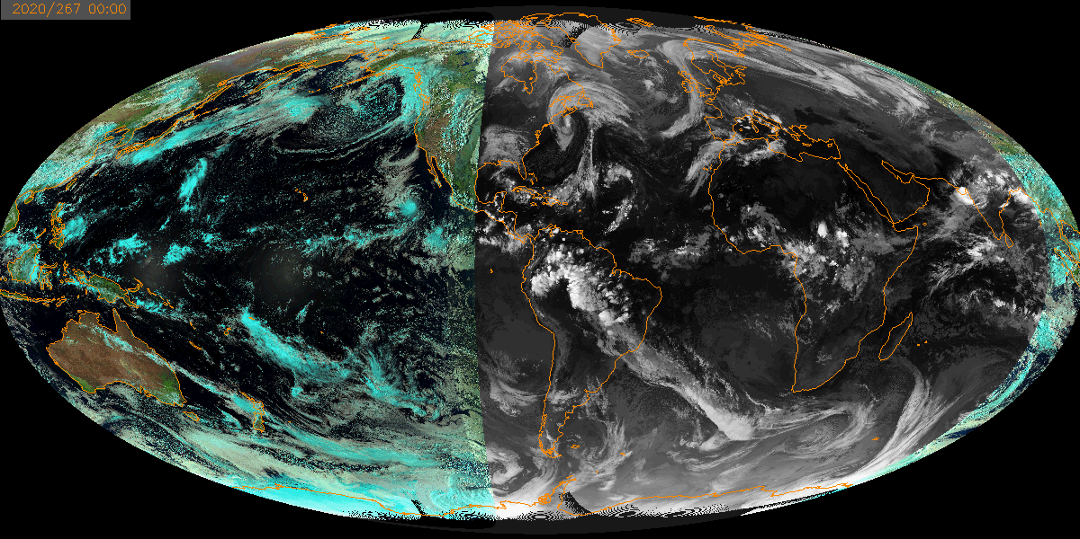
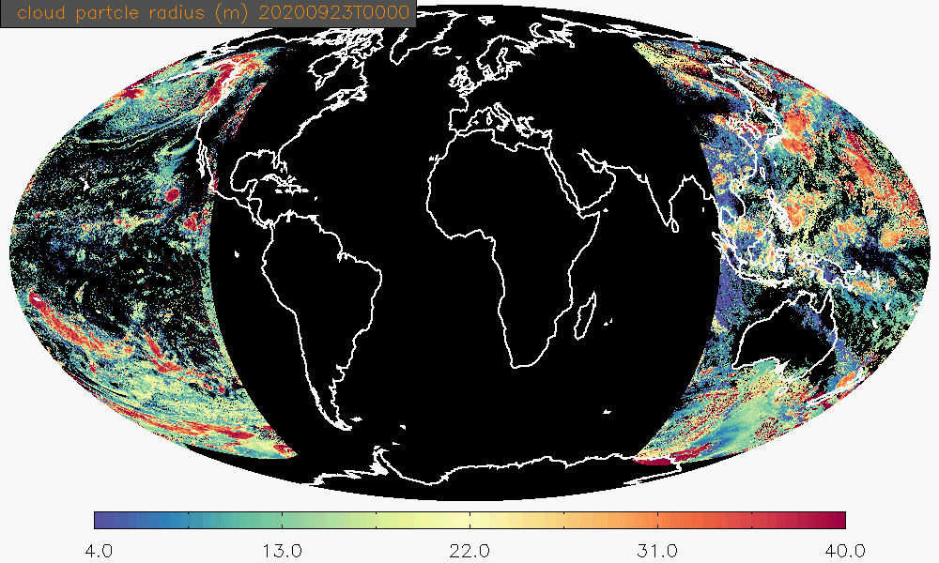
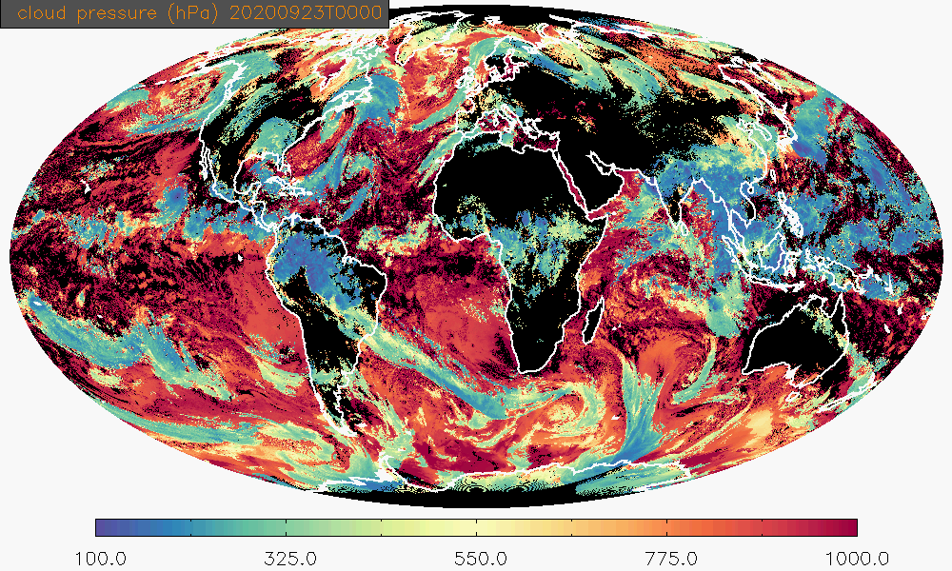
L2 Examples: NOAA/NESDIS
Natural Color RGB + 11um at night
NOAA/NESDIS Enterprise Algs ported to ISCCP-NG L1g
Products highlight improvements of ISCCP-NG over ISCCP
  Cloud particle size from NIR channels
  Day/Night consistent cloud pressure from multiple IR channels.
09/23/2020
Cloud Particle Size
(Day Only)
Cloud Pressure

Slide 5
GCOS Essential Climate Variables (EVC) for Cloud
= Consistent Day and Night
= Inconsistent Day and Night
= Day only
= Not Possible
ECV | Temporal | Spatial | ISCCP | ISCCP-NG | Improvement
Cloud Amount | 3hr | 50 km
Cloud Top Press | 3hr | 50 km |  |  | Yes
Cloud Top Temp | 3hr | 50 km |  |  | Yes
Cloud Optical Depth | 3hr | 50 km |  |  | Yes
Cloud Water Path | 3hr | 50 km |  |  | Yes
Cloud Particle Size | 3hr | 50 km |  |  | Yes
Cloud Phase | N/A | N/A |  |  | Yes
These estimates are based on current standard physical retrievals - AI/ML may be used to improve day/night consistency for both ISCCP and ISCCP-NG

Slide 6
How ISCCP-NG Uses GSICS
ISCCP-NG L1G provides scaled calibration brightness temperatures.
ISCCP-NG L1G provides GSICS coefficients and Planck Rad to BT coefficients as attributes
Users have to convert BT to Rad, apply GSICS coefficients and then convert RAD to BT.
We plan to use the Reanalysis Coefficients (RAC).

Slide 7
Unfiltered ISCCP-NG L1G Team Feedback
“When I tried to use it several years ago, the access was terribly difficult to get to and understand. It doesn't seem to have improved much since then.”
“there are multiple options from multiple sources, seems like we need to coordinate which coefficients we will use.”
“VIS is only available for MSG and only for 0.6 micron, are other solar channels available?”

Slide 8
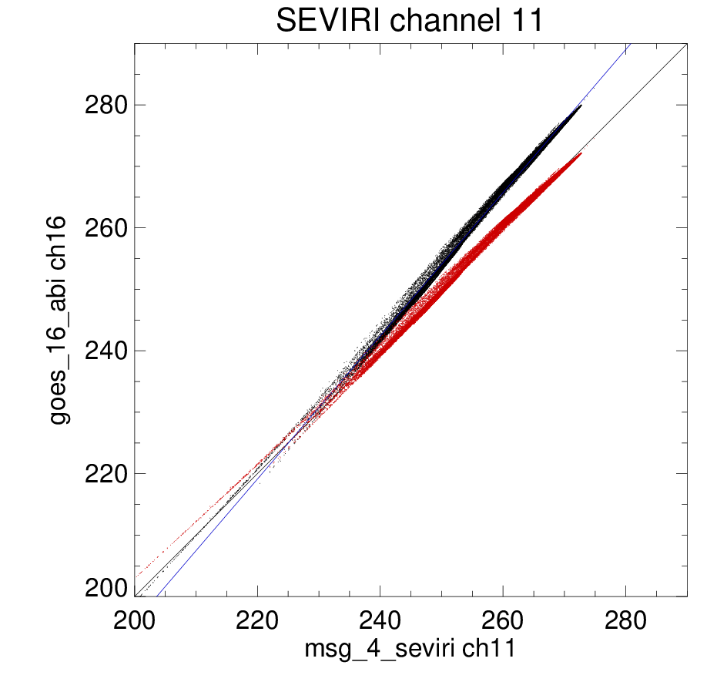

Spectral Band Adjustment (SBA)
Using a framework developed in Cloud_cci for calculating spectral band adjustment correction. Based on applying SRFs to full spectrum measured by IASI and SCIAMACHY

Slide 9
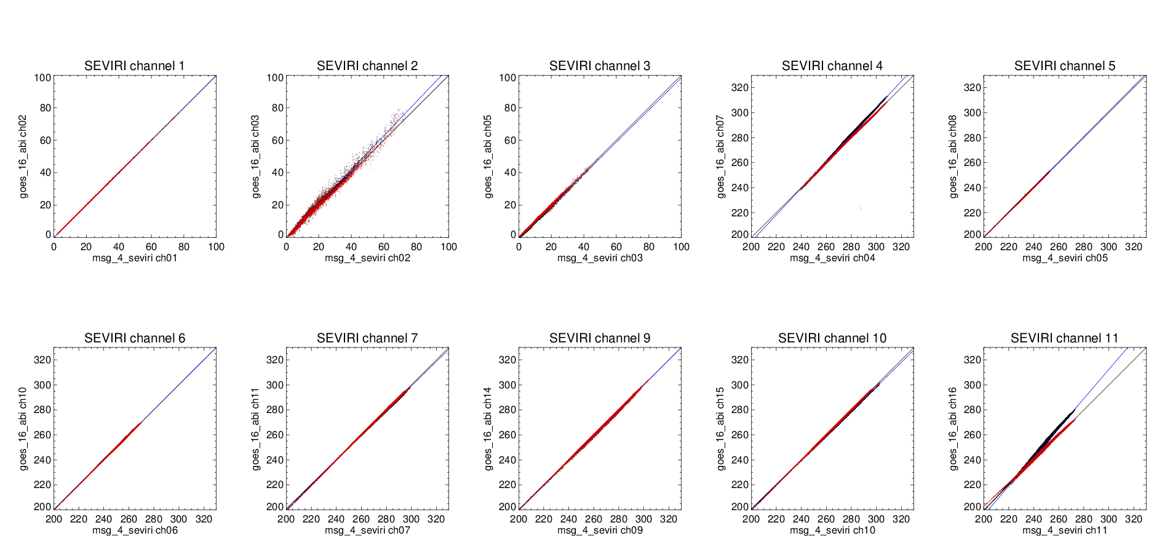
Spectral Band Adjustment (SBA)
Using a framework developed in Cloud_cci for calculating spectral band adjustment correction. Based on applying SRFs to full spectrum measured by IASI and SCIAMACHY

Slide 10
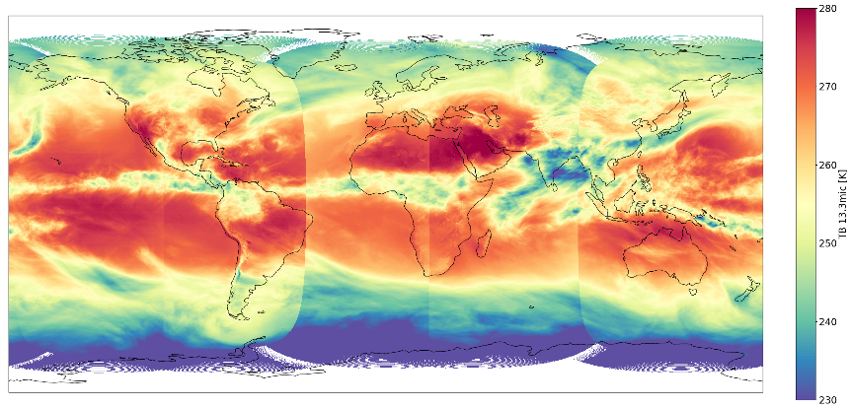
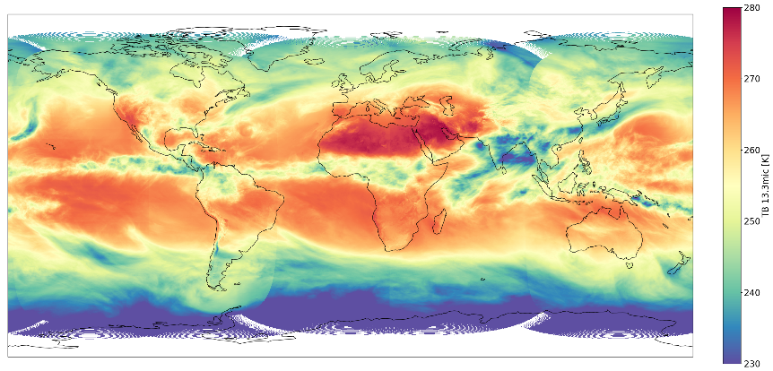

L2 Examples: DWD (EUMETSAT CM-SAF)
No Adjustment
Example Cloud Fraction from ISCCP-NL L1g from Dr. Martin Stengel DWD.
Derived from a NN trained on SEVIRI
Applied spectral band correction factors (SBAF) to all sensors look like SEVIRI.
SBAF factors remove visual artifacts.
After Adjustment

Slide 11




ISCCP-NG Requests to GSICS
Are there other external users like us that we work with?
It would be nice if the Re-Analysis Corrections (RAC) could be grouped together in one file per sensor to facilitate reprocessing efforts (like ISCCP-NG).
NOAA & NASA are considering reprocessing the GOES-R L1b record. If it does, does that invalidate the existing GOES-R GSICS corrections?
AHI and SEVIRI have the GSICS coefficients in their data stream some others (ABI) do not. Can we get all of them in the L1b?
Making the GSICS data accessible via tools in satpy or pytroll.
Set up a training meeting for the L1G Team.
The SBAF terms use imager and sounder SRFs just like the GSICS correction tools. Maybe GSICS can help generate official versions of SBAF values?

Slide 12
The End, Thank you!
andrew.heidinger@noaa.gov

Slide 13
Channels of the adv. GEO VIS/IR imagers
id | name | ABI | AHI | FCI | AMI | AGRI | SEVIRI
1 | 00_47um | 470 nm | 455 nm | 0.47 µm | 470 nm | 0.47 µm
2 | 00_51um |  | 510 nm | 0.51 µm | 509 nm
3 | 00_65um | 640 nm | 645 nm | 0.65 µm | 639 nm | 0.65 µm | 0.635 µm
4 | 00_86um | 860 nm | 860 nm | 0.86 µm | 863 nm | 0.825 µm | 0.81 µm
5 |  |  |  | 0.91 µm
6 | 01_38um | 1380 nm |  | 1.38 µm | 1.37 μm | 1.375 µm
7 | 01_60um | 1610 nm | 1610 nm | 1.6 µm | 1.61 μm | 1.61 µm | 1.64 µm
8 | 02_20um | 2260 nm | 2260 nm | 2.2 µm |  | 2.25 µm
9 | 03_80um | 3.90 µm | 3.85 µm | 3.8 µm | 3.83 μm | 3.75 µm | 3.92 µm
10 | 06_20um | 6.15 µm | 6.25 µm | 6.2 µm | 6.21 μm | 6.25 µm | 6.25 µm
11 | 06_70um | 7.00 µm | 6.95 µm |  | 6.94 μm | 7.1 µm
12 | 07_30um | 7.40 µm | 7.35 µm | 7.3 µm | 7.33 μm |  | 7.35 µm
13 | 08_60um | 8.50 µm | 8.60 µm | 8.5 µm | 8.59 μm | 8.5 µm | 8.70 µm
14 | 09_70um | 9.70 µm | 9.63 µm | 9.6 µm | 9.62 μm |  | 9.66 µm
15 | 10_40um | 10.3 µm | 10.45 µm | 10.4 µm | 10.35 μm | 10.7 µm | 10.8 µm
16 | 11_00um | 11.2 µm | 11.20 µm |  | 11.23 μm
17 | 12_00um | 12.3 µm | 12.35 µm | 12.4 µm | 12.36 μm | 12.0 µm | 12.0 µm
18 | 13_30um | 13.3 µm | 13.30 µm | 13.3 µm | 13.29 μm | 13.5 µm | 13.4 µm

