Slide 1

GSICS Agency Report
2023
Elsa Jacquette
Contributions from CNES colleagues: Aimé Meygret, Sébastien Marcq, François Bermudo, Olivier Vandermarcq, Dimitrios Kilymis, Adrien Deschamps
CNES

Slide 2
Presentation Overview
IASI status and on-going studies
IASI-NG development status
C²OMODO : French contribution to AOS
TIRCalNet
La Crau CNES Cal/Val site
PICSCAR

Slide 3
IASI status and on-going studies
IASI-B and IASI-C instruments are currently operational and stable.
Radiometric inter-comparisons are still performed at CNES between IASI-B, IASI-C and CrIS/NOAA-20.
  Very good ≤ ± 0,1 K (bias)
  Planned activity for 2023 : comparisons with CrIS/NOAA-21 when data will be available

Slide 4
IASI status and on-going studies
IASI-A : Operational service stopped on the 15th October 2021
EOL test campaign from Sept. to Nov. 2021 (8 tests), instrument definitely switched-off on the 28th November 2021 after 15 years in orbit.
  Still data analysis on some EOL tests to be performed, including EOL-03 “IASI intercalibration on SNO”
On-going studies with final results expected this year :
  The use of the Moon as a complementary radiometric source for inter comparisons of hyperspectral IR sounders, with the exploitation of lunar data acquired each month in 2021 by IASI-B and IASI-C
  IASI radiometric uncertainties budget to be included in GSICS Infrared Reference Uncertainty & Traceability Report

Slide 5
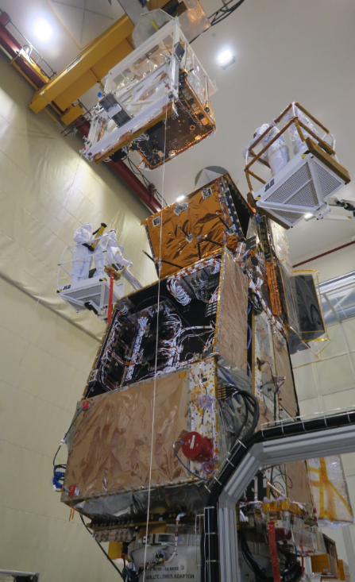
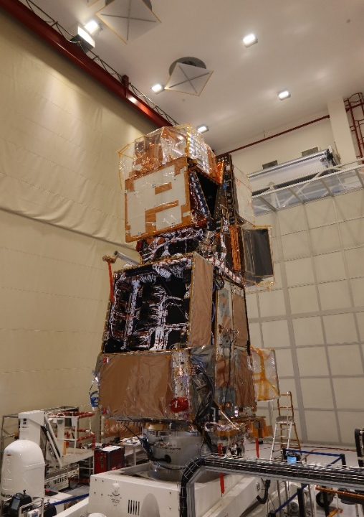
IASI-NG Program Status : Instrument Activities
Test campaign on instrument PFM Model completed:
  TVAC performances test performed in summer 2022 and test campaign concluded by software and Electro Magnetic Compatibility radiated emission and susceptibility test campaign.
  Performances budget under consolidation for Qualification Review in Q2 2023
Mechanical and Electrical Integration of IASI-NG PFM on Metop SG Satellite performed in fall 2022
Mechanical Environment test campaign of IASI-NG PFM on Metop SG Satellite performed without any issue for IASI-NG (end of 2022 for Sinus test and early 2023 for Acoustic test)
Intense activities of preparation of coming TVAC campaign test of IASI-NG PFM on Metop SG Satellite planned in Q2 2023 for one month

Slide 6
IASI-NG Program Status :
System & Ground Segment Activities
L1CPOP V1 (part of science processing algorithms) completed and delivered to EUMESAT : integrated in PDAP (Payload Data Acquisition & Processing), ready to start System Verification and Validation tests
L1CPOP V2’s full version (complete science algorithms processing) under development for delivery date in February 2024 for integration in the PDAP V3A for launch
IASTEC (IASI-NG Technical Expertise Center) : development started in November 2022. Cal/Val tools will be gradually integrated, among them inter-calibration tools for IASI-NG comparisons with IASI and CrIS.
Current launch date in Q1 2025 for Metop SG A1

Slide 7

C²OMODO : French contribution to AOS
NASA program Atmosphere Observing System (AOS) to study the links among aerosols, clouds, atmospheric convection and precipitation. Launch in 2028 (inclined orbit) and 2030 (polar orbit)
The AOS team includes several NASA Centers, universities and other space agencies : JAXA, CSA, DLR and CNES.
C²OMODO will be the French contribution to AOS : tandem of 2 identical microwave radiometers called SAPHIR-NG.
Inheritance of the SAPHIR microwave sounder from atmospheric humidity that was operated on the Megha-Tropiques satellite. With improved performances, SAPHIR-NG will provide original observations on convective systems evolution, that will feed questions related to extreme weather and the development of storms.
In addition, on-ground processing specific to the use of time-delayed / delta-t maps will be developed.
L1 products should be disseminated in NRT to NWP centers
More information on the project: https://c2omodo.ipsl.fr/about/

Slide 8
TIRCalNet
In the frame of CEOS/WGCV, experts work on the definition of a new network of instrumented sites dedicated to the radiometric calibration of TIR optical sensors : TIRCalNet.
Action coordinated by CNES and ESA, with the involvement of experts from WGCV/IVOS (InfraRed and Visible Optical Sensors) and WGCV/LPV (Land Product Validation) subgroups.
Motivated by the future TIR missions that will have an increased spatial resolution and more and more demanding LST accuracy requirements (< 0.1 K for climate studies).
Such a network for vicarious calibration would be very important for L1 and L2 Cal/Val by:
  collecting surface temperature and emissivity, and atmospheric data necessary for the simulation of observations by TIR optical sensors and thus verify their radiometric calibration
  increasing the number of matchups between in-situ measurements and space sensor observations and reduce the overall uncertainties, and reduce the efforts of individual agencies
  ensuring traceability of the space sensor radiometry to the “Système International” (SI)

Slide 9
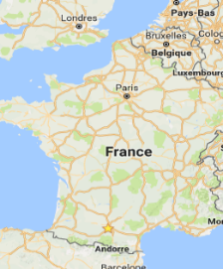
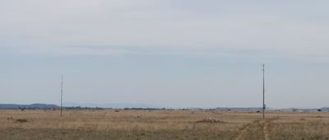
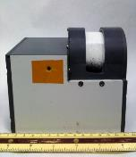
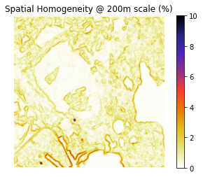
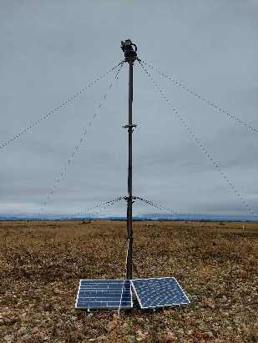
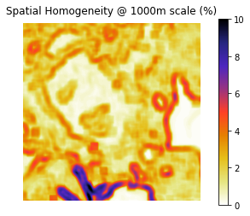
La Crau CNES Cal/Val site
La Crau CNES L1 Calibration / L2A Validation site would be a good candidate to be part of TIRCalNet.
Already part of RadCalNet network
Addition to the current VNIR automated calibration site: installation on a 9m post of a JPL radiometer (8-14µm) in December 2022 to measure surface temperature.
Work on future installation of CNES permanent instrumentation dedicated to TIR future missions with increased spatial resolution: TRISHNA, LSTM, SBG (NASA Surface Biology and Geology)
Instrument TBD: Multi-spectral system for temperature/emissivity separation?
https://calval.jpl.nasa.gov/radiometers
Estimation of Spatial Homogeneity on Landsat 8 TIRS
9

Slide 10
PICSCAR
In the frame of CEOS/WGCV/IVOS, the working group PICSCAR characterize the « Pseudo invariant calibration sites » (PICS) for the radiometric calibration of optical satellite systems (VIS and VNIR)
  PICS’s BRDF characterization
  Spectral characterization
  Atmosphere properties
  Temporal stability
  Combining multiple sites calibration results
  Revisiting the sites
More information on the website: https://picscar.magellium.com

Slide 11
Thank you for your attention !

Slide 12
Additional Slides Not Presented
Introduce/Confirm the CNES Personnel Supporting GSICS
  Executive panel : Adrien Deschamps
  GRWG members : Aimé Meygret (VIS), Elsa Jacquette (IR)
  CNES GRWG members provide support to GSICS when their funded tasks are aligned with GSICS activities

