Slide 1
GSICS Agency Report 2023
Heikki Pohjola
WMO

Slide 2
Contents
WMO Space Programme news
Core Satellite data in WMO Unified Data Policy
OSCAR/Space User Workshop and GSICS
WMO Information Day for Commercial Satellite Data Providers
WMO GSICS website status

Slide 3
WMO Space Programme News
Space System and Utilization Division under Infrastructure Department
Ken Holmlund retired, and new head of division will be Natalia Donoho from NOAA (from 3rd Apr 2023)
New staff Jesse Andries (from 22nd May 2023)
Space weather and radio frequency coordination
Existing Staff
Heikki Pohjola
Zoya Andreeva
Chang Liu (Junior Professional Officer by CMA, temporary)

Slide 4
Satellite data in WMO Unified Data Policy
Vital importance of satellite data now clearly recognized.
The concept of core satellite data is framed primarily in terms of importance to global NWP
To be considered that
no specific satellite datasets are listed as neither core nor recommended in current draft of policy. This is referred to the Manual on WIGOS.
Resolution 1; 2021
Covers all WMO Earth system data: weather, climate, hydrology, ...
Two main categories of data:
Core (shall be exchanged);
Recommended; (should be exchanged);

Slide 5
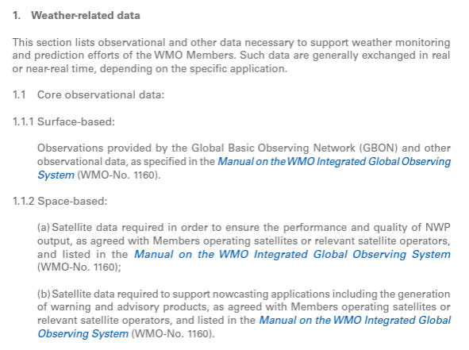
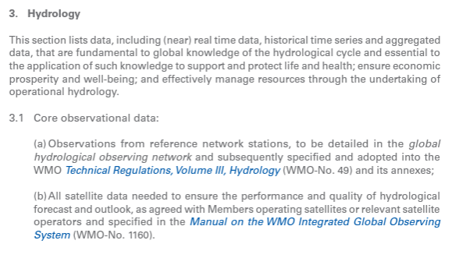
Core observational data

Slide 6
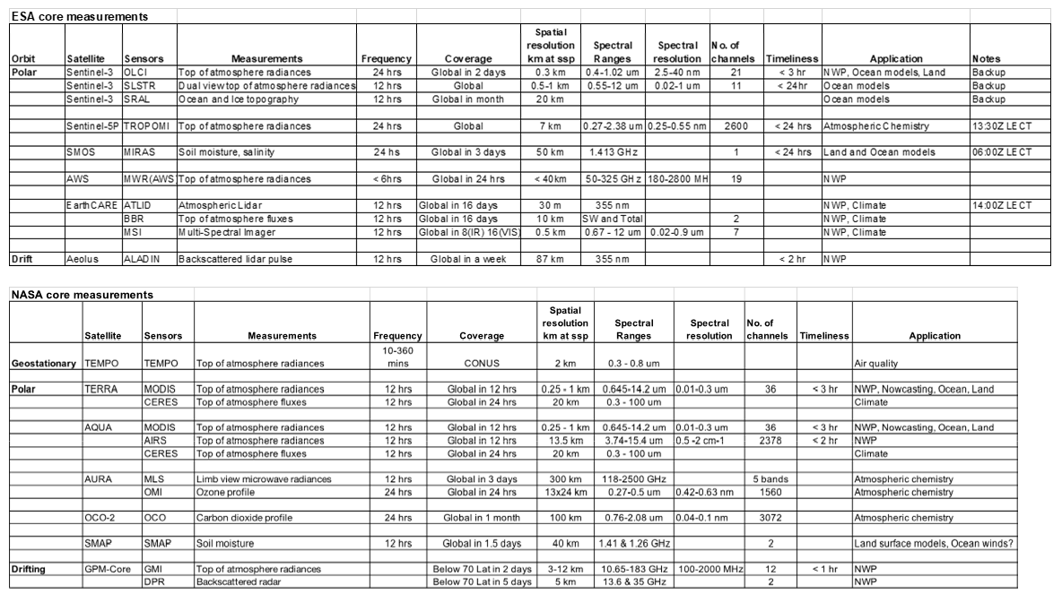
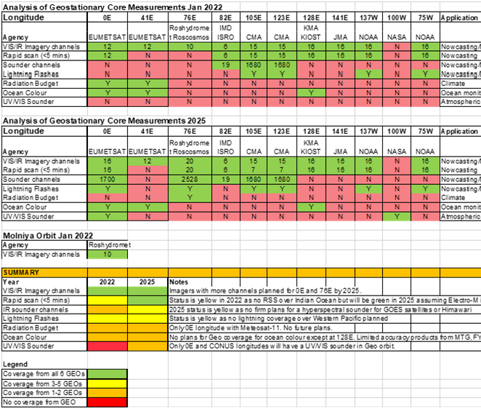
Defining Core and Recommended satellite data as per WMO Unified Data Policy
Document for current core measurement capabilities of CGMS members with WMO Expert Teams ET-SSU, ET-SWX and CGMS SWCG
GEO measurements capability
Polar orbiter measurements capability
Space weather
Letters were sent to Space Agencies (and/or Members)
Asking to nominate agency focal point and schedule bilateral discussion between WMO and Space Agency
Consolidated commitments to be tabled in WMO regulatory material (WMO WIGOS Manual) and reflected elsewhere as suitable (OSCAR/Space database)
Seek endorsement from INFCOM 3 followed by Executive Council and finally WMO Congress for the decision by WMO members

Slide 7
OSCAR/Space workshop
OSCAR/Space Workshop organized 7th to 8th Feb 2023
Objectives:
Inform users about the recent technical implementation
Inform users about the database content and update process
Collect user feedback from the user group (NWP, sat. opertors, space weather, metadata, climate applications)
GSICS was represented: using OSCAR/Space identifying reference channels/instruments
JSON API to better support GSICS activities

Slide 8
WMO Information Day for Commercial Satellite Data Providers
Information day organized 17th Jan 2023
More than 100 attendees from space agencies and private sector
Objectives
Encage with private sector
Introduce WMO, Space Programme and the association of Hydro-Meteorological Equipment Industry (HMEI)
WMO Data Policy
Company presentations
Improving communication with private sector and their representation in WMO Expert Teams

Slide 9
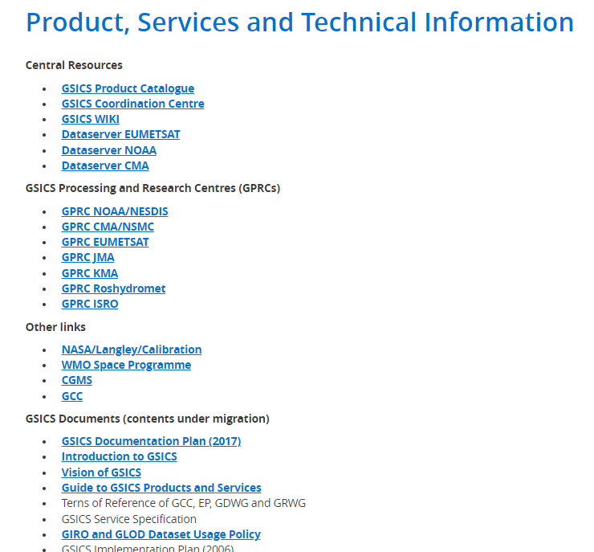
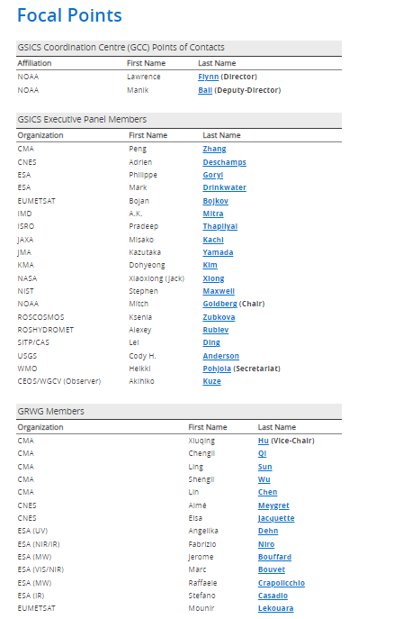
WMO GSICS website https://gsics.wmo.int/en
WMO GSICS website includes
GSICS structure
Documents
Focal points
Please check that your agency focal points are up-to-date!

Slide 10
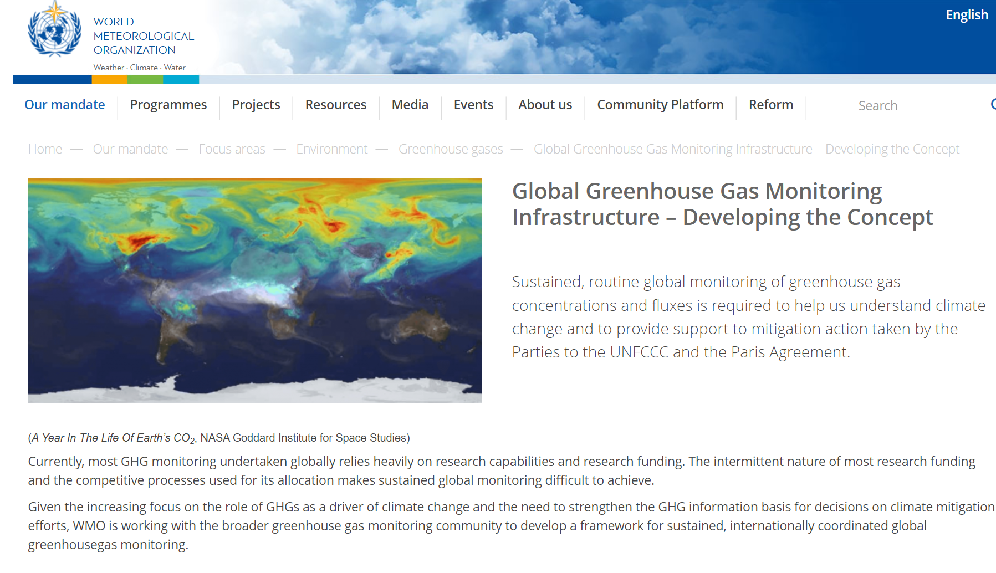
WMO high level initiatives linked to space-based observations

