Slide 1
GSICS Agency Report
2023
OKUYAMA Arata, KODERA Kazuki
and EIKI Misaki
Meteorological satellite center of JMA

Slide 2

Support to GRWG Activities for AHI
Ray-matching approach
  Himawari-9/AHI has been supported. Details will be reported at the VNIR WG meeting on Wednesday.
  Validation of Himawari-8/AHI vs. N20/VIIRS was reported at the web meeting on May 2022.
Vicarious calibration approach based on MODIS
  Himawari-9/AHI has been supported.
  The atmospheric profile data input to the approach was updated from JRA-55 to JRA-3Q in November 2022 because start of the new JMA's reanalysis project. Total column ozone data is also changed from Aura/OMI to SNPP/OMPS.
  Details will be reported at the VNIR WG meeting on Wednesday.
DCC approach
  Offline implementation is ongoing. Details will be reported at the VNIR WG meeting on Wednesday combined with our efforts for the ray-matching approach.
IR
  Himawari-9/AHI has been supported. Details will be reported at the IR WG meeting on Tuesday combined with the GEO-GEO approach.
  The inter-calibration utilized NOAA-20/CrIS and Metop-C/IASI is ongoing.

Slide 3
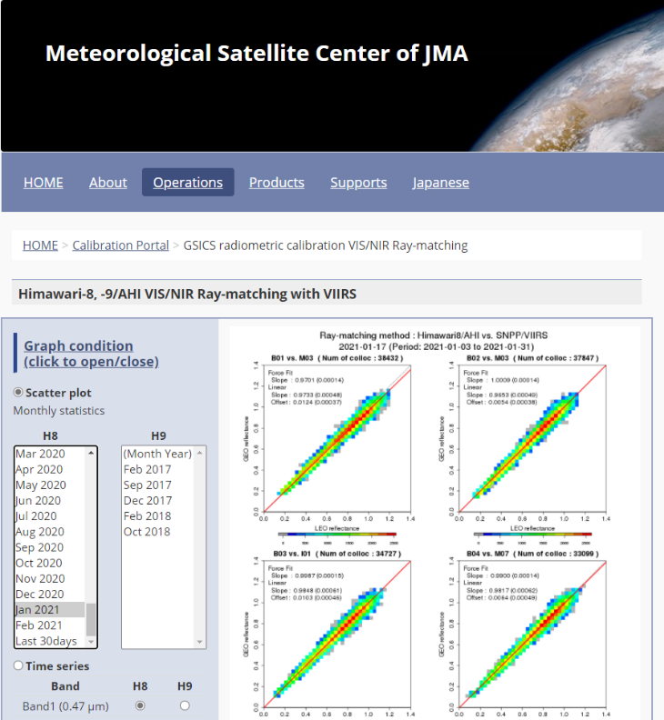
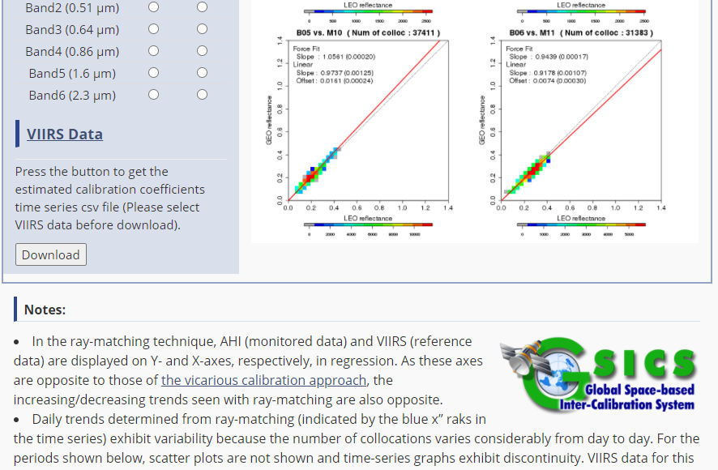
Support to GDWG Activities for AHI
Update of monitoring web page
  Calibration monitoring for Himawri-9/AHI has been available including a few past helth check observations.
  The calibration monitoring page by the ray-matching approach commenced to support NOAA-20/VIIRS from June 2022 in addition to SNPP/VIIRS.
  Navigation monitoring for Himawri-9/AHI opened from September 2022.

Slide 4
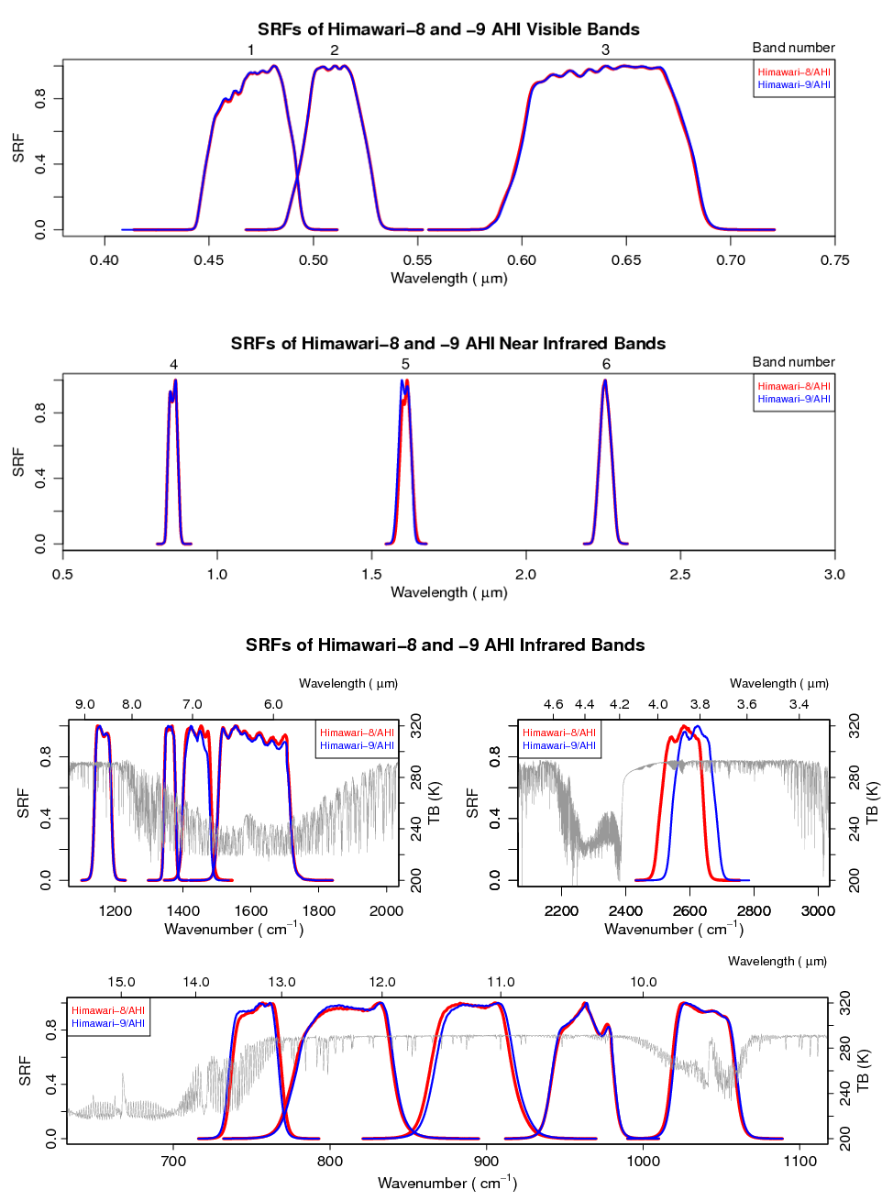
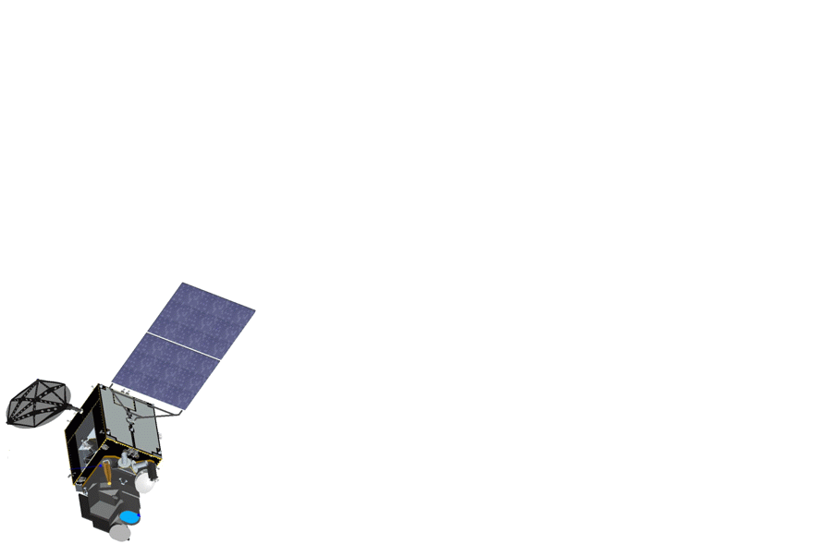
Instruments Updates
Himawari-8/AHI
Himawari-9/AHI
Himawari-8 (Launched in October 2014)
In-orbit standby since 13 December 2022
Advanced Himawari Imager (AHI) with 16 spectral bands
Full-disk observation every 10 min + regional observations every 2.5 min
Event log: https://www.data.jma.go.jp/mscweb/en/oper/event_H8.html
Himawari-9 (Launched in November 2016)
Operational since 13 December 2022
Full operation started on 13th December 2022.
Specification of H8 and H9 are same.
140.7 deg. East, 16 bands, FD obs. every 10 mins
Event log: https://www.data.jma.go.jp/mscweb/en/oper/event_H9.html
JFY
2010
2015
2020
2025
Himawari-8 Himawari-9
Launch
Operational
In-orbit standby
Manufacturing
In-orbit standby
Operational
Launch

Slide 5
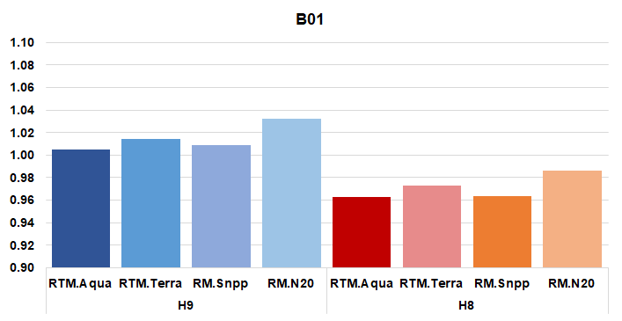
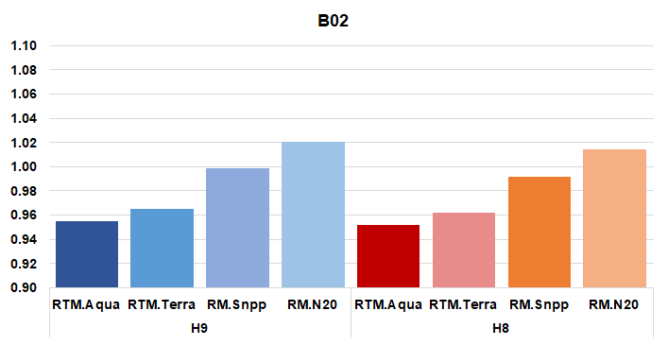
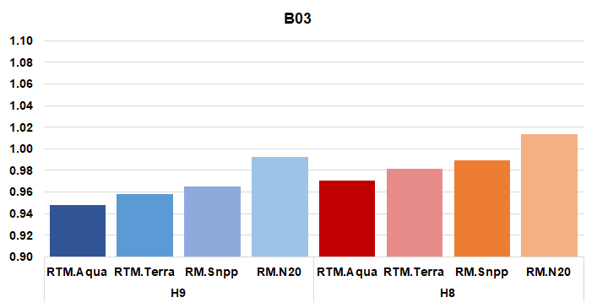
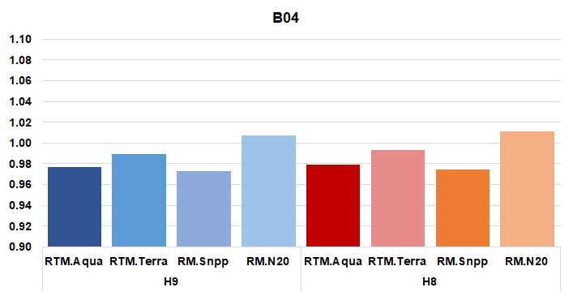
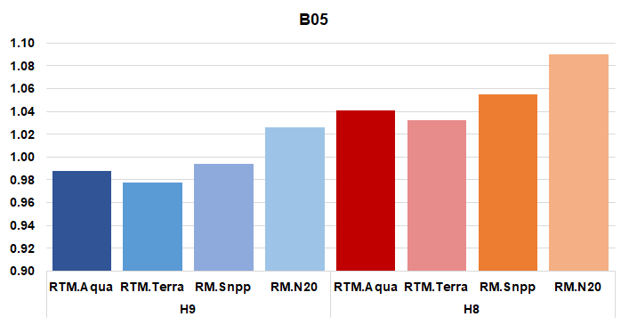
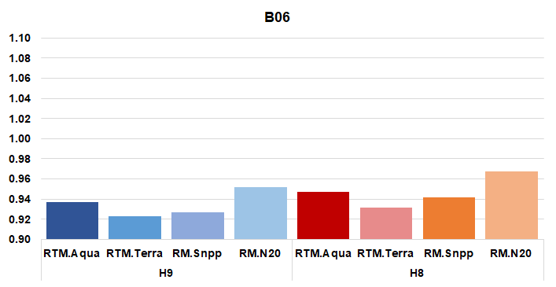
Calibration major update, AHI-9 (VNIR)
Calibration accuracy was evaluated by the ray-matching approach and vicarious calibration approach using VIIRS and MODIS.
Both of AHI8 and AHI9 are consistent with the references within around 5%, although there are differences depending on the method and the imager referred to, except for B06.
1.1
1.1
B01
B02
1.0
1.0
0.9
0.9
H9/AHI
H8/AHI
H9/AHI
H8/AHI
AHI / reference
1.1
1.1
AHI-9 | RTM Aqua/MODIS | RTM Terra/MODIS | Ray-match. SNPP/VIIRS | Ray-match. N20/VIIRS
B01(0.47) | 1.005 | 1.014 | 1.009 | 1.032
B02(0.51) | 0.955 | 0.965 | 0.998 | 1.020
B03(0.64) | 0.947 | 0.957 | 0.964 | 0.992
B04(0.86) | 0.976 | 0.989 | 0.972 | 1.007
B05(1.61) | 0.987 | 0.977 | 0.993 | 1.025
B06(2.26) | 0.936 | 0.922 | 0.926 | 0.951
B03
B04
1.0
1.0
0.9
0.9
H9/AHI
H8/AHI
H9/AHI
H8/AHI
1.1
B05
1.1
B06
AHI-8 | RTM Aqua/MODIS | RTM Terra/MODIS | Ray-match. SNPP/VIIRS | Ray-match. N20/VIIRS
B01(0.47) | 0.962 | 0.973 | 0.963 | 0.986
B02(0.51) | 0.951 | 0.961 | 0.991 | 1.014
B03(0.64) | 0.970 | 0.981 | 0.989 | 1.013
B04(0.86) | 0.979 | 0.993 | 0.974 | 1.010
B05(1.61) | 1.040 | 1.031 | 1.054 | 1.090
B06(2.26) | 0.946 | 0.931 | 0.941 | 0.967
1.0
1.0
0.9
0.9
H9/AHI
H8/AHI
H9/AHI
H8/AHI
Data period: RTM vicarious cal.: 2022/09/01-30; Ray-matching: 2022/09/02-30

Slide 6
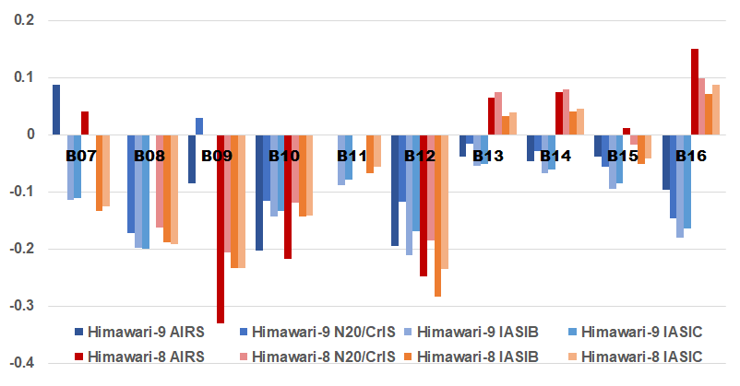
Calibration major update, AHI-9 (IR)
AHI - reference [K]
2022/09/02 - 30
AHI9 | AIRS | N20/CrIS | IASI-B | IASI-C
B07 (3.9) | 0.09 | - | -0.12 | -0.11
B08 (6.2) | - | -0.17 | -0.20 | -0.20
B09 (6.9) | -0.09 | 0.03 | 0.00 | 0.00
B10 (7.3) | -0.20 | -0.12 | -0.15 | -0.14
B11 (8.6) | - | - | -0.09 | -0.08
B12 (9.6) | -0.20 | -0.12 | -0.21 | -0.17
B13 (10.4) | -0.04 | -0.02 | -0.06 | -0.05
B14 (11.2) | -0.05 | -0.03 | -0.07 | -0.06
B15 (12.4) | -0.04 | -0.06 | -0.10 | -0.09
B16 (13.3) | -0.10 | -0.15 | -0.18 | -0.17
The brightness temperature (Tb) biases for both AHI8 and AHI9 are stable and within 0.3K at the standard radiance corresponsing to clear sky sea surface temperature.
There are some cases that have relatively larger value at lower temperature.
Tb bias at the standard radiance [K]
AHI8 | AIRS | N20/CrIS | IASI-B | IASI-C
B07 (3.9) | 0.04 | - | -0.13 | -0.13
B08 (6.2) | - | -0.16 | -0.19 | -0.19
B09 (6.9) | -0.33 | -0.21 | -0.24 | -0.23
B10 (7.3) | -0.22 | -0.12 | -0.14 | -0.14
B11 (8.6) | - | - | -0.07 | -0.06
B12 (9.6) | -0.25 | -0.19 | -0.28 | -0.24
B13 (10.4) | 0.06 | 0.07 | 0.03 | 0.04
B14 (11.2) | 0.07 | 0.08 | 0.04 | 0.05
B15 (12.4) | 0.01 | -0.02 | -0.05 | -0.04
B16 (13.3) | 0.15 | 0.10 | 0.07 | 0.09
The bias wrt. CrIS at B07, the bias wrt. AIRS at B08 and the bias wrt. AIRS and CrIS at B11 are omitted because of its large uncertainty.

Slide 7
Additional Slides not Presented
Introduce/Confirm the Agency’s Personnel supporting GSICS

Slide 8
Personnel supporting GSICS
EP
  YAMADA Kazutaka
GRWG
  OKUYAMA Arata
  IR, Lunar, GEO-GEO
  KODERA Kazuki
  VNIR Ray-matching, DCC
  EIKI Misaki
  VNIR vicarious calibration (RTM approach using LEO)
GDWG
  OKUYAMA Arata
GPRC Points of contacts for operational matters
  OKUYAMA Arata

Slide 9
References
The Level-1 products validation between H8 and 9
  https://www.data.jma.go.jp/mscweb/en/oper/healthcheck/[L1]Validation_H9_processing_forMSCWEB.pdf
Calibration portal
  https://www.data.jma.go.jp/mscweb/en/oper/calibration/calibration_portal.html
Event log
  https://www.data.jma.go.jp/mscweb/en/oper/event_H9.html

