Slide 1

GSICS Agency Report
2023
Presenter
Philippe Goryl
European Space Agency

Slide 2
Presentation Overview
Summary of Agency’s GSICS Activities, Actions, and Achievements
Agency’s Support to GDWG Activities
Agency’s Support to GRWG Activities
Agency’s Instruments Updates & Planned launches that are relevant to GSICS
Agency’s Calibration Major Updates
Submit the report before 02/27/2023
Record the PowerPoint Presentation in 10 minutes

Slide 3
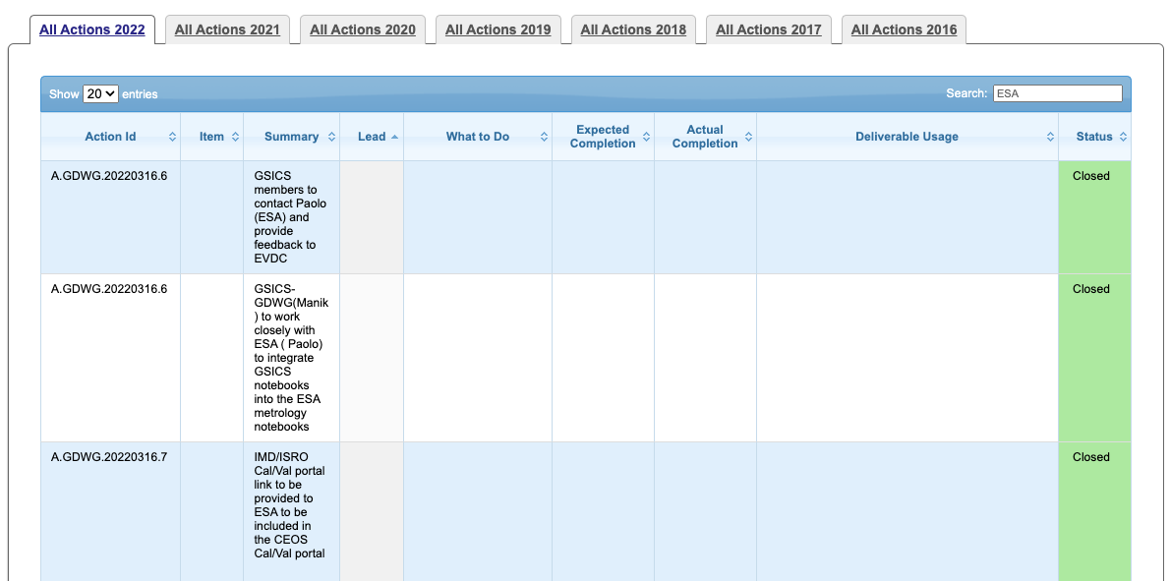
Summary of Agency’s GSICS Activities,
Actions, and Achievements
There are no open actions for ESA
  https://www.star.nesdis.noaa.gov/smcd/GCC/MeetingActions.php
Notes:
In particular, there was a nice work between Paolo and Manik to integrate GSICS notebooks onto the ESA metrology notebooks in calval portal that was done last year and the IMD/ISRO link was included in the Cal/val portal.

Slide 4
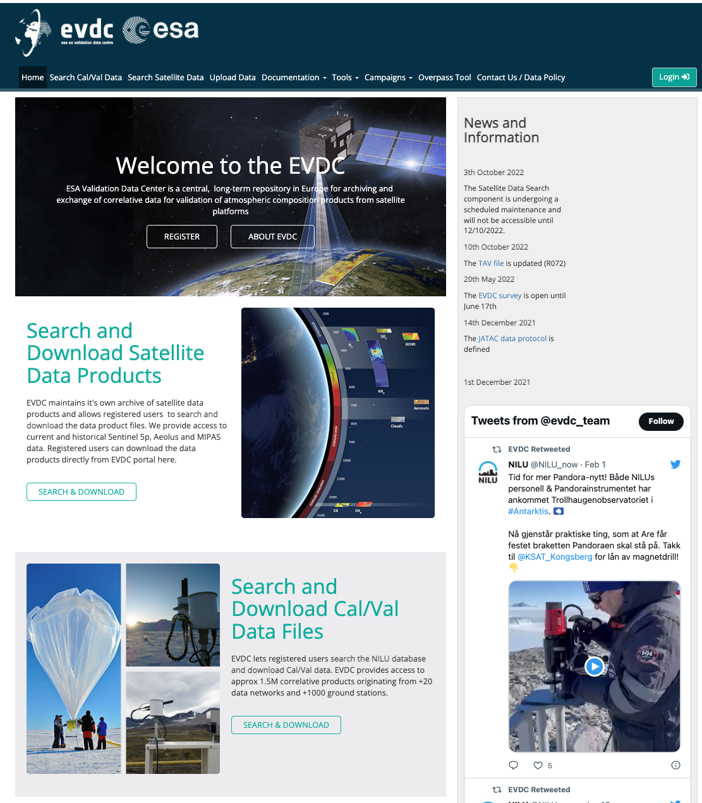
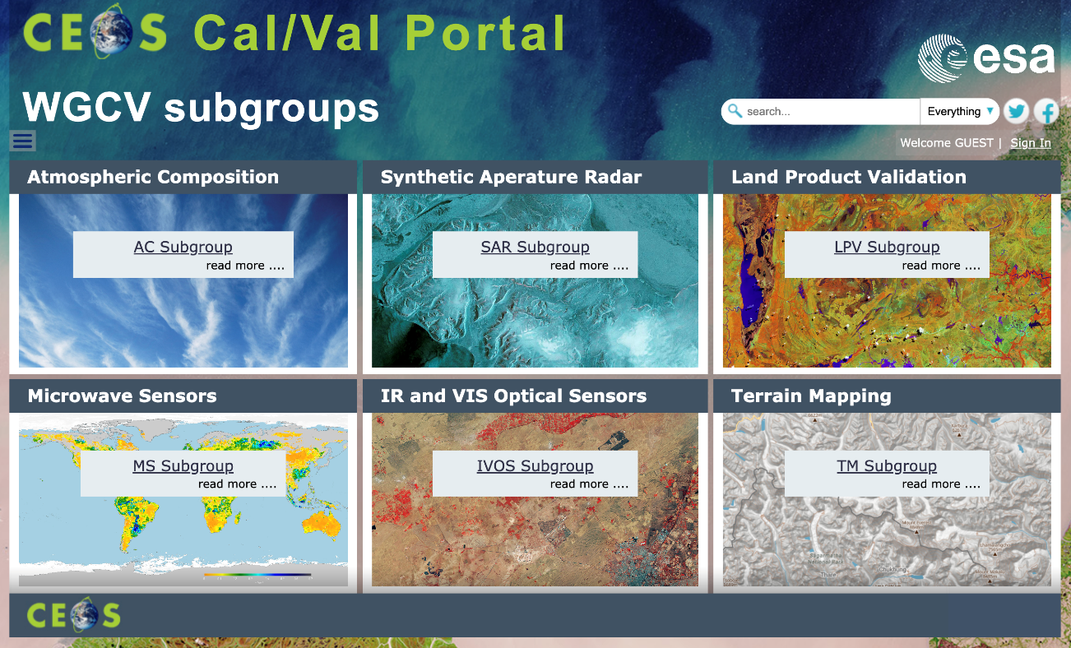
Agency’s Support to GDWG Activities
Status and updates of the main webportals supporting cal/val activities in different domains:
CEOS Cal/Val portal (https://calvalportal.ceos.org/)
ESA Atmospheric Validation Data Centre (EVDC) (https://evdc.esa.int/)
Pi-MEP Salinity (https://www.salinity-pimep.org/)
Quality Assurance for Soil Moisture (https://qa4sm.eu/)
(see P. Castracane presentation GDWG breakout Session 1st March 09:30 EST)

Slide 5
Agency’s Support to GRWG Activities
GRWG Annual Meeting 27 Feb. 03 March 2023 - ESA contributions
Session | Title | Presenter | Date/Time EST | Date/time CET
Mini Conference | ESA Cal/Val Strategy for Optical Land-Imaging Satellites and Pathway towards Interoperability | Paolo Castracane on behalf of Fabrizio Niro | 27.02.2023/∼10:30 | 27.02.2023/∼ 16:30
UVN Spectrometer | ESA FDR4ATMOS project | Melanie Coldewey-Egbers DLR (Remote) | 28.02.2023/∼14:15 | 28.02.2023/∼20:15
Space Weather | SWARM and SMOS introducing space weather observation | Raffaele Crapolicchio (remote) | 28.02.2023/14:00 | 28.02.2023/ 20:00
Space Weather | ESA Assets and intercalibration capability | Piers Jiggens ESA (remote) | 28.02.2023/14:15 | 28.02.2023/ 20:15
VIS/NIR (and Lunar Session) | TRUTHS status | Thorsten Fehr (remote) | 02.03.2023/∼9:05 | 02.03.2023/∼15:05
VIS/NIR (and Lunar Session) | FDR4VGT: towards a 20+ years harmonised data record of land surface reflectances derived from VGT-1, VGT-2 and Proba-V sensors | Marta Luffarelli – Rayference (remote) | 02.03.2023/∼9:20 | 02.03.2023/∼15:20
VIS/NIR (and Lunar Session) | Status of the Lunar Irradiance Model of ESA (LIME) | Agnieszka Bialek - NPL (remote) | 02.03.2023/∼14:20 | 02.03.2023/∼20:20
Microwave | ESA microwave activities - GSICS 2023 report | Raffaele Crapolicchio (remote) | 02.03.2023/morning | 02.03.2023/afternoon
Cross Cutting | GSICS and CEOS-WGCV | Philippe Goryl (remote) | 03.03.2023/∼11:00 | 03.03.2023/∼17:00

Slide 6
CM22 Outcome for Earth Observation
EO TOTAL: 2.7B€ on 3.03B€
Close to 90% of proposed envelope
Guaranteeing continuity of current activities and programmes and allowing start of new projects
ESA MS Demonstrated
Overwhelming support to climate and environmental actions
Strategic relevance of EO sector
for climate and environment
Climate as top concern for European Citizens (Harris survey)
FutureEO
Undersubscribed, but highest contribution ever on yearly basis, 400 M€/year
Copernicus
Oversubscription shows continued support by MS
Customised EO
Climate Space (Oversubscribed)
Digital Twin Earth (Near full subscription)
TRUTHS (Continuity of Activities)
InCubed-2 (Scalable programme)
Aeolus-2: Oversubscribed
Notes:
2.66 for EO is closely above CM19 results, an excellent result in the light of the difficult geo-political circumstances and taking into account that FutureEO (our CM22 driver/locomotive) is a difficult programme to sell

Slide 7

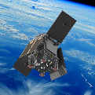
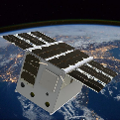
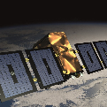
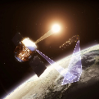
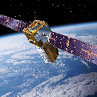
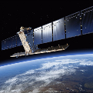
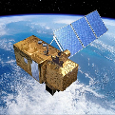
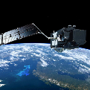
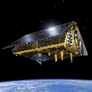
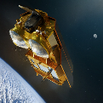
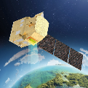
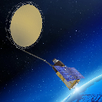
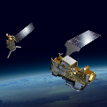

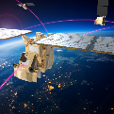
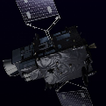
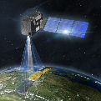
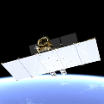
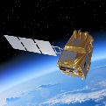
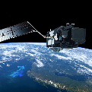
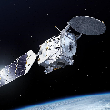
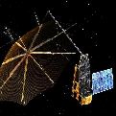
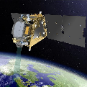
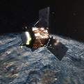
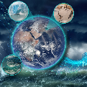
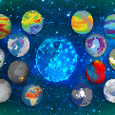
Planned EO Satellite Launches 2022 – 2032 (Indicative dates)
Science
SCOUT-2 HydroGNSS
SCOUT-1 ESP-MACCS
ALTIUS
TRUTHS
Aeolus-2
Copernicus
Meteorology
S-1C
S-2C
S-5A Instrument
S-3C
S-6B
CRISTAL A
CHIME A
CIMR A
CRISTAL B
CHIME B
S-5B Instrument
CIMR B
MetOp-SG A1
MetOp-SG B1
AWS
MetOp-SG A2
MetOp-SG B2
2022 | 2023 | 2024 | 2025 | 2026 | 2027 | 2028 | 2029 | 2030 | 2031 | 2032
MTG I1 (Imagery)
MTG S1 (Sounding)
MTG I2 (Imagery)
MTG I3 (Imagery)
S-4A Instrument
CO2M A/B
CO2M C
ROSE-L A
LSTM A
ROSE-L B
LSTM B
S-6A NG
S-3A NG (TOPO)
S-1A NG
EE 6 EarthCARE
EE 7 Biomass
EE 8 Flex
EE 9 FORUM
EE 10 Harmony
EE 11
    7
Notes:
In term of programme and planned satellites there are 44 EO satellites planned for launch between 2022 – 2032. 3 lines of mission and objective: Meteorology operated by EUMETSAT, Operational Copernicus with the European Commission and the science line or Earth explorer.
In the short therm , relevant for GSICS, there will be Eartcare in 2024 The main goal of the mission is the observation and characterization of clouds and aerosols and the overall measurement of the reflected solar radiation and the infrared radiation emitted from Earth's surface and atmosphere. Eathcare is done in cooperation with JAXA.
Biomass in 2024. is a sar P band mission providing measurements of global forest biomass
FLEX in 2024, Hyperspectral mission for monitoring the chlorophyll fluorescence in terrestrial vegetation.
On the longer term there will be FORUM Far-infrared Outgoing Radiation Understanding and Monitoring Earth's radiation budget.
And HARMONY that will accompany S1. two identical satellites SAR in band C they will monitor changes in the Earth’s surface, as well as monitor ocean surface conditions like wind, currents, and temperature.
In Copernicus, the C unit of the current Sentinel are in preparation with a launch of S1C this year hopefully and S2C next year and S3C in 2025.
This will be completed by the Copernicus Expansion Mission around 2028 with CRISTAL Copernicus Polar Ice and Snow Topography Altimeter
CIMR Copernicus Imaging Microwave Radiometer
LSTM High resolution land Surface Temperature
CHIME – Hyperspectral mission
ROSE-L which a band L SAR mission.
2022 = MTG-I1 / S-1C (Q4)
2023 = EE6 (March) / EE7 (August)
2024 = S-2C (Q1) / MTG-S1 (Q1) / MetOp-SG A1 + S-5 (Q1) / AWS (Q1/Q2) / SCOUT-1 ESP-MACCS (Q3) / SCOUT-2 HydroGNSS (Q4) / EE8 Flex (Q4)
2025 = S-3C (Q1) / MTG-I2 / MetOp-SG B1 (Q1) / ALTIUS (Q1) / CO2M A/B (Q4)
2026 = S-6B (Q1) / EE9 FORUM (Q4) / CO2M C (Q4)
2028 = TRUTHS / CRISTAL A (Q3) / ROSE-L A (Q3) / CHIME A (Q4) / LSTM A (Q4)
2029 = CIMR A (Q1) / Aeolus-2 / EE10 Harmony (Q4/30)
2030 = CRISTAL B (Q3) / ROSE-L B (Q3) / CHIME B (Q4) / LSTM B (Q4) / s-6A NG (Q4)
2031 = CIMR B (Q1) / MetOp-SG A2 (Q1) / S-3A NG (TOPO) (Q4) / EE11 (Q4/32)
2032 = MTG-I3 / MetOp-SG B2 (Q1) / S-1A NG
For the Sentinels 1D, 2D, 3D, the Commission prefers not to be specific and only indicates a 4/5 years launch window at this point
S1-D = 2024-2028
S2-D = 2025-2028
S3-D = 2025-2028

Slide 8
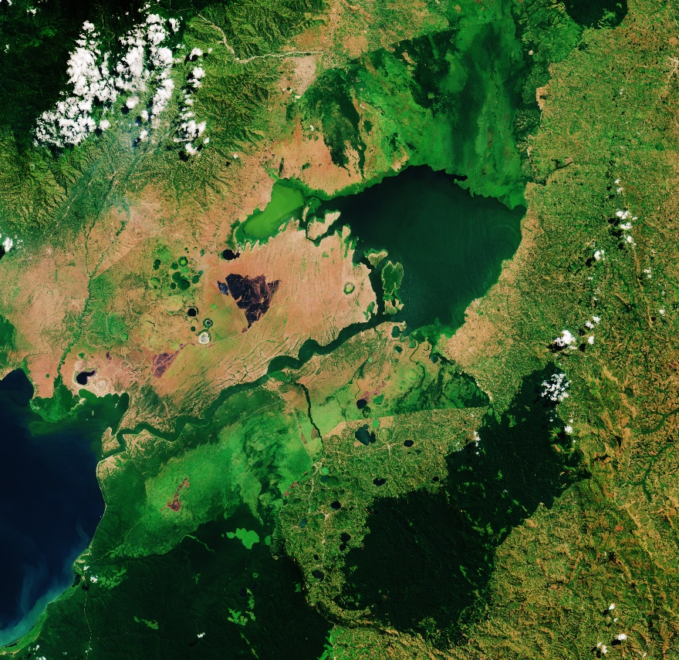
Sentinel-2 Collection-1
Collection 1 being generated by reprocessing full S2 archive for all user products (Level-1B, Level-1C and Level-2A).
Products will use the latest Processing Baseline (05.XX) which includes Copernicus DEM 30m, geometric refinement with S2 GRI, etc.
Reprocessing campaign on-going, first products published on 24 January 2023 on DIAS platforms (CREODIAS, Mundi and ONDA).
Collection-1 will be CEOS-ARD compliant: http://ceos.org/ard
Lake George (Uganda)
More information at:
https://sentinels.copernicus.eu/ca/web/sentinel/technical-guides/sentinel-2-msi/copernicus-sentinel-2-collection-1-availability-status
DOI landing pages:
L1C (https://doi.org/10.5270/S2_-742ikth)
L2A (https://doi.org/10.5270/S2_-znk9xsj)

Slide 9
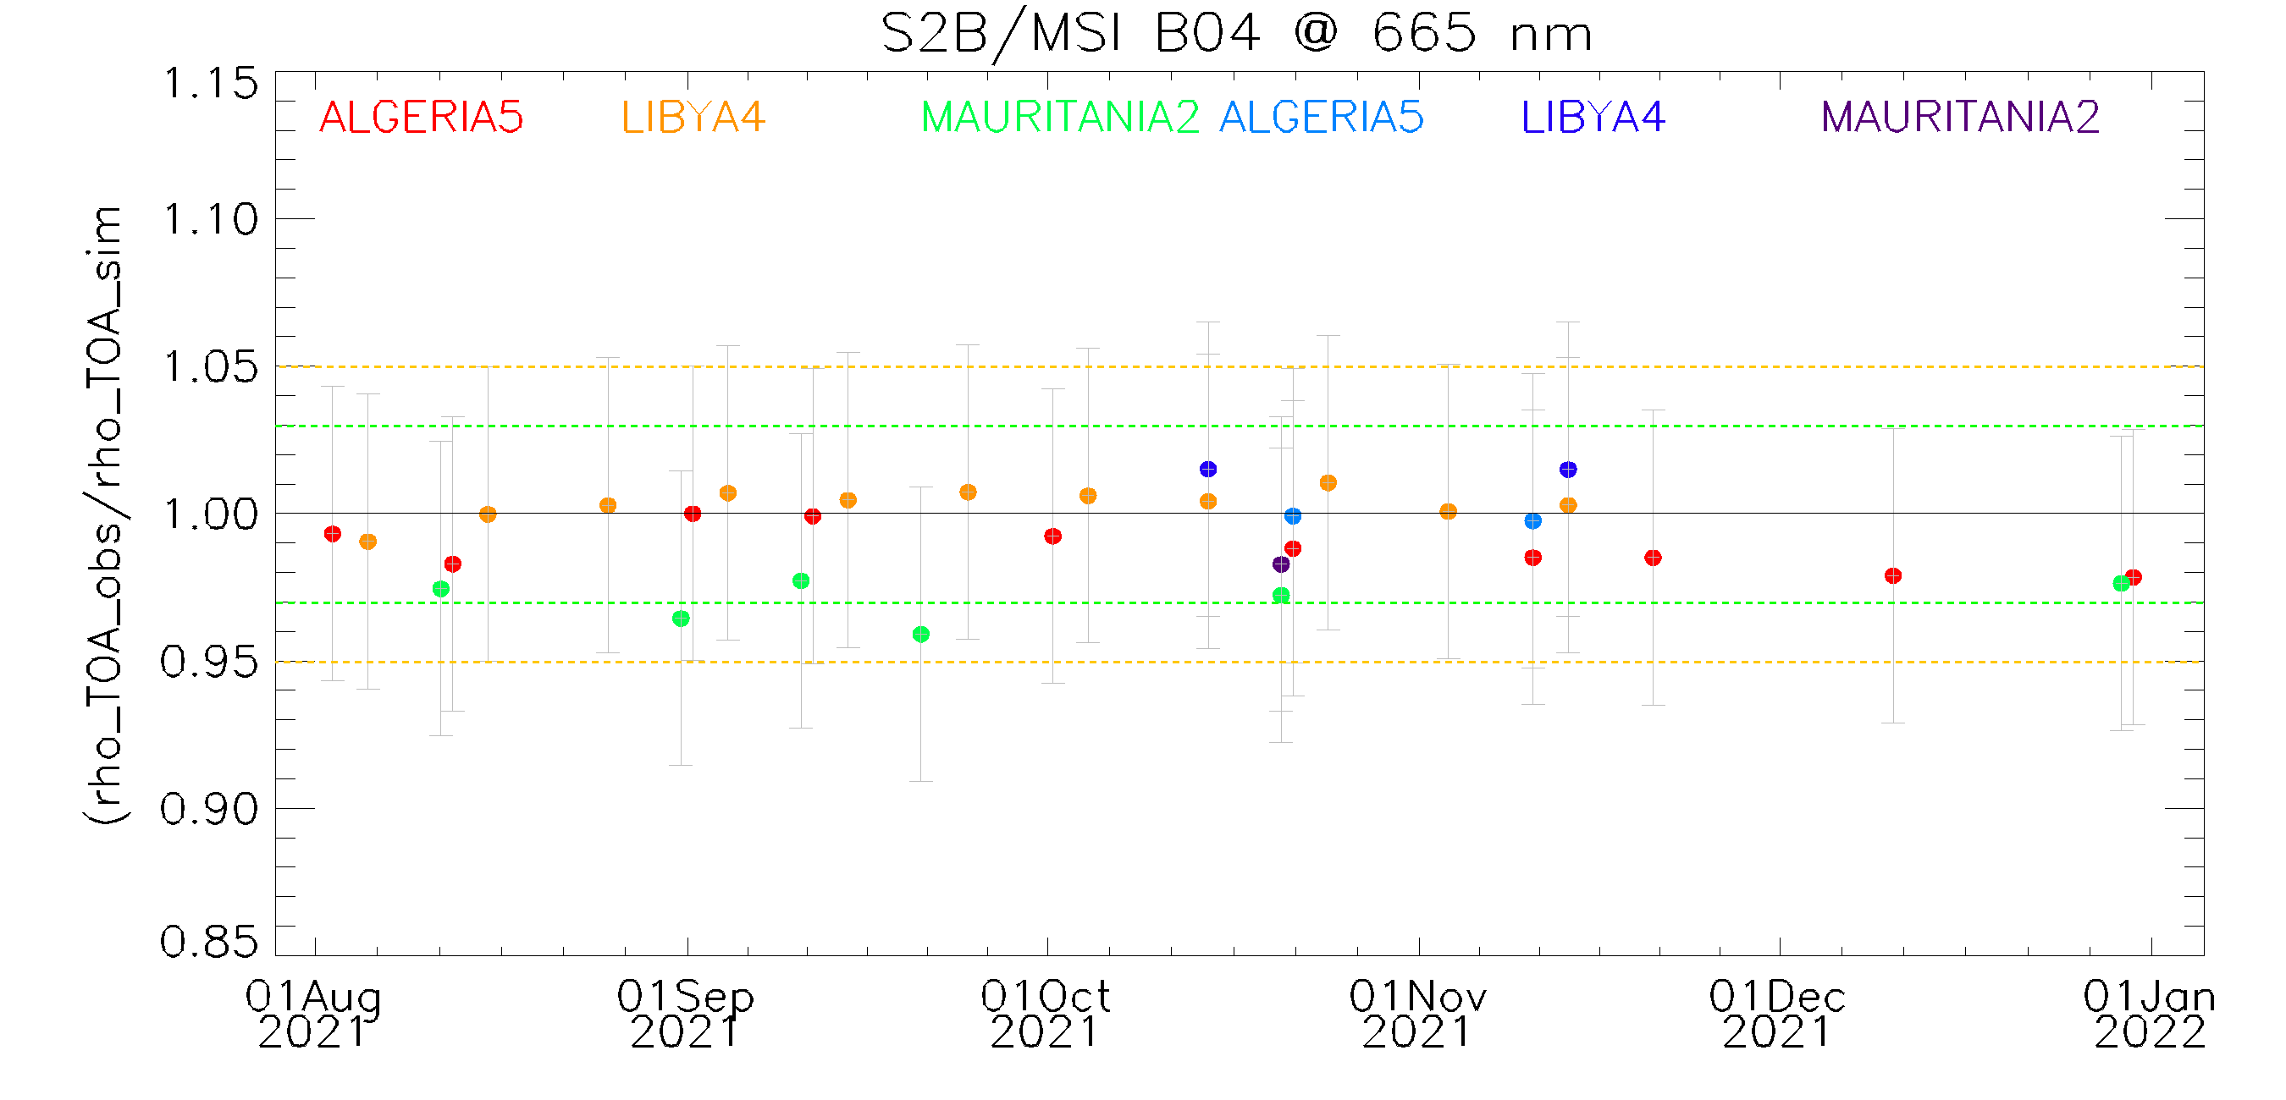

Sentinel-2 B Collection-1 over PICS
Collection-1 implements the Correction of the radiometric bias between Sentinel-2A and Sentinel-2B (keeping Sentinel-2A as reference): Sentinel-2A and Sentinel-2B radiometric cross-calibration results have highlighted a small bias for VNIR bands B01 to B09. This radiometric difference was mitigated by applying a radiometric bias correction of 1.1% to Sentinel-2B VNIR bands B01 to B09.
  Desert-PICS : 6 CalVal sites & period Oct-Dec 2021
      MSI-B: 9 Acqs (ALG5, LIB4, MAU2)
Collection-1: Cold colour
Operational: Warm colour
Collection-1: Cold colour
Operational: Warm colour
  Sentinel-2B radiometry shows higher values than the operational one by 1.1-1.6% (Bias correction taken in account).
Notes:
Collection-1 implements the Correction of the radiometric bias between Sentinel-2A and Sentinel-2B (keeping Sentinel-2A as reference):
Sentinel-2A and Sentinel-2B radiometric cross-calibration highlighted a small bias for VNIR bands B01 to B09.
This radiometric difference was mitigated by applying a radiometric bias correction of 1.1% to Sentinel-2B VNIR bands B01 to B09.

Slide 10
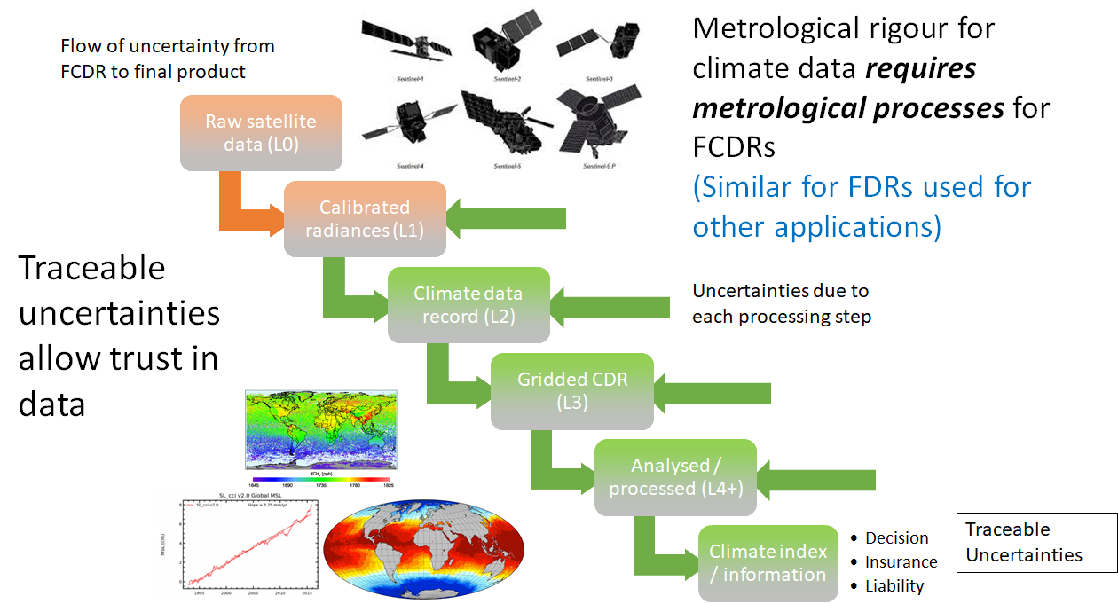
Fundamental Data Record
ESA Heritage Valorisation Programme built on two pillars: Analysis Ready Data (ARD) and Fundamental Data Record (FDR)
(An FCDR consists of a long, harmonised record of uncertainty-quantified sensor observations that are calibrated to physical units and located in time and space, together with all ancillary and lower-level instrument data used to calibrate and locate the observations and to estimate uncertainty.
The term Fundamental Data Record may be applied to records meeting similar standards to an FCDR, but which is either too short to be informative about climate variability and change, or whose contents are relevant for purposes not considered to be climate applications. (Logically, one should define FDR as the baseline concept and add climate-specific requirements to define FCDR, and this may yet be recommended.)

Slide 11


ESA FDR projects
FDR | INSTRUMENTS
FDR4ATMOS | Calibrated irradiance and reflectance from ERS-2 GOME + ENVISAT SCIAMACHY (1995-2012) – possibly extended with GOME-2 (MetOp A B C)
FDR4ALT | ERS-1/-2 and ENVISAT MWR / RA(2) (1991-2012) for altimetry waveforms and TOA BT + TDPs – possibly extended with with SARAL/ALtiKa
FDR - Medium Resolution Optical/SWIR/TIR | ERS ATSR, Envisat AATSR and MERIS,
FDR4AVHRR | AVHRR full-mission Level-1b dataset (1981 – ….)
FDR4VGT | TOA reflectance from SPOT-VGT-1/-2 and PROBA-V sensors (1998 – 2020) based on Sentinel-2 processing level.

Slide 12
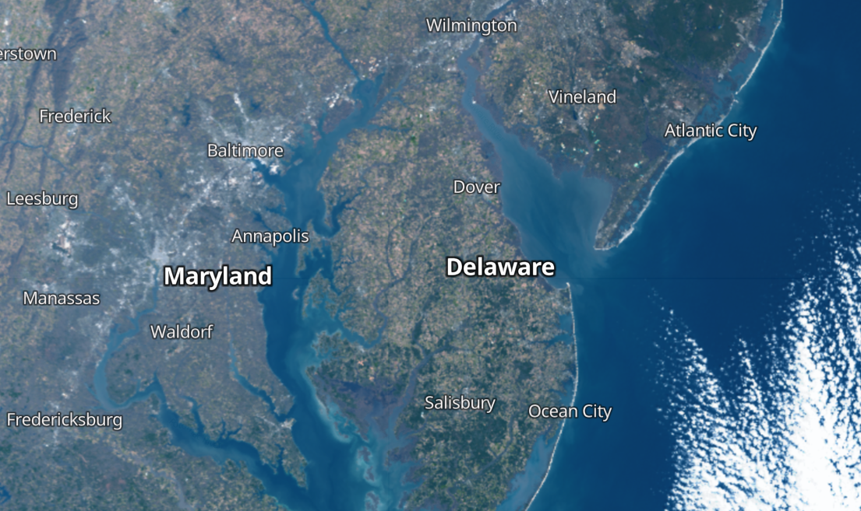
THANK YOU
FOR YOUR
ATTENTION
Notes:
In the Additional slide, you will find slides related to Space Weather and the confirmation of the Agency’s personnel supporting GSICS.

Slide 13
Additional Slides Not Presented
Agency’s Status of Observing System Report, if applicable (template provided in another file). Can be submitted one week after the annual meeting
Agency’s Reprocessing Activities, if any
Introduce/Confirm the Agency’s Personnel Supporting GSICS
  GRWG members/GDWG members
  Other Key Agency Personal
Agency’s GSICS activities to be discussed in this joint meeting
  Agenda items that are especially of interest to your agency
  Agency’s activities that may be of interest to the GSICS community

Slide 14
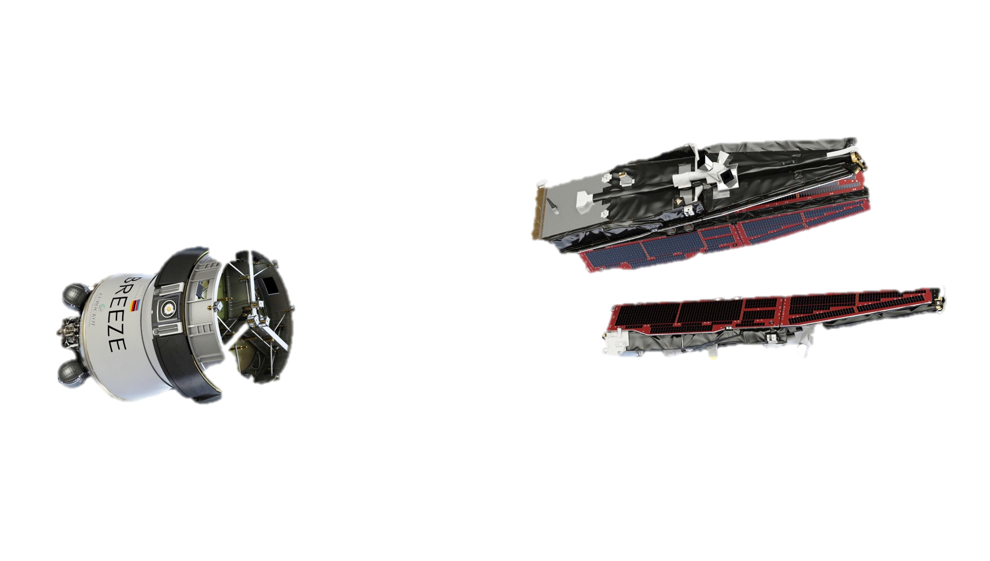
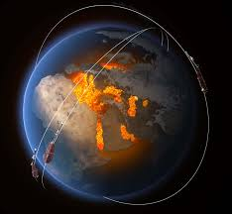


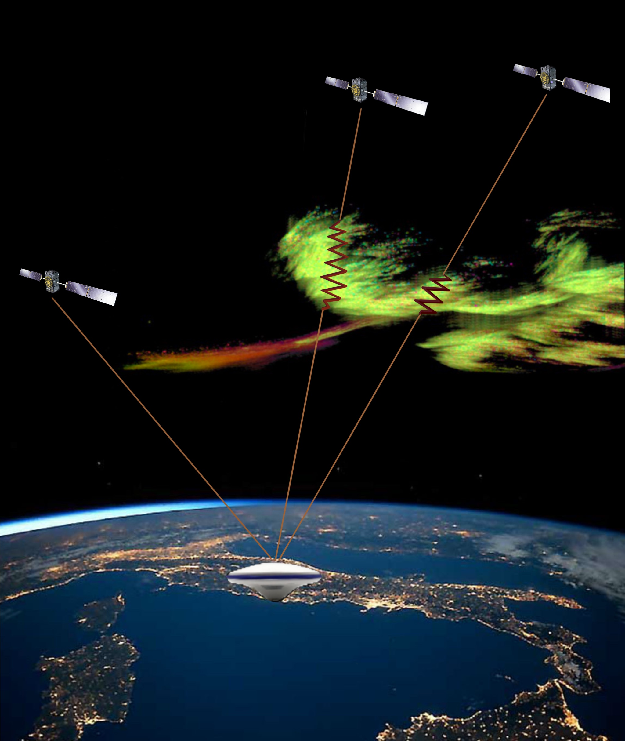
SWARM: “EN ROUTE VERS” LE SPACE WEATHER
KEY PRIORITY OF THE SWARM DISC
7 related DISC projects: AEBS, AMPS, IPIR, SITE, SLIDEM, TIRO & AURORA-X
3 DISC ITTs Exploring Swarm data for space weather applications – kicked off in 2022
Multi-mission synergy : CSES, CryoSat & GRACE-FO Calibrated platform Magnetometer
Complementary to ground obs. and dedicated SSA payload/satellites (e.g. Lagrange)
+
Swarm DISC
SCARF
Level 2
data processing
Extension of SCARF activities
New Products and Services
Public Outreach
Web stories,
Press releases
…
Level 1b
data
Swarm Webpages
Data Handbook
Swarm Wiki,
…
CONS
PRO
R&D PROJECTS
INTENS, VIP, EPHEMERIS …
Movement of satellite (8 km/s wrt surface): time-space ambiguity
Data latency: downlink when satellite close to ground station (few per day) possible to increase to 2/orbit (Northern + Southern stations)
Global coverage of both hemispheres with same accuracy
In-situ measurements with very high accuracy + multi-s/c observations
Provide e.g. “auroral zone view” (60 – 90 deg latitude) within < 8 minutes
Notes:
SPACE WEATHER

Slide 15
SMOS EMERGING APPLICATION: SPACE WEATHER
KEY OBSERVABLE: Solar flux at 1.4 GHz, full Stokes vector in near-real time
Solar physics studies
Thermosphere modelling
Early assessment of Solar flare/CME impact on:
  Communication infrastructure
  Flight Radar devices
  GPS fade signal
Scientific study SMOS Flare completed
Validation of the SMOS mission for Space Weather operations: The potential of near real-time solar observation at 1.4 GHz (Space Weather Journal, 2021)
Follow-on project to develop a prototype product on going (Q3-2022)
Credits: Solar images are from SOHO, Earth and SMOS images are from ESA, and the radio burst plot is from the University of Alcalá.
Notes:
"ESA's SMOS mission (top right) was originally conceived to compute soil moisture and sea surface salinity maps (bottom right). It has nevertheless probed that it can also work as an orbital solar radio observatory able to detect solar radio bursts (bottom left) from ﬂares associated with coronal mass ejections (top left)"

Slide 16
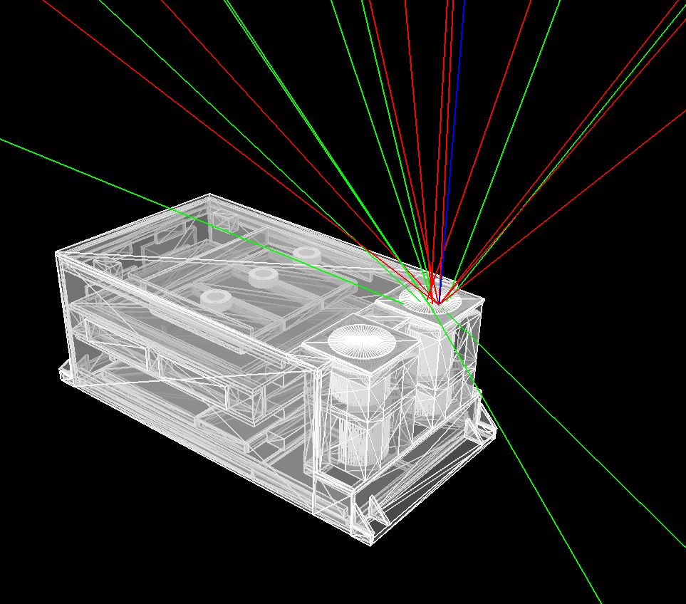
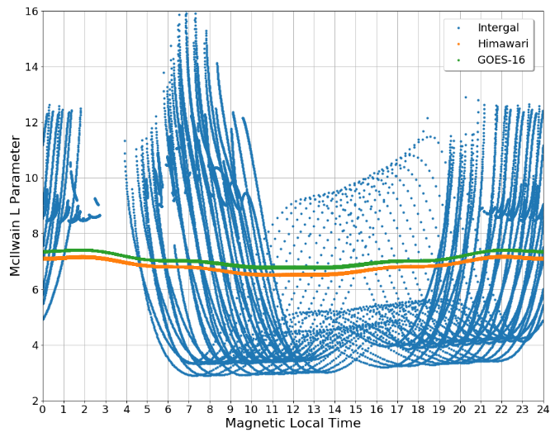
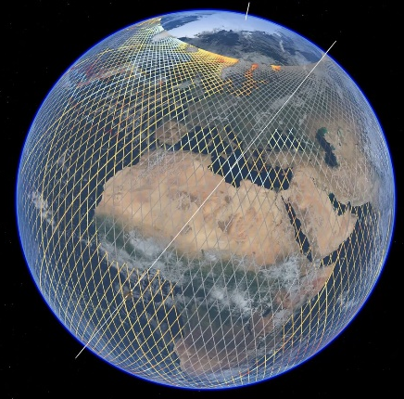
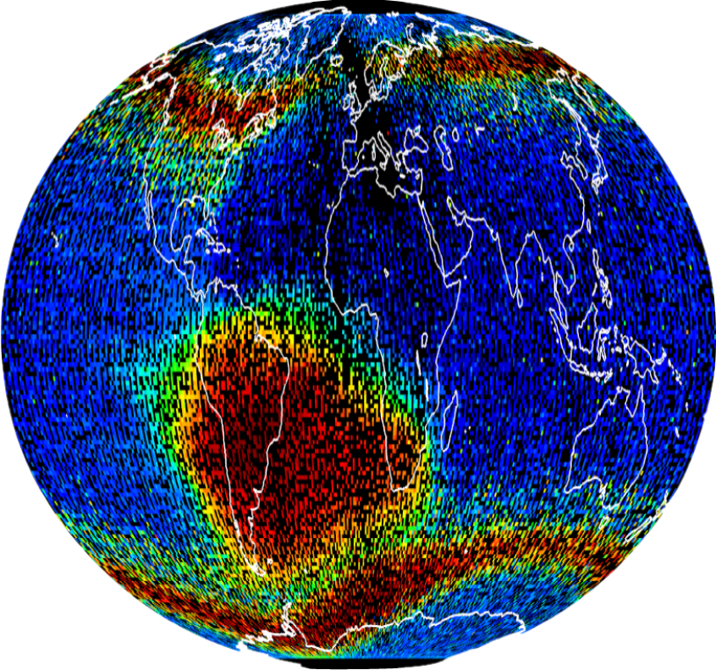
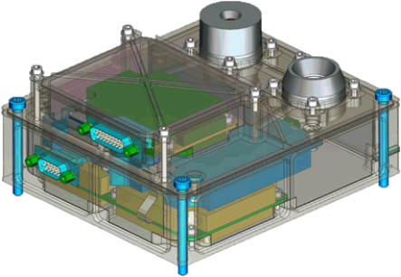
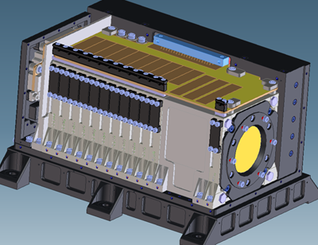
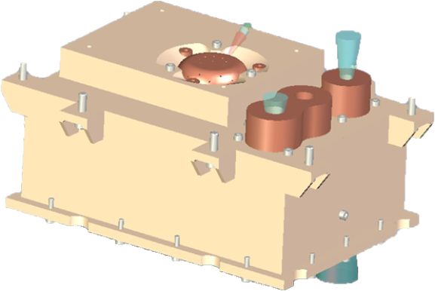
ESA Radiation Assets and Intercalibration Capability
ESA and its contractors are provisioning various historical, current and near real-time particle radiation monitor data sets which can be exploited in the implementation of a Global Space-based Inter-Calibration System (GSICS) in tandem with tools and expertise
Contributing to CGMS (Coordination Group for Meteorological Satellites) SWCG Inter-Calibration Task Group to conduct comparisons of data to verify their performance for use in space weather monitoring and modelling
Instruments cover a range of interesting orbits (GEO, LEO, high LEO (1600 km), MEO and eccentric orbits)

Slide 17
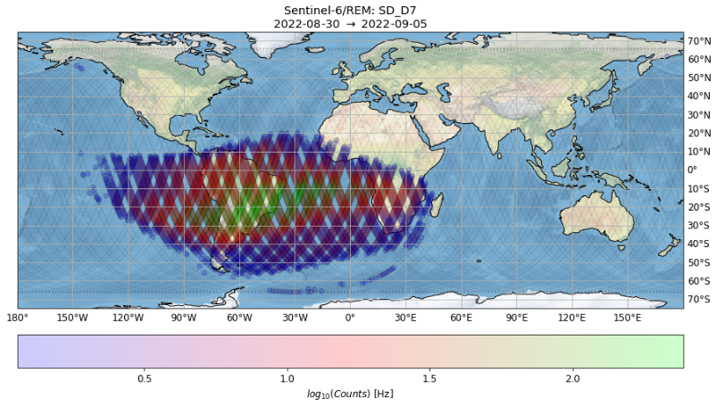
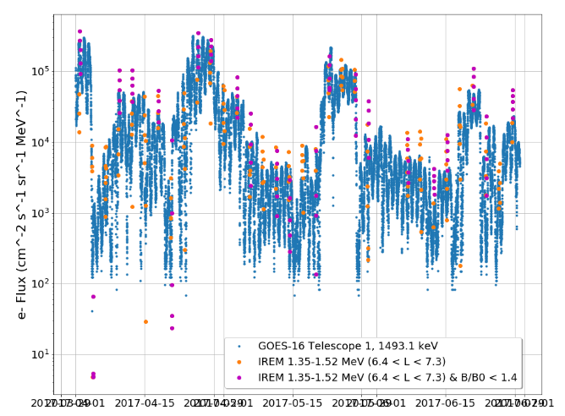
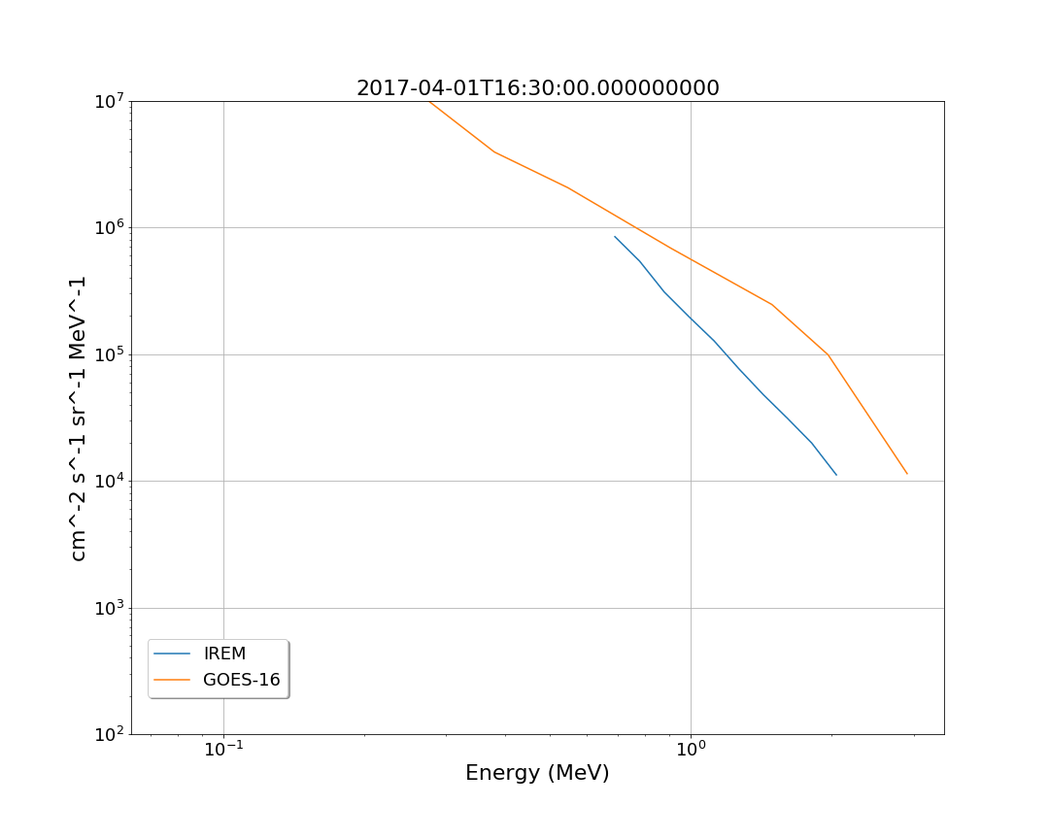
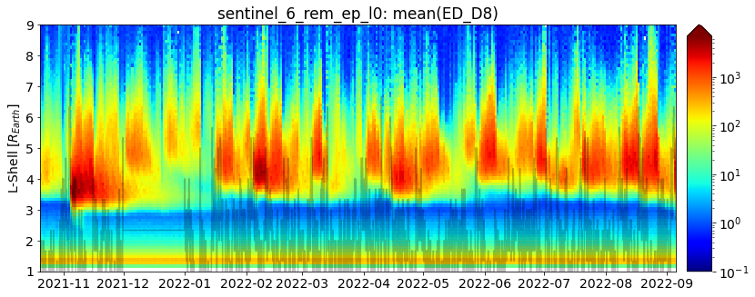
Example radiation data and comparisons
Historic science mission data comparisons shown below
Example of new radiation monitor data from Sentinel-6 (right)
Another unit has been launched into GEO on MTG-I in late 2022 to join an earlier unit on EDRS-C launched in 2019
Further units will be launch in LEO on MetOP-SG
Separate radiation monitors will be launched on other GEO missions (HOTBIRD) and a suite on Lunar Gateway
Protons
Electrons

Slide 18
Introduce/Confirm the Agency’s
Personnel supporting GSICS

