Slide 1
GSICS Agency Report 2023
Jiyoung Kim,
Tae-Hyeong Oh, and Euidong Hwang
KMA/NMSC
Notes:
I would like to briefly introduce the KMA’s GSICS Agency Report. My name is Jiyoung Kim, working for the KMA/National Meteorological Satellite Center.

Slide 2
Presentation Overview
Summary of KMA’s GSICS Activities, Actions, and Achievements
KMA’s Support to GDWG Activities
KMA’s Support to GRWG Activities
KMA’s Calibration Major Updates
Notes:
Today’s my presentation would be like this. Firstly I will summarize the KMA’s GISICS activities, actions, and achievements. And then I will introduce GDWG and GRWG activities and calibration major updates.

Slide 3
Summary of KMA’s GSICS Activities, Actions, and Achievements
Current Status of KMA activities
Generation of GSICS product for IR
Demonstration phase of GK2A/AMI IR channels with IASI/CrIS for NRTC and RAC
GK2A AMI VIS/NIR channels
Ray-matching using SNPP and NOAA-20/VIIRS and lunar calibration
Achievements Summary
Develop and update NOAA-20/VIIRS for ray matching method and DCC based on NASA algorithm in VIS/NIR calibration
Notes:
Let me show you the current status of KMA activities. KMA has been generating GSICS product for IR channels as demonstration phase of AMI IR channels with IASI/CrIS for NRTC and RAC.
And for the AMI VIS/NIR channels we applied the ray-matching method using SNPP and NOAA-20/VIIRS and lunar calibration.
As achievements summary, we developed and updated NOAA-20/VIIRS for ray matching method and DCC based on NASA algorithm in VIS/NIR calibration.

Slide 4
KMA’s Support to GDWG Activities
KMA Tasks to support the GDWG Activities:
To set up and operate a GitHub project for GDWG activities
To develop a plotting tool environment in KMA
To review GPRC websites
Overview of the resources and time taken for this support
Tae-Hyeong Oh (new member), 30 days/year
Notes:
KMA tasks to support the GDWG activities are three. To set up and operate a GitHub project, develop a plotting tool environment, and review GPRC websites. And Mr. Tae-Hyeong Oh is a new focal point of the KMA GDWG activities.

Slide 5
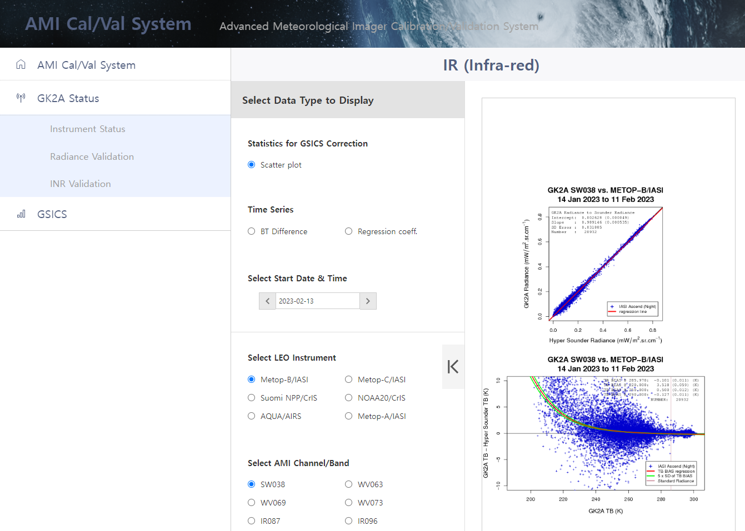
KMA’s Support to GDWG Activities
Landing page (Cal/Val portal)
Instrument Status (new)
Radiometric Validation (new)
INR Validation (new)
GSICS Performance
Event logs
Information of incomplete imagery
Processing Events
Data Outage
Landing page:
http://nmsc.kma.go.kr/enhome/html/main/main.do
Event logging:
http://nmsc.kma.go.kr/enhome/html/bbs/listNotice.do?bbsCd=00026
Notes:
This slide shows the newly opened AMI Cal/Val System to monitor instrument status, radiometric and INR validation, and GSICS performance as well as event logs.

Slide 6
KMA’s Support to GRWG Activities
KMA Task Summary to support the GRWG Activities:
Monitoring of GEO-LEO using MetOp-B, -C/IASI, SNPP and NOAA-20/CrIS for IR
Application of gap-filling method to inter-calibrate with CrIS
Demonstration phase for NRTC and RAC data (MetOp-B, -C/IASI, SNPP and NOAA20/CrIS)
Develop GEO-GEO direct comparison for both IR and visible channels
Long-term analysis AMI vs AHI (application of SBAF)
Develop and update calibration approaches
Lunar calibration
Ray matching method and GSICS DCC with NOAA-20/VIIRS
Overview of the resources and time taken for this support
Jiyoung Kim, Tae-Hyeong Oh(VNIR), and Euidong Hwang(IR)
Issues
GK2A AMI VNIR channels seasonal variation
Notes:
Let me summarize the KMA’s GRWG activities. There are three tasks. First one is to monitor GEO-LEO using MetOp- B and C/IASI, SNPP and NOAA-20/ CrIS for IR.
Second one is to develop GEO-GEO direct comparison for both IR and visible channels.
Third one is to develop and update the calibration approaches like this.
There is an issue of seasonal variation of AMI VNIR channels.

Slide 7
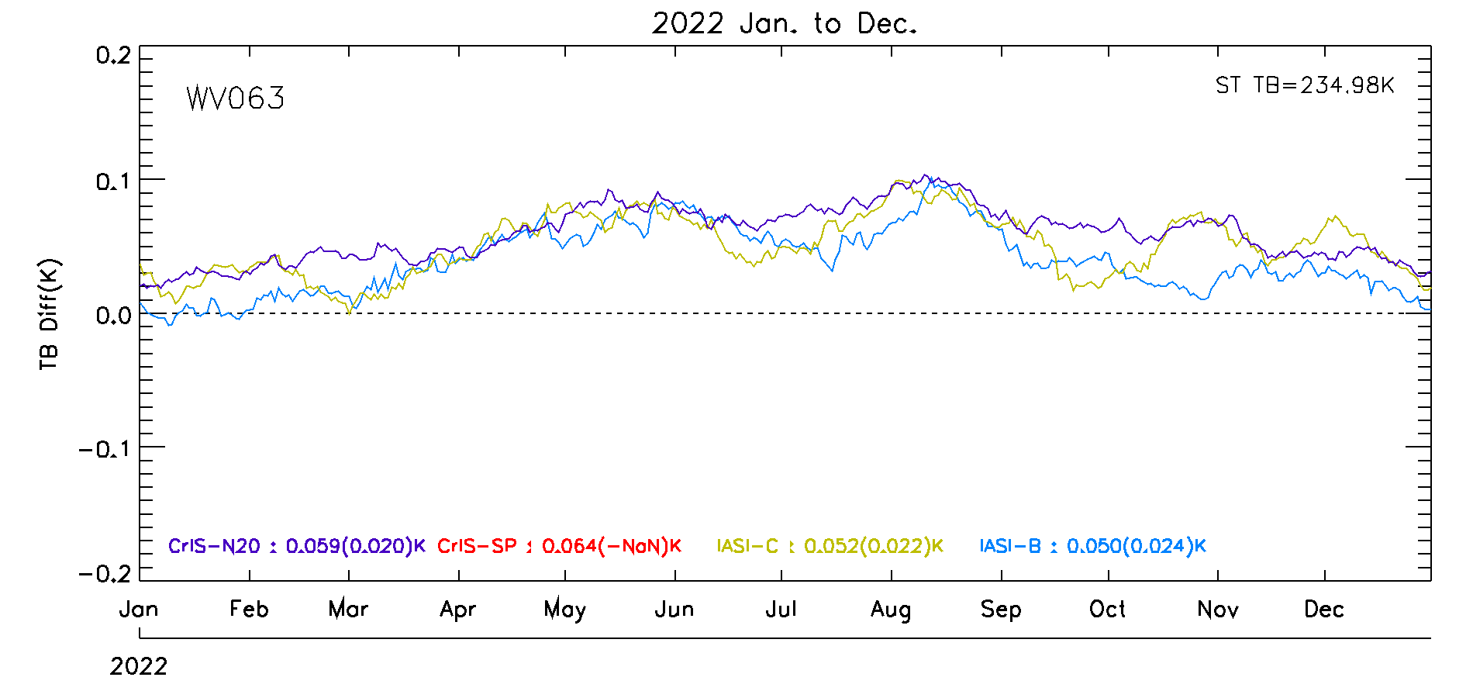
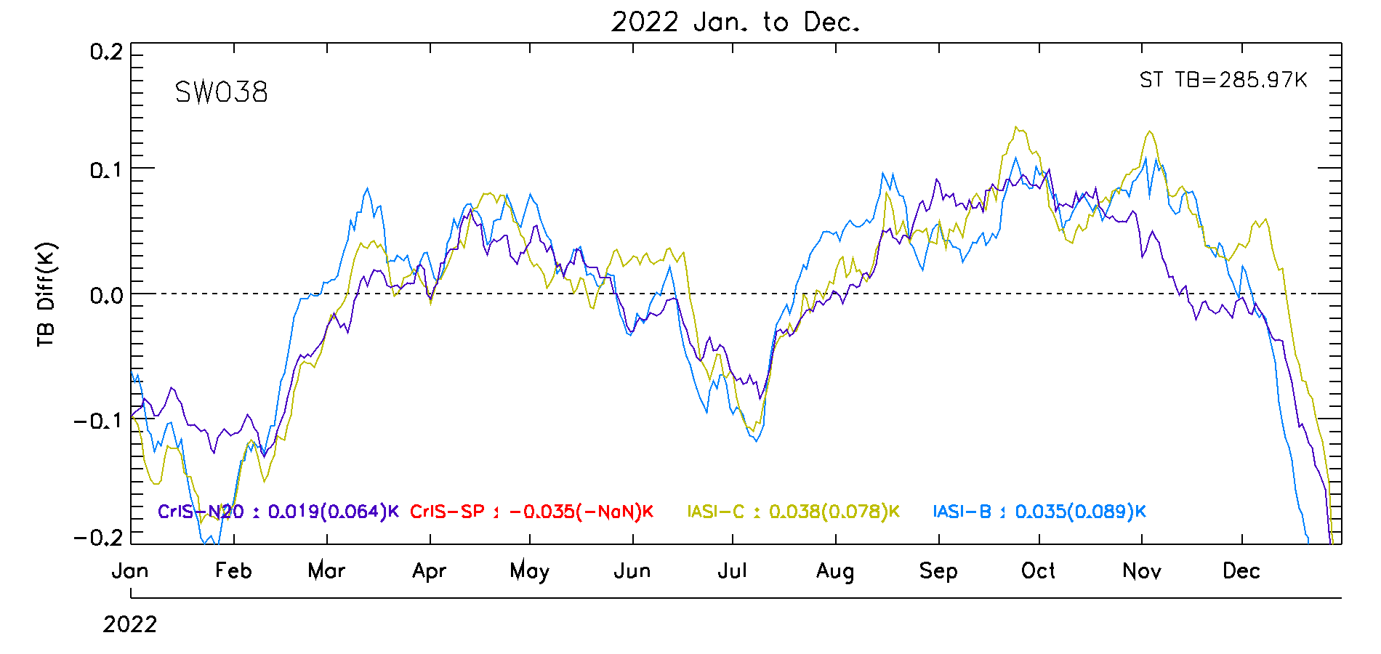
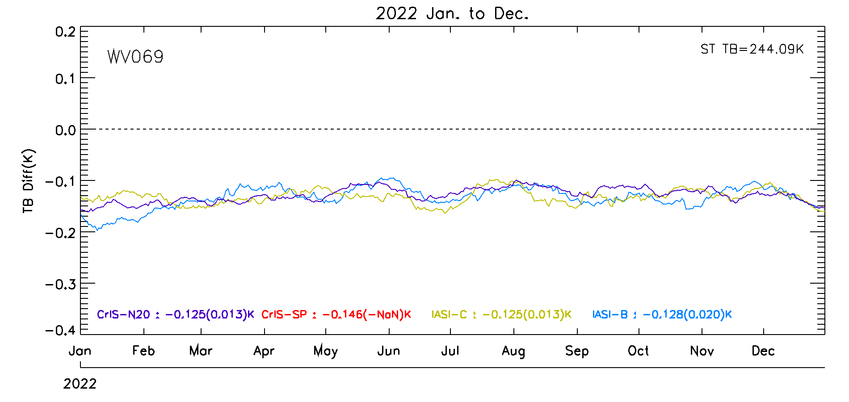
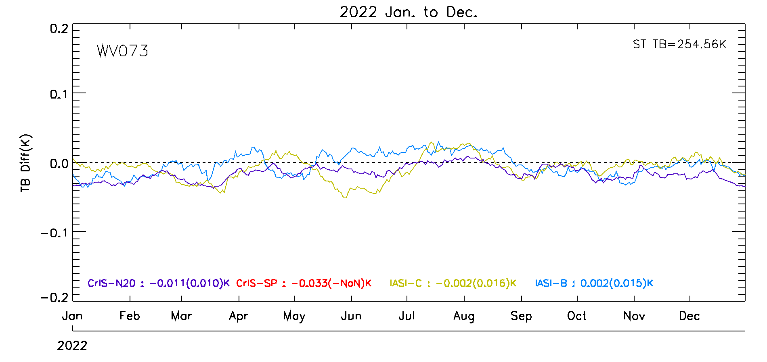
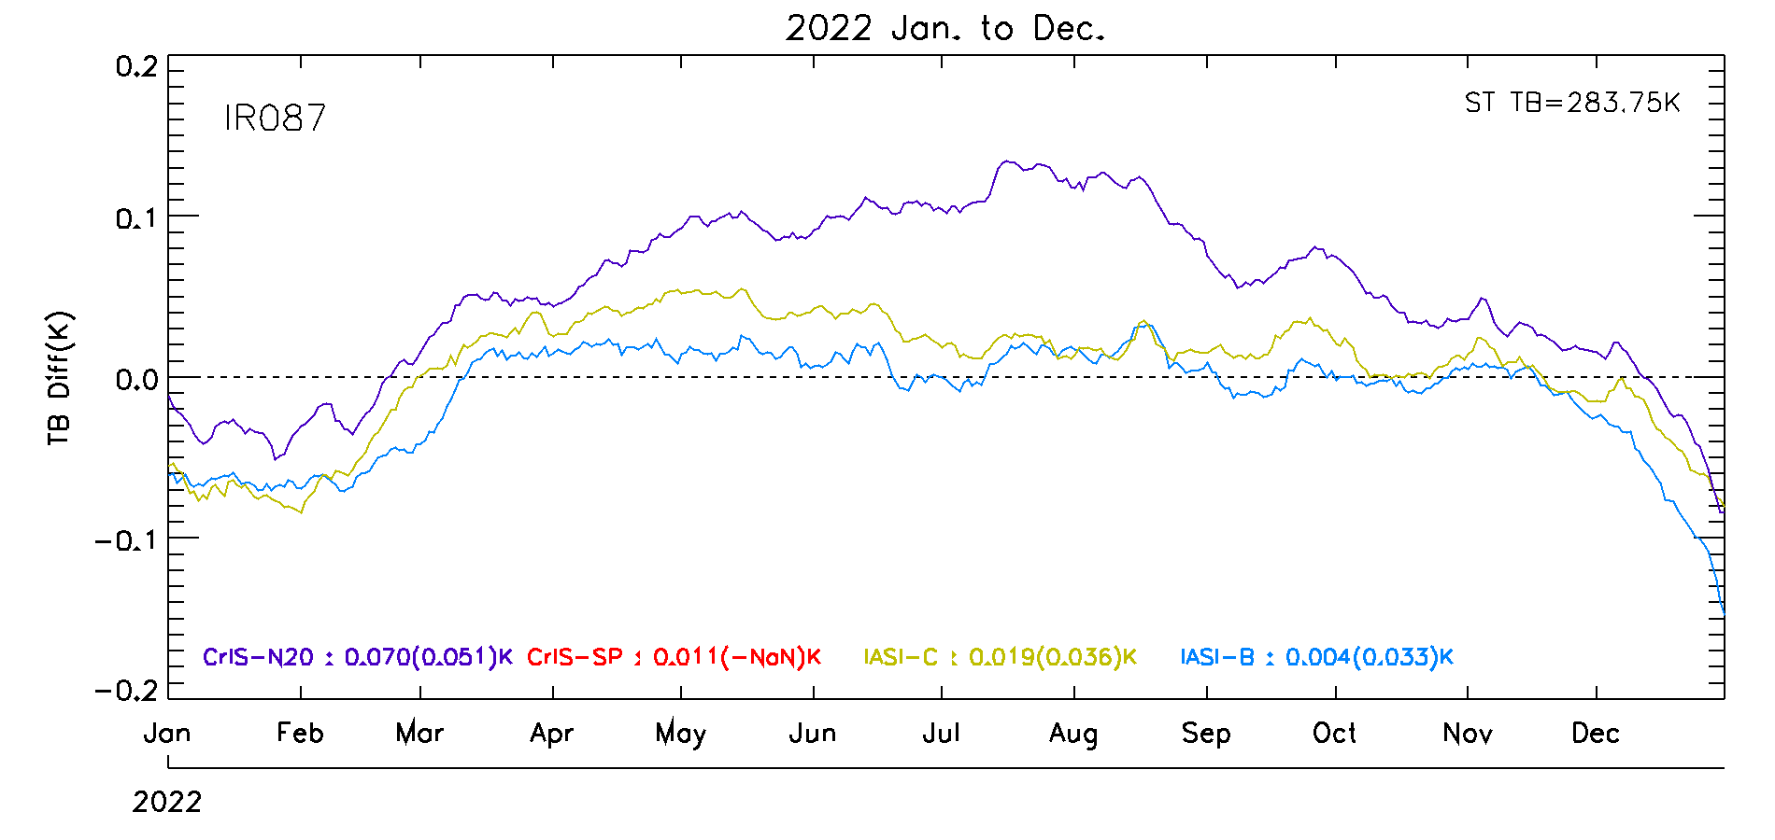
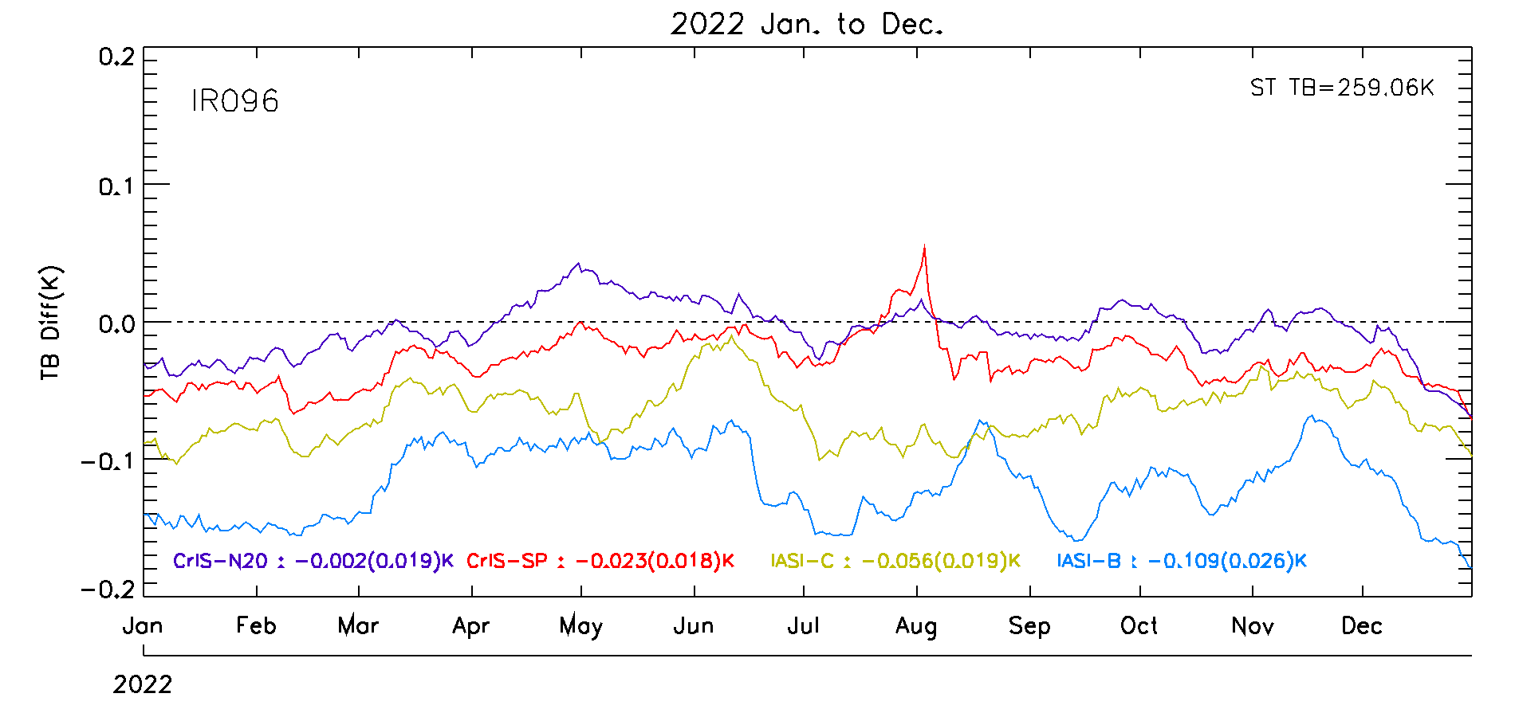
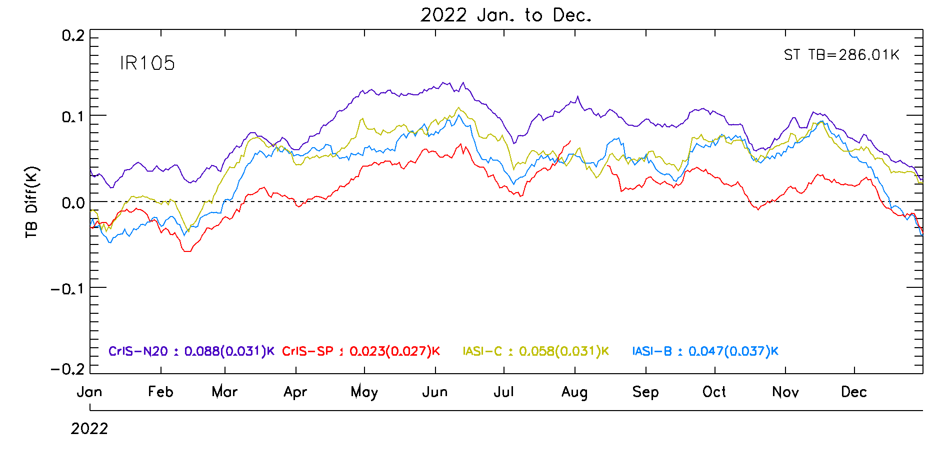
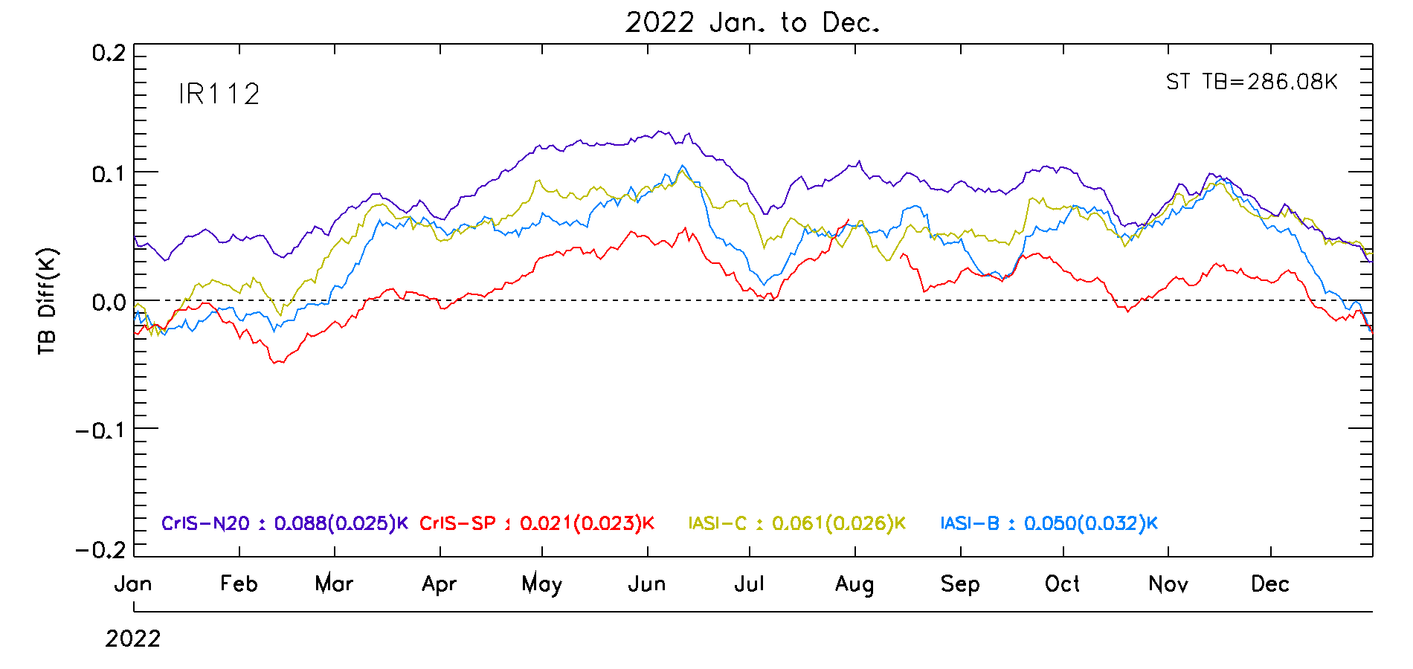
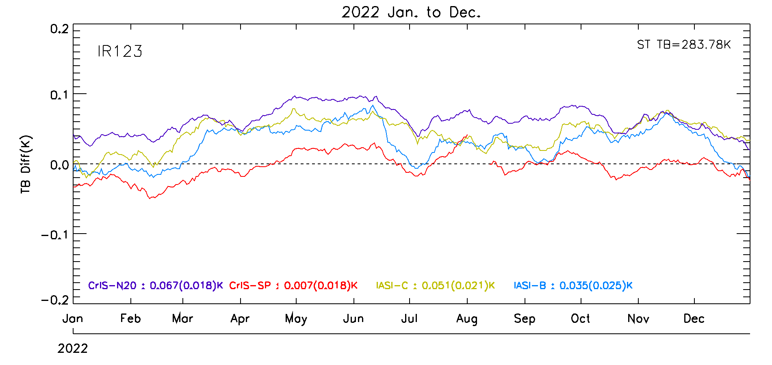
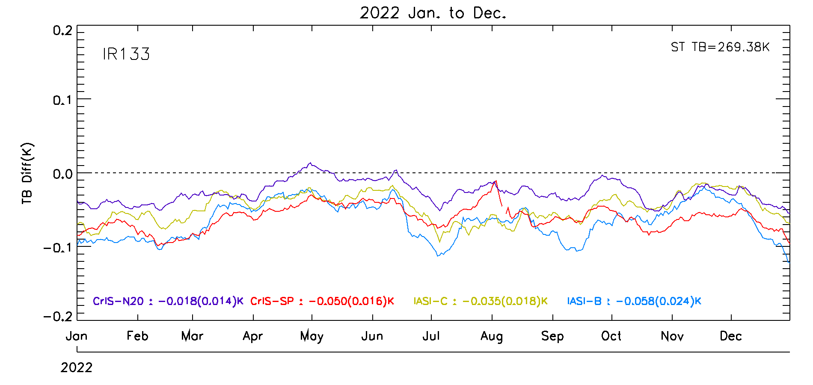
KMA’s Calibration Major Updates (IR)
GEO-LEO using IASI-B, IASI-C, CrIS-NOAA20, CrIS-SNPP (CrIS applied gap-filling method for full spectral resolution data) for RAC
Notes:
This slide shows the major updates for AMI IR Calibration by the GEO-LEO inter-calibration. We used 4 instruments (IASI-B, IASI-C, CrIS-NOAA20, and CrIS-SNPP) for reanalysis correction.
The calibration results for AMI IR channels are stable. But you can see the relatively large variation at the bias of SW038 channel.

Slide 8
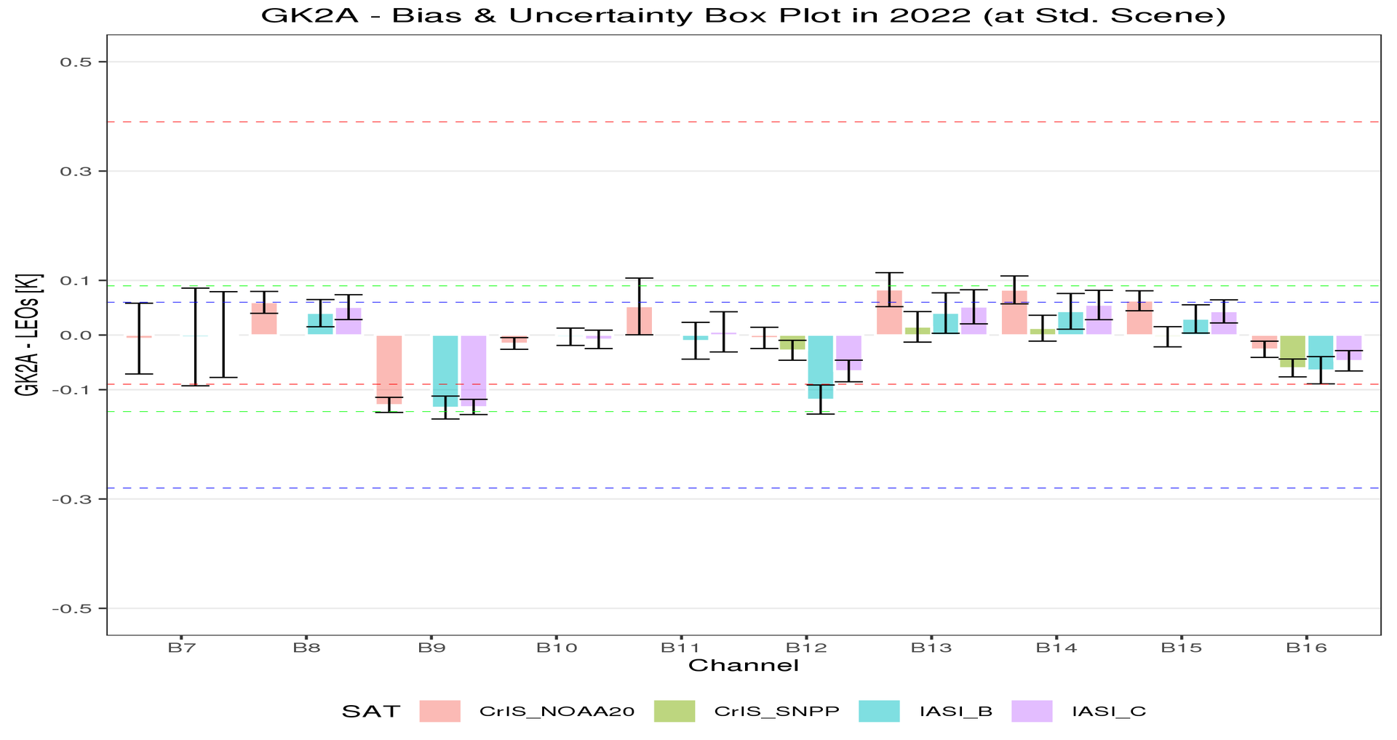
KMA’s Calibration Major Updates (IR)
Statistical Summary of GK2A/AMI IR Calibration Performance in Jan. 1 ~ Dec. 31, 2022
GK2A AMI IR channels are stable
GK2A AMI has relatively large negative bias around -0.13K for 6.9µm (WV channel)
SW038 channel has relatively large uncertainty of 0.09 (Metop_B)
S-NPP has no data due to module malfunction (May 2021 ~)
Reference Satellite |  | Bias (Uncertainty)
 |  | SW038 (3.8㎛) | WV063 (6.3㎛) | WV069 (6.9㎛) | WV073 (7.3㎛) | IR087 (8.7㎛) | IR096 (9.6㎛) | IR105 (10.5㎛) | IR112 (11.2㎛) | IR123 (12.3㎛) | IR133 (13.3㎛)
CrIS | NOAA-20 | -0.01 (±0.06) | 0.06 (±0.02) | -0.13 (±0.01) | -0.02 (±0.01) | 0.05 (±0.05) | -0.01 (±0.02) | 0.08 (±0.03) | 0.08 (±0.03) | 0.06 (±0.02) | -0.03 (±0.01)
 | S-NPP | - | - | - | - | - | -0.03 (±0.02) | 0.01 (±0.03) | 0.01 (±0.02) | -0.00 (±0.02) | -0.06 (±0.02)
IASI | Metop-B | -0.00 (±0.09) | 0.04 (±0.02) | -0.13 (±0.02) | -0.00 (±0.02) | -0.01 (±0.03) | -0.12 (±0.03) | 0.04 (±0.04) | 0.04 (±0.03) | 0.03 (±0.03) | -0.06 (±0.02)
 | Metop-C | -0.00 (±0.08) | 0.05 (±0.02) | -0.13 (±0.01) | -0.01 (±0.02) | 0.01 (±0.04) | -0.07 (±0.02) | 0.05 (±0.03) | 0.05 (±0.03) | 0.04 (±0.02) | -0.05 (±0.02)
Standard Temp.(K) |  | 285.9 | 234.9 | 244.1 | 254.5 | 283.7 | 259.1 | 286.1 | 286.0 | 283.8 | 269.4
Notes:
As I already mentioned, AMI IR calibration performance is stable. But it would be notable that there are relatively large negative bias around -0.13 K for 6.9 um WV channel, and relatively large uncertainty of 0.09 at SW038 channel.

Slide 9
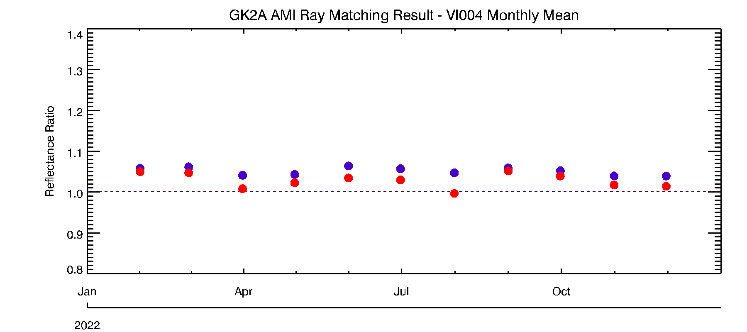
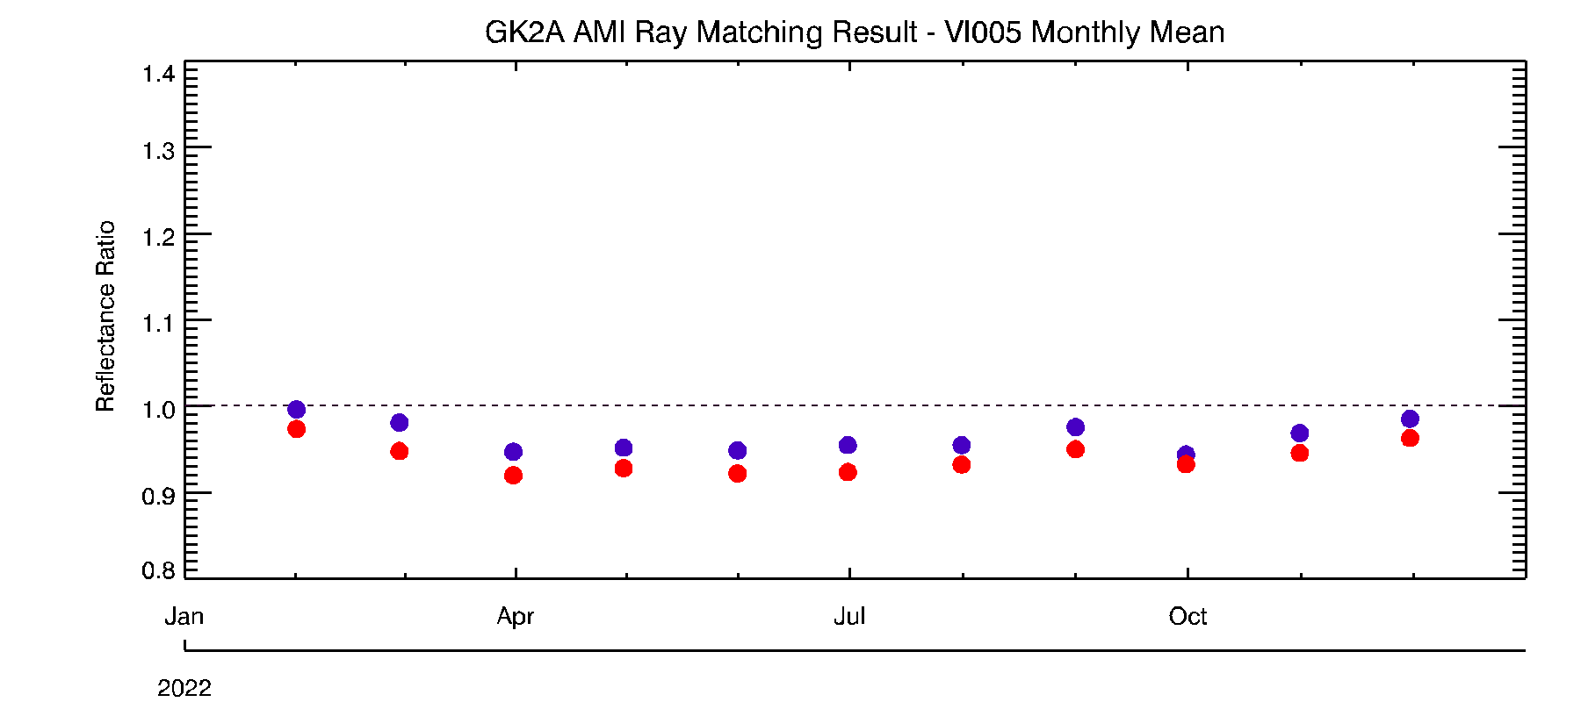
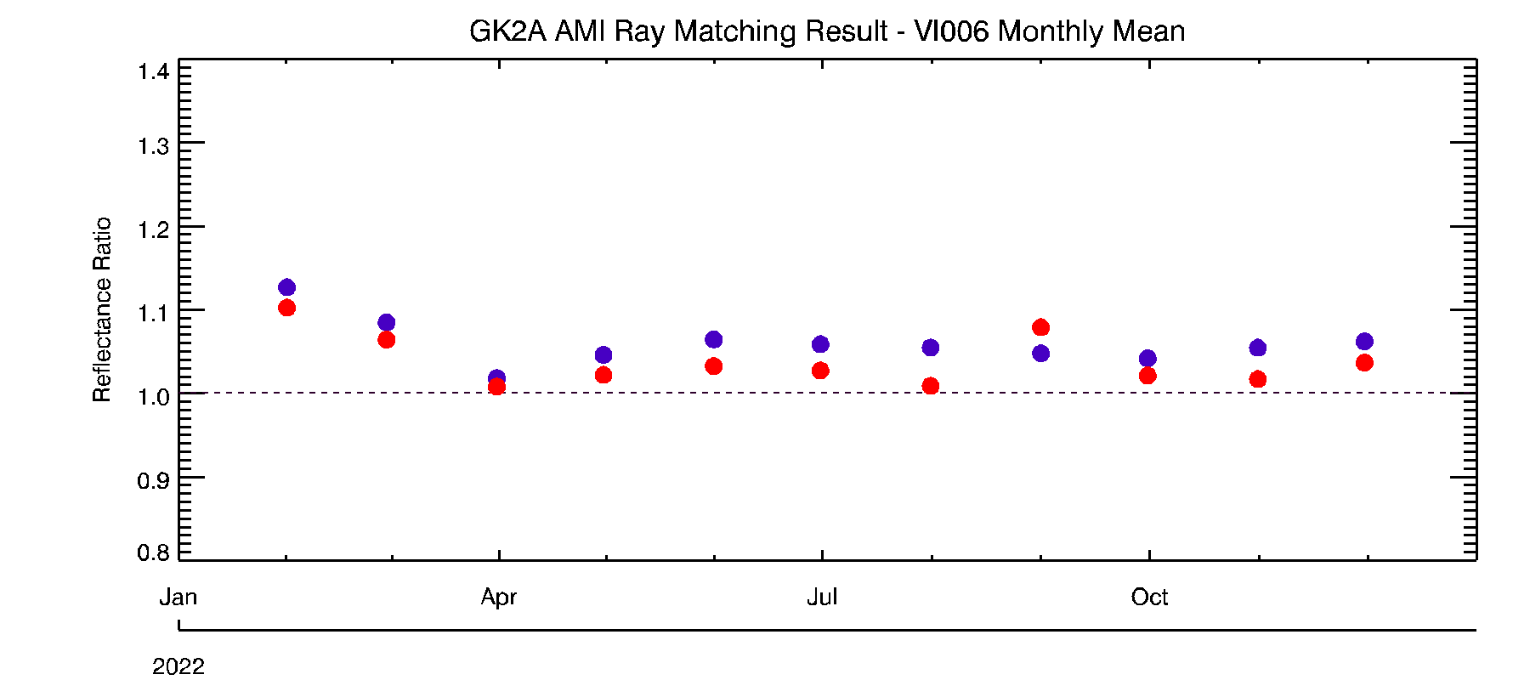
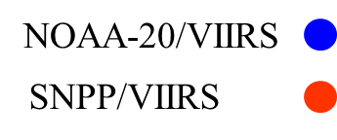
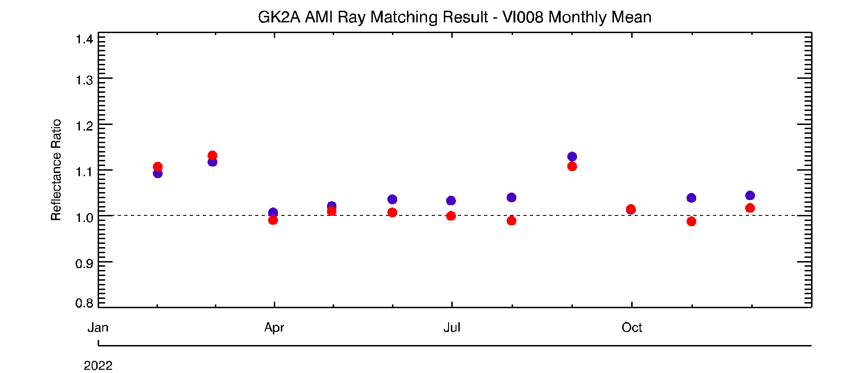
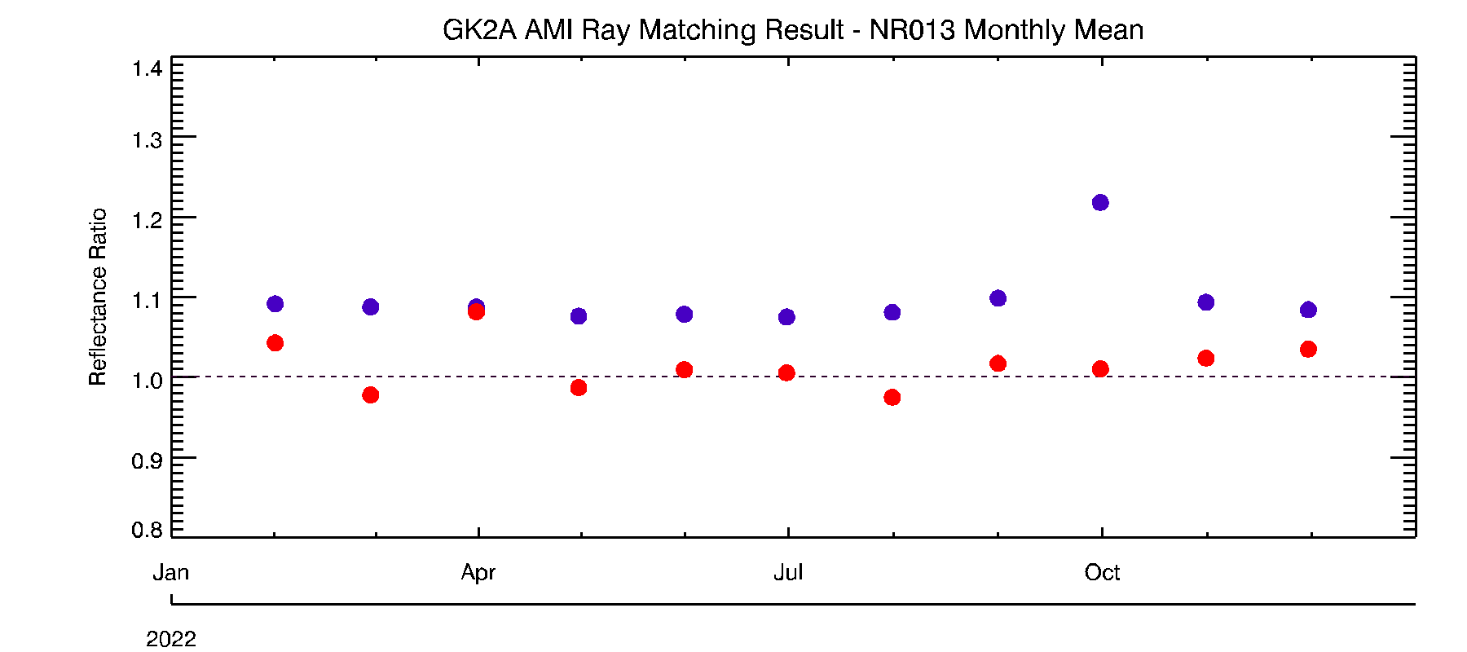
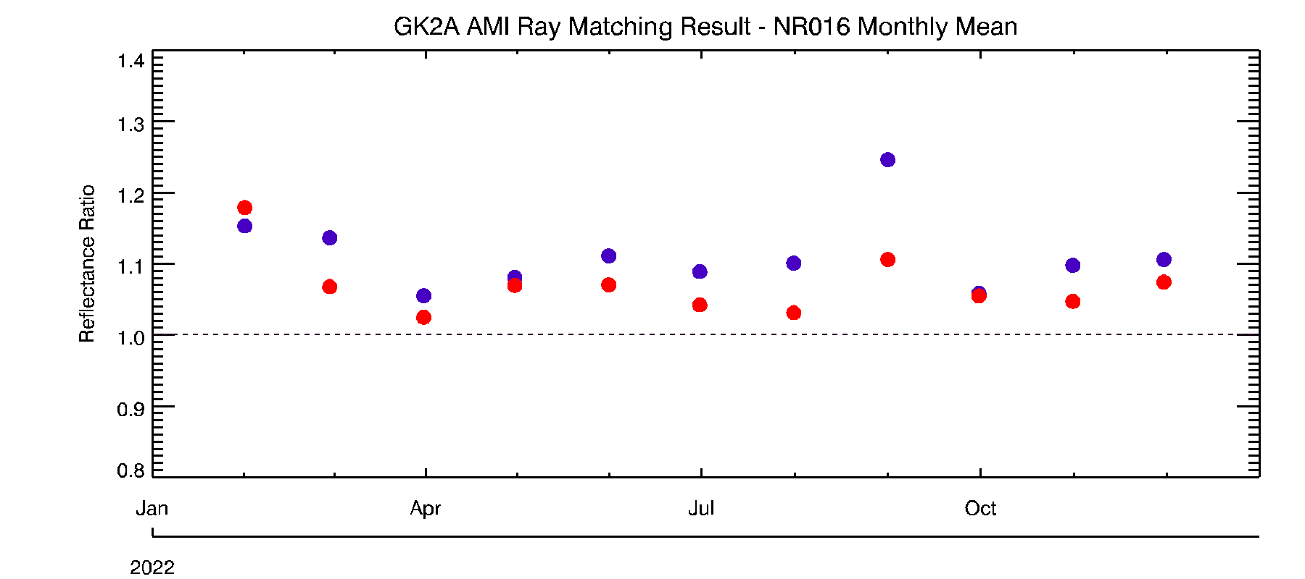
KMA’s Calibration Major Updates (VNIR)
Ray-Matching Method (NOA-20 and SNPP VIIRS) (January - December 2022)
Reflectance Ratio = AMI_Ref / LEO_Ref
Reference Satellite | Mean Bias (Uncertainty)
 | VI004 (0.47 μm) | VI005 (0.51 μm) | VI006 (0.64 μm) | VI008 (0.86 μm) | NR013 (1.37 μm) | NR016 (1.61 μm)
NOAA-20/VIIRS | -2.15 (±1.79) | 2.01 (±1.08) | 4.13 (±1.01) | 2.51 (±1.15) | 2.14 (±0.63) | 8.89 (±1.33)
S-NPP/VIIRS | -3.45 (±2.01) | -0.35 (±1.03) | 2.11 (±0.92) | 0.59 (±1.01) | -2.25 (±0.71) | 5.41 (±0.95)
Notes:
This slide shows calibration results for the AMI VIS/NIR channels. Mean bias are mostly less than 5% except for NR016 channel.

Slide 10
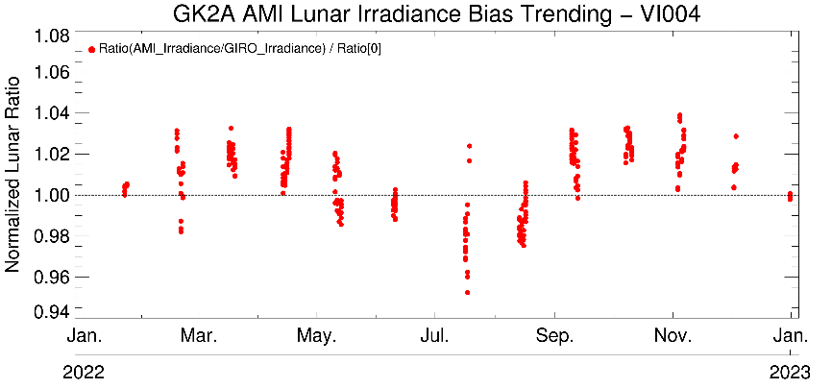
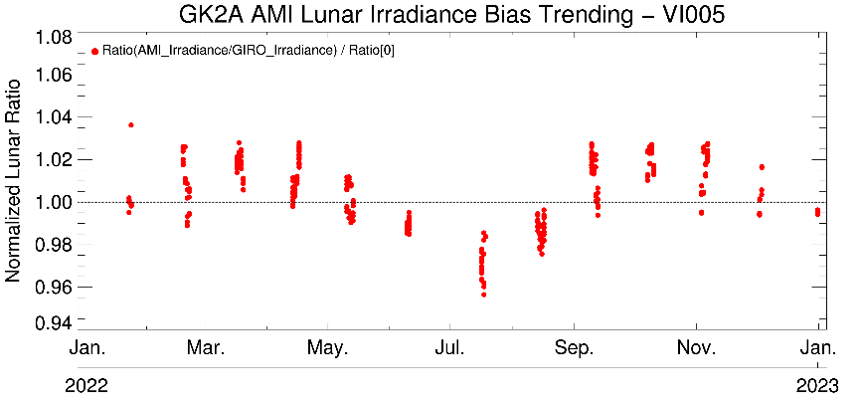
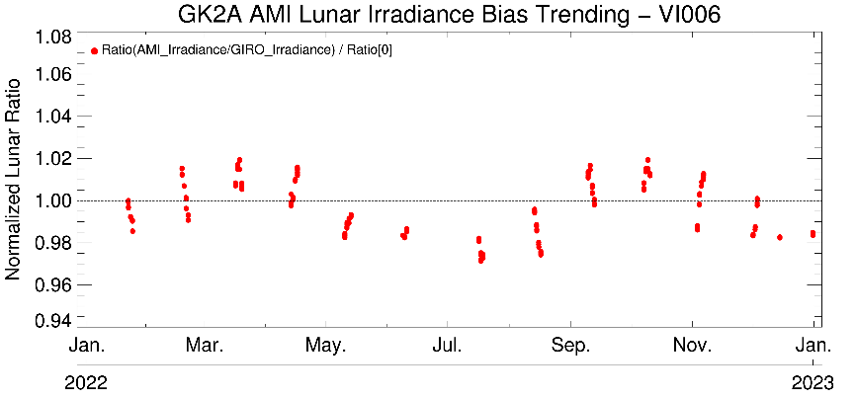
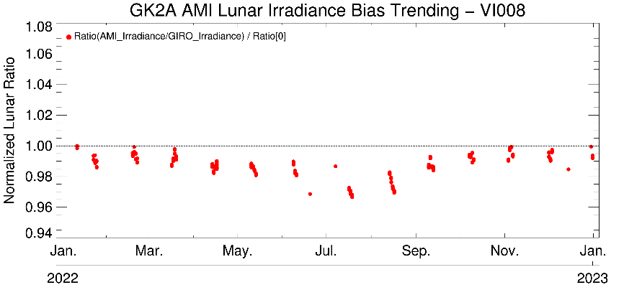
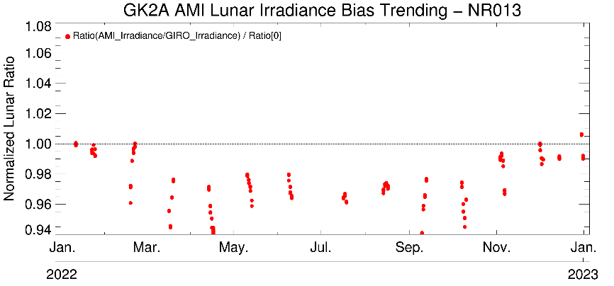
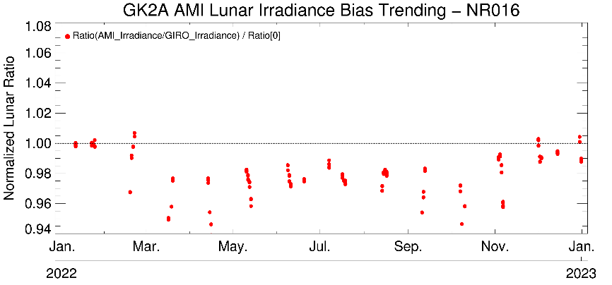
KMA’s Calibration Major Updates (VNIR)
Lunar Calibration Results using GIRO (January - December 2022)
Show the seasonal variation on ray-matching method and lunar Calibration
Notes:
This slide shows lunar calibration results using GIRO. You can see the large seasonal variation of the normalized lunar ratio. Thank you for your attention!

Slide 11
Thank you

Slide 12
KMA’s Personnel supporting GSICS
GSICS EP
Dohyeong Kim
GRWG
Jiyoung Kim, Tae-Hyeong Oh, and Euidong Hwang (new member)
GDWG
Tae-Hyeong Oh (new member)
Member | GRWG | GDWG | GEO-LEO | DCC RTM | Moon | GEO-GEO
Jiyoung Kim (Mr.) | Y |  | Y | Y | Y | Y
Euidong Hwang (Mr.) | Y |  | Y |  |  | Y
Tae-Hyeong Oh (Mr.) | Y | Y |  | Y | Y

Slide 13
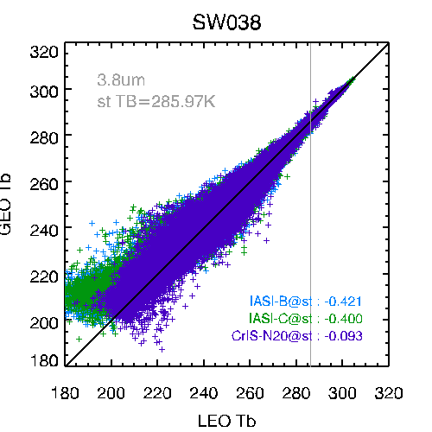
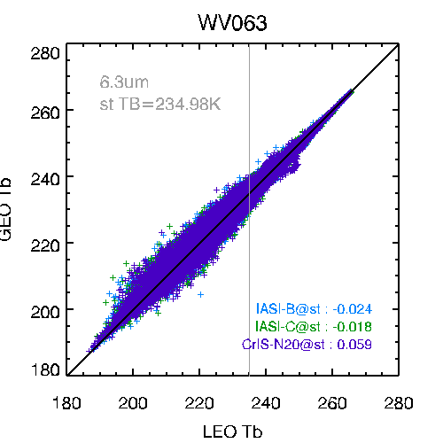
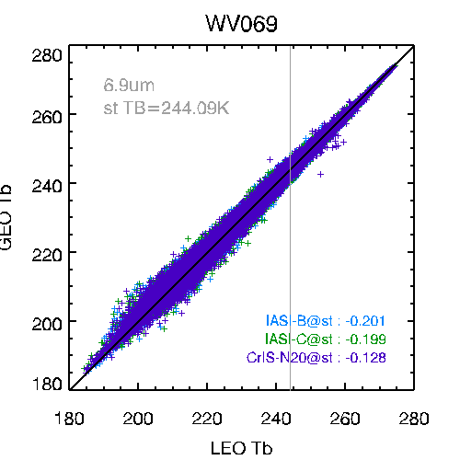
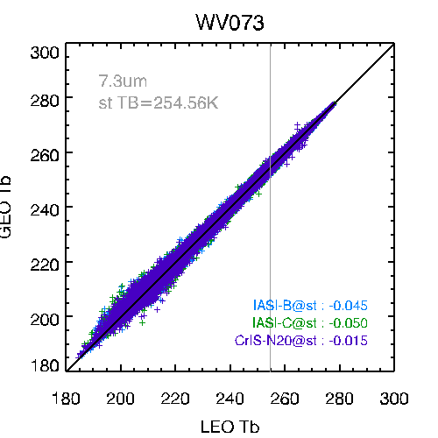
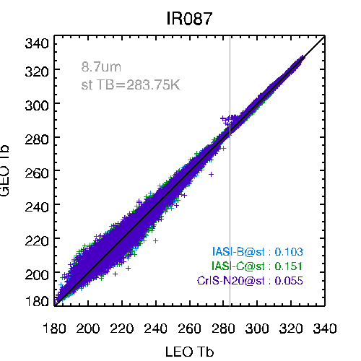
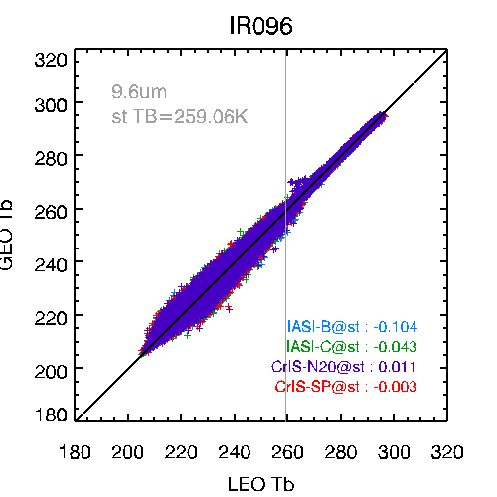
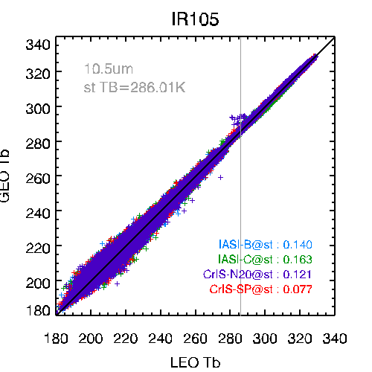
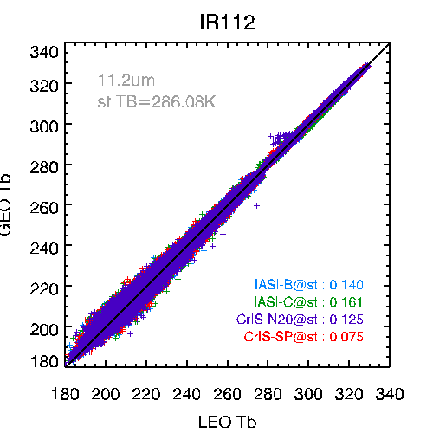
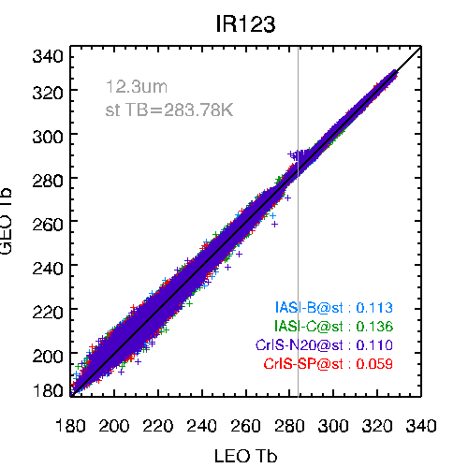
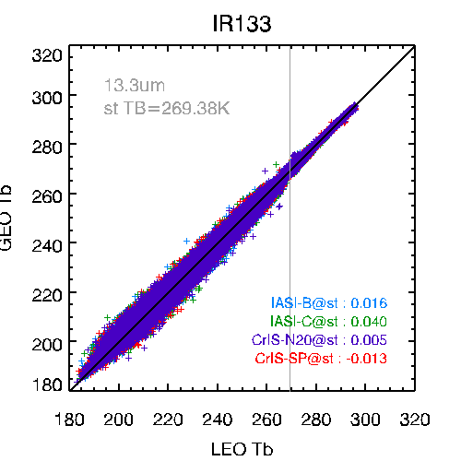
KMA’s Calibration Stand-up Items (VNIR)
Tb Bias(AMI – LEOs)(K) @ standard scene (IASI-B, IASI-C, CrIS-NOAA20, CrIS-SNPP)
Period of data : Jan. 1, 2022 – Dec. 31, 2022

Slide 14
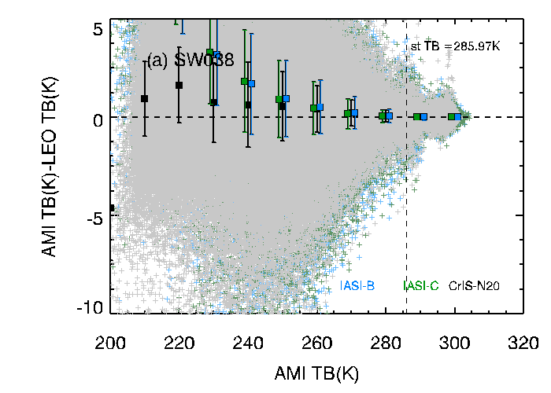
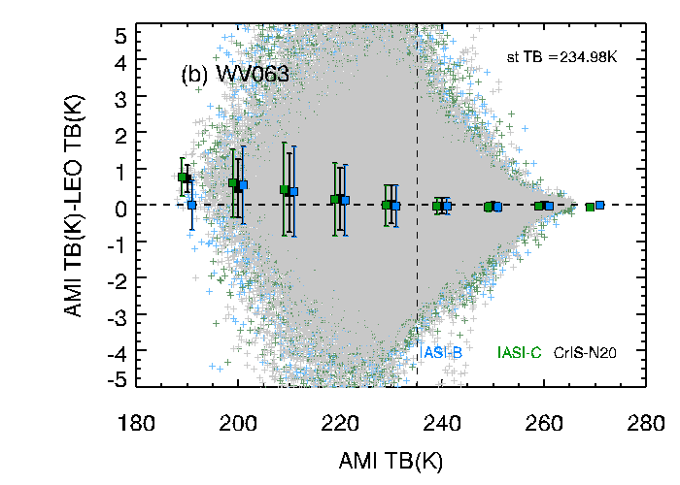
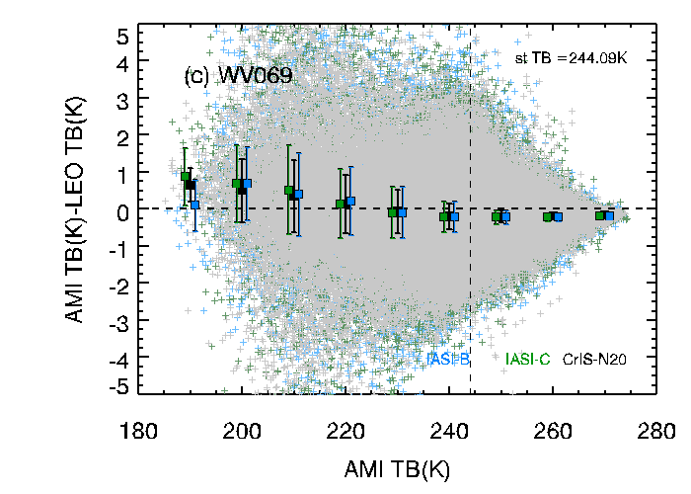
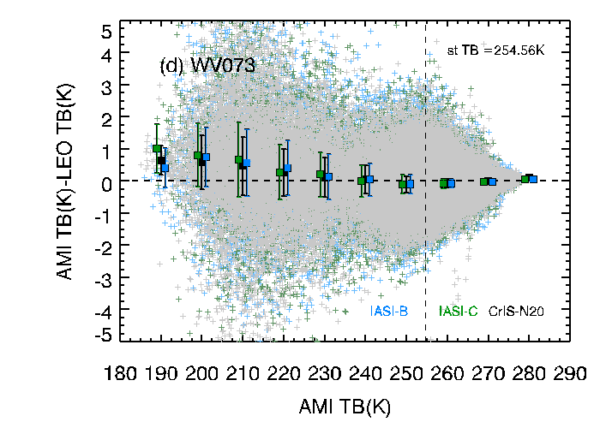
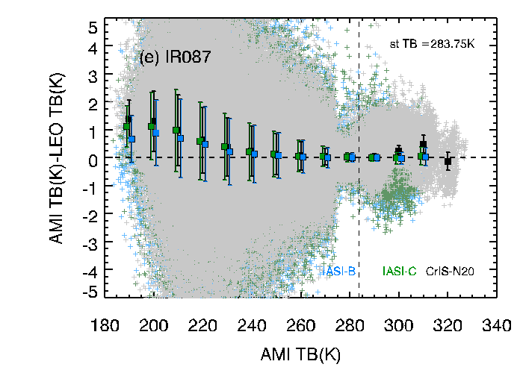
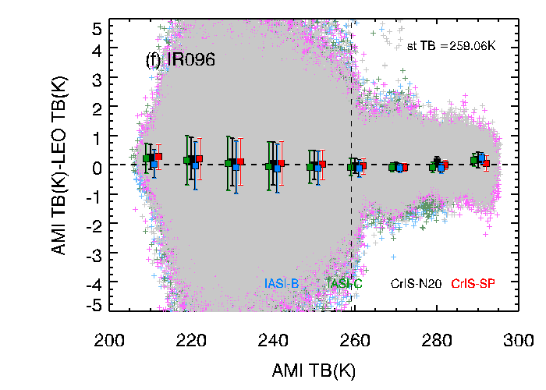
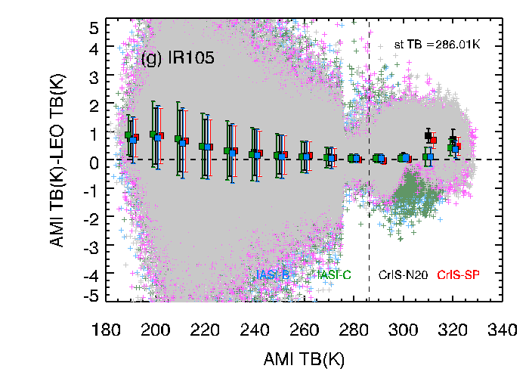
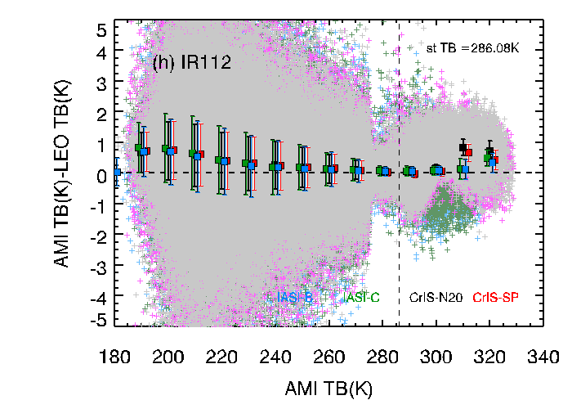
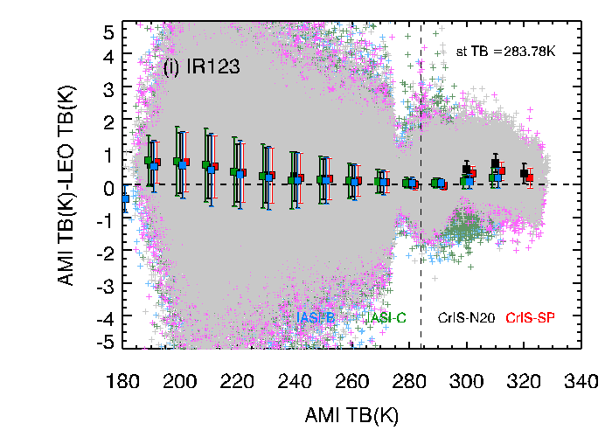
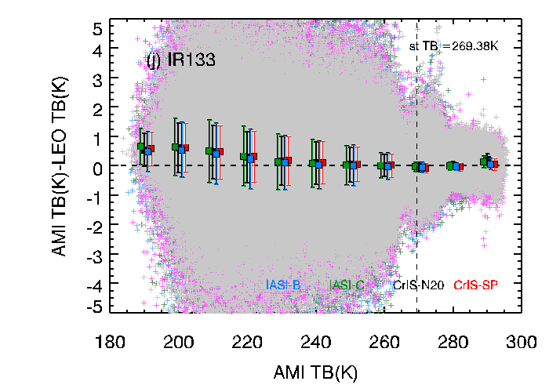
KMA’s Calibration Stand-up Items (VNIR)
The mean of ΔTB (for 10K bin) and standard error (IASI-B, IASI-C, CrIS-NOAA20, CrIS-SNPP)
Period of data : Jan. 1, 2022 – Dec. 31, 2022
For 3.8µm and all three WV channels, ΔTB at warmer temperature are more stable than those at lower temperature.
From 8.7 to 13.3µm channels, the ΔTB (TB_{AMI}-TB_{LEOs}) at hot scene (>300K) show large positive anomaly

