Slide 1
FY-3E/X-EUVI Calibration Improvements and Applications
Qiao Song, Jinping Dun, Cong Huang, and FY-3E/X-EUVI Teams
National Satellite Meteorological Center (National Center for Space Weather)
China Meteorological Administration

Slide 2
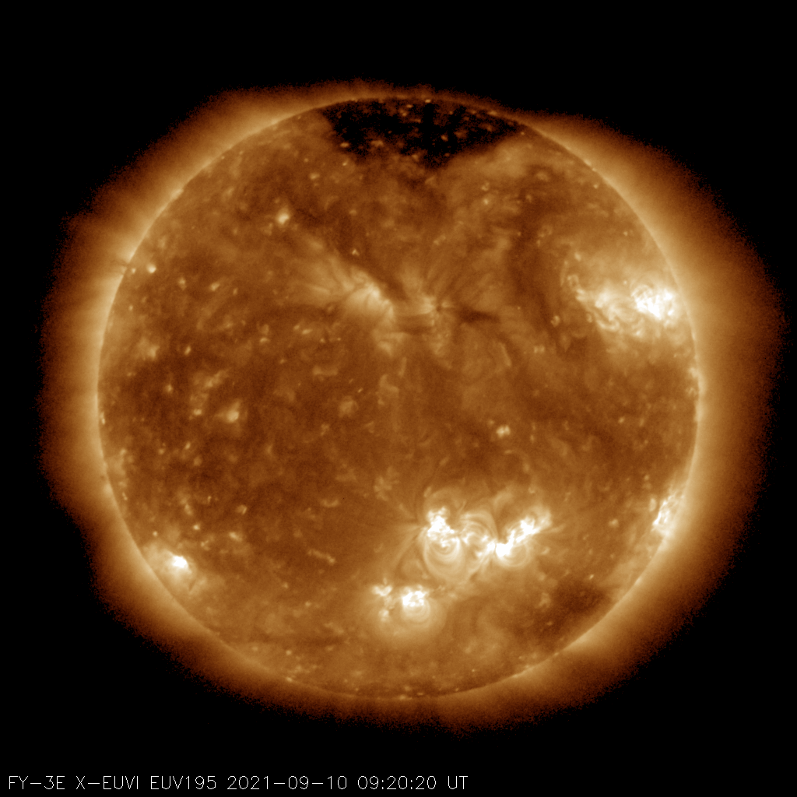
Presentation Overview
Introduction
Performance Test Results
Pre-launch Testing of Effective Area Distribution
In-orbit Imaging Resolution Measurement
Calibration
Radiometric Calibration
Flat Field Correction Methods
Brightness Degradation Calibration
Applications of Space Weather

Slide 3
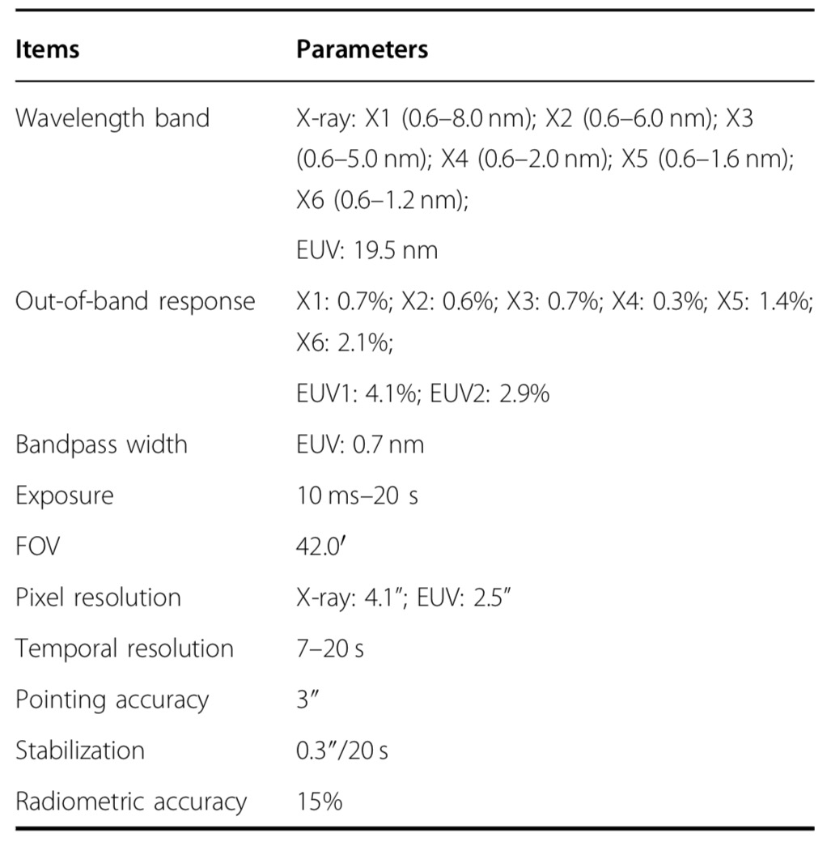
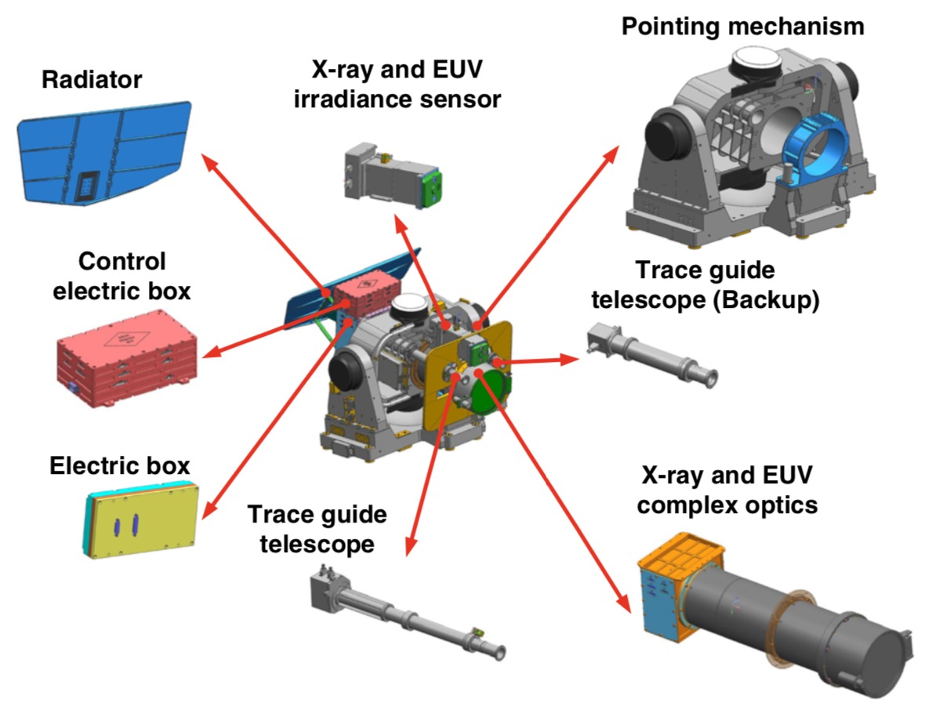
1.1 Solar X-ray & Extreme Ultraviolet Imager (X-EUVI)
(Chen et al., Light, 2022)
Notes:
FY-3E, launched on 4 July 2021, and X-EUVI is the first solar X-ray and EUV imager of China in orbit.
irradiance
sensor
parameter abbreviation
Extreme
Ultraviolet
Imager

Slide 4
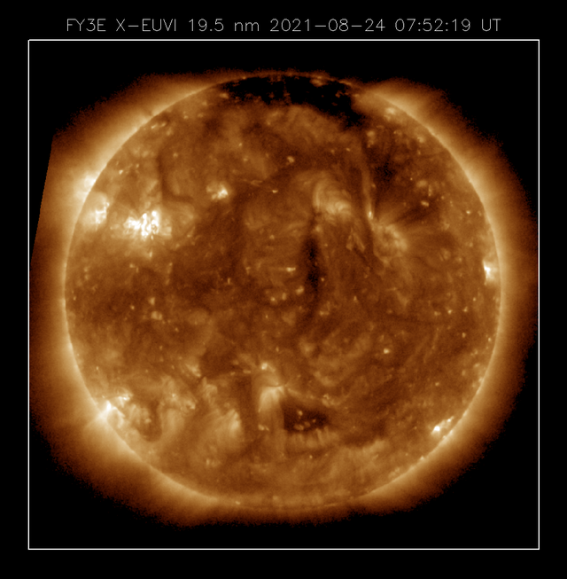
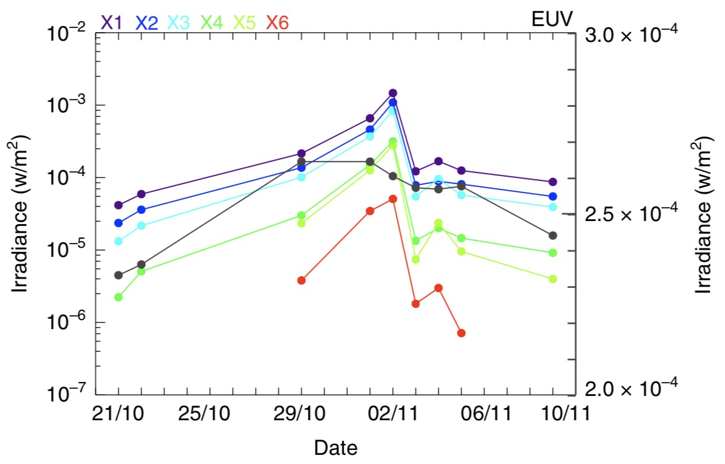
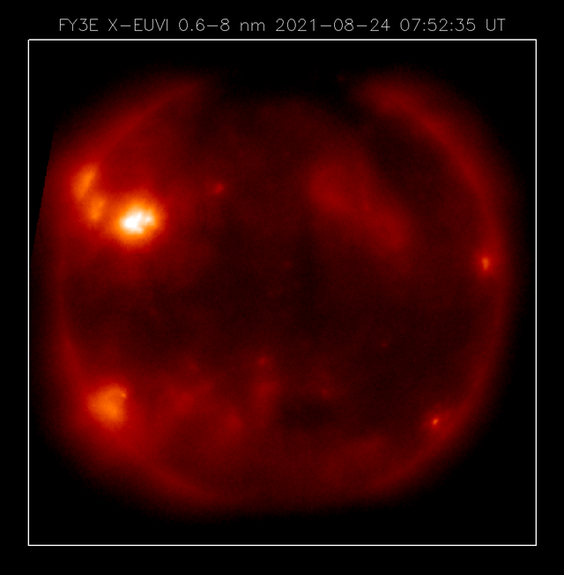
1.2 X-EUVI: Observations
Solar irradiance variations measured by X-EUVS
(Chen et al., Light, 2022)
Solar EUV & X-ray images observed by X-EUVI

Slide 5
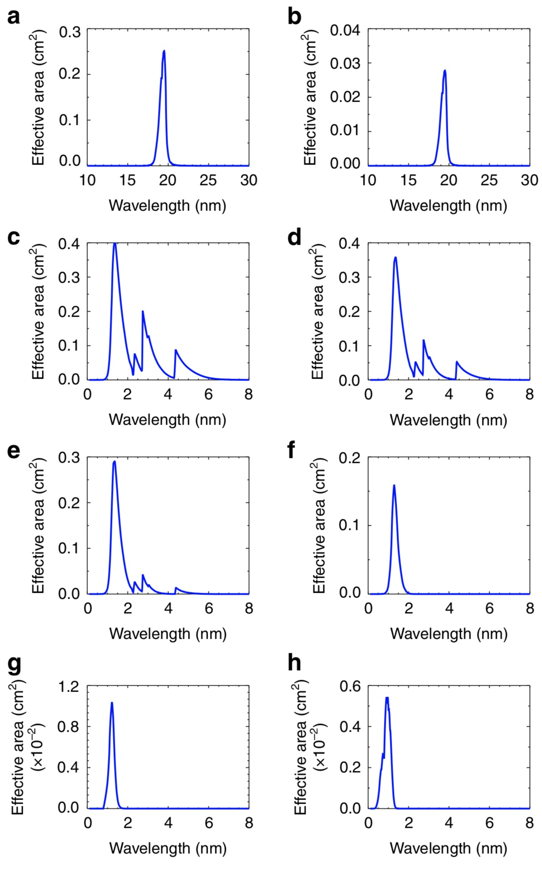
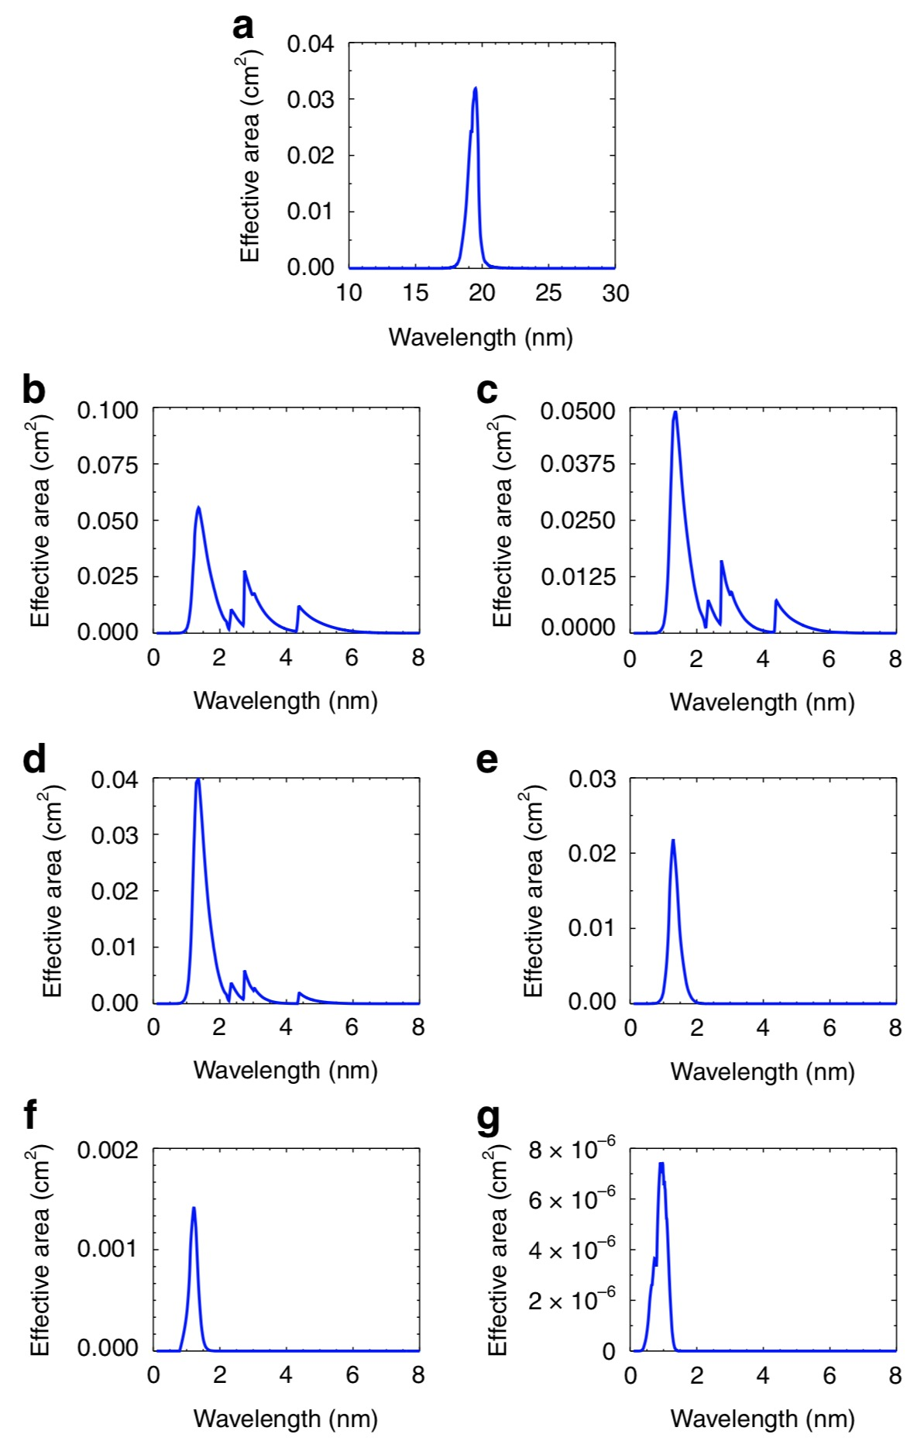
2.1 Performance Test Results: Effective Area Distribution
EUV1
EUV2
EUV
Pre-launch Testing of Effective Area Distribution for X-EUVI (left) and X-EUVS (right)
EUV: 19.5 nm
X1: 0.6-8.0 nm
X2: 0.6-6.0 nm
X3: 0.6-5.0 nm
X4: 0.6-2.0 nm
X5: 0.6-1.6 nm
X6: 0.6-1.2 nm
X1
X2
X1
X2
X3
X4
X3
X4
X5
X6
X5
X6
(Chen et al., Light, 2022)
Notes:
Effective
Area Distribution
Performance Test Results

Slide 6
2.2 Performance Test Results: Resolution
In-orbit observation of a point target to reveal the resolution of X-EUVI
(Chen et al., Light, 2022)

Slide 7
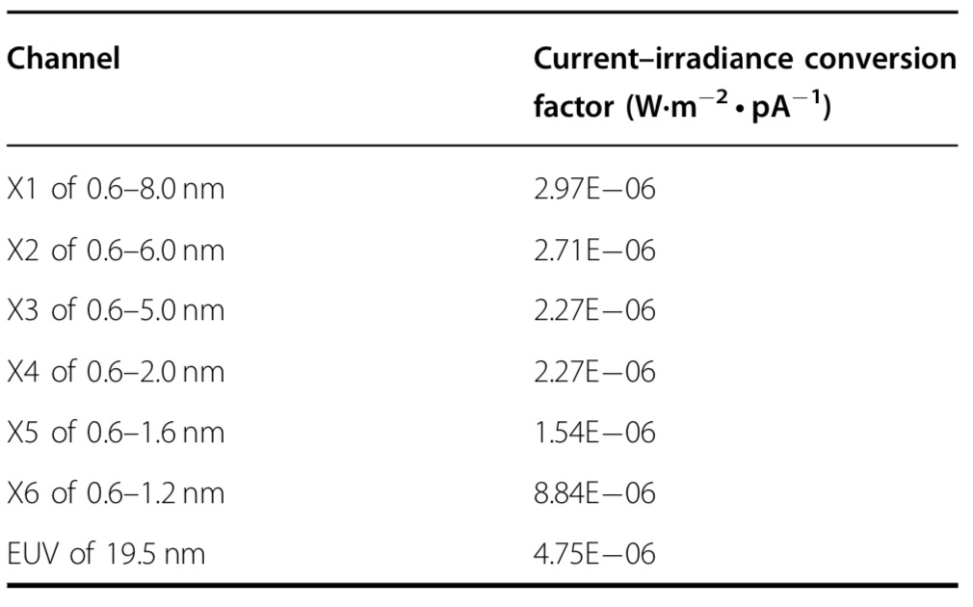
3.1.1 Radiometric Calibration
Before launching, X-EUVS is calibrated in CIOMP. First, the parameters of the sensor optics are calibrated by an X-ray and EUV reflectometer, which include the transmittance of the pre-filter, transmittance of the passband filter and reflectivity of the mirror. The irradiance of the full-disk Sun can be calculated by the formula.
where E_{sun} is the solar full-disk irradiance, I_{d} is the photon current tested by the sensor, R_{d} is the response factor of the diode, A is the entrance pupil area, and τ is the system transmittance, which is the product of the filter transmittance and mirror reflectivity.
Current-irradiance conversion factors of the X-ray and EUV sensor
(Chen et al., Light, 2022)

Slide 8
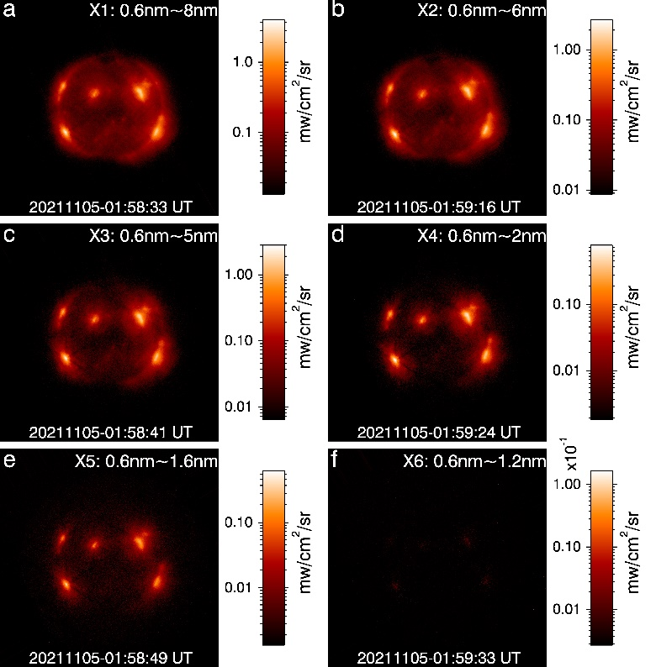
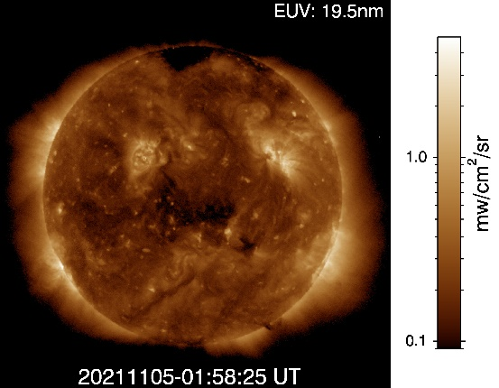
3.1.2 Radiometric Calibration
The irradiance data of X-EUVS was applied to calibrate the X-EUVI images. The X-ray and EUV absolute brightness images are obtained.
(Chen et al., Light, 2022)

Slide 9
3.2.1 Flat Field Correction: KLL Algorithm
An algorithm to calculate the flat field coefficient based on series of rotated images captured X-EUVI onboard FengYun-3E satellite is proposed. The method includes:
Determination of the solar disk centers and radiuses
Calculation of the rotation angles
Coordinate transformation to expand the solar disk into rectangles
Derivation of the flat matrix using KLL algorithm.
(Ding et al., Frontiers in Physics, 2022)
The Hough gradient method is used to detect the disk circle in EUV solar image

Slide 10
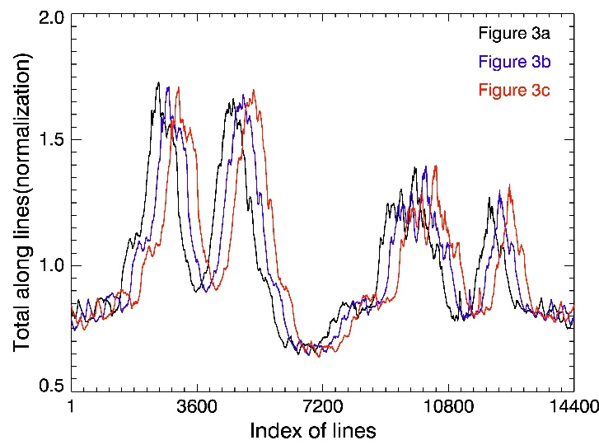
3.2.2 Flat Field Correction: KLL Algorithm
After the location of the image centroid is determined, the rotation angles between the sequence images need to be calculated. The method to calculated the rotation angle is developed from the log-polar transform.
The processes are divided into three steps including extracting rays from the center of the image, calculating the sum of the gray values along the ray to obtain the polar gray curve, and determining the rotation angle between the sequence images based on two curves using the correlation algorithm.
(Ding et al., Frontiers in Physics, 2022)

Slide 11
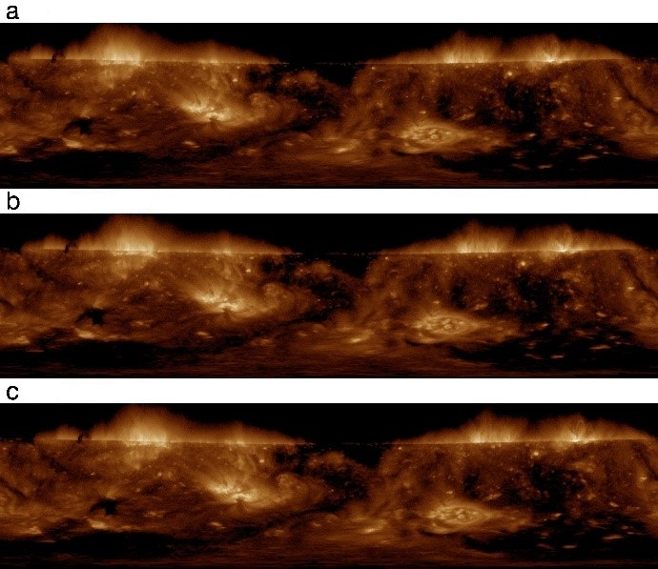
3.2.3 Flat Field Correction: KLL Algorithm
After the solar image centers are determined, the Cartesian coordinate system is established with the center as the origin, and then the solar images are expanded into rectangular shapes
The FY-3E satellite rotates relative to the Sun, and the solar images taken by X-EUVI are rotated relative to the center of the field of view.
The flat field was determined using KLL algorithm and the rotation angles.
(Ding et al., Frontiers in Physics, 2022)

Slide 12
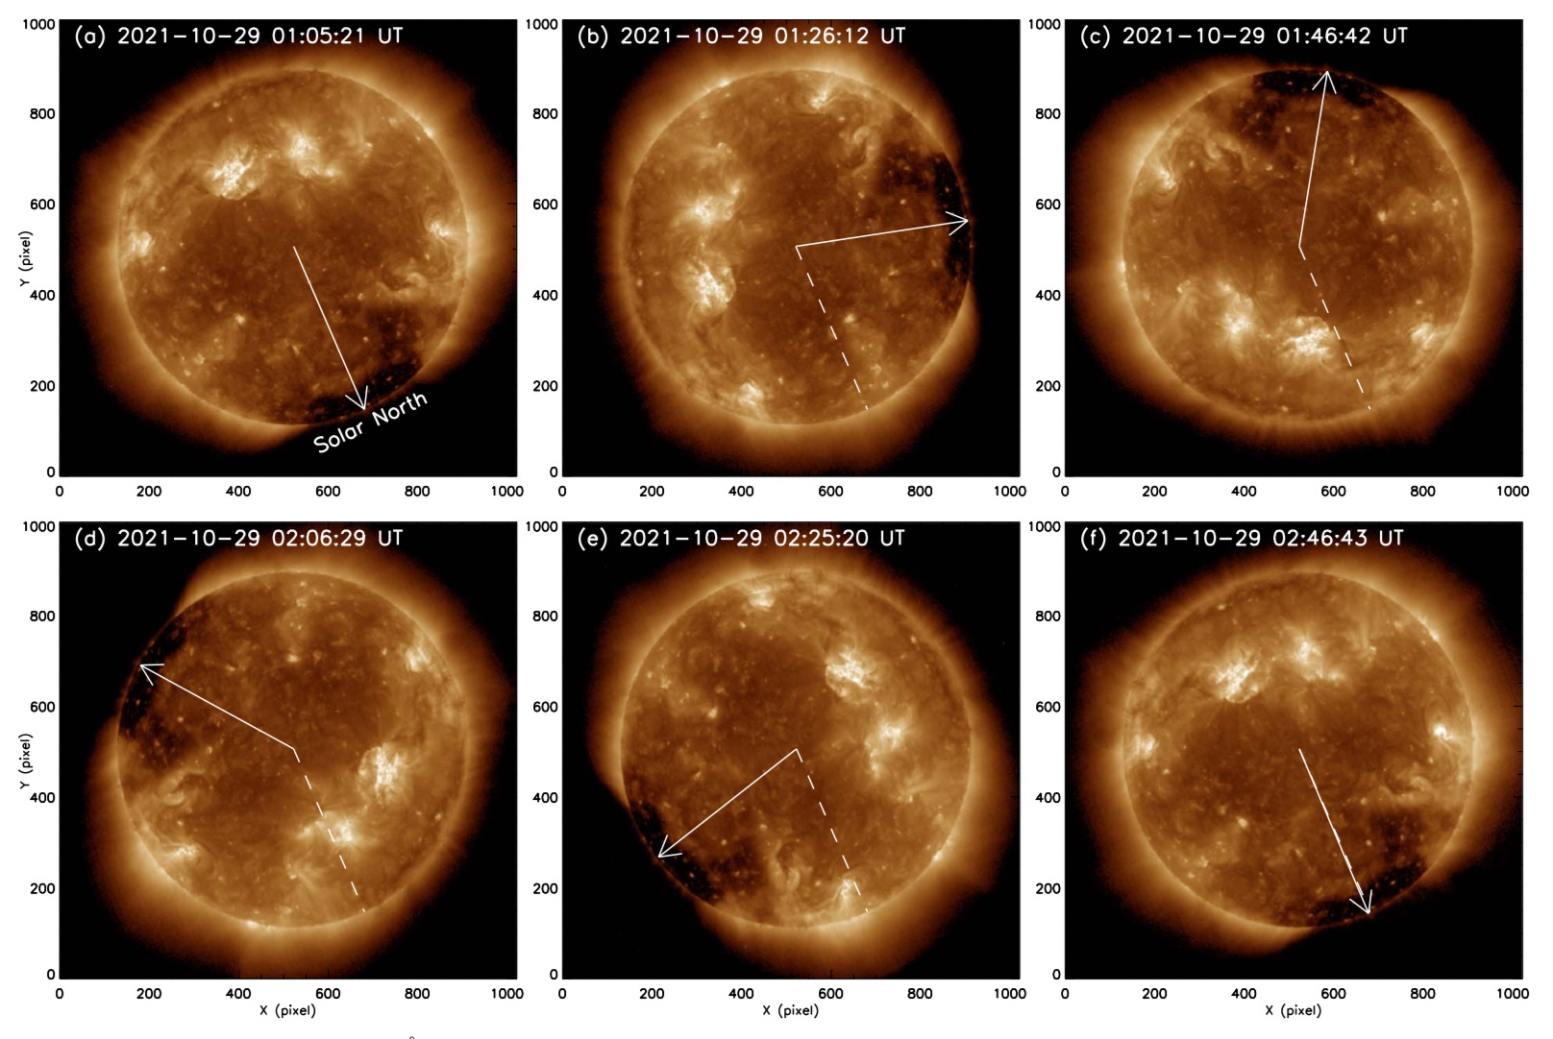
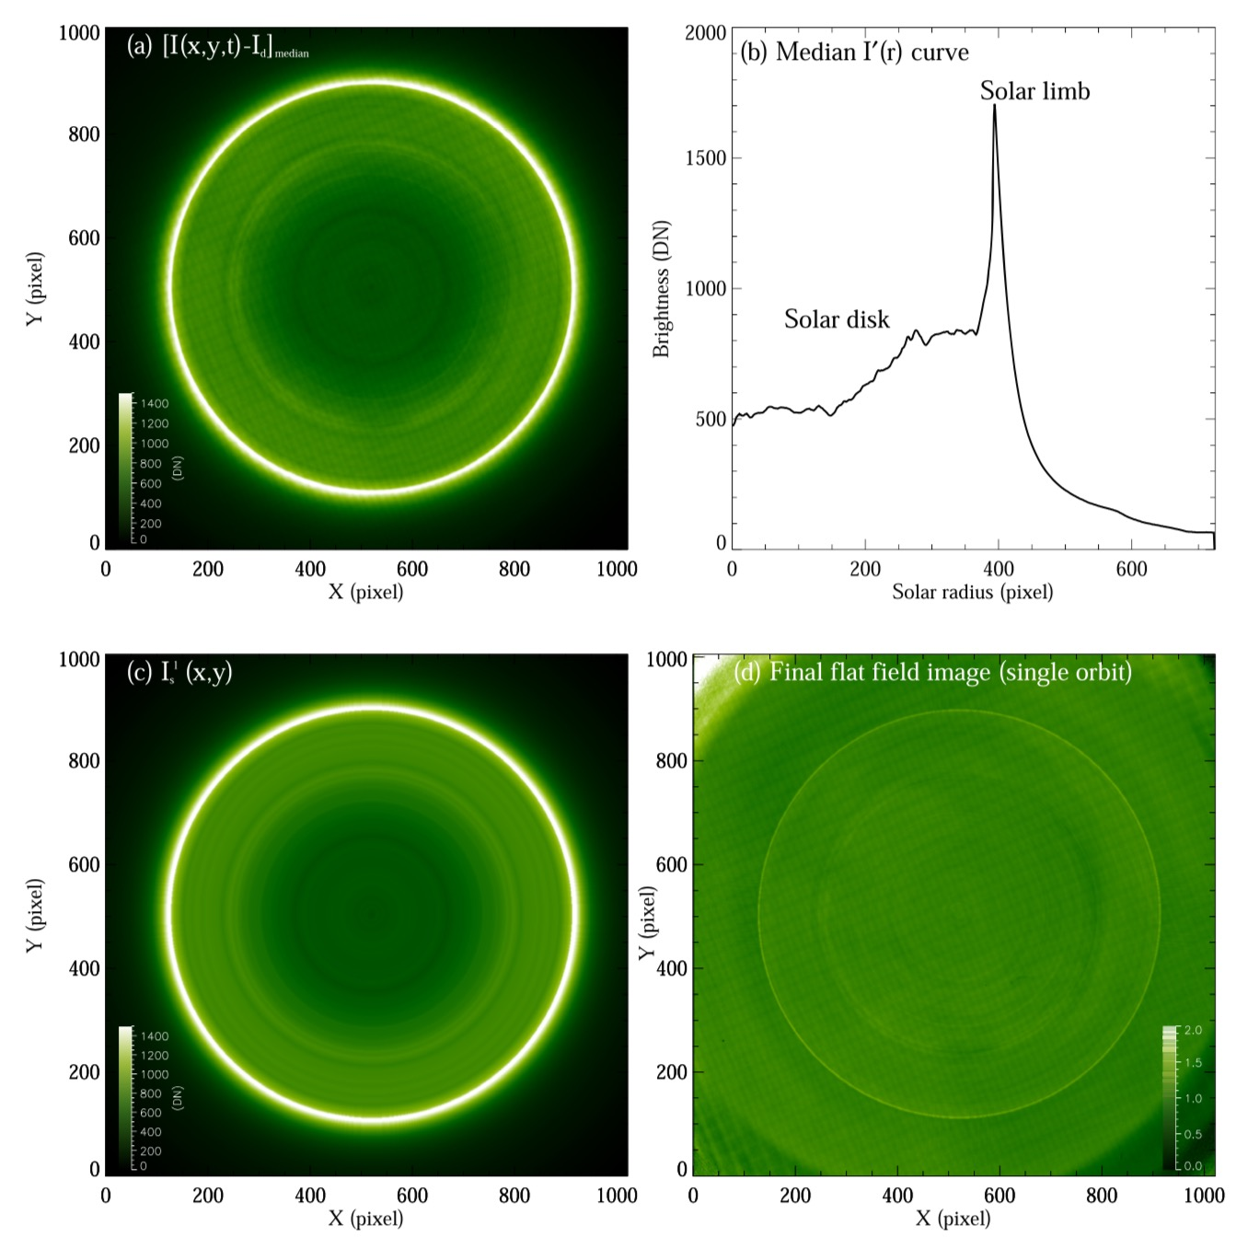
3.3.1 Flat Field Correction: Median Method
(Song et al., RAA, 2022)

Slide 13
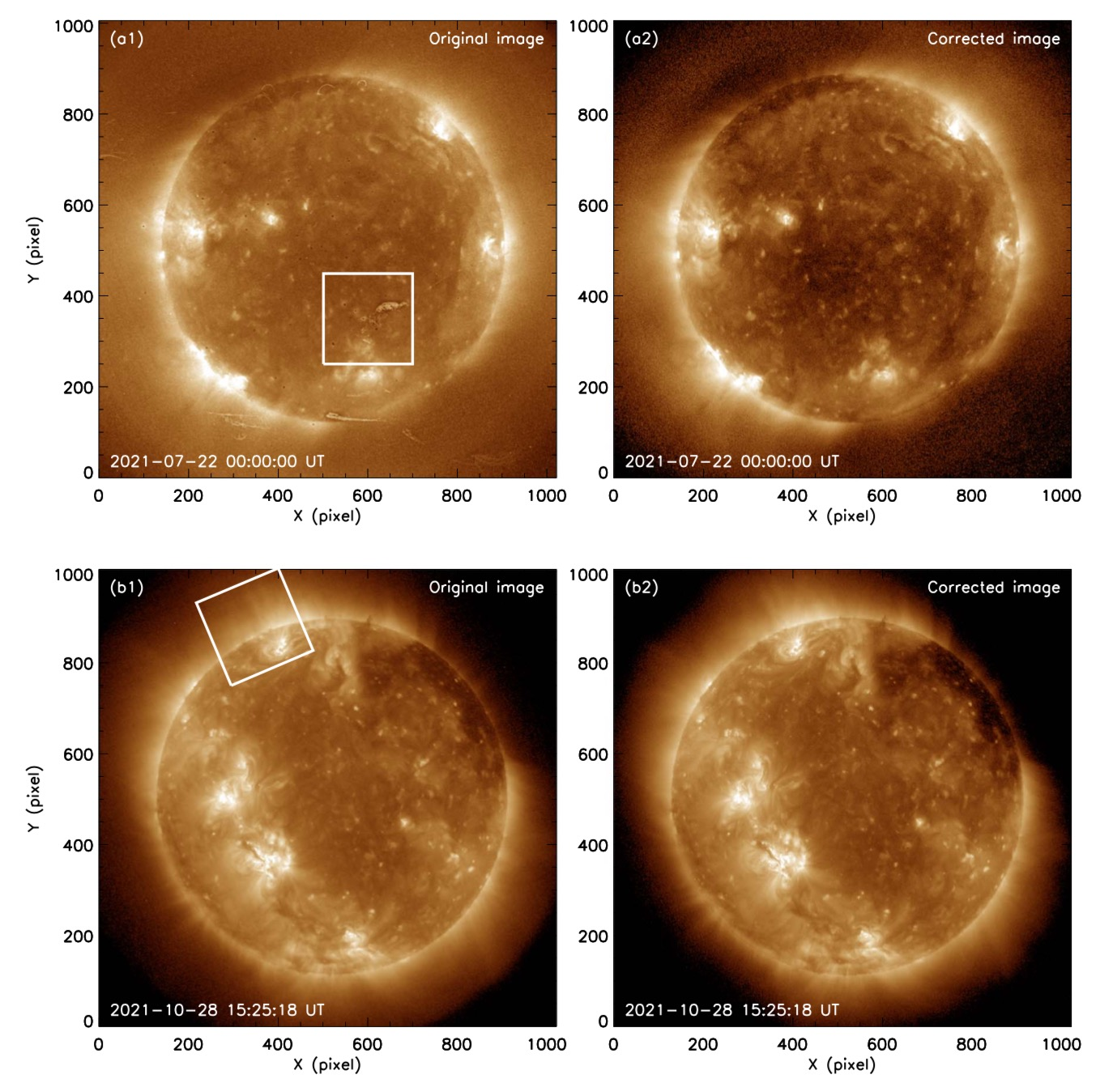
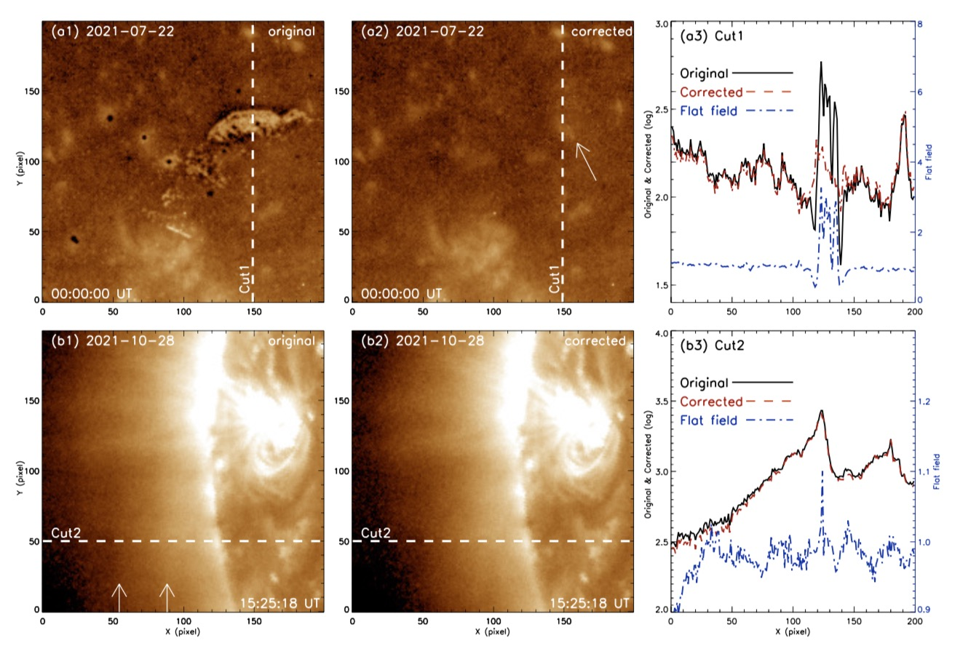
3.3.2 Flat Field Correction: Median Method
(Song et al., RAA, 2022)

Slide 14
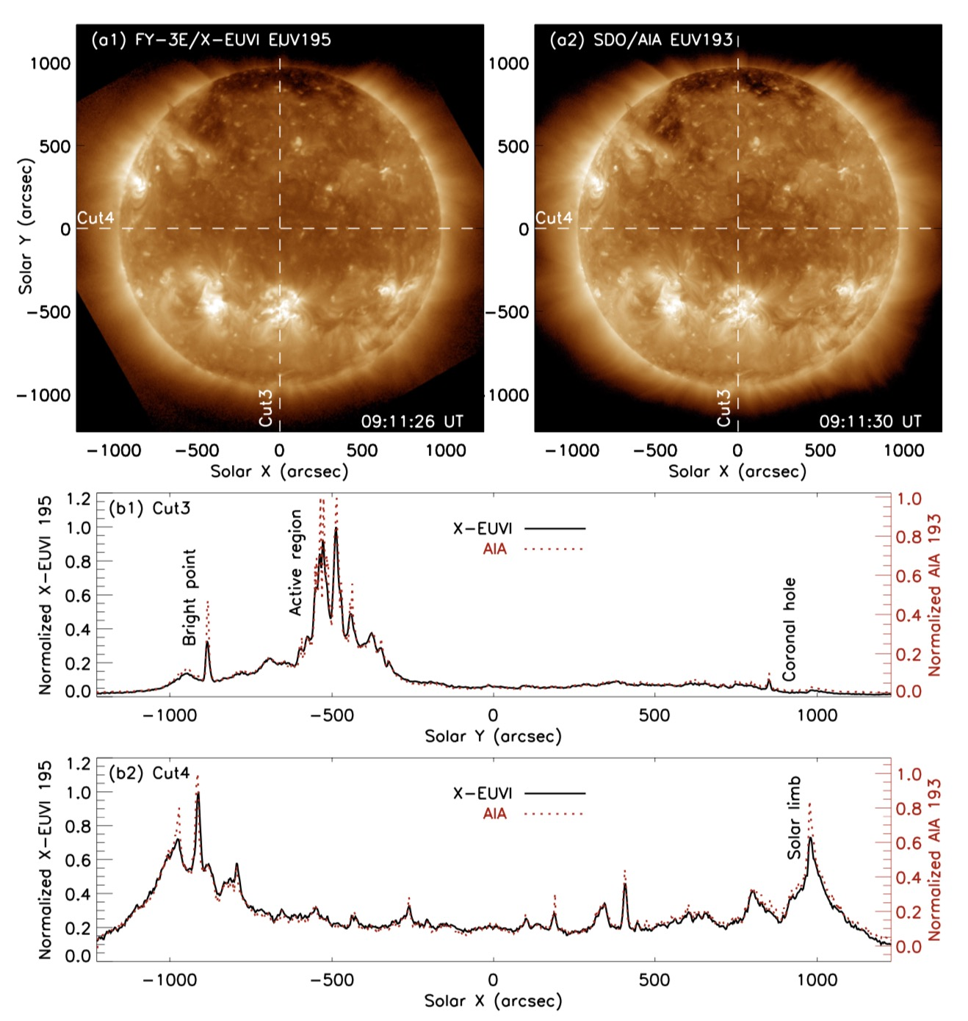
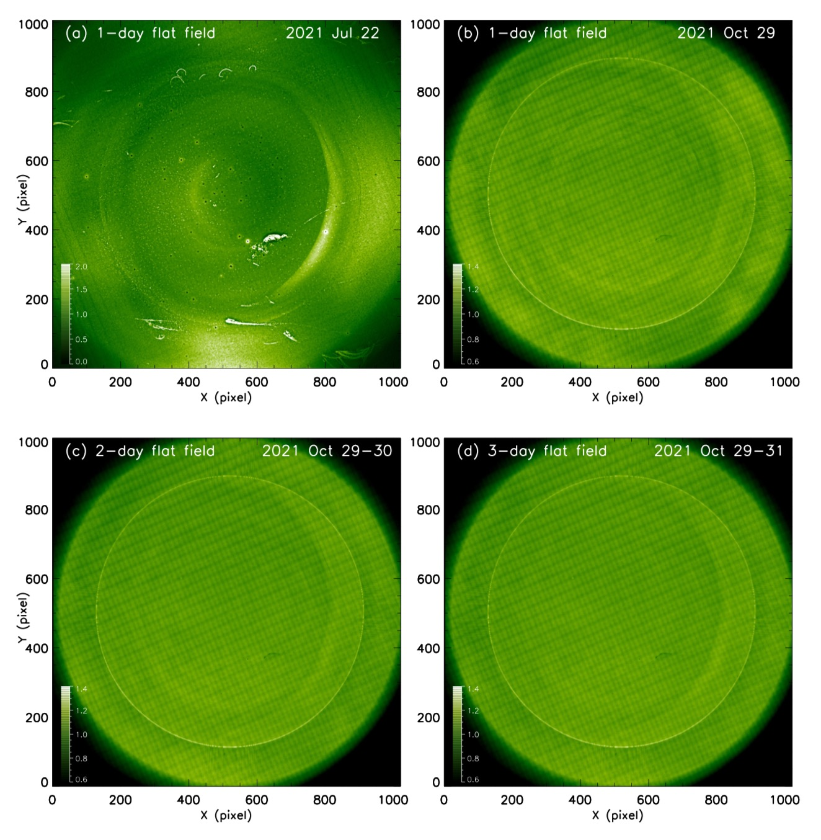
3.3.3 Flat Field Correction: Median Method
(Song et al., RAA, 2022)

Slide 15
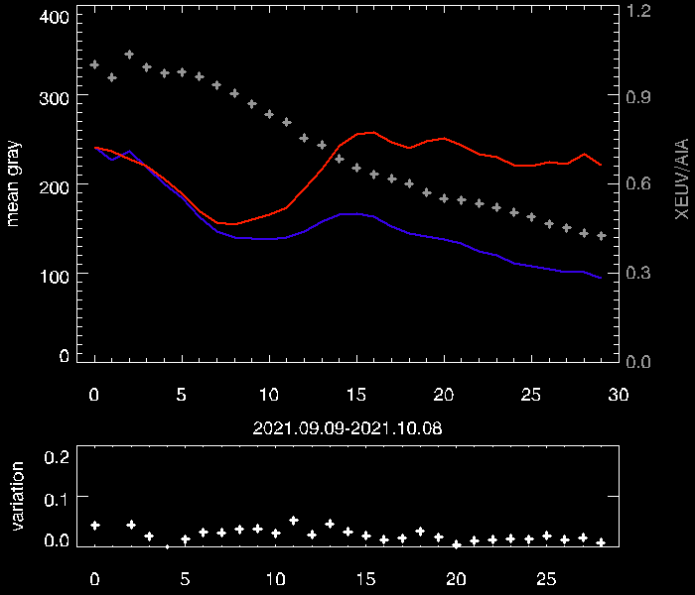
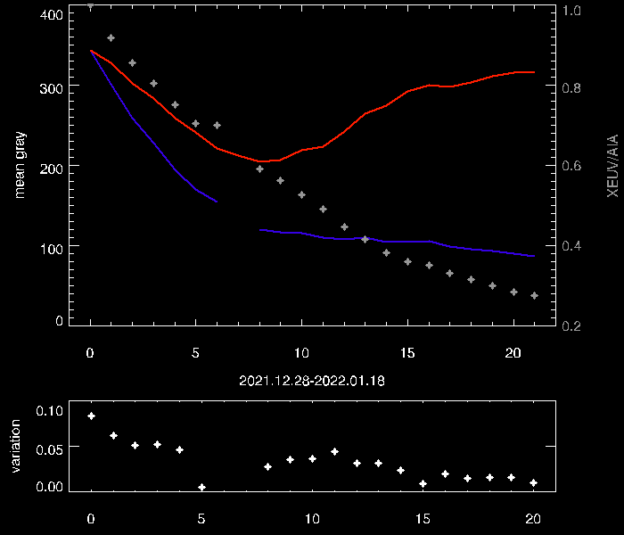
3.4.1 Brightness Degradation Calibration
We found that X-EUVI has a brightness degradation of images due to detector contamination when operating in orbit. The main reason for the brightness degradation is the presence of water vapor inside the instrument and the adsorption of water vapor on the surface of the detector at low temperature. After heating for decontamination, the image brightness and instrument response have basically recovered.
SDO/AIA
SDO/AIA
15-day degradation of full-channel mode
30-day degradation of EUV 195 single-channel mode
X-EUVI
X-EUVI
Credit: Lingping He, CIOMP

Slide 16
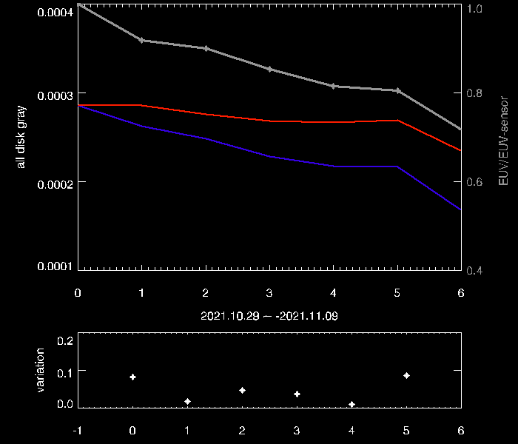
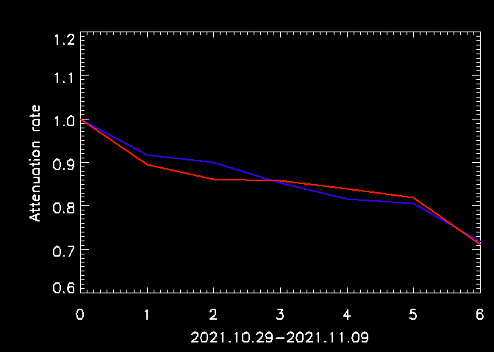
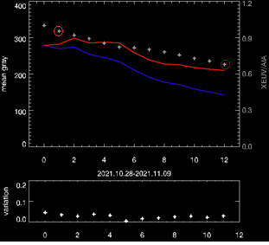
3.4.2 Brightness Degradation Calibration
We calibrated the image degradation using X-EUVS and SDO/AIA data, respectively, and the results showed that they were basically the same.
Regular heating and decontamination are carried out to ensure the performance of the instrument.
The degradation calibrated by X-EUVS
X-EUVS
SDO/AIA
The degradation calibrated by SDO/AIA
Credit: Lingping He, CIOMP

Slide 17
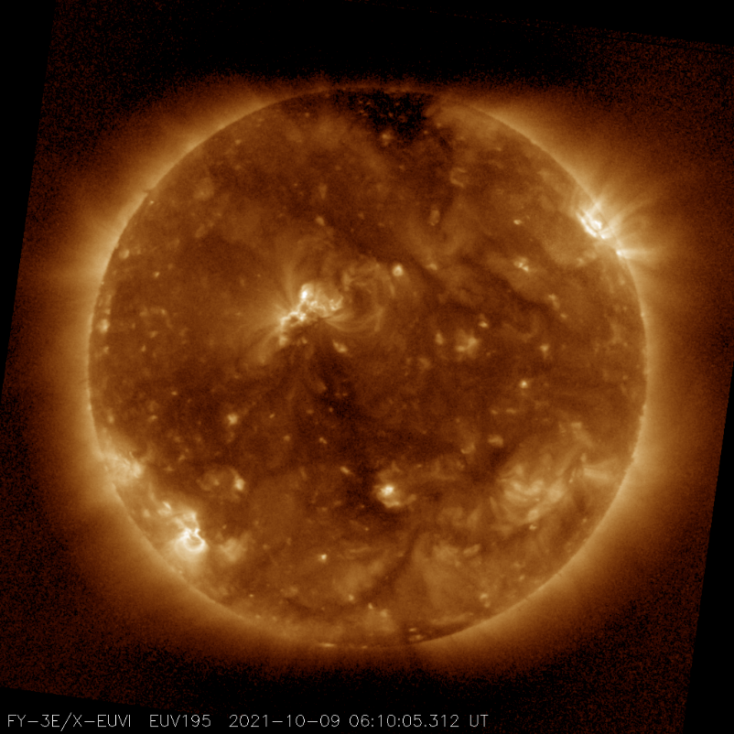
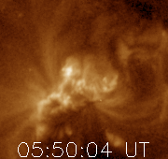
4.1 Applications: Solar Flares & Active Regions
Monitoring our star: the Sun is the main source of space weather
Active Region 12882
HF Radio, Navigation …

Slide 18
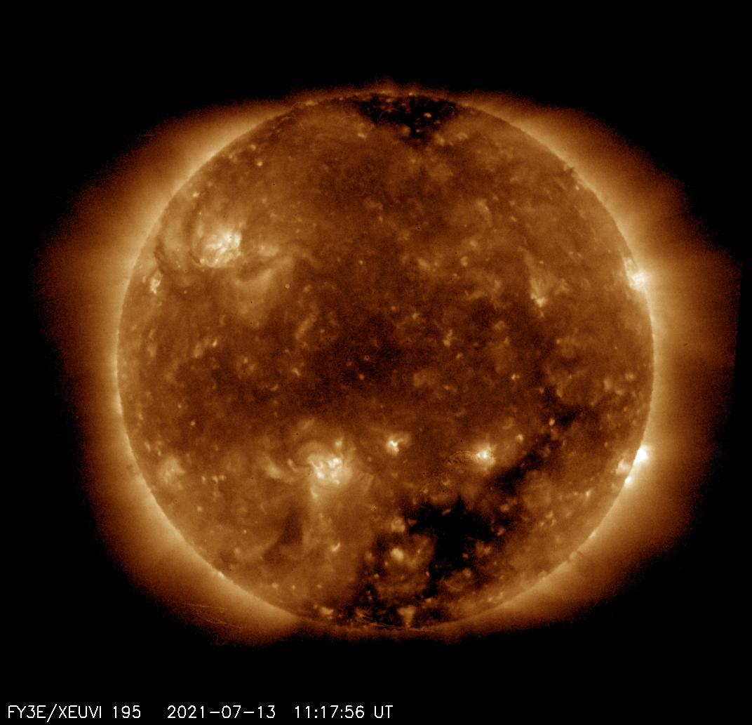
4.2 Applications: Solar Filaments & Coronal Holes
Filament eruption
Coronal Hole High Speed
Streams
CMEs
Geomagnetic Storms
Geomagnetic Storms
Spacecraft operations, Power systems…
Spacecraft operations, Power systems…

Slide 19
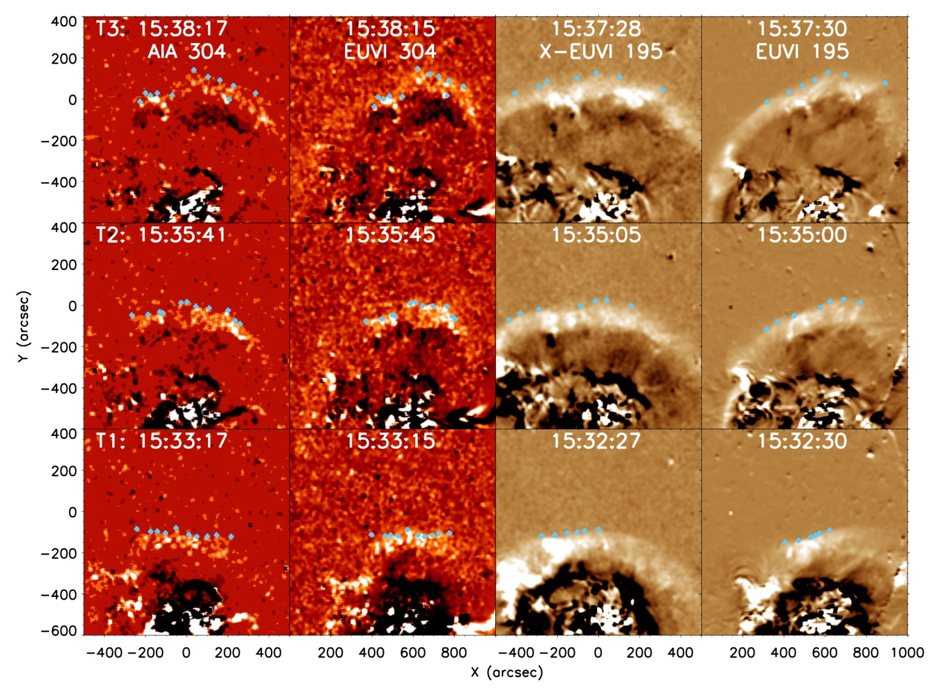
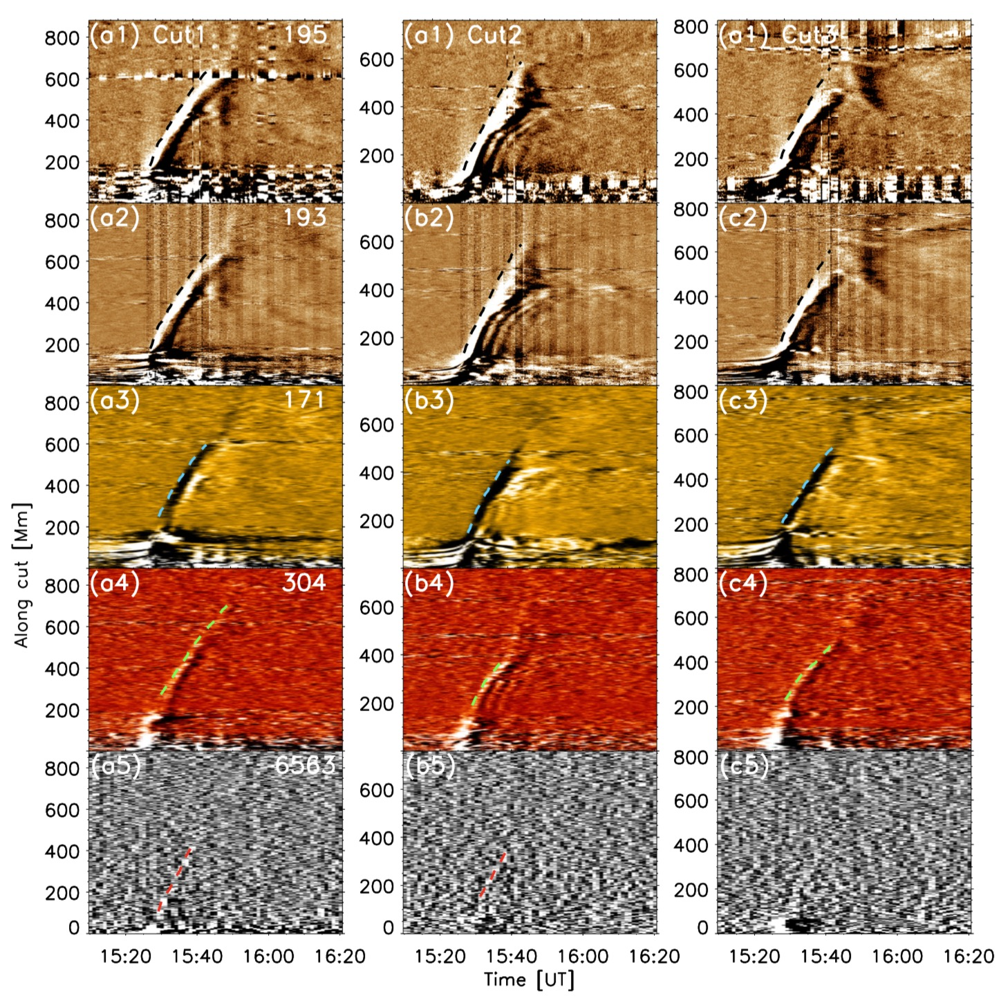
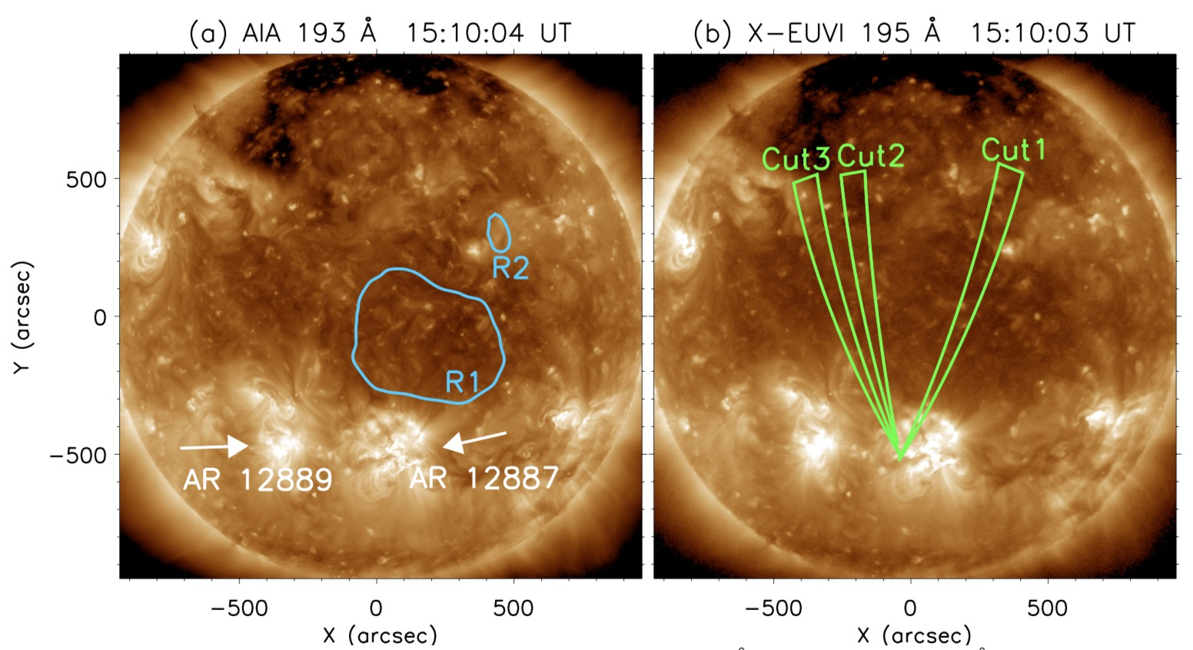
4.3 Applications: Solar EUV Wave Research
(Hou et al., ApJ, 2022)

Slide 20
Thank you for your attention, if you have any questions or comments, please contact us
Jinping Dun dunjp@cma.gov.cn,
Qiao Song songq@cma.gov.cn
National Satellite Meteorological Center (National Center for Space Weather)
China Meteorological Administration

