Slide 1
Straylight Characterization of ABI, AHI, (and AMI)
Hui Xu, Xiangqian Wu and Fangfang Yu
1
2
3
1 Global Science and Technology (GST), Inc.
2 NOAA/NESDIS/STAR
3 CI-SESS/ESSIC/University of Maryland (UMD)

Slide 2
Outline
Introduction
Characterize GOES ABI straylight
Time-difference processing and coordinate transformation
Straylight magnitude estimation
Straylight in GOES ABI
Straylight in Himawari AHI
Comparison between GOES ABI and Himawari AHI
Conclusions
Acknowledgements

Slide 3
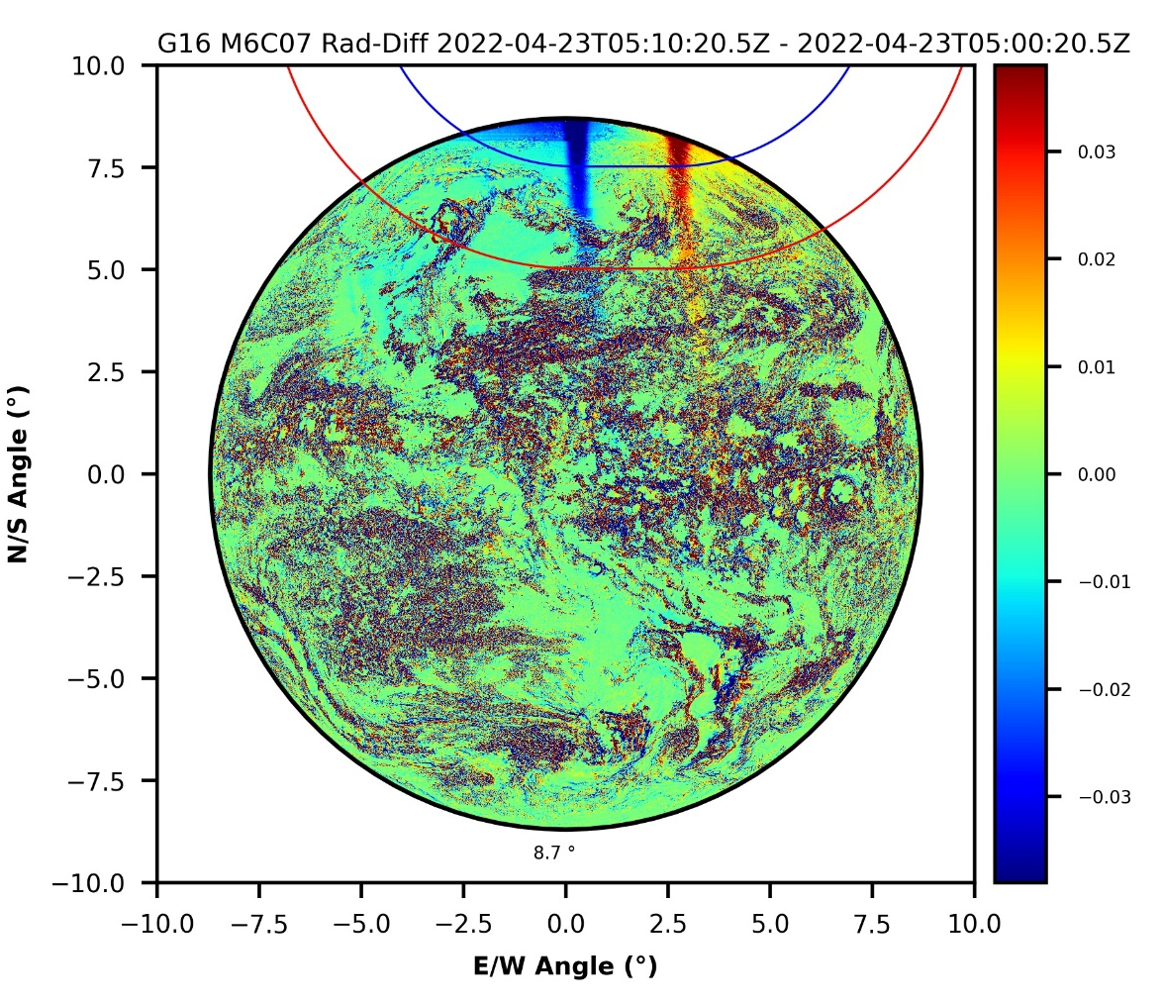
Introduction
The straylight is periodically observed between February to May around spring equinox and August to November around fall equinox in all three GOES ABI’s CH07 full disk images , due to the leak of solar light into the instrument.
Typical straylight signal observed in GOES-16 ABI CH07
The ABI full disk CH07 observations are divided into several zones with different radiometric performance requirements:
Exclusion Zone
Exclusion zone: ABI pixels within Sun’s 5.0-degree ring (blue cycle). In this zone, there is no requirement on the radiometric performance.
Zone of Reduced Data Quality (ZRDQ): ABI pixels between Sun’s 5.0-degree (blue cycle) and 7.5-degree (red cycle) rings. The radiometric requirement is 2 K at 300 K scene temperature.
Zone of normal performance (ZONP): ABI pixels outside Sun’s 7.5-degree ring (red cycle). The radiometric requirement is 1 K at 300 K scene temperature.
ZRDQ
ZONP
This study is to evaluate the maximum magnitude of straylight in the ZRDQ and ZONP zones and find out whether it meets the instrument requirement.
CH07 radiance difference between two consecutive images

Slide 4
Introduction
The straylight contamination in GOES ABI images are changed from time to time and day by day, which depends on the relative position of the Earth and the Sun.
straylight
midnight
Apparent daily movement of the Sun from west to east, due to the Earth’s rotation.
straylight
midnight
Apparent annual movement of the Sun between north to south, due to the Earth revolution around the Sun.
straylight
midnight

Slide 5
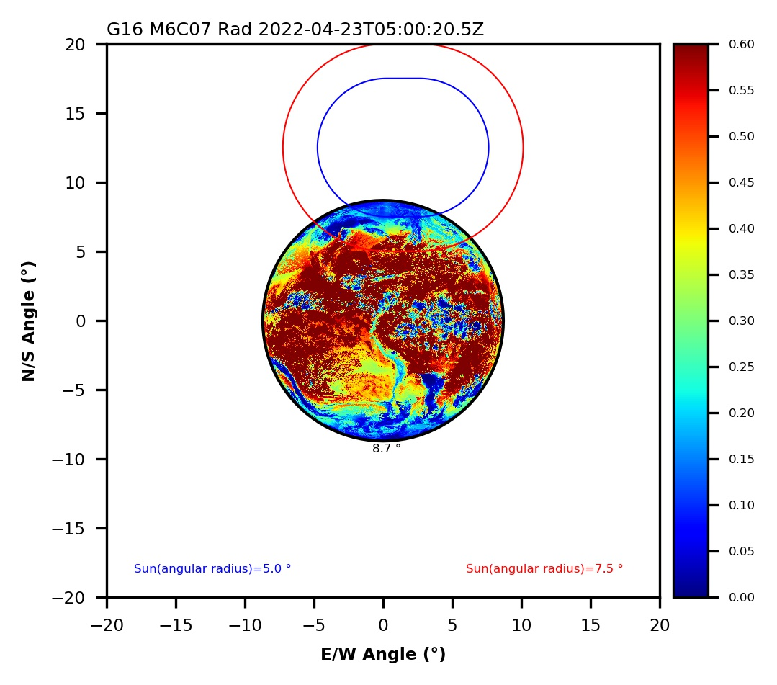
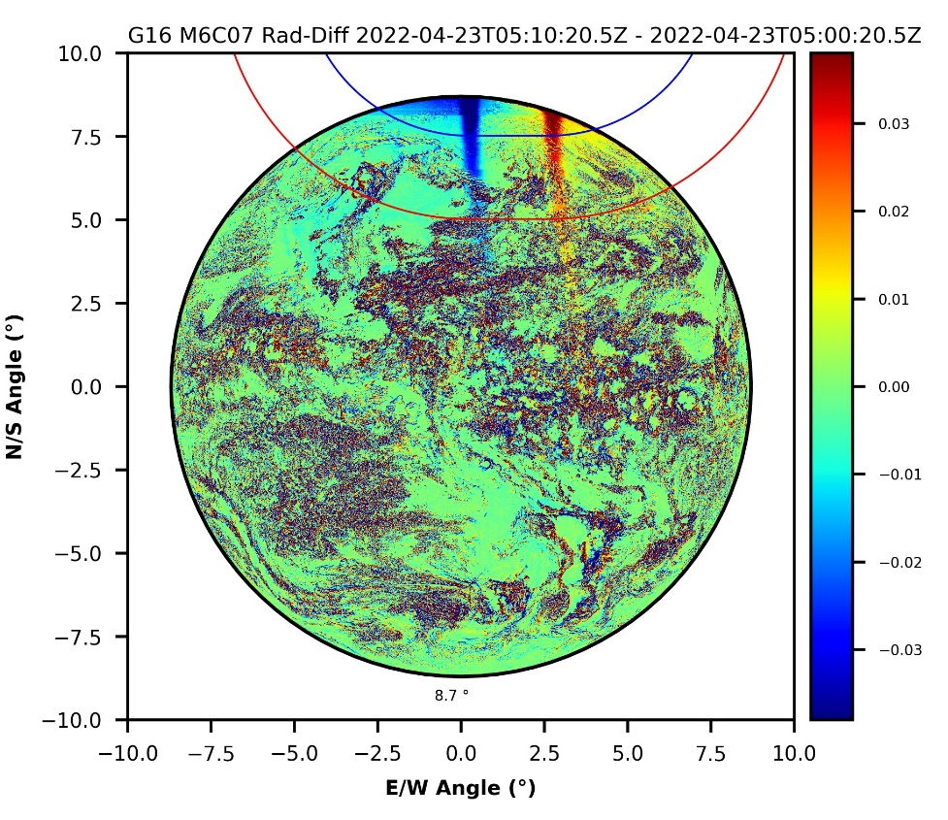
Characterize GOES ABI straylight
Consecutive time-difference processing
To remove the strong background information emitted from the Earth and thus enhance the straylight signal at night, the radiance difference between two consecutive full-disk images is calculated and used to characterize the straylight.
CH07 Radiance
CH07 Radiance Difference
Tracking straylight using consecutive radiance difference
UT 0440
UT 0450
UT 0500
UT 0510
The straylight signal moves from west to east in the ABI FD image along with the rotation of the earth.
hardly seen in the radiance image
enhanced with the radiance difference

Slide 6
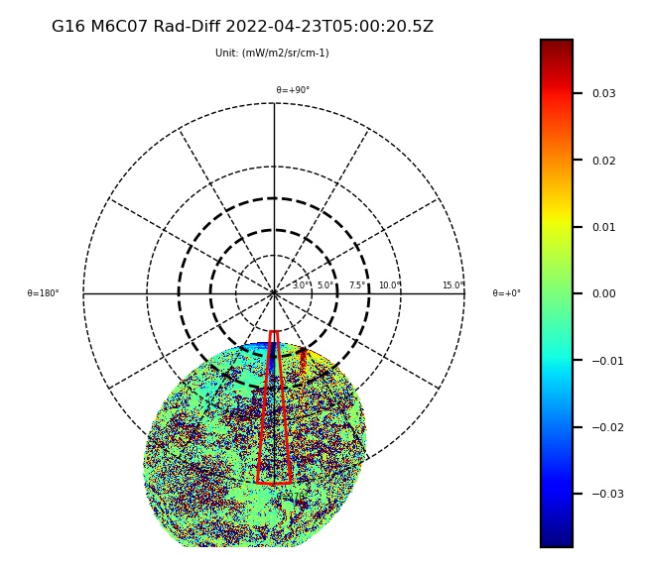
Characterize GOES ABI straylight
Coordinate transformation
Since the sun was moving when the data was scanned by the instrument, it is essential to remove the relative solar motion to accurately obtain the Sun’s position at each ABI scanned pixel.
Therefore, the consecutive image difference map is then further converted from the ABI Fixed Grid Coordinate (FGC) to the Sun Centered Coordinate (SCC).
In the SCC, the Sun’s position is fixed in the coordinate center, and each of ABI’s pixels is projected onto the SCC according to its relative position to the Sun.
ABI Fixed Grid Coordinate (FGC)
Sun Centered Coordinate (SCC)
Angular distance between the Sun and Earth
UT 0440
UT 0450
Sun’s Position
UT 0500
UT 0510
In SCC, the straylight moves with the earth together and its intensity is associated with the angular distance between the scanned pixel and the Sun.
The closer the pixel to the Sun, the stronger the straylight was observed

Slide 7
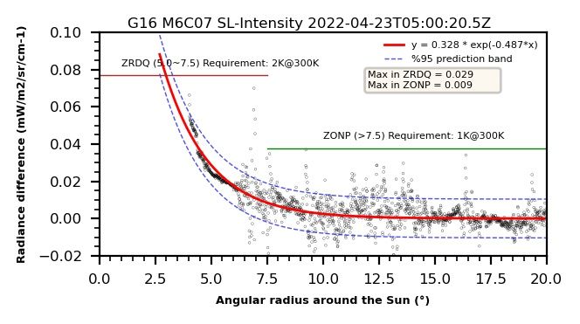
Characterize GOES ABI straylight
Straylight magnitude estimation
The SCC grid is first divided into a series of sub-regions from the 0 to 360 degree in polar angle with an equal interval of 10 degree.
The radiance difference data in each of the sub-regions are then averaged along the Sun angular distance path in every 0.01 degree.
Next, in each of the divided regions, an exponential function is used to calculate the straylight magnitude at angular distance of 5.0 (Max in ZRDQ) and 7.5 (Max in ZONP) degrees.
Finally, the maximum straylight magnitude in ZRDQ and ZONP of all the sub-regions are used to check if they meet the requirement.
Max in ZRDQ
Max in ZONP

Slide 8
Straylight in GOES ABI
From 08/10/2022 to 09/01/2022
G18
G17
G16
As shown, the ABI straylight intensity increases along with the earth moving upwards in the sun centered grid until the sun is fully blocked by the earth.

Slide 9
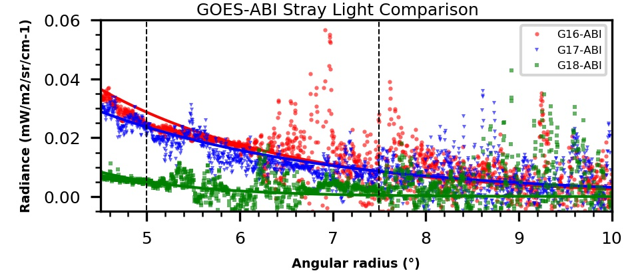
Straylight in GOES ABI
04/23/2022
G16
G17
G18
ZRDQ
ZONP
1 K
GOES-18 ABI overall has the lowest straylight signal (Green one), indicating that the solar light leak issue has been greatly improved in GOES-18 ABI as compared with the other two.

Slide 10
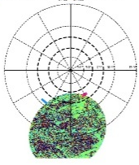
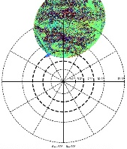
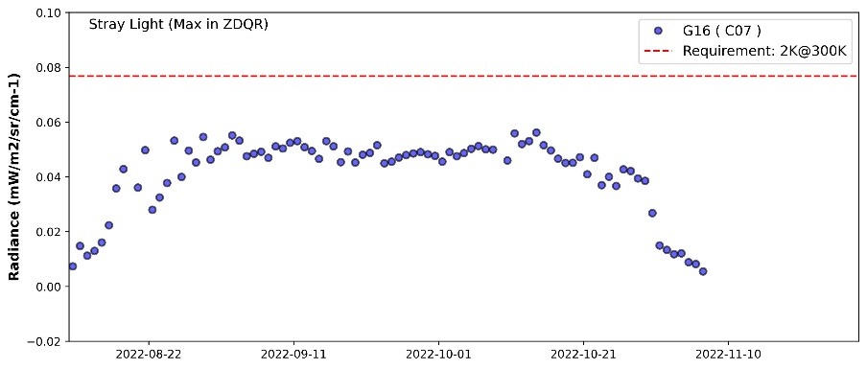
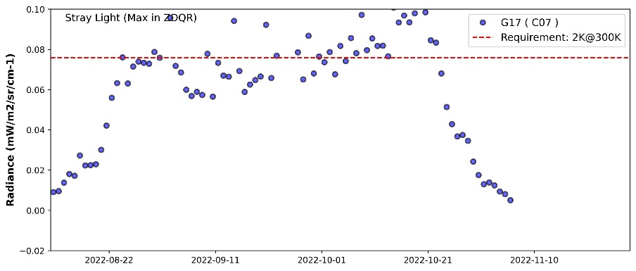
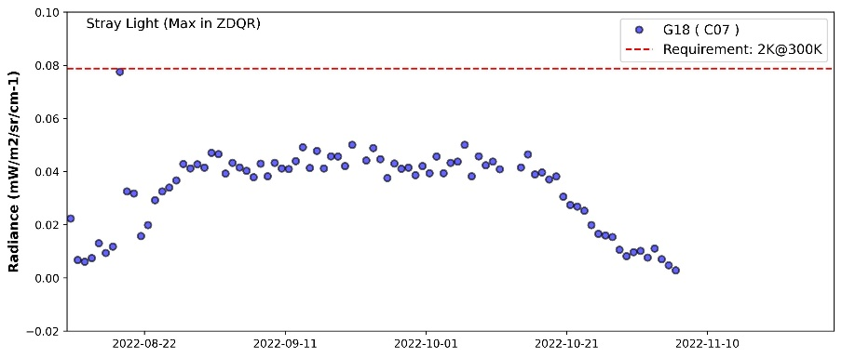
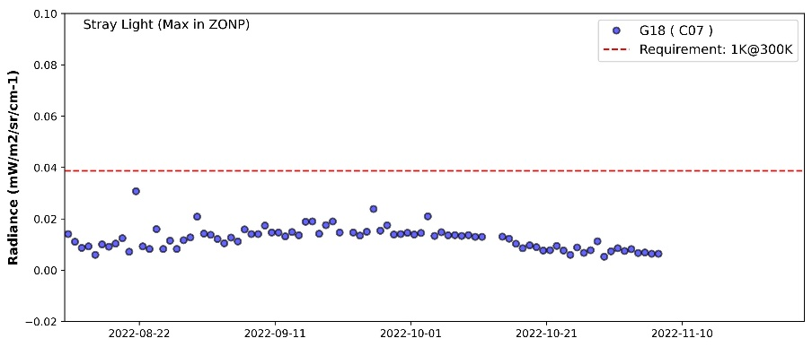
Straylight in GOES ABI
08/15
09/20
11/01
A whole eclipse season from 08/10/2022 to 11/10/2022
Max in ZRDQ
G16
G17
G18
Max in ZONP
G16
G17
G18
Both G16 and G18 ABI CH07 straylight magnitudes meet the instrument requirement in this whole eclipse season.
However, sometimes the G17 ABI straylight magnitude is higher than the instrument requirement.

Slide 11
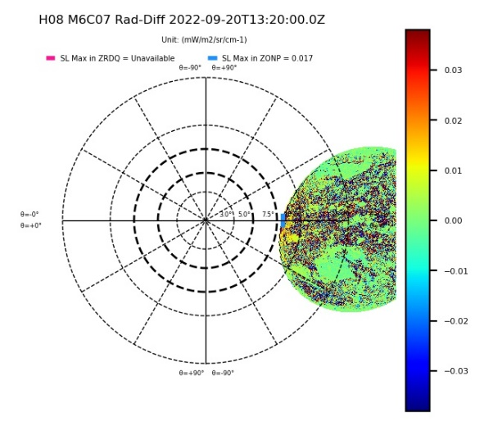
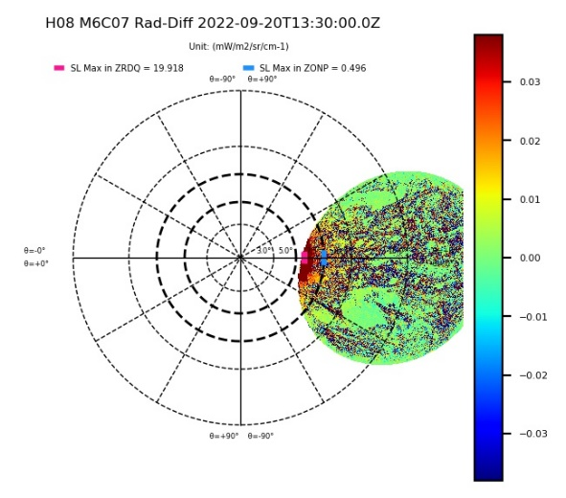
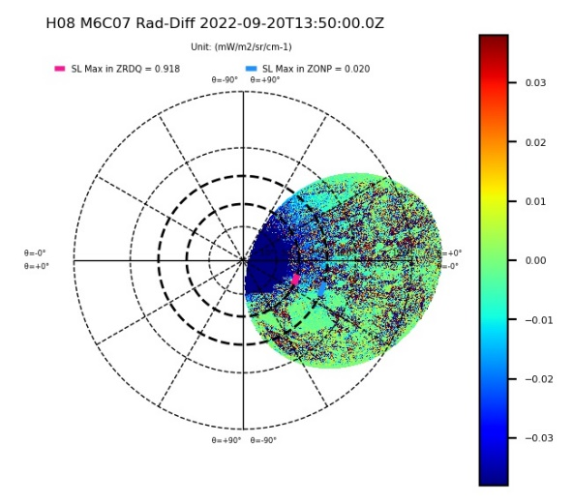
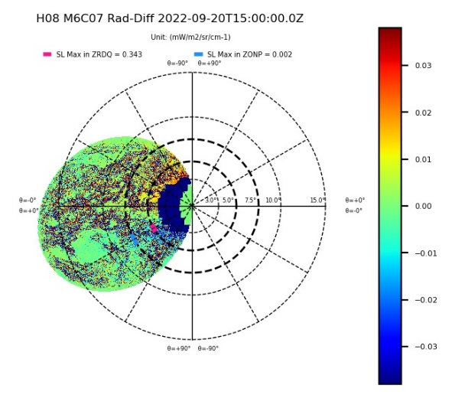
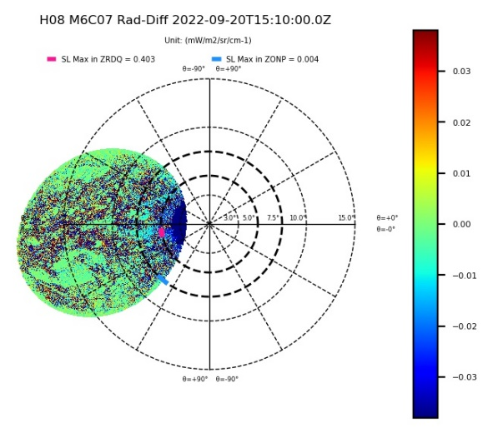
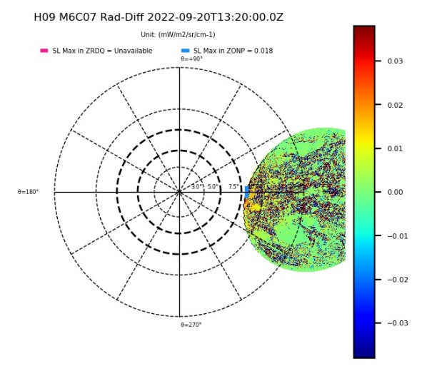
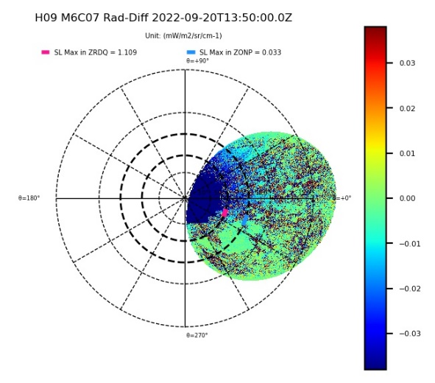
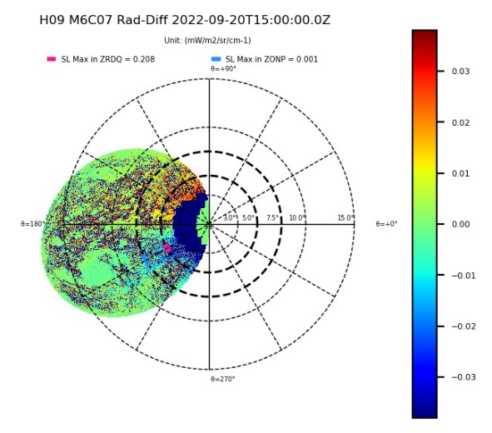
Straylight in Himawari AHI
09/20/2022
Himawari-8 AHI
Himawari-9 AHI
The straylight signal becomes very large for both Himawari-8/9 AHI when the Earth towards the Sun in SCC.

Slide 12
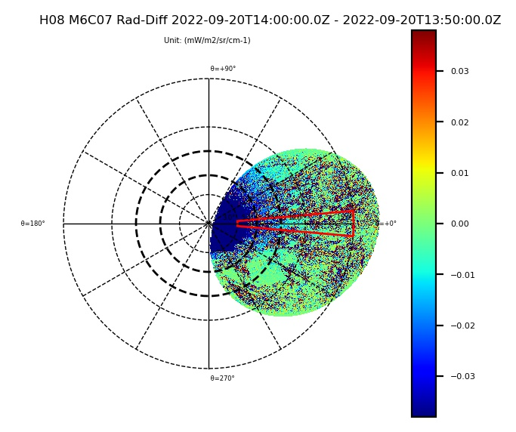
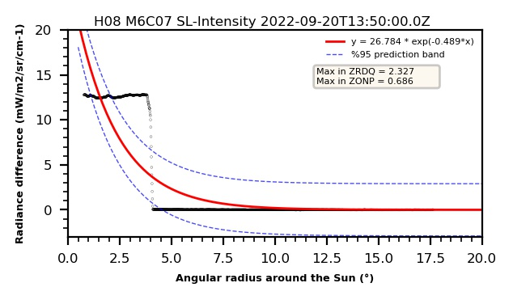
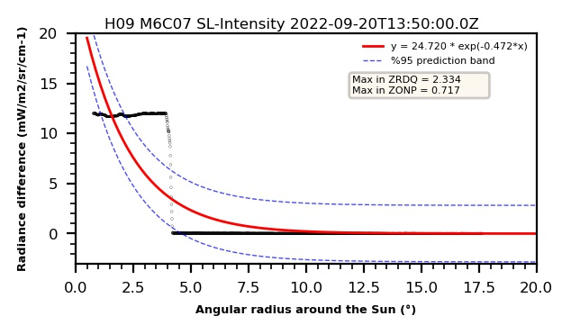
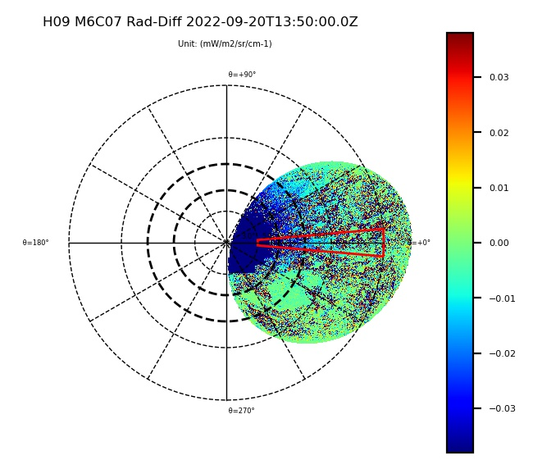
Straylight in Himawari AHI
Himawari-8 AHI
09/20/2022
Max ~= 13 mW/m2/sr/cm-1
Himawari-9 AHI
UT 1350
Max ~= 12 mW/m2/sr/cm-1
The straylight signal is very large and saturated when the pixels close to the Sun.
The maximum values are around 13 and 12 in radiance (mW/m2/sr/cm-1) for H8 and 9AHI respectively.

Slide 13
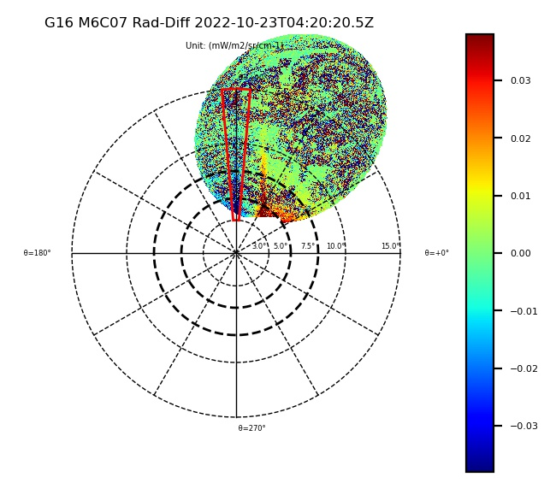
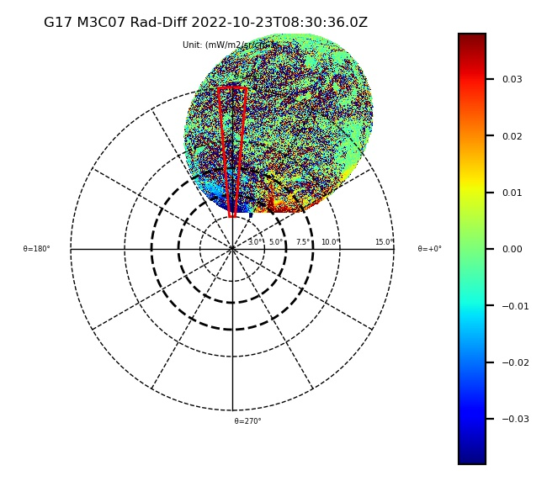
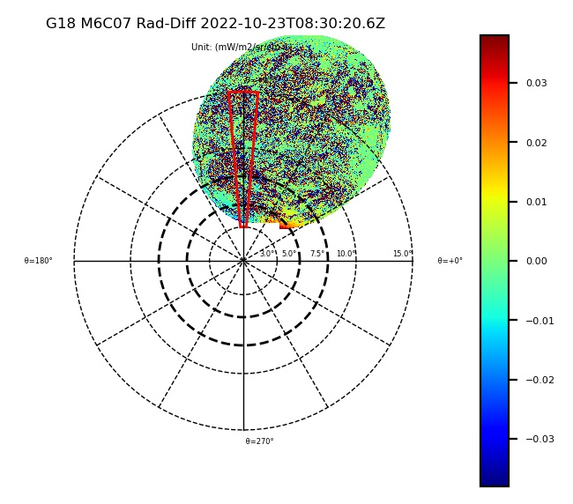
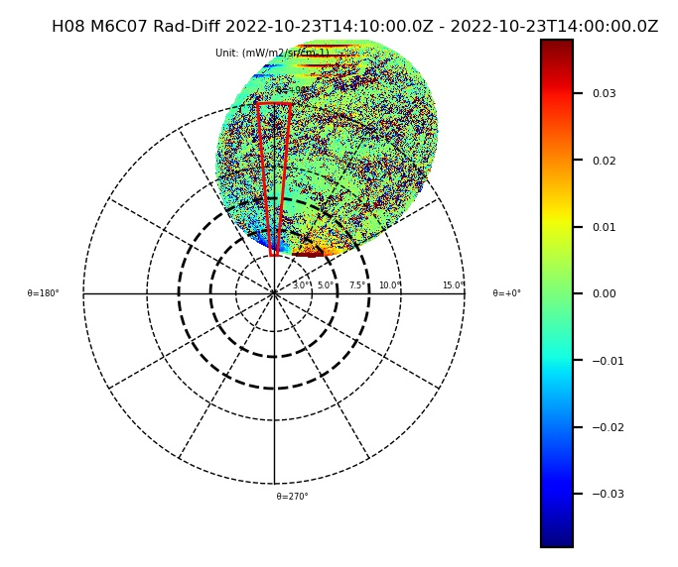
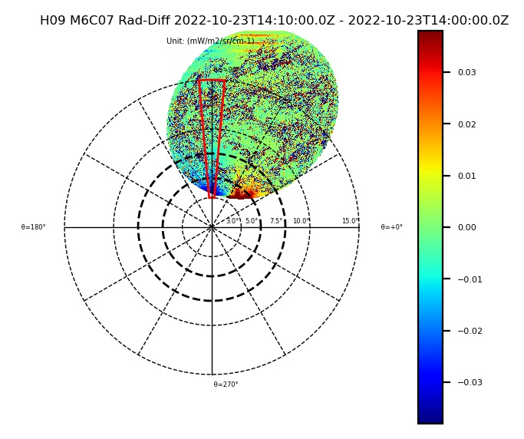
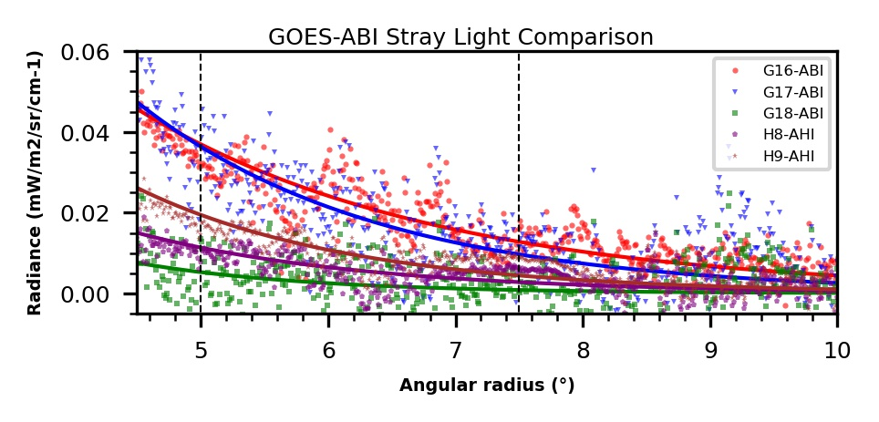
Comparison between GOES ABI and Himawari AHI
GOES-16
GOES-17
GOES-18
10/23/2022
Straylight can also be found in the ZONP region in AHI data, which is known as the “sneak path”.
Himawari-8 AHI
Himawari-9 AHI
Straylight magnitude comparisons
The lowest straylight magnitudes is observed in G8 ABI as compared with the other four instruments for the selected timelines.

Slide 14
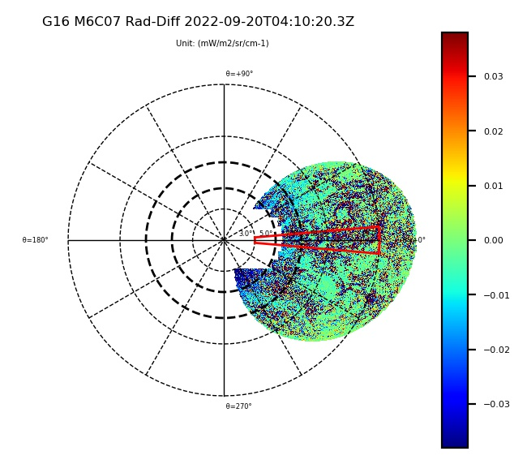
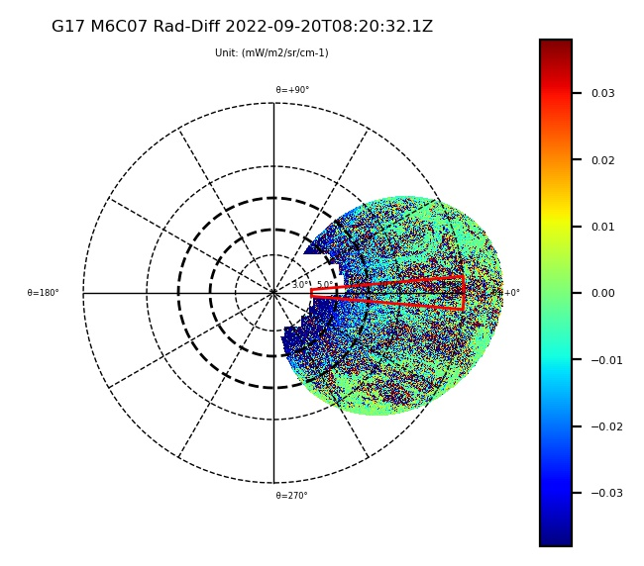
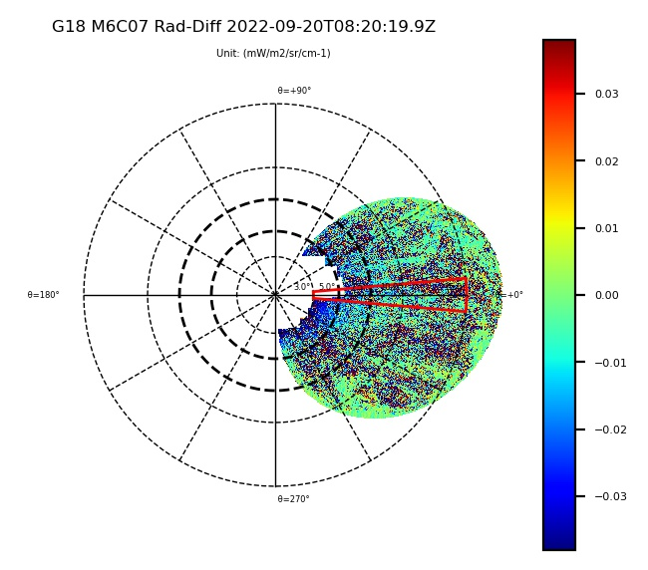
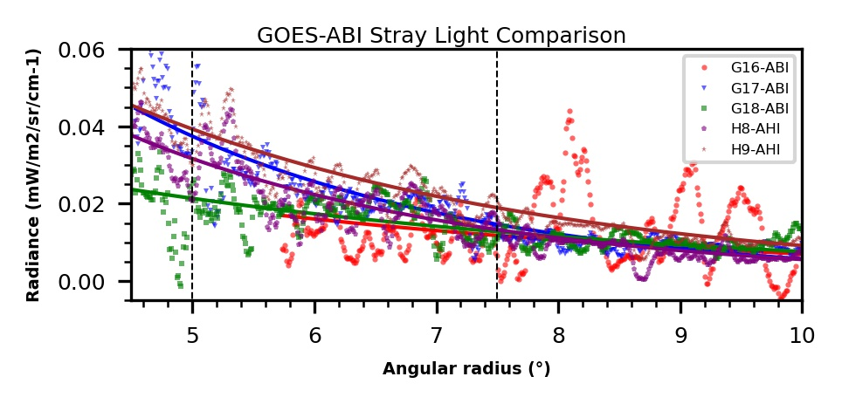
Comparison between GOES ABI and Himawari AHI
GOES-16
GOES-17
GOES-18
09/20/2022
ABIs have the bright object avoidance (BOA) mechanism, which can automatically exclude those seriously contaminated pixels.
Himawari-8 AHI
Himawari-9 AHI
Straylight magnitude comparisons
ZRDQ
ZONP
The straylight magnitudes in G16 (red) and G18 (blue) ABIs are overall lower than the other three instruments for the selected timelines.

Slide 15
Conclusions
Stray light rejection around local midnight during eclipse season is a unique challenge for satellite instrument on geostationary orbit.
Especially for a 3-axis stabilized platform.
And for the shortwave infrared channels (such as 3.7 µm channel).
Six (of a total of seven) ABI-type instruments (GOES-16/17/18, AHI-8/9, and AMI) were routinely collecting data in various capacity in fall 2022.
That offered a rare opportunity to compare their performances.
It was found that:
Overall, ABI met the requirements for stray light rejection.
Among them, GOES-18 ABI is noticeably better, whereas GOES-17 ABI is slightly worse.
Both AHI are subject to serious stray light contamination.
AMI data are being analyzed. Results will be amended and reported later.

Slide 16
Acknowledgements
The stray light discussed in this presentation was first discovered on 12 February 2015. Hours later, Takura Miyakawa shared this with a NOAA delegation visiting the Himawari Operation Enterprise Corporation (HOPE) in Tokyo. We thank JMA for timely sharing this information with us, which later led to significant improvement to the straylight rejection for ABI & AMI.
The time difference technique that was used extensively in this work was originally inspired in a conversation with Tim Schmit.
Xi Shao developed the framework of converting from the ABI Fixed Grid Coordinate (FGC) to the Sun Centered Coordinate (SCC).
We thank JMA & KMA colleagues for providing AHI & AMI data for this study and other assistance.
This presentation is solely the opinions of the authors and does not constitute a statement of policy, decision, or position on behalf of NOAA or the U.S. government.

