Slide 1
JMA Report for GDWG 2023
OKUYAMA Arata
Meteorological Satellite Center of JMA

Slide 2
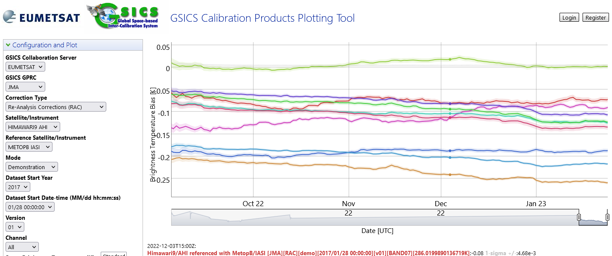
JMA GSICS Corrections
Status of GSICS Correction by JMA
The following Corrections are available from the GSICS server in EUMETSAT
Near-Real Time Correction
Himawari-8 and 9 / AHI / IR with reference to IASI-A/-B, AIRS: Demo. phase
MTSAT-2 / IMAGER / IR with reference to AIRS, IASI-A: Demo. phase
Re-analysis Correction
Himawari-8 and 9 / AHI / IR with reference to IASI-A/-B, AIRS: Demo. phase
MTSAT-2 / IMAGER / IR with reference to AIRS, IASI-A: Demo. phase
IASI-A had been supported until Oct. 2021. Implementation of IASI-C and CrIS is ongoing.

Slide 3
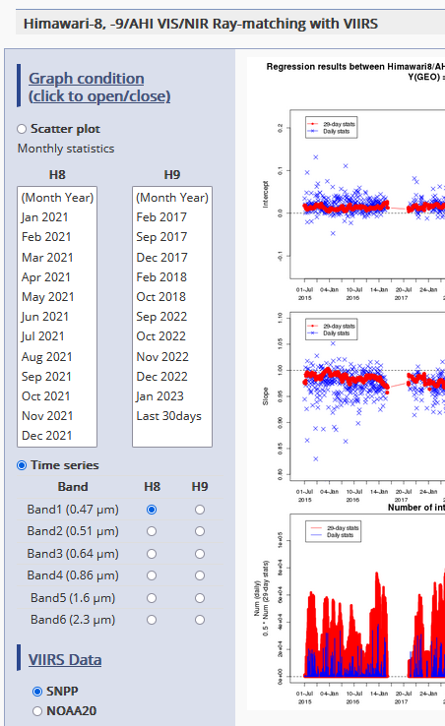
JMA GPRC web pages
Landing page (cal. portal)
Calibration monitoring
The monitoring web page started to post Himawari-9 full operational observation data in Dec. 2022.
The page based on the ray-matching approach started to support NOAA20/VIIRS in May 2022.
Navigation monitoring
The page started to support Himawari-9 in Sep. 2022.
Event logging
Instrument information
Event logging
Information of incomplete imagery
Processing Events
Data Outage

Slide 4
references
Landing page:
https://www.data.jma.go.jp/mscweb/en/oper/calibration/calibration_portal.html
Event logging:
https://www.data.jma.go.jp/mscweb/en/oper/event_H9.html
h

