Slide 1
Moving from MODIS to VIIRS: evolutions of EUMETSAT implementation of the GSICS DCC algorithm
S. Wagner
With the support from R. Shanbhag*, V. Debaecker*, A. Mousivand
GSICS Annual Meeting – 27.02-03.02 2023
* Telespazio support
GSICS Annual Meeting – 27.02 – 03.03 2022

Slide 2
EUMETSAT concept for GSICS VNIR product generation
Data input – Ground segment
Data extraction
DCC
…
Data extraction Lunar Cal
DCC
Moon
Intermediate data
Data processing
DCC
…
Data processing
Lunar Cal
GSICS DCC product
GSICS Lunar product
Intermediate products
Data reader + blend processor
GSICS VIS/NIR product
EUMETSAT GSICS data server

Slide 3
Legacy system and evolutions
Current EUMETSAT GSICS products for VNIR:
Based on DCC only ➔ GSICS DCC ATBD
Automated stand-alone system running every day (over a 30-day sliding window)
Software coded in Perl / IDL / C++
Missions / channels in scope: MSG/SEVIRI VIS0.6 at (0, 0), (41.5E, 0) and (45.5E,0)
Reference instrument: MODIS Aqua
GPPA status = demonstration
New system being developed = MICMICS
Brand-new multi-mission / multi-function framework running every day (over a 30-day sliding window) ➔ should it be adjusted with the change to NOAA-20/VIIRS?
Software coded in Python
Missions / channels in scope: geostationary imagers + polar imagers / all channels up to ~1 μm (and beyond to try…)
Reference instrument: NOAA-20 VIIRS

Slide 4
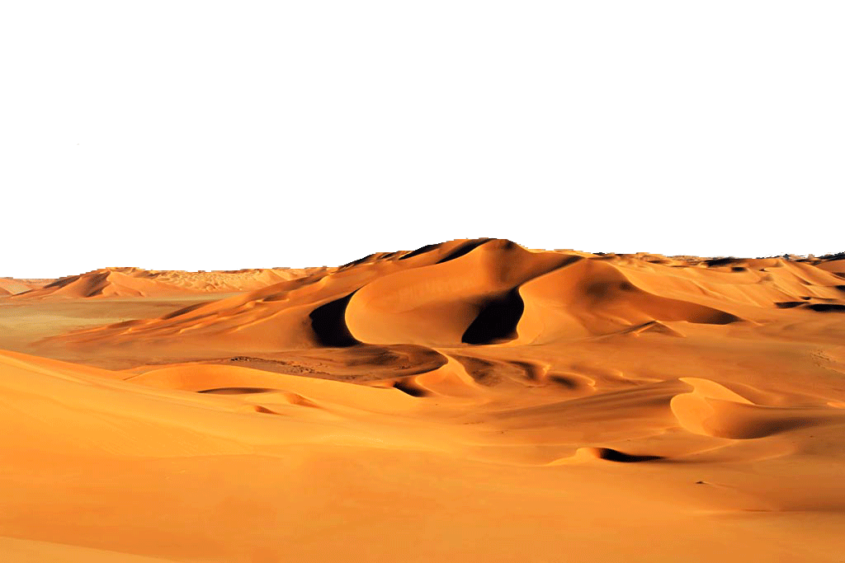
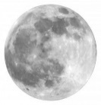
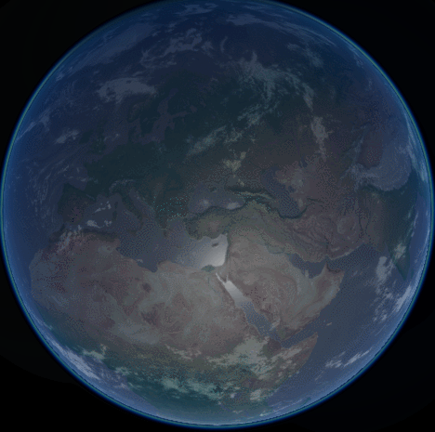
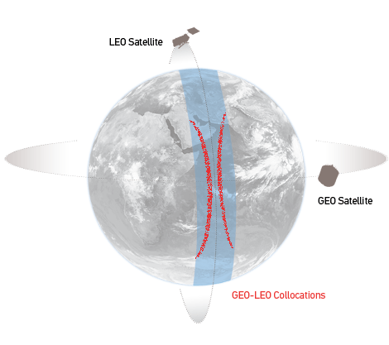
MICMICS: Mission Integrated Calibration Monitoring & Inter-Calibration System
Instruments
DCC Calibration
Instruments
MSG SEVIRI VIS/NIR
DCCICS
DCCCS
MSG SEVIRI IR
DCC Inter- Calibration
DECS
IHICS
Imager-Hyperspectral Inter-Calibration
MTG FCI VIS/NIR
Desert Calibration
MTG FCI IR
ICBS
IIICS
Imager-Imager Inter-Calibration
Inter-Calibration Blender
S3
SLSTR & OLCI VIS/NIR
LCS
NWPC
S3 SLSTR IR
Lunar Calibration
NWP Calibration
MTG LI VIS
LICS
MICMICS
CPMs
NWPIC
EPS AVHRR IR
Lunar Inter-Calibration
NWP Inter-Calibration
VIS/NIR channels
Thermal channels
EPS-SG VII VIS/NIR
Rayleigh Inter-Calibration System
RAYICS
EPS-SG VII IR
PCOLT
Pre-Colocation Tool
EPS AVHRR VIS/NIR
Rayleigh Calibration System
RAYCS
COLT
Colocation Tool
EPS-SG MWI/ICI MW
Ray-Matching Inter-Calibration System
RAYMICS
EPS-SG 3MI VIS/NIR
DFTL
DCCXTRM
SUBTL
Data-Fusion Tool
DCC Extraction Module
LXTRM
CO2M
CLIM & MAP
Subsetter Tool
Lunar Extraction Module

Slide 5
MICMICS: Mission Integrated Calibration Monitoring & Inter-Calibration System
Instruments
DCC Calibration
Instruments
MSG SEVIRI VIS/NIR
DCCICS
DCCCS
MSG SEVIRI IR
DCC Inter- Calibration
DECS
IHICS
Imager-Hyperspectral Inter-Calibration
MTG FCI VIS/NIR
Desert Calibration
MTG FCI IR
ICBS
IIICS
Imager-Imager Inter-Calibration
Inter-Calibration Blender
S3
SLSTR & OLCI VIS/NIR
LCS
NWPC
S3 SLSTR IR
Lunar Calibration
NWP Calibration
MTG LI VIS
LICS
MICMICS
CPMs
NWPIC
EPS AVHRR IR
Lunar Inter-Calibration
NWP Inter-Calibration
VIS/NIR channels
Thermal channels
EPS-SG VII VIS/NIR
Rayleigh Inter-Calibration System
RAYICS
EPS-SG VII IR
PCOLT
Pre-Colocation Tool
EPS AVHRR VIS/NIR
Rayleigh Calibration System
RAYCS
COLT
Colocation Tool
EPS-SG MWI/ICI MW
Ray-Matching Inter-Calibration System
RAYMICS
EPS-SG 3MI VIS/NIR
DFTL
DCCXTRM
SUBTL
Data-Fusion Tool
DCC Extraction Module
LXTRM
CO2M
CLIM & MAP
Subsetter Tool
Lunar Extraction Module

Slide 6
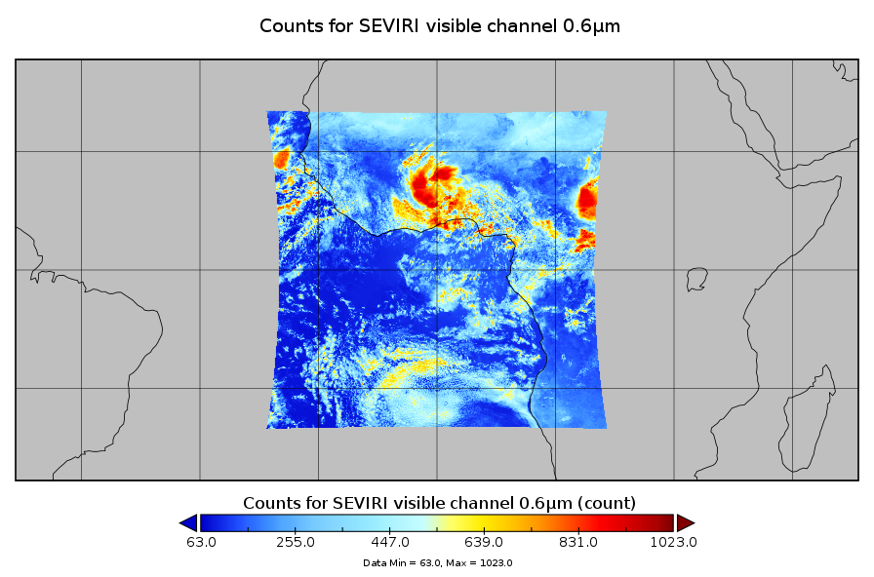
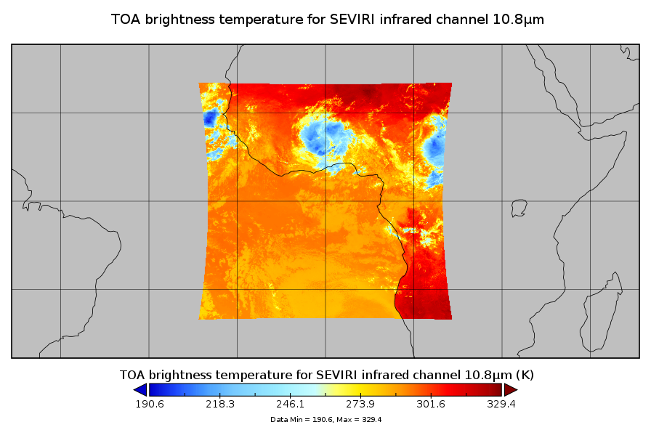
MICMICS DCCICS workflow
Level 1C products
11μm band available ?
Data subsetter
Subsets of L1C products over ROI
DCCXTRM
(DCC extraction)
DCCICS
Yes
GSICS DCC products
GEO imagers such as SEVIRI, FCI
Polar radiometers such as AVHRR, SLSTR, METimage
Inter-Calibration Blender
Calibration Output Database

Slide 7
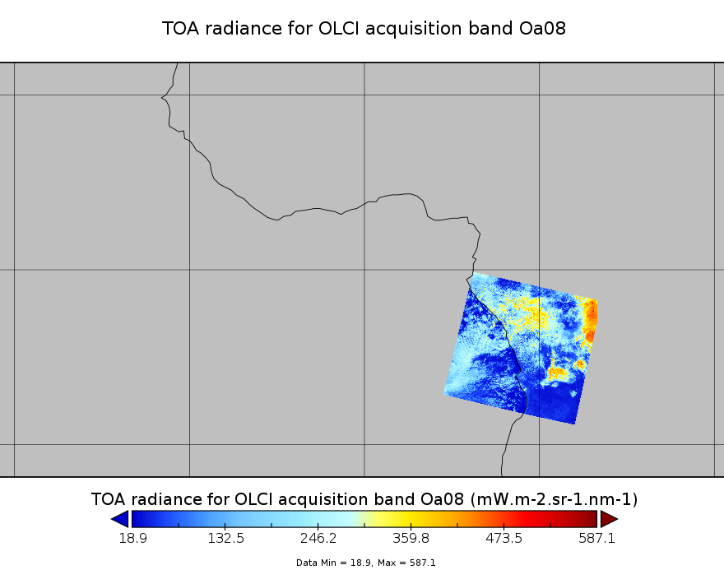
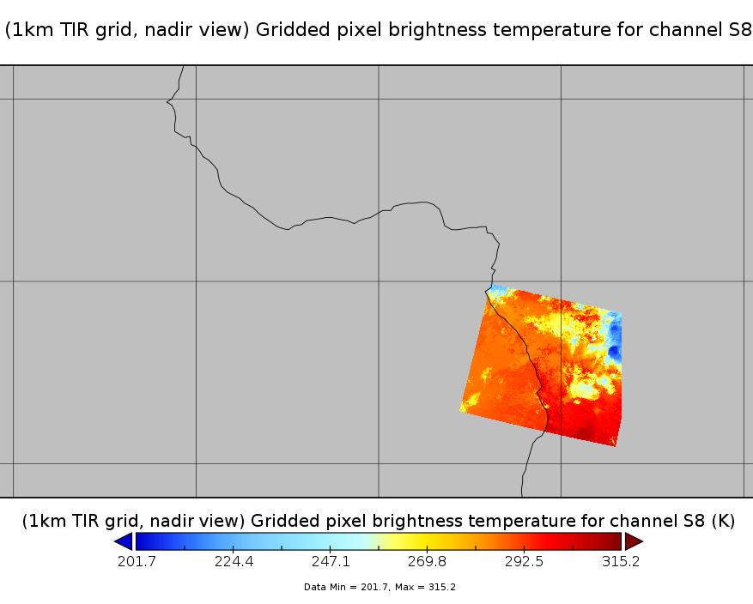
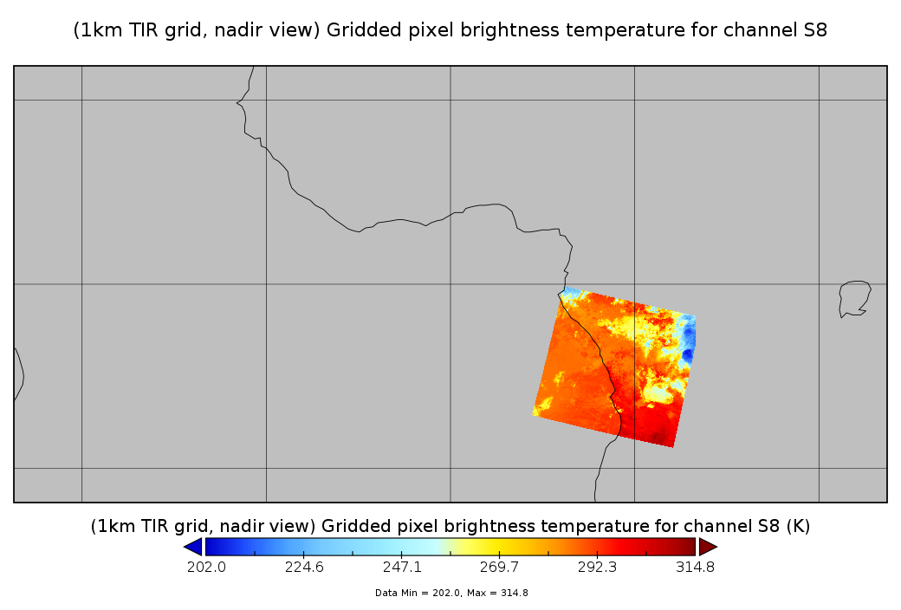
MICMICS DCCICS workflow
Level 1C products
11μm band available ?
Data subsetter
Subsets of L1C products over ROI
DCCXTRM
(DCC extraction)
DCCICS
Data-fused products over ROI
No
GSICS DCC products
Data fusion
(Remapping of IR sensor to monitored instrument grid)
OLCI
SLSTR
SLSTR
GEO imagers such as LI
Polar radiometers such as OLCI, 3MI
Inter-Calibration Blender
Calibration Output Database

Slide 8
Set-up for MSG/SEVIRI
Reference channels
Reference radiance: as per the GSICS ATBD (for Lon 45.5E, same as for Lon 41.5E)
For SWIR, no reference value from VIIRS ➔ based on typical radiance for SEVIRI
Homogeneity test done on all channels (not only on VIS0.6)
SEVIRI channel | VIIRS reference band
VIS0.6 | M5
VIS0.8 | M7
NIR1.6 | M10 (only for SBAF – no ref value)
HRV | M5

Slide 9
Some preliminary results for SEVIRI
Meteosat-11 / SEVIRI
Meteosat-9 / SEVIRI (45.5E)

Slide 10
Generating LEO/LEO DCC products
Some specific aspects need to be considered for LEO sensors:
Equatorial crossing time ➔ impact on the availability of convective cells / DCC pixels
Number of satellite over passes :
Impact on the availability of convective cells / DCC pixels
Definition of the accumulation time window to derive a product
Possibility to have multiple inter-calibration areas to consolidate the results ➔ GEO areas
Current status in MICMICS:
DCCICS intermediate products + GSICS LEO/LEO products under validation (S3 OLCI/SLSTR)
Reference bands for OLCI + SLSTR to be confirmed

Slide 11
Future developments / evolutions
System:
Decommissioning of the current system in favour of MICMICS ➔ Current demo DCC product for SEVIRI VIS0.6 versus MODIS Aqua will be discontinued
Products:
GEO/LEO
Activation of the DCCICS workflow for MTG-I1 / FCI + LI + commissioning activities
Reprocessing of the MSG SEVIRI data to derive consistent time series over the MSG life time
LEO/LEO
Finalise the current validation activity
Reprocessing of the S3 OLCI + SLSTR data to derive consistent time series over the S3 life time
Activation of the DCCICS workflow for Metop/AVHRR
Prepare EPS-SG METimage / 3MI
GPPA: plan to enter the GPPA with new (enhanced) products.

Slide 12
Thank you!
Questions are welcome.

