Slide 1
Validation using Ray-matching and DCC with VIIRSs through parallel observation of Himawari-8,9
KODERA Kazuki and OKUYAMA Arata
Meteorological Satellite Center of
Japan Meteorological Agency

Slide 2
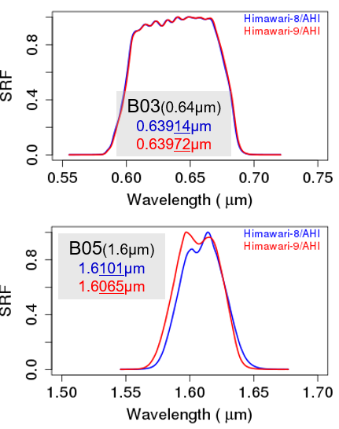
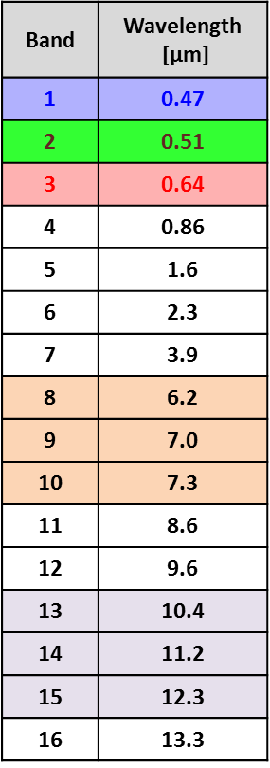
Introduction
Himawari-9/AHI started to observe as operational satellite on 13th December 2022.
Although AHI onboard Himawari-9 has the same observation function as that onboard Himawari-8, there are slight differences due to sensors individual variability.
E.g.) Center wavelength and shape of SRFs
Before the switchover, parallel observation of Himawari-8,9/AHI was performed. (27th Sep. to 13th Dec. 2022)
Validations for the difference between AHI8 and AHI9 by Ray-matching and DCC methods.
VNIR

Slide 3
Outline
Ray-matching method
Outline of implementation in JMA
Validation results for AHI8 and AHI9
DCC method
Outline of test implementation in JMA
Validation results for AHI8 and AHI9
Comparing Ray-matching and DCC methods on AHI9 biases validation
Comparison with the direct comparison(GEO-GEO approach) : AHI9 vs. AHI8
The validation of AHI sensor sensitivity trends

Slide 4
Outline of Ray-matching method in JMA
Input data
Himawari-8/9 data is not corrected by solar diffuser on real-time basis
VIIRS data is downloaded from NOAA CLASS server.
Himawari-8/9 AHI data
(2 km resolution)
SNPP or N20
VIIRS SDR
Himawari-8/9 AHI | Band01 (0.47 μm) | Band02 (0.51 μm) | Band03 (0.64 μm) | Band04 (0.86 μm) | Band05 (1.6 μm) | Band06 (2.3 μm)
SNPP or N20 VIIRS | M3 (0.49 μm) |  | I1 (0.64 μm) | M7 (0.87 μm) | M10 (1.6 μm) | M11 (2.3 μm)
Collocating
Observation time difference | < 5 min.
Satellite zenith angle difference | < 10 deg.
Satellite azimuth angle difference | < 10 deg.
Sun glint angle (AHI only) | > 25 deg.
Brightness temperature @ 10.4 μm (AHI only) | < 273.15 K
STDV of reflectance/Mean of reflectance | < 5%
data filtering
Details of our implementation is shown on back-up slides.
Pass
Collocations
Apply SBAFs
SBAFs
Using NASA SBAF Tool (B01-05) and calculating radiative transfer model (B06)
Outcomes

Slide 5
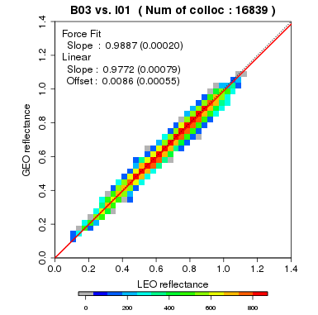
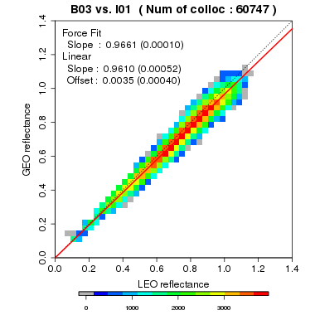
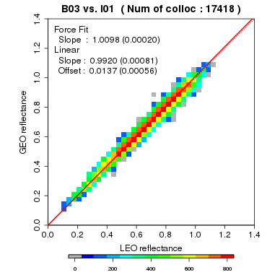
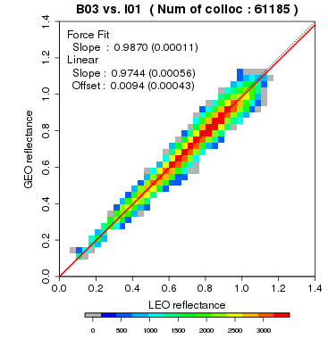
Validation results by Ray-matching method
B03 (0.64um) of AHIs
AHI biases against references in Oct.2022 | AHI9 |  | AHI8
 | Vs. N20 | Vs. SNPP | Vs. N20 | Vs. SNPP
B01 (0.47 μm) | 2.9% | 1.0% | -1.5% | -3.5%
B02 (0.51 μm) | 1.5% | 0.0% | 1.1% | -0.6%
B03 (0.64 μm) | -1.1% | -3.4% | 1.0% | -1.3%
B04 (0.86 μm) | 0.5% | -2.8% | 0.9% | -2.5%
B05 (1.6 μm) | 2.5% | -0.8% | 8.9% | 5.5%
B06 (2.3 μm) | -5.1% | -7.2% | -3.5% | -5.7%
AHI9 vs.N20
AHI9 vs.SNPP
Scatter plot variation and number of collocations of AHI9 are similar to those of AHI8.
The differences between AHI9 and AHI8 are in ~5%. (except B05)
In both AHIs, the differences against N20 and SNPP are in ~2%.
Moyer et al. (2021) indicates that ~2% bias exists between SNPP and N20 in all reflective solar bands.
These ray-matching results are good agreement with this reference.
AHI8 vs.N20
AHI8 vs.SNPP

Slide 6
Outline
Ray-matching method
Outline of implementation in JMA
Validation results for AHI8 and AHI9
DCC method
Outline of test implementation in JMA
Validation results for AHI8 and AHI9
Comparing Ray-matching and DCC methods on AHI9 biases validation
Comparison with the direct comparison(GEO-GEO approach) : AHI9 vs. AHI8
The validation of AHI sensor sensitivity trends

Slide 7
Test implementation outline of DCC method in JMA
Input data
Himawari-8/9 AHI data
(2 km resolution)
SNPP or N20
VIIRS SDR
Bin sizes for AHI bands |  | Bin sizes for VIIRS bands
B01 | 1.70 | M3 | 1.06
B02 | 2.60
B03 | 1.79 | I1 | 2.04
B04 | 1.37 | M7 | 0.50
B05 | 0.086 | M10 | 0.050
B06 | 0.030 | M11 | 0.041
Input data is the same as Ray-matching method.
Select DCC
Region of selecting DCC | 20S.~20N. and 120E.~160E.
BT | < 206.8 K
Satellite zenith angle | < 40 deg.
Sun zenith angle | < 40 deg.
Relative azimuth angle | 10 < RAA < 170 deg.
STDV of IR(VNIR) /Mean of IR(VNIR) | < 3%
data filtering to get DCC pixels
Apply Hu model
Hu model
Bin sizes are tentative and come from approximately 0.3% of the mean values.
Calculation
N20 reference value *1
VIIRS
Mode/mean value
VIIRS radiance value for 140E *1
M3 | 570.81 (mode)
I1 | 439.89 (mode)
M7 | 267.57 (mode)
M10 | 17.87(mean)
M11 | 8.67(mean)
AHI
mode/mean value
AHI value vs. N20 reference value*1
AHI / N20_ref. *SBAF
AHI value vs. N20 observation derived from SDR
AHI / N20_sdr *SBAF
AHI value vs. SNPP observation derived from SDR
AHI / SNPP_sdr *SBAF
SBAFs
Comparison with
each mode (in B01-B04) or mean (in B05-B06)
* Deseasonalization is NOT applied yet in this test implementation.
*1: In here, N20 reference value means the reference DCC radiances of N20/VIIRS calculated for each GEO domain suggested by Raj at the past GSICS VNIR monthly meeting. These values (right bottom table) refer to Raj’s following presentation.
Reference http://gsics.atmos.umd.edu/pub/Development/20210610/DCC_ATBD_June_10_2021.pdf
http://gsics.atmos.umd.edu/pub/Development/20230112/Bhatt_VIIRS_DCC_reference4GEOsV1.pdf

Slide 8
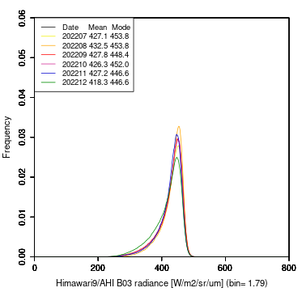
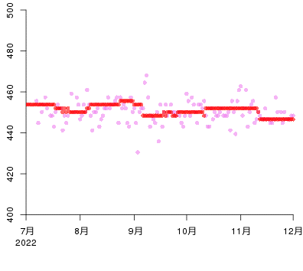
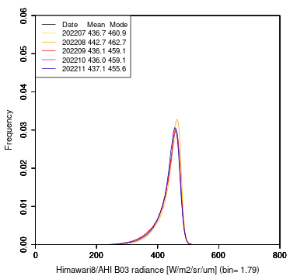
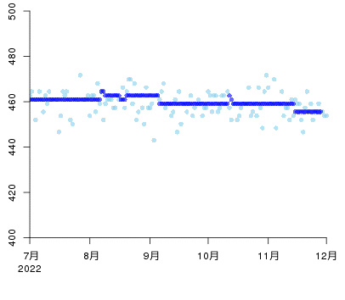
Validation results by DCC method
B03 (0.64um) of AHI9
AHI biases against references in Oct.2022 | AHI9 |  |  | AHI8
 | Vs. N20_ref. | Vs. N20_sdr | Vs. SNPP_sdr | Vs. N20_ref. | Vs. N20_sdr | Vs. SNPP_sdr
B01(0.47 μm) | 6.2% | 7.1% | 2.0% | 1.0% | 1.8% | -2.9%
B02(0.51 μm) | -0.9% | -0.1% | -4.7% | -1.8% | -1.0% | -5.6%
B03(0.64 μm) | 3.1% | 4.6% | -2.5% | 4.8% | 6.2% | -1.0%
B04(0.86 μm) | 4.2% | 5.3% | -0.9% | 4.2% | 5.3% | -0.9%
B05 (1.6 μm) | -6.2% | -1.6% | -4.3% | -1.0% | 3.8% | 1.2%
B06 (2.3 μm) | -12.7% | -8.0% | -8.5% | -11.2% | -6.4% | -6.9%
Re-analysis period(+/- 14days)
Daily period (1day)
Mode radiance (W/m^2/sr/um)
Tuning period
Jul. Aug. Sep. Oct. Nov. Dec.
2022
B03 (0.64um) of AHI8
AHI9’s PDFs are smooth as similar to AHI8’s.
Time series are stable but AHI9’s plots seem to have slight larger variation than AHI8’s.
The differences between AHI9 and AHI8 are in ~5%. But in B01, it seems that AHI9 has slight large bias against N20.
Mode radiance (W/m^2/sr/um)
Re-analysis period(+/- 14days)
Daily period (1day)
Jul. Aug. Sep. Oct. Nov. Dec.
2022

Slide 9
Outline
Ray-matching method
Outline of implementation in JMA
Validation results for AHI8 and AHI9
DCC method
Outline of test implementation in JMA
Validation results for AHI8 and AHI9
Comparing Ray-matching and DCC methods on AHI9 biases validation
Comparison with the direct comparison(GEO-GEO approach) : AHI9 vs. AHI8
The validation of AHI sensor sensitivity trends

Slide 10
Comparison by Ray-matching and DCC methods
In Oct,2022
AHI9 is Brighter
AHI9 biases against N20
AHI9 is Brighter
AHI9 biases against AHI8
AHI9 is darker
AHI9 is darker
Differences between Ray-matching and DCC methods are within about 5% except NIR bands(B05 and B06).
In the point of differences between AHI9 and AHI8, Ray-matching and DCC methods are good agreement. (<1%)
However, the AHI9 biases validated by DCC method are larger than those by Ray-matching method.
These may indicate there is room of improvement in our DCC test implementation.
In VIS bands, DCC with N20_ref. results are better agreement with ray-matching results than DCC with N20_sdr. On the other hand, in NIR bands, DCC with N20_sdr seems to be better.

Slide 11
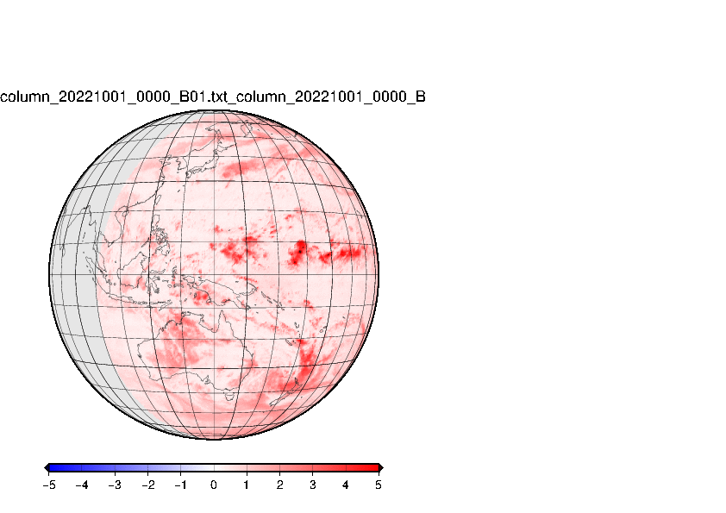
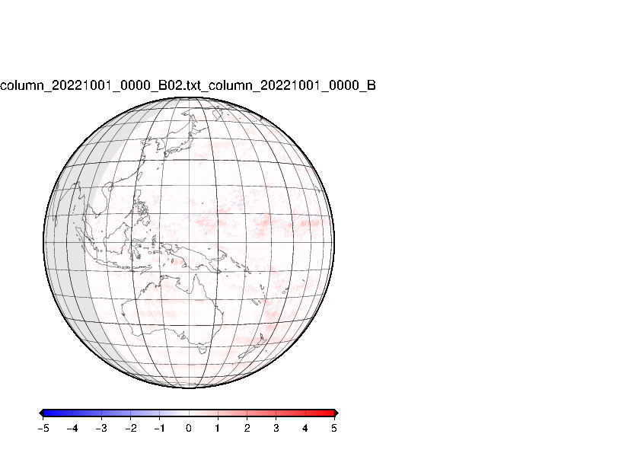
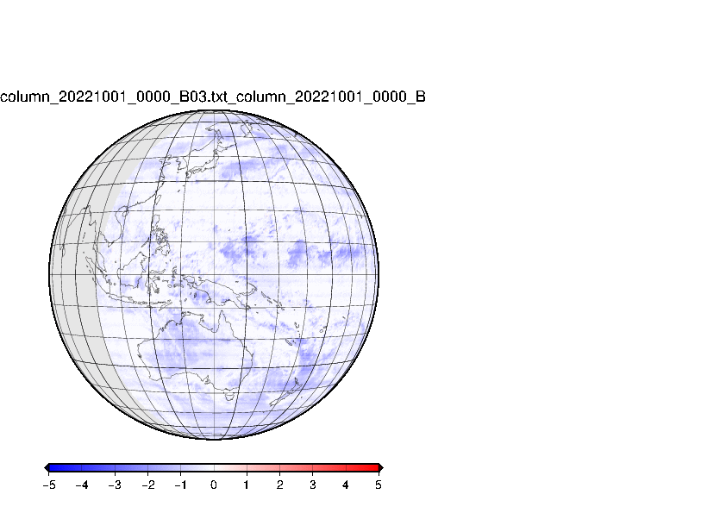
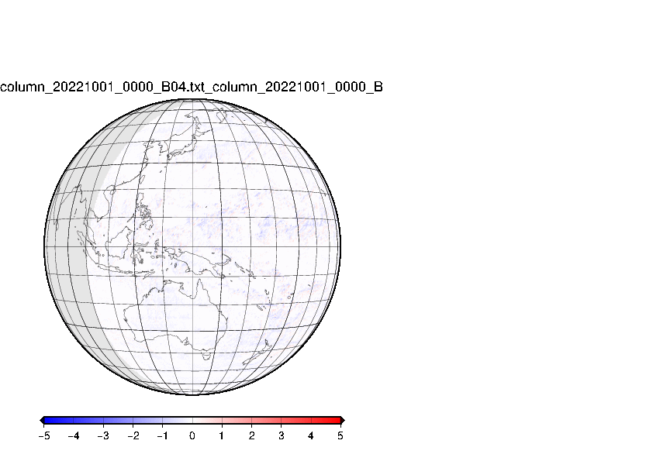
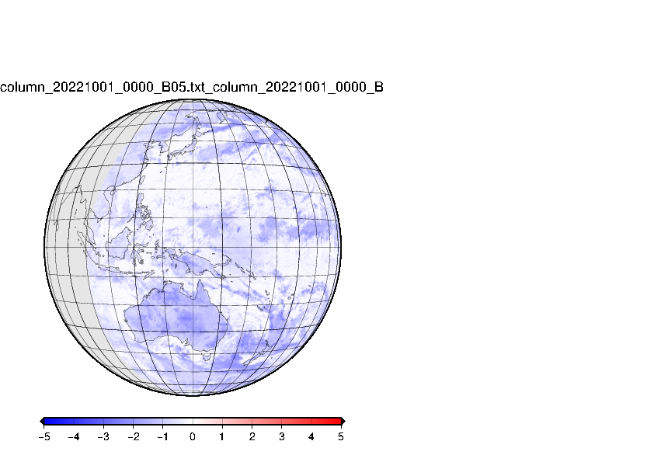
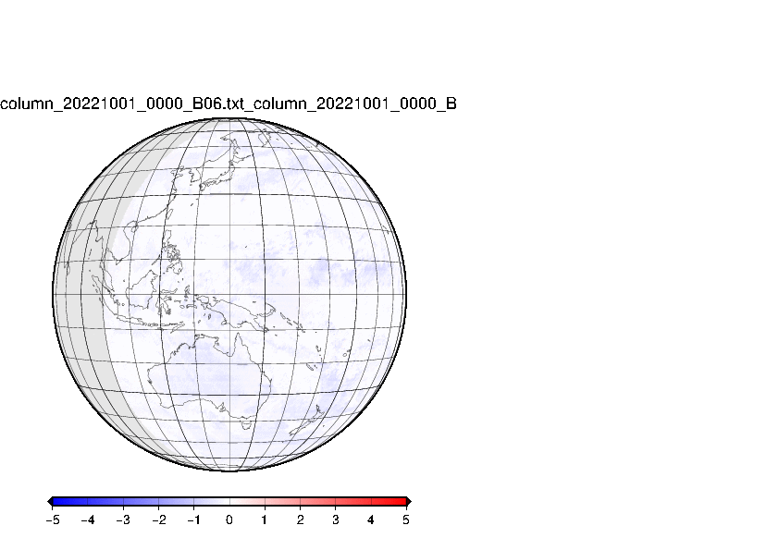
GEO-GEO approach : AHI9 vs. AHI8
GEO-GEO approach
AHI9 minas AHI8 reflectance for each pixel under the conditions: same time and position
Not considering the difference of SRFs. But in VNIR band, AHI9 SRFs are almost same as AHI8 SRFs (SBAFs~1) except B05.
These results are able to be regarded as the differences of AHI9 and AHI8 except B05.
(1day loop on Oct. 1st,2022)
Double difference AHI9-AHI8 by GSICS methods
B01 (0.47um)
B02 (0.51um)
B03 (0.64um)
B04 (0.86um)
( in Oct.,2022)
AHI9 bias against AHI8
B05 (1.6um)
B06(2.3um)
Large daily variation is not seen.
In B01, AHI9 is 3~5% brighter than AHI8 in particularly around bright clouds like DCC.
In B03, AHI9 is 2~3% darker than AHI8. B02, B04 and B06 have small differences(within ~1%)
These results are good agreement with the Ray-matching and DCC validations.

Slide 12
Outline
Ray-matching method
Outline of implementation in JMA
Validation results for AHI8 and AHI9
DCC method
Outline of test implementation in JMA
Validation results for AHI8 and AHI9
Comparing Ray-matching and DCC methods on AHI9 biases validation
Comparison with the direct comparison(GEO-GEO approach) : AHI9 vs. AHI8
The validation of AHI sensor sensitivity trends

Slide 13
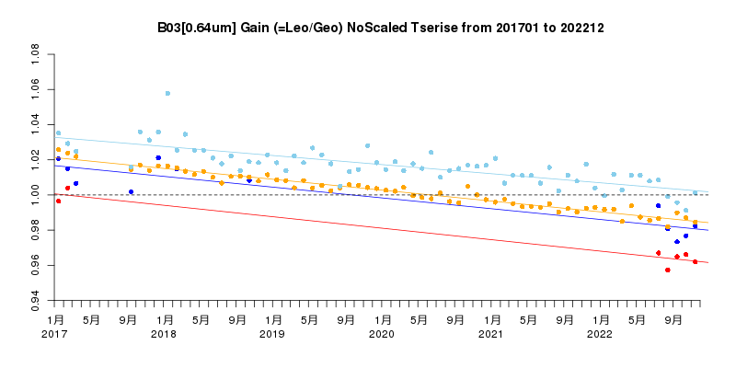
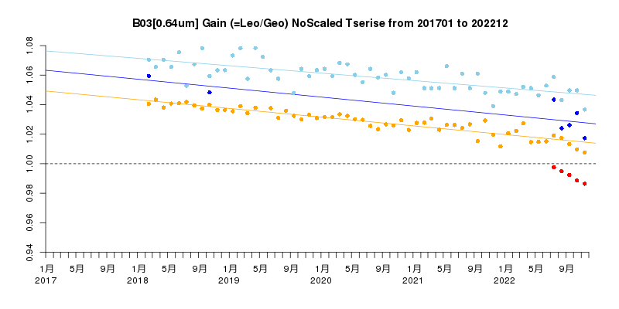
AHI sensor sensitivity trends
B03 (0.64um) against SNPP
AHI9 DCC: -0.61%/yr (±0.09%)
AHI9 Ray-matching: -0.65%/yr (±0.07%)
AHI8 DCC: -0.52%/yr (±0.05%)
AHI8 Ray-matching: -0.62%/yr (±0.02%)
DCC method has larger variations than Ray-matching method.
The trends of AHI9 are good agreement with these of AHI8. (<0.1%/yr)
Although AHI9 had been in standby operation and AHI9 hadn't observed (except health check) until Dec. 2022, it seems that the sensor sensitivity of AHI9 has changed as well as that of operational AHI8.
AHI9 data is limited yet (only a few months since operational start). After getting enough data, more investigation are needed.
Health Check
Parallel Obs.
Jan May Sep Jan May Sep Jan May Sep Jan May Sep Jan May Sep Jan May Sep
2017 2018 2019 2020 2021 2022
B03 (0.64um) against N20
AHI9 DCC: -0.61%/yr (±0.17%)
AHI9 Ray-matching: NA
AHI8 DCC: -0.50%/yr (±0.06%)
AHI8 Ray-matching: -0.59%/yr (±0.03%)
* No collocations for AHI9 Ray-matching with N20 during past HC periods
Jan May Sep Jan May Sep Jan May Sep Jan May Sep Jan May Sep Jan May Sep
2017 2018 2019 2020 2021 2022

Slide 14
Summary and future works
Summary
JMA’s operational satellite was switched over to Himawari-9 from Himawari-8 on 13th Dec. 2022.
For operational start of Himawari-9, we validated AHI9 data quality and compared with AHI8 by using parallel observation data.
The differences between AHI9 and AHI8 validated by Ray-matching and DCC methods are within ~5%.
These result also are good agreement with GEO-GEO comparison.
Himawari-9 had NOT observed since launch in Dec. 2016. (except health check.) However, the sensor sensitivity of AHI9 might have changed as well as AHI on-board the operational satellite Himawari-8.
Future works
Himawari-9 has solar diffuser as on-board calibration target same as Himawari-8.
We will work on the SD data analysis after we can get enough data like 1year.
Some improvements might be needed in our DCC test implementation.
e.g., applying deseasonalization.

Slide 15
END
That all, thank you for your attention.
Any questions or comments?
Contact: k_kodera@met.kishou.go.jp

Slide 16
Backup slides

Slide 17
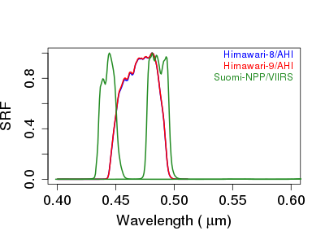
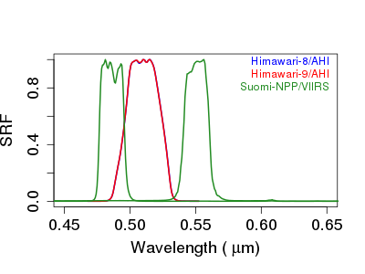
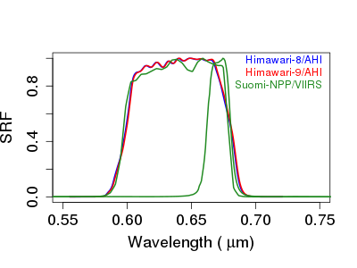
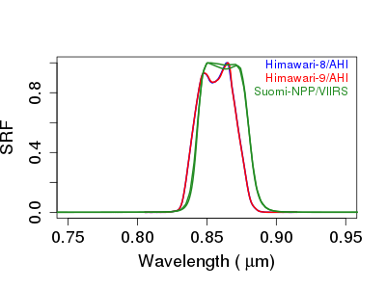
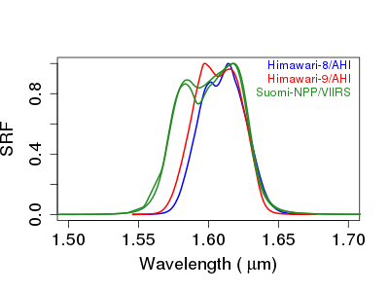
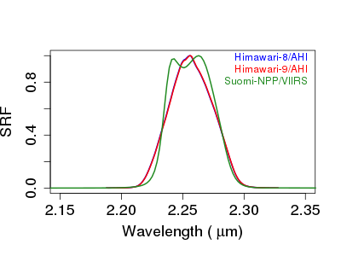
SRF differences (AHI8,AHI9 and NPP/VIIRS)
M2
M3
M3
M4
M5
I1
B01
(0.47μm)
B02
(0.51μm)
B03
(0.64μm)
M7 I2
M10 I3
M11
B04
(0.86μm)
B05
(1.6μm)
B06
(2.3μm)

Slide 18
AHI9 biases Comparison by Ray-matching and DCC methods
In Oct,2022
AHI9 is Brighter
Against N20
Against SNPP
Against AHI8
AHI9 is darker
Differences between Ray-matching and DCC methods are within approximately 5%.
In the point of differences between AHI9 and AHI8, Ray-matching and DCC methods are good agreement. (<1%)
However, the AHI9 biases validated by DCC method are larger than those by Ray-matching method.
These may indicate there is room of improvement in our DCC test implementation.

Slide 19
JMA Ray-matching criteria Table
Table A
Ray-Matching criteria | Ray-Matching threshold
Monitored sensor | Himawari8 and Himawari9 / AHI
Reference sensor and version | SNPP and NOAA20 / VIIRS NOAA
Radiance or reflectance pair regression | Reflectance
SBAF | SCIAMACHY 1st order fit ( for AHI B01~B05) Radiative transfer model ( for AHI B06 ) *Under condition of “All sky tropical ocean”
Latitude Domain | ± 20° latitude of sub-satellite location
Longitude Domain | ± 20° longitude of sub-satellite location
Underlying surface | Targets meeting TB < 273.15K
Spatial grid resolution | AHI 1 pixel vs. average of VIIRS 3x3 pixels (for M band) AHI 1 pixel vs. average of VIIRS 5x5 pixels (for I band) * See the backup slide of “Our implementation details –resolution difference-”
AHI/VIIRS pixel resolution | 2km / 0.75km(M) or 0.375km(I) * We use AHI data resampled to 2km resolution for All VNIR bands.
AHI/VIIRS sub-sampling | 2km / 0.75km(M) or 0.375km(I)
Spatial homogeneity ( STDV of reflectance/Mean of reflectance ) | < 5% * See the backup slide of “Our implementation details –spatial homogeneity-” slide.

Slide 20
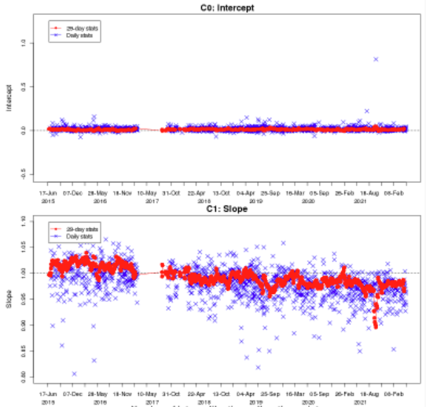
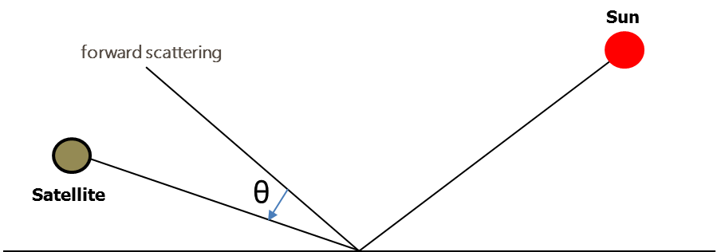
JMA Ray-matching criteria Table
Table A
Table B
Ray-Matching criteria | Ray-Matching threshold
Time matching difference | < 5 minutes
Solar zenith angle (SZA) difference | <10°
View zenith angle (VZA) difference | <10°
Relative azimuthal angle (RAA) difference | <10°
Scattering angle difference | -
Sun glint angle (Scattering angle) | >25°for AHI only
Linear regression, regression through space offset | Linear regression with offset and linear regression via the origin (force-fit regression)
Ray-Matching ATBD 2011 (NASA)​ | Ray-Matching threshold​
Timeline temporal resolution​ | Monthly and daily​
Outlier Filter​ | -
Other criteria​ | -
Temporal regression​ | -​
Intercept
slope
θ： Sun glint angle

Slide 21
Our implementation details – resolution difference -
To considering resolution difference of Input data, our implementation is following way.
Collocating
Matching up AHI 1 pixel with VIIRS 1pixel
Comparison for AHI refl. with VIIRS refl.
Comparing refl. of AHI 1 pixel with average refl. of VIIRS 3x3 pixels in M bands
Input Data we use in ray-matching
AHI : 2km resolution
VIIRS : 0.75km(M) 0.375km(I)
AHI 1 pixel
VIIRS 1 pixel
Match up
Compare
Reflectance of
AHI 1 pixel
Average reflectance
on 3x3 VIIRS M band pixels

Slide 22
Our implementation details – spatial homogeneity -
Pixels in green area are used for checking spatial homogeneity.
The condition of spatial homogeneity check is
STDV of reflectance
Mean of reflectance
< 5%
AHI data
2km / 1pixel
VIIRS data M bands
0.75km / 1pixel
Spatial homogeneity area

Slide 23
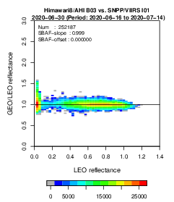
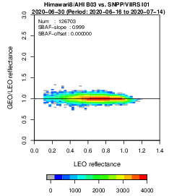
Remove outliers in warm scenes
Some outliers
Apply threshold of 273K
Fig.1. Ray-matching in All scenes (without TB condition)
Fig.2. Ray-matching in cold scenes (with TB condition of 273K )

Slide 24
Rough uncertainty estimation
AHI9 is Brighter
Bar plots show the biases by validation on 1 month statistic period in Oct.
Error bars mean the range of the biases by validation in 1day period in Oct.
As rough estimation, Ray-matching method seems to have ~1% uncertainty at least.
AHI9 is darker

